Slide 1
Relational Databases (Part 2)
Session 14
INST 301
Introduction to Information Science

Slide 2
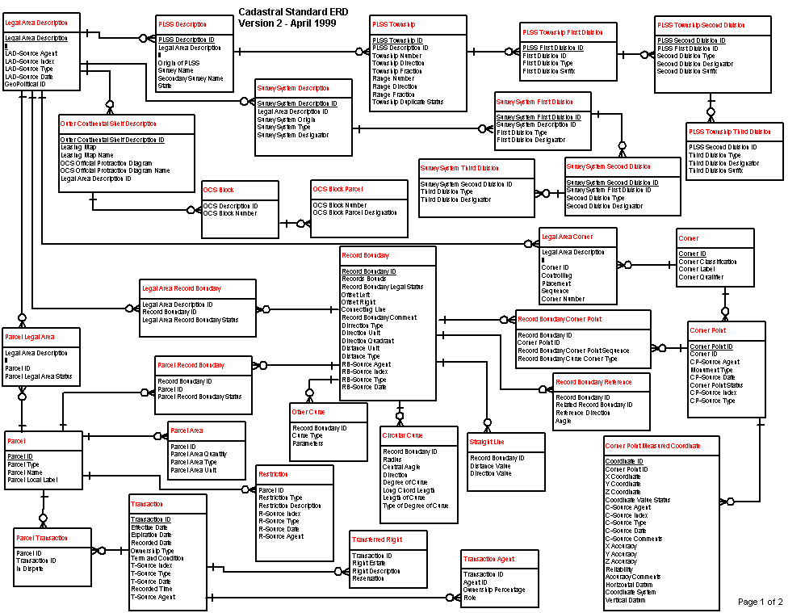

Slide 3
“Project Team” E-R Example
manage-role
1
1
member-of
M
student
team
1
M
creates
human
implement-role
1
M
needs
1
client
project
d
php-project
ajax-project

Slide 4
Making Tables from E-R Diagrams
Pick a primary key for each entity
Build the tables
One per entity
Plus one per M:M relationship
Choose terse but memorable table and field names
Check for parsimonious representation
Relational “normalization”
Redundant storage of computable values
Implement using a DBMS

Slide 5
One Possible Table Structure
Persons: id, fname, lname, userid, password
Contacts: id, ctype, cstring
Ctlabels: ctype, string
Students: id, team, mrole
Iroles: id, irole
Rlabels: role, string
Projects: team, client, pstring

Slide 6
CREATE TABLE persons (
id MEDIUMINT UNSIGNED NOT NULL AUTO_INCREMENT,
fname VARCHAR(15) NOT NULL,
lname VARCHAR(30) NOT NULL,
userid VARCHAR(40) NOT NULL,
password VARCHAR(40) NOT NULL,
PRIMARY KEY (id)
) ENGINE=INNODB;
CREATE TABLE ctlabels (
ctype SMALLINT UNSIGNED NOT NULL AUTO_INCREMENT,
string VARCHAR(40) NOT NULL,
PRIMARY KEY (ctype)
) ENGINE=INNODB;
CREATE TABLE contacts (
ckey MEDIUMINT UNSIGNED NOT NULL AUTO_INCREMENT,
id MEDIUMINT UNSIGNED NOT NULL,
ctype SMALLINT UNSIGNED NOT NULL,
cstring VARCHAR(40) NOT NULL,
FOREIGN KEY (id) REFERENCES persons(id) ON DELETE CASCADE,
FOREIGN KEY (ctype) REFERENCES ctlabels(ctype) ON DELETE RESTRICT,
PRIMARY KEY (ckey)
) ENGINE=INNODB;
CREATE TABLE rlabels (
role SMALLINT UNSIGNED NOT NULL AUTO_INCREMENT,
string VARCHAR(40) NOT NULL,
PRIMARY KEY (role)
) ENGINE=INNODB;
CREATE TABLE projects (
team SMALLINT UNSIGNED NOT NULL AUTO_INCREMENT,
client MEDIUMINT UNSIGNED NOT NULL,
string VARCHAR(40) NOT NULL,
FOREIGN KEY (client) REFERENCES persons(id) ON DELETE RESTRICT,
PRIMARY KEY (team)
) ENGINE=INNODB;
CREATE TABLE students (
id MEDIUMINT UNSIGNED NOT NULL,
team SMALLINT UNSIGNED,
mrole SMALLINT UNSIGNED,
FOREIGN KEY (id) REFERENCES persons(id) ON DELETE CASCADE,
FOREIGN KEY (team) REFERENCES projects(team) ON DELETE SET NULL,
FOREIGN KEY (mrole) REFERENCES rlabels(role) ON DELETE SET NULL,
PRIMARY KEY (id)
) ENGINE=INNODB;
CREATE TABLE iroles (
ikey MEDIUMINT UNSIGNED NOT NULL AUTO_INCREMENT,
id MEDIUMINT UNSIGNED NOT NULL,
irole SMALLINT UNSIGNED NOT NULL,
FOREIGN KEY (id) REFERENCES persons(id) ON DELETE CASCADE,
FOREIGN KEY (irole) REFERENCES rlabels(role) ON DELETE CASCADE,
PRIMARY KEY (ikey)
) ENGINE=INNODB;
INSERT INTO rlabels
(string) VALUES
('Project Manager'),
('System Architect'),
('Data Architect'),
('Test Designer'),
('PHP Programmer'),
('JavaScript Programmer'),
('Database Administrator'),
('XML Designer');
INSERT INTO ctlabels
(string) VALUES
('primary email'),
('alternate email'),
('home phone'),
('cell phone'),
('work phone'),
('AOL IM'),
('Yahoo Chat'),
('MSN Messenger'),
('other');
INSERT INTO persons
(fname, lname, userid, password) VALUES
('Sam', 'Cooper', 'coopers', SHA('pass')),
('Lindsey', 'Goshen', 'goshenl', SHA('pass')),
('Tommy', 'Teller', 'tellert', SHA('pass')),
('Nancy', 'Lange', 'langen', SHA('pass'));

Slide 7
RideFinder Exercise
Design a database to match passengers with available rides for Spring Break
Drivers phone in available seats
They want to know about interested passengers
Passengers call up looking for rides
They want to know about available rides

Slide 8
Exercise Steps
Create an E-R model
What entities?
What attributes?
What relations?
Build the Tables
One per entity
Plus one per many-to-many relation
Build the Queries
What happens when a passenger calls?
What happens when a driver calls?

Slide 9
Exercise Logistics
Work in dissimilar teams of 2
Build an E-R model (10 minutes)
One team will present theirs to the class (5 min)
Create the database (25 minutes)
Create tables
Put data in the tables
Create the queries
One team will demo theirs to the class (5 min)

Slide 10
1NF: Single-valued indivisible (atomic) attributes
Split “Doug Oard” to two attributes as (“Doug”, “Oard”)
Model M:M implement-role relationship with a table
2NF: Attributes depend on complete primary key
(id, impl-role, name)->(id, name)+(id, impl-role)
3NF: Attributes depend directly on primary key
(id, addr, city, state, zip)->(id, addr, zip)+(zip, city, state)
4NF: Divide independent M:M tables
(id, role, courses) -> (id, role) + (id, courses)
5NF: Don’t enumerate derivable combinations

Slide 11
Database Integrity
Registrar database must be internally consistent
Enrolled students must have an entry in student table
Courses must have a name
What happens:
When a student withdraws from the university?
When a course is taken off the books?

Slide 12
Referential Integrity
Foreign key values must exist in other table
If not, those records cannot be joined
Can be enforced when data is added
Associate a primary key with each foreign key
Helps avoid erroneous data
Only need to ensure data quality for primary keys

Slide 13
Concurrency
Possible actions on a checking account
Deposit check (read balance, write new balance)
Cash check (read balance, write new balance)
Scenario:
Current balance: $500
You try to deposit a $50 check and someone tries to cash a $100 check at the same time
Possible sequences: (what happens in each case?)
Deposit: read balance
Deposit: write balance
Cash: read balance
Cash: write balance
Deposit: read balance
Cash: read balance
Cash: write balance
Deposit: write balance
Deposit: read balance
Cash: read balance
Deposit: write balance
Cash: write balance

Slide 14
Database Transactions
Transaction: sequence of grouped database actions
e.g., transfer $500 from checking to savings
“ACID” properties
Atomicity
All-or-nothing
Consistency
Each transaction must take the DB between consistent states.
Isolation:
Concurrent transactions must appear to run in isolation
Durability
Results of transactions must survive even if systems crash

Slide 15
Making Transactions
Idea: keep a log (history) of all actions carried out while executing transactions
Before a change is made to the database, the corresponding log entry is forced to a safe location
Recovering from a crash:
Effects of partially executed transactions are undone
Effects of committed transactions are redone
the log

Slide 16
Key Ideas
Databases are a good choice when you have
Lots of data
A problem that contains inherent relationships
Join is the most important concept
Project and restrict just remove undesired stuff
Design before you implement
Managing complexity is important

