Slide 1

Relational Databases 1(Lab)
Session 13
INST 301
Introduction to Information Science

Slide 2
Example of Join
Student Table
Department Table
“Joined” Table

Slide 3
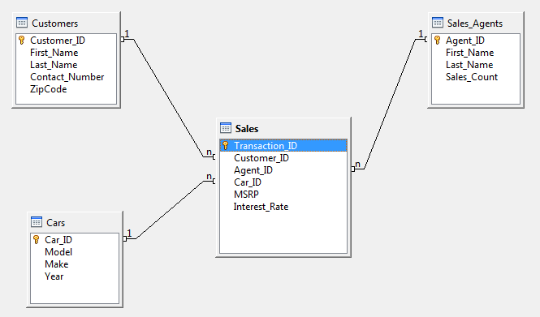
Car Sales ER Diagram

Slide 4
Making Tables from E-R Diagrams
Create the Database using Apache Open Office Base Application
Build the tables
  One per entity
  Plus one per M:M relationship
  Choose terse but memorable table and field names
Pick a primary key for each entity
Retrieve Tuples as per the requirement

Slide 5
Referential Integrity
Foreign key values must exist in other table
  If not, those records cannot be joined
Can be enforced when data is added
  Associate a primary key with each foreign key
Helps avoid erroneous data
  Only need to ensure data quality for primary keys

Slide 6
Before You Go
On a sheet of paper, answer the following (ungraded) question (no names, please):
What was the muddiest point in today’s class?

