Slide 1
Data as an Asset
Session 10
INST 301
Introduction to Information Science

Slide 2
Data as a Model
Data represents some aspect(s) of reality
Reality itself is way too complex
All models are wrong
Some models are useful
Things that are useful are useful for a purpose
Which need not be the original intended purpose

Slide 3
Some Examples
Bank account
Airline ticket
Email

Slide 4
Find the Data
Date: Wed Dec 20 08:57:00 EST 2000
From: Kay Mann <kay.mann@enron.com>
To: Suzanne Adams <suzanne.adams@enron.com>
Subject: Re: GE Conference Call has be rescheduled
Did Sheila want Scott to participate? Looks like the
call will be too late for him.

Slide 5
Some Aspects of Reality
People
Places
Organizations
Events
Objects
Concepts
Amounts
Times
Time periods
Statements
Attitudes

Slide 6
Historical Development
Big Data
Knowledge bases
Data mining
OLAP
Data warehousing
Database management systems
COBOL
1960s ,70s 1980s 1990s 2000 2010
(and before)

Slide 7
Data abstraction
moving from the nuts and bolts to the big picture
hiding the complexity of data storage and operations from the user
levels of abstraction - from the trees to the forest
the physical level
the conceptual level
the view level

Slide 8
Database Management System
Special-purpose programming language for:
Defining a database
Data
Relationships
Populating the database
Initialization, update, deletion, …
Using the database
Queries
Reports

Slide 9
Database Lifecycle
Identify a need
Analyze specific goals
Create a model
Implement the database
Initialize the data
Use it for the intended purpose(s)
Support the business process(es)
Interoperate with other data systems
Optionally, repurpose the data
Migrate or retire the data

Slide 10
Data Warehouse
Collection of technologies designed to convert heaps of data to usable information
an environment, not a process
Three applications
improve traditional information presentation technologies
support online analytical processing
enable use of data mining techniques
Notes:
Data marts - implementation of the data warehouse in which the data scope is somewhat limited compared to the enterprise-wide data warehouse - may contain summarized departmental data

Slide 11
Data Warehouse
Aggregates data from different systems
Can require reconciliation that no system needed
Updated mostly by addition
Permits current and historical analysis
Read-intensive offline analysis
Different access pattern than operational systems
Small number of expert users

Slide 12
Online Analytical Processing (OLAP)
Exploration tool
Slice and dice to “preprocess” the data
Visualization to explore relationships
Example:
What percentage of employees in the southeast region who had been covered under health plan A have switched to health plan B since January, broken down by employee family demographics and by office, and how does that compare with our projections?
Notes:
Traditional tools describe and report on what is in a database

Slide 13
Data Mining
Statistical analysis to uncover patterns
Rule-based:
We know what pattern we want
Supervised:
We have examples of patterns like what we want
Unsupervised:
We know what kind of a pattern we want

Slide 14
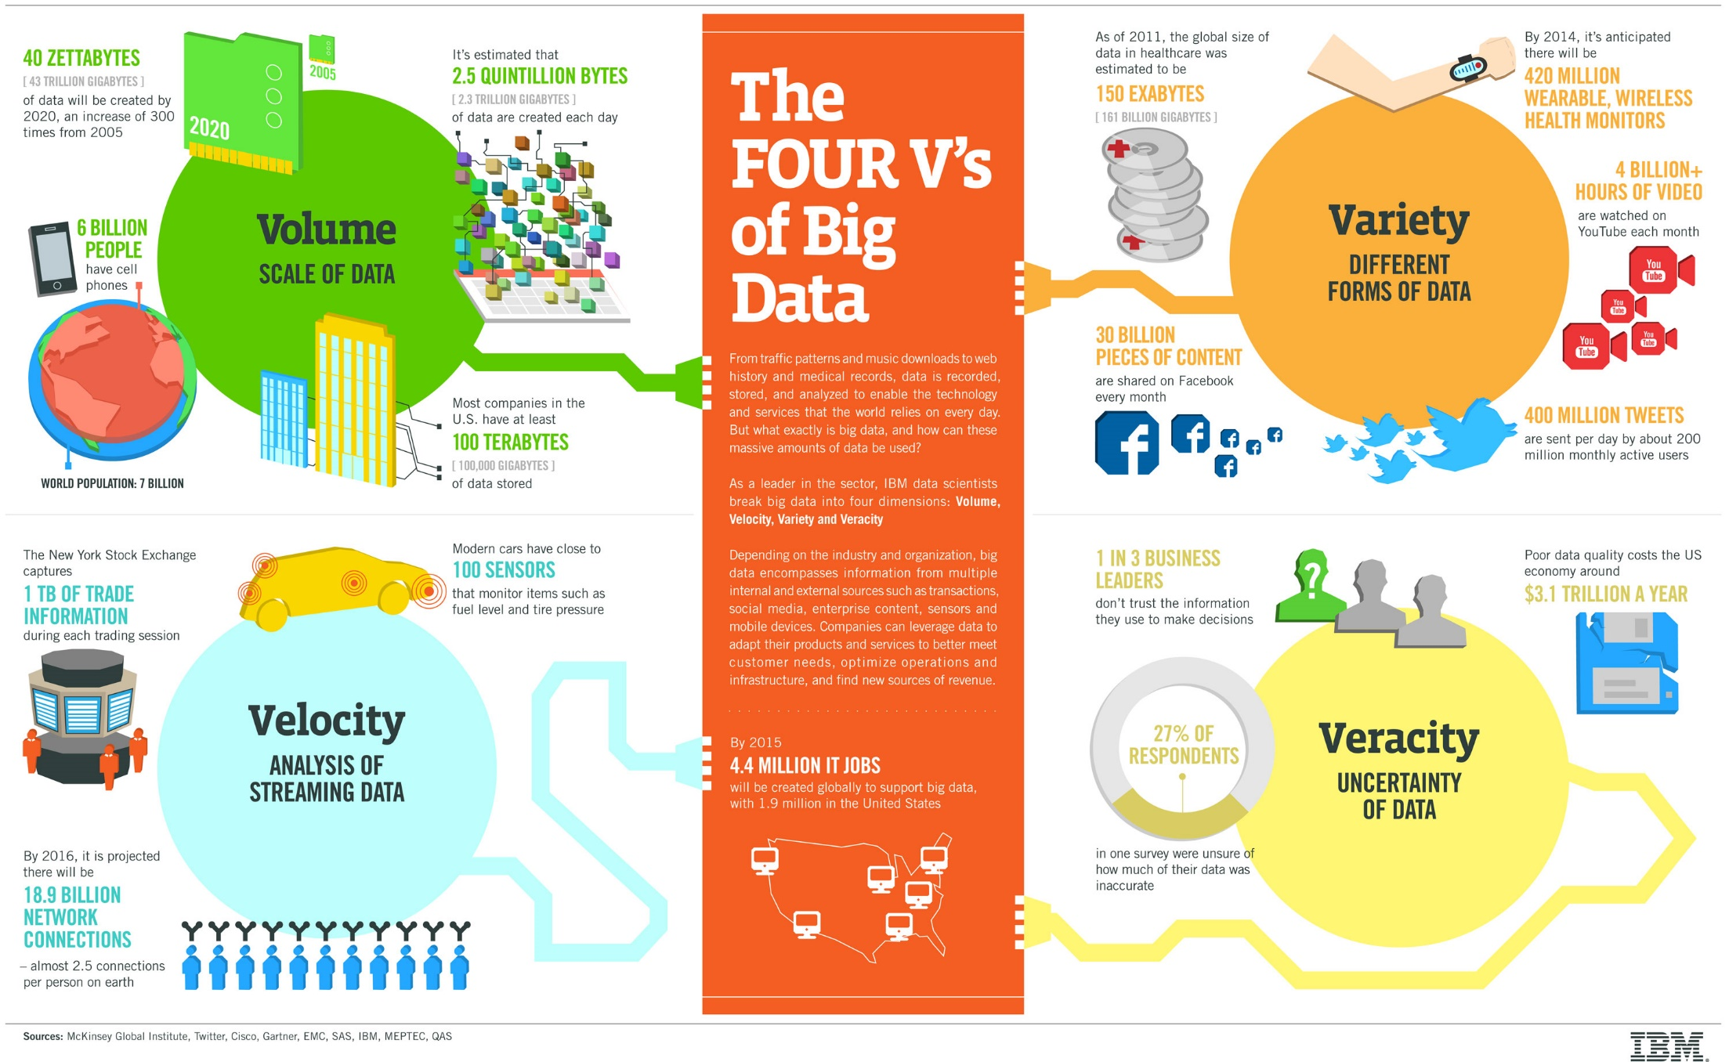

Slide 15
Data Quality
Valid
Accurate
Precise
Consistent
Complete
Current
…

Slide 16
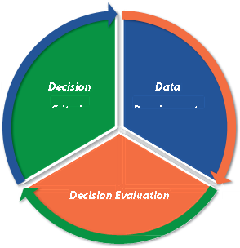
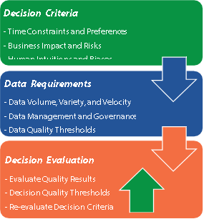
Data-Driven Decisions

