Slide 1
The Saturn V
HONR 269i
To the Moon and Back: The Apollo Program
Apollo 11 Launch

Slide 2
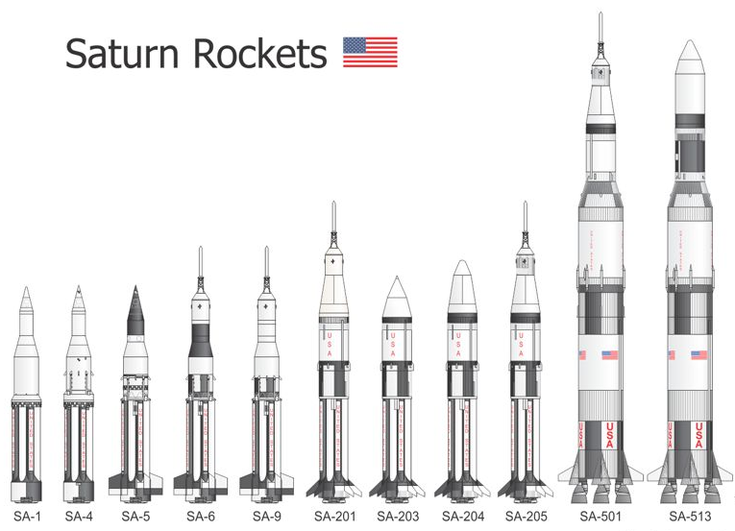

Slide 3
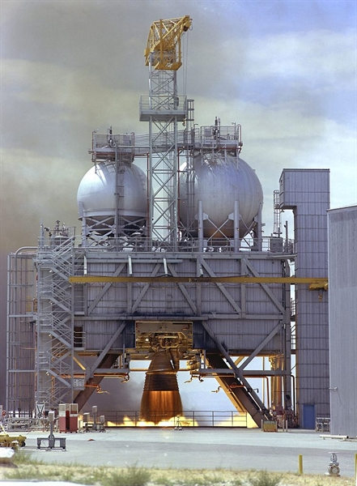
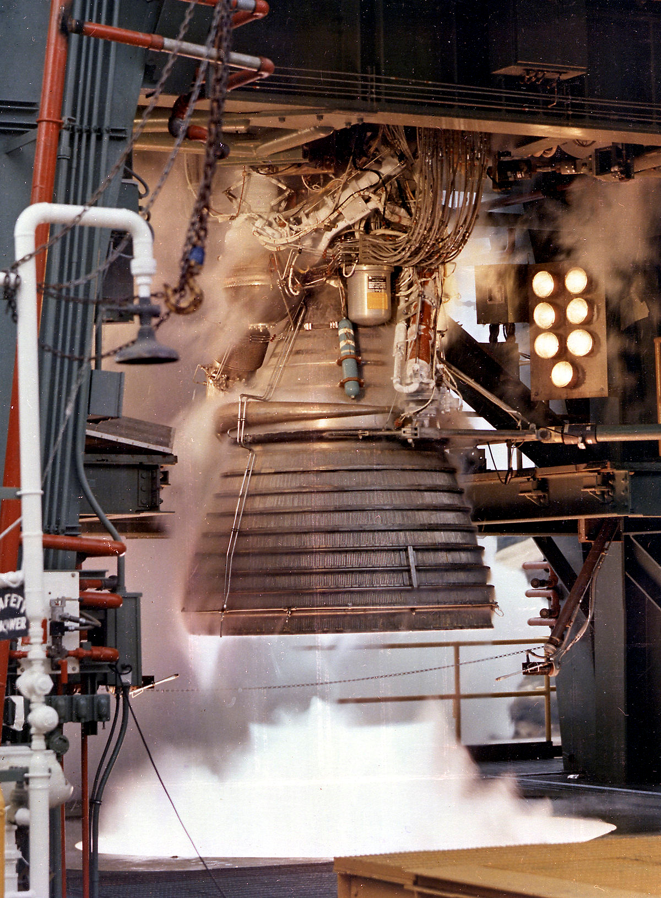
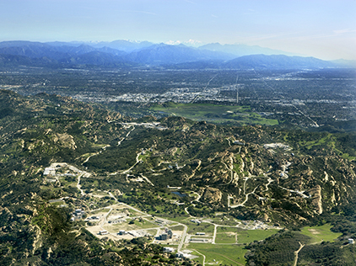
J-2→
F-1
(Rocketdyne)
Santa Susanah
Field Laboratory

Slide 4
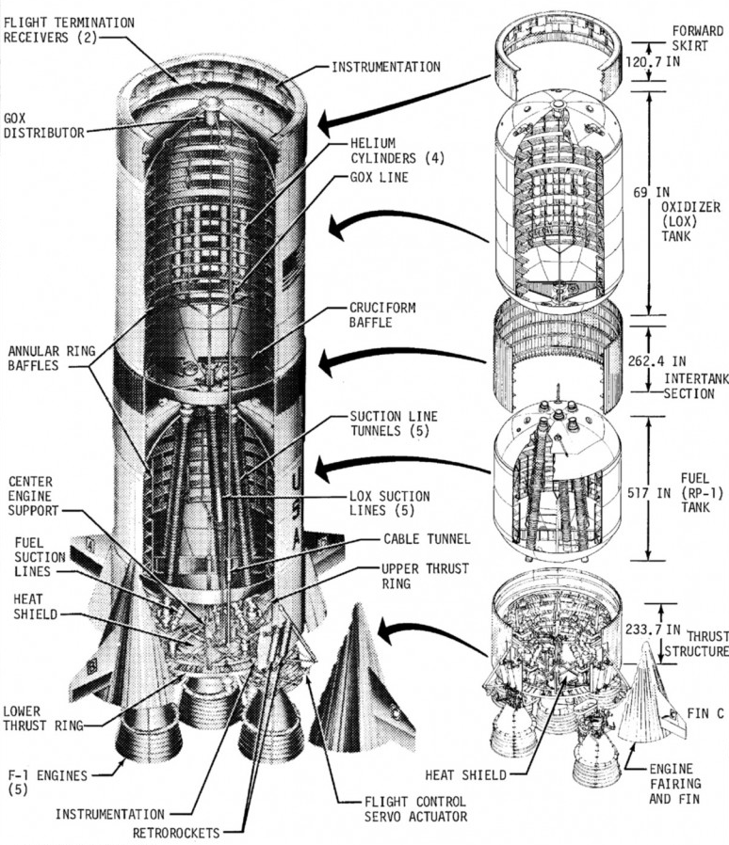
S-IC
First Stage

Slide 5
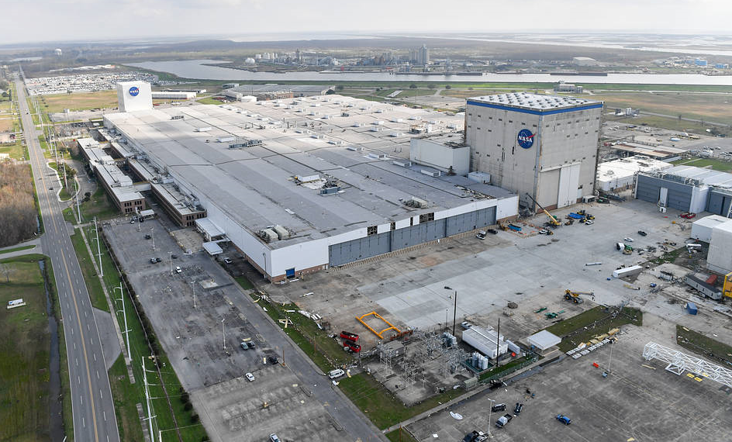
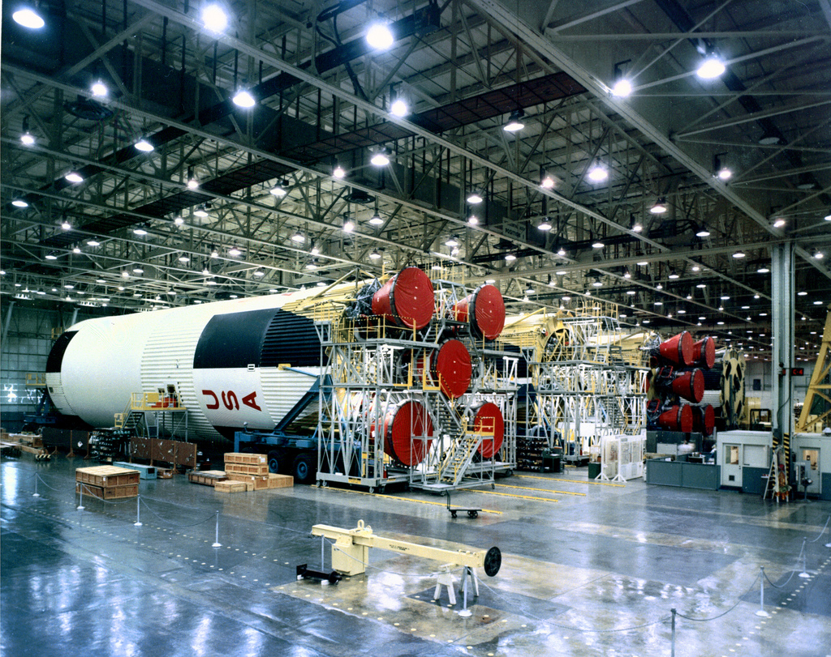
(Boeing) Michoud Assembly Facility (S-IC)

Slide 6
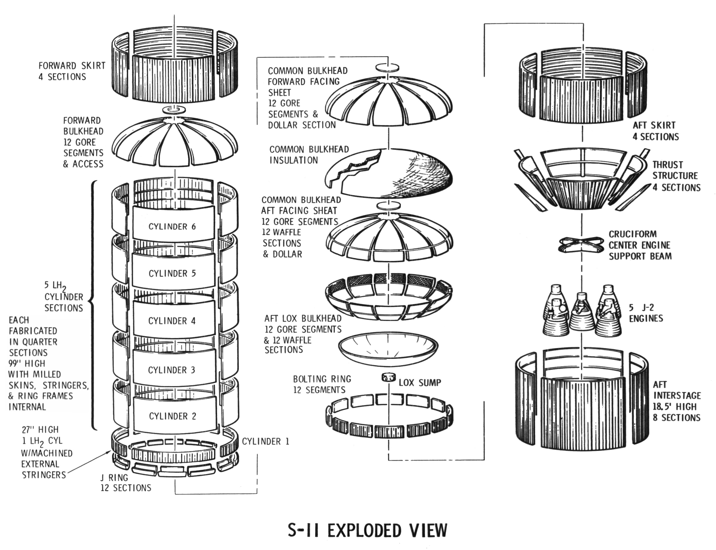

Slide 7
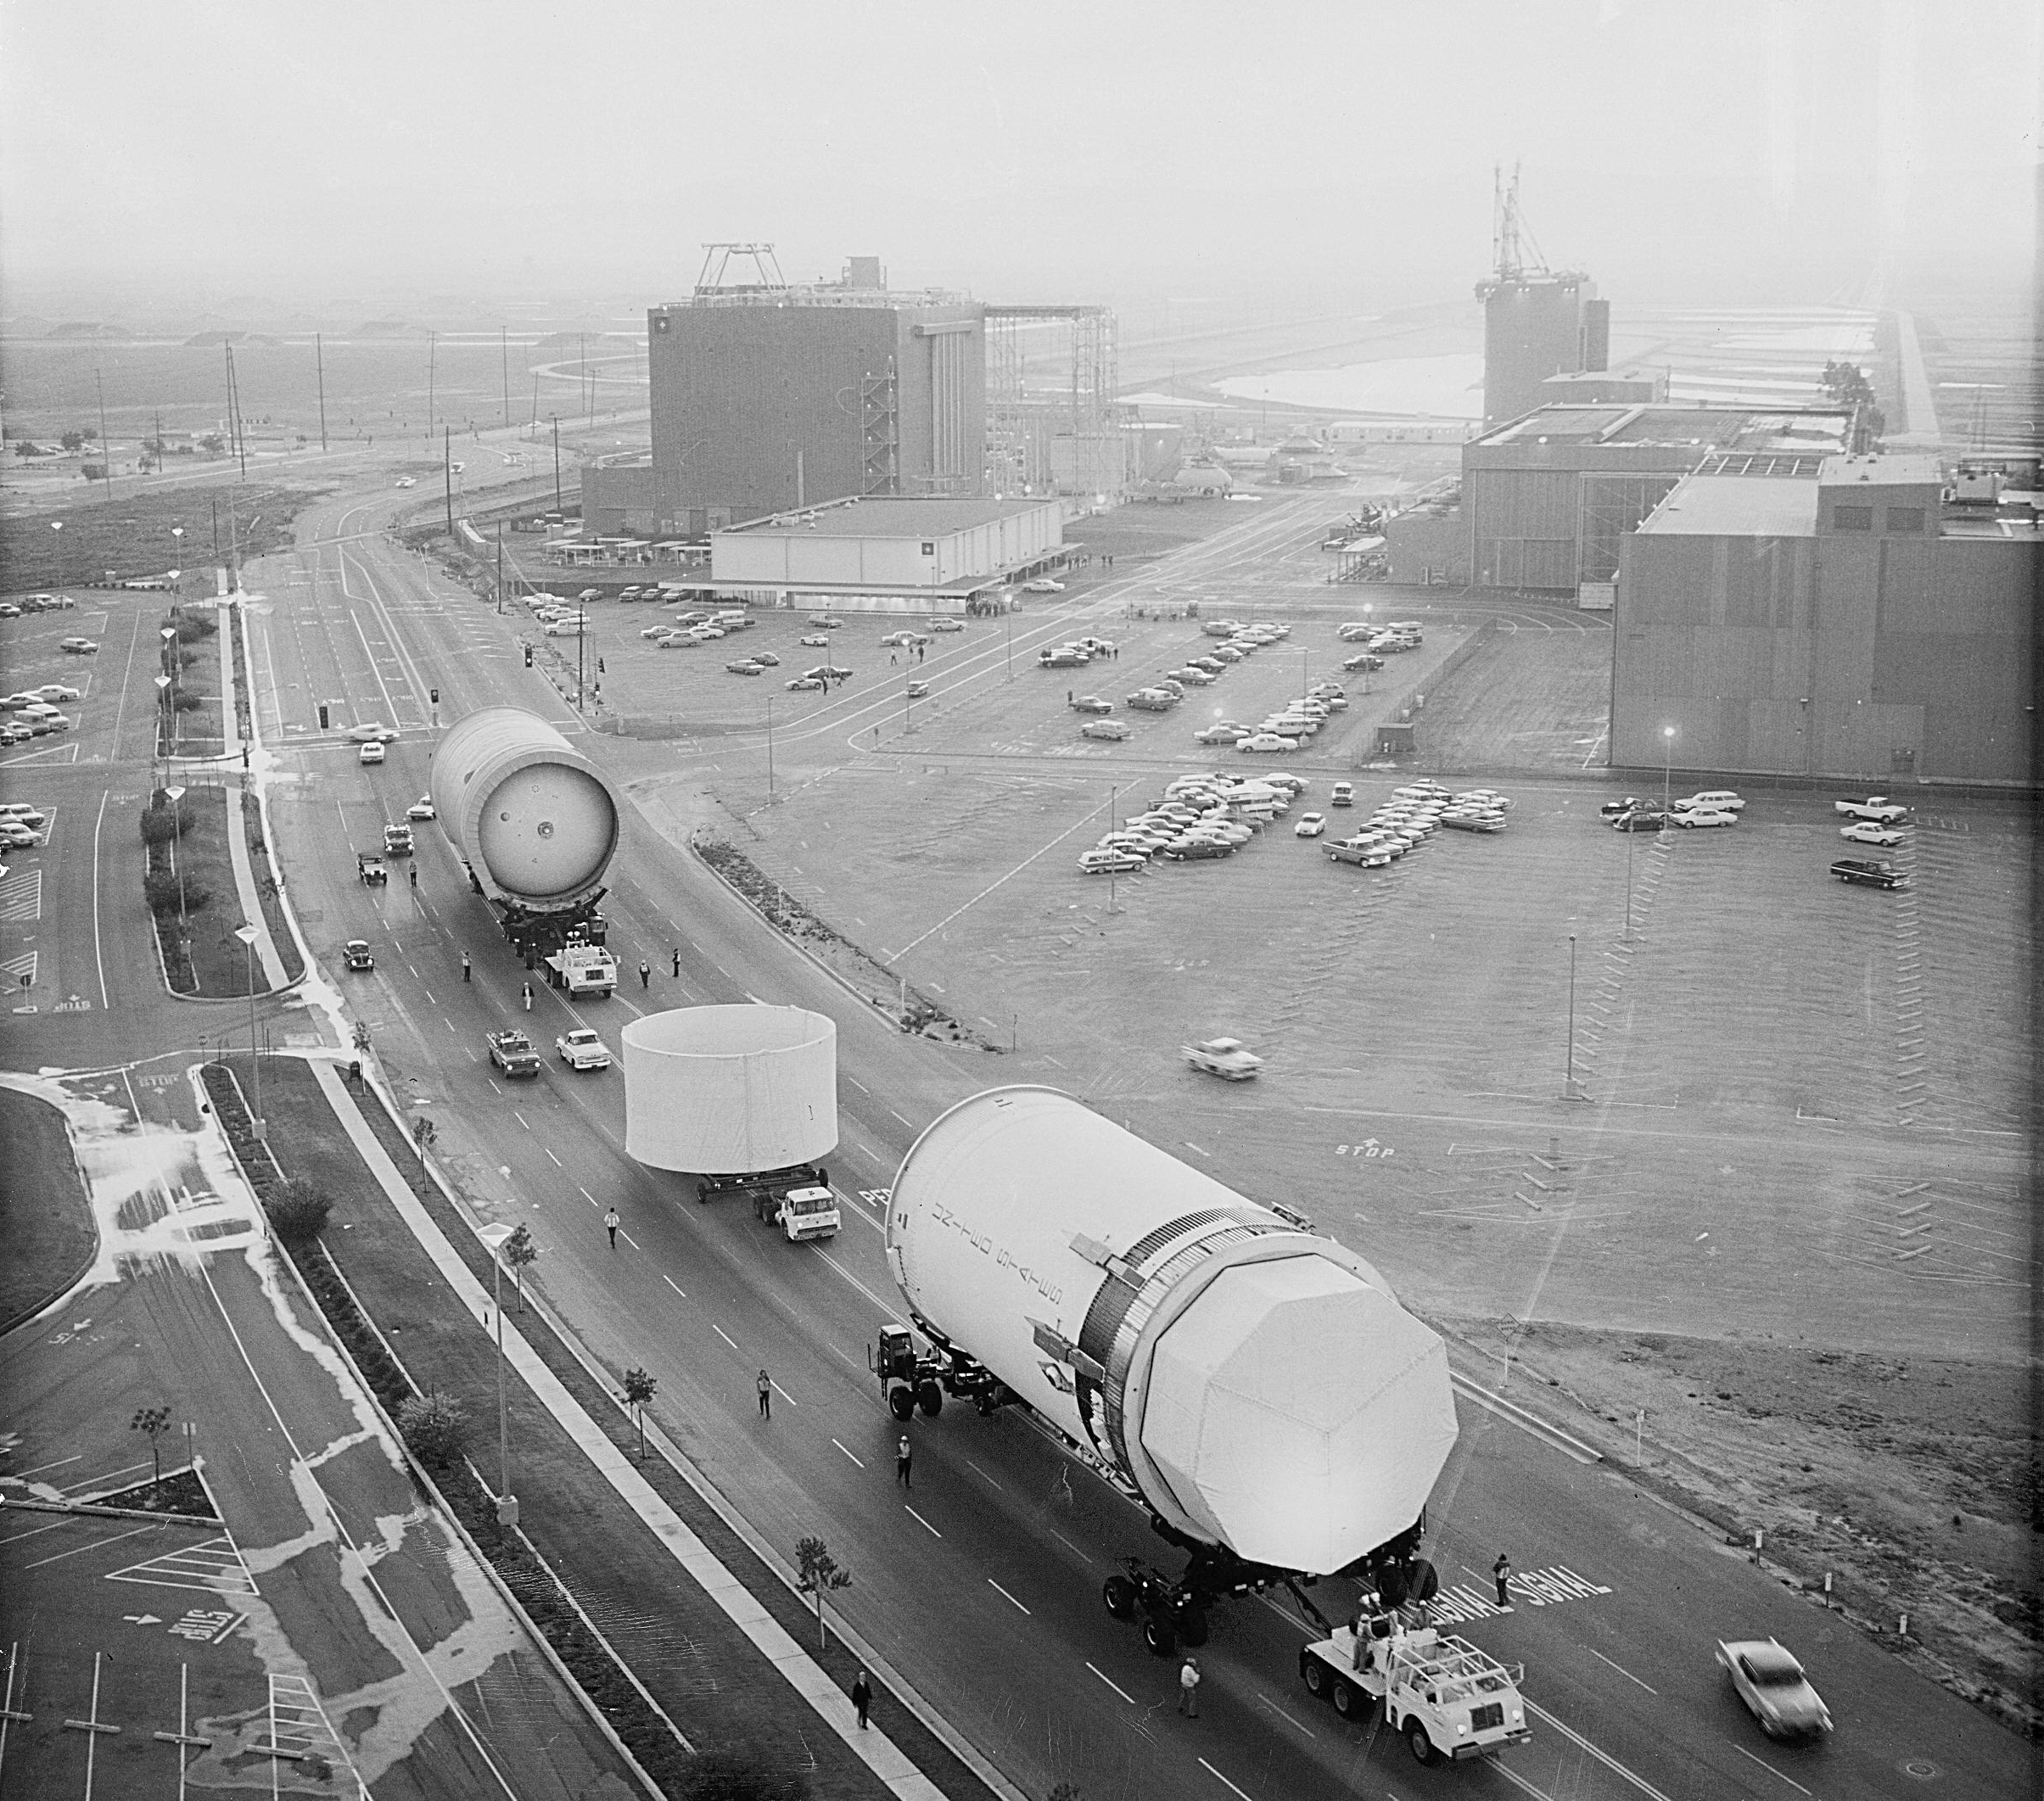
(North American)
Seal Beach
Assembly Facility
(S-II Second Stage)

Slide 8
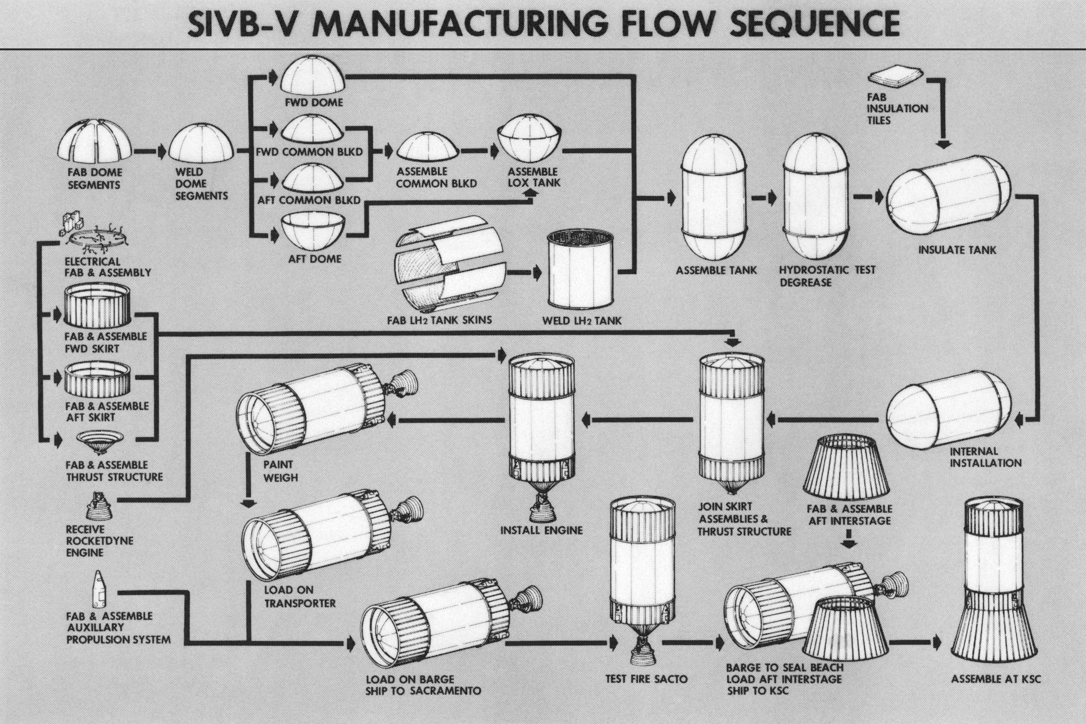

Slide 9
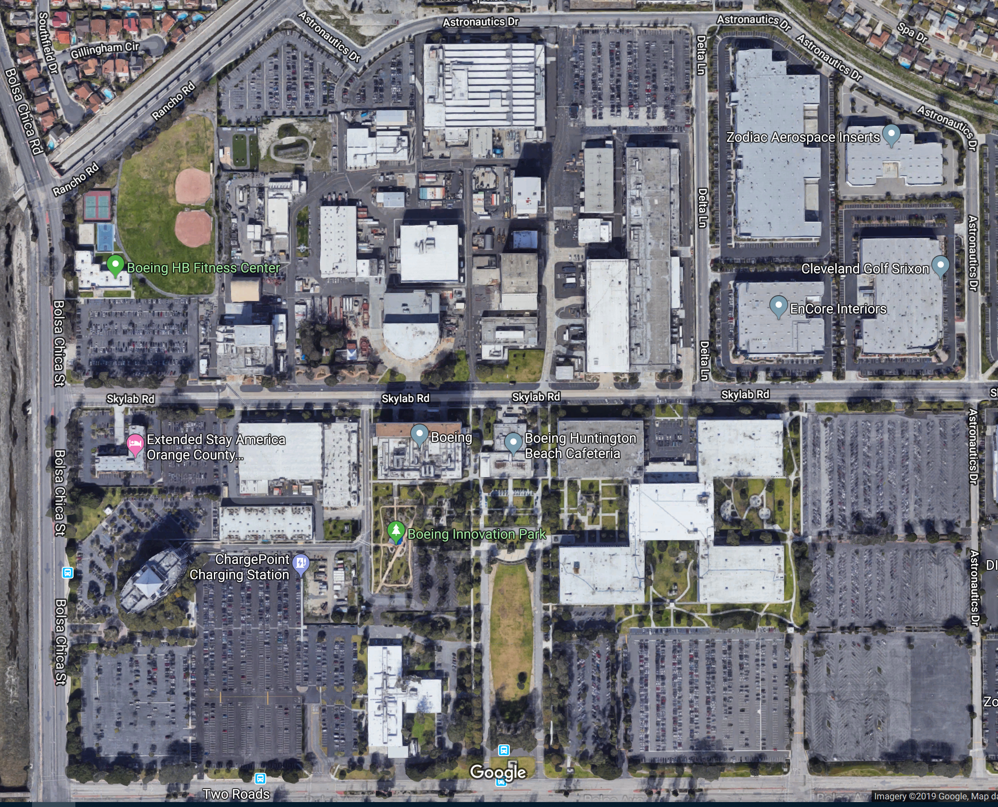
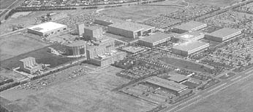
(Douglas) Huntington Beach Facility
(S-IVB Third Stage)

Slide 10
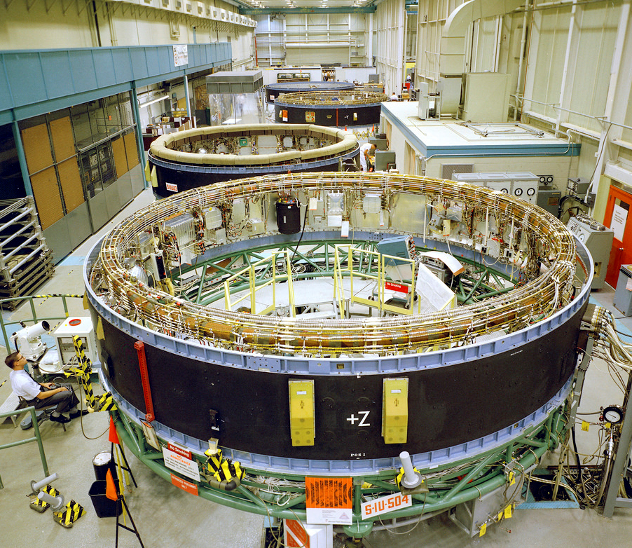
(IBM)
Huntsville Plant
(Instrument Unit)

Slide 11
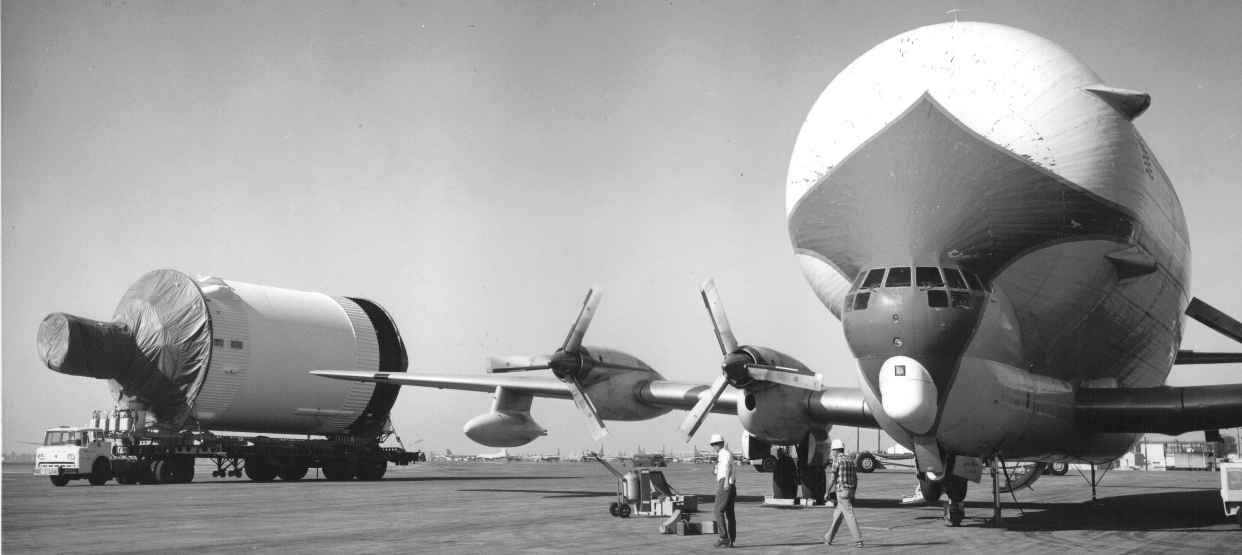
The Pregnant Guppy

Slide 12
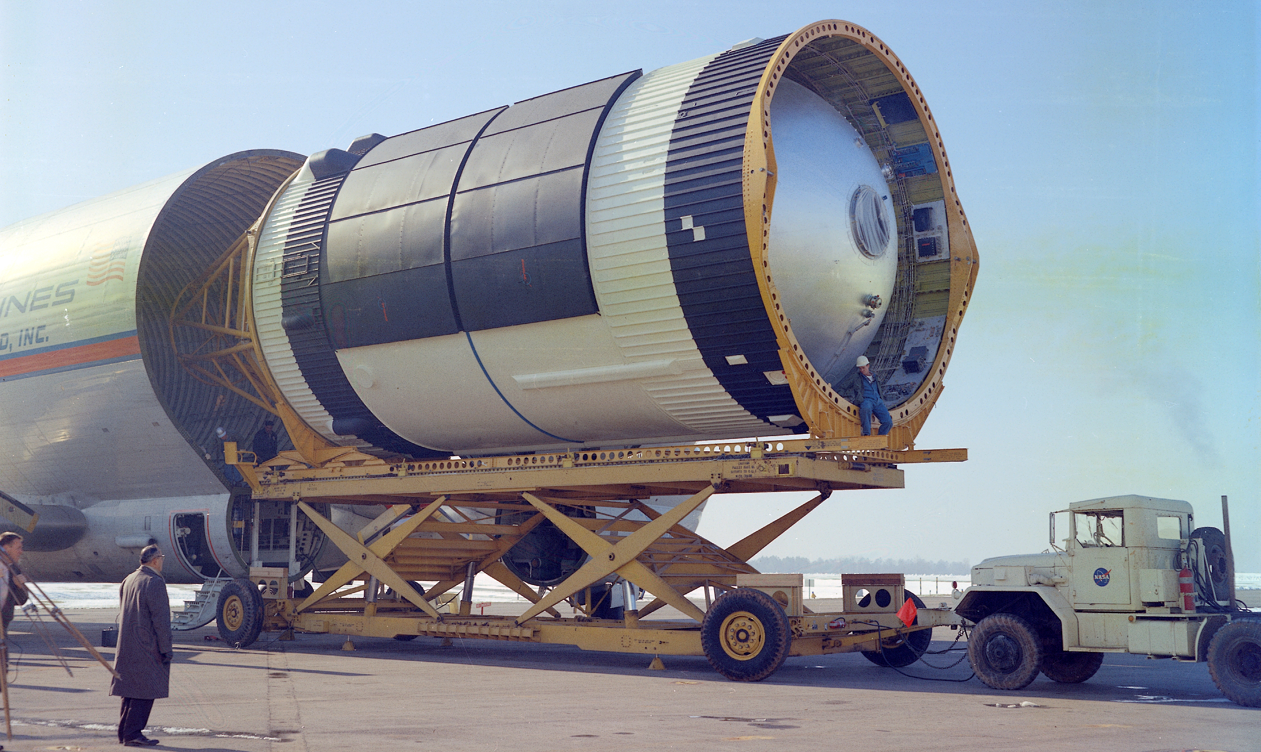

Slide 13
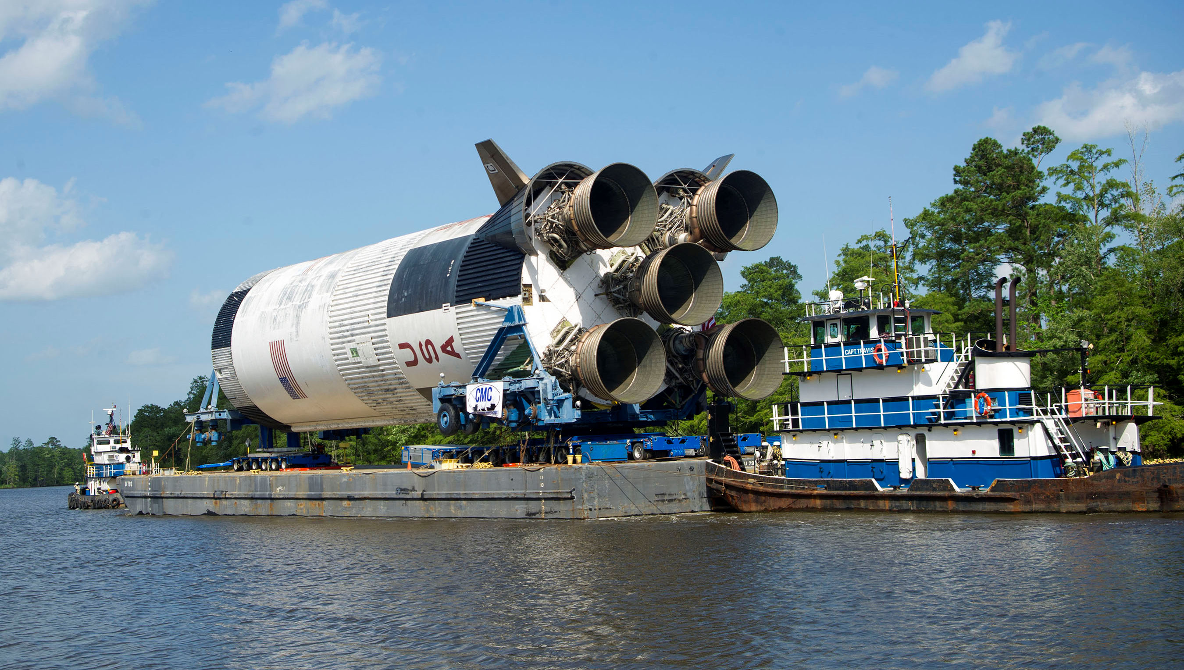

Slide 14
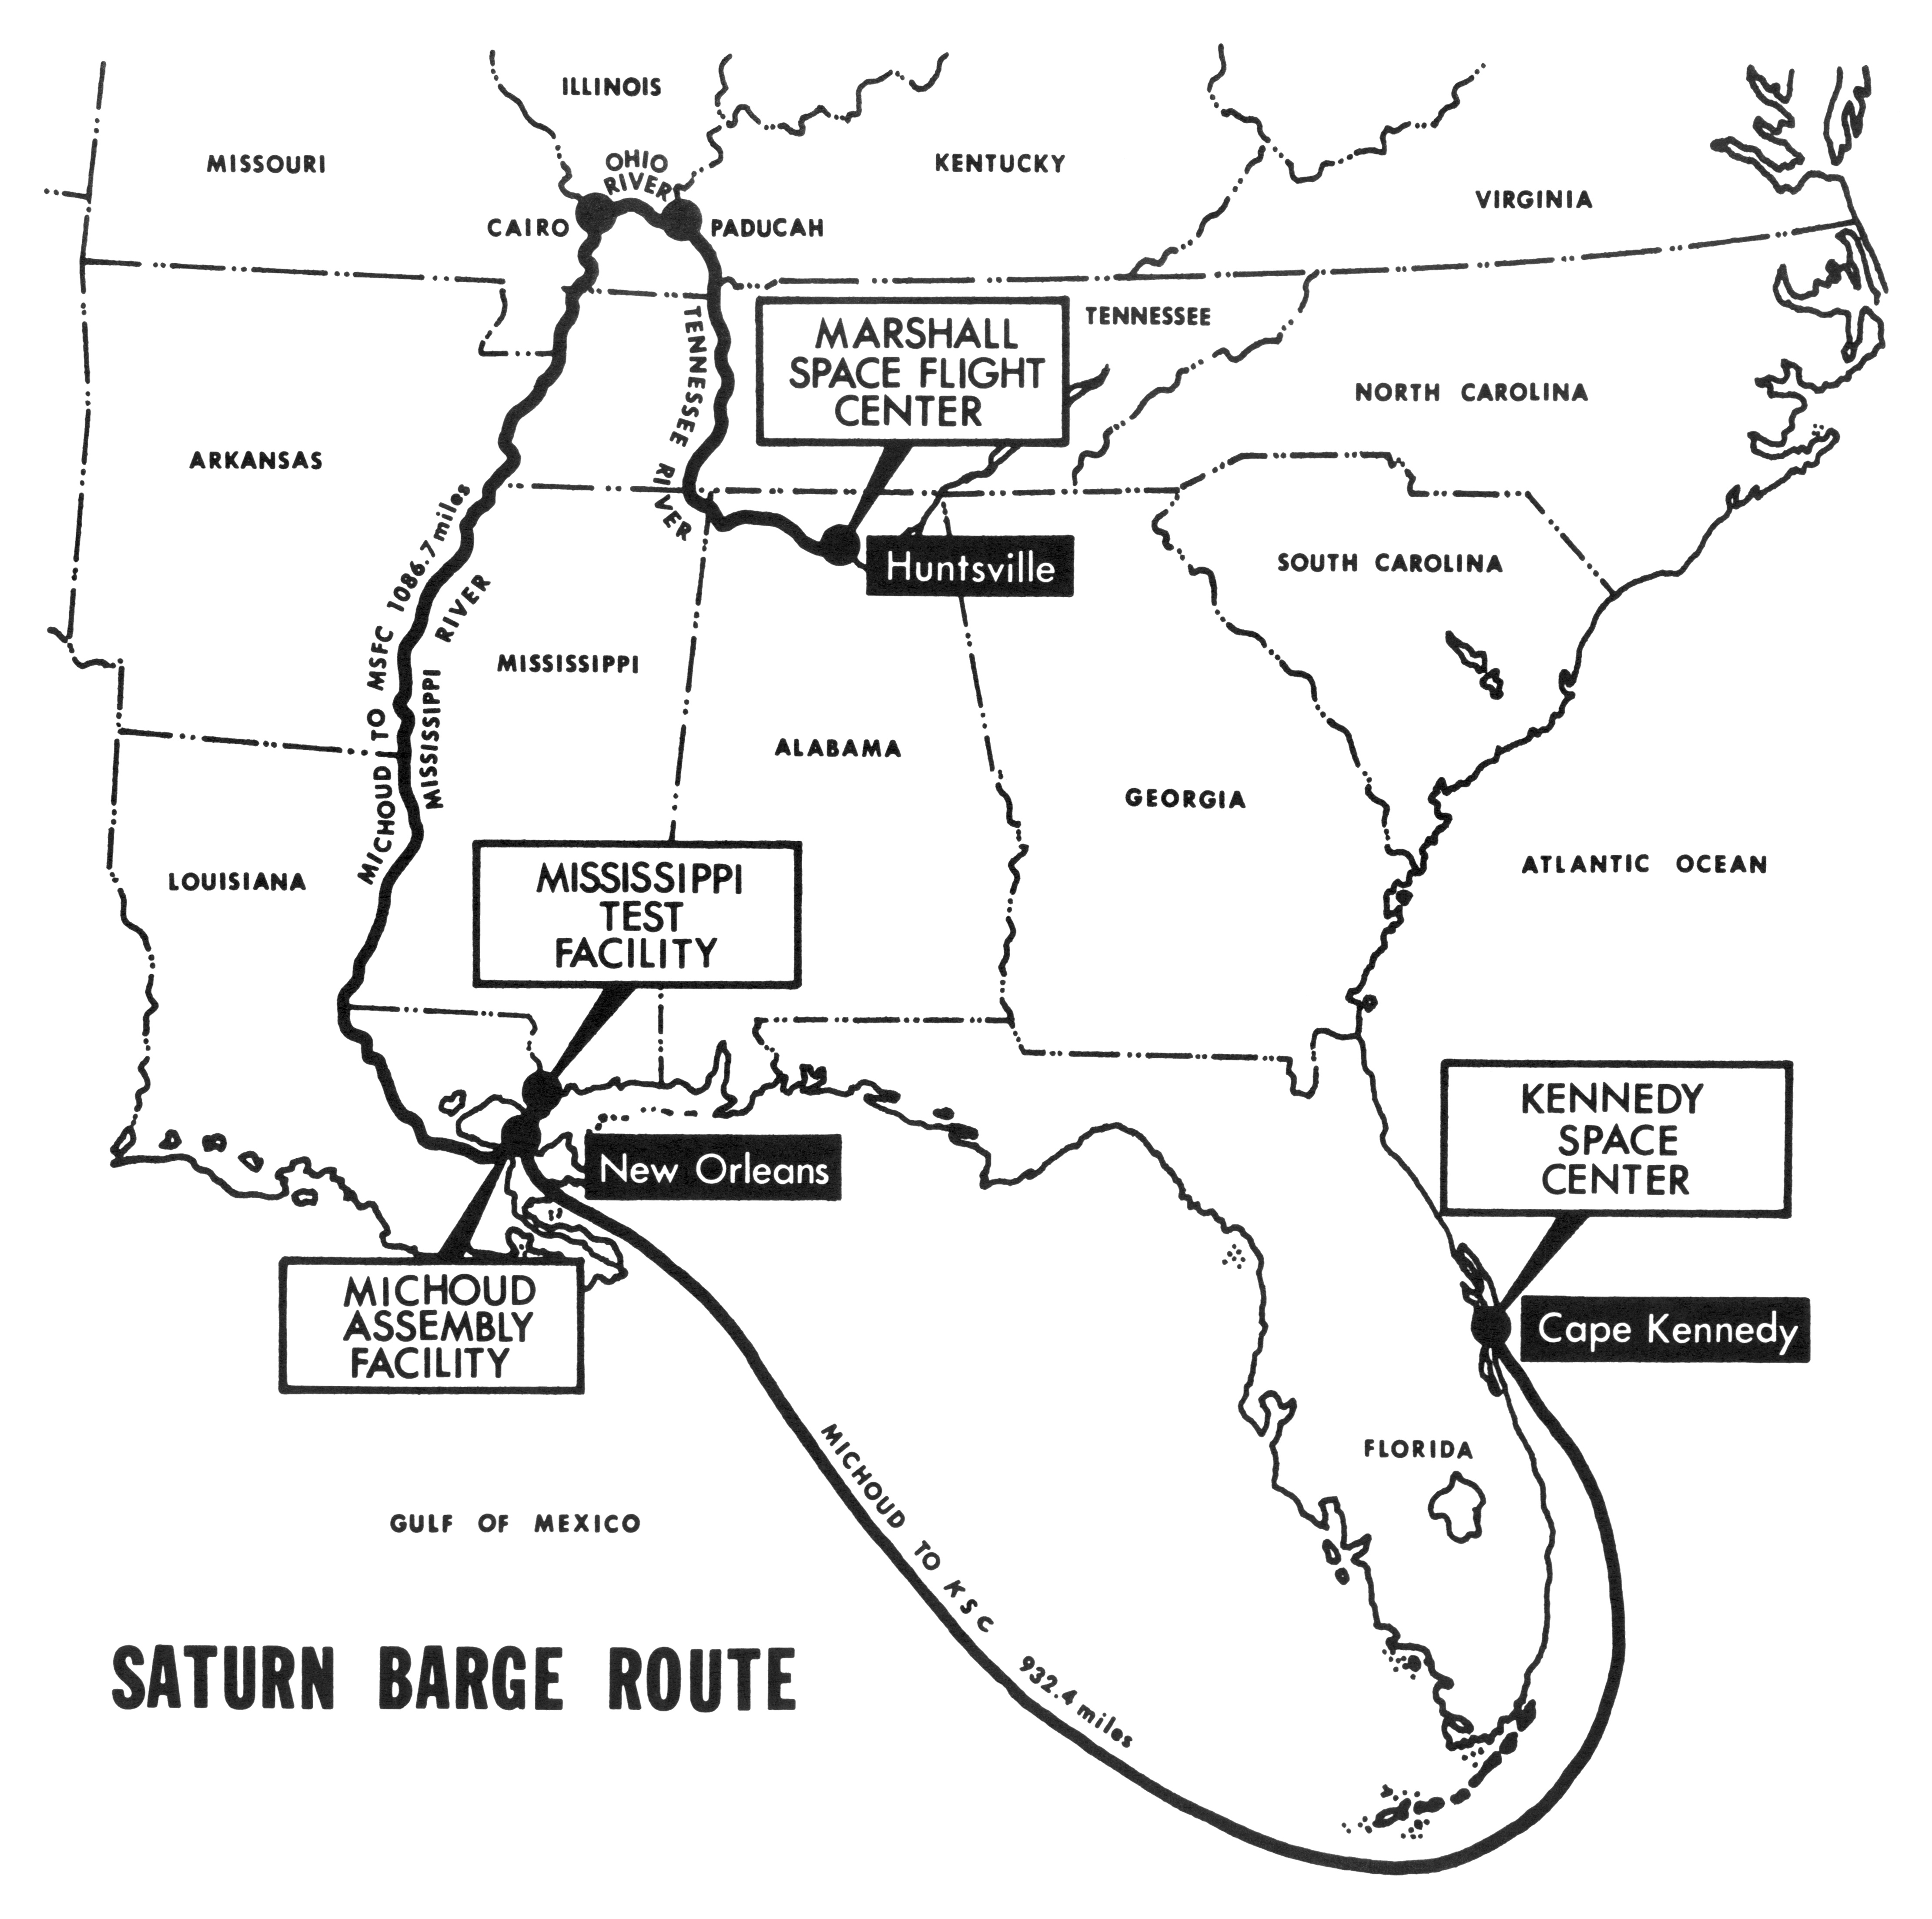
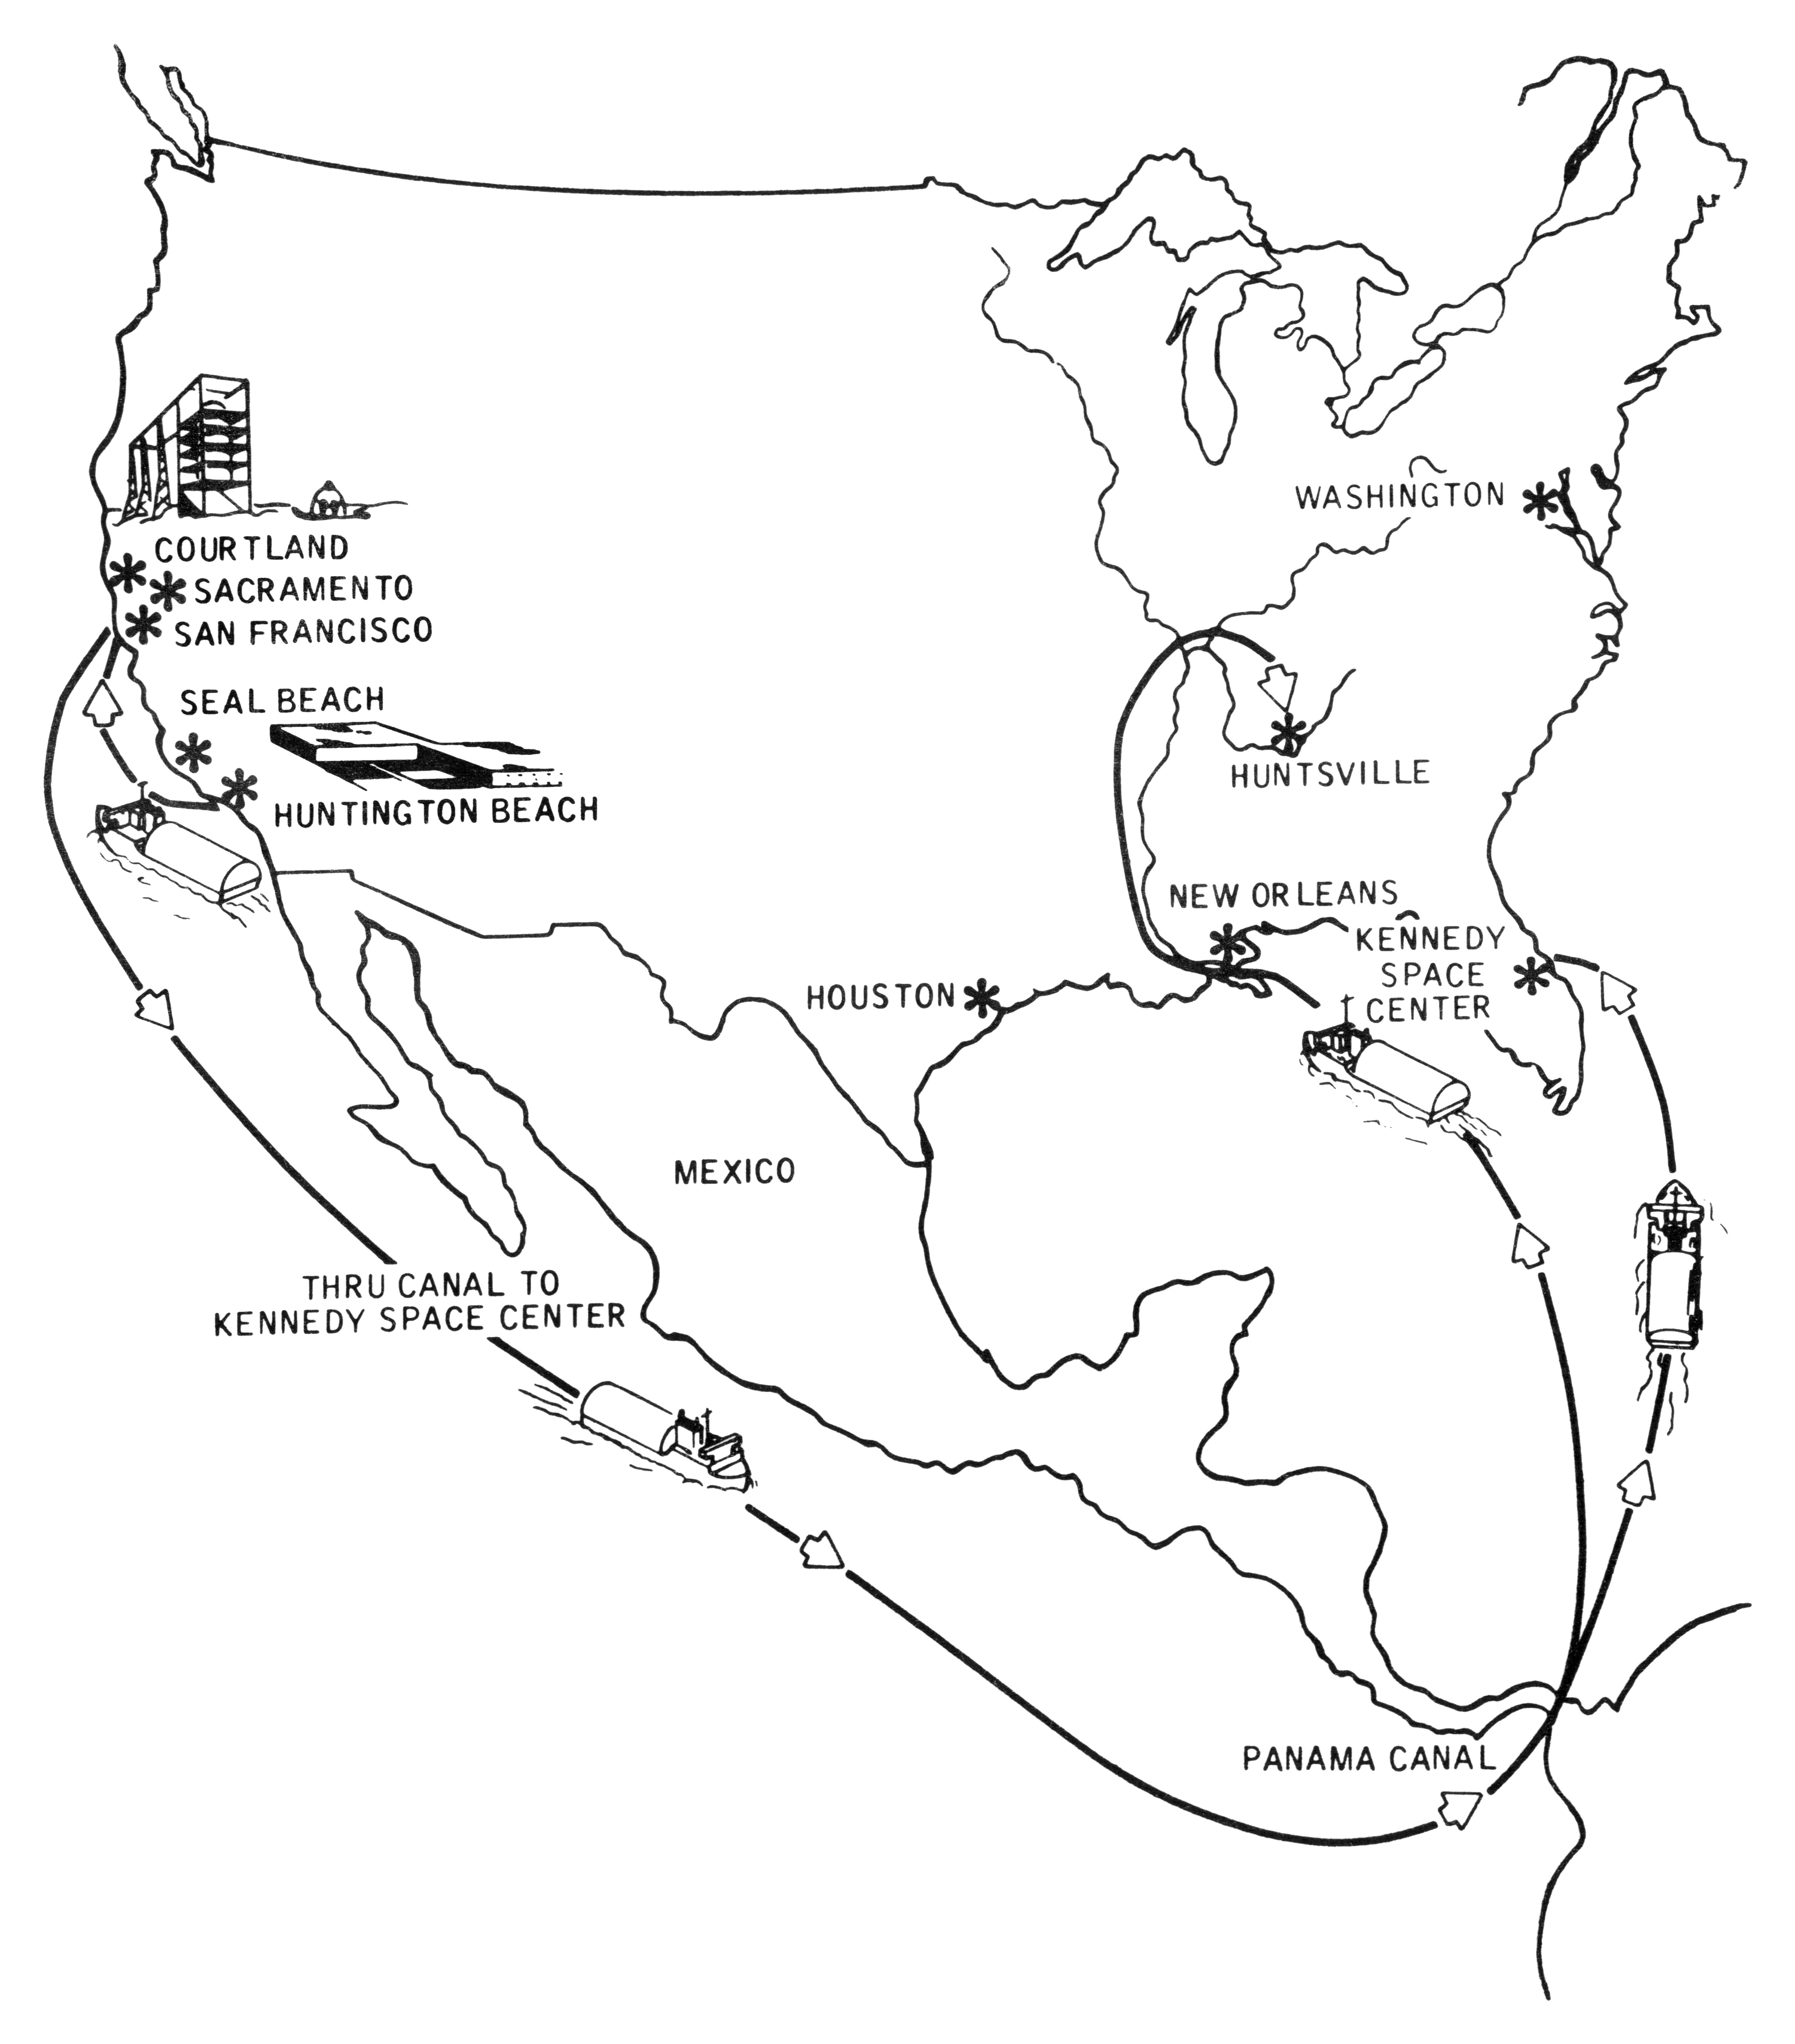

Slide 15
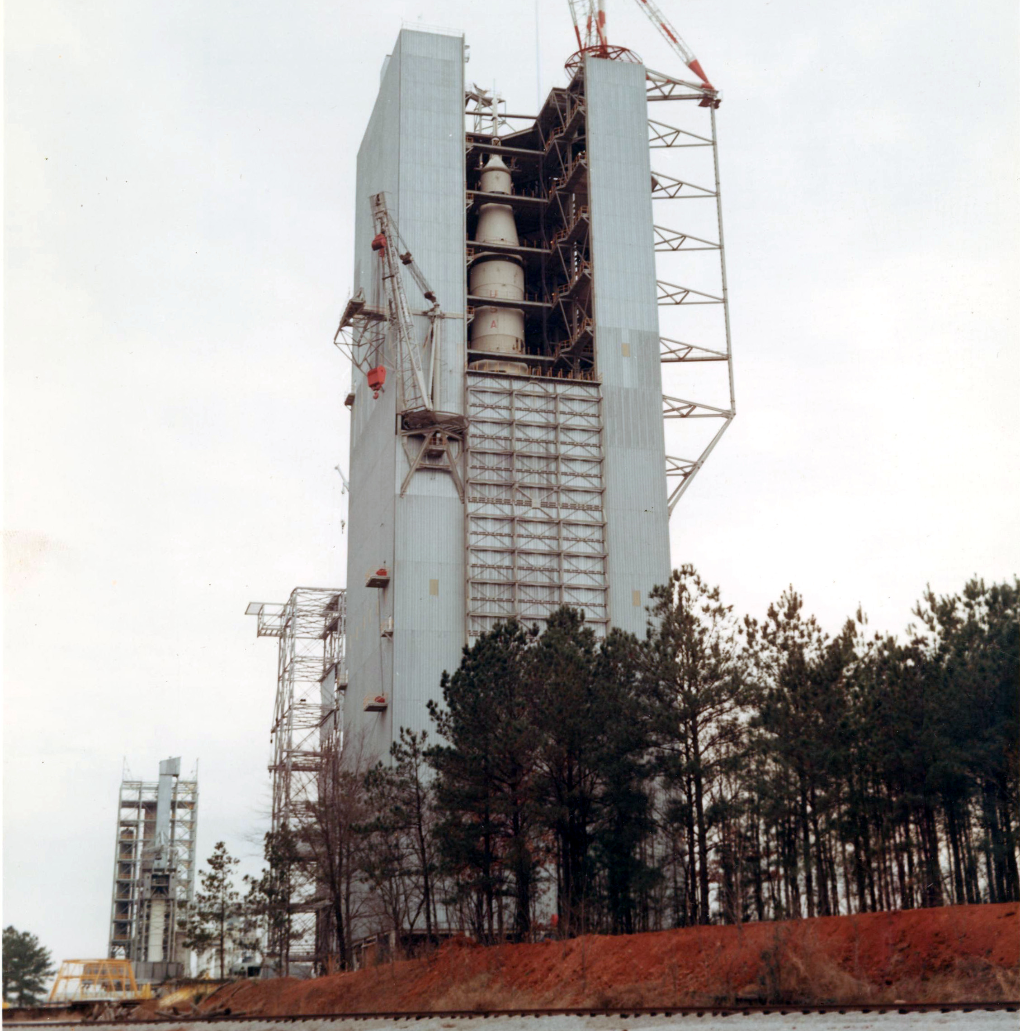
Dynamic Test Facility (Marshall Space Flight Center)

Slide 16
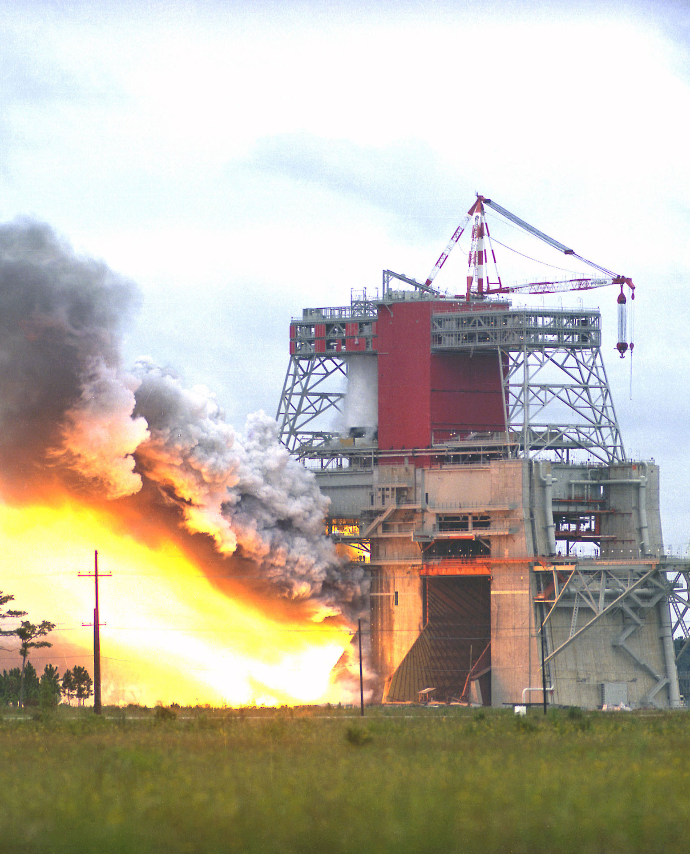
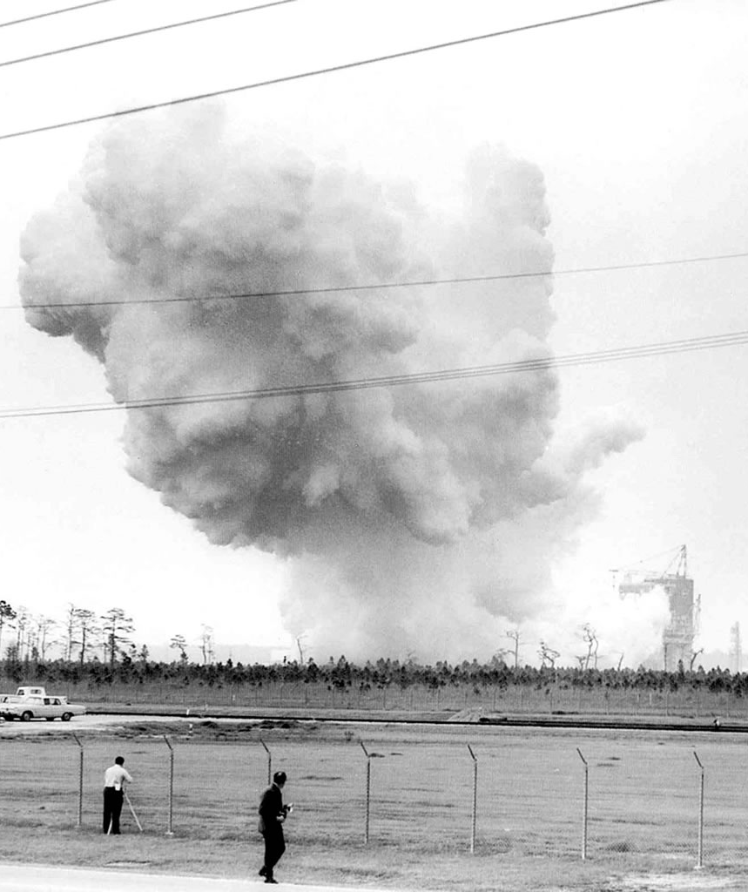
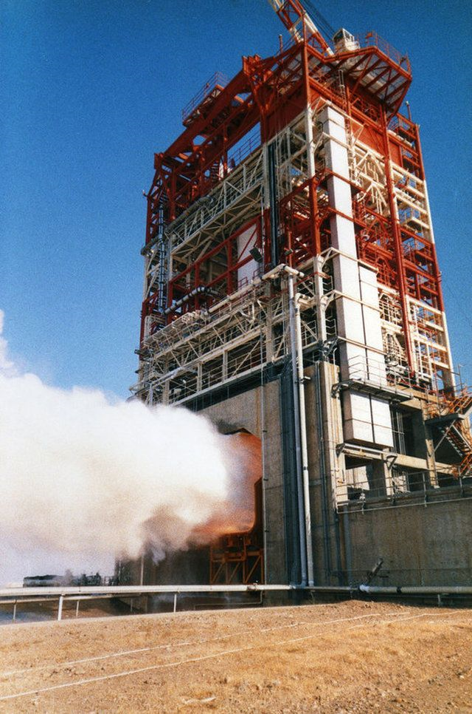
Mississippi Test Facility
S-IC S-II
Sacramento
Test Facility
S-IVB

Slide 17
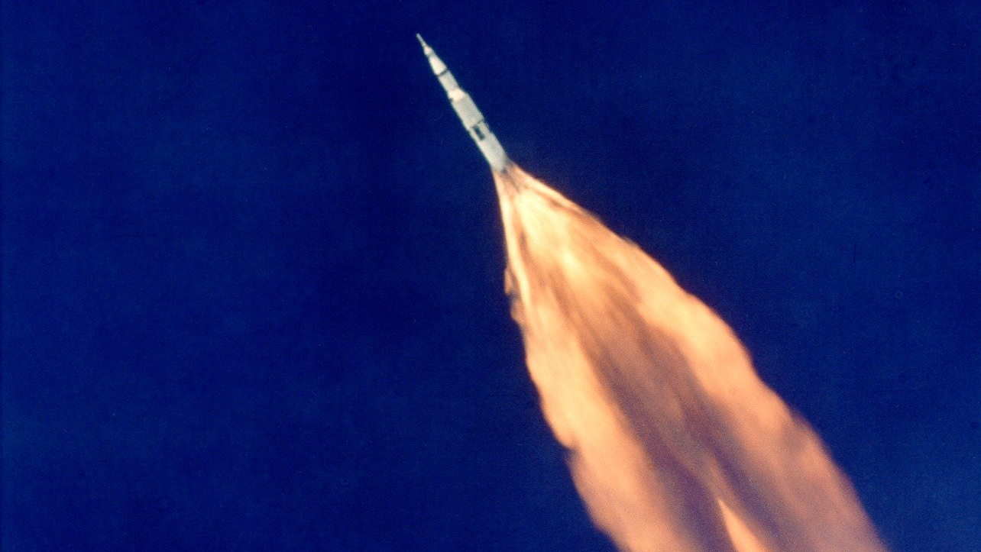

Slide 18
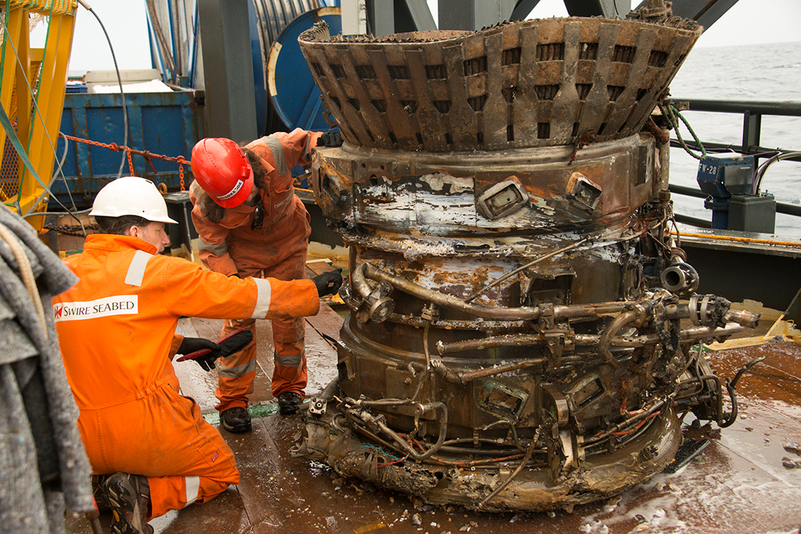
A
Used
F-1

Slide 19
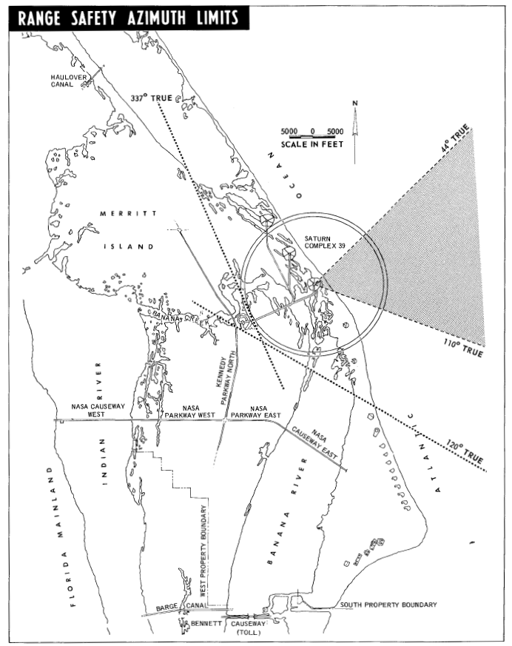
Saturn V Mission Sequence
SA-500F (May-October 1966)
  Facilities integration vehicle
Apollo 4 (November 1967)
  All-up test
Apollo 6 (April, 1968)
  Pogo
  SLA failure
  Two S-II engine failures
  S-IVB restart failure
Apollo 8 (December, 1968)
  First crewed flight

Slide 20
Discussion Groups
Moon Machines Video (“Saturn V”)
  An overview of Marshall Space Flight Center’s Saturn V development
Bilstein Chapter 2 (“Aerospace Alphabet: ABMA, ARPA, MSFC”)
  The evolution of the Saturn design
Bilstein Chapter 6 (“From the S-IV to the S-IVB)
  Development of the third stage
Bilstein Chapter 7 (“The Lower Stages: S-IC and S-II)
  Development of the first and second stages

