Slide 1
Lunar Module
HONR 269i
To the Moon and Back: The Apollo Program

Slide 2
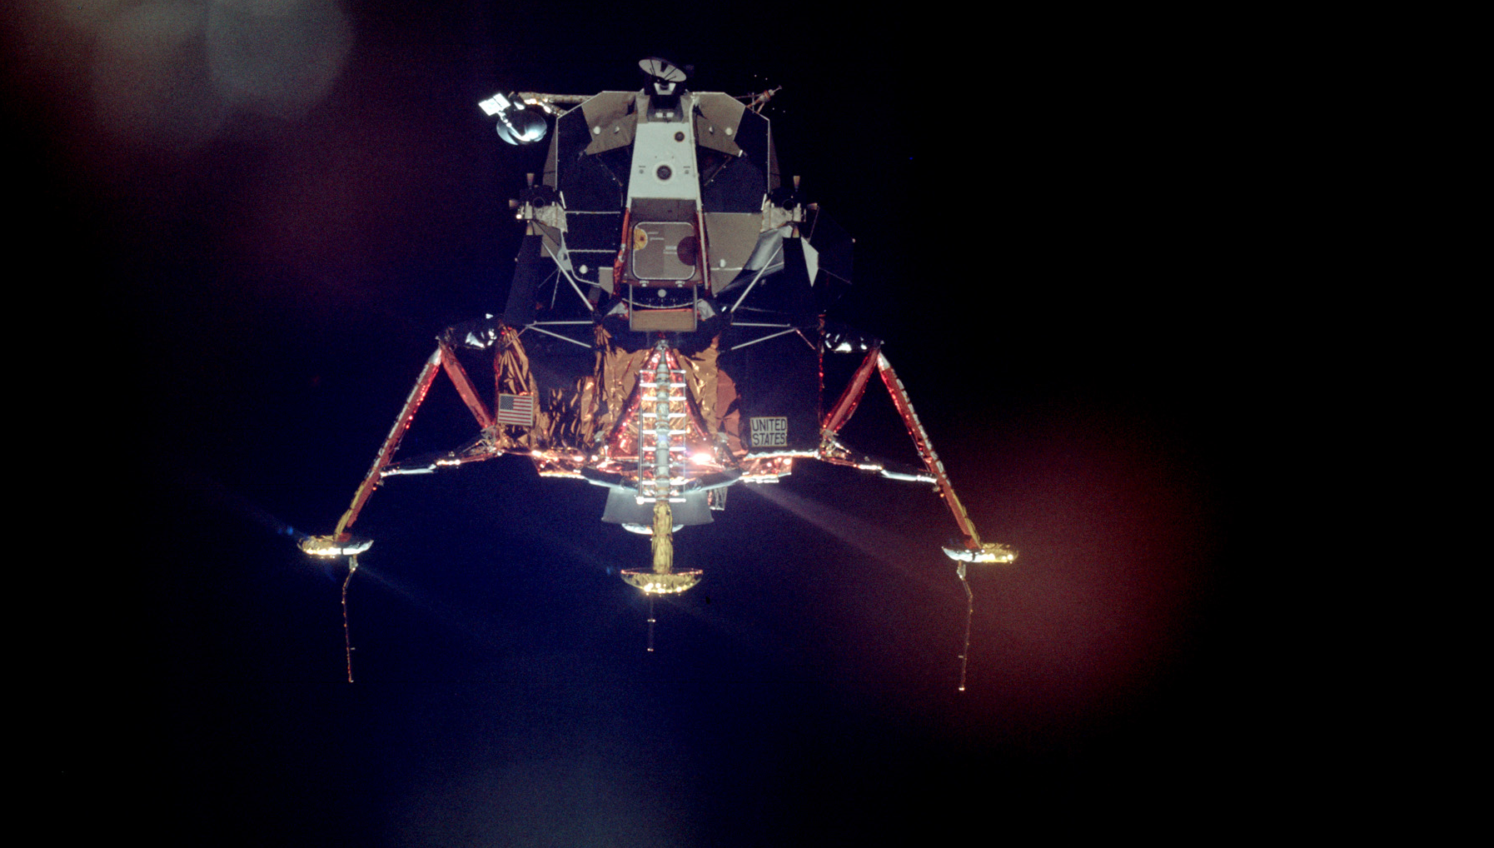

Slide 3
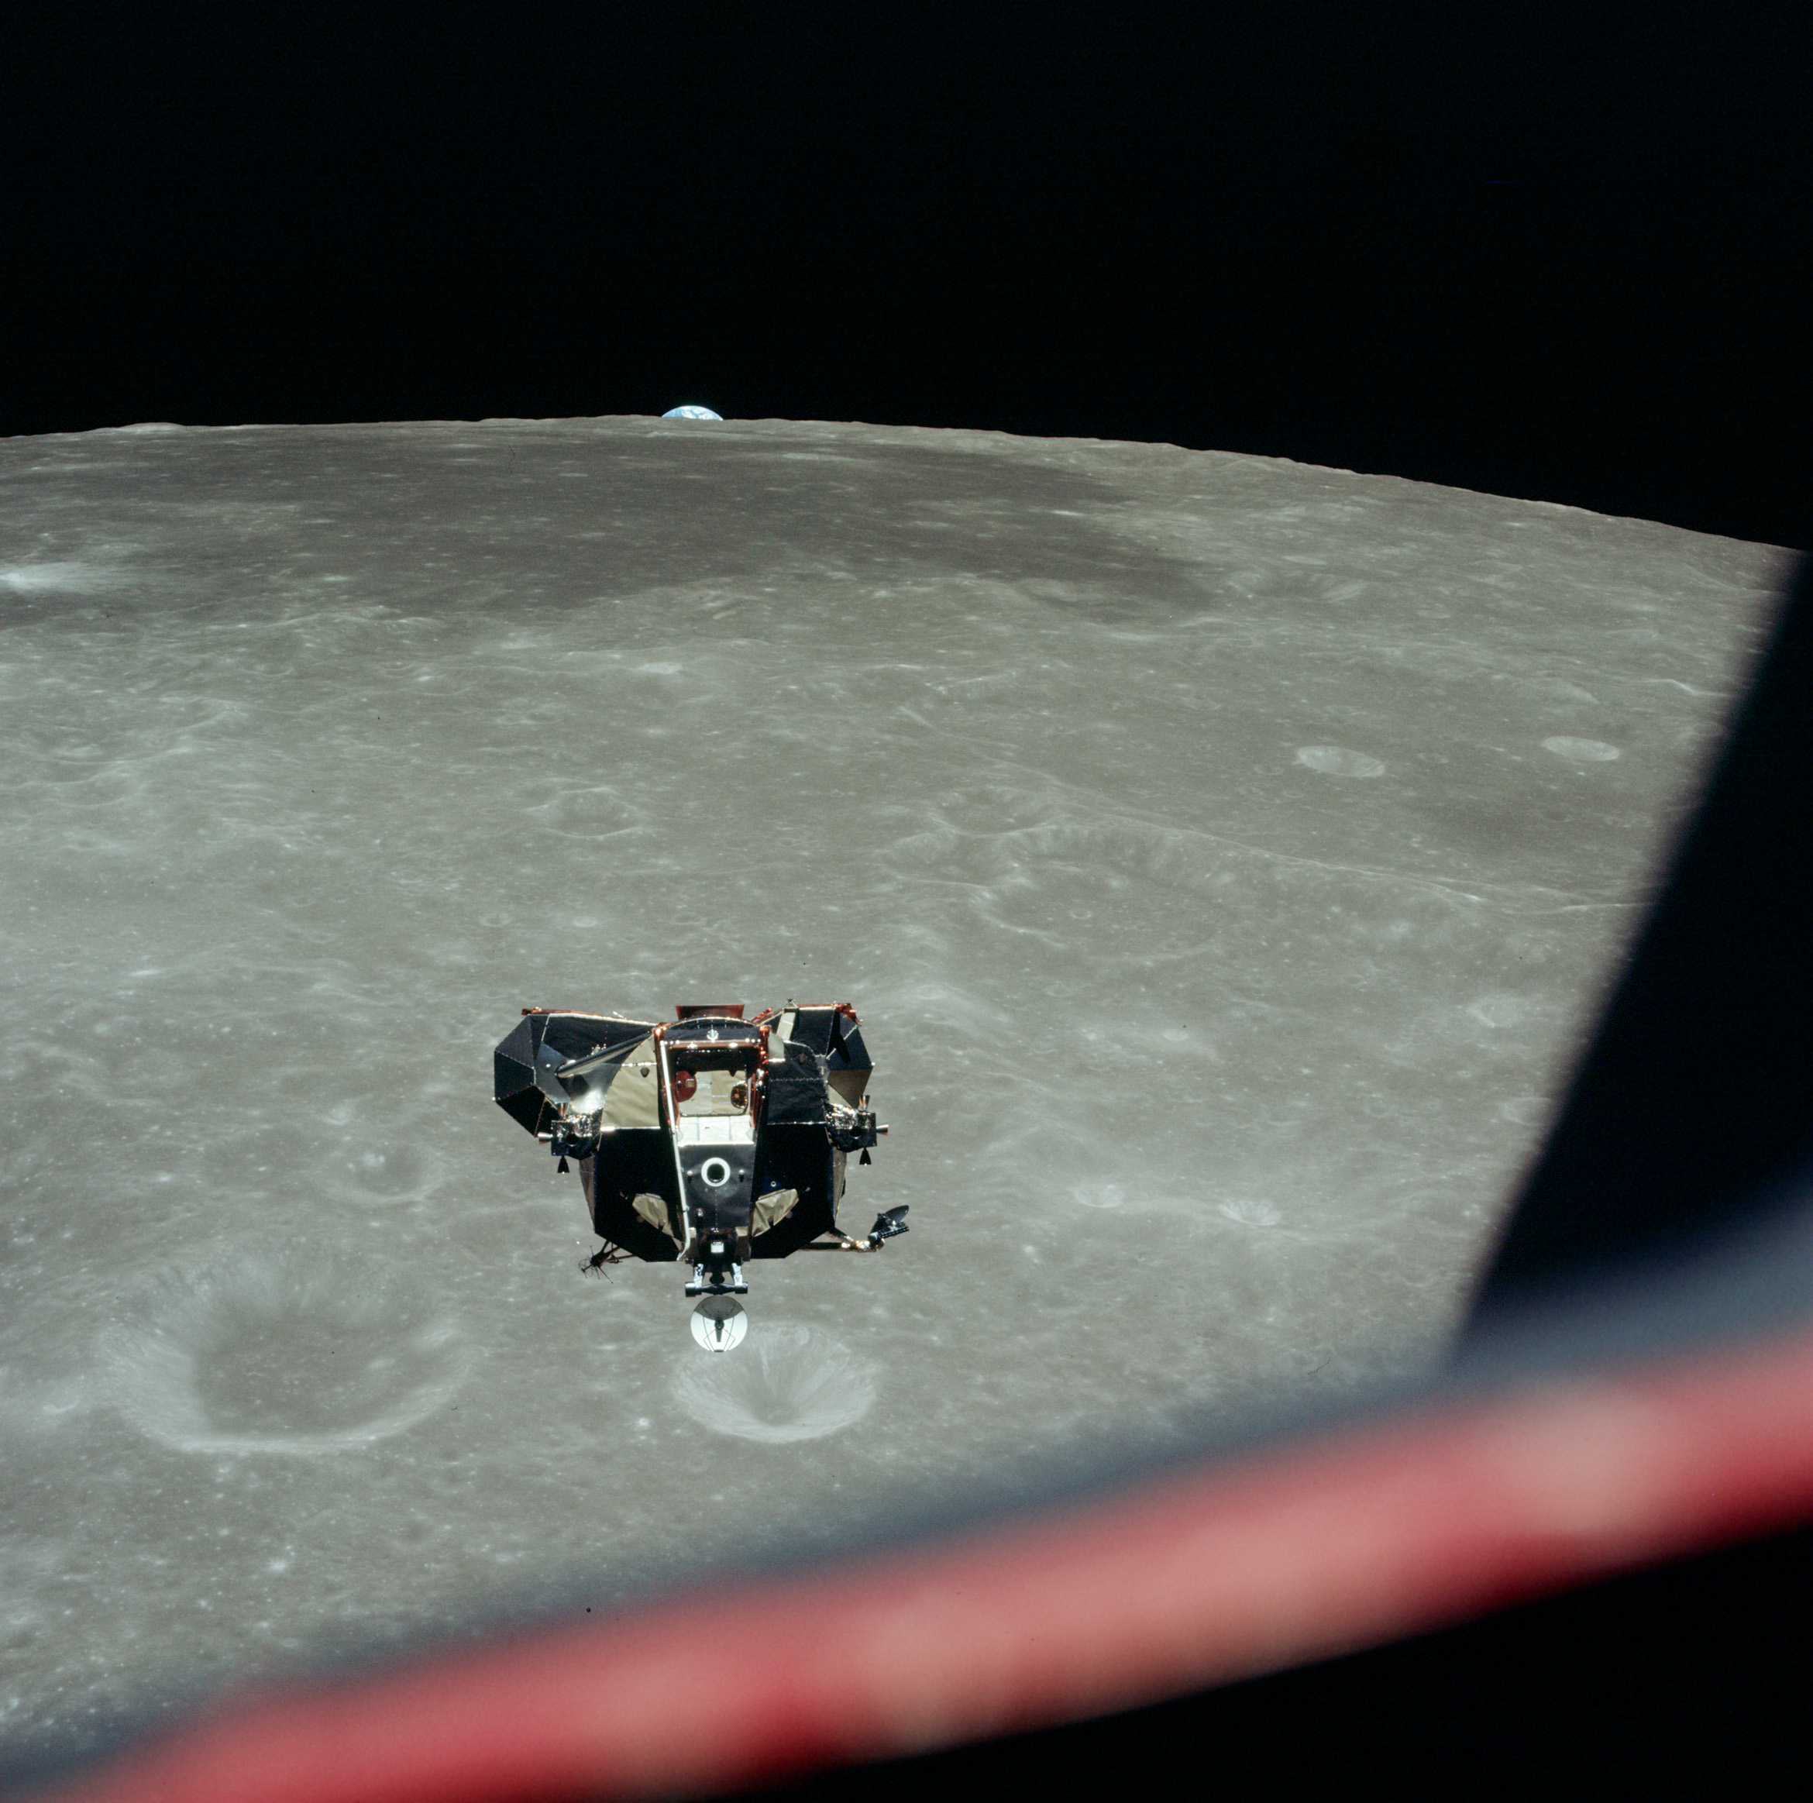

Slide 5
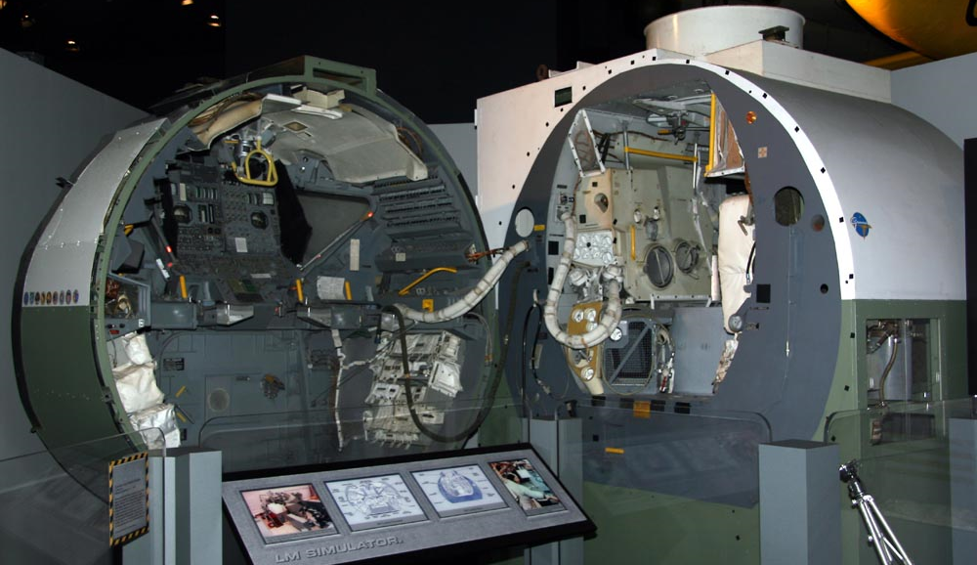

Slide 6
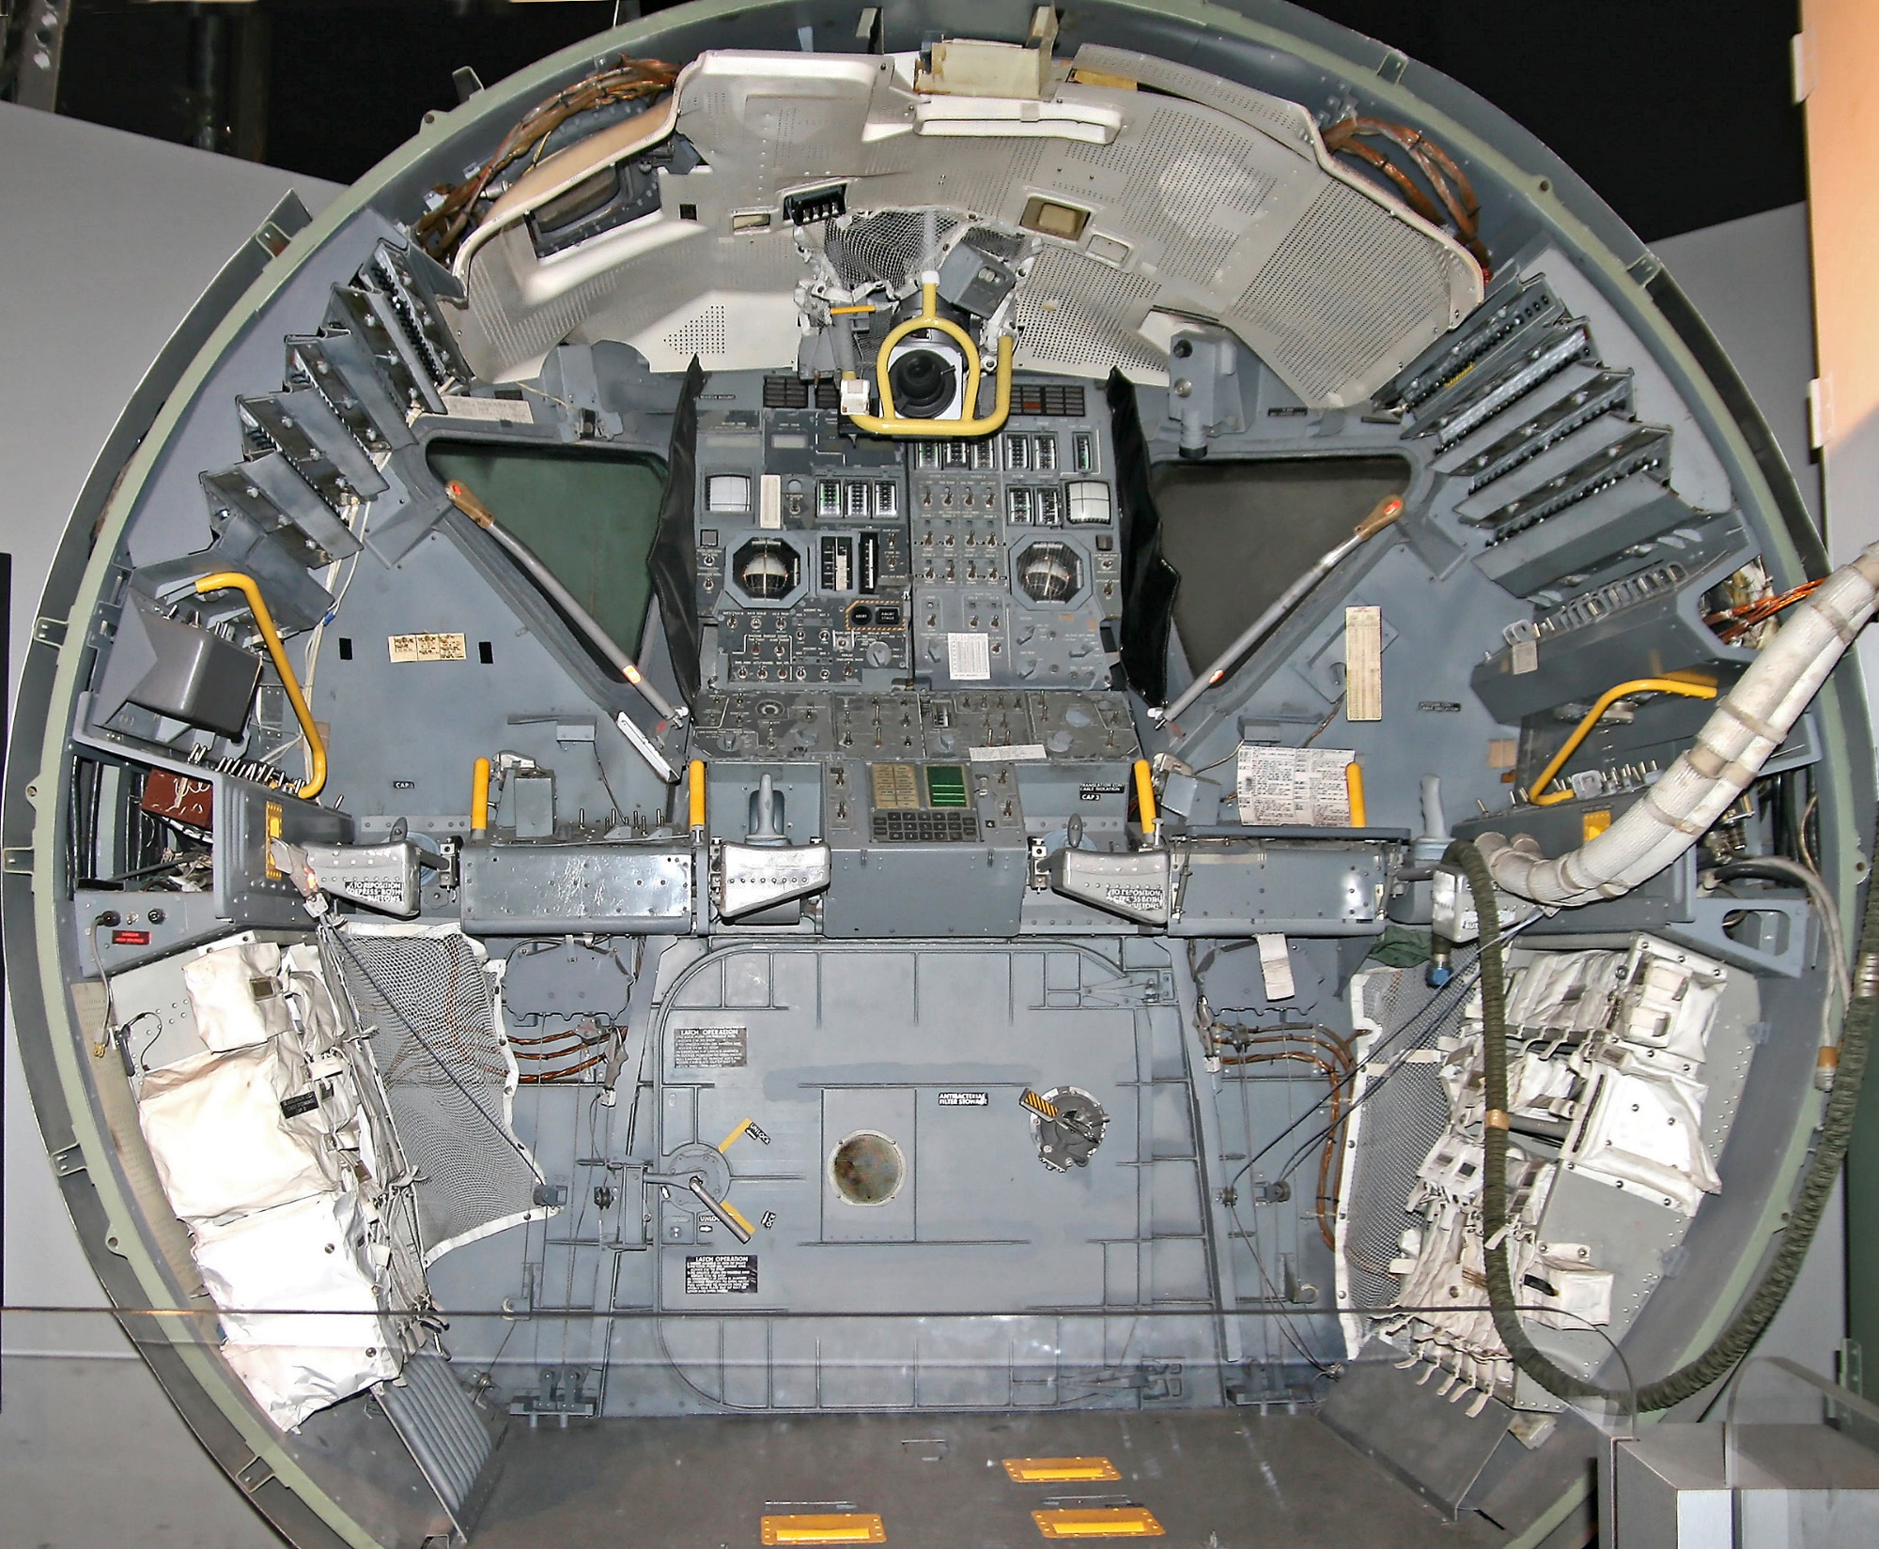

Slide 7
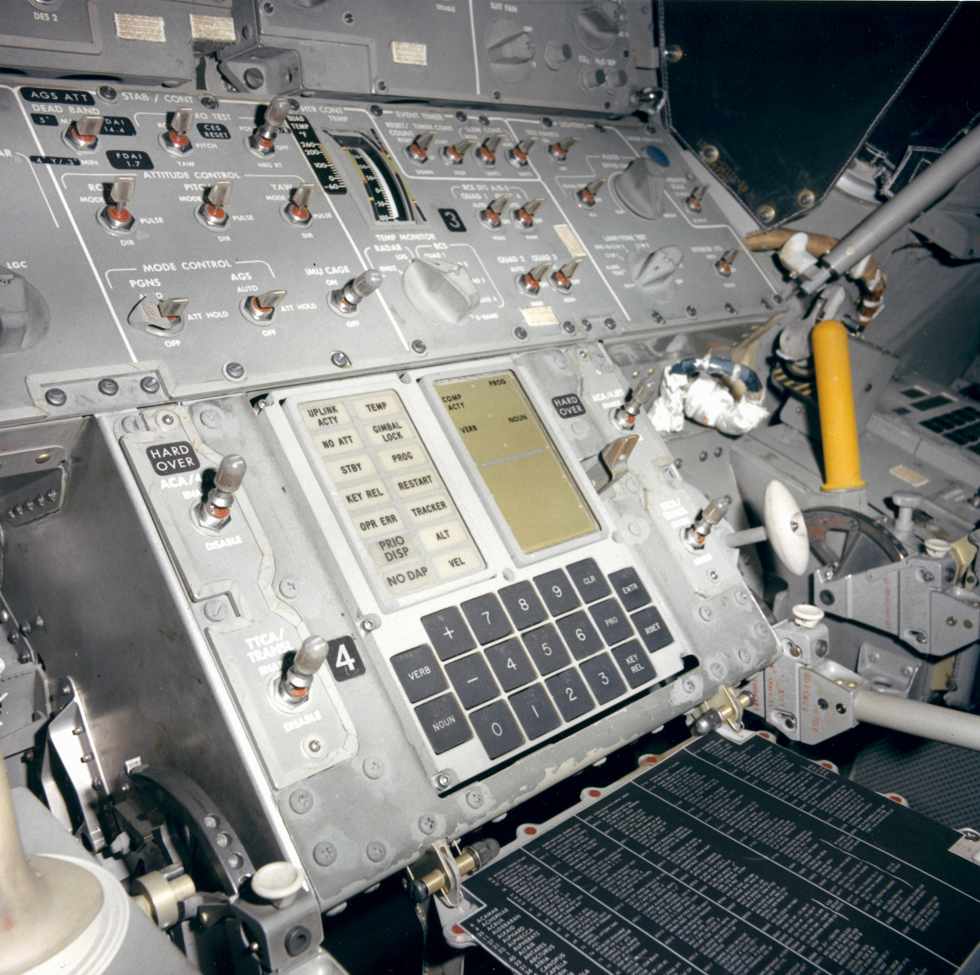

Slide 8
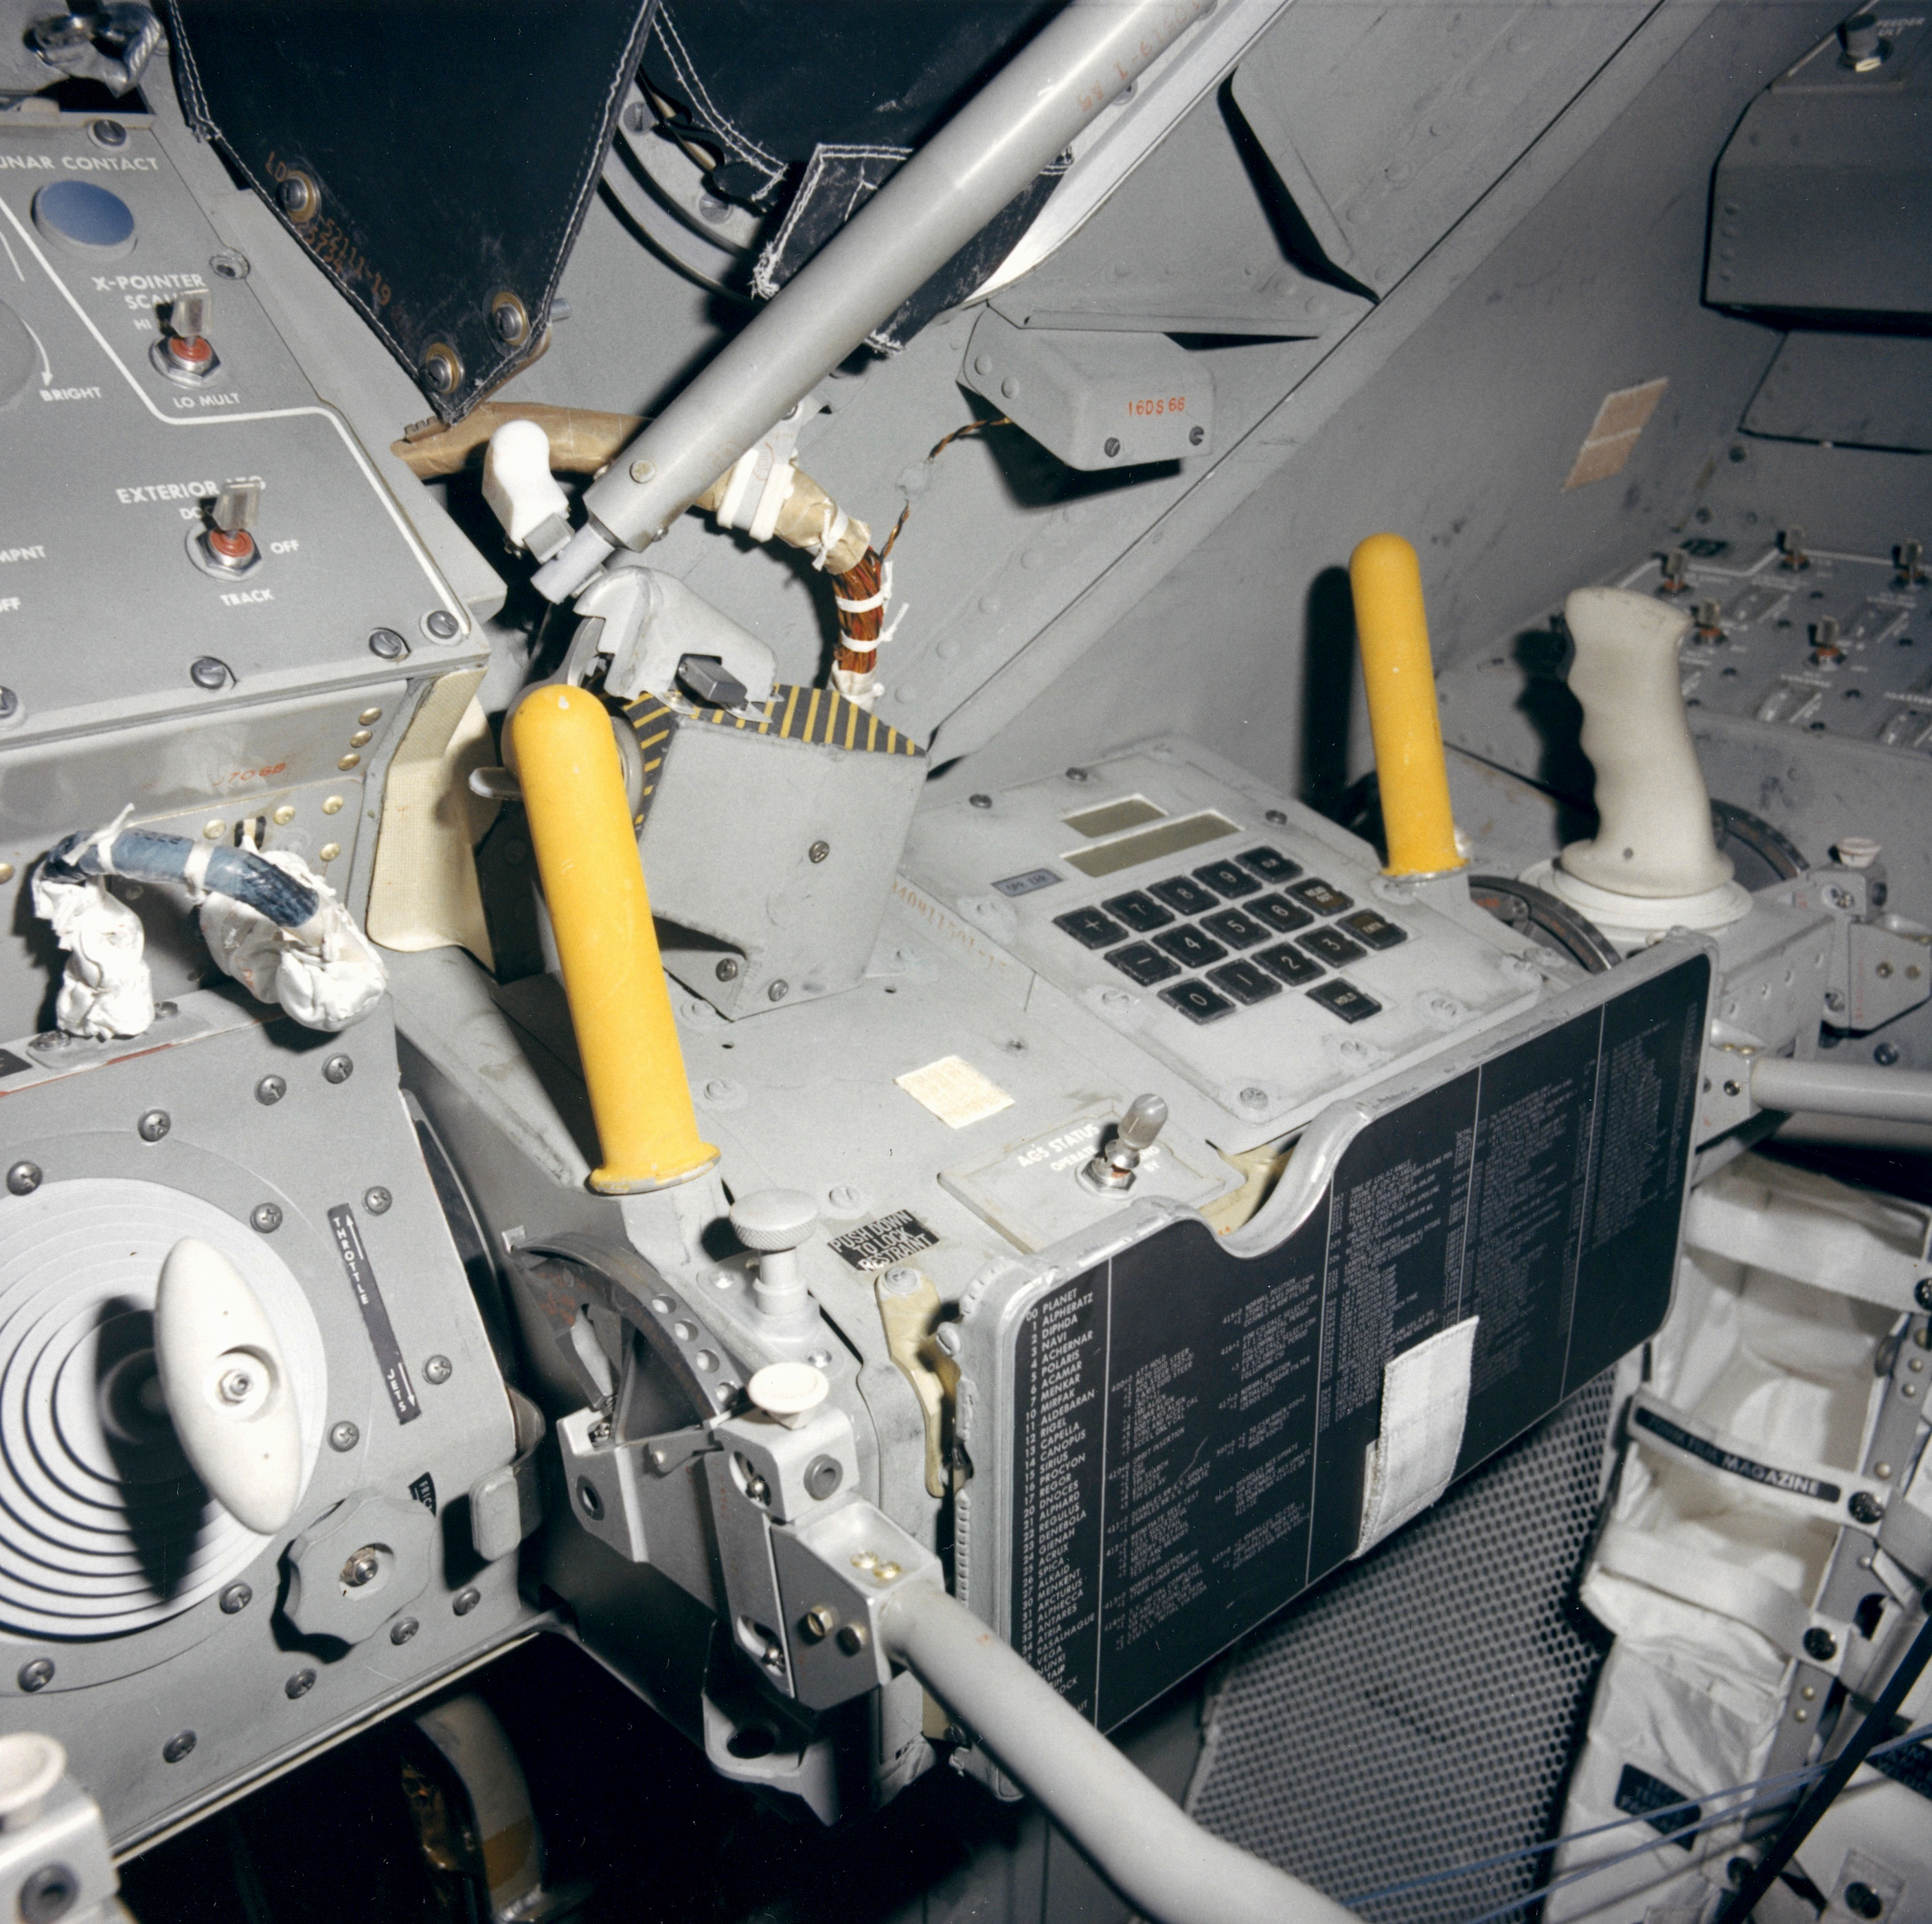

Slide 9
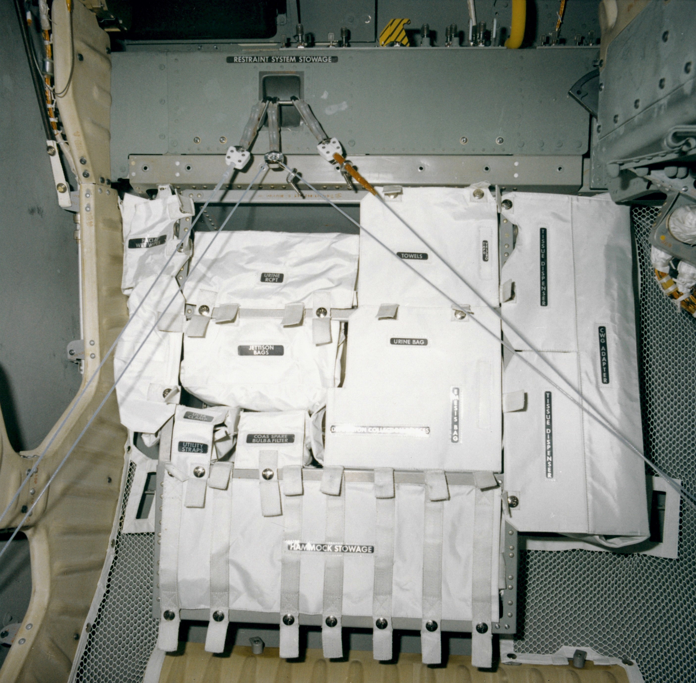

Slide 10
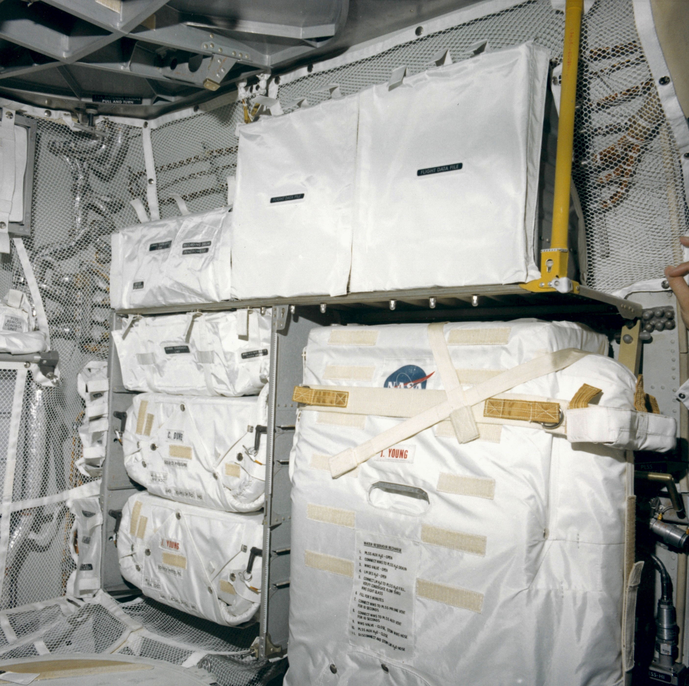

Slide 11
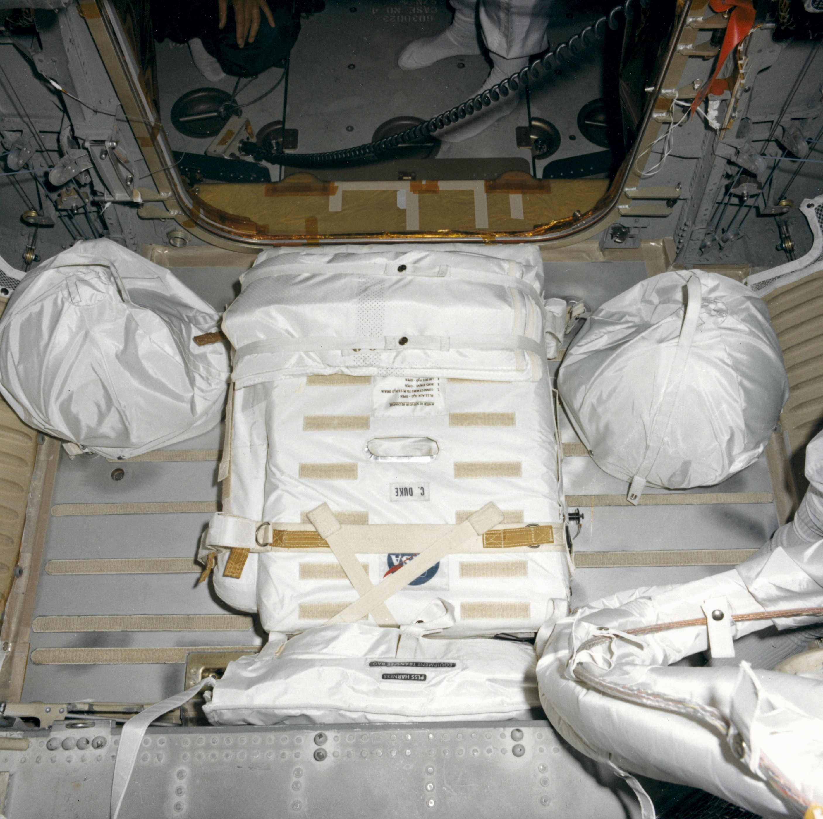

Slide 12
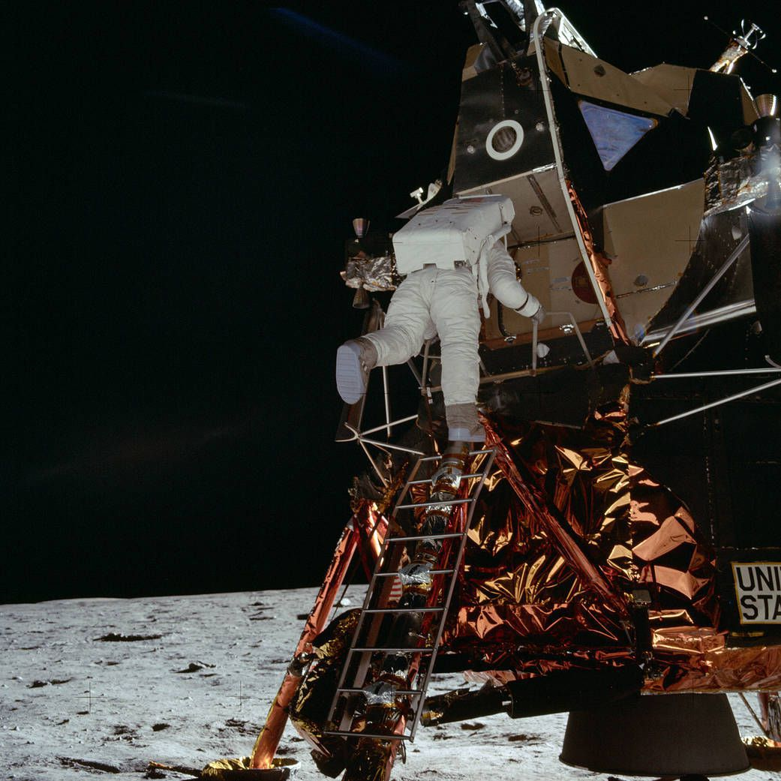

Slide 13
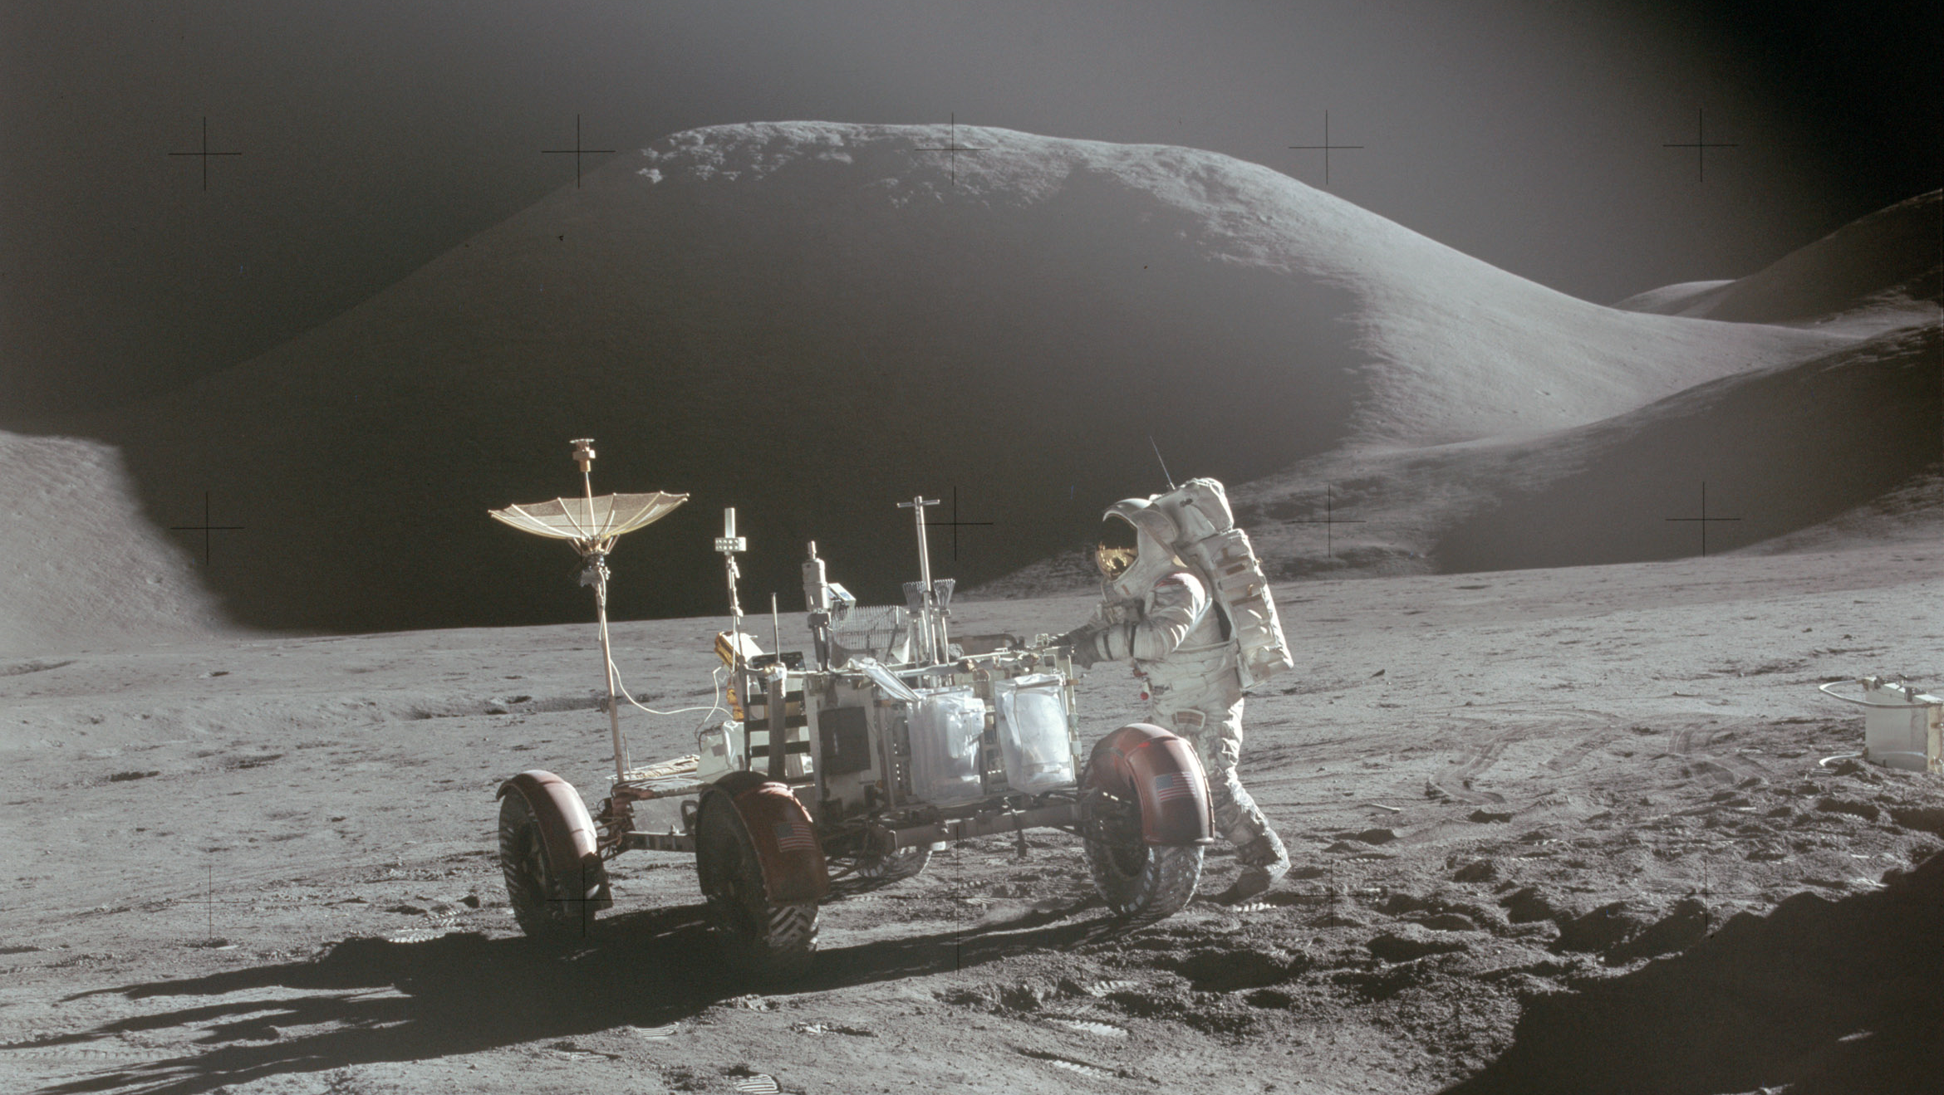

Slide 14
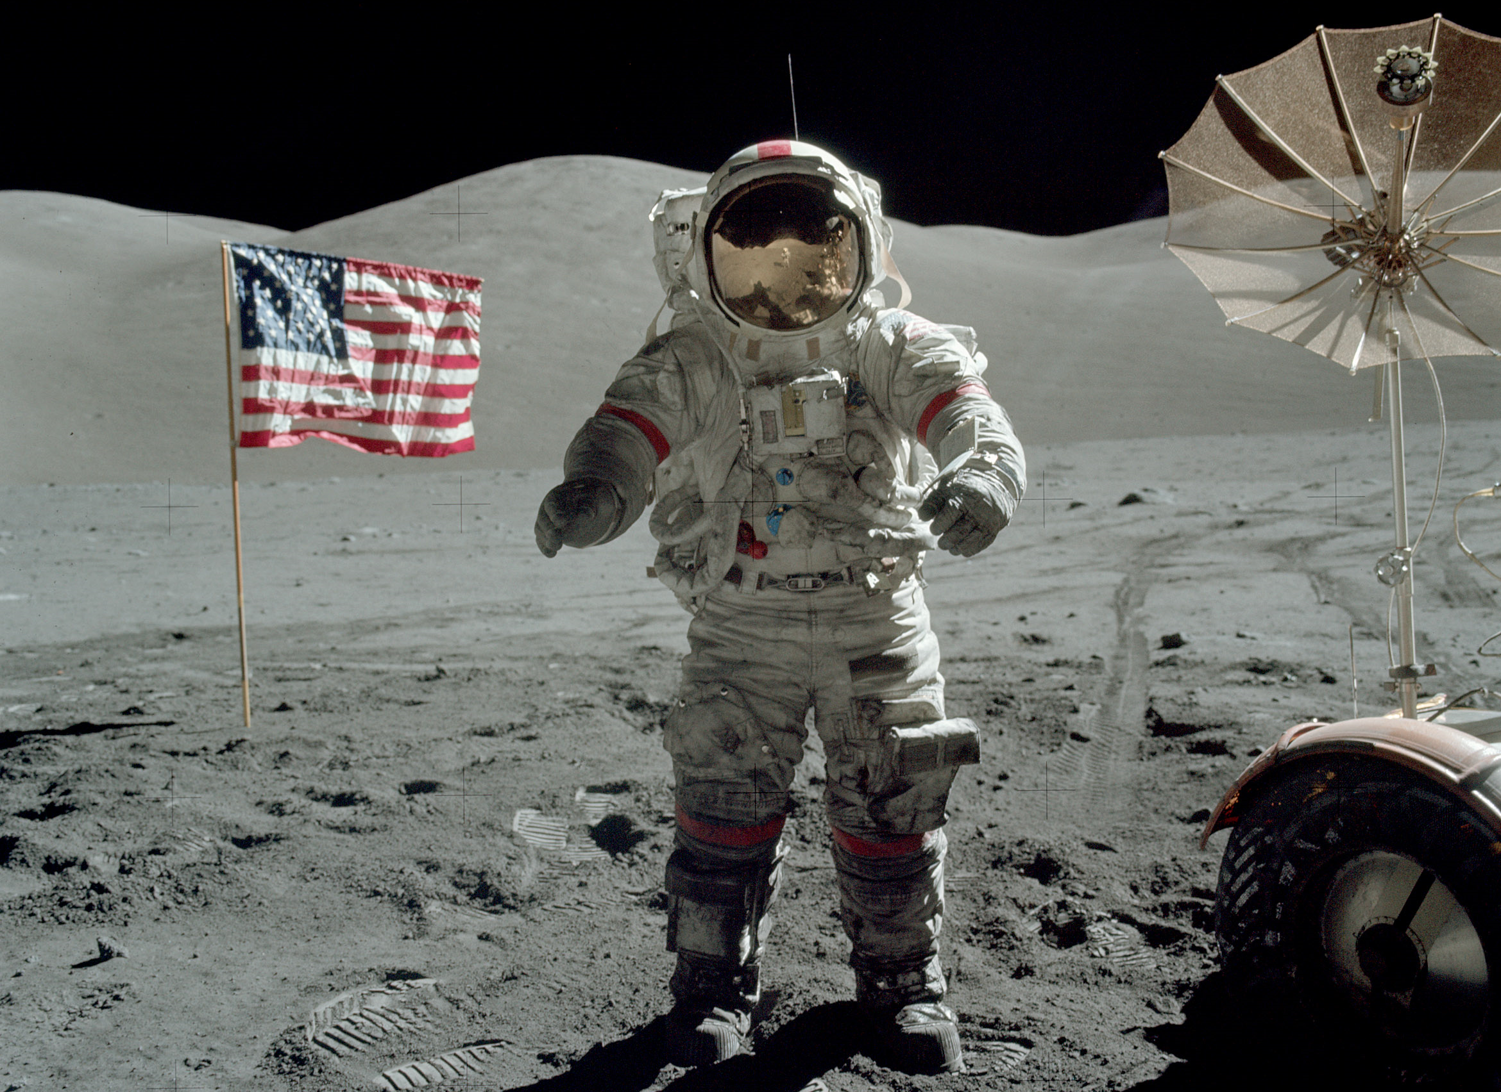

Slide 15
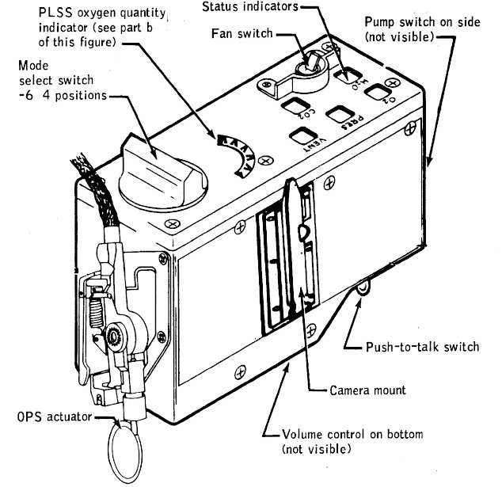
PLSS Remote Control Unit

Slide 16
Learning as You Go
Seats?
  Too heavy, too far from the windows
Forward docking port?
  Too small to exit with a PLSS backpack
Fuel cells?
  Too late
Descent engine throttling
  Parallel development, but both worked
Ascent engine injector
  No parallel development until 1967, but it was needed!

Slide 17
Risk Management
Schedule risk vs. safety risk
Qualitative vs. quantitative
Failure Modes and Effects Analysis
Critical Items List
  Criticality 1: Loss of life or vehicle if the component fails
  Criticality 2: Loss of mission if the component fails
  Criticality 3: All others
Exception, Waiver or Retention Rationale
  Design, Test, Inspection, History, Use

Slide 18
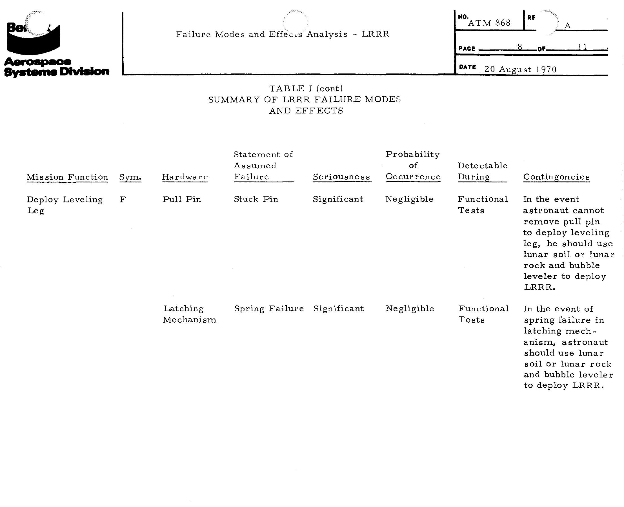
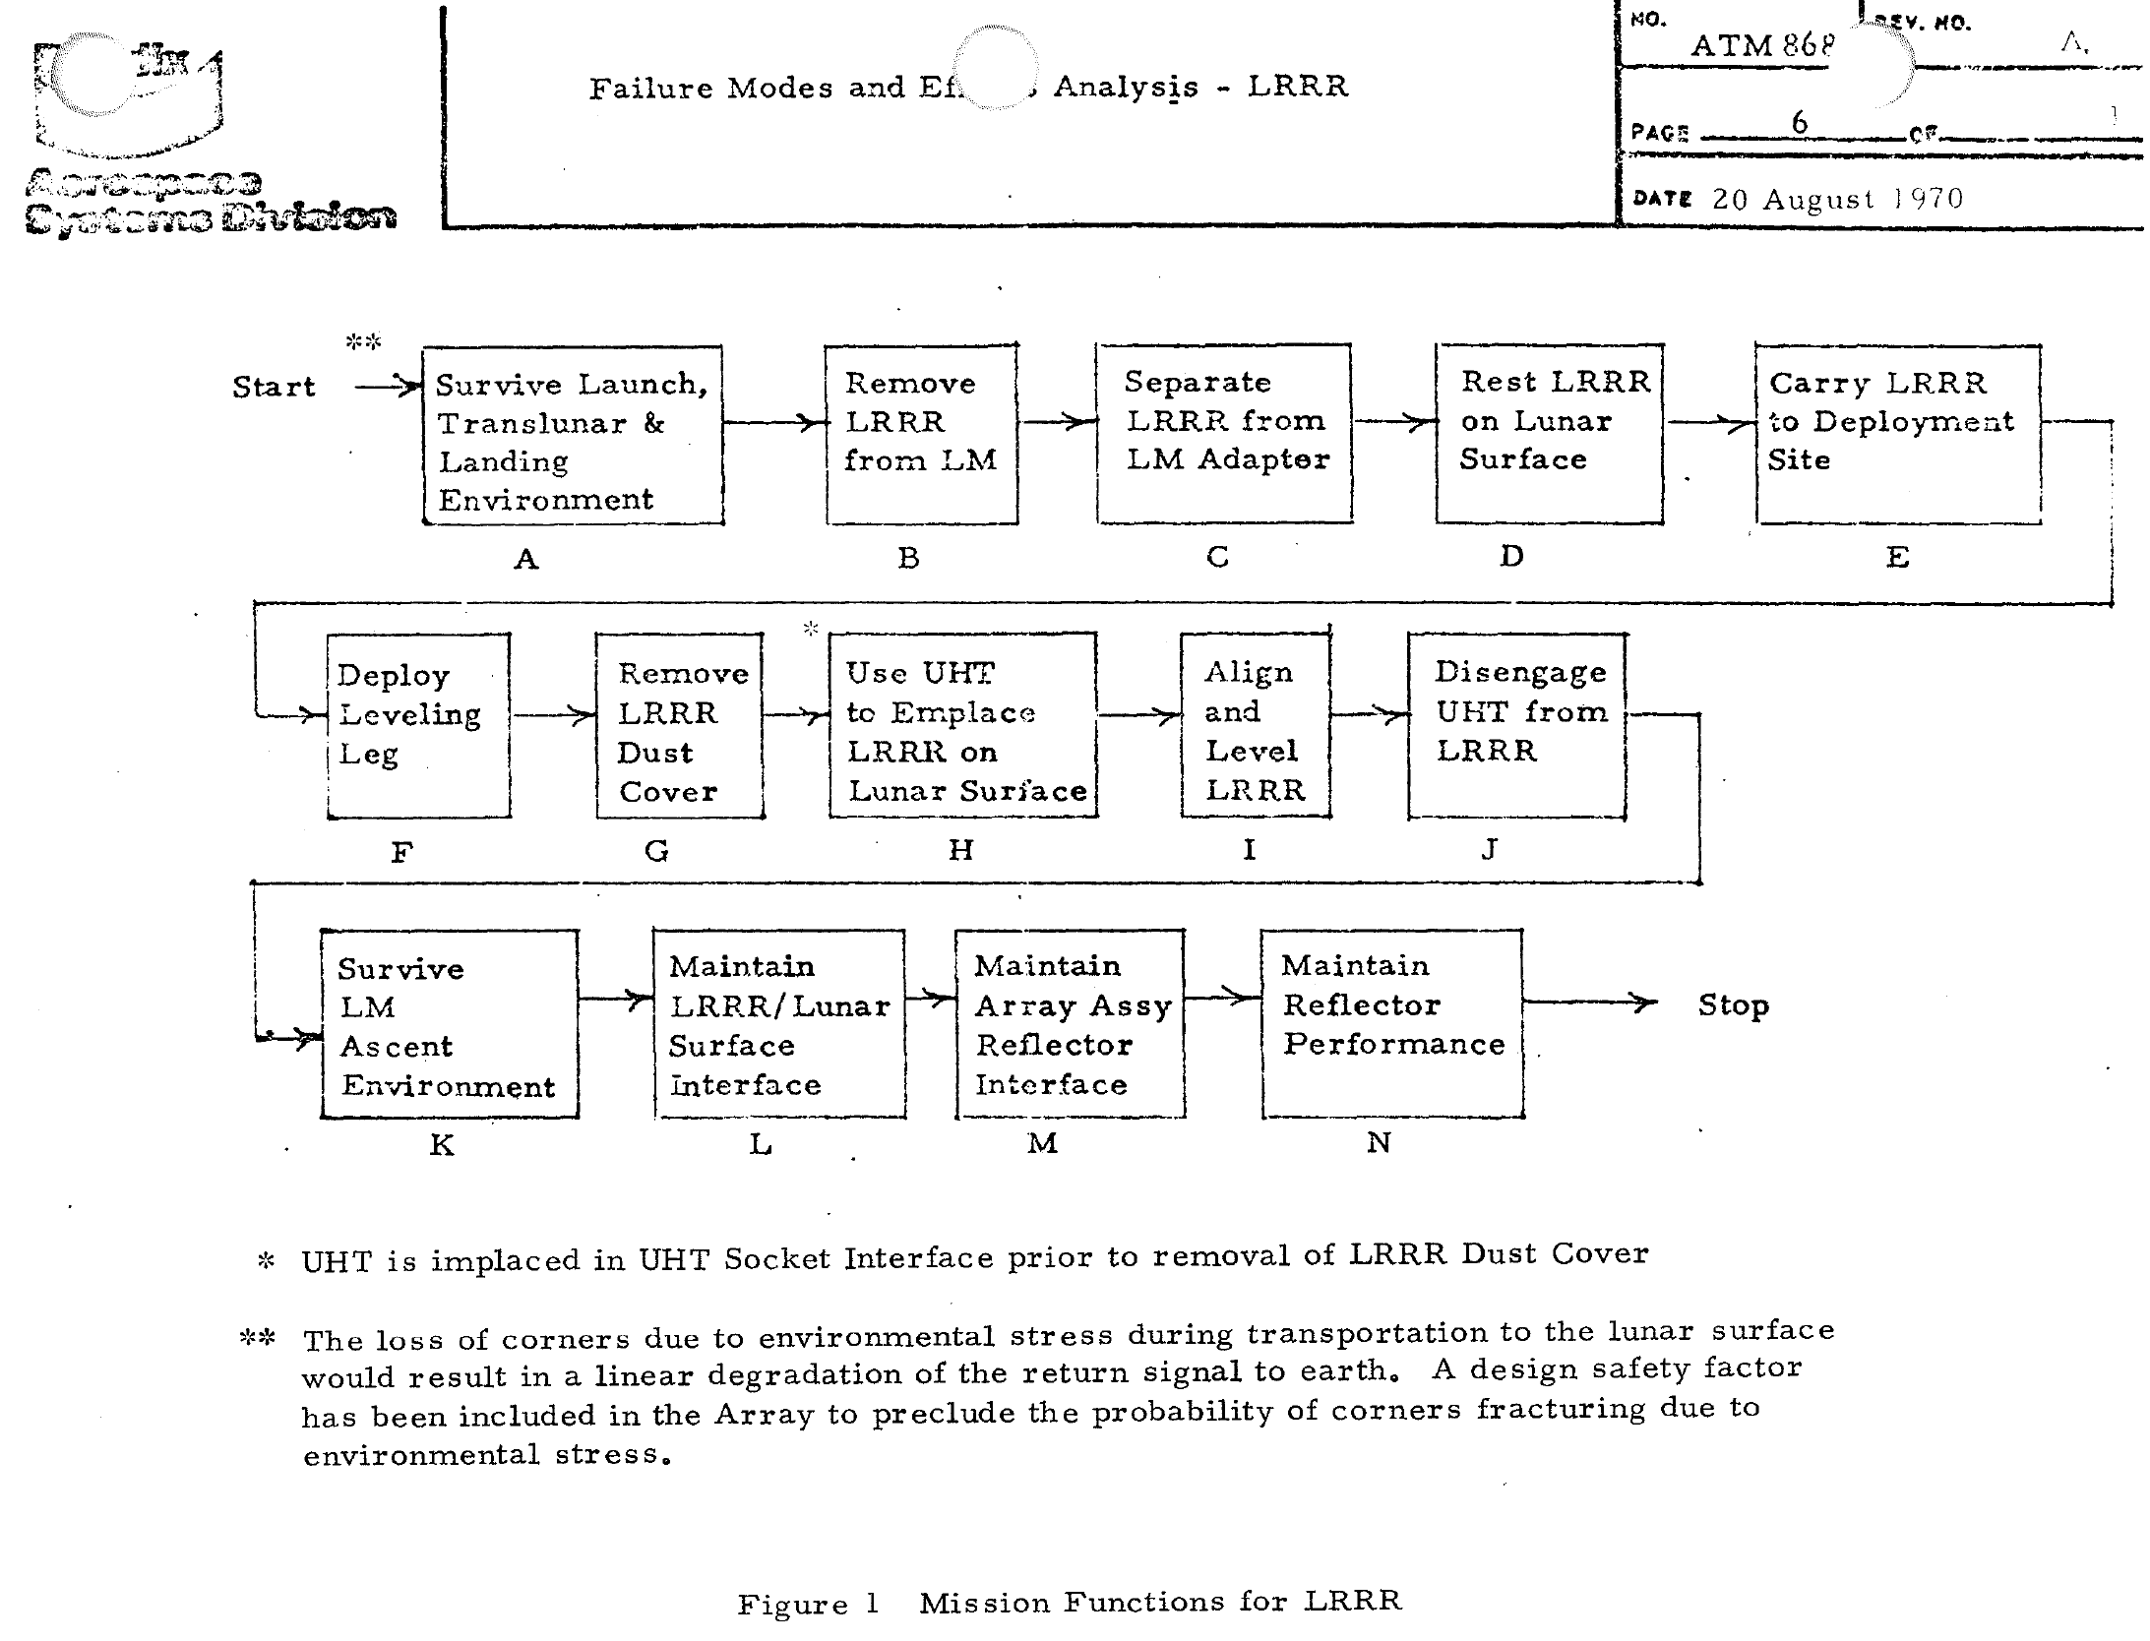
Failure Modes and Effects Analysis (FMEA)

Slide 19
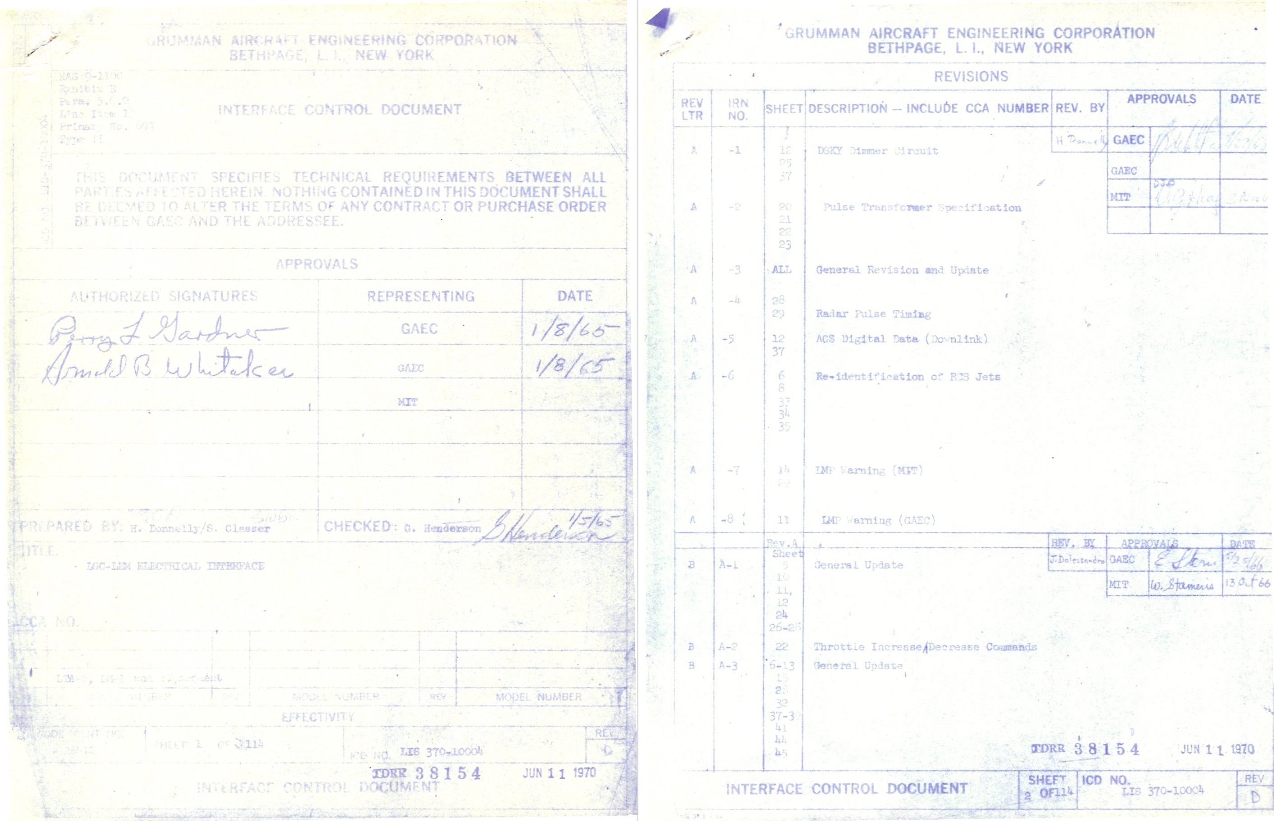
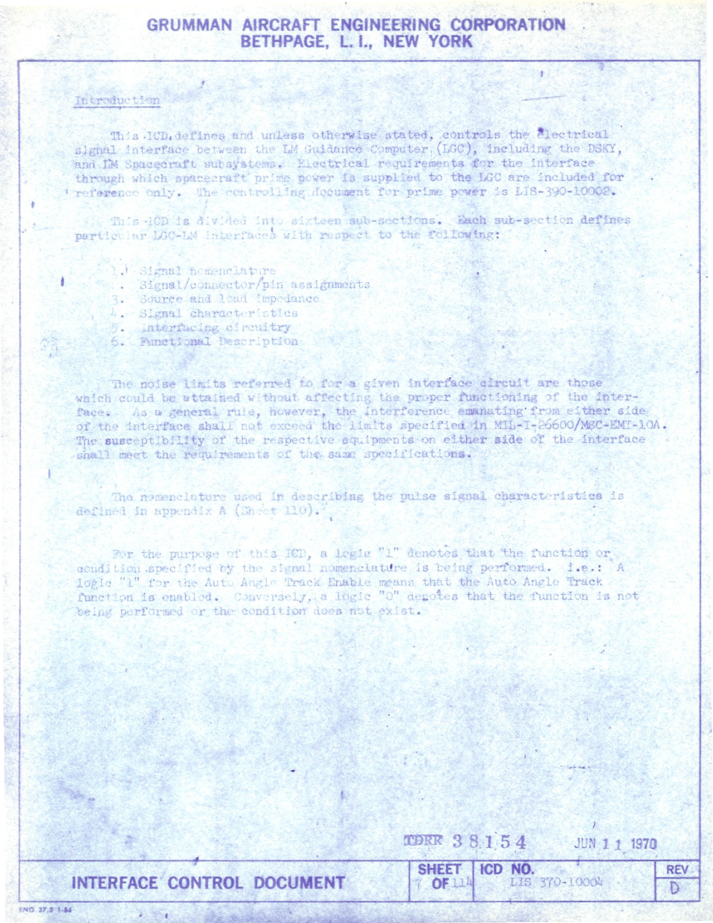
Interface Control Documents

Slide 20
Subcontracted LM Components
NEW YORK (21)
Ascent Engine - Skirt Bell and Valves
Caution and Warning Electronic Assembly
Control Electronic Section
Exterior Tracking Light
H20 Bacteria Filter
Heater Assembly (RCS)
Helium Filter Aircraft
Lighting Control Assembly
Mission Timer
Panel Overlay
PLSS Condensate Collector
Program Reader Assembly
Propellant Filters
Propellant Level Detectors
Propellant Tanks
Relays
Sensor Probe
Signal Conditioning Electronics Assembly
Waste Management System
Window Panel Assembly
Windows
MASSACHUSETTS (9)
Attitude and Translation Control Assembly
Descent Engine Control Assembly
Discrete Transducers
Event Timer
Landing Radar and Rendezvous Radar Subsystem
Miniature Switch
Mission Timer
Toggle Switch
Transistors
CALIFORNIA (56)
Abort Electronics Assembly
Absolute and Differential Pressure Transducers
Absolute Pressure Switch
Actuator Bellows Assembly
Air Filter
Ambient Helium Tanks
Ascent - GOX Tanks Ascent Helium Storage
Ascent Engine - Injector and Combustion Chamber
Ascent Propellant Tanks
Bulkhead Feedthrough Connectors
Burst Disk
Cable Cutter Explosive Devices
Circular Connectors
Coaxial Switches and Connectors
Coupling Disconnects
Coupling Test Points
Data Storage
Data Entry Display Assembly
Descent Engine
Diplexer
Disconnect
Disconnect. Flight Half
Descent Propellant Tanks (LM 6 and later)
Docking Lights
End Detonator Cartridges
Explosive Nut and Bolt Assembly
Explosive Valves
Gimbal Drive Actuators
CALIFORNIA (contd.)
Helium Explosive Valves
Helium Filter
Helium Pressure Valve
Helium Quad Check Valve
Helium Relief Valve
Helium Valve - Descent Regulator
High Pressure O2 Control Assembly
Initiator
Interstage Disconnect
Landing Gear Uplock Cutter Assembly
Latching Valve
Oxygen Fill Disconnect
Potentiometer
Pressure Relief Valve
Propellant Filter
Propellant Quantity Measuring Device
Propellant Solenoid Valve
Quad Check Valve
RCS Explosive Cartridge
Reaction Control Subsystem
Regulating Valve
Steam Vent Divider
Suit Loop Switch
Supercritical Helium Tanks
Surge Tank Disconnect
Transducer
TTCA Transducer
Universal Ball Joint

Slide 21
Subcontracted LM Components
NEW JERSEY (8)
Communication Subsystem
Helium Temperature Pressure indicator
Propellant Quantity indicator
Range/Altitude Indicator
Rotary Switch
Rough Combustion Cutoff
Solenoid Valve
Synchros
CONNECTICUT (7)
Caution and Warning
C02 Sensor
Component Caution
Environmental Control Subsystem
Inverter
Pressure Garment Assembly 02 Connectors
Waveguides
MINNESOTA (7)
Attitude Control Assemblies
Flag indicators (Talkbacks)
Pushbutton Switch
Self-Luminous Devices
Signal Strength Meters
Target Assembly
X (Cross) Pointers
MICHIGAN (6)
Circuit Breakers
Flight Director Attitude Indicators
Gimbal Angle Sequencing Transformation Assembly
Helium Latch Valve
Relief Valve
Time Delay
OHIO (4)
Digital Uplink Assembly
Electroluminescent Lamps
Interior Floodlight
Portable Utility Light
ARIZONA (3)
Circuit Interrupter
Fire-in-The-Hole (FITH) Connector
Interrupter
VIRGINIA (3)
C-Band Transponder
Electrical Control Assembly
RF Signal Sampling Sensor
FLORIDA (2)
Pulse Code Modulation/Timing Electronic Assembly
INDIANA (2)
Descent Propellant Tanks (LM4 and 5)
Heat Exchanger Discrete
MISSOURI (2)
Ascent and Descent Batteries
Bacteria Filter
VERMONT (2)
Retractable Cable
Wire
IOWA (1)
Thrust/Weight Indicator
MAINE (1)
Propellant Quantity Gaging System
MARYLAND (1)
Oxygen Hose
NORTH CAROLINA (1)
Pyro Battery
RHODE ISLAND (1)
Flex Lines
TENNESSEE (1)
Cold Plate Assembles

Slide 22
Discussion Groups
Moon Machines video (“The Lunar Module”)
  An overview of LM development
Brooks Chapter 6 (“Lunar Module”)
  The view from NASA, focused on preliminary design
Kelly Chapter 5 (“Engineering a Miracle”)
  The view form Grumman, focused on preliminary design
Lutz Report (“Development of the Extravehicular Mobility Unit”)
  An “Apollo Experience Report” focused on the spacesuit and PLSS

Slide 23
Activity: Case Studies
James Webb
Werner Von Braun
Boris Chertok
Max Faget
Margaret Hamilton
Katherine Johnson
Gene Kranz
Gunter Wendt
Valentina Tereshkova
Alan Sheppard
Jim Lovell

