Slide 1
The Command Module
HONR 269i
To the Moon and Back: The Apollo Program
The Apollo 11 Command Module

Slide 2
Chronology
MIT guidance computer contract award (August 1961)
North American CSM contract award (November 1961)
LOR mode decision (July 1962)
First Block II CSM design (January 1964)
First boilerplate launch (March 1964)
First Block I launch (January 1966, Little Joe 2)
Apollo 1 fire in a Block I CM (January 1967)
First Block II launch (October 1968, Apollo 7)

Slide 3
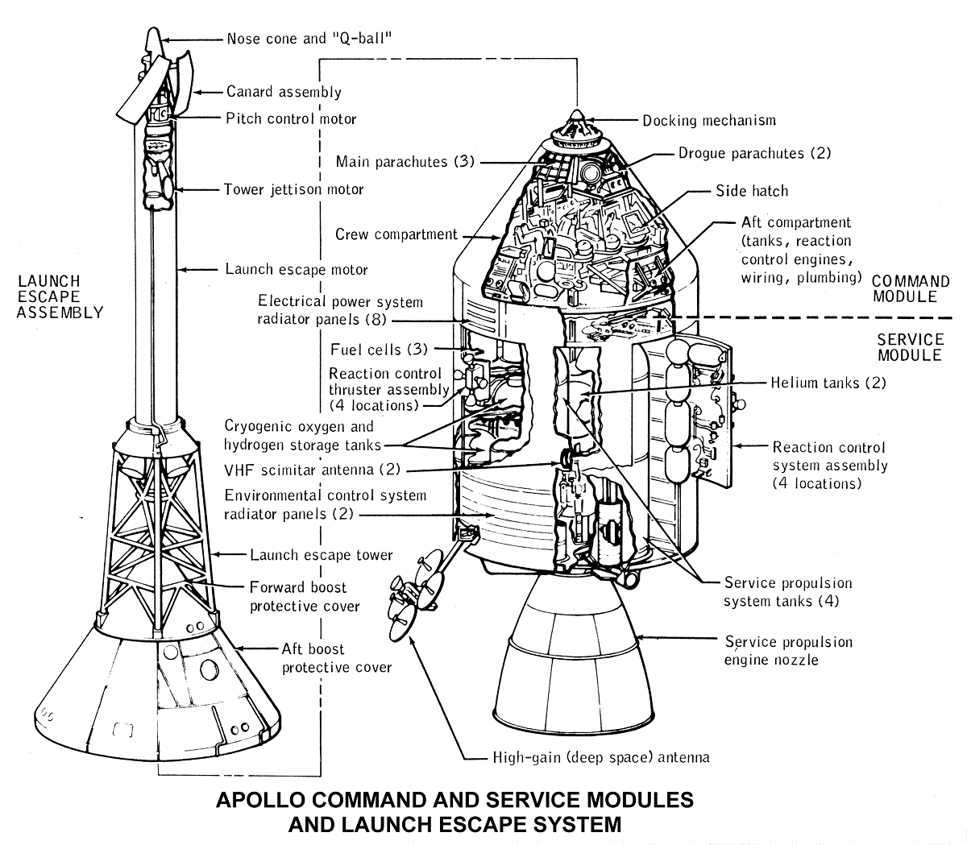

Slide 4
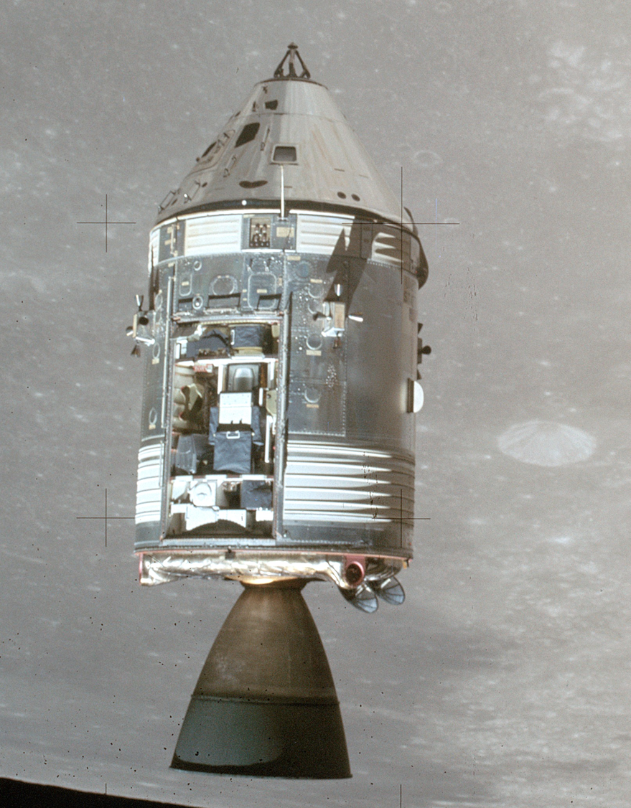

Slide 5
Some Design Questions
How many stageable modules?
The Soviets had 3, we had 2. Why?
How to transfer to the Lunar Module?
The Soviets used spacewalks, we used a tunnel. Why?
Whether to land on land or in the water
We tried land; it was hard.
How to navigate?
We spent $100 million for onboard navigation, and then did it from Earth.
When to wear spacesuits?
A bad decision on this killed three cosmonauts.
Whether to use normal air or pure oxygen?
Oxygen is much lighter. It killed three astronauts.
Whether to put a TV camera aboard
We had the technology to do this, but had chosen not to in Gemini.

Slide 7
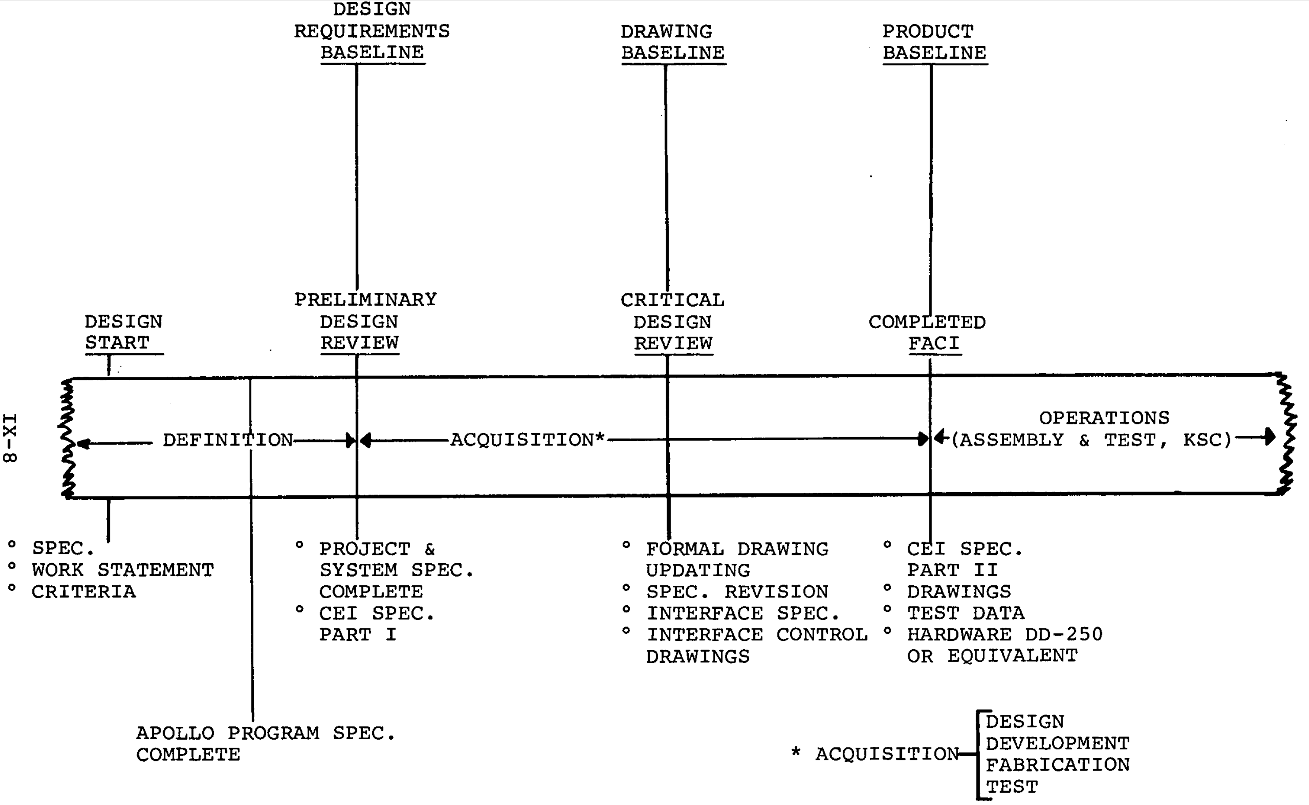
Configuration Management

Slide 8
Configuration Control Board

Slide 9
Apollo Guidance Computer
Clock speed: ~500 µsec
ROM: ~70kB
RAM: ~4kB
Word length: 16 bits (15+parity)
Weight: 70 lbs.
Power: 55 watts
Language: Assembler
Peripherals: DSKY, IMU, landing radar, engine, …

Slide 10
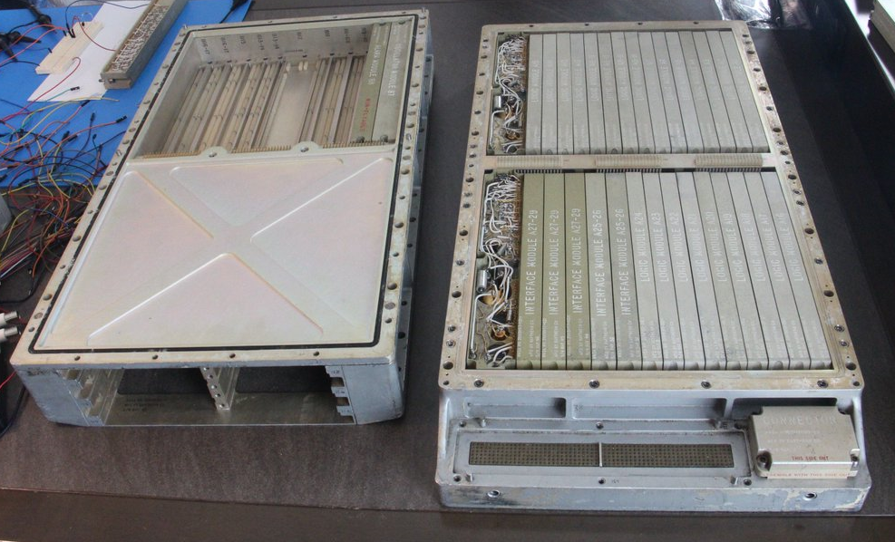
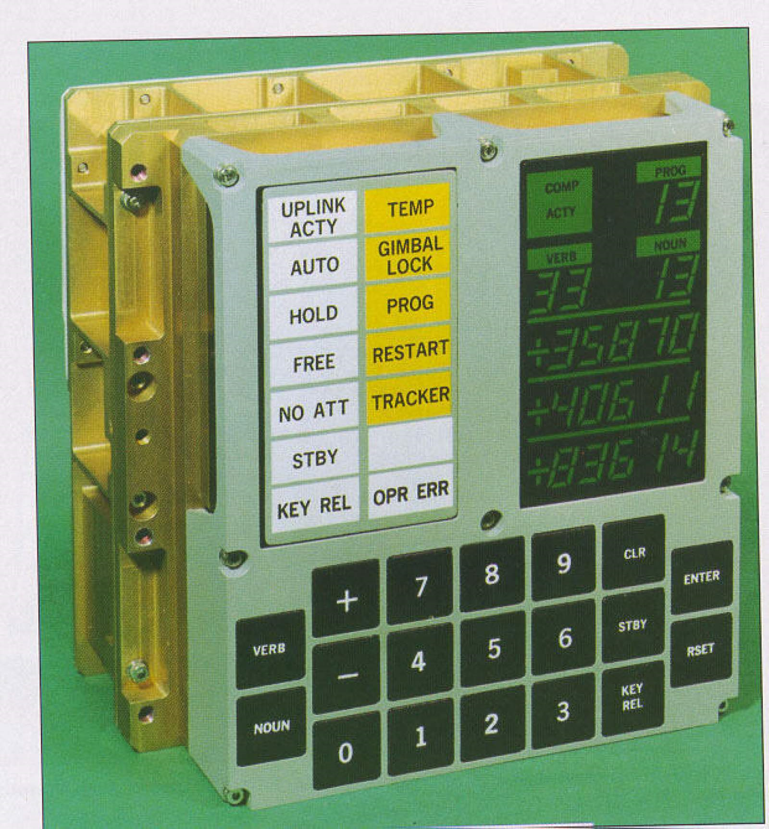
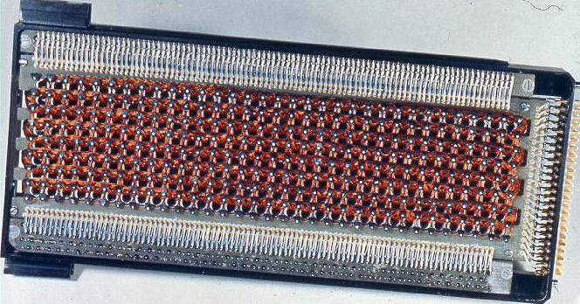

Slide 11
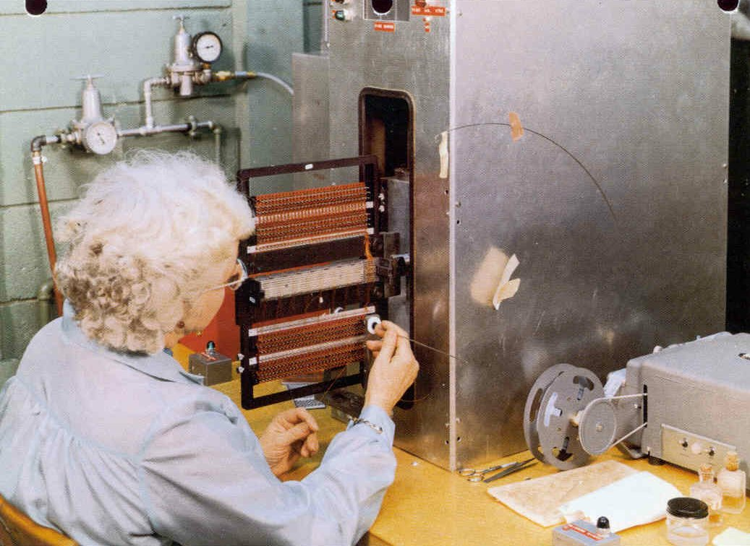
Programming Core Rope Memory

Slide 12
Discussion Groups
Moon Machines Video (“Command Module”)
An overview, including interviews with some of its builders
Brooks Chapter 5 (“Command Module and Program Changes”)
The view from NASA
Gray Chapter 12
The view from the North American (the CSM prime contractor)
Mindell Chapter 5 (“Braincase on the Tip of a Firecracker: Apollo Guidance”)
The view from MIT (the Guidance and Navigation prime contractor)

Slide 13
Activity: Case Studies
James Webb
Werner Von Braun
Boris Chertok
Max Faget
Margaret Hamilton
Katherine Johnson
Gene Kranz
Gunter Wendt
Valentina Tereshkova
Alan Sheppard
Jim Lovell

