Slide 1
The Mode Decision
HONR 269i
To the Moon and Back: The Apollo Program
Lunar Orbit Rendezvous

Slide 2
Four Bad Ideas
Direct Ascent
Required an enormous rocket and made the landing much more difficult
Earth Orbit Rendezvous, then Direct Ascent
Required salvo launches and made the landing much more difficult
Lunar Orbit Rendezvous
Rendezvous failure at the moon would be fatal
Lunar Surface Rendezvous
Navigation errors on landing would be fatal

Slide 3
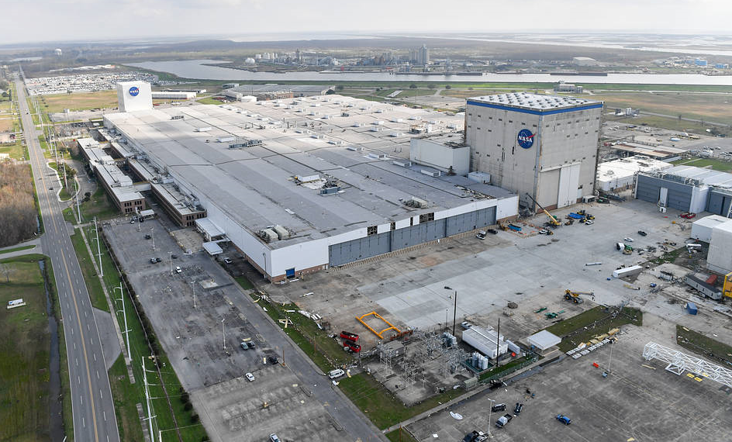
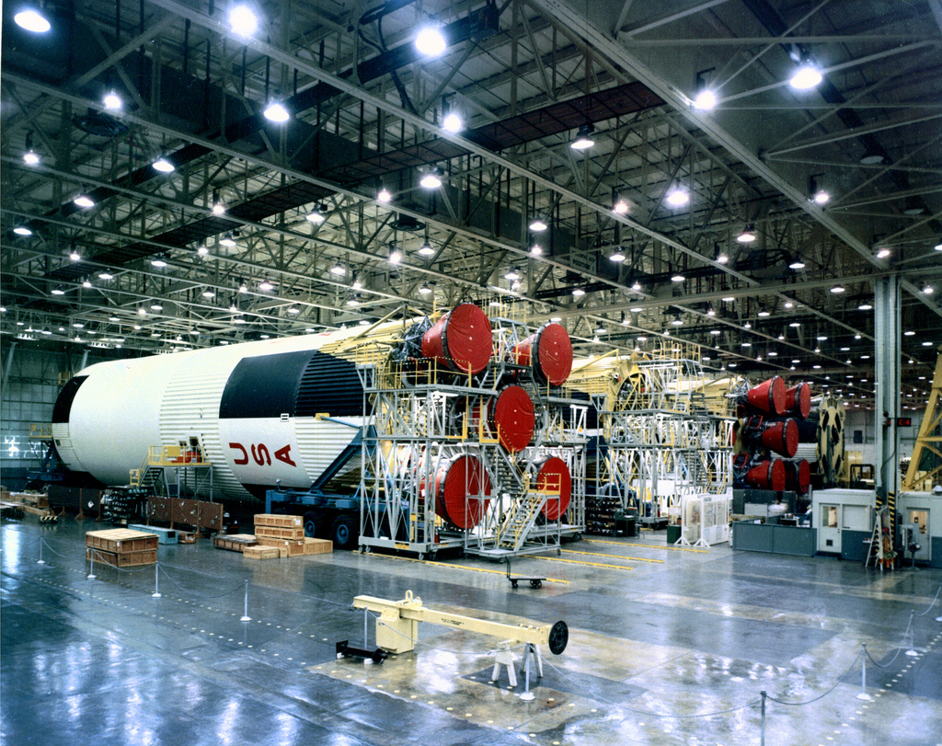
The Michoud Assembly Facility

Slide 4
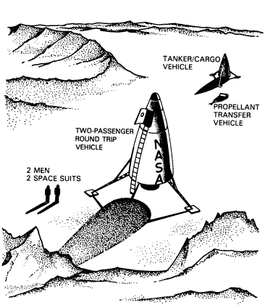
Lunar Surface Rendezvous

Slide 5
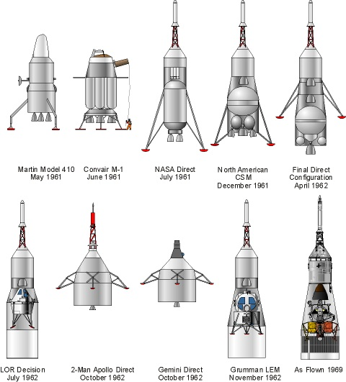
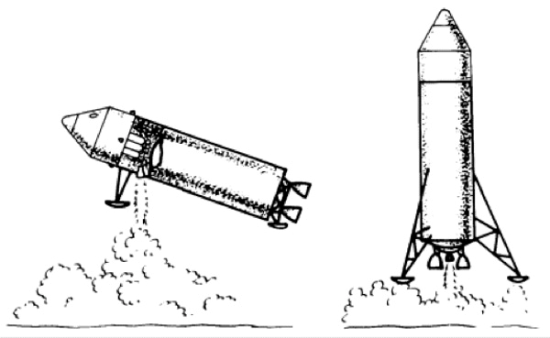
EOR/Direct Ascent vs. Lunar Orbit Rendezvous

Slide 6
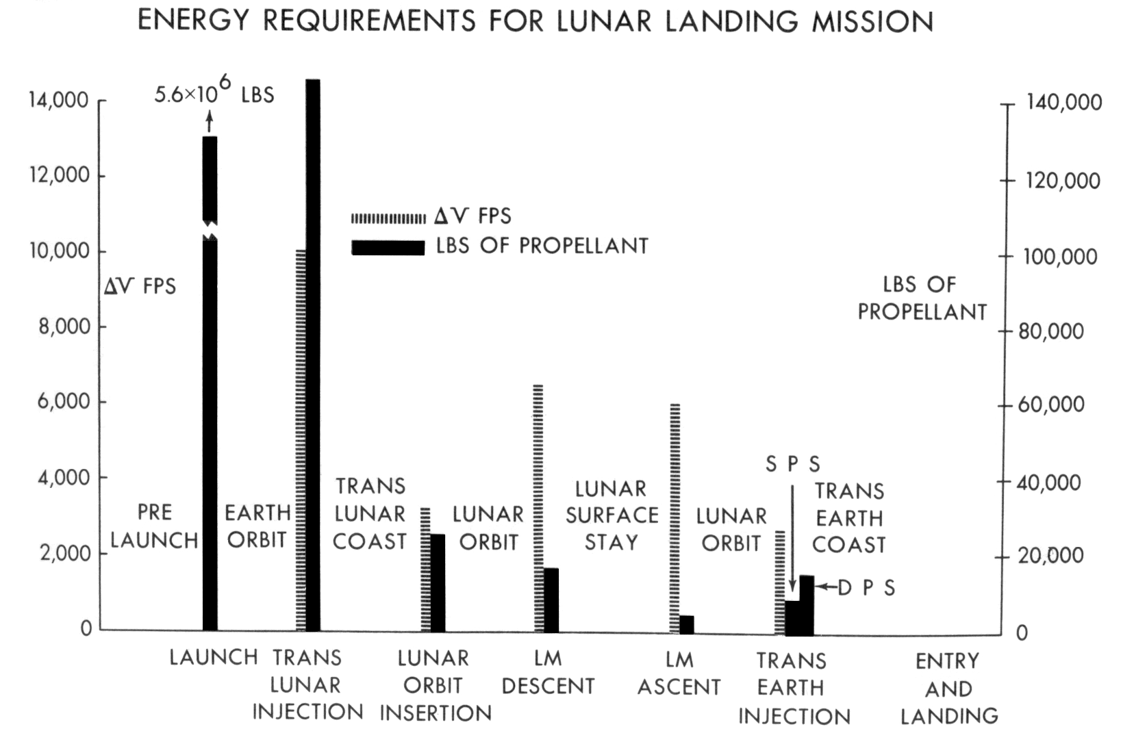
“Halfway to Anywhere”
Apollo Lunar Landing
Mission Symposium, 1966

Slide 7
Advantages and Disadvantages of LOR
Pro
Specialized lander can be optimized for that purpose
Separate vehicles can be developed and tested in parallel
Use of fewer launch vehicles reduces cost and risk
Con
Rendezvous had never been tested
Lander would not provide adequate shielding from a solar flare
Increased development cost for second crewed vehicle

Slide 8
Radiation Hazard
Stubbs et al., Interplanetary Conditions During the Apollo Missions, 2012

Slide 9
Dramatis Personae
Robert C. (“Bob”) Seamans
D. Brainerd Holmes
Joseph F. (“Joe”) Shea
John C. Houbolt
Thomas E. (“Tom”) Dolan
Werner Von Braun
Charles W. Frick
Maxime A. (“Max”) Faget
Jerome B. (“Jerry”) Wiesner
Nicholas E. Golovin

Slide 10
Timeline
Dolan’s company-funded MALLAR studies begin at Vought (1958)
RCA and STL awarded DARPA study contracts for SAINT (late 1958)
Dolan briefing at Langley (early 1960)
Seamans leaves RCA to join NASA (September 1960)
Lundin committee recommends EOR as the mission mode (June 1961)
Houbolt minority report to the Golovin Committee (October 1961)
Shea leaves STL to join NASA (December 1961)
Decision to build the Saturn V (January 1962)
First American manned orbital flight (February 1962)
NASA selects Lunar Orbit Rendezvous for Apollo (July 1962)
Lunar Module contract awarded to Grumman (November 1962)

Slide 11
Optimizing for the Short Term
Saturn V is to Mars as Saturn 1B is to the Moon
By not pursuing Nova, NASA failed to invest in human solar system exploration
Growth potential of the “Apollo system” was severely limited
Lunar Module science payload was initially a few hundred points
Incentives for Marshall Space Flight Center to agree to LOR
Workload balancing for payloads (later realized as Skylab and Lunar Rover)
Promise to consider autonomous resupply (never funded)
Offer to continue work on Nova launch vehicle after Apollo funding peak (not done)

Slide 12
Discussion Groups
Annis Podcast (Apollo: The Mode Decision”)
A detailed recounting of many aspects of the mode decision
Alesi Article (“Do We Want to Go To the Moon or Not?”)
The mode decision from the perspective of Lunar Orbit Rendezvous advocates
Houbolt Report (“Manned Lunar Landing Thtough the Use of LOR”
The minority report the Golovin Committee that Houbolt sent directly to Seamans
Cox Chapter 9 (“What Sonofabitch Thinks It Isn’t the Right Thing to Do?”)
A vivid description of the end game for the mode decision debate

Slide 13
Activity: Case Studies
James Webb
Werner Von Braun
Boris Chertok
Max Faget
Margaret Hamilton
Katherine Johnson
Gene Kranz
Gunter Wendt
Valentina Tereshkova
Alan Sheppard
Jim Lovell

