Slide 1
Congressional Support
HONR 269i
To the Moon and Back: The Apollo Program

Slide 2
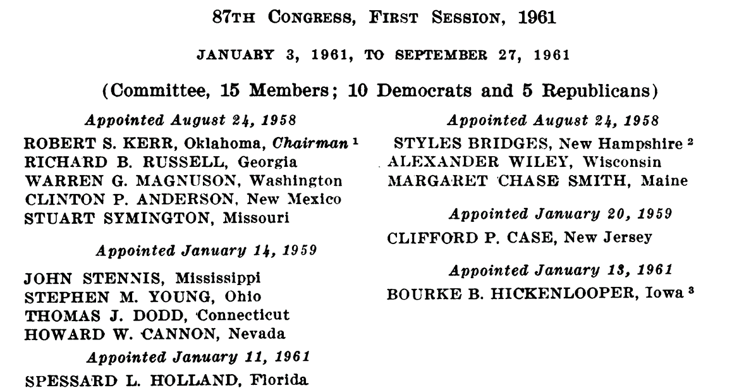
The Senate in 1961
Committee on Aeronautical and Space Sciences
Majority Leader
Mike Mansfield
Committee on Aeronautical & Space Sciences
Robert S. Kerr
Committee on Appropriations:
Carl Hayden
Subcommittee on Independent Offices
Committee on Government Operations
Small Business Committee
Armed Services Committee
Judiciary Committee
Committee on Foreign Relations
Joint Committee on Atomic Energy

Slide 3
Senate Aero & Space Science Committee Staff
Staff Director
Everard H. Smith
Chief Clerk
Carter Bradley
Assistant Chief Clerk
Dr. Earl W. Lindvelt
Professional Staff:
William Deachman, Elaine Galloway, William A. Reynolds, Glen P. Wilson

Slide 4
The House of Representatives in 1961
Speaker of the House
Sam Rayburn
Committee on Science and Astronautics
Chair: Overton Brooks (later George P. Miller)
Committee on Appropriations
Chair: Clarence Cannon
Subcommittee on Independent Offices
Committee on Government Operations
Armed Services Committee
Joint Committee on Atomic Energy

Slide 5
Influence Operations
Congressional Relations
Preparing for testimony
Responding to requests
Public Relations
Media liaison
Talking points
Public events
Lobbying
“Interest group democracy”
First Ammendment: Congress shall make no law … abridging the freedom of speech … or the right of the people to petition the Government for a redress of grievances.
Campaign contributions

Slide 6
Public Opinion
William Sims Bainbridge, Impact of Space Exploration of Public Opinions, Attitudes and Beliefs, 2015
May 1961
Spend $40 Billion: Yes: 33%; No: 58%
January 1962
Need to land on Moon: Urgent: 22%; None: 52%
November 1962
Agree with Kennedy’s Apollo decision: Yes: 42%; No 42%
May 1963
Need to land on Moon: None: 53%
October 1964
Beat Russians to the Moon: Go all out 26%; Not too important: 66%
June 1965
Space spending: 16% Spend more; 33% Spend less
February 1967
Send a man to Moon before Russia: Important: 33%; Not important: 61%

Slide 8
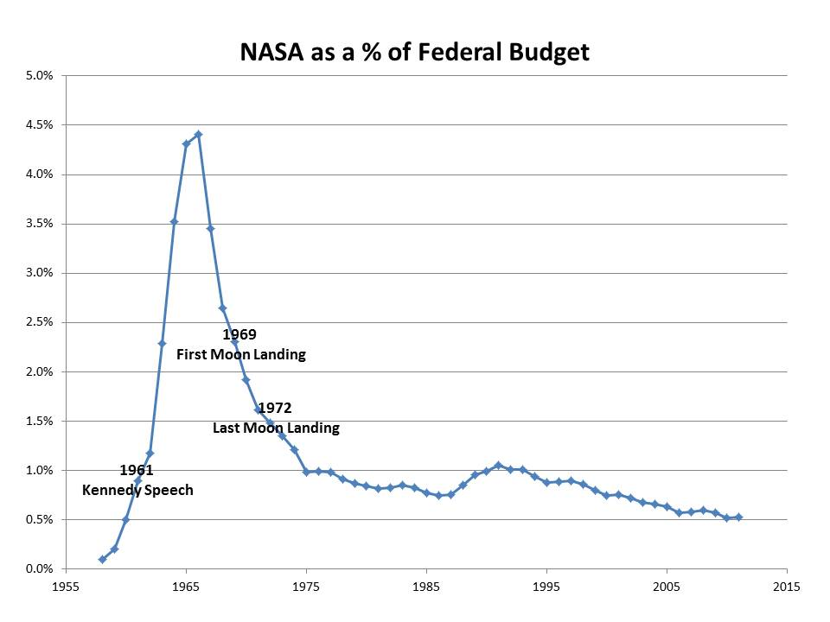

Slide 9
Discussion Groups
Brooks Letter (“Recommendations re the National Space Program”)
A May 4 letter to LBJ in the run up to Kennedy’s call for a Moon landing
Kaufmann Chapter 1 (“The Kennedy Administration’s Lunar Campaign”)
A provocative account of NASA and Administration public influence campaigns
Berger Article (“How Albert Thomas Won Houston NASA’s Flagship Center”)
A story of a powerful House Appropriations subcommittee chairman’s influence
Sputnik Declassified (NOVA program)
A documentary illustrating the political reaction to Sputnik

