Slide 1
The Decision to Go to the Moon
HONR 269i
To the Moon and Back: The Apollo Program
Eisenhower’s Farewell Address

Slide 2
Dramatis Personae
Nikita S. Khrushchev, First Secretary of the Communist Party (USSR)
John F. (“Jack”) Kennedy, President
Lyndon B. Johnson (“LBJ”), Vice President
James E. (“Jim”) Webb, NASA Administrator
Robert S. (“Bob”) McNamara, Secretary of Defense
Theodore C. (“Ted”) Sorenson, Special Counsel to the President
Jerome B. (“Jerry”) Wiesner, Science Advisor
Robert S. Kerr, Senator
George M. Low, NASA Chief of Manned Space Flight
David E. Bell, Budget Director

Slide 3
Chronology
4th Kennedy-Nixon Debate (October 21, 1960)
Kennedy elected (November 8, 1960
  NASA: Low Committee formed (January 5, 1961)
Inaugural address (January 20, 1961)
  NASA: Webb starts as Administrator (February 14, 1961)
First Soviet manned orbital flight (April 12, 1961)
Bay of Pigs invasion (April 17, 1961)
  NASA: Fleming Committee formed (May 2, 1961)
Joint session of Congress (May 25, 1961)
Vienna Summit with Khrushchev (June 4, 1961)
$1.8 Billion authorized for NASA (July 21, 1961)

Slide 4
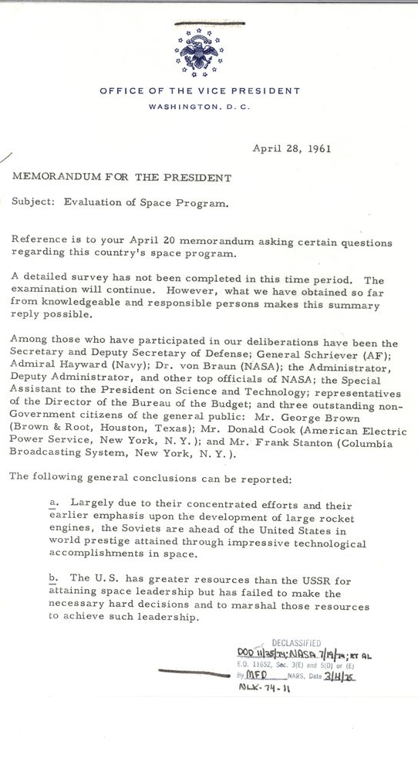
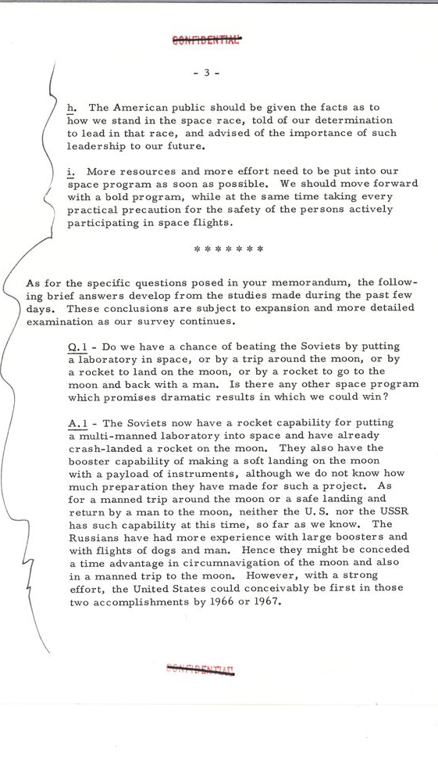

Slide 5
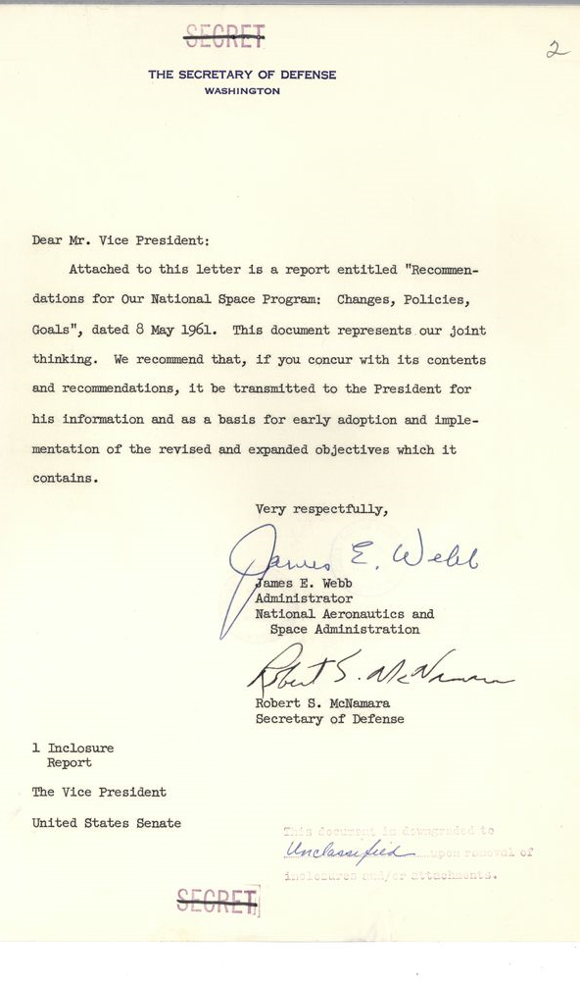
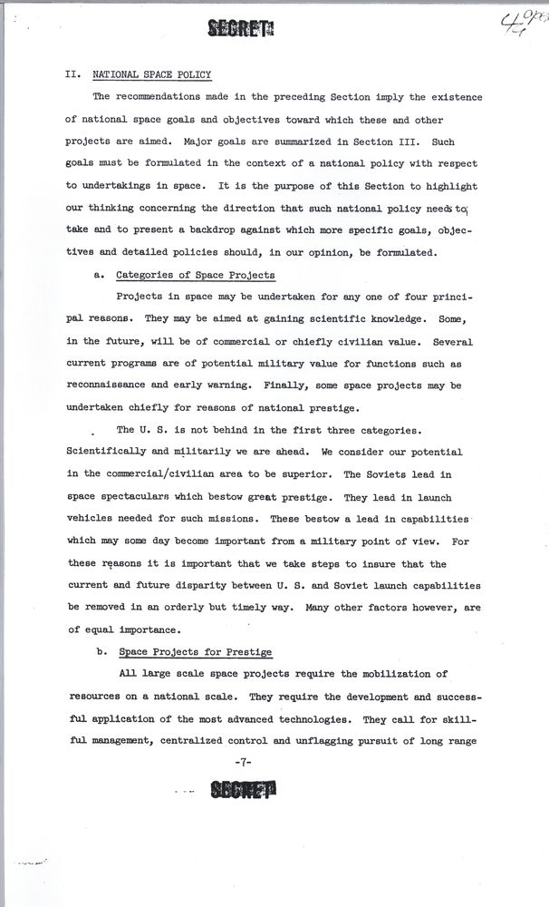
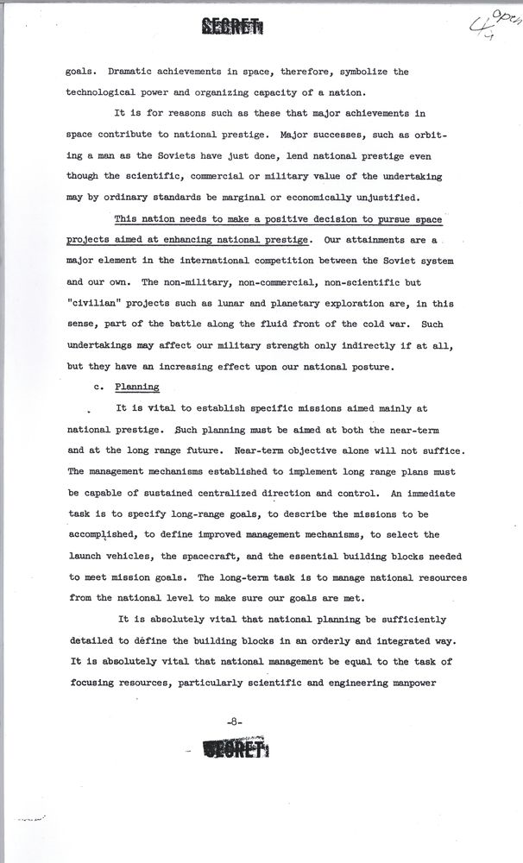

Slide 6
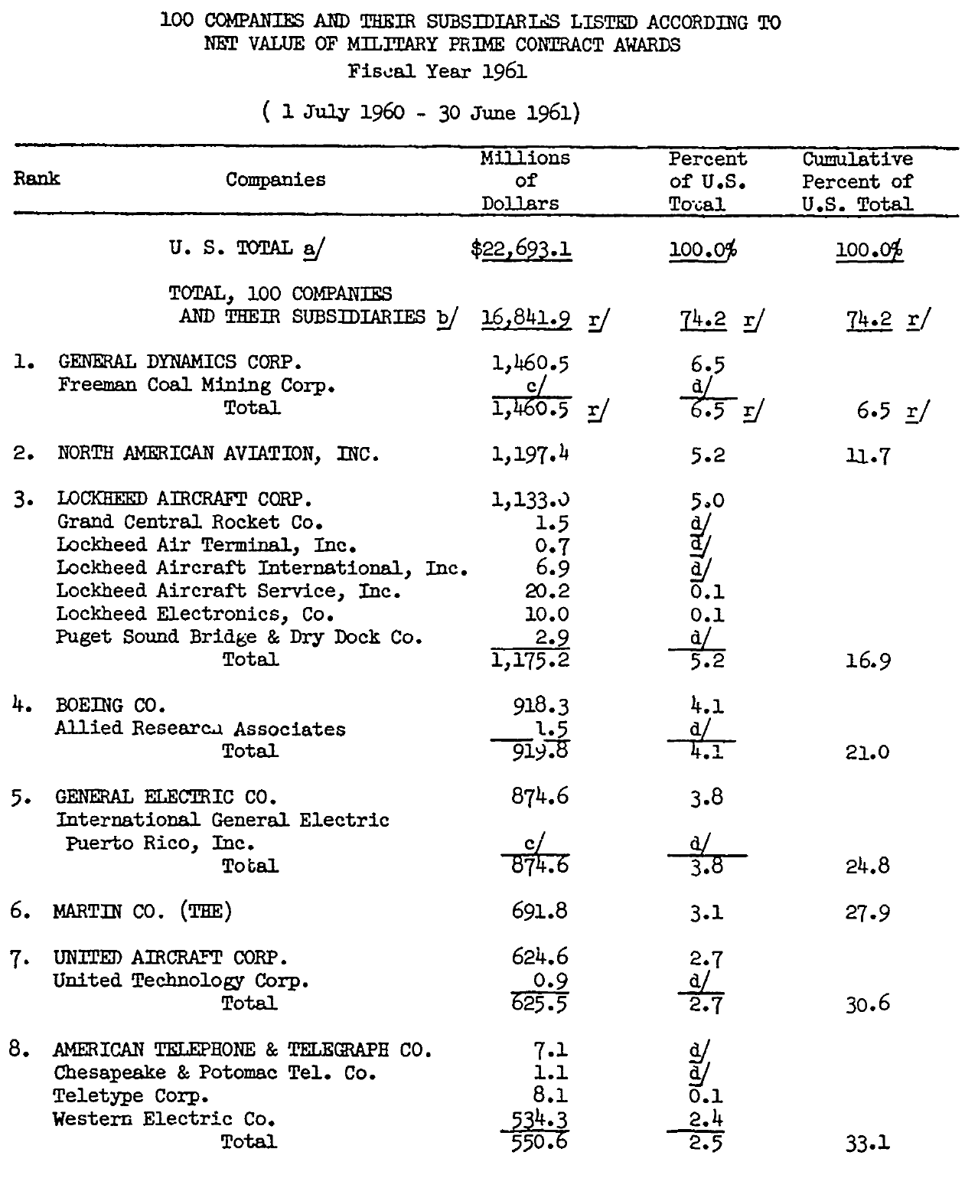
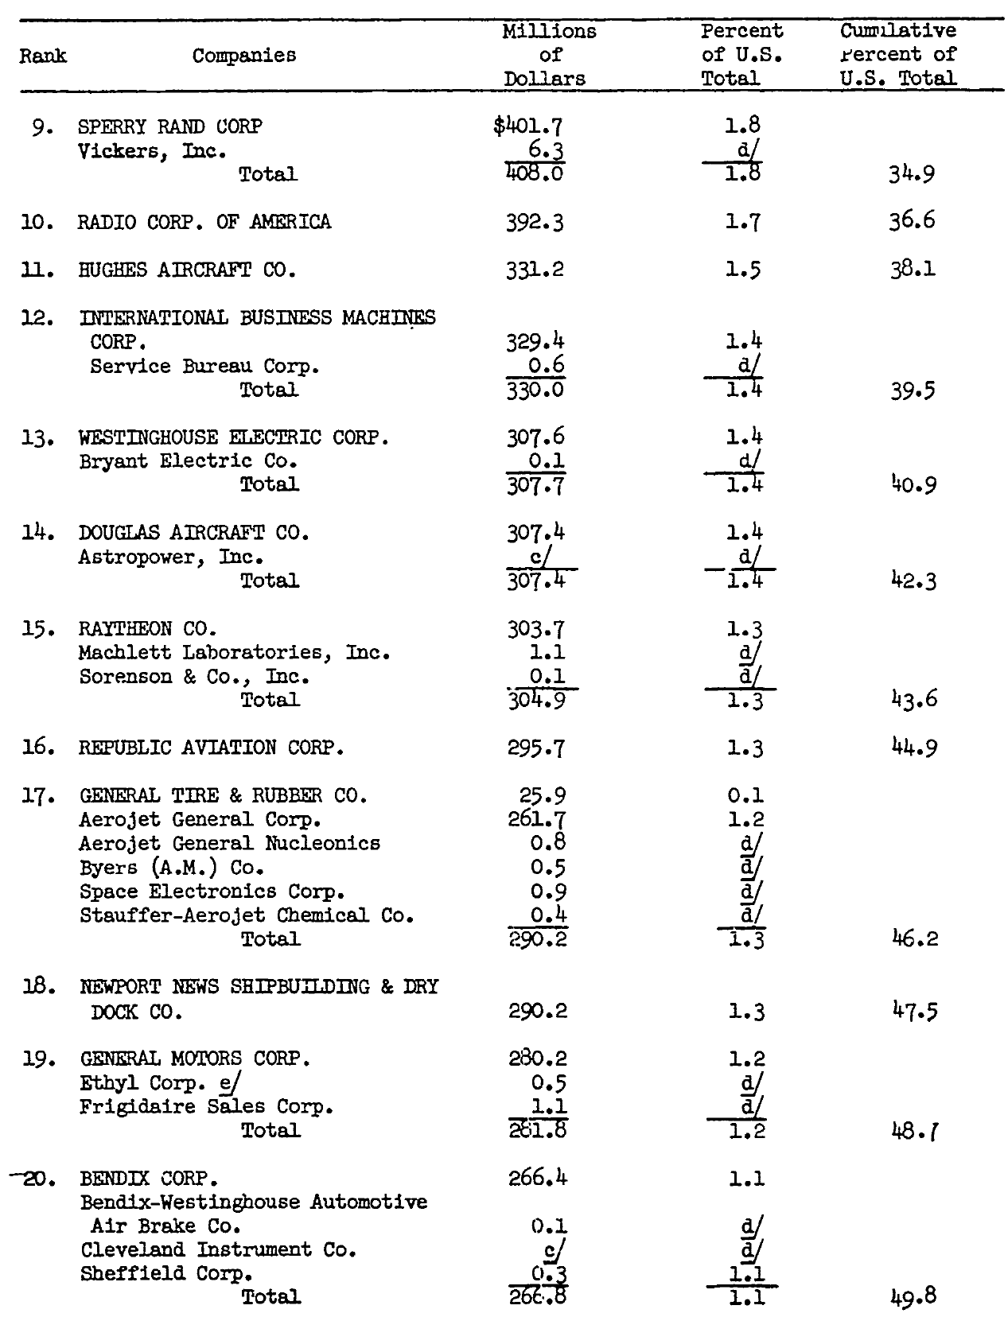
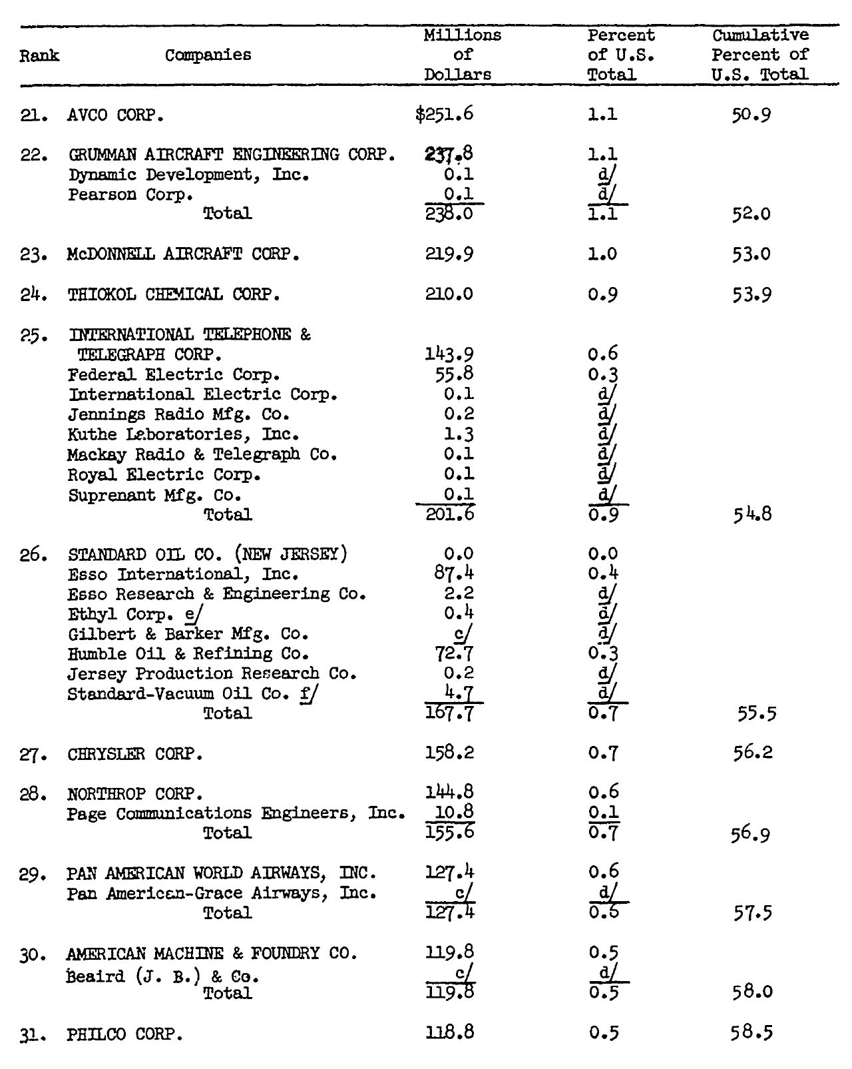
Source: DoD Comptroller

Slide 7
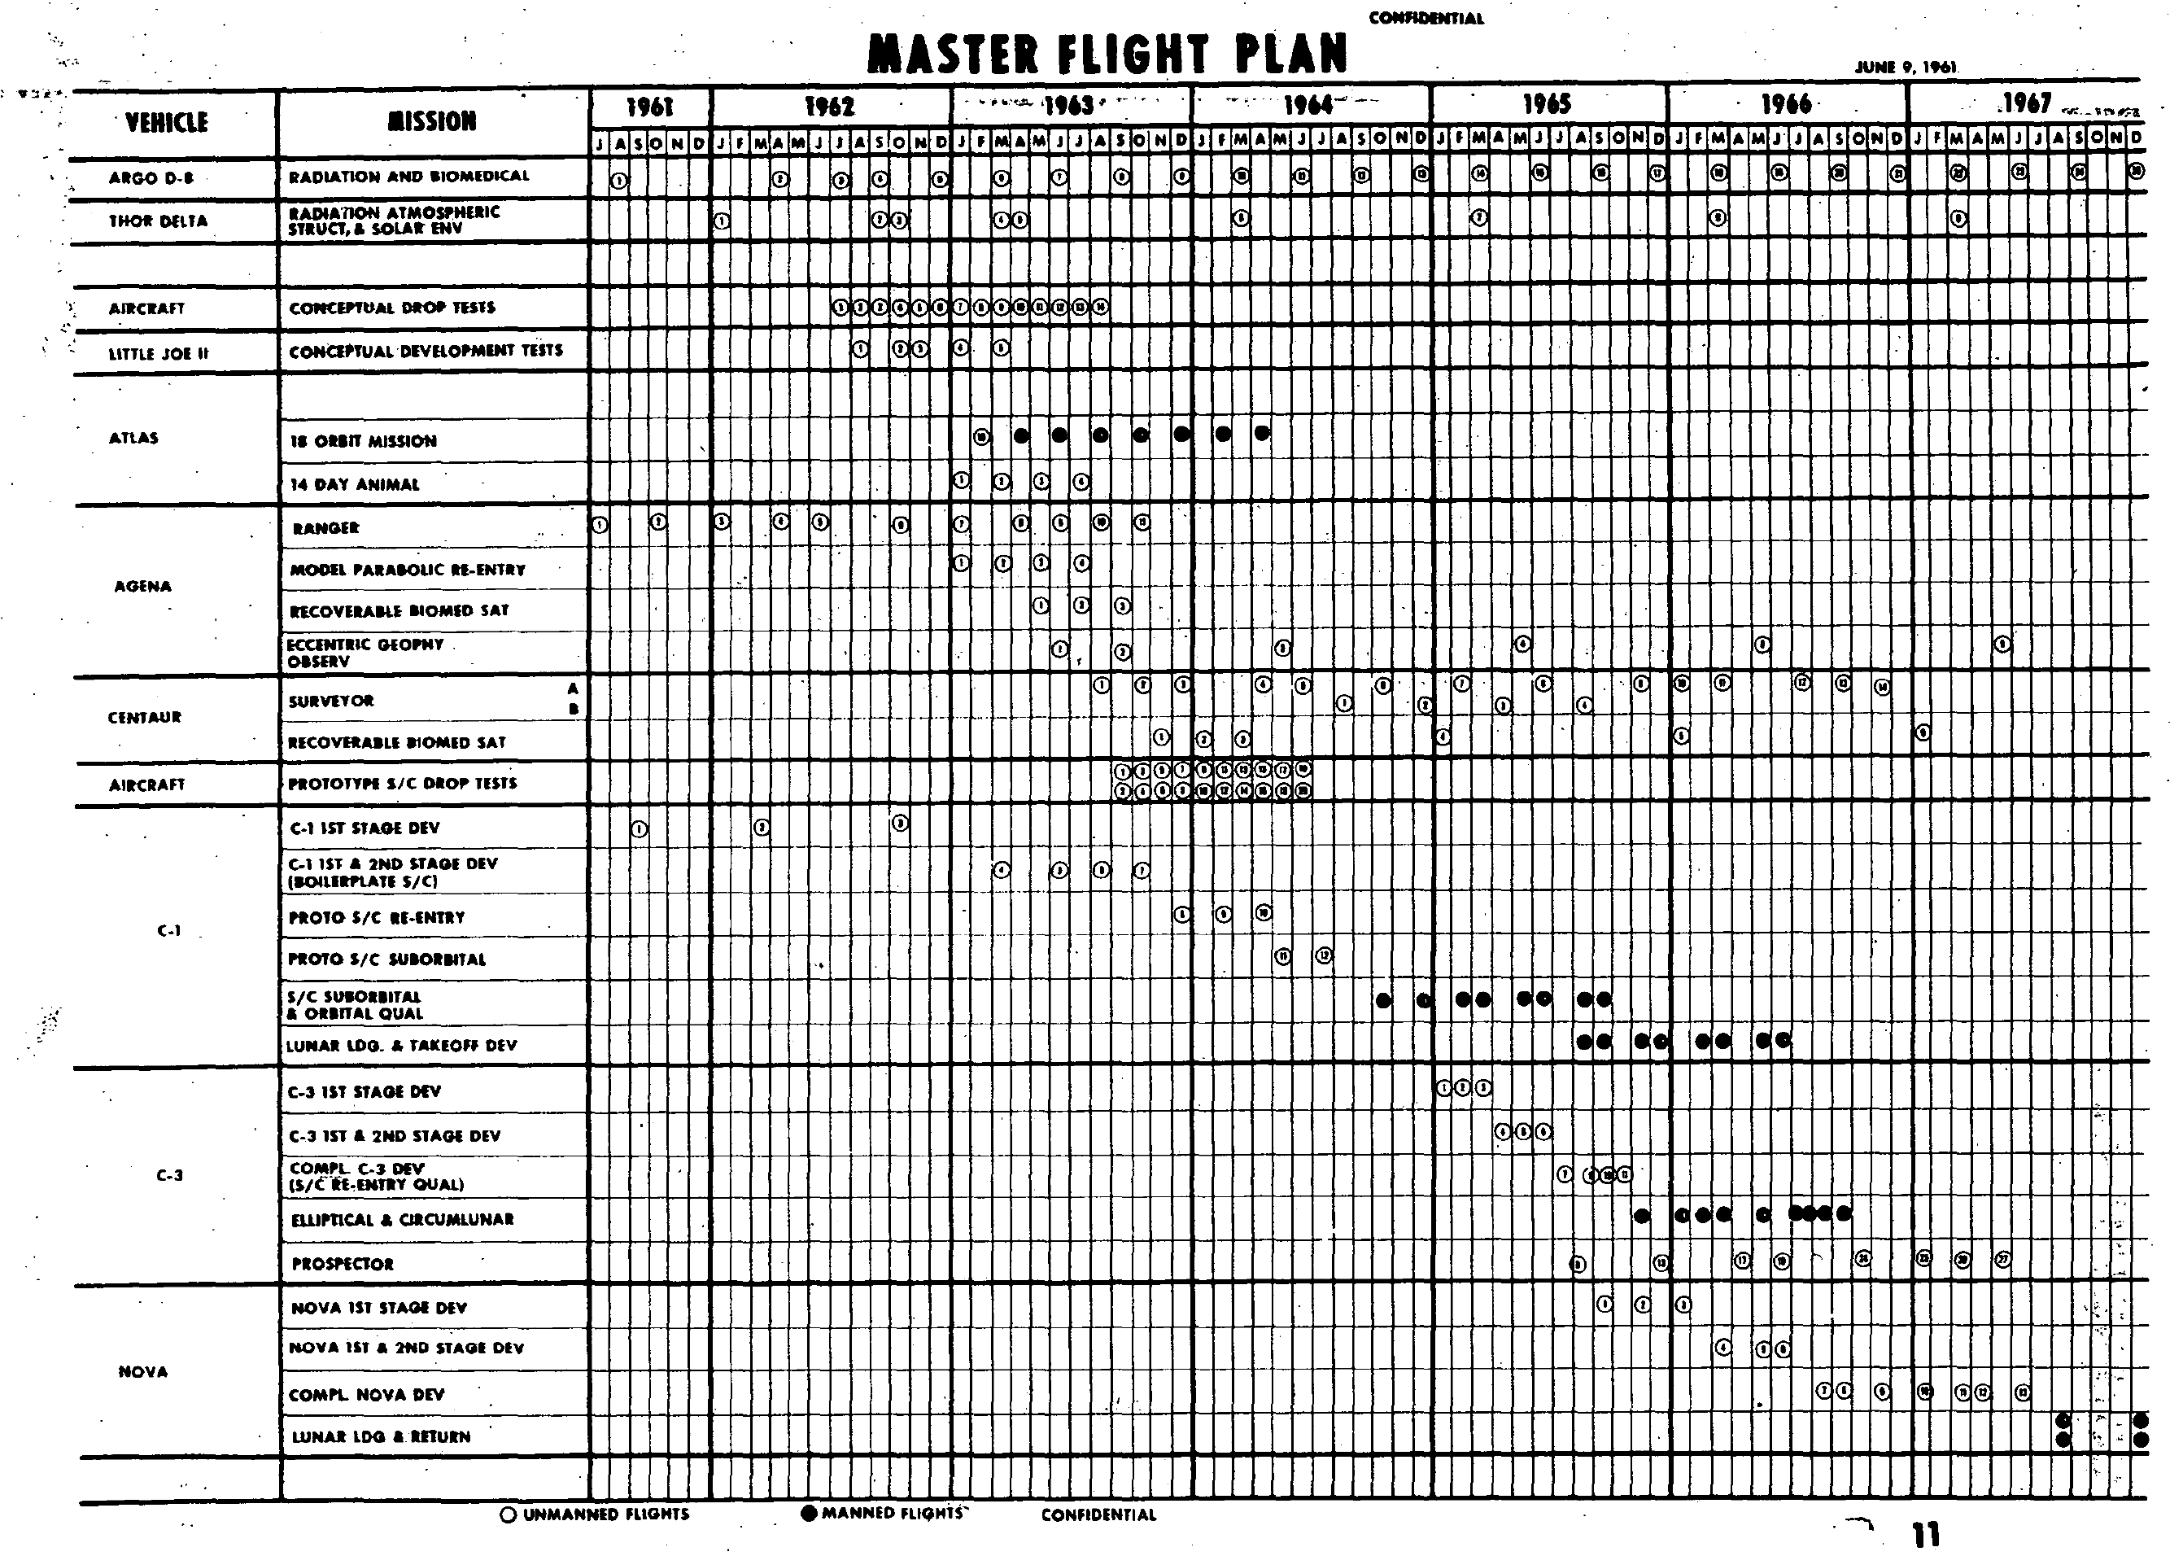
Fleming
Report
(June 16 1961)

Slide 8
A “Rational Actor” Perspective
American leadership was essential to the American way of life
  And American leadership demanded leadership in space
The Soviet Union had much larger rockets in 1961
  And they could probably make them large enough to fly around the moon
Landing on the Moon would require 10 times the rocket thrust
  And the Americans had started design work on what became the F-1 in 1955
The American economy was far larger than the Soviet economy
  So the Americans would have a good chance to win a “moon race”

Slide 9
A “Bureaucratic Politics” Perspective
NASA
  Launch vehicles capable of reaching anywhere in the solar system
  Advanced human spaceflight technology
  Balanced program
Department of Defense
  Preserving the aerospace industrial base
  Investments in solid-fuel rockets
  Gaining human spaceflight experience
Politicians
  Strengthening Kennedy’s negotiating position at the Vienna summit
  Leadership in the eyes of the world, and in the eyes of the American people
  Special interests

Slide 10
Discussion Groups
Day, Space Review (“Pay No Attention to the Man with the Notebook …”)
  A journalist sitting on discussions on how to react, 2 days after Gagarin’s launch
Launius Chapter 2 (“Kennedy and the Decision to Go to the Moon”)
  A critical view, casting Kennedy as taking a page from Khrushchev’s playbook
Kennedy Recording (“Meeting on the Presidential Budget”)
  A secretly made recording in which Kennedy explains why Apollo is important
Logsdon (“The Apollo Decision and its Lessons for Policy-Makers”)
  An appreciative view, articulating four factors that make such decisions possible

Slide 11
Logsdon’s Apollo-Like Decision Circumstances
The objective must be known to be technologically feasible, with a high degree of probability, at the time the decision … is made
The objective must have been the subject of sufficient political debate so that … potential sources of support have time to develop
Some dramatic “occasion for decision” must occur to create an environment in which …. policies to achieve it become politically feasible.
There must be in leadership positions ... individuals … who have the political skill to choose the situations in which such activities can be initiated.

