Slide 1
Apollo 11: Lunar Landing
HONR 269i
To the Moon and Back: The Apollo Program
Lunar Landing
3D Visualization

Slide 2
Apollo 11 Landing Site Selection Criteria
Smoothness: The sites should have relatively few craters
Slope: The general slope of the landing area must be less than 2 degrees
Approach path: There should be no large hills, tall cliffs or deep craters which could cause incorrect altitude signals to the landing radar
Free-return: The sites must be within reach of the Apollo spacecraft in the free-return trajectory
Fuel: Sites near the lunar equator were selected to allow for minimizing the need for plane change maneuvers by the CSM
Launch delays: Three sites were selected to allow for launch delays of up to 5 days

Slide 3
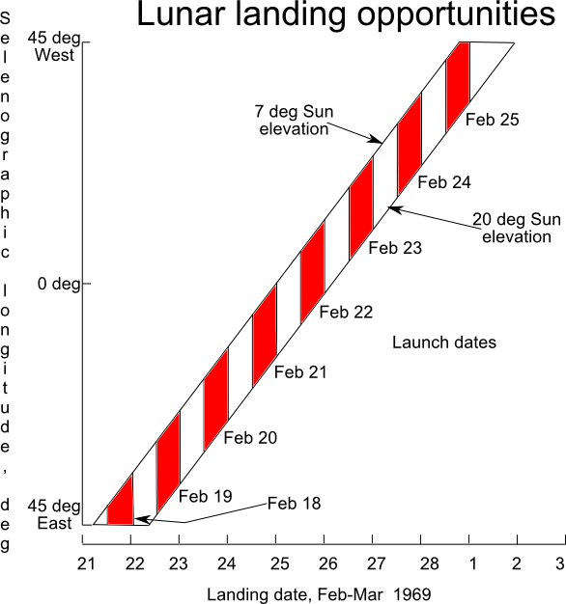
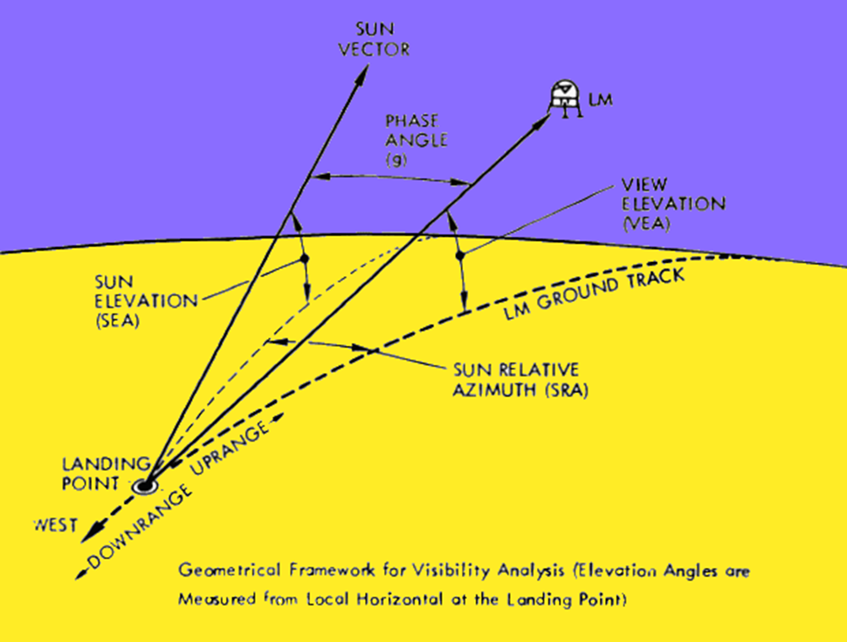

Slide 4
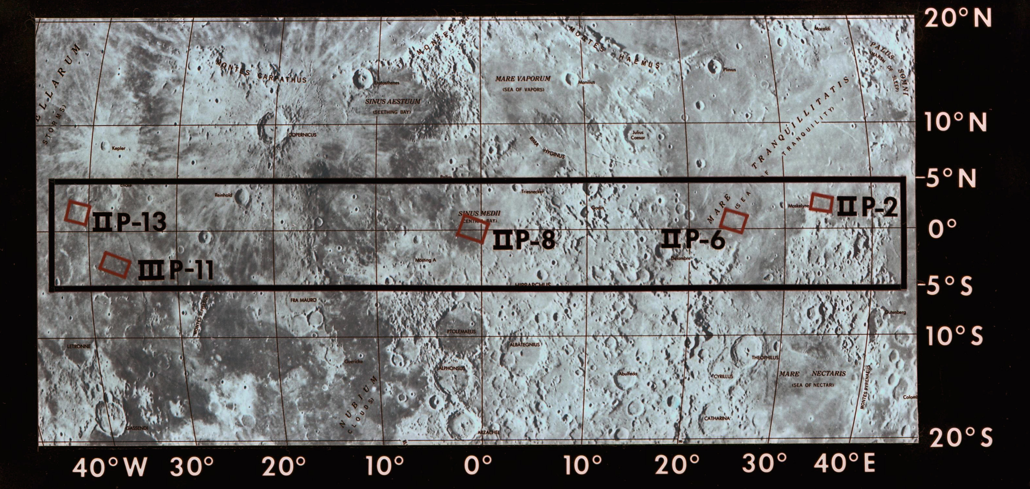

Slide 5
Possible Apollo 11 Launch Dates

Slide 6
Decision Points
Launch
Translunar Injection
Lunar Orbit Insertion
Lunar orbit circularization (LOI-2)
Descent Orbit Insertion
Powered Decent Initiation
Post-landing lunar stay
EVA
Continued lunar orbit operations after docking

Slide 7
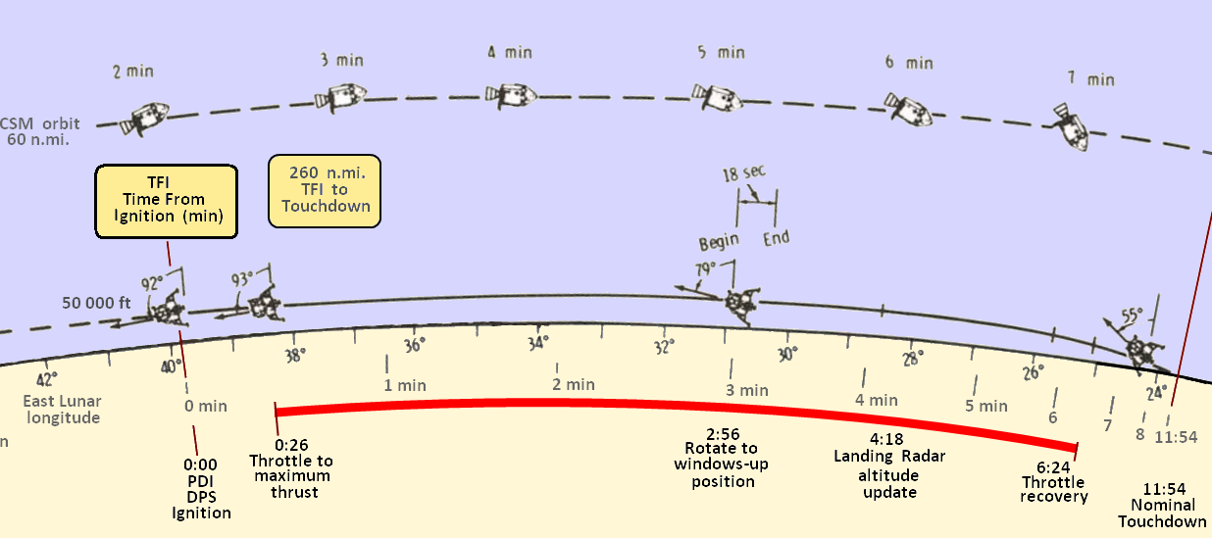

Slide 8
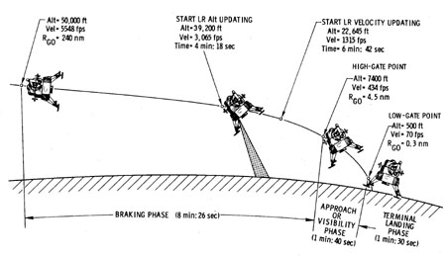
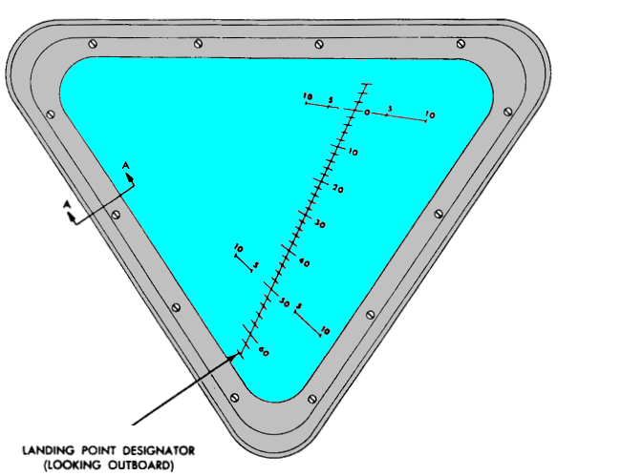
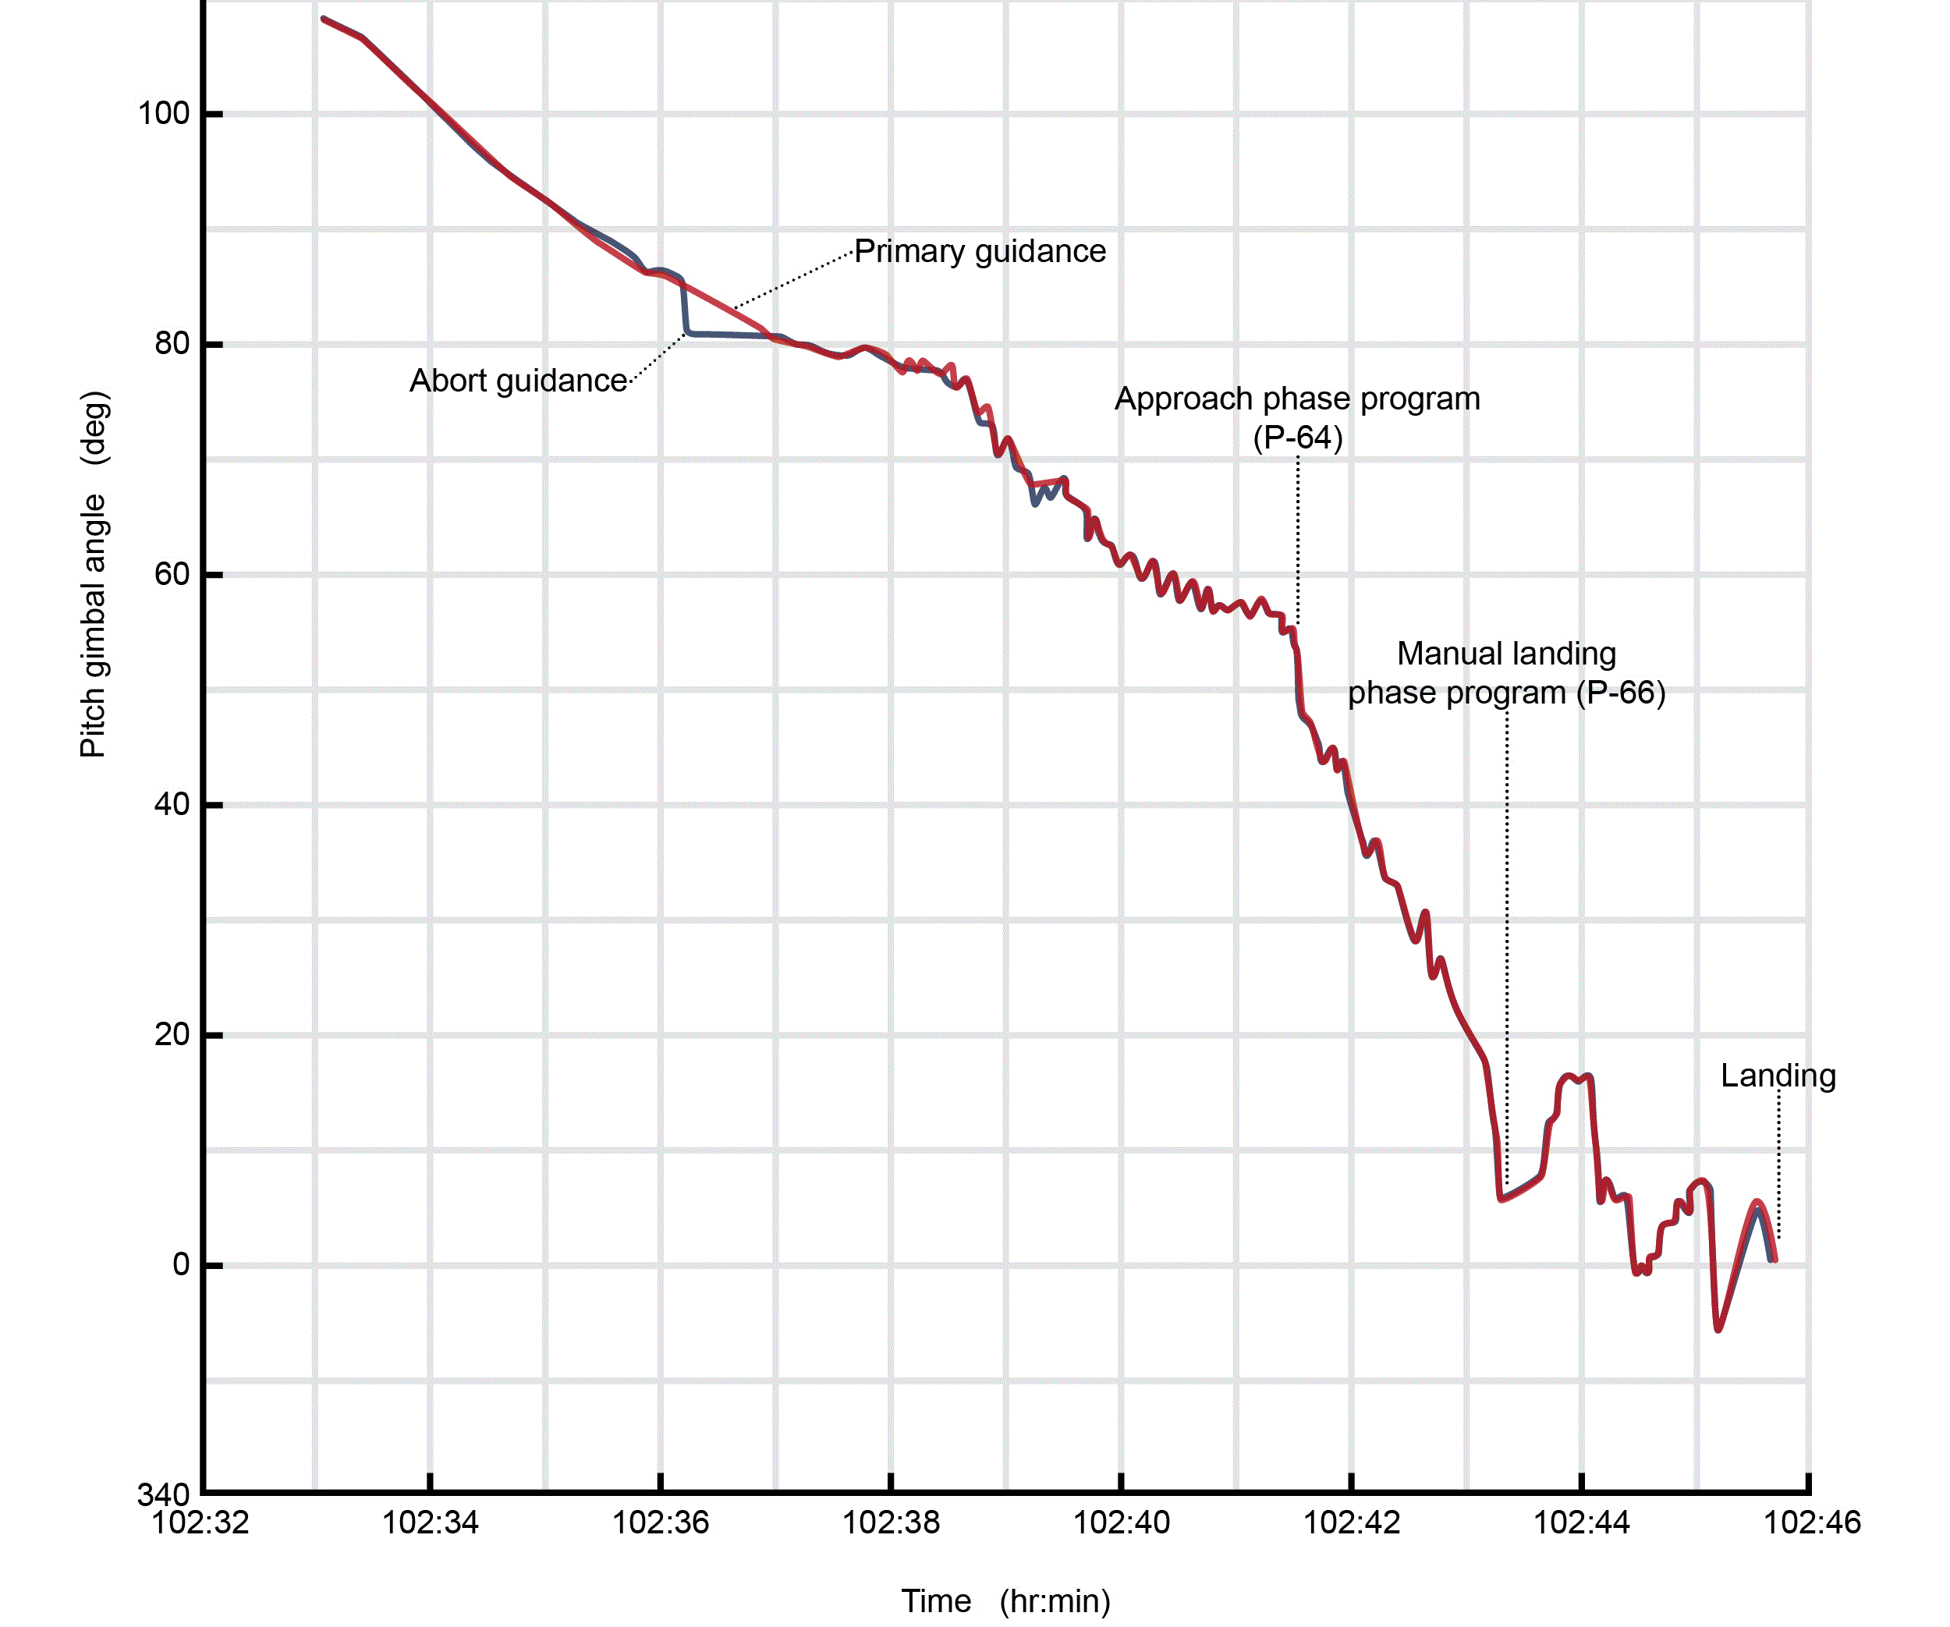
Lunar Landing

Slide 9
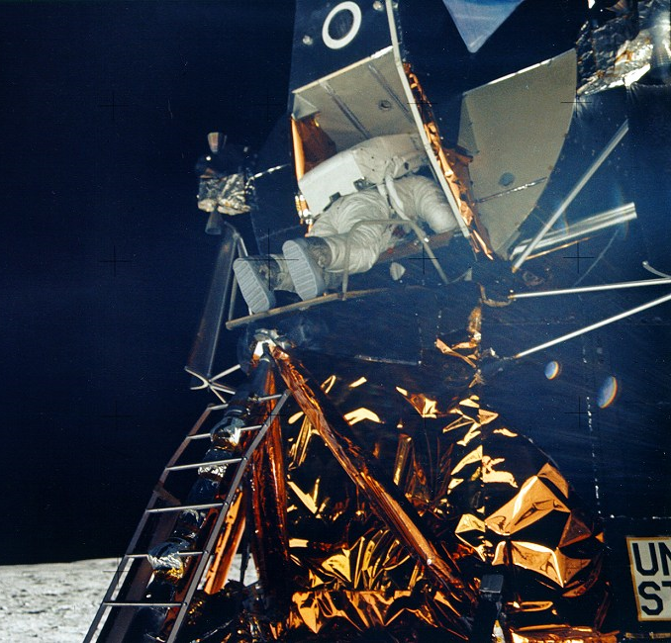
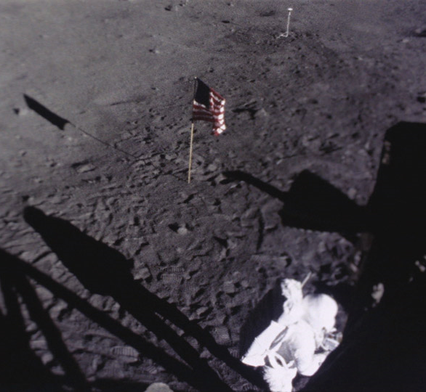
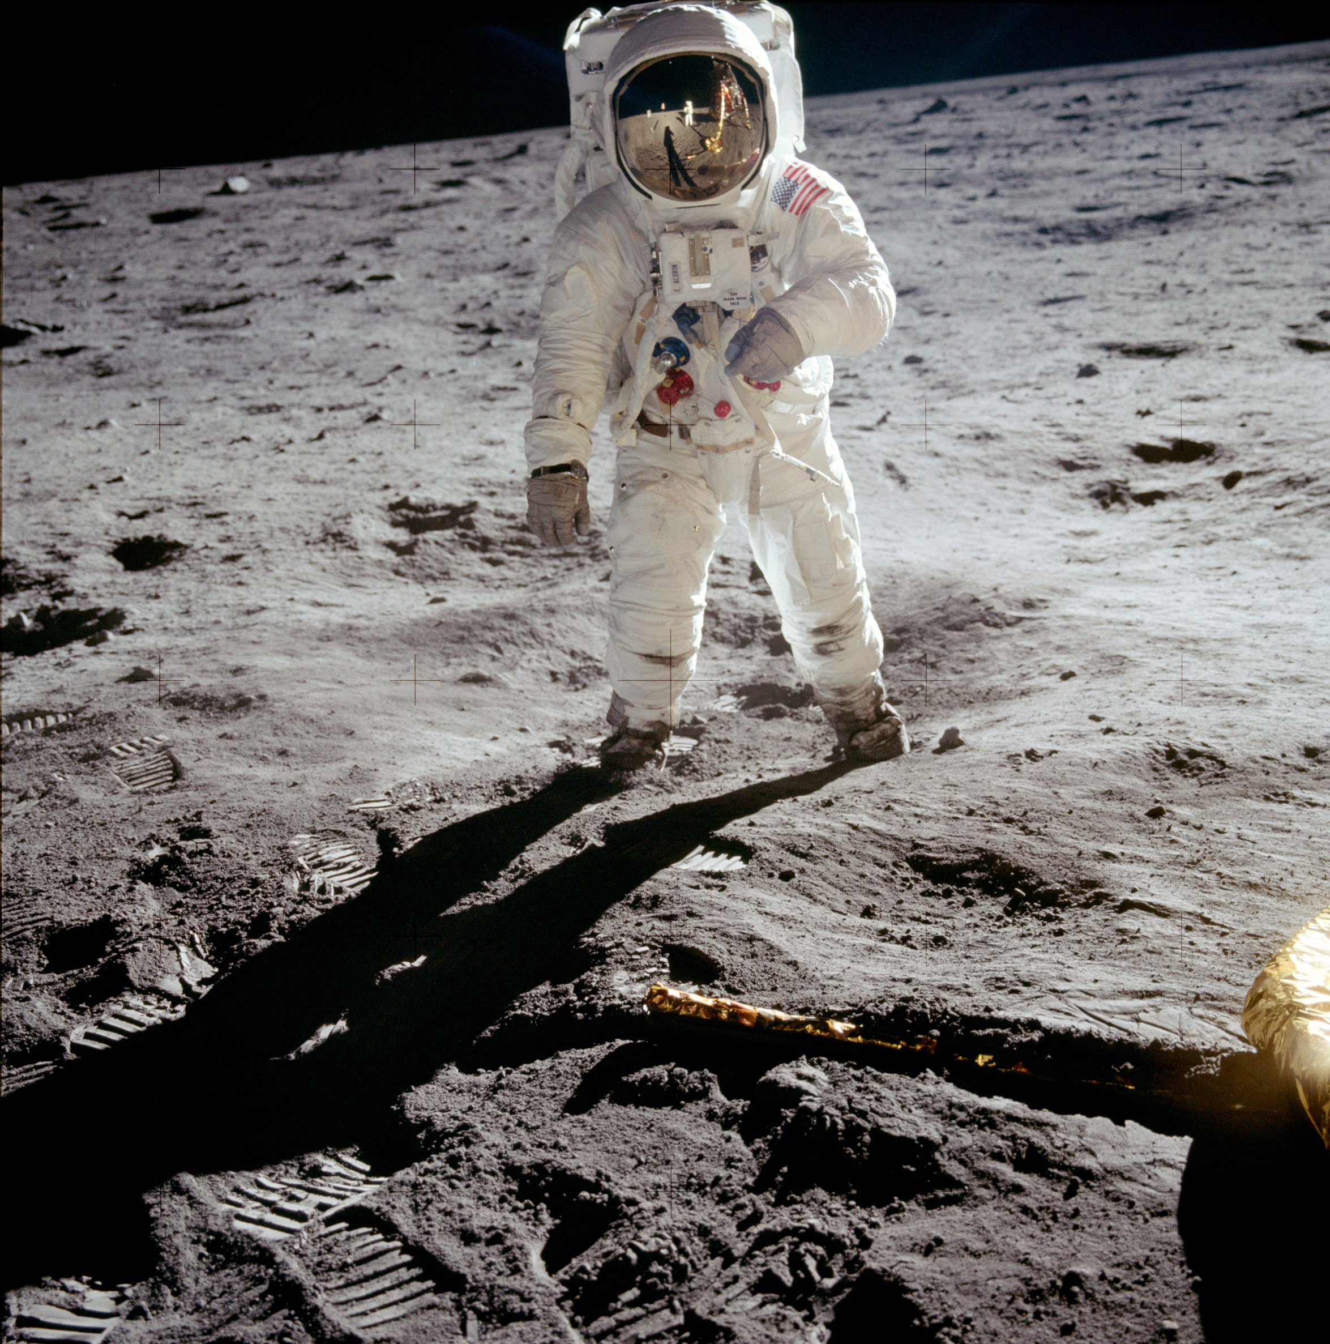
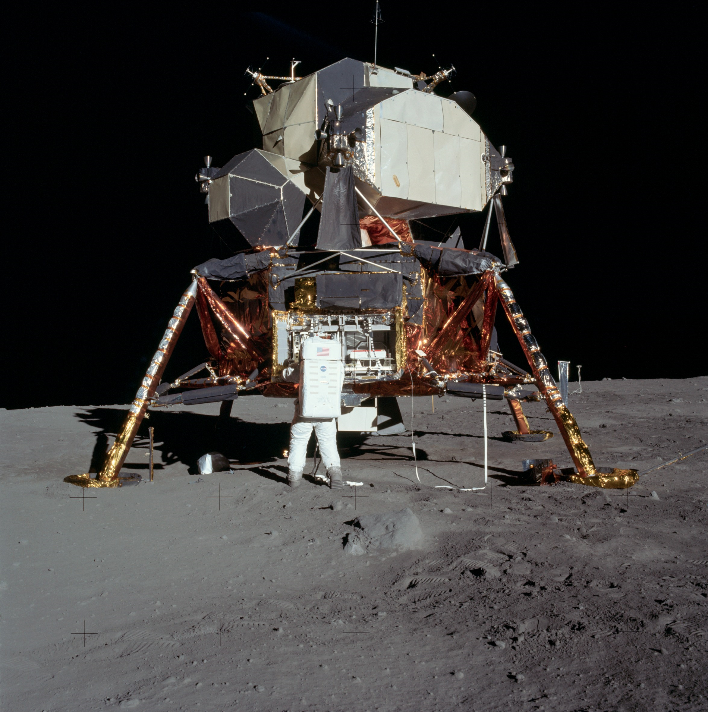
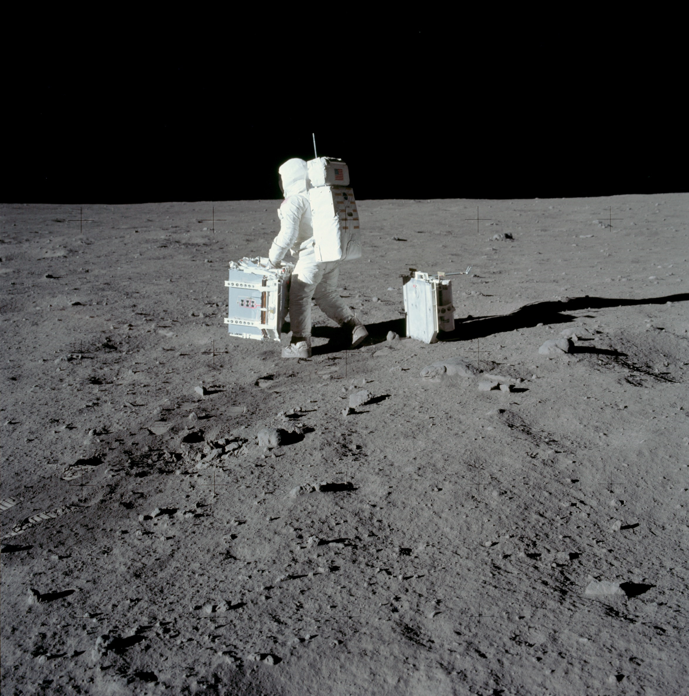

Slide 10
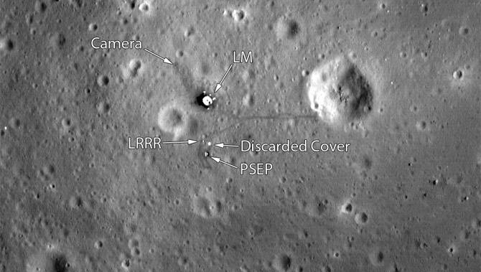

Slide 12
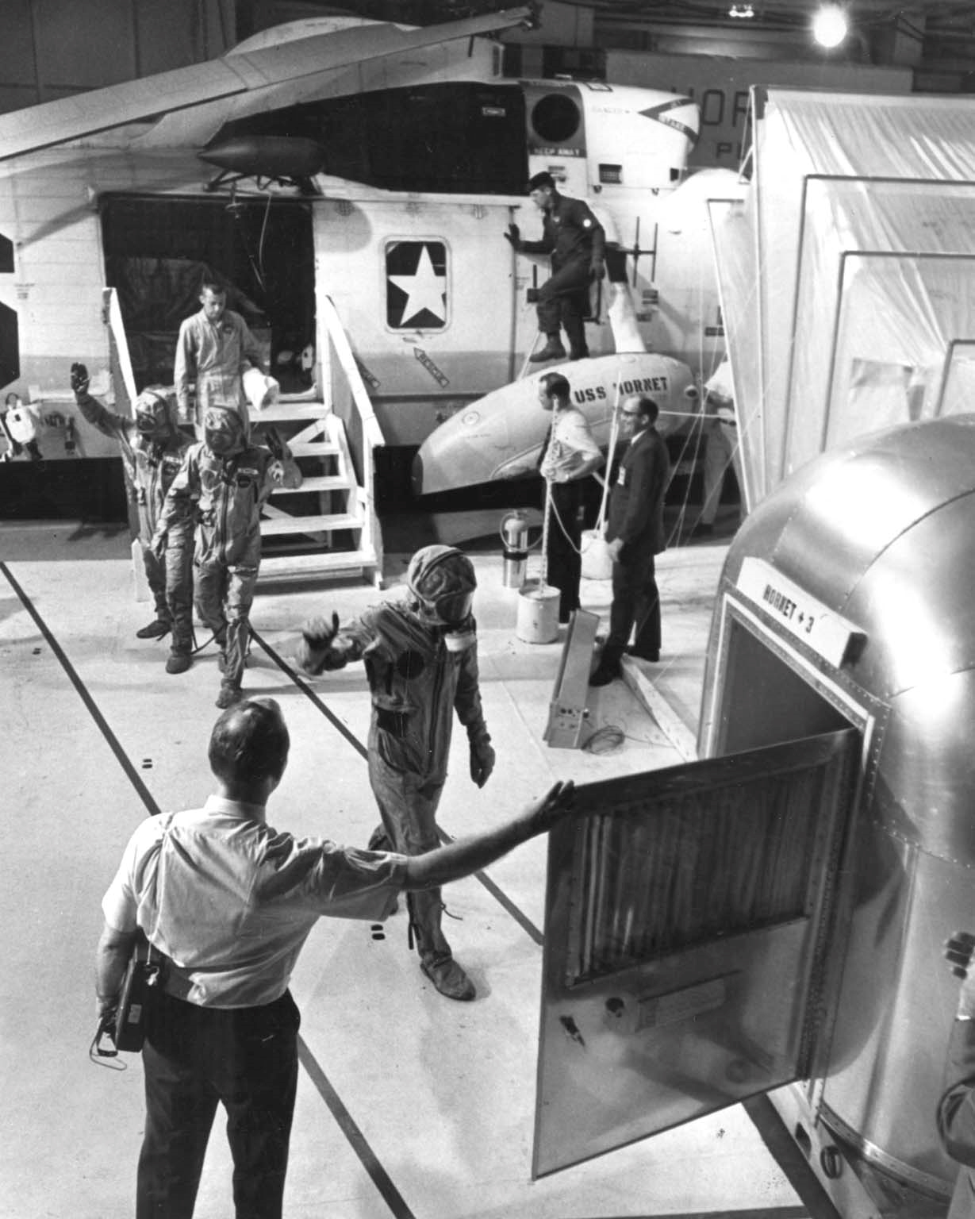
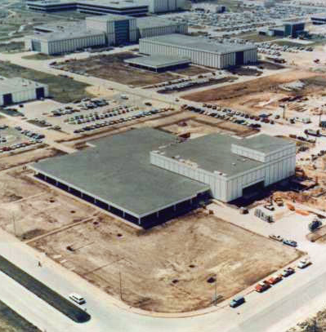

Slide 13
Discussion Groups
Chaikin Chapter 5 (“The First Lunar Landing”)
The astronauts’ view of Apollo 11
Cox Chapter 24 (“We … We’re Go on That Flight!”)
Mission control’s view of Apollo 11
Harland Chapter 2 (“Magnificent Desolation”)
The first moonwalk
Glenn lecture video (“40th Anniversary of Apollo 11”)
The three Apollo 11 astronauts tell their story 40 years later

