Slide 1
Apollo 8: Lunar Orbit
HONR 269i
To the Moon and Back: The Apollo Program
Onboard Audio

Slide 2
Apollo Mission Sequence
As Planned
As Flown
A Uncrewed Saturn V
B Uncrewed LM
C CSM Earth Orbit
D CSM/LM Earth Orbit
E CSM/LM higher Earth Orbit
F CSM/LM Lunar Orbit
G Lunar Landing
A Apollo 4, 6
B Apollo 5
C Apollo 7
C’ Apollo 8
D Apollo 9
F Apollo 10
G Apollo 11

Slide 3
Apollo Crew Planning
Apollo 7 (C)
  CDR: Schirra
  CMP: Eisele
  LMP: Cunningham
Apollo 10 (F)
  CDR: Stafford
  CMP: Young
  LMP: Cernan
Apollo 8 (D)
  CDR: McDivitt
  CMP: Scott
  LMP: Schweickart
Apollo 11 (G)
  CDR: Conrad
  CMP: Gordon
  LMP: Williams
Apollo 9 (E)
  CDR: Borman
  CMP: Collins
  LMP: Anders
Apollo 12 (H)
  CDR: Armstrong
  CMP: Lovell
  LMP: Aldrin
Bean
Haise

Slide 4
Astronaut Math in mid-1967
30 astronauts in first 3 (of 5) astronaut groups
  The Original 7, The New 9, The 14
10 of 30 were no longer available
  2 grounded, 3 retired, 5 dead (2 in the Apollo 1 fire, 3 in airplane crashes)
18 of 20 needed to fill 6 crews
  Cooper and Bean were not assigned
13 of 18 had flight experience
  6 of 9 Gemini commanders as CDR
  5 of 7 as CMP (4 with rendezvous experience)
  2 as LMP
5 rookies were therefore needed
  1 as CMP (Eisele), 4 as LMP

Slide 5
Arguments in Favor of a Lunar Orbit Mission
Provide valuable operational experience … This will enhance the probability of success of subsequent more complex lunar missions
Provide an opportunity to evaluate … MSFN and onboard navigation …
Permit validation of communications … at lunar distance
… improve consumables requirements prediction …
… verification of ground support elements and the onboard computer program
Increase the depth of understanding of thermal conditions …
Confirm astronauts’ ability to see, use and photograph lunar landmarks …
… an opportunity for additional photographs … for training crewmen …

Slide 6
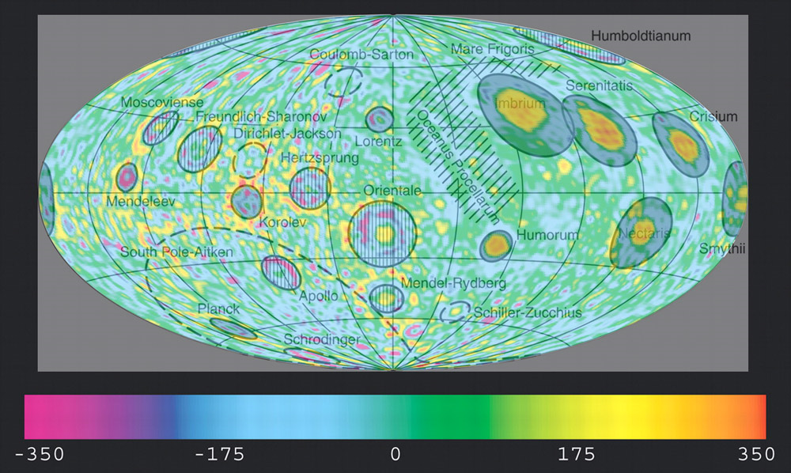

Slide 7
Arguments Against a Lunar Orbit Mission
Marginal design conditions in the Block II CSM may not have been uncovered with only one manned flight
The life of the crew depends on the successful operation of the Service Propulsion System during the Transearth Injection maneuver
The three days endurance level required of backup systems in the event of an abort is greater than from an Earth orbit mission
Only landmark sightings and lunar navigation require a lunar mission …

Slide 8
Missing Redundancy
No “LM Lifeboat” for consumables or communication between TLI and TEI
No option for LM DPS TEI in the event of an SPS failure during LOI

Slide 9
Primary Mission Objectives
Demonstrate crew/space vehicle/mission support facilities performance during a manned Saturn V mission with CSM
Demonstrate performance of nominal and selected backup Lunar Orbit Rendezvous (LOR) mission activities, including: Trans-Lunar Injection; CSM navigation, communications, and midcourse corrections; CSM consumables assessment, and passive thermal control

Slide 10
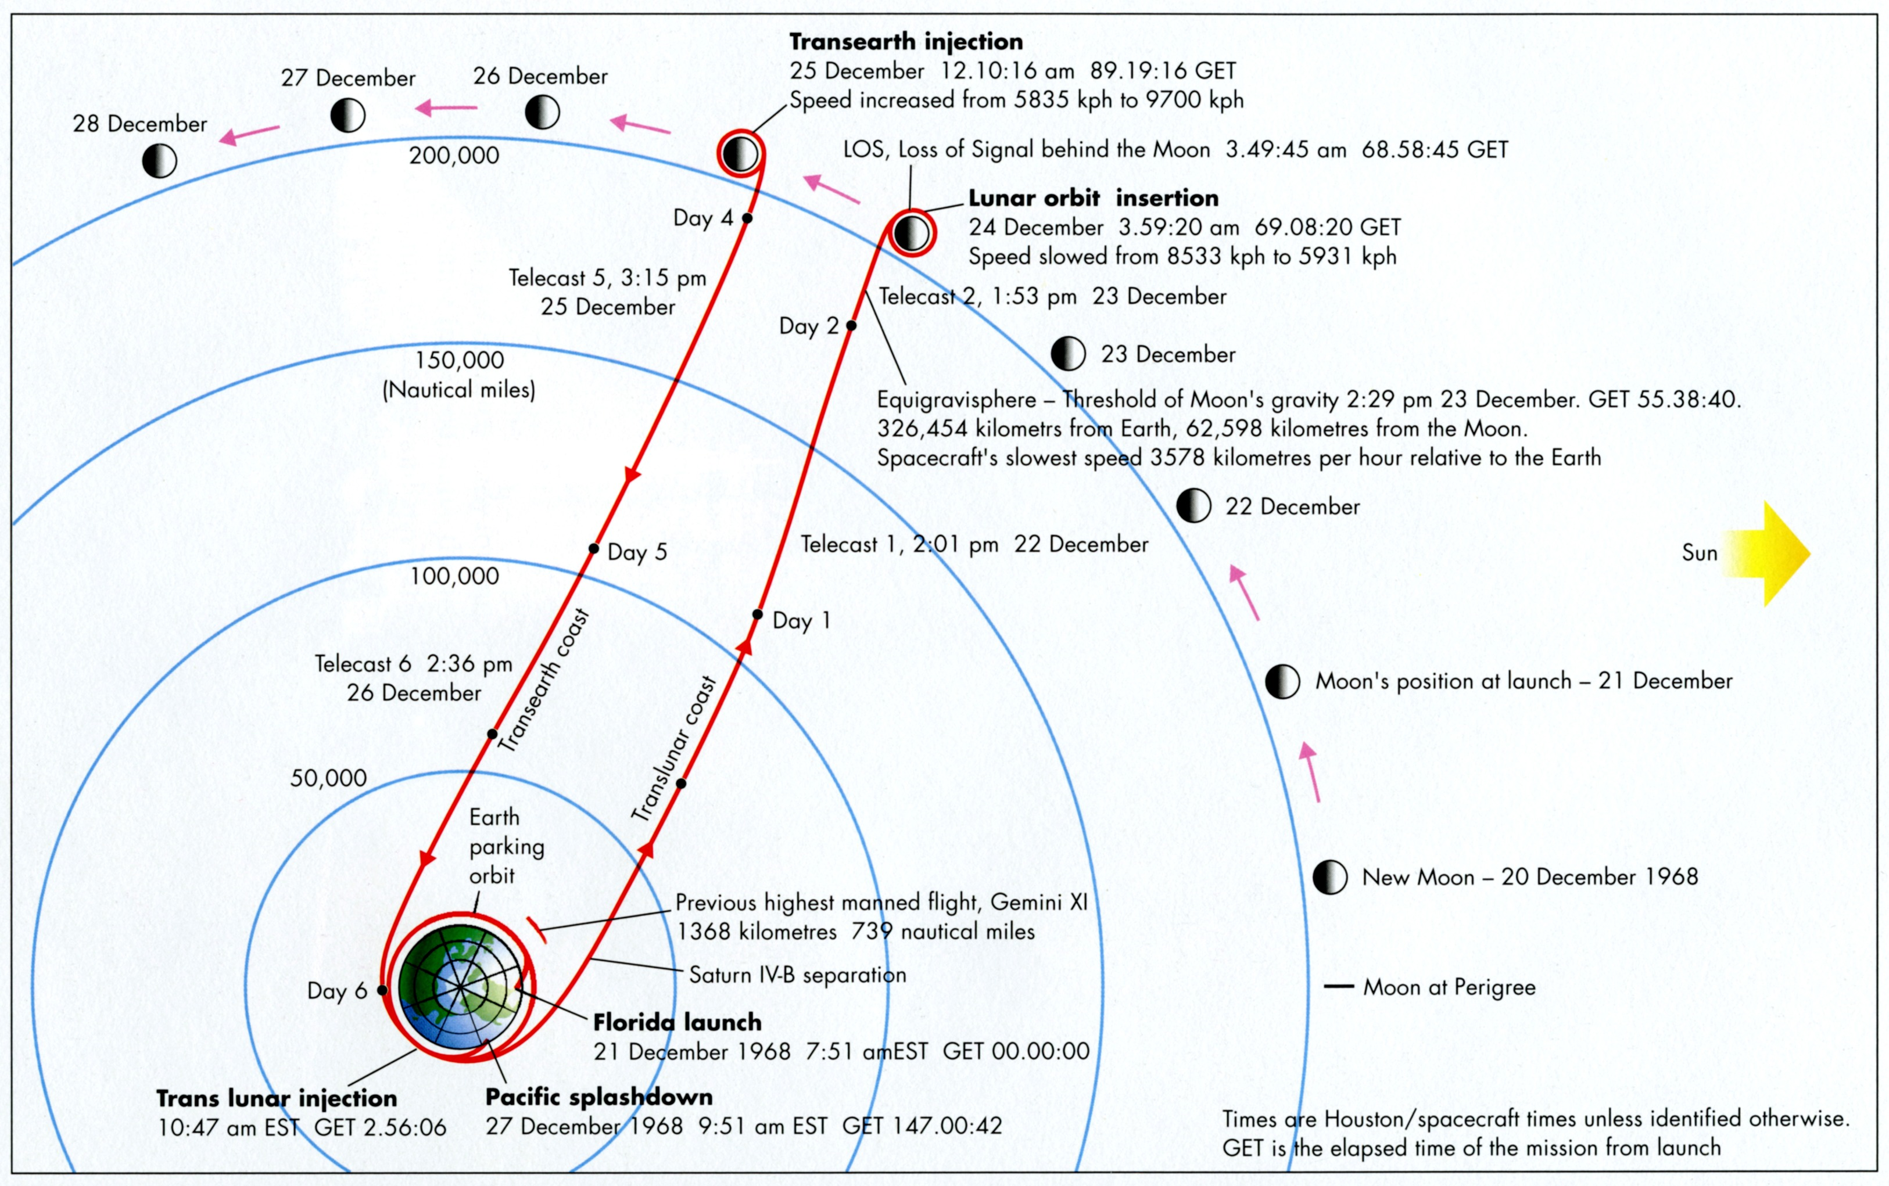

Slide 11
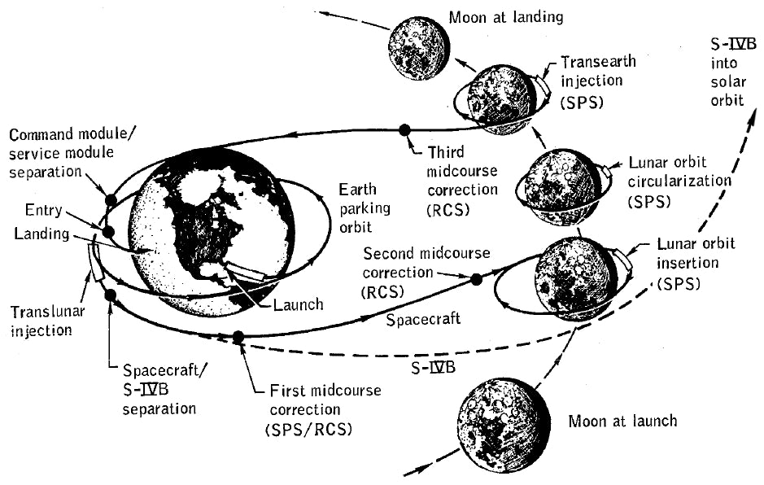

Slide 12
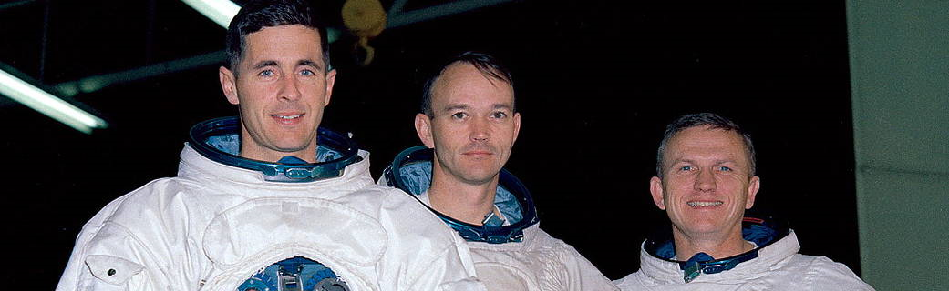
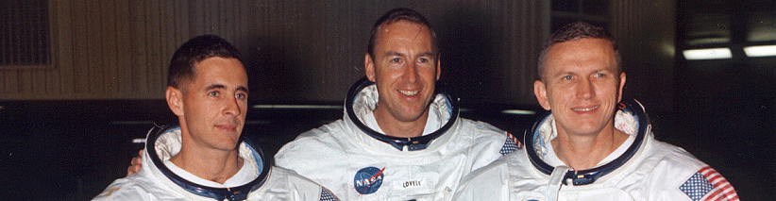

Slide 13
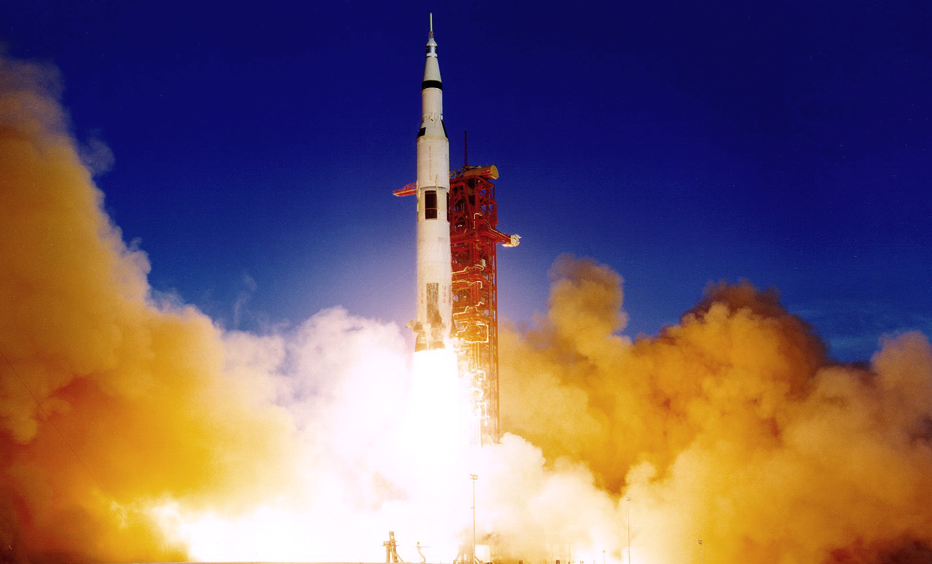


Slide 14
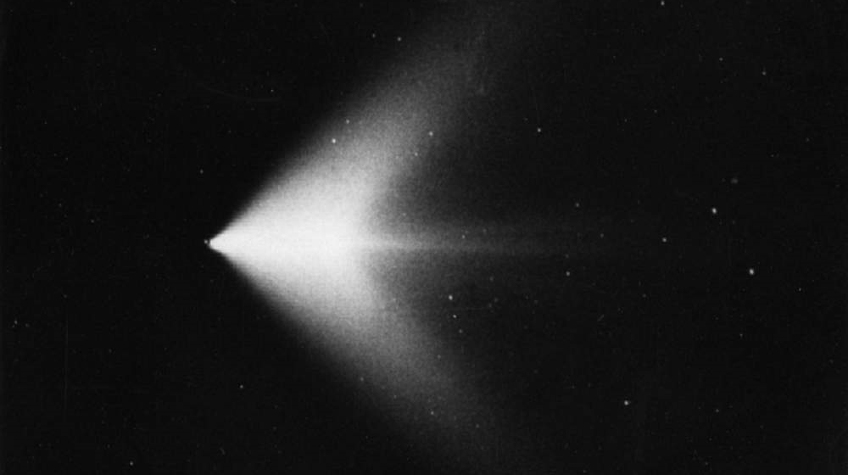

Slide 15
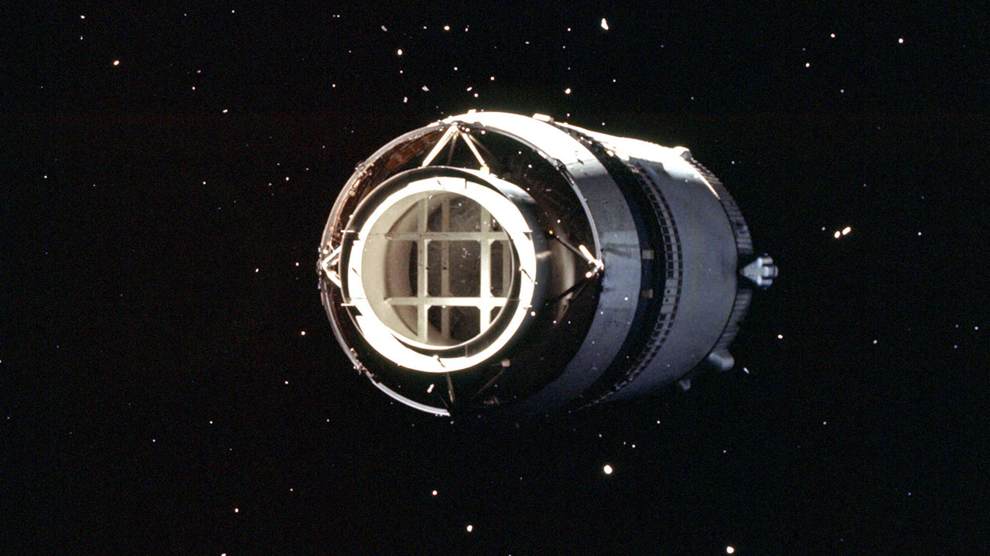

Slide 16
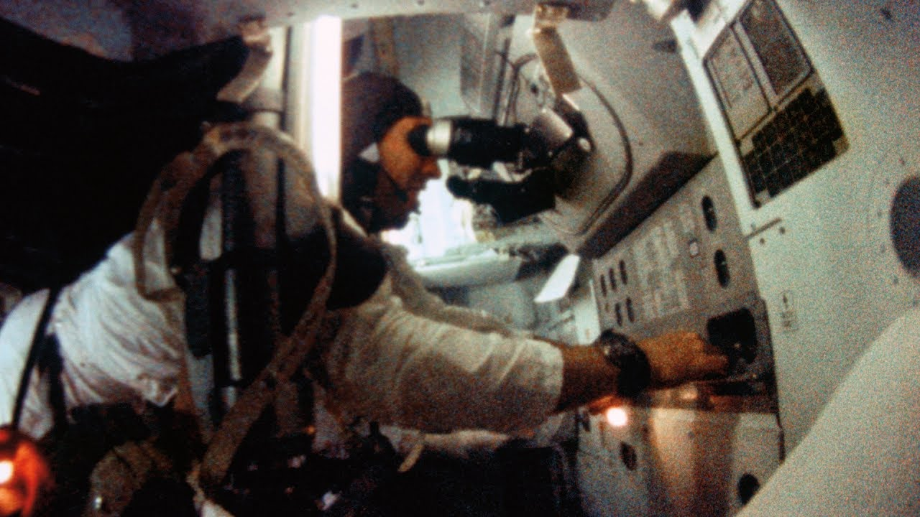

Slide 17
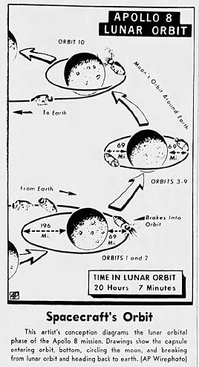
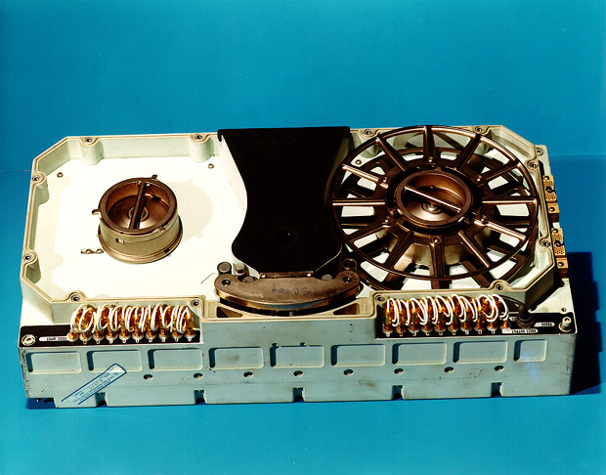
Lunar Orbit Insertion

Slide 18
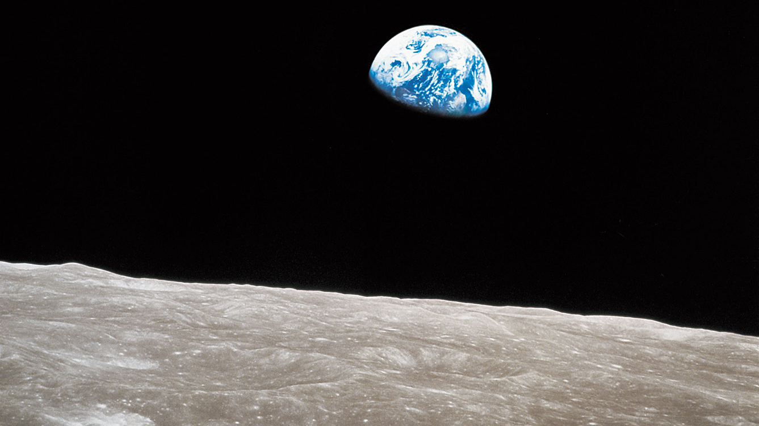

Slide 20
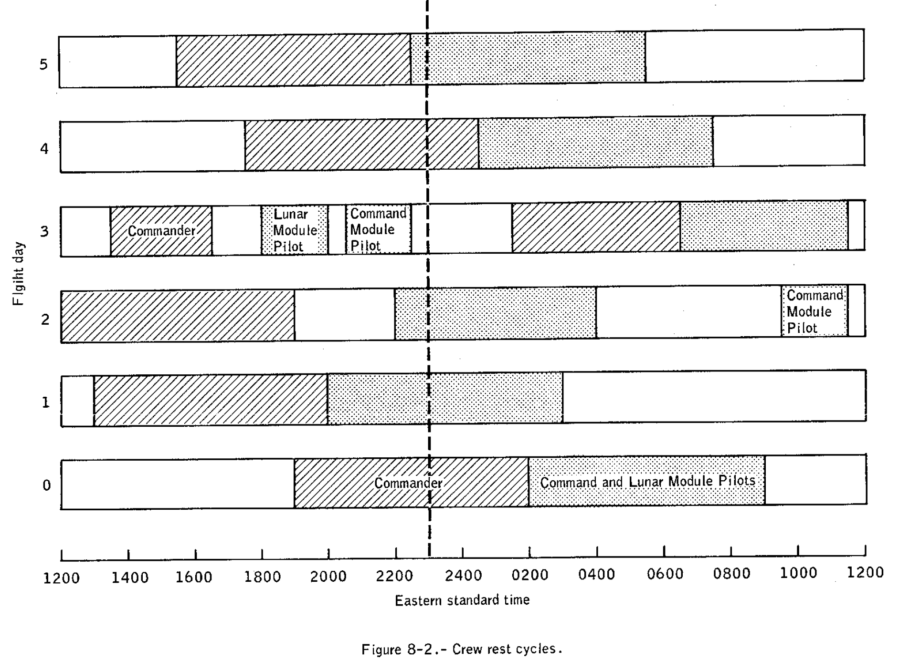

Slide 21
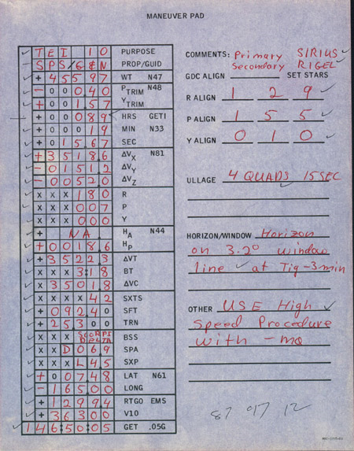
Purpose: The PAD is intended for the burn that will return the Apollo 8 crew to Earth at the end of Rev 10.
Systems: The burn will be made using the SPS engine, under the control of the Guidance and Navigation system.
CSM Weight (Noun 47): 45,597 pounds.
Pitch and yaw trim (Noun 48): -0.40° and +1.57°.
Time of ignition (Noun 33): 89 hours, 19 minutes, 15.67 seconds.
Change in velocity (Noun 81), fps: x, +3,518.6; y, -151.2; z, -52.0.
Spacecraft attitude: Roll, 180°; Pitch, 7°; Yaw, 0°. Expected apogee of resulting orbit (Noun 44): Not applicable.
Expected perigee of resulting orbit (Noun 44): 18.6 nautical miles (34.4 km).
Delta-V_{T}: 3,522.3 fps (1,073.6 m/s).
Burn duration or burn time: 3 minutes, 18 seconds.
Delta-V_{C}: 3,501.8 fps.
Sextant star: Star 42 (Peacock, or Alpha Pavonis)
Boresight star: Dschubba, or Delta Scorpii.
COAS Pitch Angle: Down 6.9°.
COAS X Position Angle: Left 4.5°.
Expected splashdown point (Noun 61): 7.48° north, 165° west
Range to go at the 0.05 g event: 1,299.4 nautical miles.
Expected velocity at the 0.05 g event: 36,300 fps.
Predicted GET of 0.05 g event: 146 hours, 50 minutes and 5 seconds GET.

Slide 22
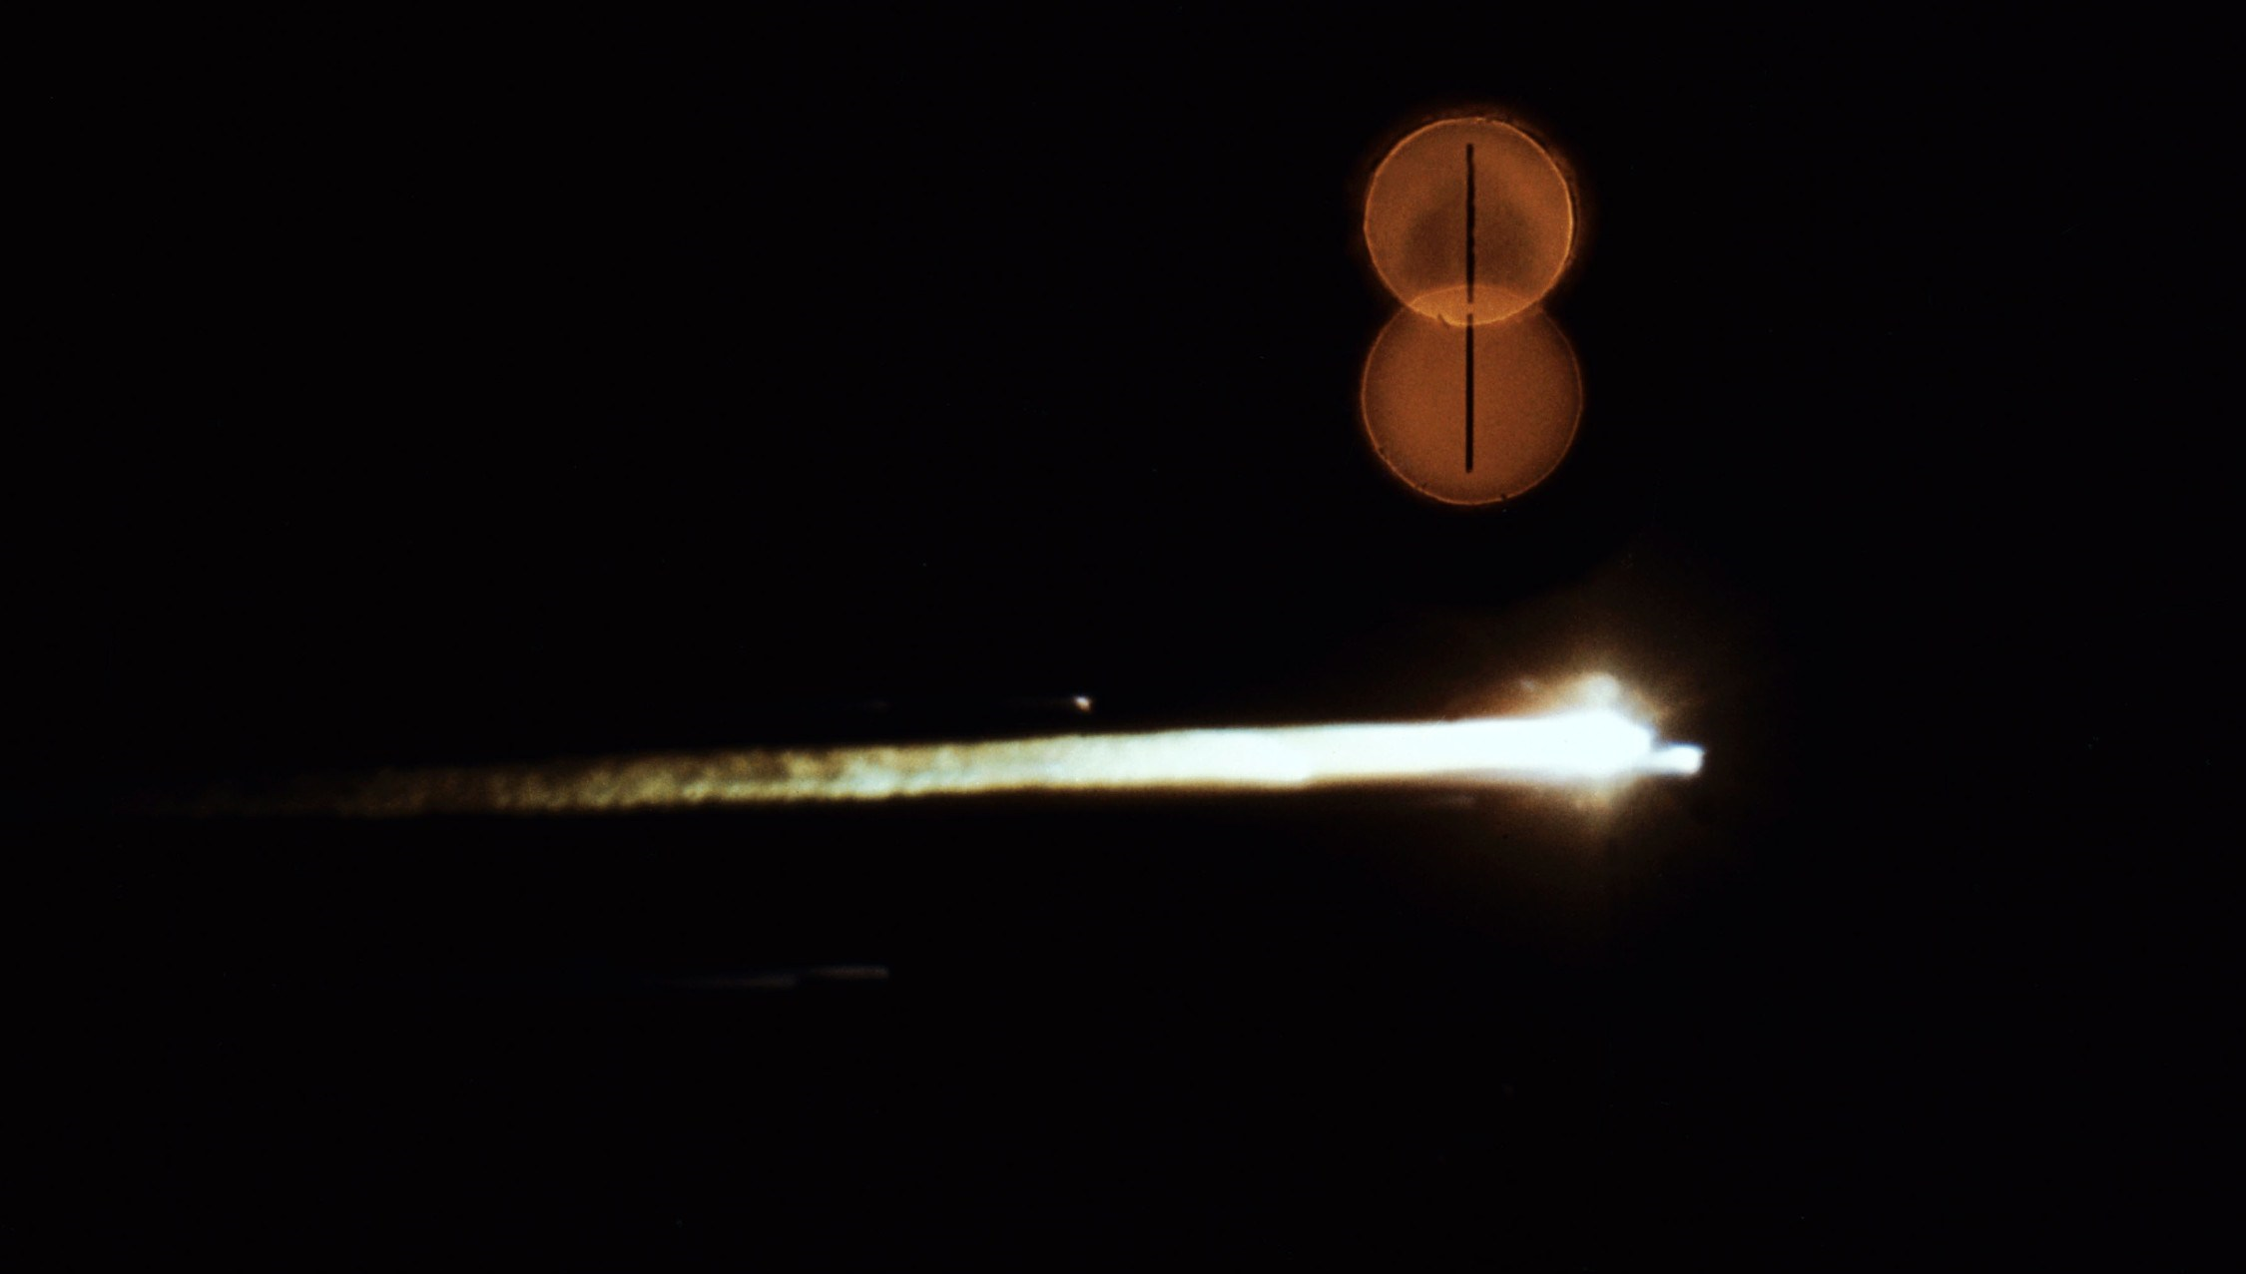

Slide 23
Anomalies
Preflight: Contamination of spacecraft LOX
Launch: S1C camera malfunction
Launch: Intermittent operation of S-II power supplies
Launch: SII engine oscillations
Translunar: Drop in chamber pressure during first SPS burn
Throughout: Hatch and side windows obscured
Throughout: Obscuration of telescope field of view
Throughout: Abnormal shifts in computer readout of optics trunnion angle
Throughout: Noisy cabin fans
Throughout: Inoperative personal radiation dosimeter
Transearth: Erratic potable water quantity measurement
Reentry: Entry monitor system malfunctions
Landing: Seawater inflow through cabin pressure relief valve
Recovery: Inoperative swimmer’s interphone
Recovery: Failure of CM recovery loop

Slide 24
Discussion Groups
Kluger Chapter 7
  How the lunar orbit decision was made
Chaikin Chapter 3 (“First Around the Moon”)
  Apollo 8 from the Astronaut’s perspective
Woods Chapter 15 (“Re-entry”)
  Reentry into the Earth’s atmosphere from a lunar trajectory
From the Earth to the Moon video episode 4 (“1968”)
  An interleaved telling of the story of 1968’s social unrest and Apollo 8

