Slide 1
Voskhod, Soyuz and Zond
HONR 269i
To the Moon and Back: The Apollo Program

Slide 2
Every Soviet Human Spaceflight Before Apollo 11
  May 1963: Last of 4 single-person Mercury orbital flights (Mercury-Atlas 9)
June 1963: Last of 6 single-person Vostok flights (Vostok 6)
October 1964: First multi-crew spacecraft (Voskhod 1)
March 1965: First EVA (Voskhod 2)
  March 1965-November 1966: 10 crewed Gemini missions
  January 1966: Korolev’s death
  May 1966 Voskhod 3 cancelled
  January 1967: First spacecraft fatalities (Apollo 1)
April 1967: First inflight fatality (Soyuz 1)
  October 1968: Apollo 7
October 1968: First Soviet crewed rendezvous (Soyuz 3)
  December 1968: Apollo 8
January 1969: First docking of two crewed spacecraft (Soyuz 4&5)
  March-May 1969: Apollo 9, Apollo 10

Slide 3
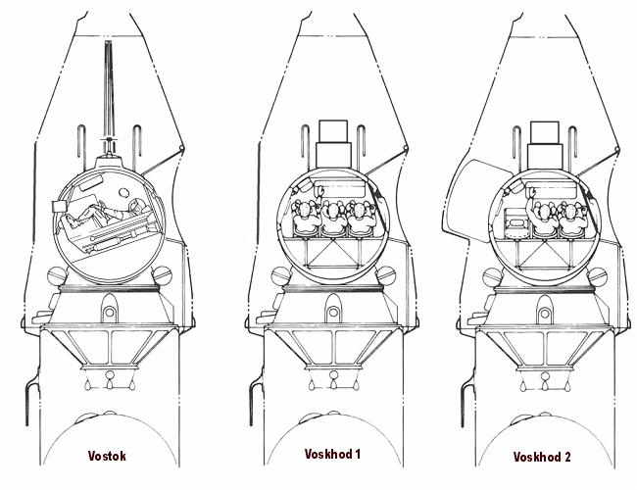

Slide 4
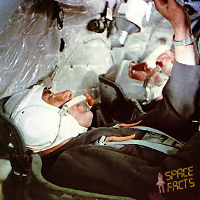
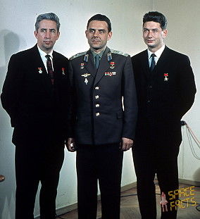

Slide 5
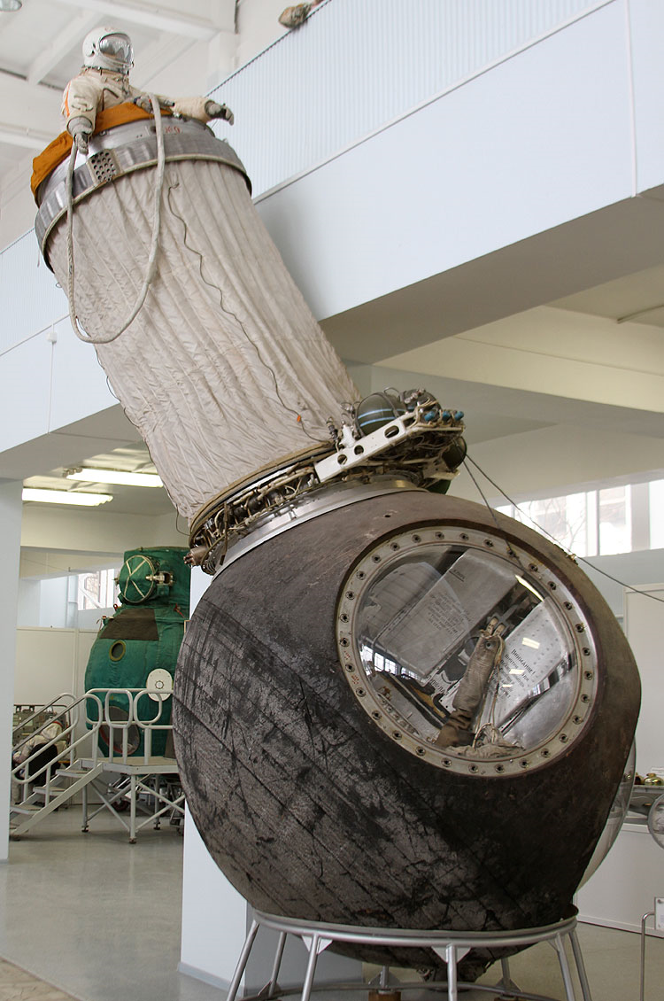
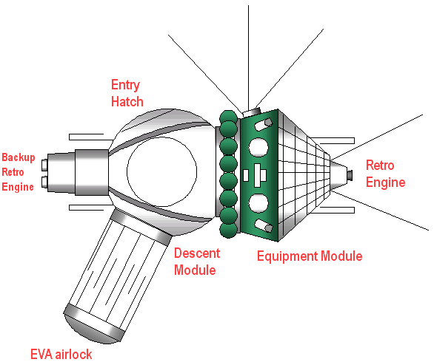

Slide 6
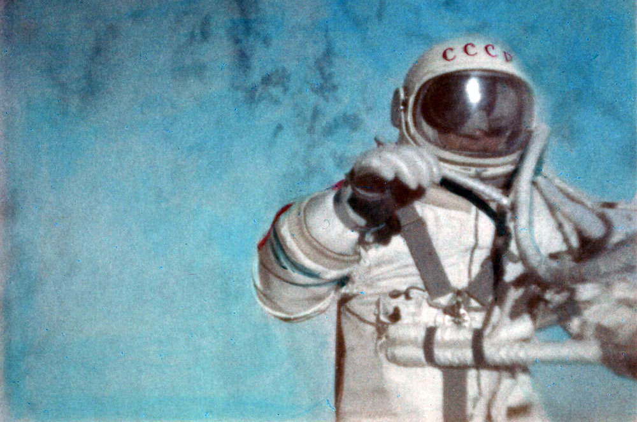

Slide 7
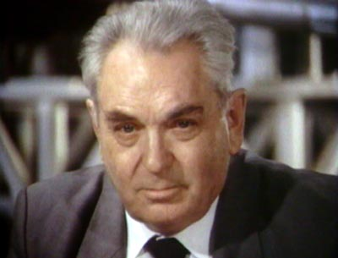
Vasily Mishin
Chief Designer
OKB-1
1966-1974

Slide 8
Soyuz 7K-OK Program
November 1966 Attitude control failure, self-destruct (Kosmos 133)
December 1966 Launch failure
February 1967 Ballistic reentry, heat shield failure, sank (Kosmos 140)
April 1967 Fatal parachute failure (Soyuz 1)
October 1967 First automatic docking (Kosmos 186/188)
April 1968 Automatic docking (Kosmos 212/213)
August 1968 Orbital test (Kosmos 238)
October 1968 First Soviet rendezvous, docking failure (Soyuz 2/3)
January 1969 First crew transfer between spacecraft by EVA (Soyuz 4/5)
October 1969 Rendezvous failure, docking failure (Soyuz 6/7/8)
June 1970 17.7 day long-duration flight (Soyuz 9)
April 1971 Docking failure (Soyuz 10/Salyut 1)
June 1971 Depressurization on reentry resulted in 3 deaths (Soyuz 11)

Slide 9
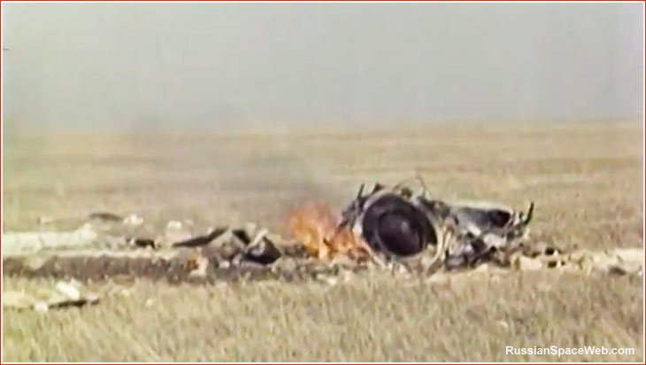

Slide 10
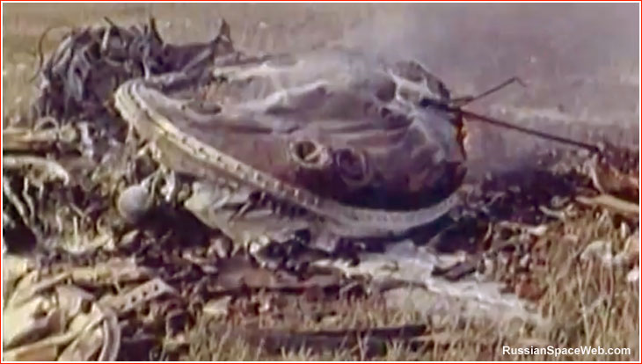

Slide 11
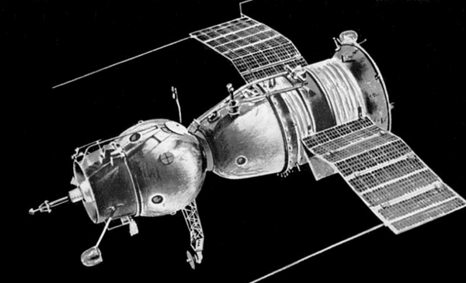

Slide 12
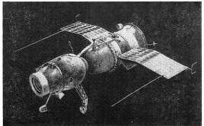

Slide 13
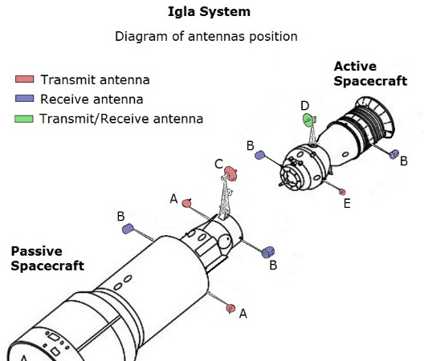
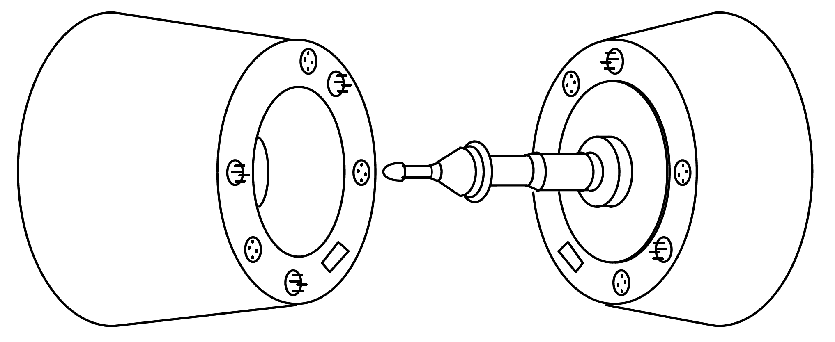
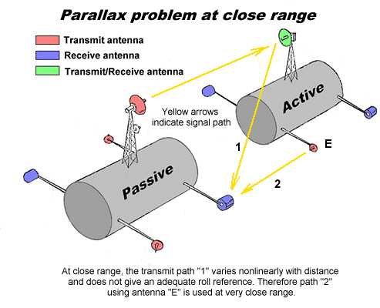

Slide 14
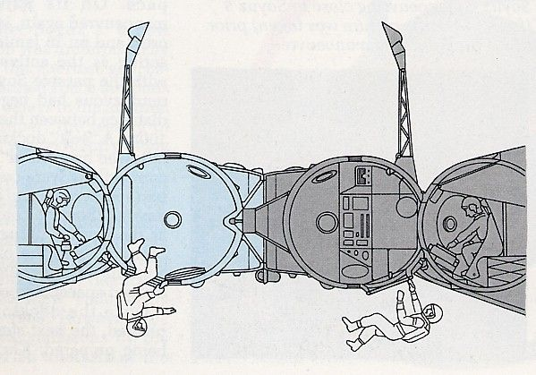

Slide 15
Uncrewed Zond (7K-L1) Flights
March 1967: First Earth orbital test (Kosmos 146)
April 1967: Earth orbital test with no restart (Kosmos 157)
September 1967: Launch failure
November 1967: Launch failure
March 1968: Deep space mission, self-destruct before landing (Zond 4)
April 1968: Launch failure
July 1968: Explosion on the launch pad during testing
September 1968: First circumlunar flight, ballistic reentry (Zond 5)
November 1968: Circumlunar, skip reentry, depressurized, crashed (Zond 6)
January 1969: Launch failure
August 1969: Circumlunar flight, skip reentry (Zond 7)
October 1970: Circumlunar flight, ballistic reentry (Zond 8)

Slide 16
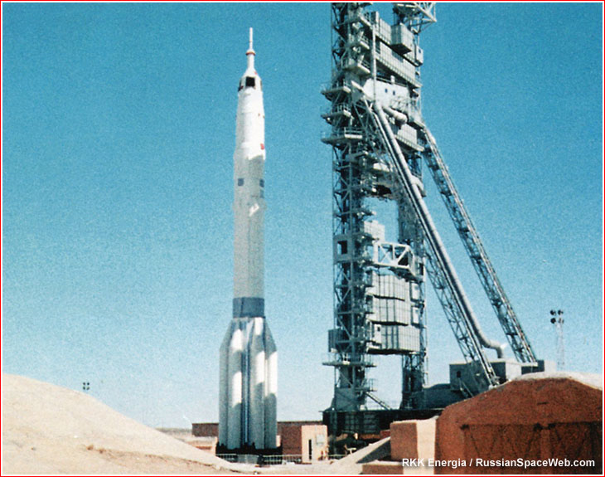

Slide 17
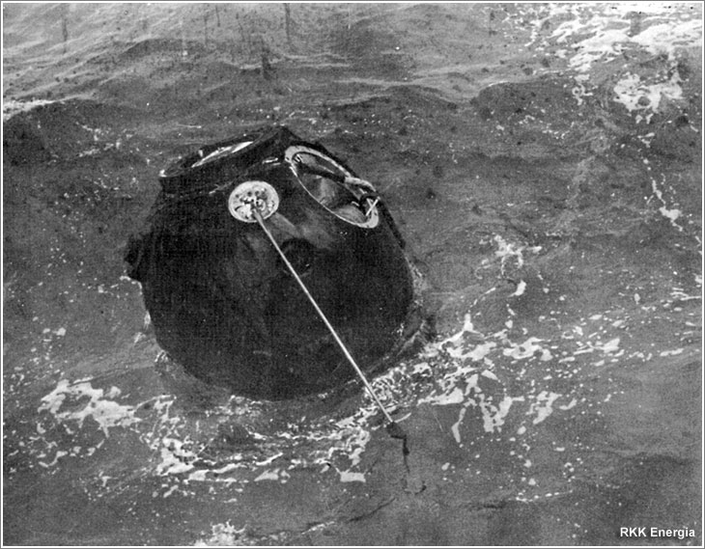
Zond 5

Slide 18
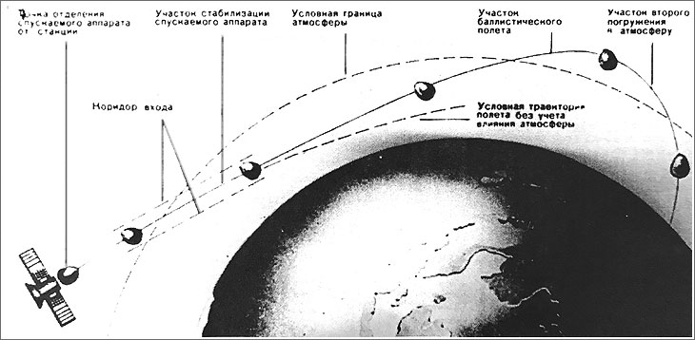
Zond 6 “Skip” Reentry

Slide 19
Discussion Groups
Scott Chapter 3 (“Red Star, White Star”)
  Astronaut perspectives on the American and Soviet space programs
Chertok Volume 3 Chapter 9 (“The Voskhods and the First Spacewalk”)
  An insider’s story of Voskhod 1 and Voskhod 2
Spacewalker video
  A dramatization of the Voskhod 2 mission
Harvey Chapter 5 (“The First Cosmonauts to the Moon”)
  The Zond and Soviet lunar landing programs

