Slide 1
Gemini: EVA
HONR 269i
To the Moon and Back: The Apollo Program
Gemini XII

Slide 2
Umbilical and Independent EVA (before Apollo 11)
Gemini 4 (36 minutes): Handheld maneuvering unit
Gemini 9 (129 minutes): Backpack maneuvering unit [EVA aborted]
Gemini 10 (39 minutes): Proximity operations [EVA aborted]
Gemini 11 (38 minutes): Tethering two spacecraft [EVA aborted]
Gemini 12 (129 minutes): Body restraint tests
Apollo 9 (46 minutes): No umbilical

Slide 3
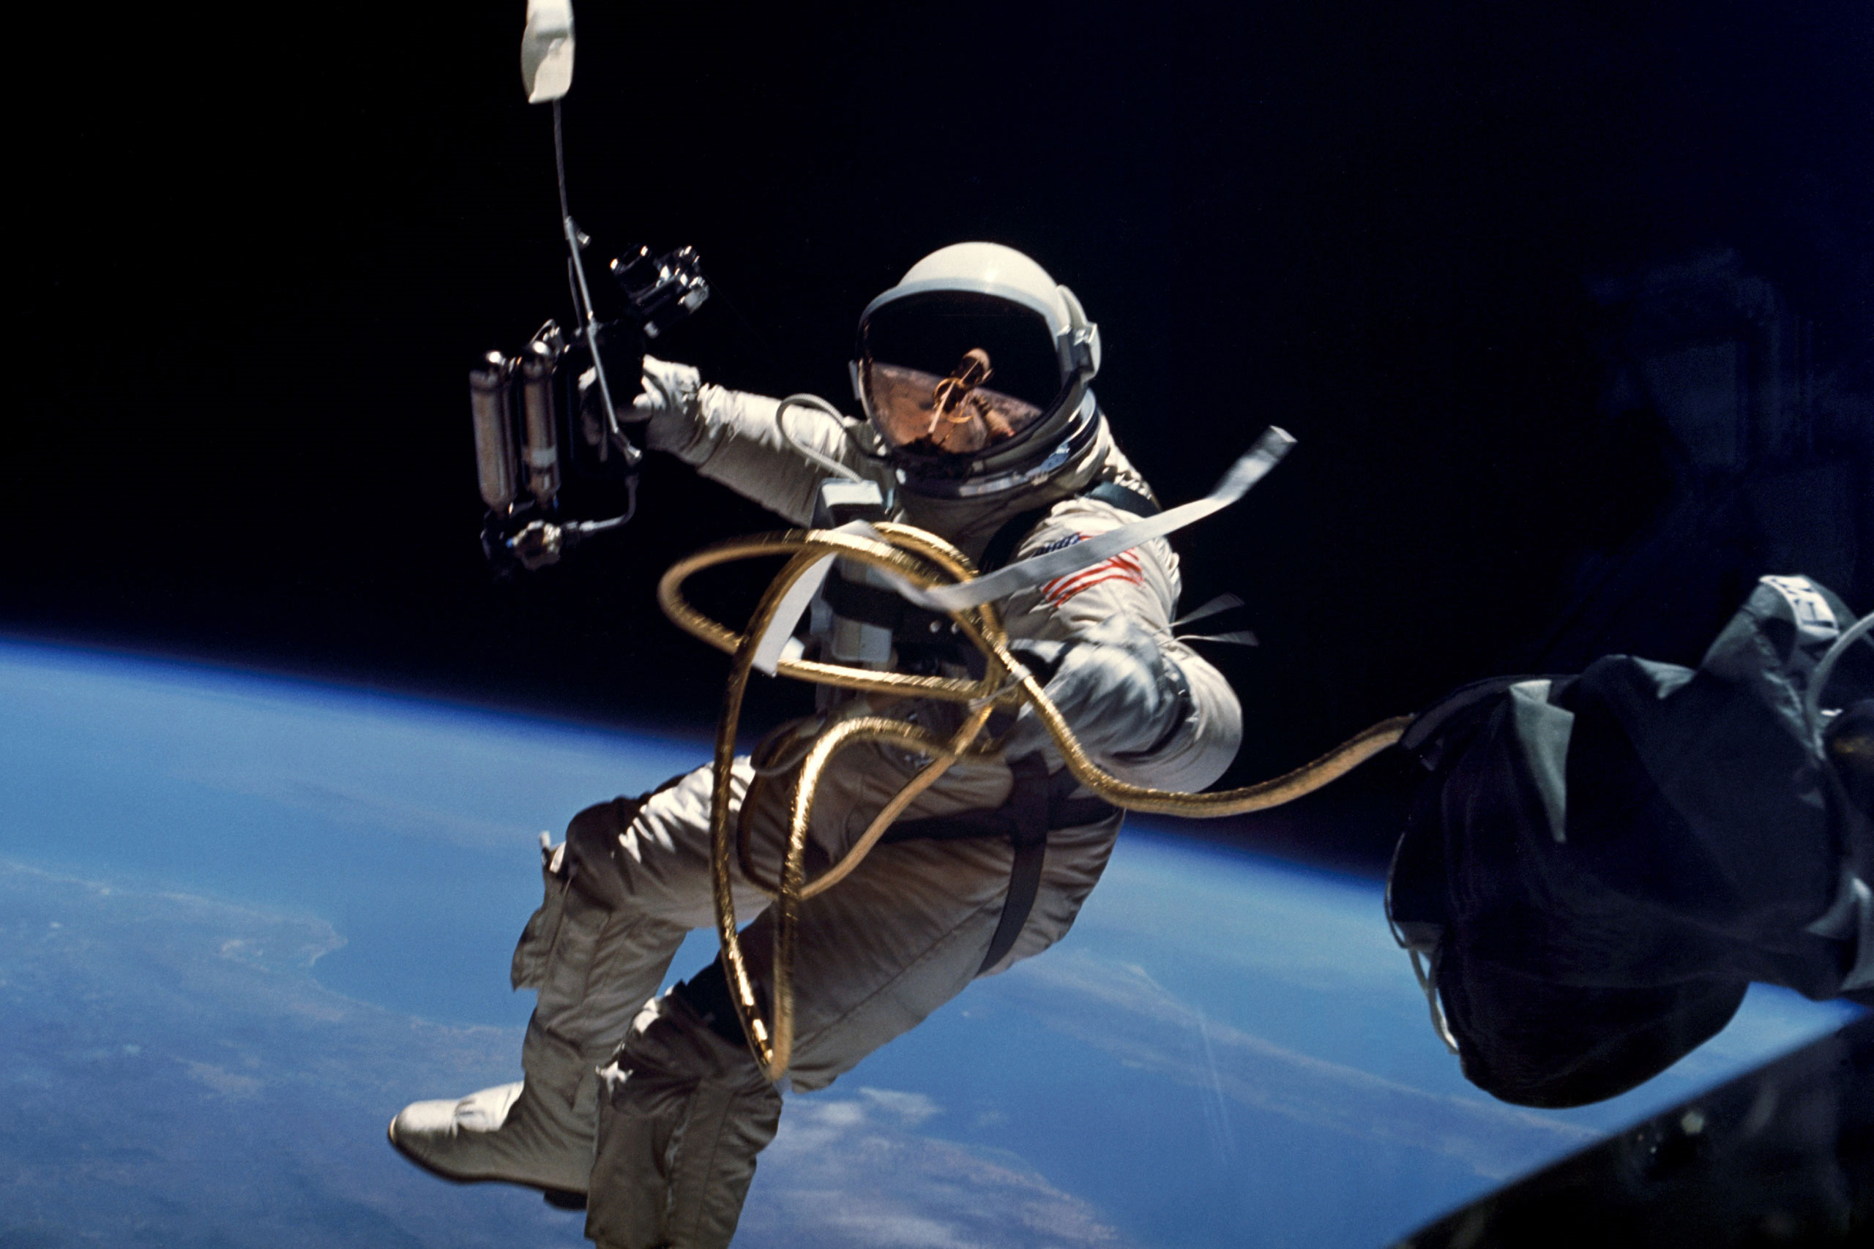

Slide 4
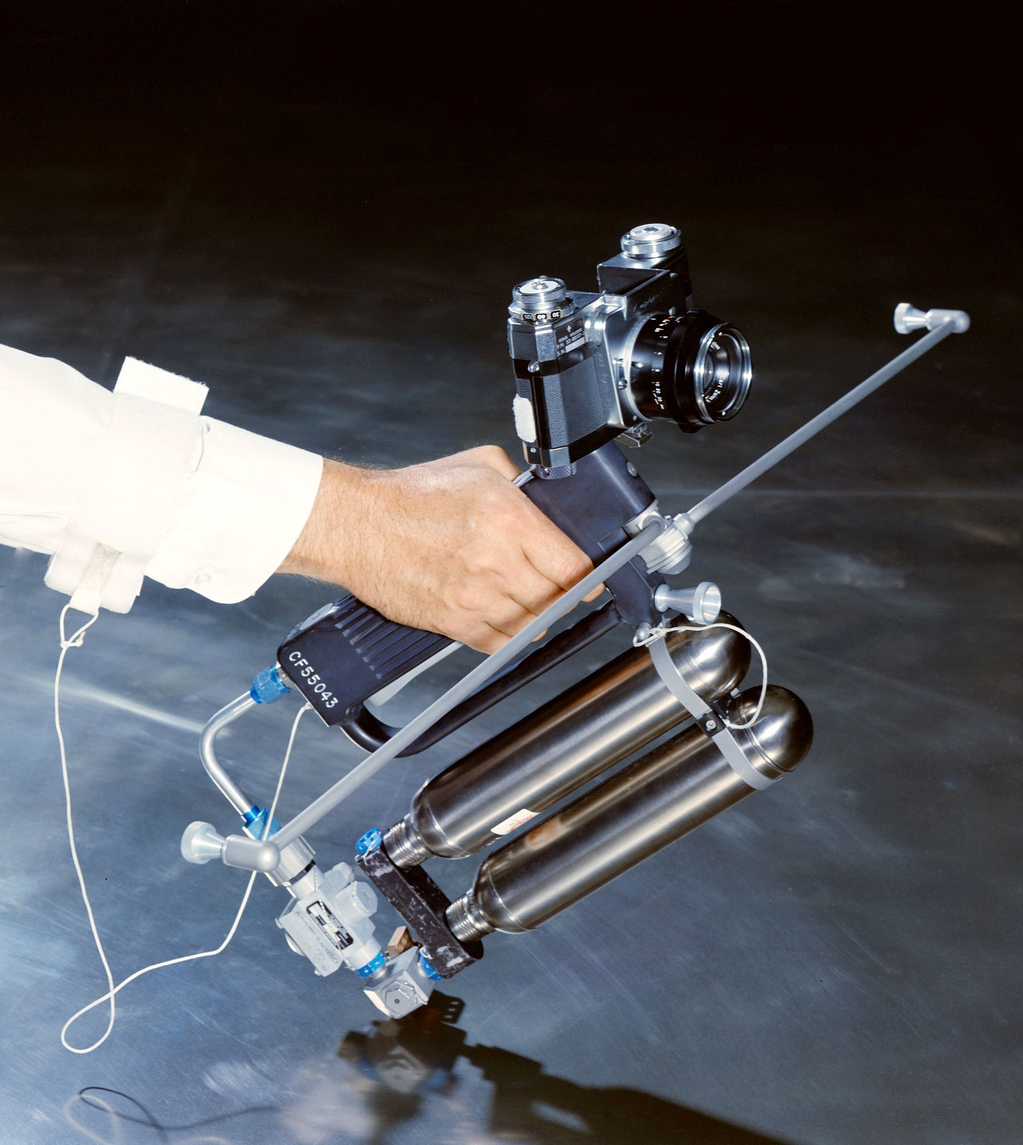
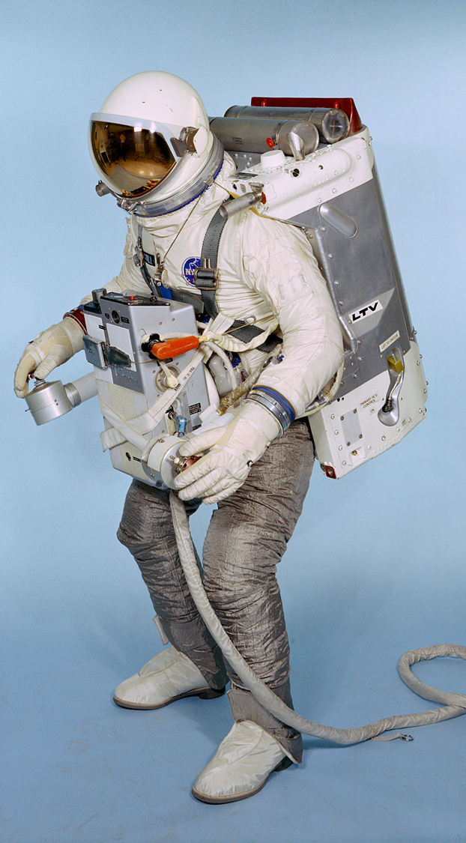
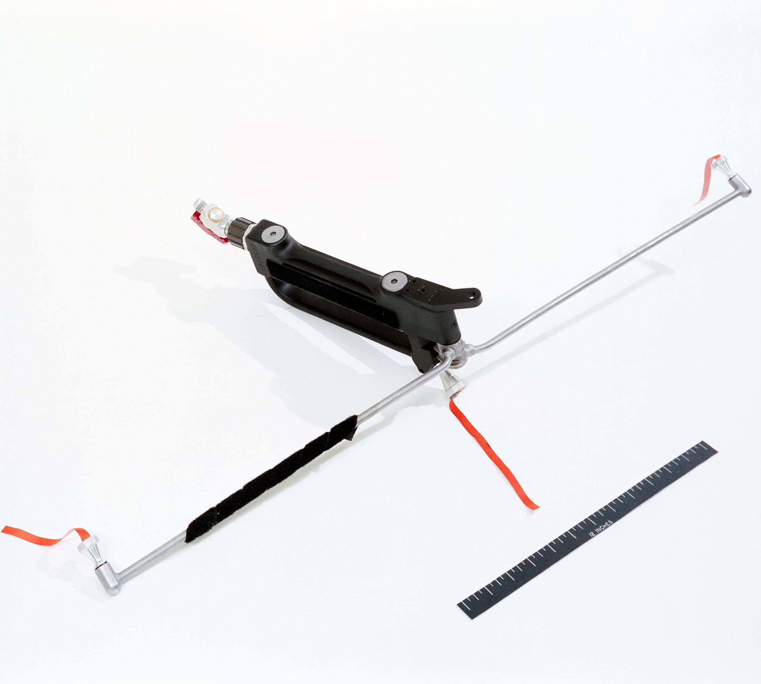
Maneuvering Units
Gemini 4
6 ft/sec
Gemini 9
250 ft/sec
Gemini 10 and 11
84 ft/sec

Slide 5
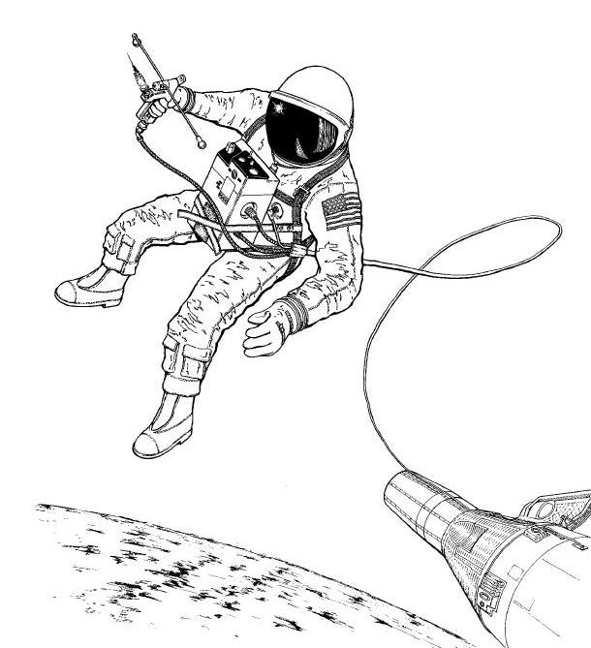
Gemini 10/11 Handheld
Maneuvering Unit

Slide 6
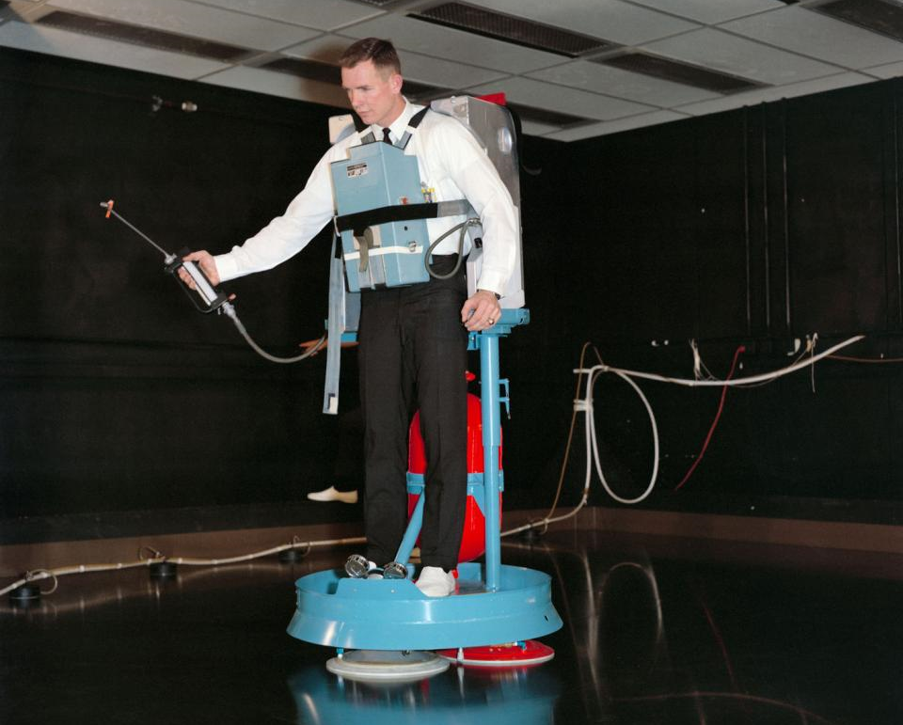
Air-Bearing
Floor
EVA Trainer
(Gemini 8)

Slide 7
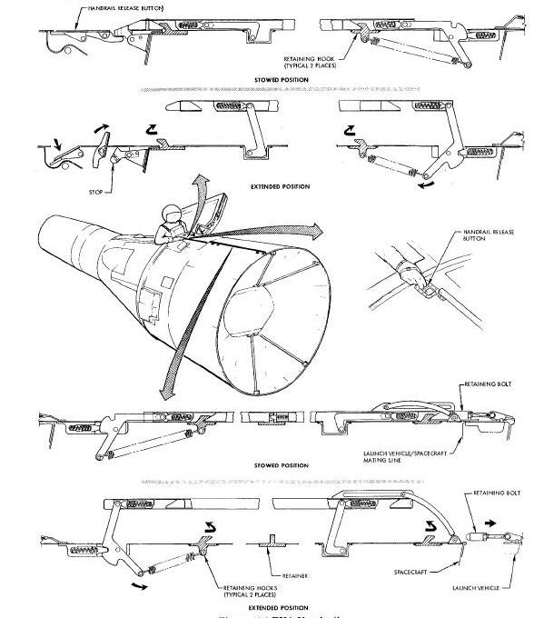
Adapter Section
Handrails

Slide 8
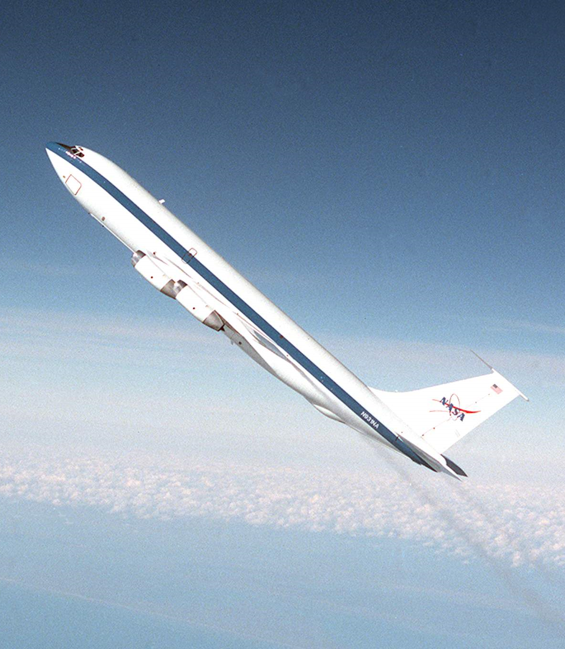
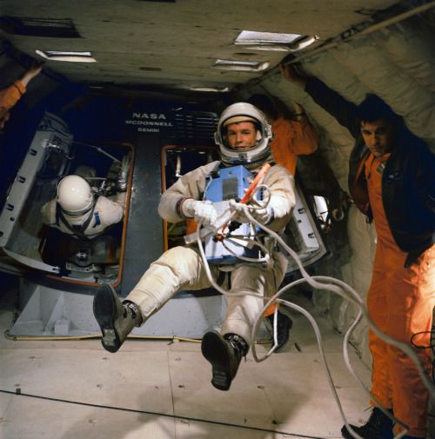

Slide 9
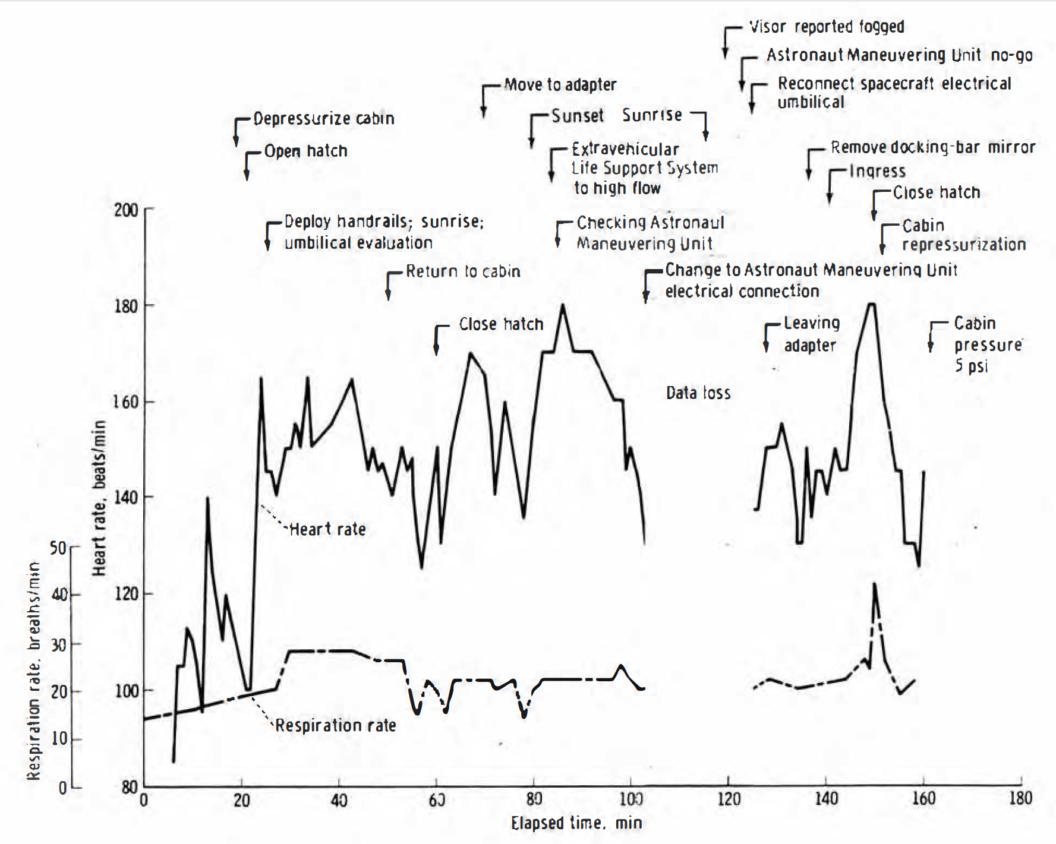
Gemini 9

Slide 10
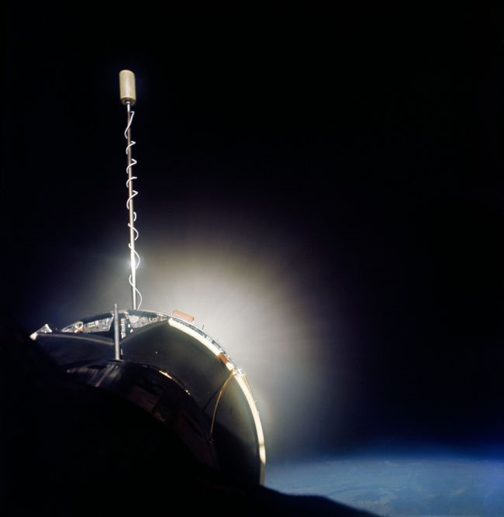
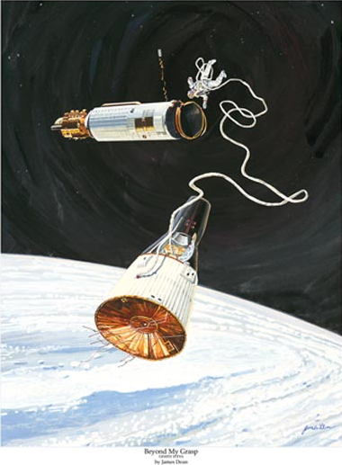

Slide 11
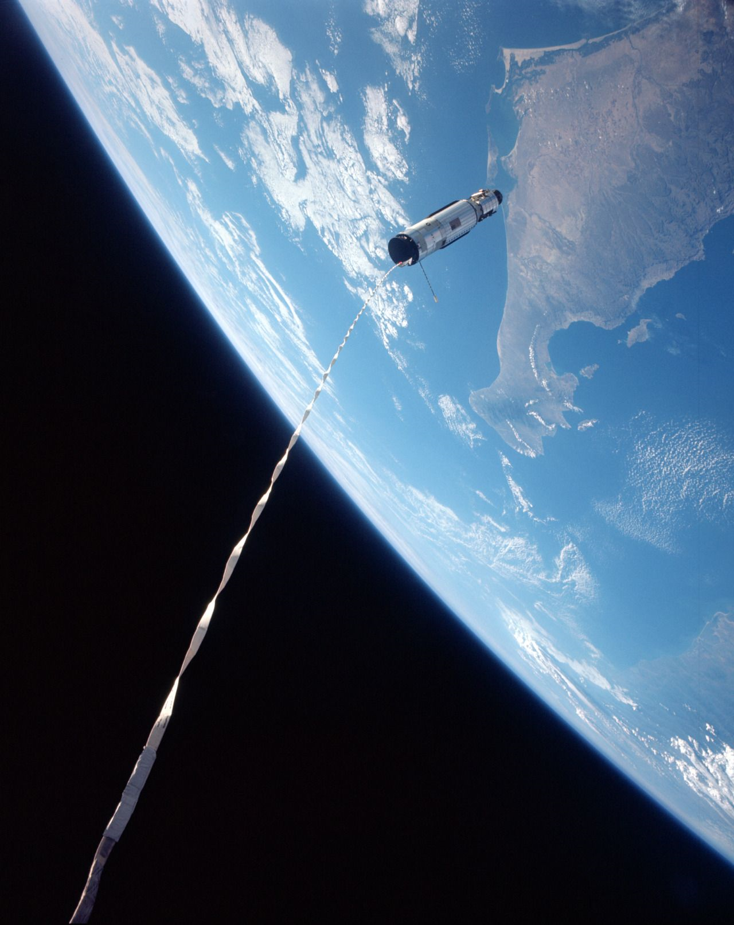
Gemini 11
Tethered
Stationkeeping

Slide 12
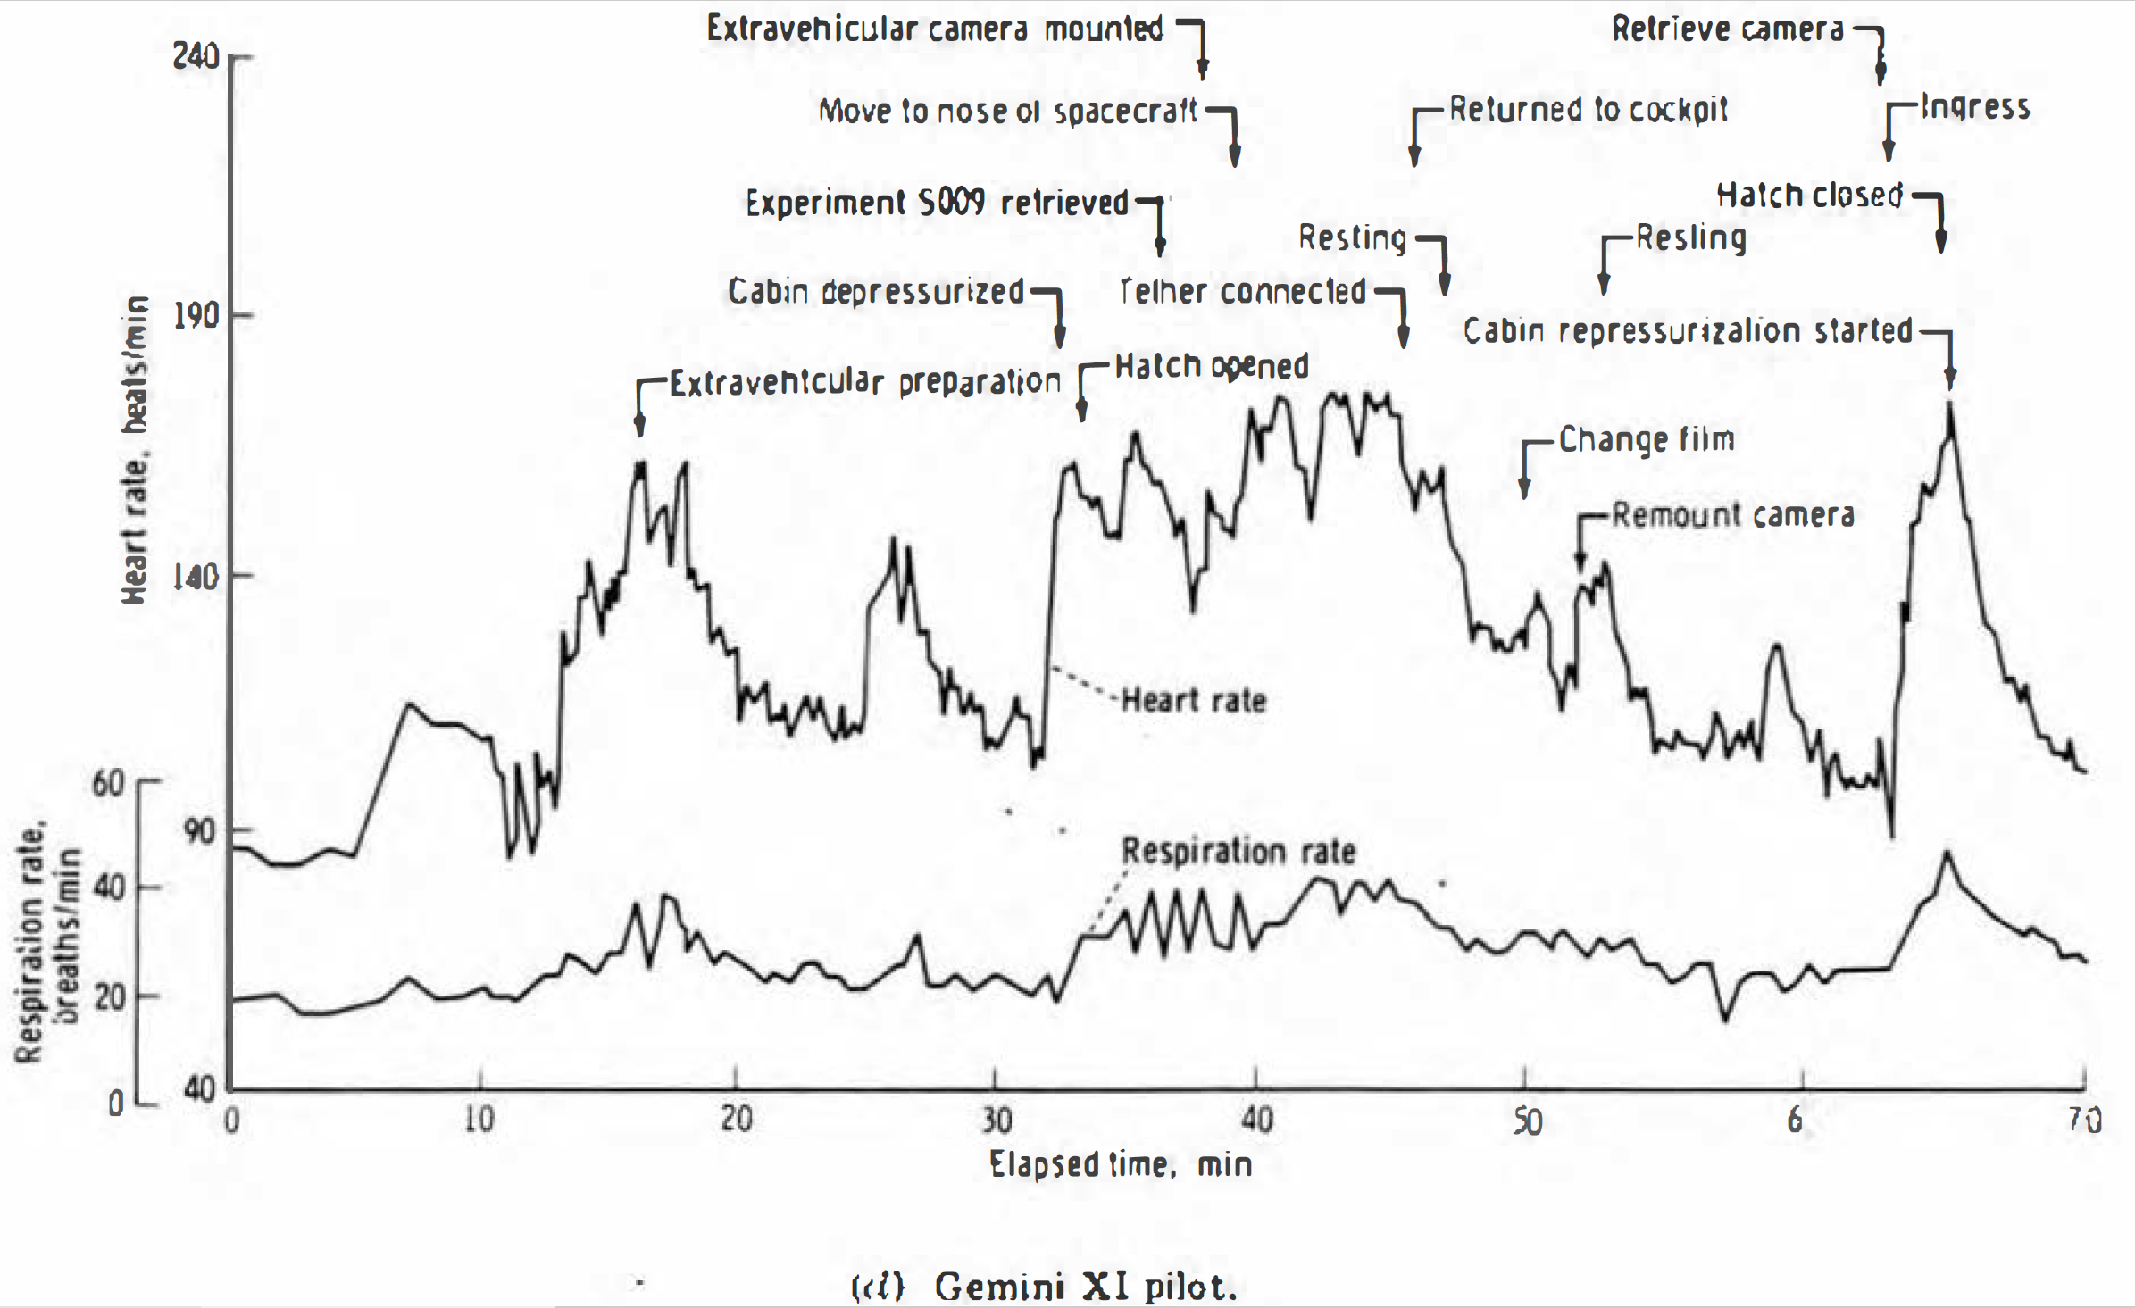

Slide 13
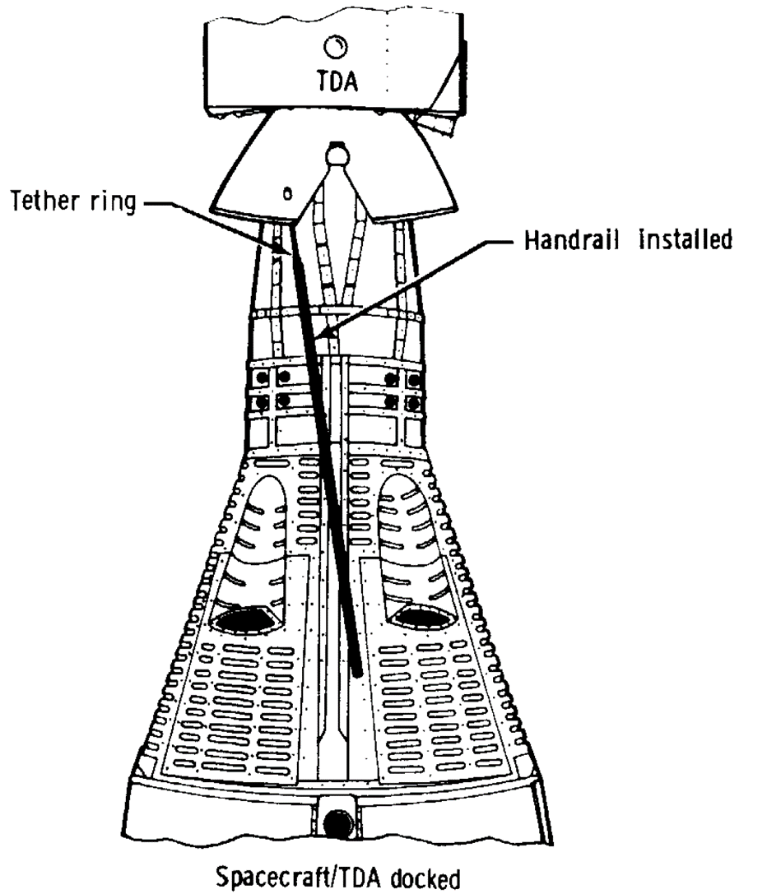
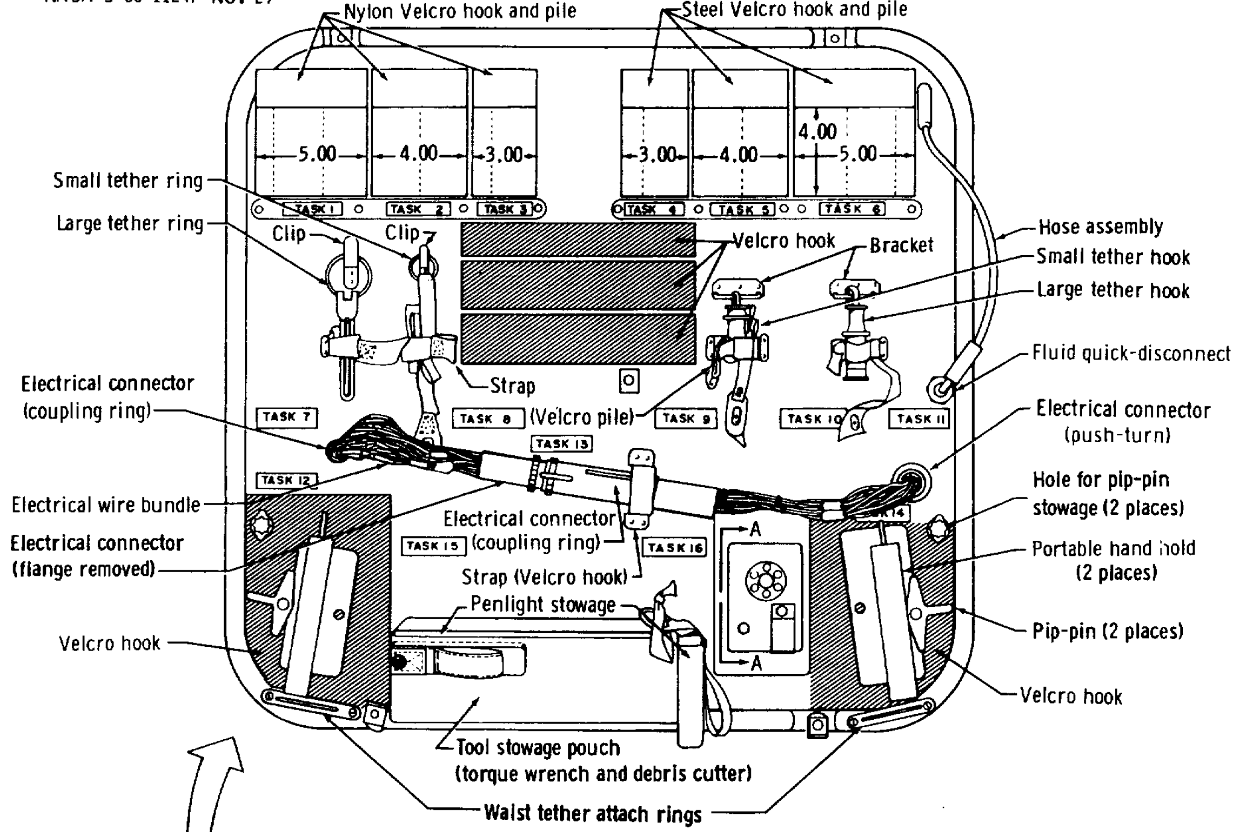
Gemini 12 Body Position Aids

Slide 14
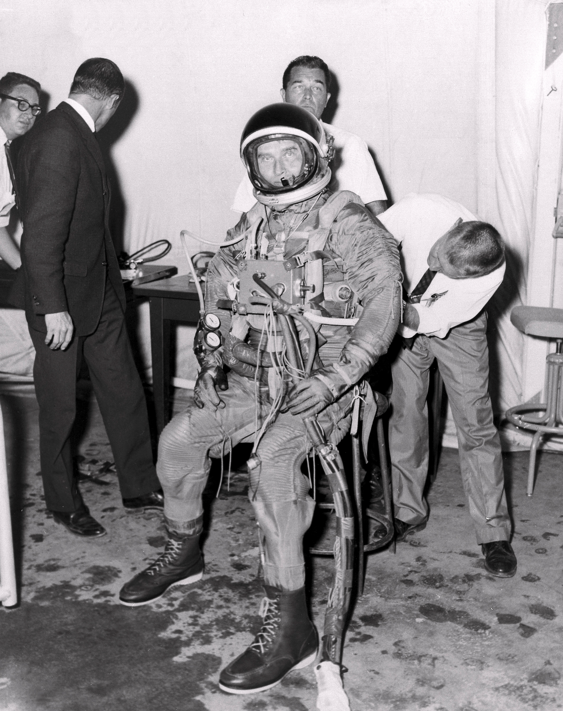
Neutral Buoyancy Experimentation
Boeing Bioastronautics Division: 1963 [water pressurized]
  Air Force X-20 DynaSoar (cancelled December 1963)
Mattingly and Loats (“Environmental Research Associates”): 1964 [air pressurized]
  Langley Manned Orbiting Research Laboratory (study ended 1966)
  Gemini
Marshall Space Flight Center: 1964 [air]
  Wet Workshop (alternative to Skylab)
General Electric Space Technology Lab: 1964 [water]
  Air Force Manned Orbiting Laboratory
  MSFC Wet Workshop
Convair: 1964 [water]
  Air Force (Manned Orbiting Laboratory?)

Slide 15
Gemini Neutral Buoyancy Simulations (1966)
  Gemini 9A: June 3-6
  ERA Wet Workshop demo to MSFC and MSC: June 15
June 30/July 1: Gemini 10 procedures development
  Gemini 10: July 18-21
  Gilruth letter directing neutral buoyancy training: July 25
July 28/29: Gemini 9 postflight evaluation (Cernan)
August 10: Gemini 11 procedures development
August 22: Gemini 12 procedures development
September 11/12: Gemini 12 training (Aldrin)
  Gemini 11: September 12-15
September 14: Gemini 12 procedures development
October 16/17/29: Gemini 12 training (Aldrin)
  Gemini 12: November 11-15
December 1: Gemini 12 postflight evaluation (Aldrin)

Slide 16
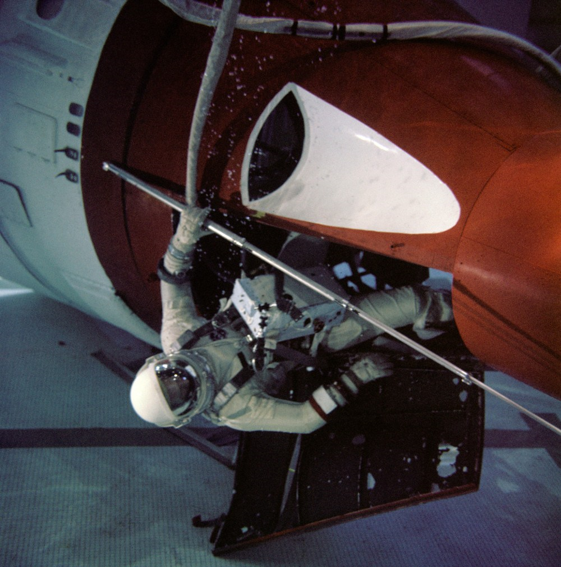


Slide 17
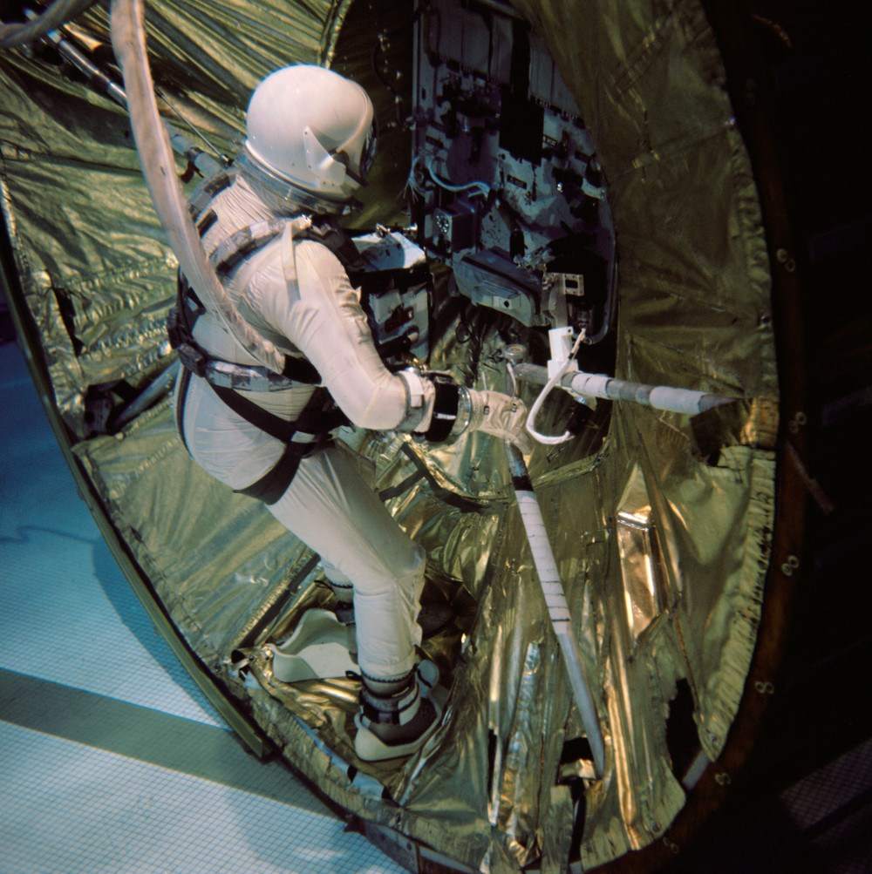
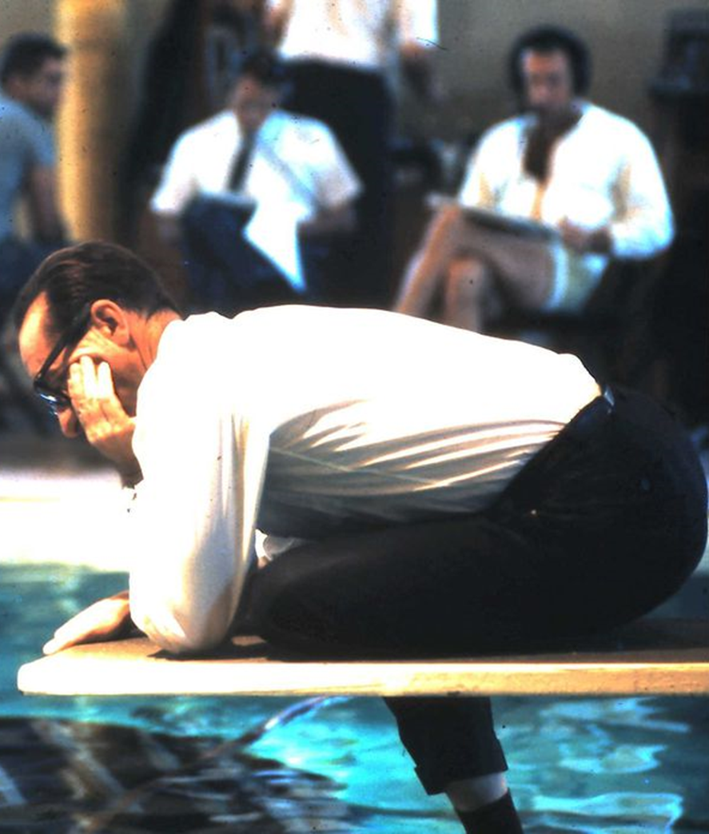

Slide 18
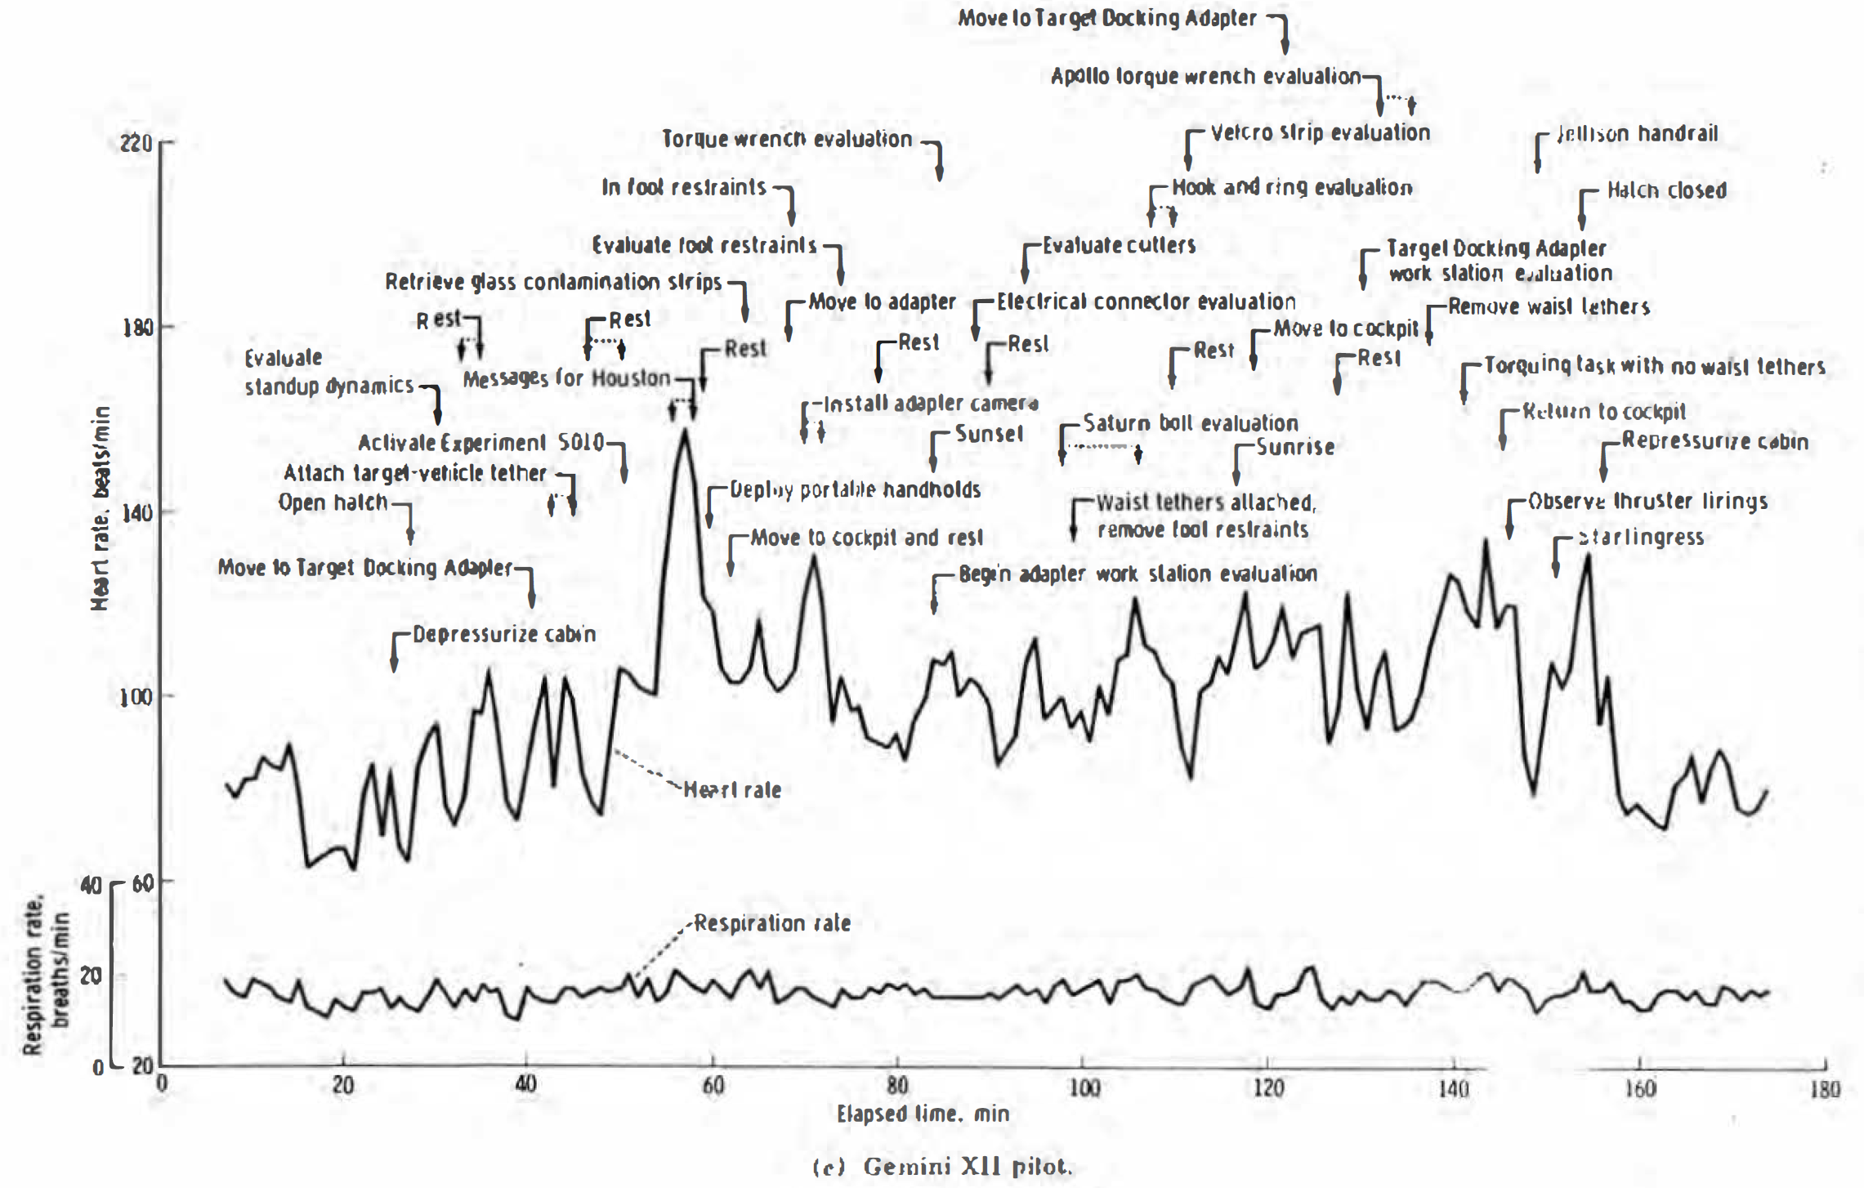

Slide 19
Gemini Accomplishments
Long duration flight
Rendezvous and docking
EVA
Precision landing
Tethered stationkeeping
Flight experience
Mission operations experience
Training experience
Launch operations experience
Responsive planning experience
Hardware maturation

Slide 20
Discussion Groups
Portree (“Spacewalks that Never Were: The Gemini EVA Planning Group”)
  The original plans for Gemini EVA – no plan survives first contact with reality!
Gemini Summary chapter 9 (“Body Positioning and Restraints during EVA”)
  A description of what was learned during the Gemini “EVA crisis”
Neufeld (“Practicing for Space Underwater: Inventing Neutral Buoyancy Training”)
  A nicely nuanced treatment of the development of the invention of underwater training
Gemini 12 Mission video
  An excellent documentary on the Gemini XII underwater training and the mission

