Slide 1
Astronauts
HONR 269i
To the Moon and Back: The Apollo Program

Slide 2
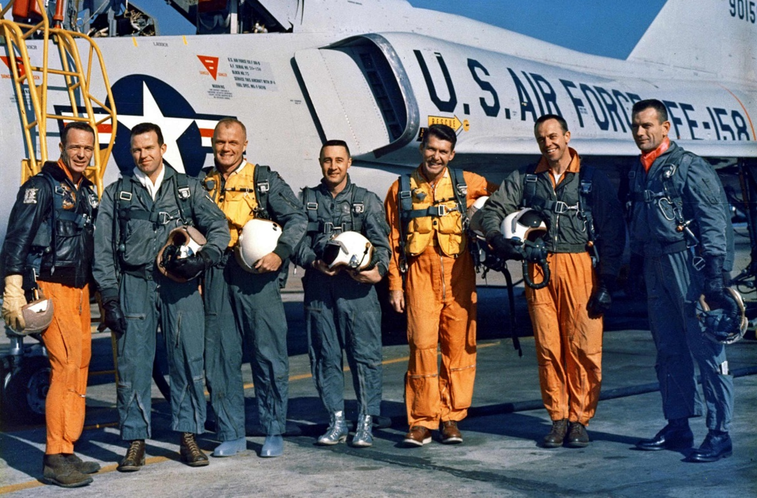
“Mercury 7” Astronaut Selection
Criteria
Age<40, Height<5’11”, Hours≥1500, Test Pilot, Jets, B.S., Active Duty
Screened 110 of 508 military test pilot records
58 Air Force, 47 Navy, 5 Marine
Interviewed 69 of those 110
16 declined, 21 were rejected (6 for height!)
Ran medical tests on the remaining 32
1 failed (Lovell)
Selected 7 of the remaining 31
2 more were selected in later rounds (Conrad, Givens)
Six flew in Project Mercury

Slide 3
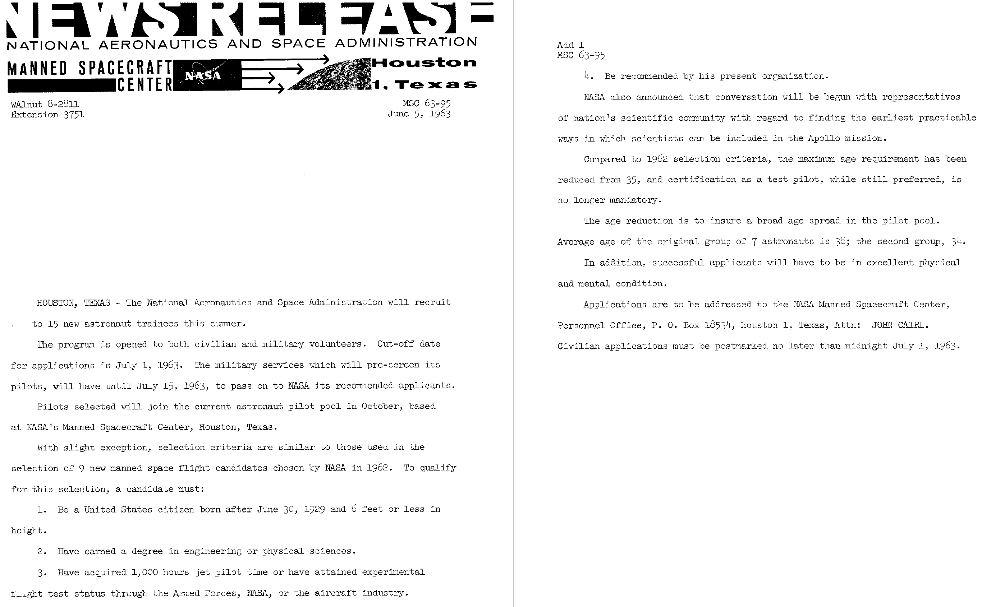
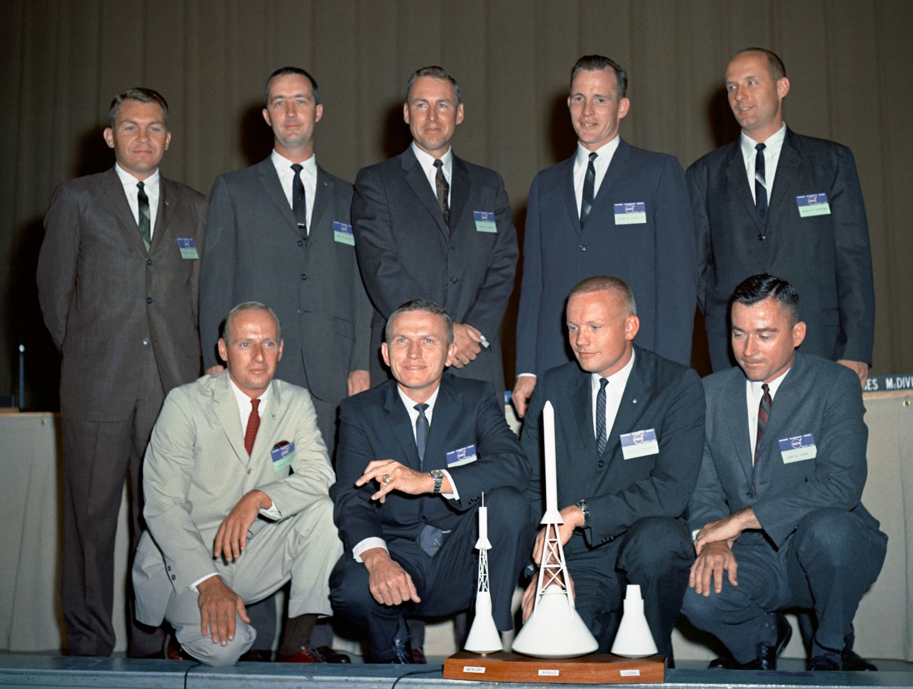
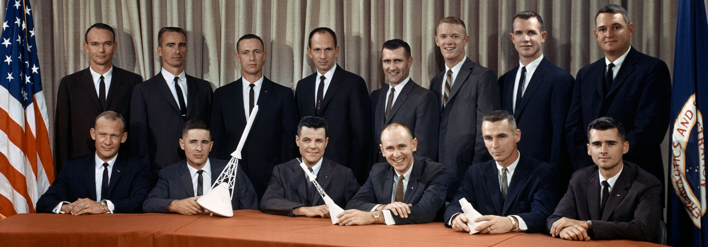

Slide 4
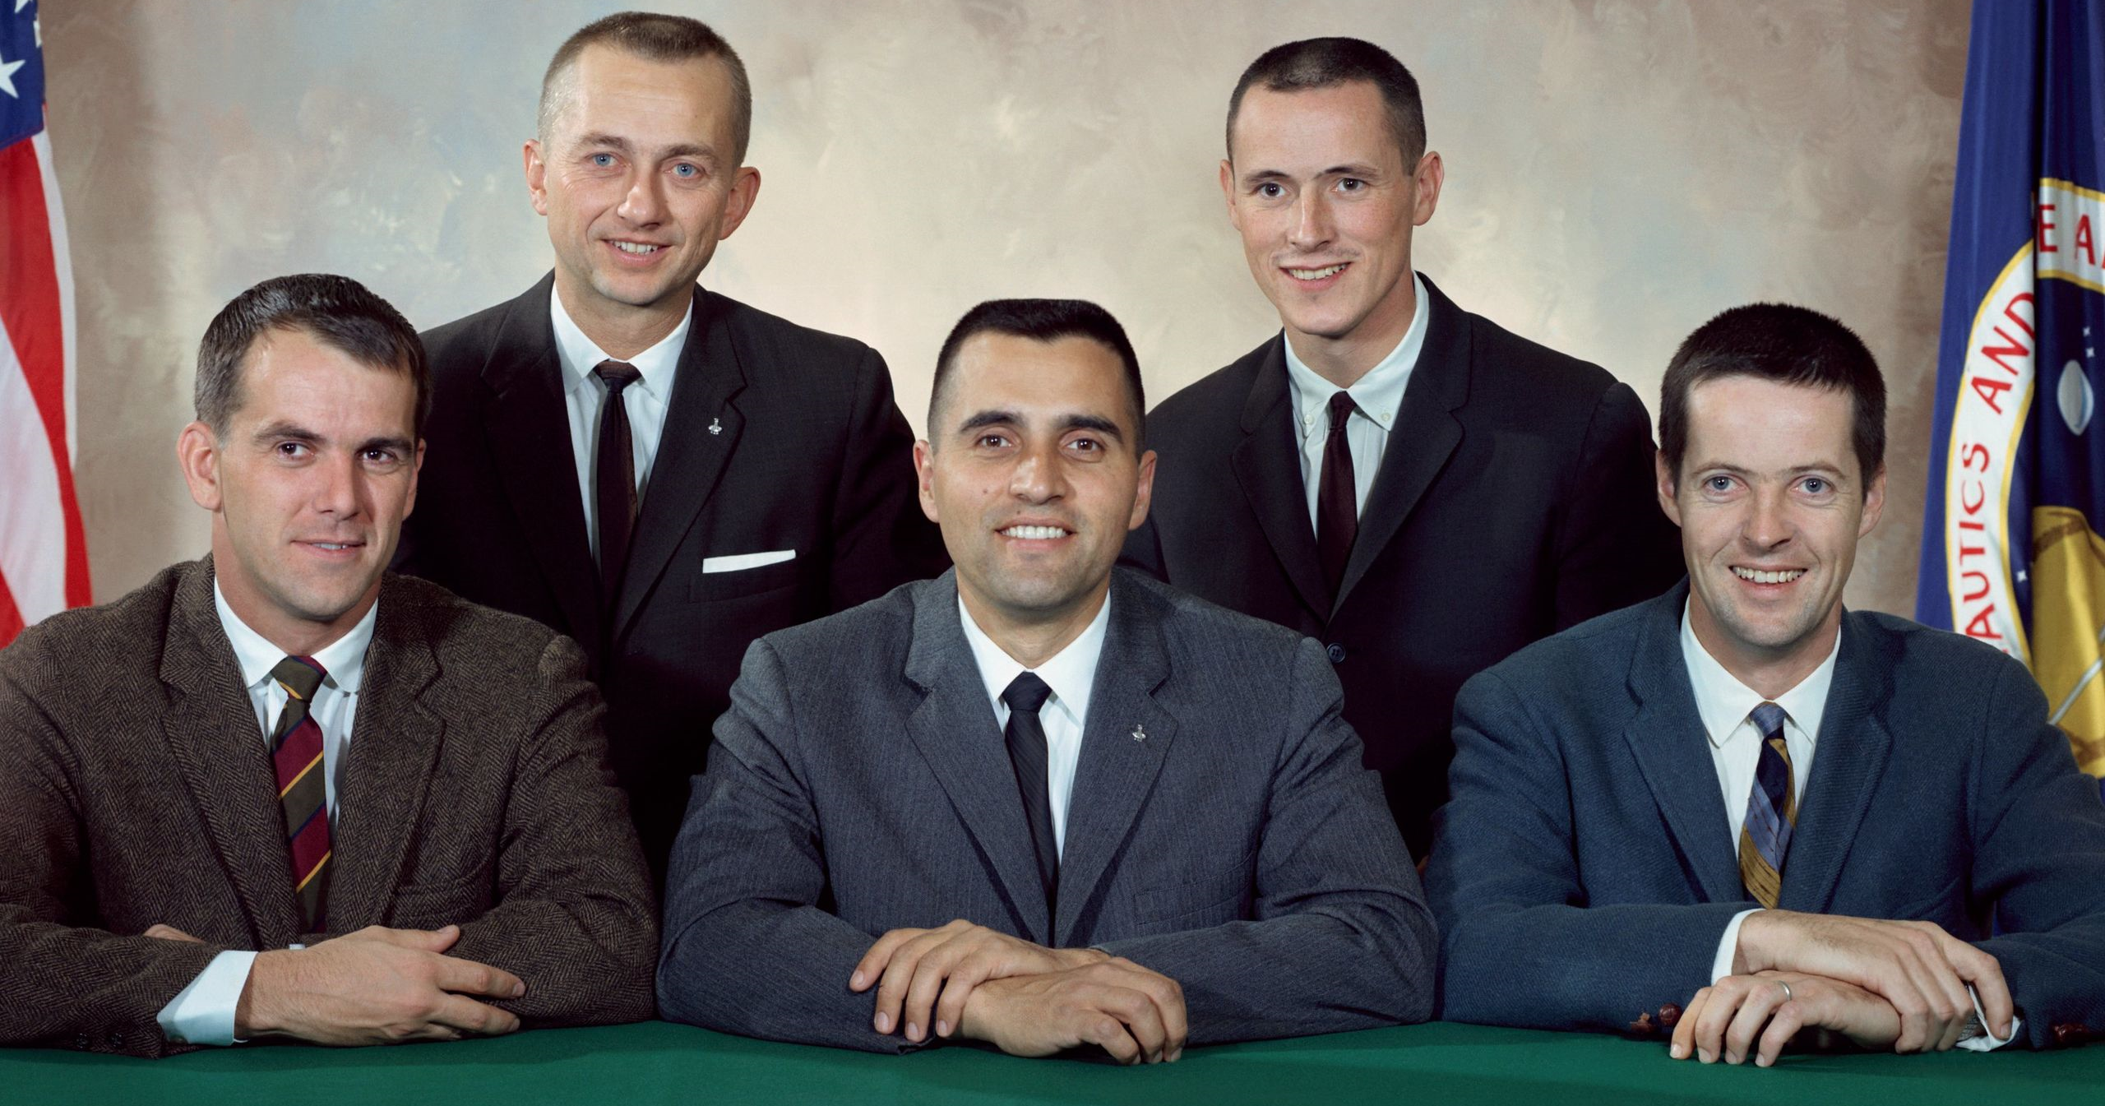

Slide 5
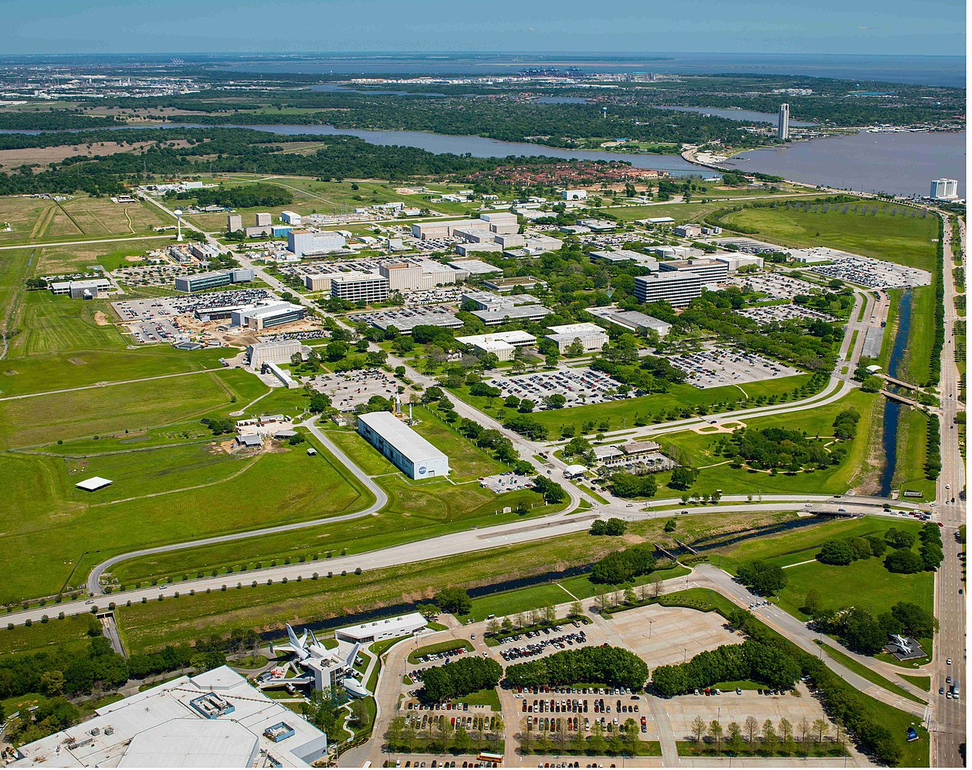
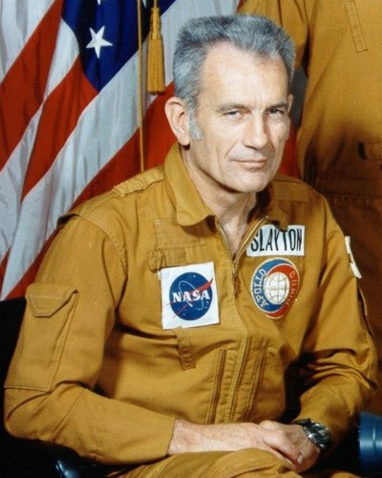
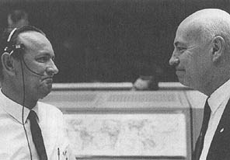
Houston
Manned Spacecraft Center: Bob Gilruth
Flight Crew Operations: Deke Slayton
Astronaut Office: Alan Sheppard
Flight Crew Support
Aircraft Operations
Flight Operations: Chris Kraft
Mission Control

Slide 6
The Rotation
Astronaut Candidate Training
Orbital mechanics, Spacecraft systems, Survival, Geology, …
CAPCOM, (Apollo) Support Crew
Support crew: Spacecraft tests, Logistics, Protocol, …
Backup Crew
Train to fly the mission (individually or as a crew)
Prime Crew (3 flights later)
Fly the mission

Slide 7
Group 1 (7): “Mercury 7”
Mercury (6), Gemini (3), Apollo (1), ASTP (1), Shuttle (1)
Group 2 (9):
Gemini (8), Apollo (8), Skylab (1), ASTP (1), Shuttle (1)
Group 3 (14):
Gemini (5), Apollo (10), Skylab (1)
Group 4 (6): Scientists
Apollo (1), Skylab (3)
Group 5 (19)
Apollo (9), Skylab (4), ASTP (1), Shuttle (7)
Group 6 (11): Scientists
Shuttle (7)
Group 7 (7): MOL Transfer
Shuttle (7)

Slide 11
Discussion Groups
Chaikin Chapter 2 (“The Office”)
The culture of the Astronaut Office at Houston
Slayton Chapter 14 (“Flight Crew Operations”)
How the early Gemini astronauts got selected for a flight
Collins Chapter 3
Brief profiles of the first 30 astronauts by the best writer among them
Moon Shot video
An astronaut-centered documentary (based on Sheppard’s book)

