Slide 1
Management of the
Soviet Space Program
HONR 269i
To the Moon and Back: The Apollo Program
First Orbit

Slide 2
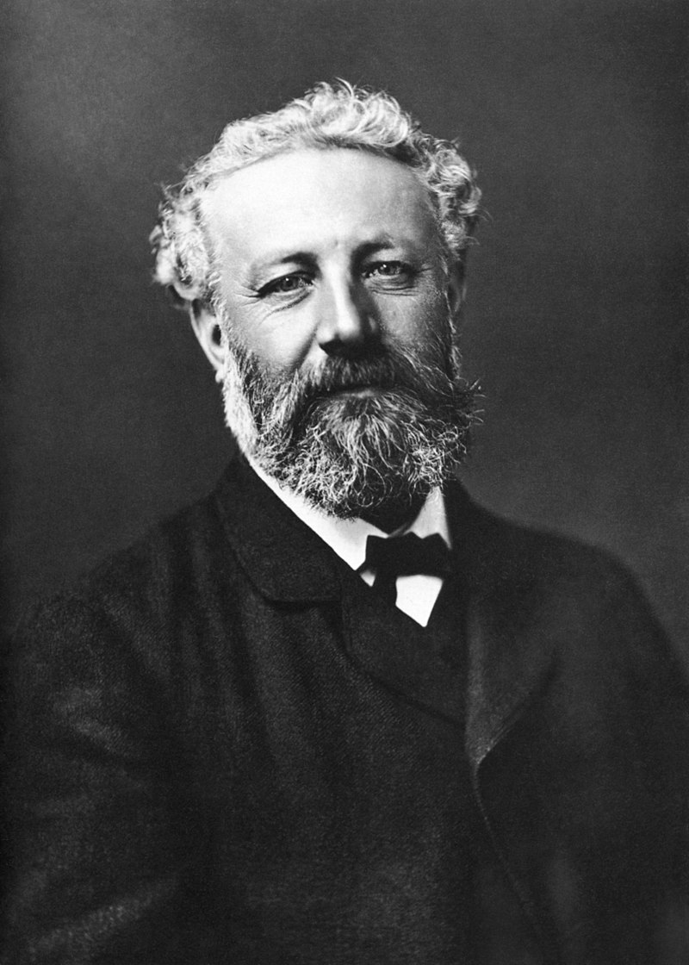
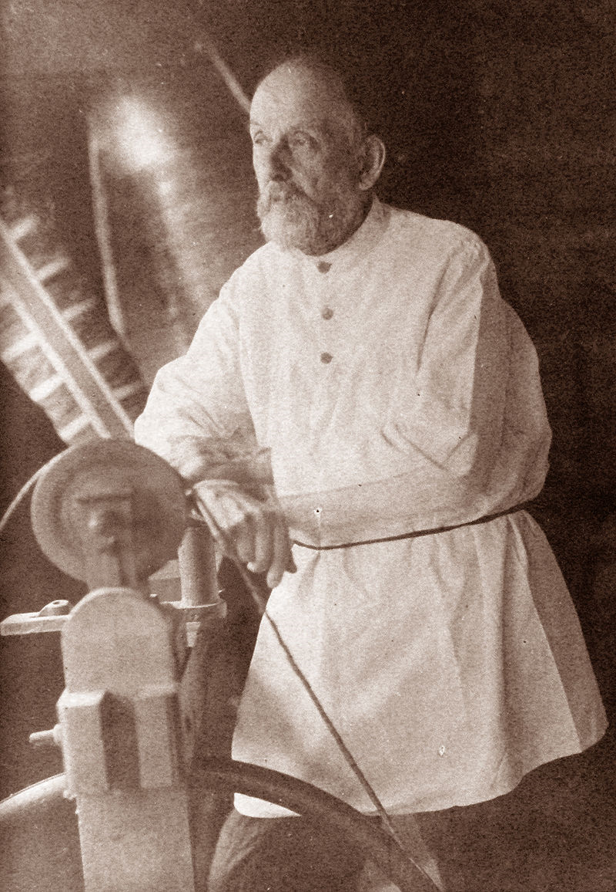
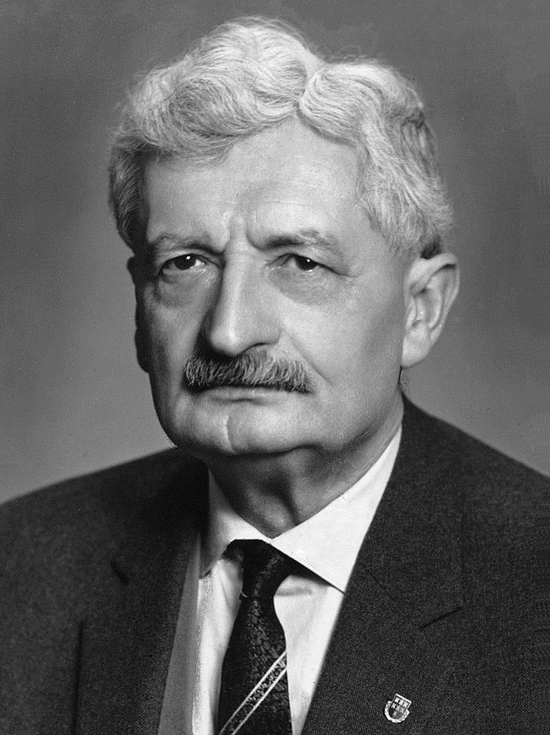
Konstantin Tsiokovsky
(1857-1935)
Jules Verne
(1828-1905)
Hermann Oberth
(1894-1989)

Slide 3
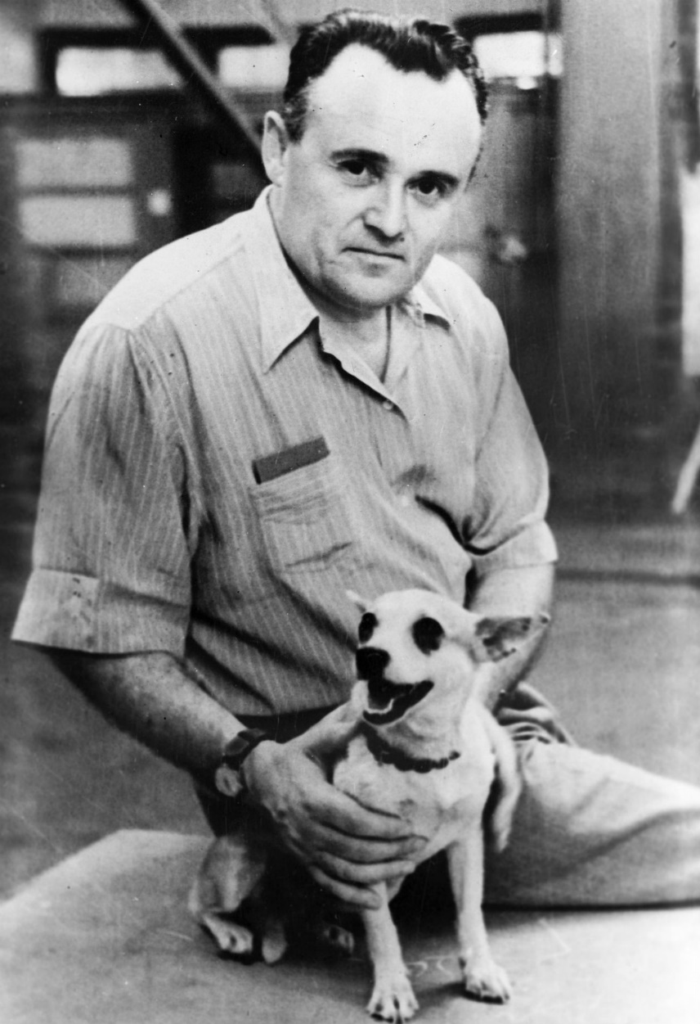
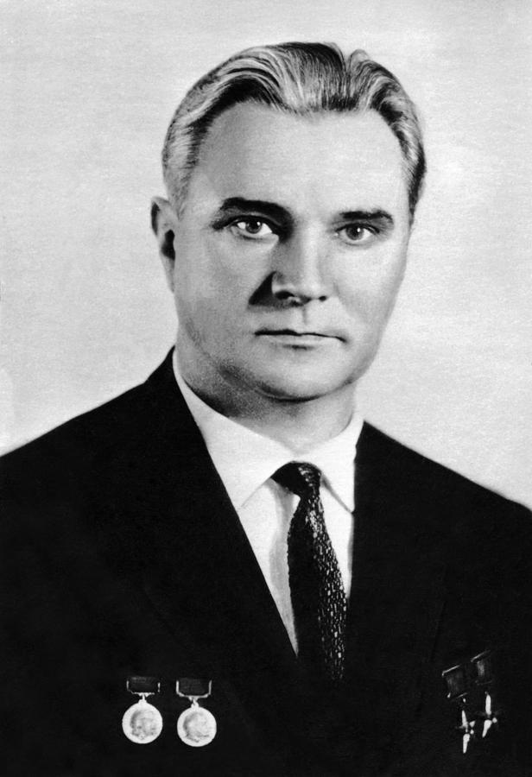
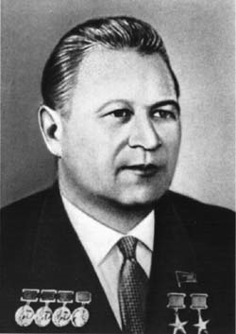
(R7, N1, Vostok, Voskhod, Soyuz, LK)
Sergei Korolev
(Engines)
Valentin Glushko
(UR 500)
Vladimir Chelomey

Slide 4
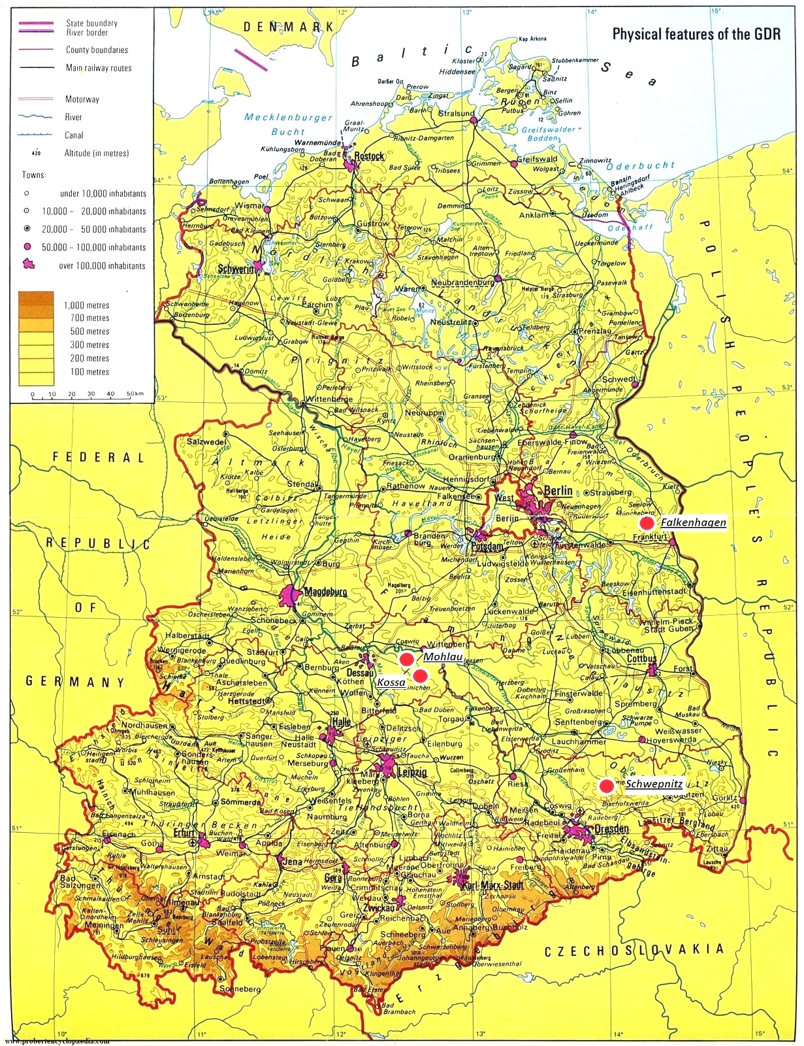
Peenemünde
Mittelwerk

Slide 5
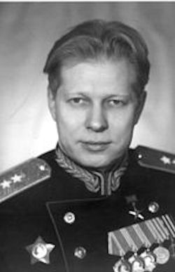
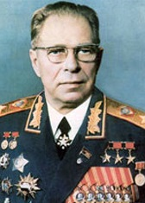
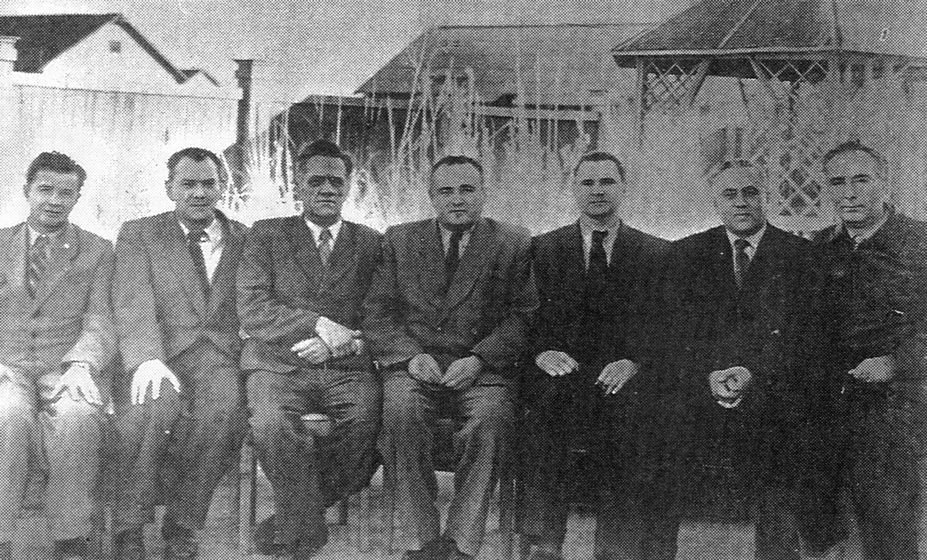
Learning Russian
(Minister of Defense) MO
(Military-Industrial Commission) VPK: Dmitry Ustinov
(Strategic Rocket Forces) RVSN: Mitrofan Nedelin
(State Committee for Defense Technology) GKOT
(Scientific Research Institute) NII-88
Council of Chief Designers
(Experimental Design Bureau) OKB-1: Sergey Korolev
(Experimental Design Bureau) OKB-456: Valentin Glushko
(Experimental Design Bureau) OKB-52: Vladimir Chelomey
(Cosmonaut Training Center) TsPK: Yevgeny Karpov

Slide 6
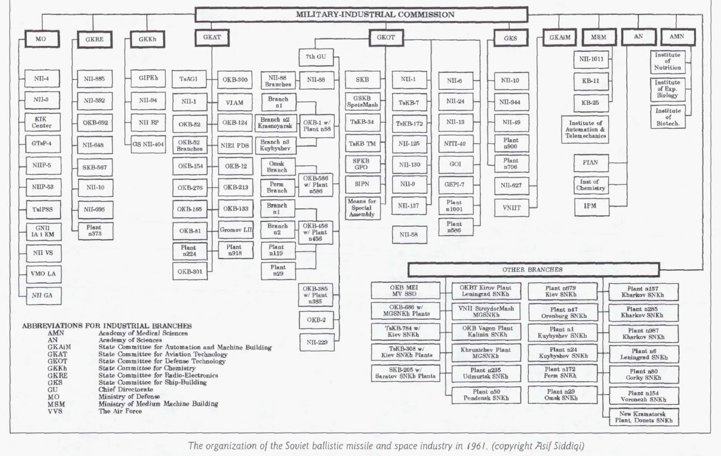
KOROLEV
CHELOMEY
GLUSHKO

Slide 7
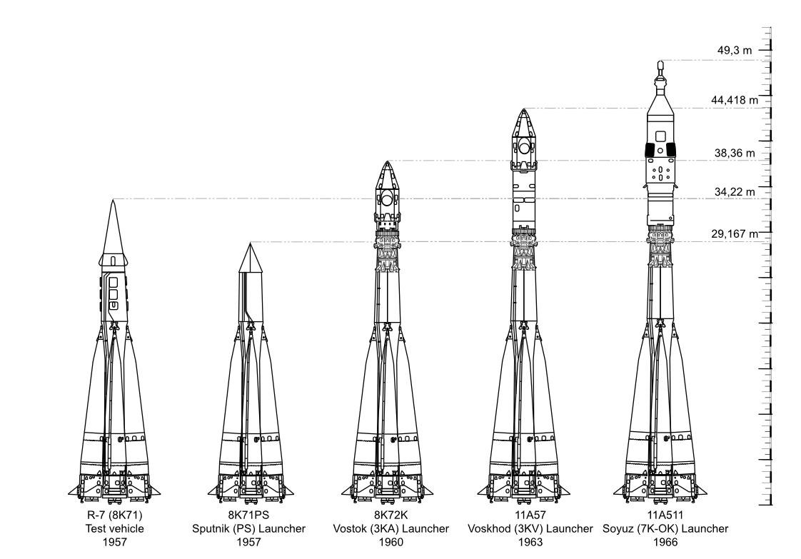

Slide 8
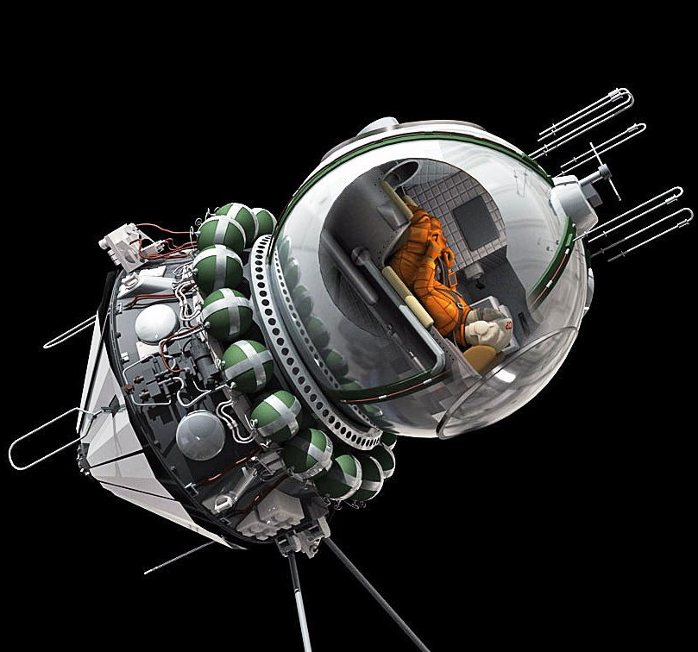
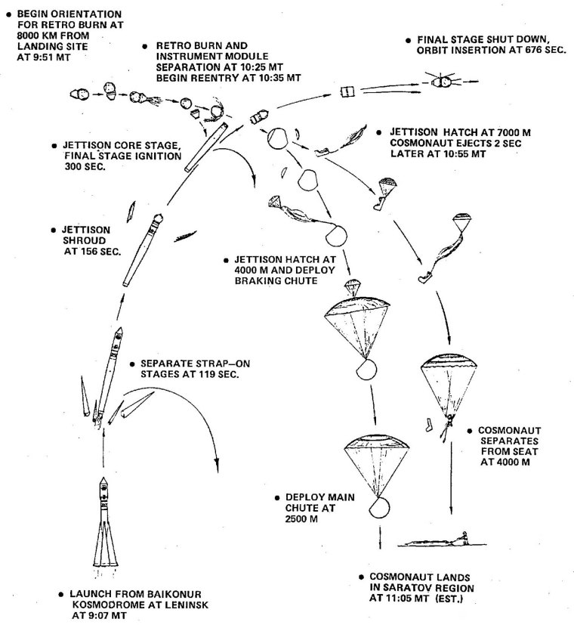

Slide 9
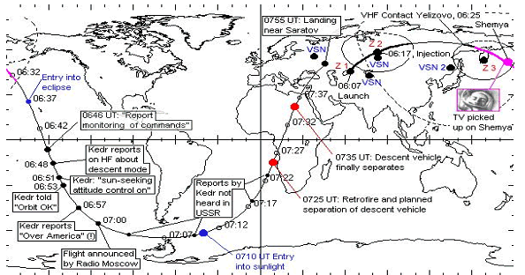
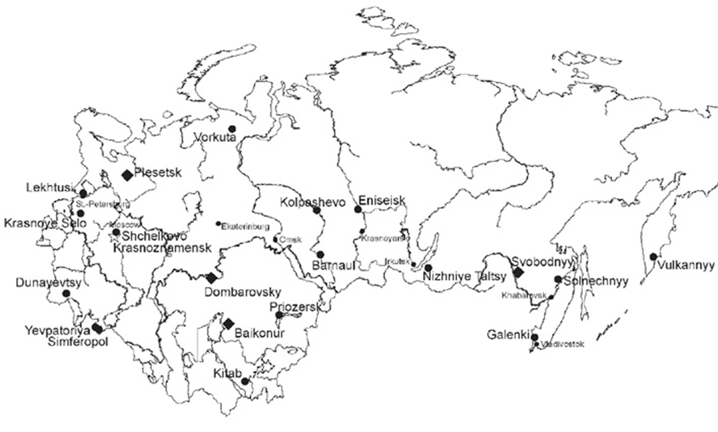
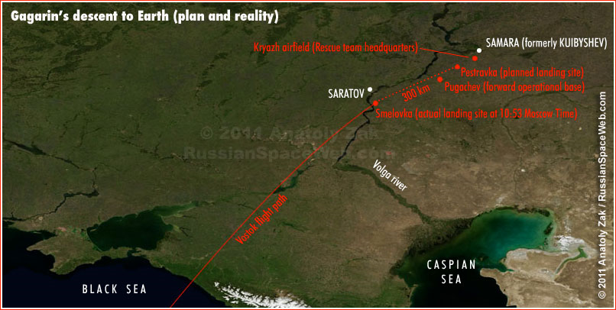
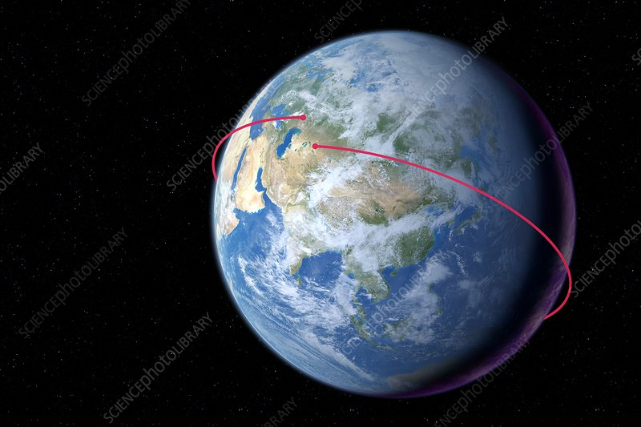
Vostok 1

Slide 10
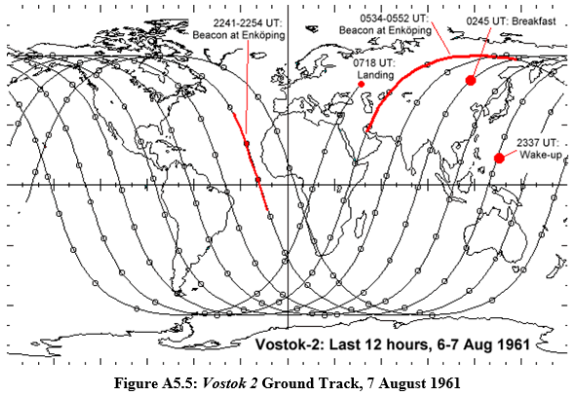
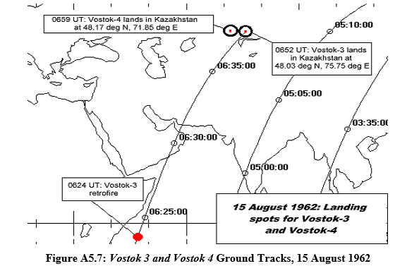
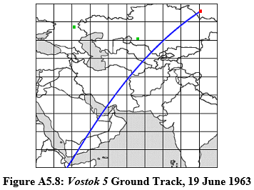
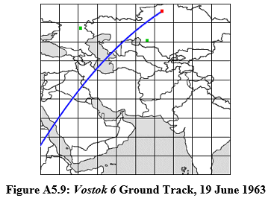

Slide 11
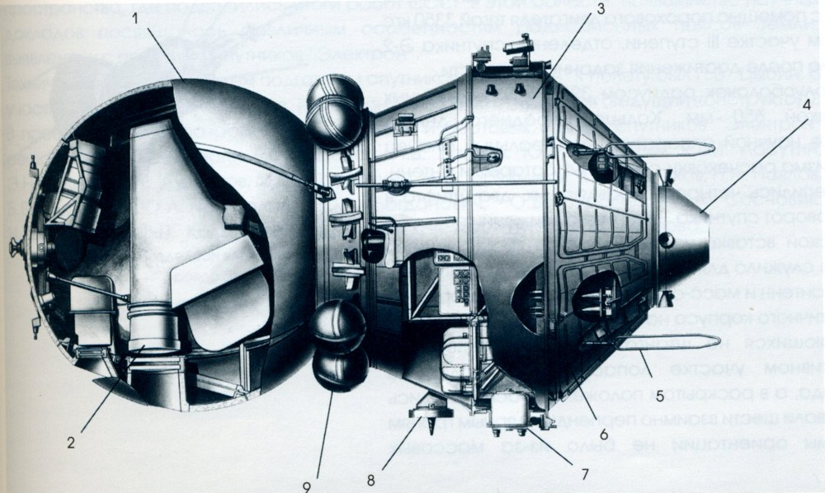
Zenit-2 Series Reconissaince Satellites (Object OD-2)

Slide 12
Timeline
Vostok 1: Yuri Gagaran, 2 hours (April 1961)
Vostok 2: Gherman Titov, 25 hours (August 1961)
  Mercury-Atlas 6: John Glenn, 5 hours (February 1962) [+STS-95]
  Mercury-Atlas 7: Scott Carpenter, 5 hours (May 1962)
Vostok 3: Andriyan Nikolayev, 94 hours (August 1962)
Vostok 4: Pavel Popovich, 71 hours (August 1962) [+Soyuz 14]
  Mercury-Atlas 8: Wally Schirra, 9 hours (October, 1962) [+Gemini 6, Apollo 7]
  Mercury-Atlas 9: Gordon Cooper, 34 hours (May, 1963) [+Gemini 5]
Vostok 5: Valery Bykovsky, 119 hours (June 1963)
Vostok 6: Valentina Tereshkova, 71 hours (June 1963)

Slide 13
Discussion Groups
Chertok Volume 2 Chapter 9 (“Managers and Colleagues”)
  An insider’s view of the time when OKB-1 split off from NII-88
Siddiqi Chapter 6 (“Organizing for the Space Program”)
  How the management structure above OBK-1 evolved
First Orbit video
  The story of Vostok 1
Siddiqi Chapter 9 (“Space Politics”)
  The rise of Chelomey

Slide 14
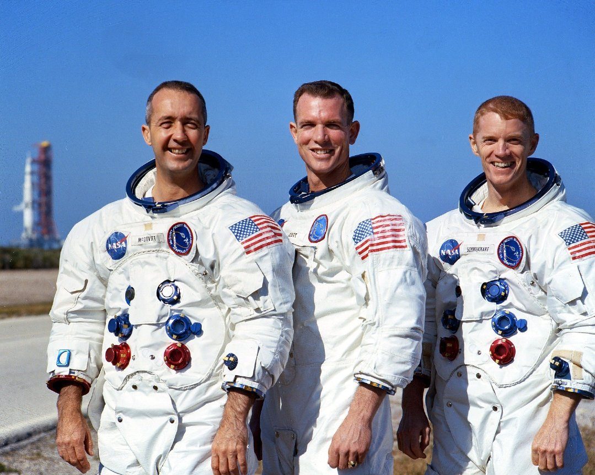
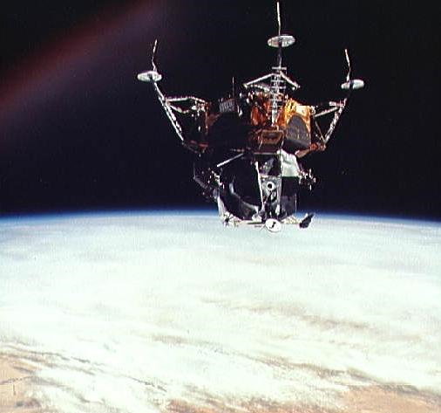
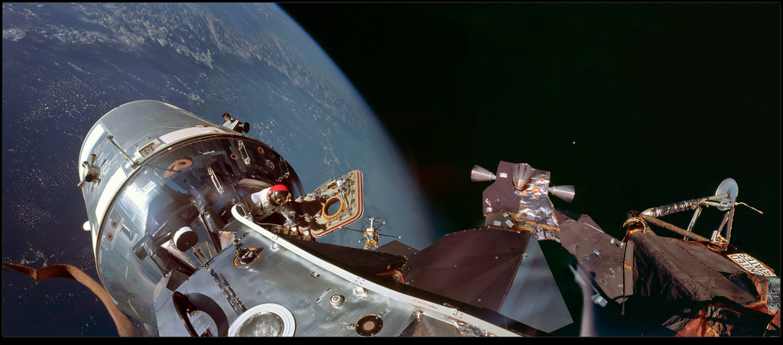
Apollo
9

Slide 15
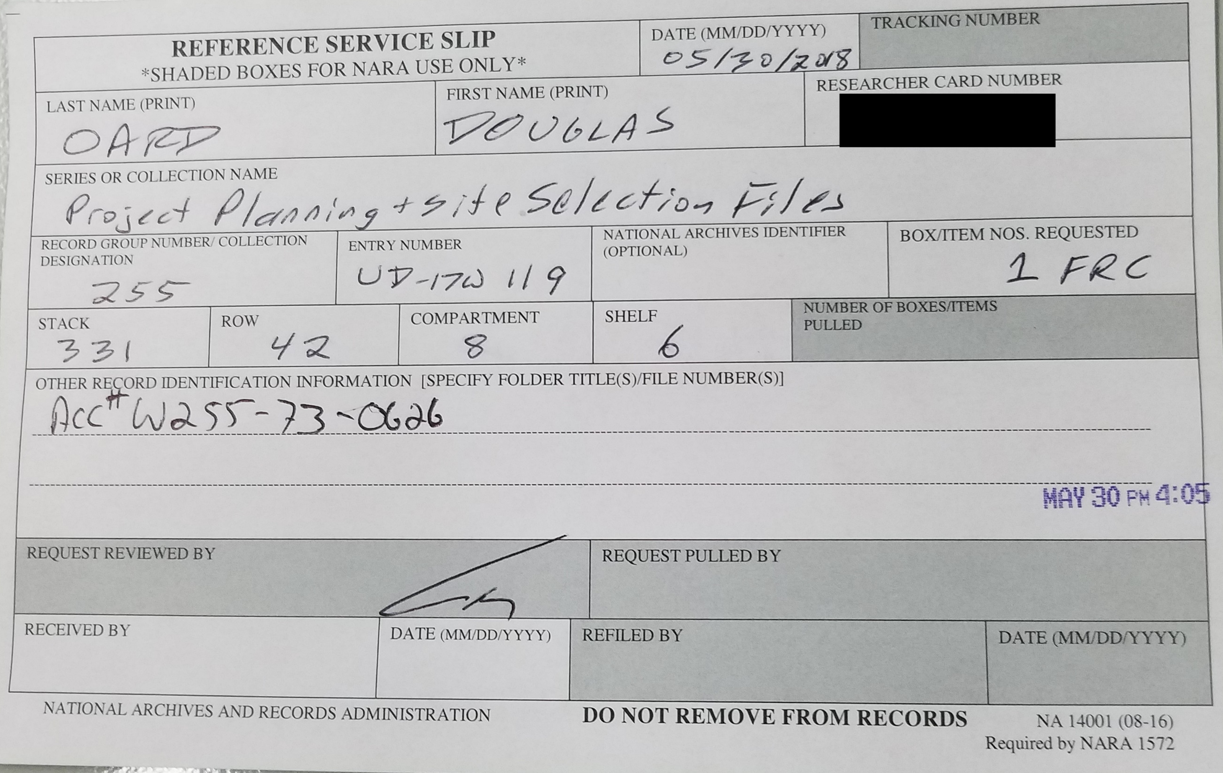

Slide 16
Case Study Comments
Accuracy
Compliance with instructions
  Single-spaced, length
Citations
  Missing, bracketed superscript, author but no year
Grammar

