Slide 1
To the Moon and Back: The Apollo Program
HONR 269i
Lecture 1: Apollo in 60 Minutes

Slide 2
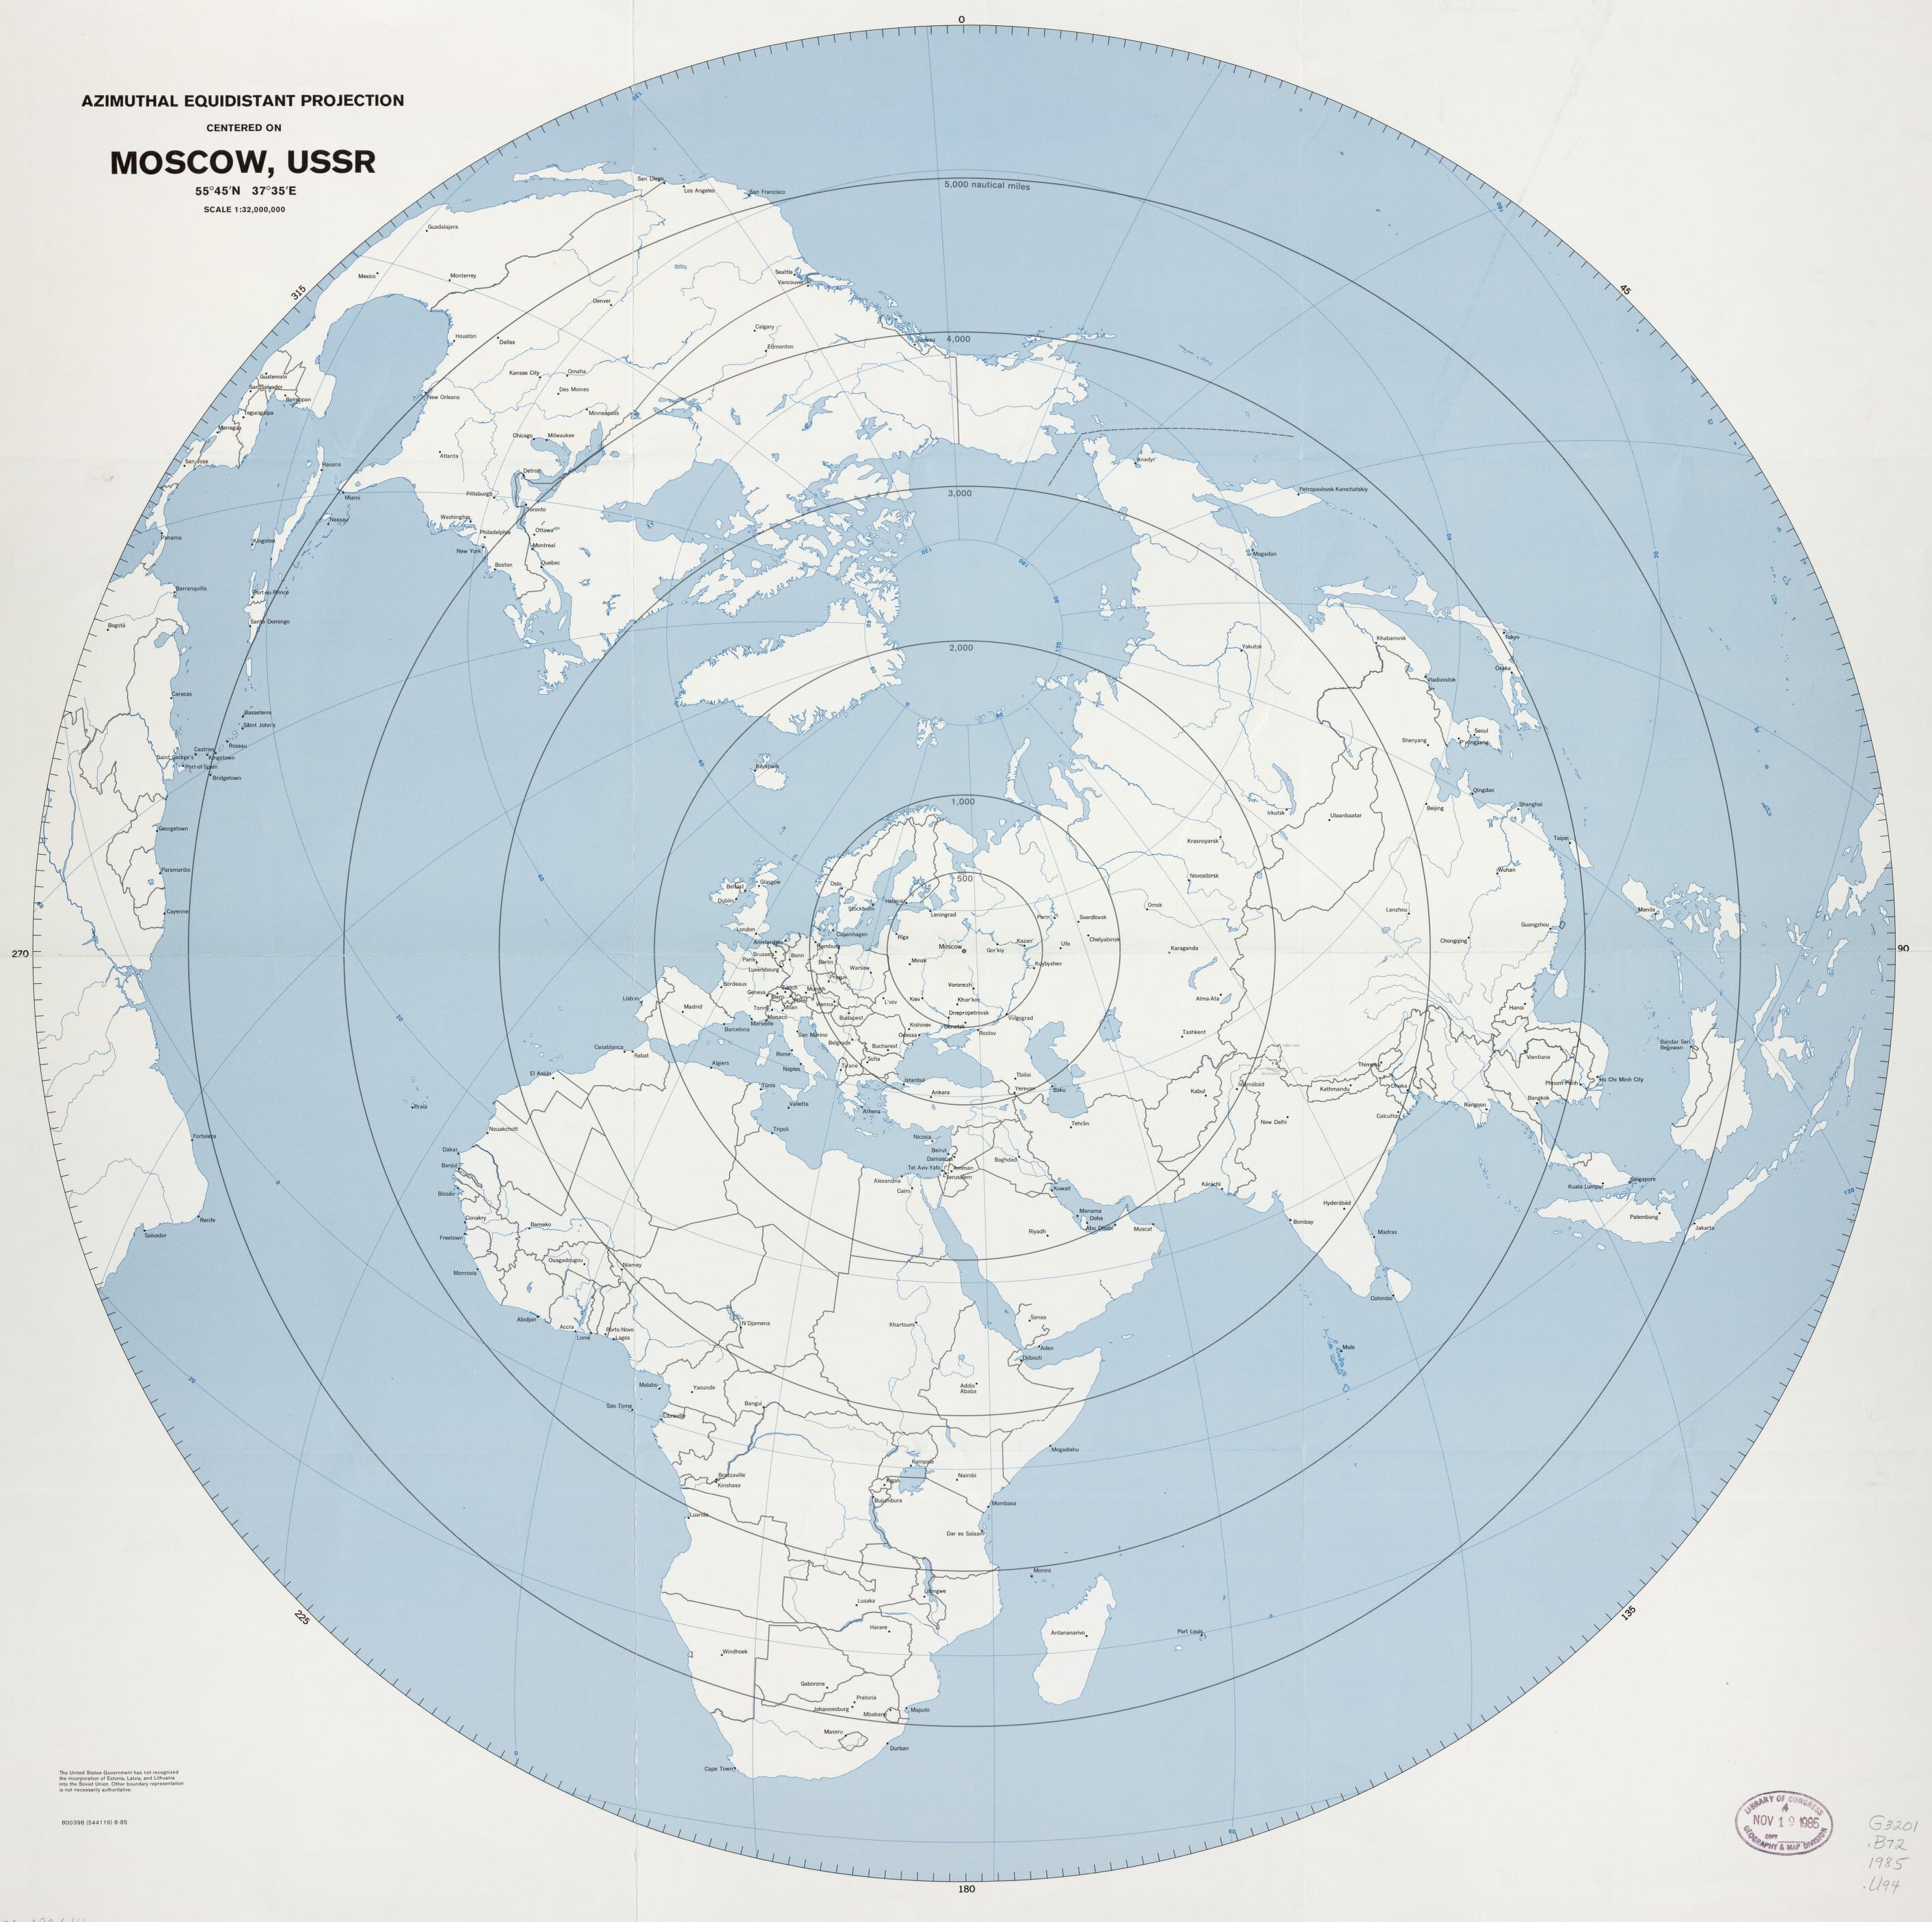
The View From Moscow

Slide 3
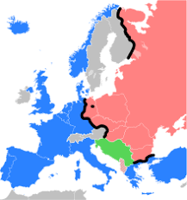
The “Cold War”

Slide 4
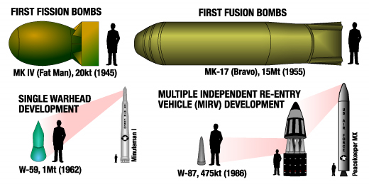
Nuclear Weapons

Slide 5
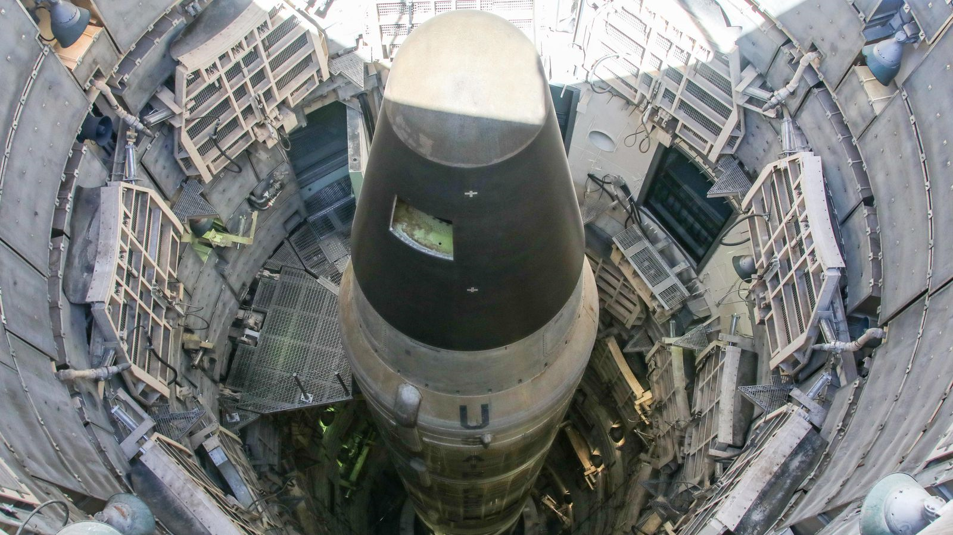
Intercontinental Ballistic Missiles

Slide 6
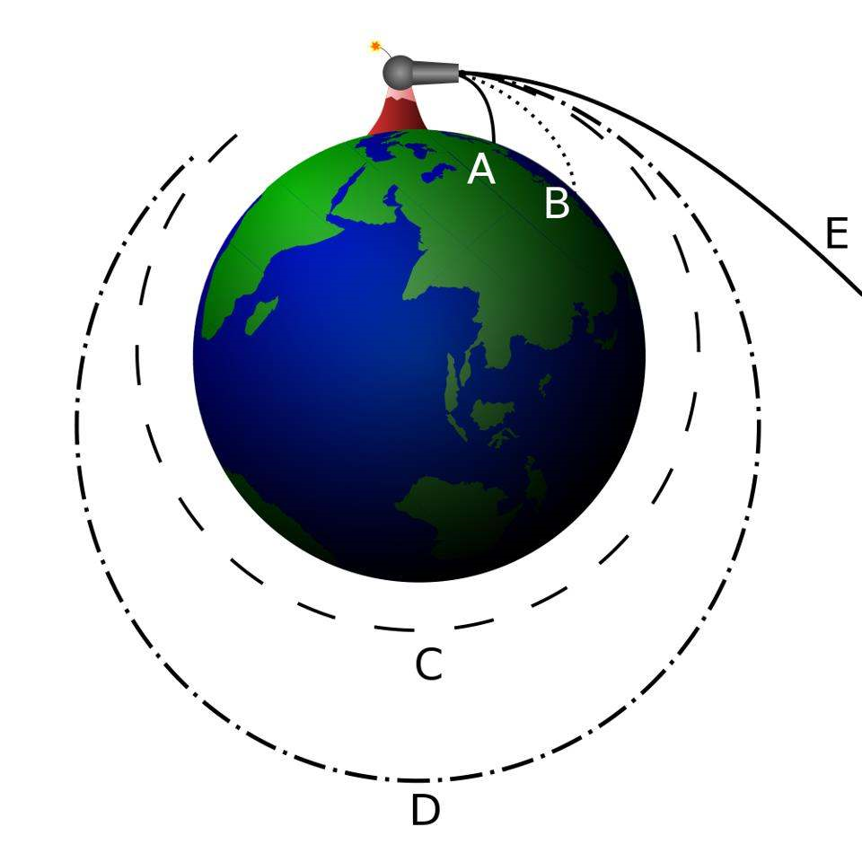
Orbital Mechanics

Slide 7
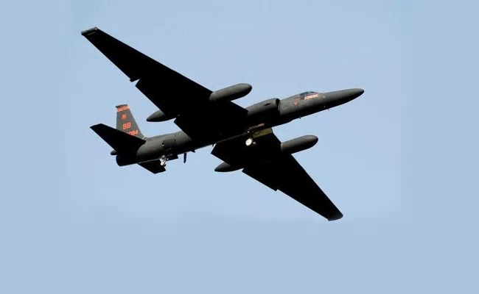
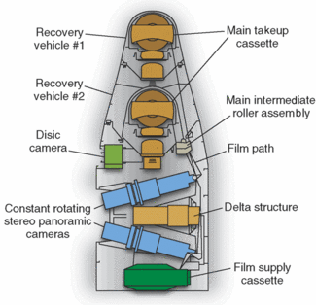
Reconnaissance

Slide 8
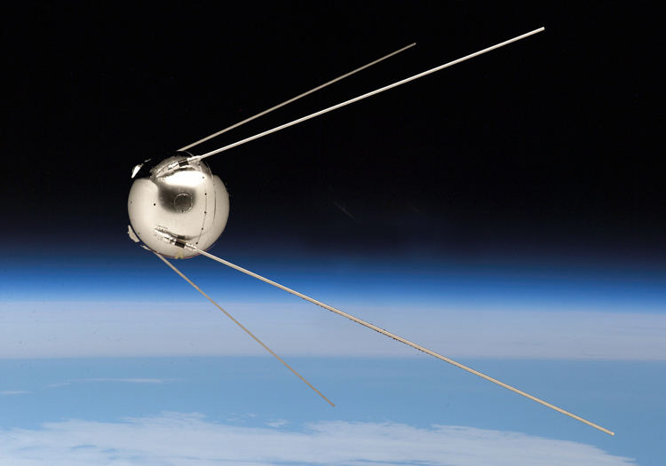
Sputnik

Slide 9
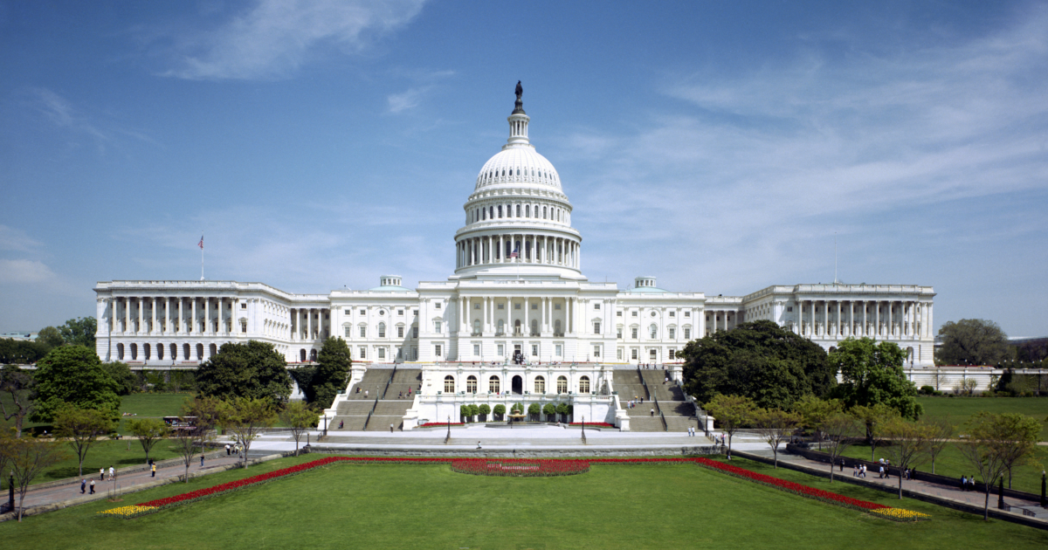
American Domestic Politics

Slide 11
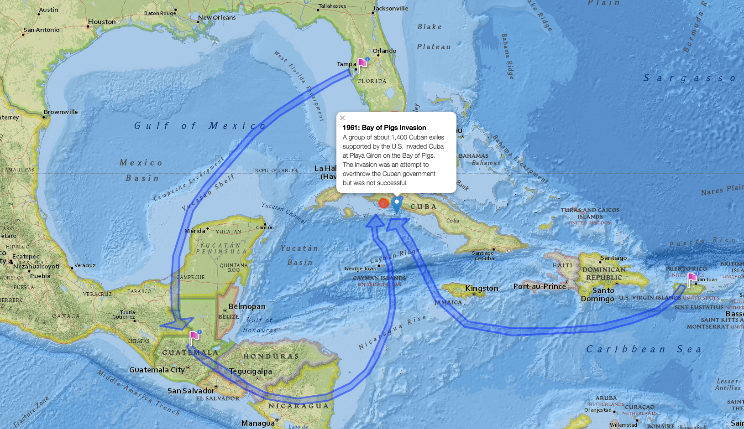

Slide 12
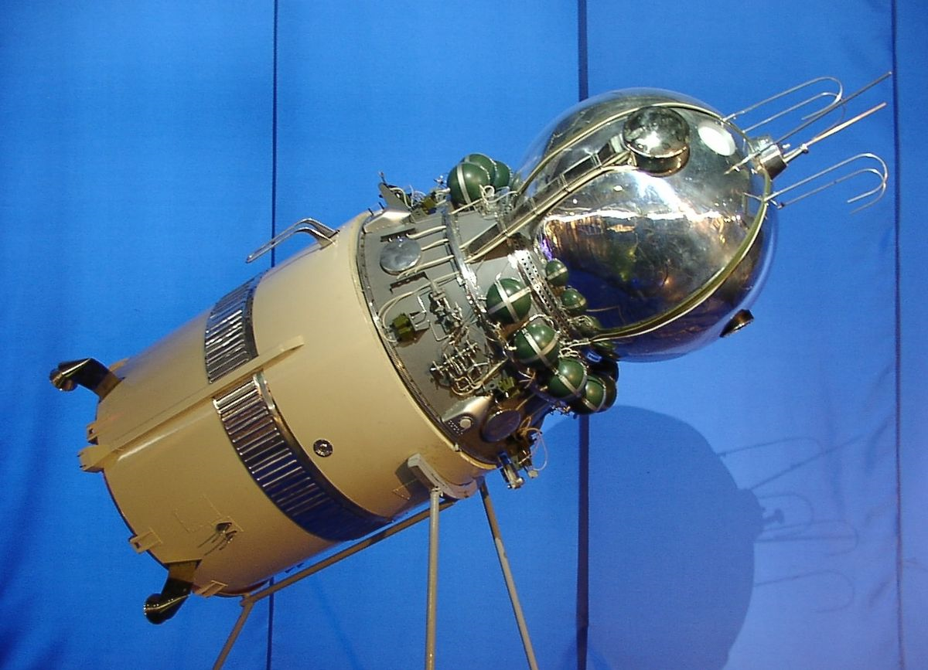
Vostok

Slide 13
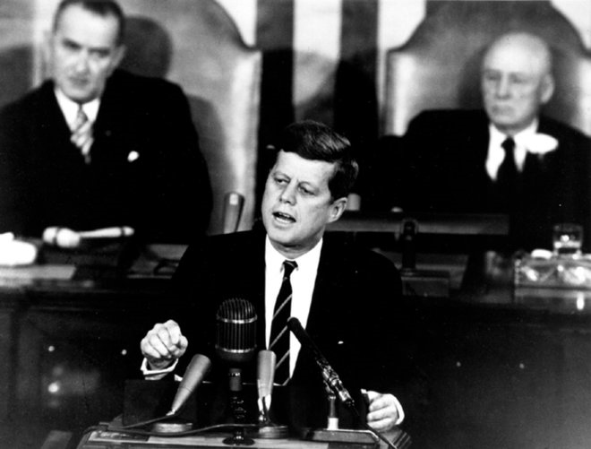
The Apollo Decision

Slide 14
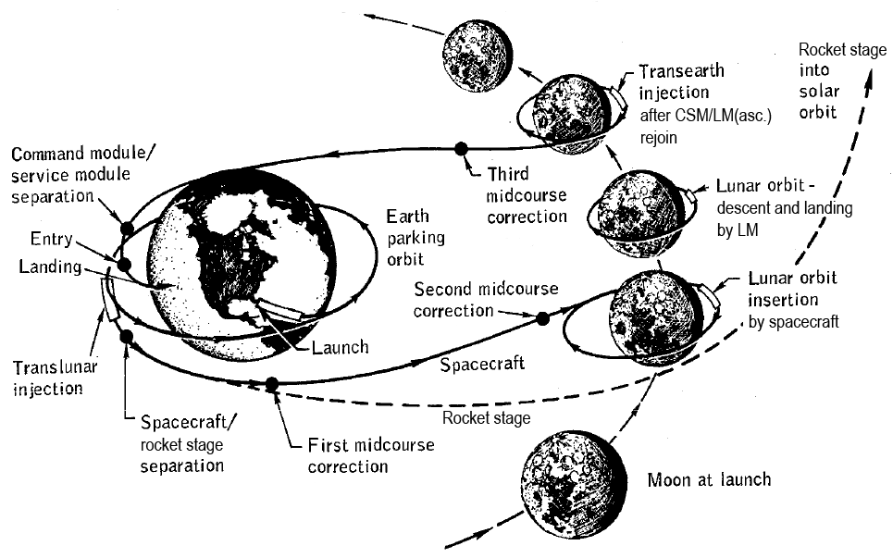
Lunar Orbit Rendezvous

Slide 15
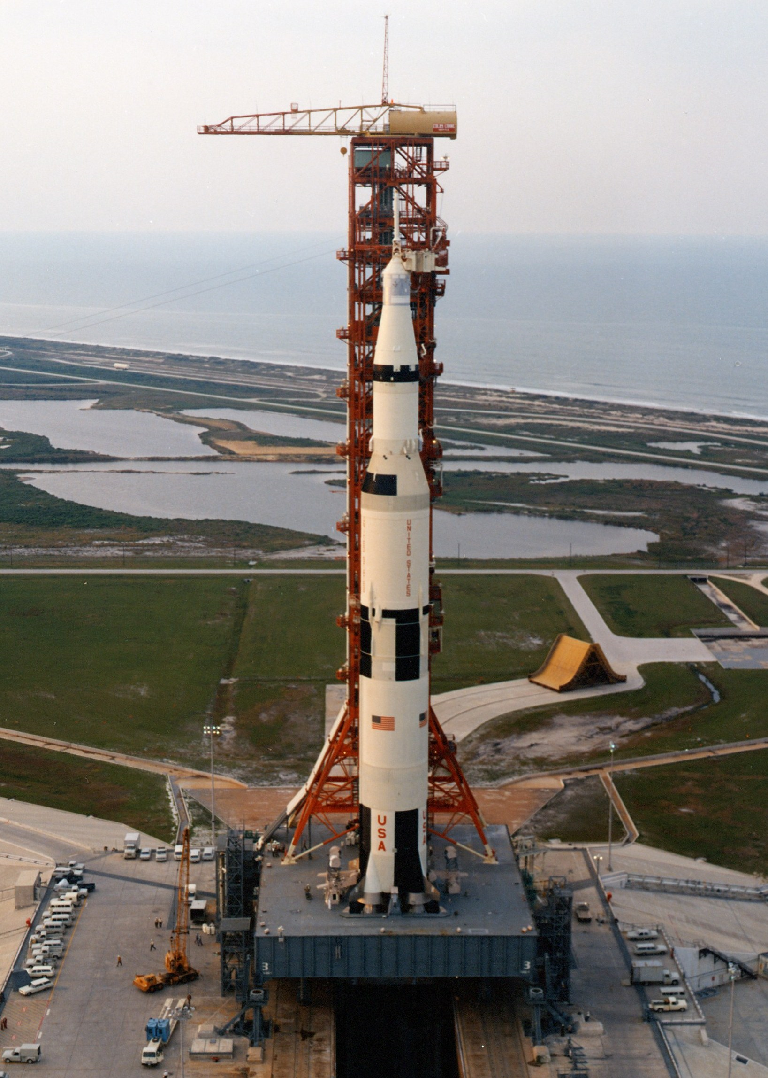
The Saturn V Rocket

Slide 16
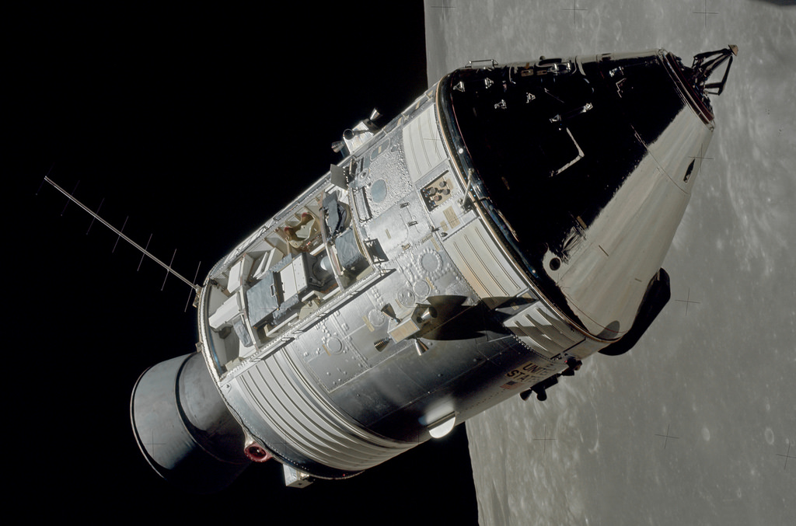
The Apollo Command and Service Modules

Slide 17
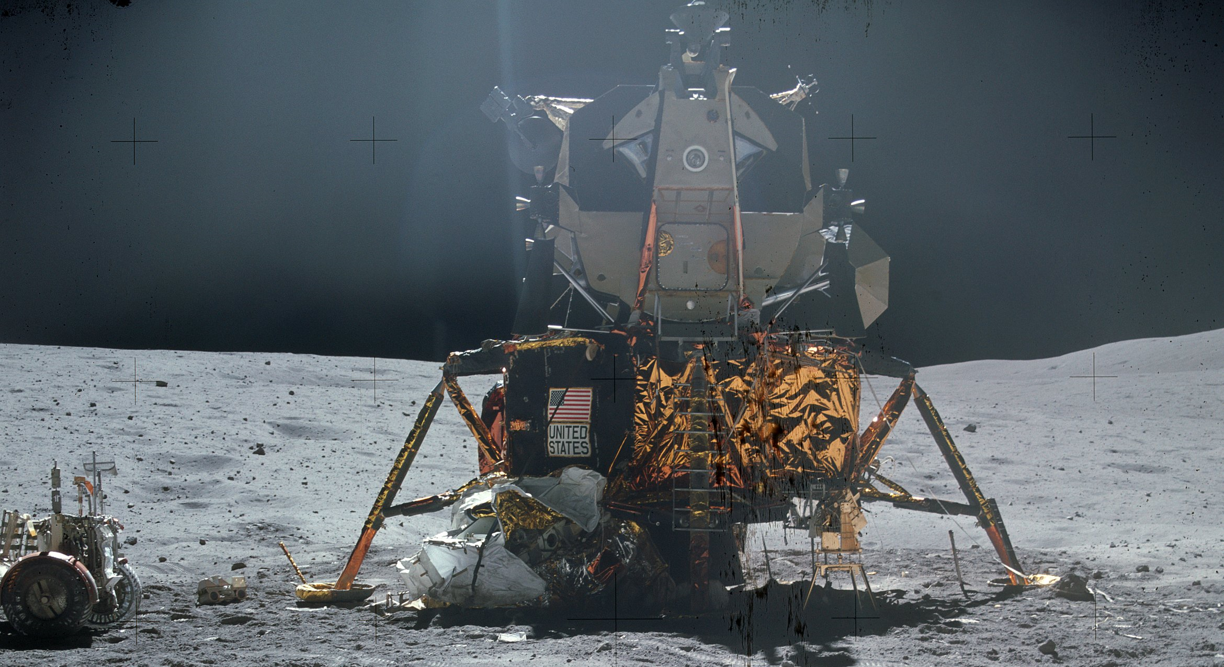
The Lunar Module

Slide 18
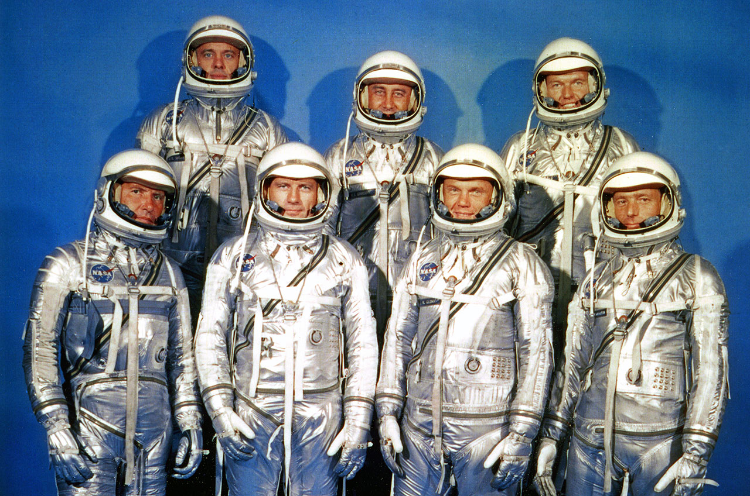
Astronauts

Slide 19
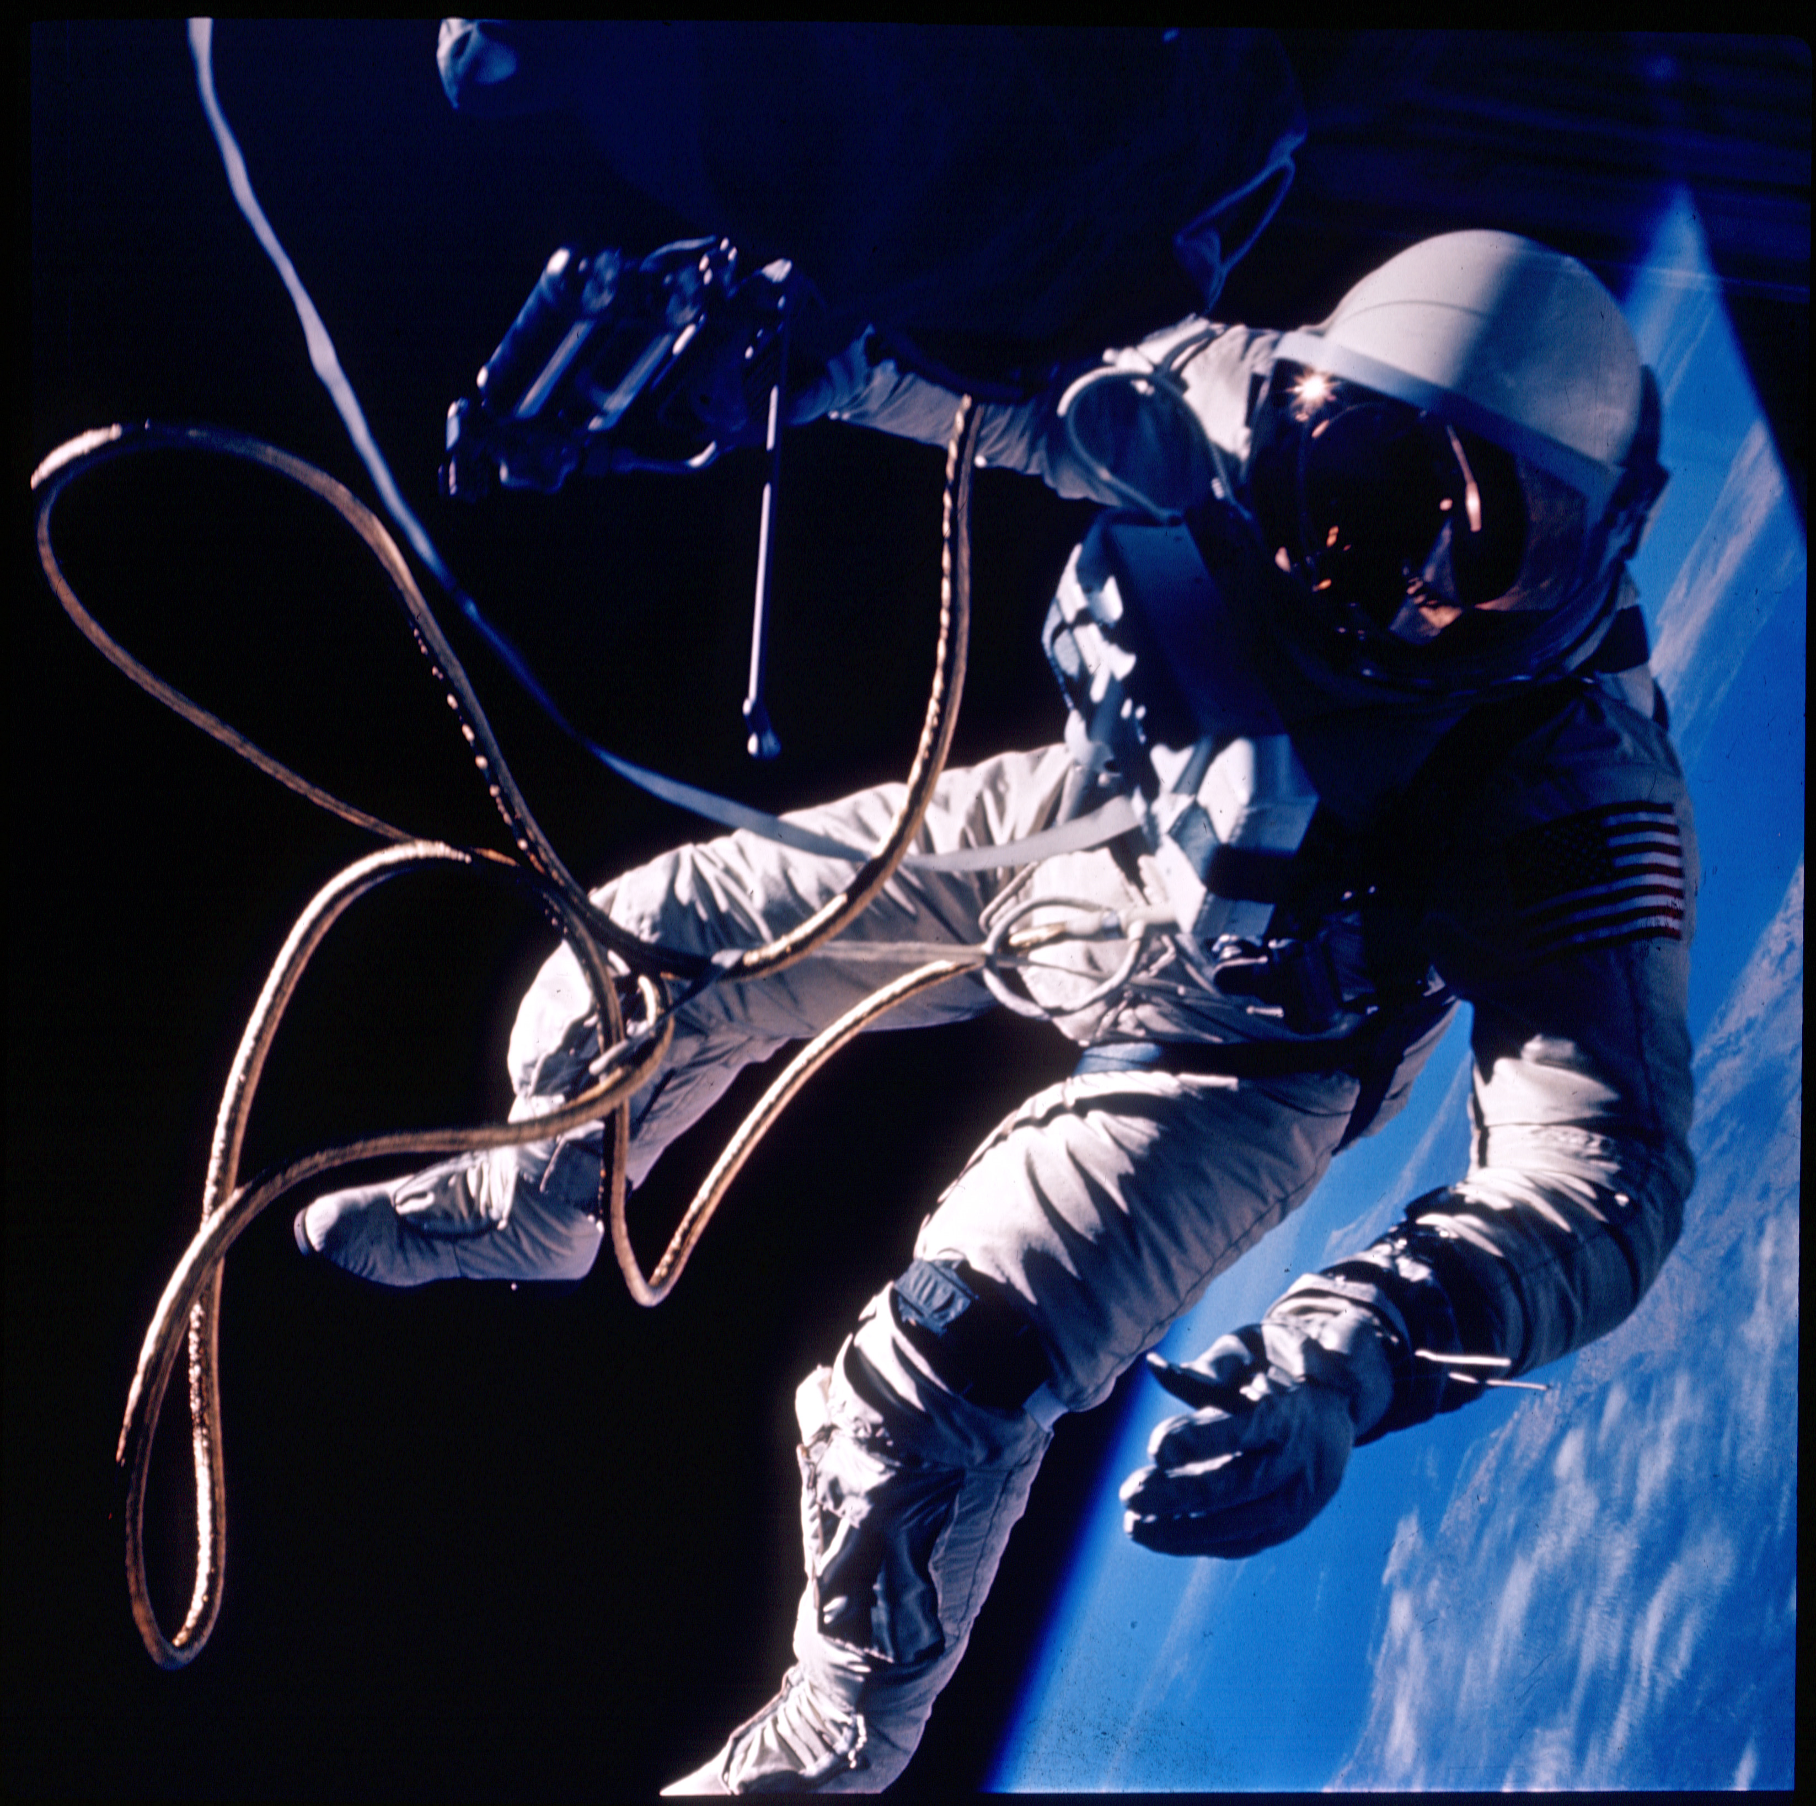
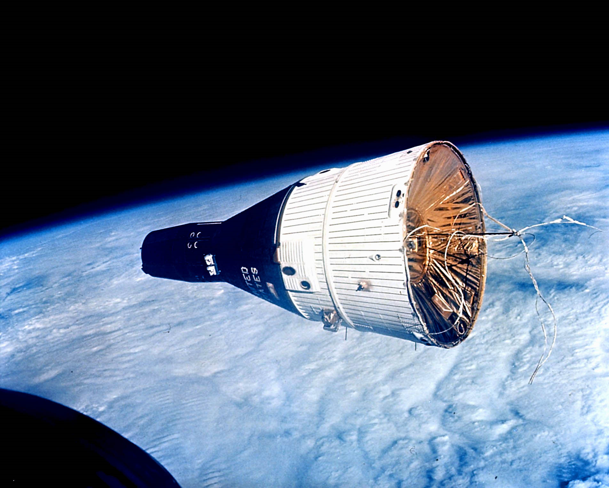
Gemini

Slide 20
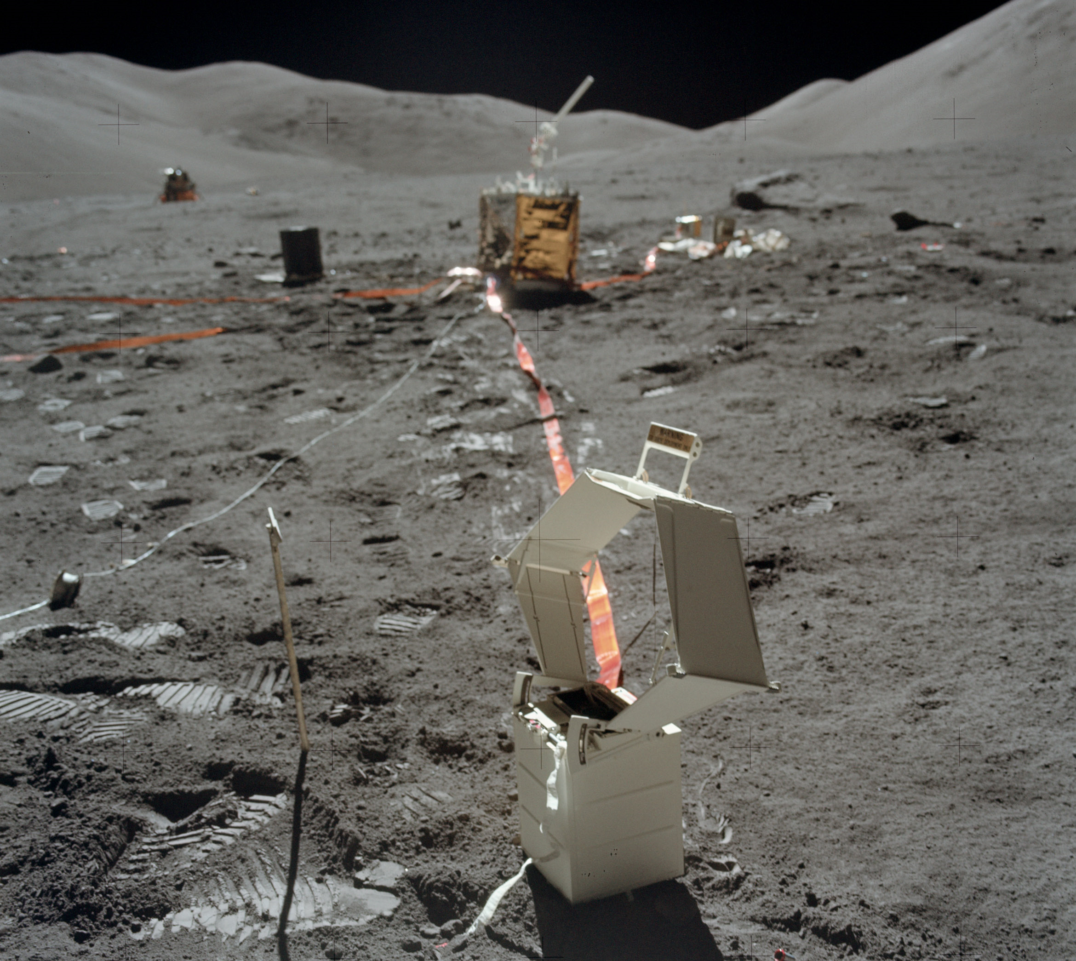
Science

Slide 21
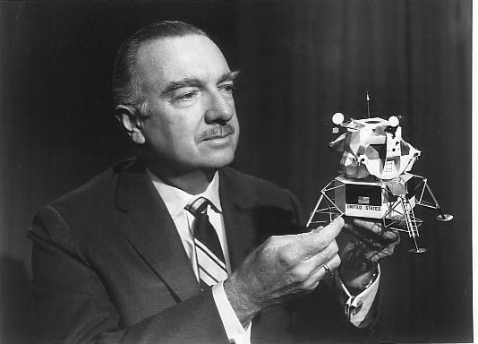
Public Relations

Slide 22
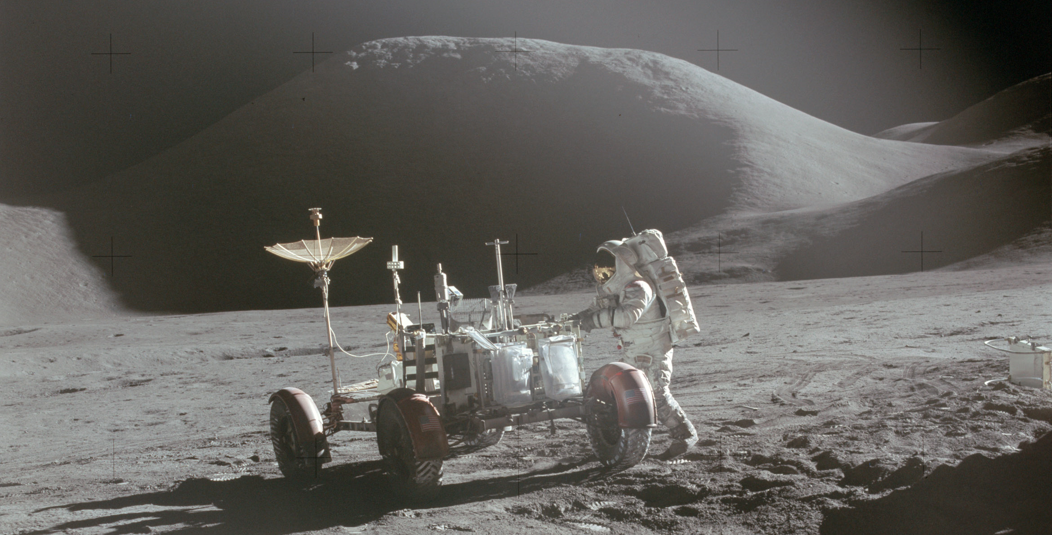
Operational Apollo

Slide 23
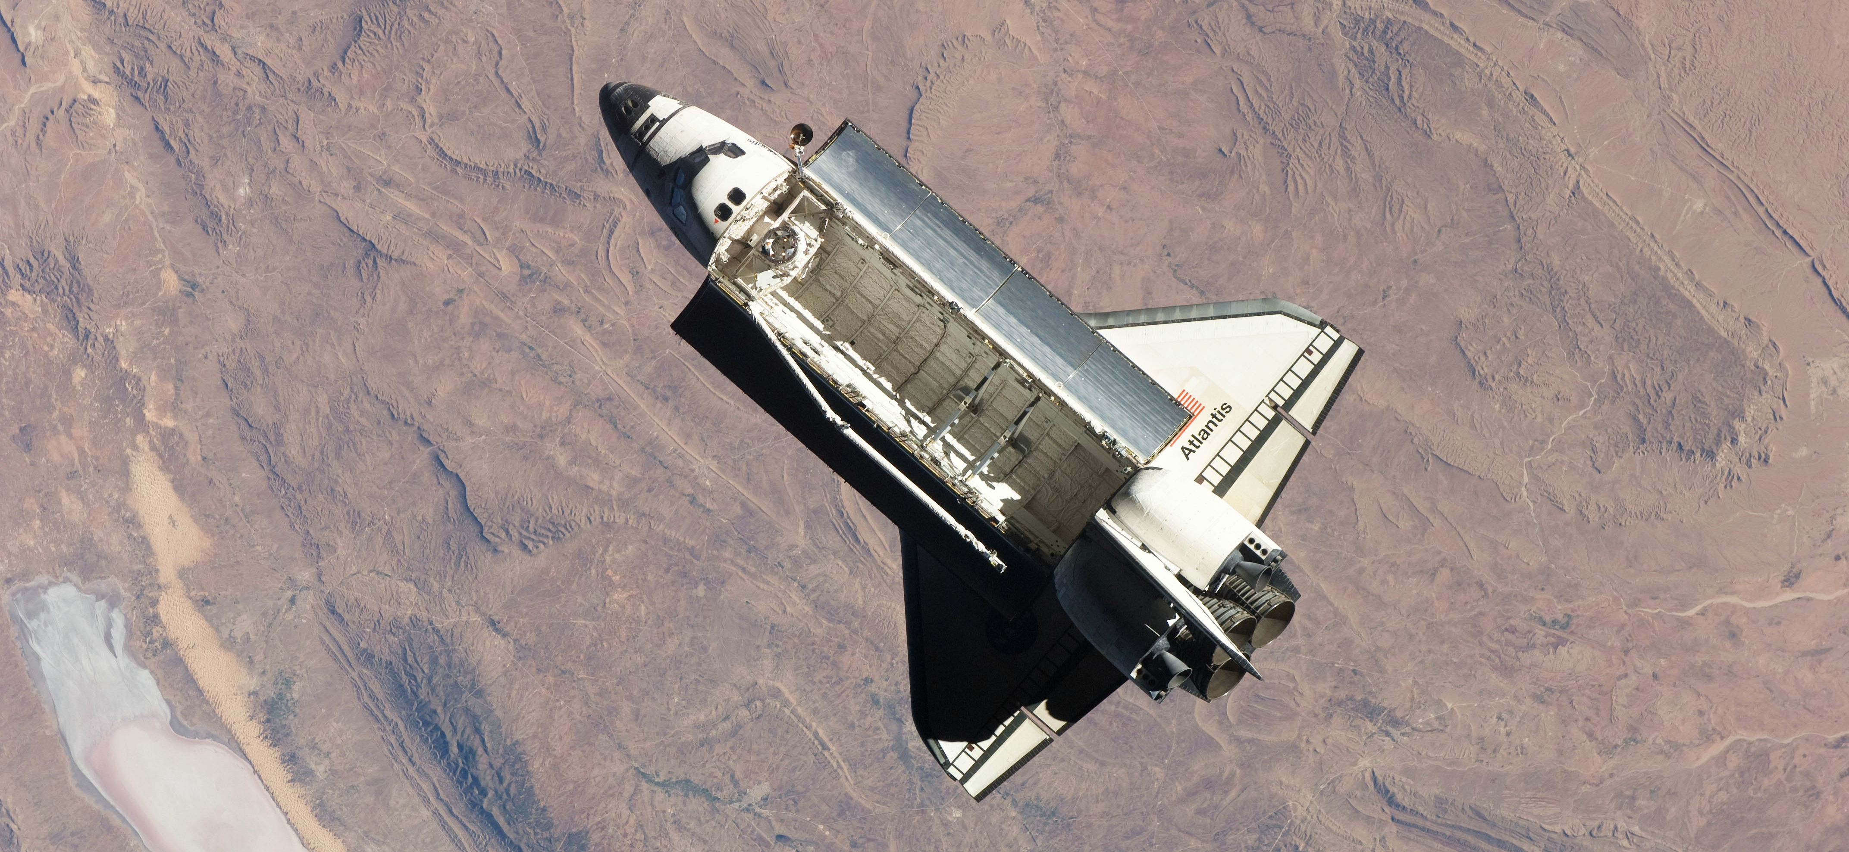
The Space Shuttle Decision

Slide 24
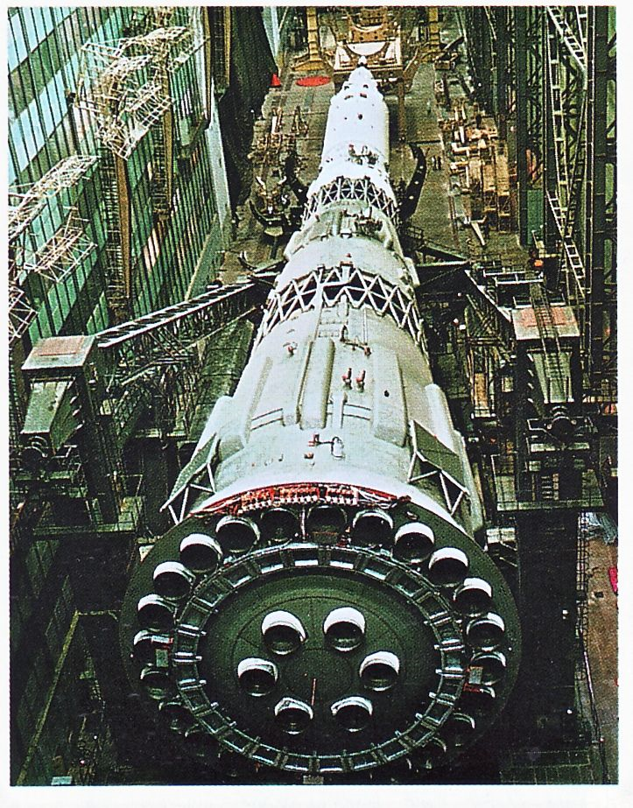
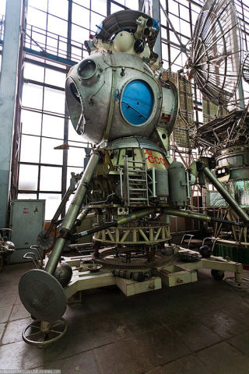
The Soviet Lunar Program

Slide 25
Some Lessons of Apollo
Clarity
Political commitment
Societal support
Near-term time frame
Economic capacity
Organizational capacity
Technology readiness
Existing infrastructure
…

Slide 26
Wicked Problems
The problem is not understood until after the formulation of a solution.
Wicked problems have no stopping rule.
Solutions to wicked problems are not right or wrong.
Every wicked problem is essentially novel and unique.
Every solution to a wicked problem is a 'one shot operation.'
Wicked problems have no given alternative solutions.
Jeff Conklin, Wicked Problems and Social Complexity, 2005

Slide 27
Term Paper
Pick one big thing to study
A social challenge, a large-scale technology challenge, an armed conflict, …
Choice is due in about 3 weeks (Feb 19)
Draw on the lessons of Apollo
Compare and contrast, at the level of enablers and inhibitors
Learn about your chosen challenge –what do we know already?
Compile insights throughout the semester
Write early and then get several people to read it!
Due on Sunday May 19 at 9 PM

Slide 28
Learning Together
30-minute lecture
Provides some common background
30-minute group discussion
Collective sensemaking
Guided by written discussion questions
Scribe uploads a one-page summary to ELMS (same day)
15-minutes of support for your current “activity”
Activities are designed to be completed in 3 hours per week
Class discussion is intended to help you make progress

Slide 29
Reading, Watching, and Listening
One hour of preparation for every class session
Reading, video, or audio
Assignments are linked from the schedule (keyed to “student number”)
Skim first to allocate your time well
Read for comprehension, not for detail
Goal is to bring important points to the discussion

Slide 30
Tweeting 1969

Slide 31
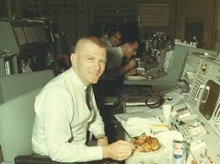
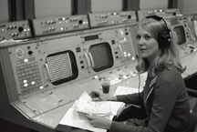
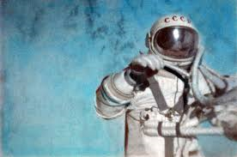
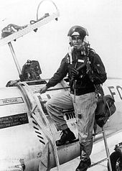
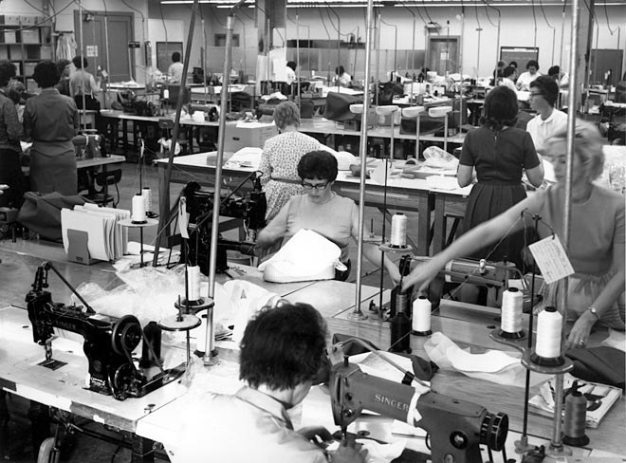
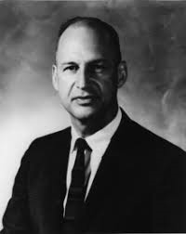
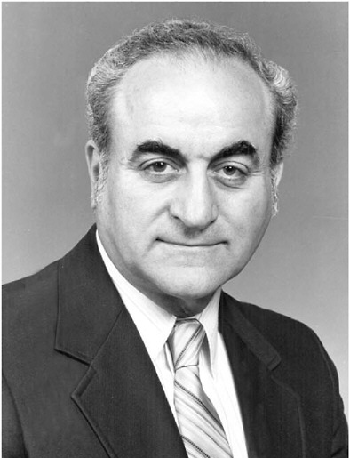
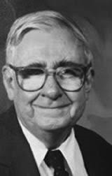
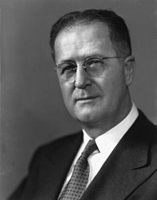
Adopt Someone: An Individual Perspective

Slide 32
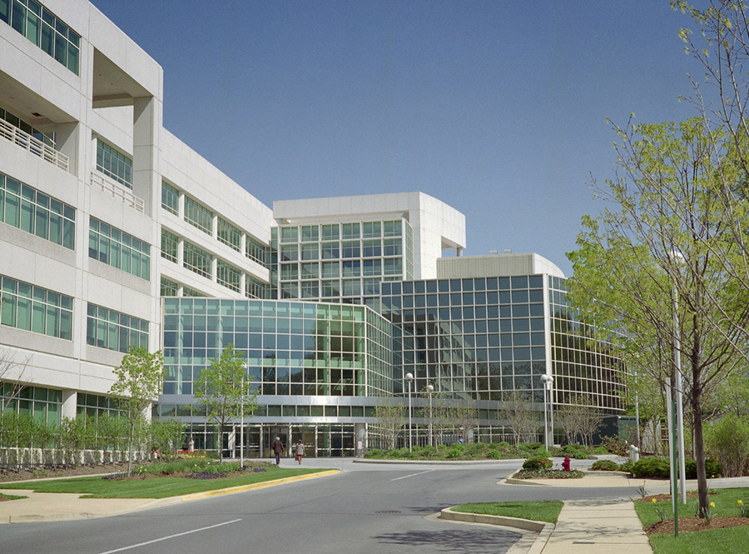
Archival Records: An Organizational Perspective

Slide 33
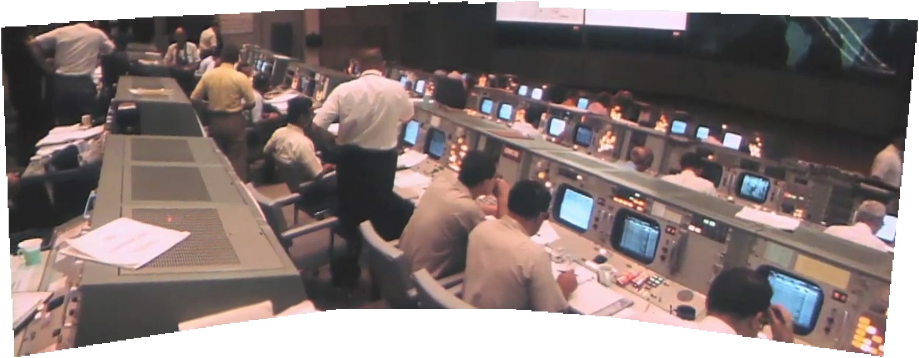
Immersion: An Operational Perspective

Slide 34
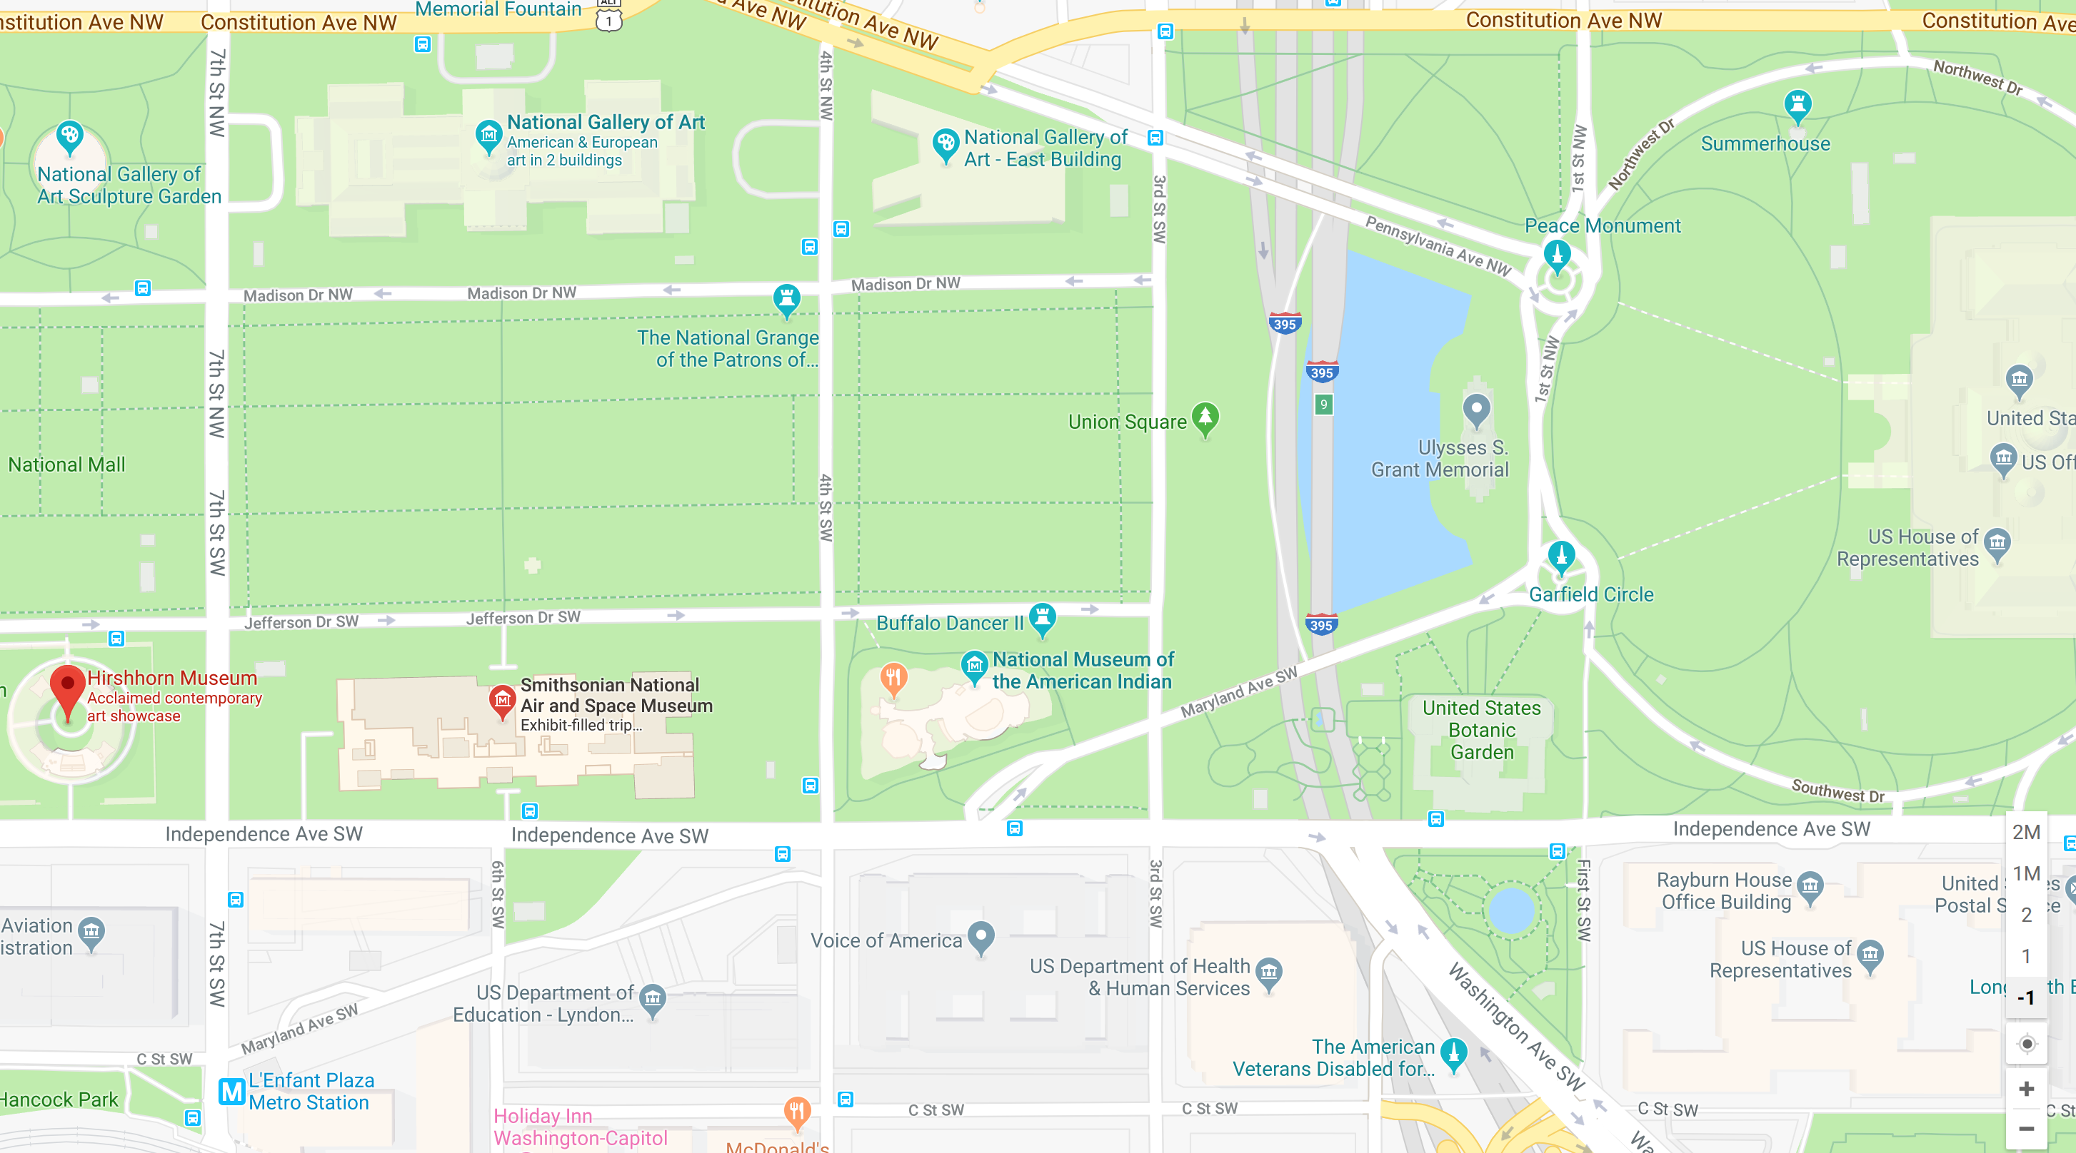
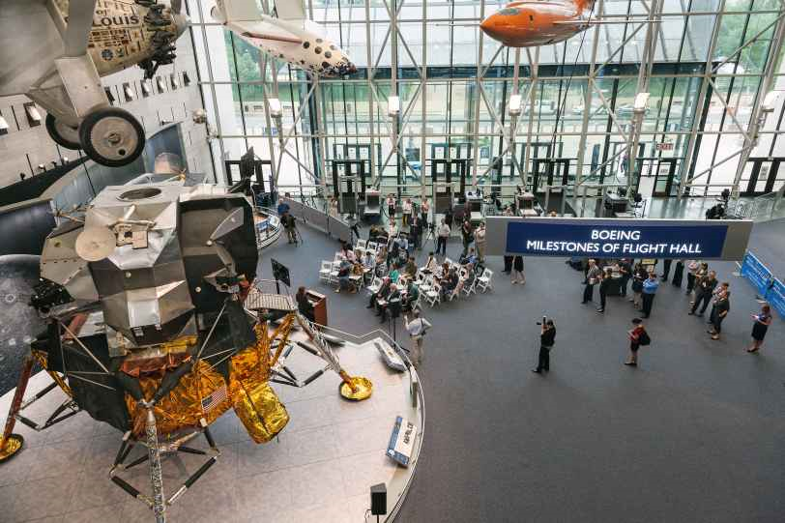
But First: A Museum Tour
This Sunday (Feb 3) at 2 PM
A week from Saturday (Feb 9) at 2 PM

Slide 35
What’s Where
Course Web Site
Schedule
Grading, etc.
Links to most things (including most readings)
ELMS
Copyrighted materials (Files for PDF, Modules for Video)
Recorded class sessions (Panopto)
Student work
Grades
Twitter (#ApolloAt50 or @ApolloProf)
Email (oard@umd.edu -- please don’t use ELMS to send messages)
Office Hours (Tu/Th before class in PXT 1109C, Wed 1:30 in HBK 0302C)

