Slide 1
Apollo 15: Lunar Rover
INST 154
Apollo at 50

Slide 2
Cancellations
January 1970
Apollo 20 was cancelled to provide a Saturn V for Skylab
Apollo 18 and Apollo 19 were delayed until after Skylab to provide a backup
April 1970
Apollo 14 was assigned to repeat the aborted Apollo 13 mission to Fra Mauro
September 1970
Apollo 18 and 19 were cancelled for financial reasons
Apollo 15’s planned H mission was converted to a J mission
Apollo 16 and Apollo 17 would also fly J missions, as originally planned

Slide 3
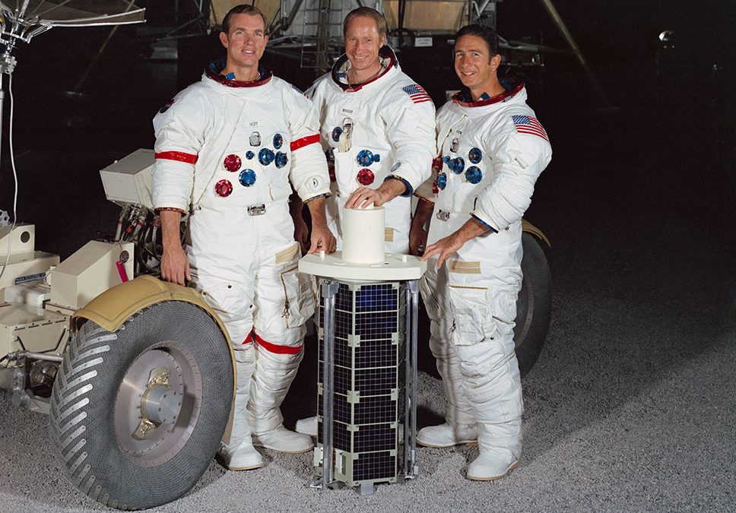

Slide 4
EVA-First Plan

Slide 5
Sleep-First Plan

Slide 6
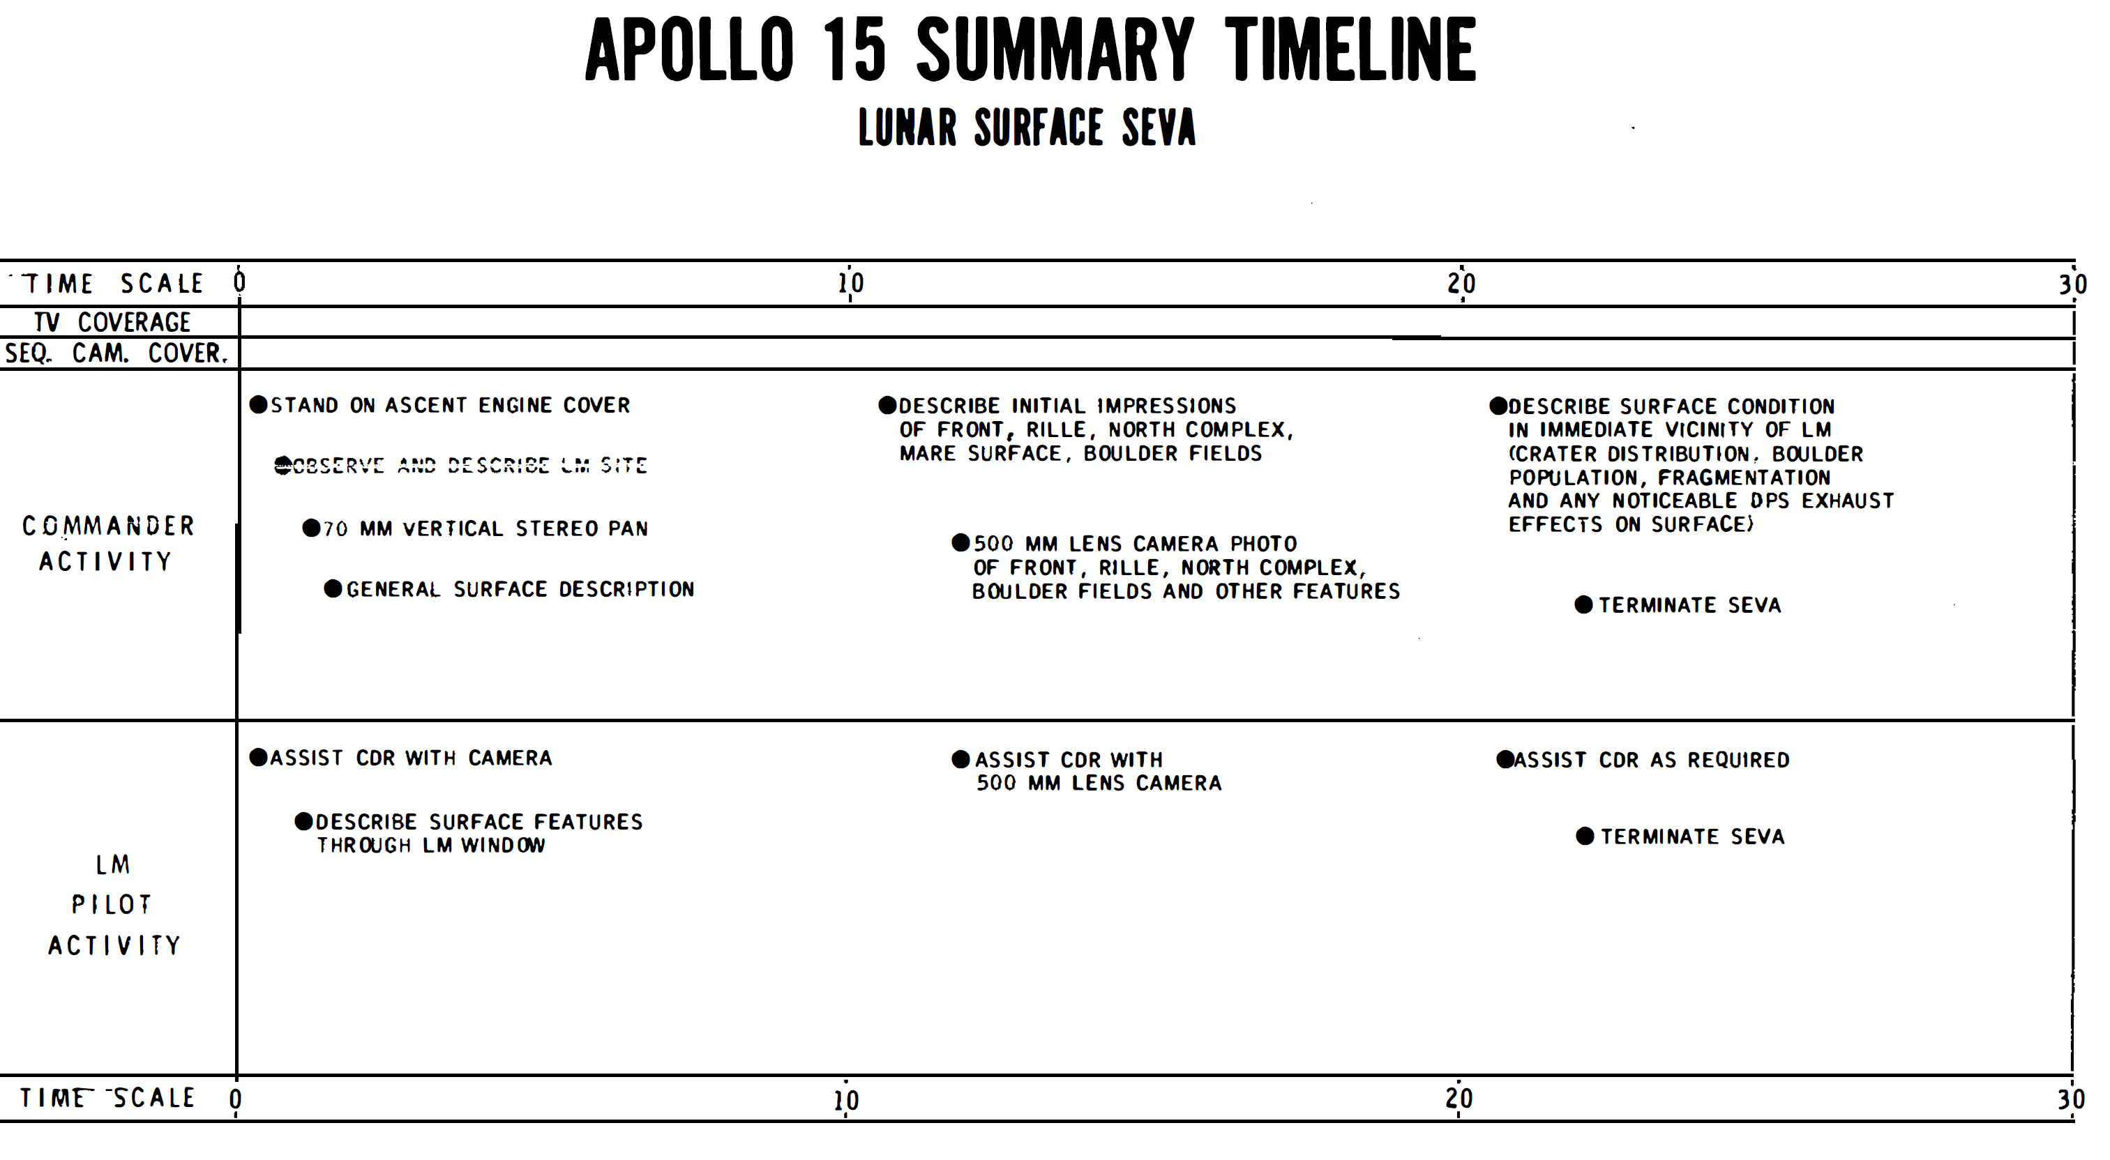

Slide 7
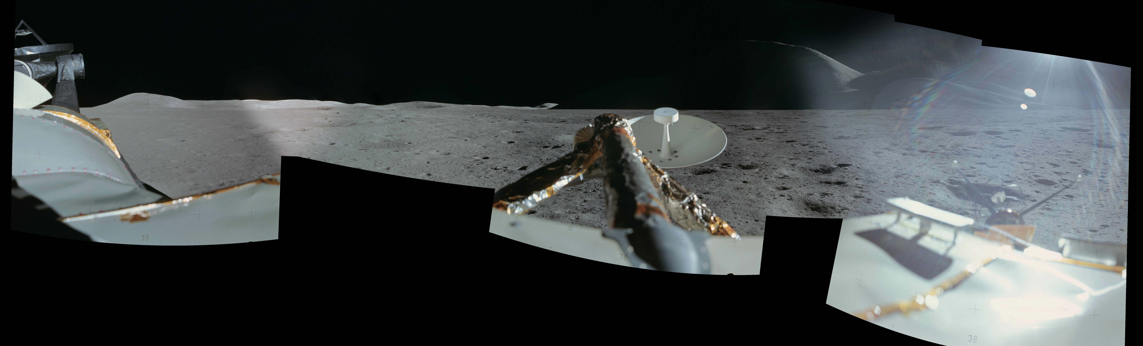

Slide 8
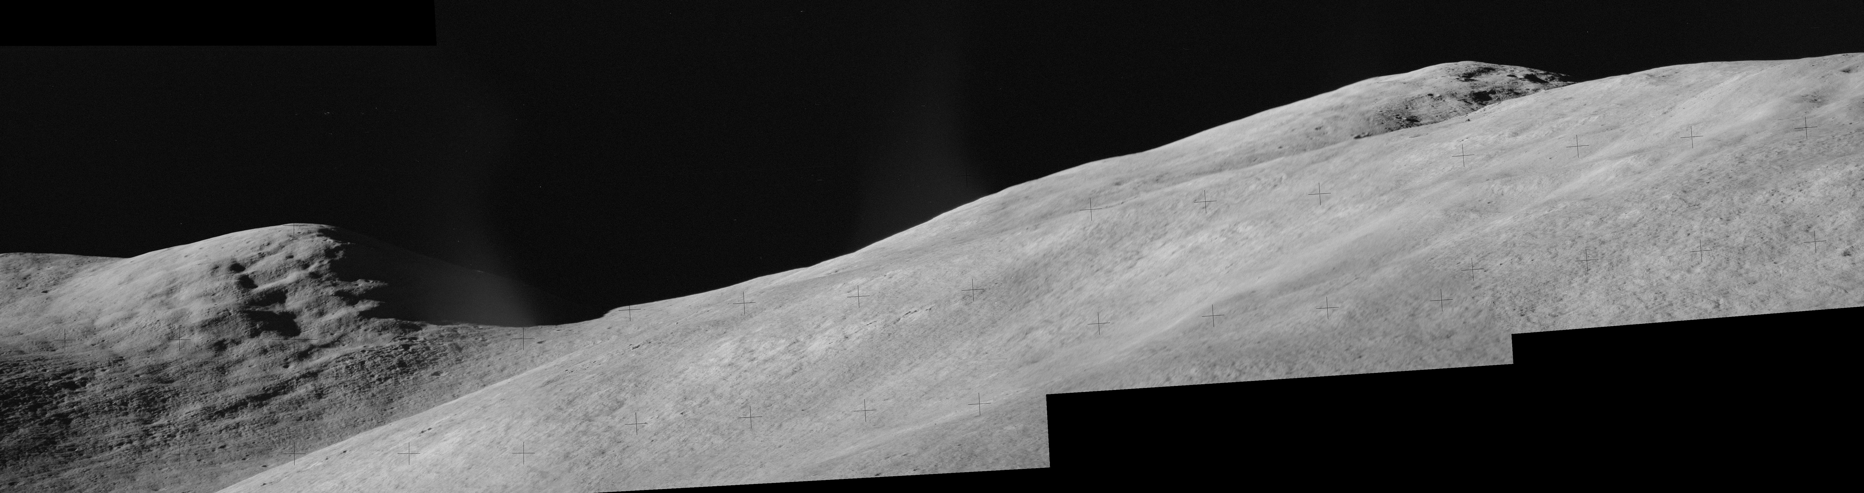
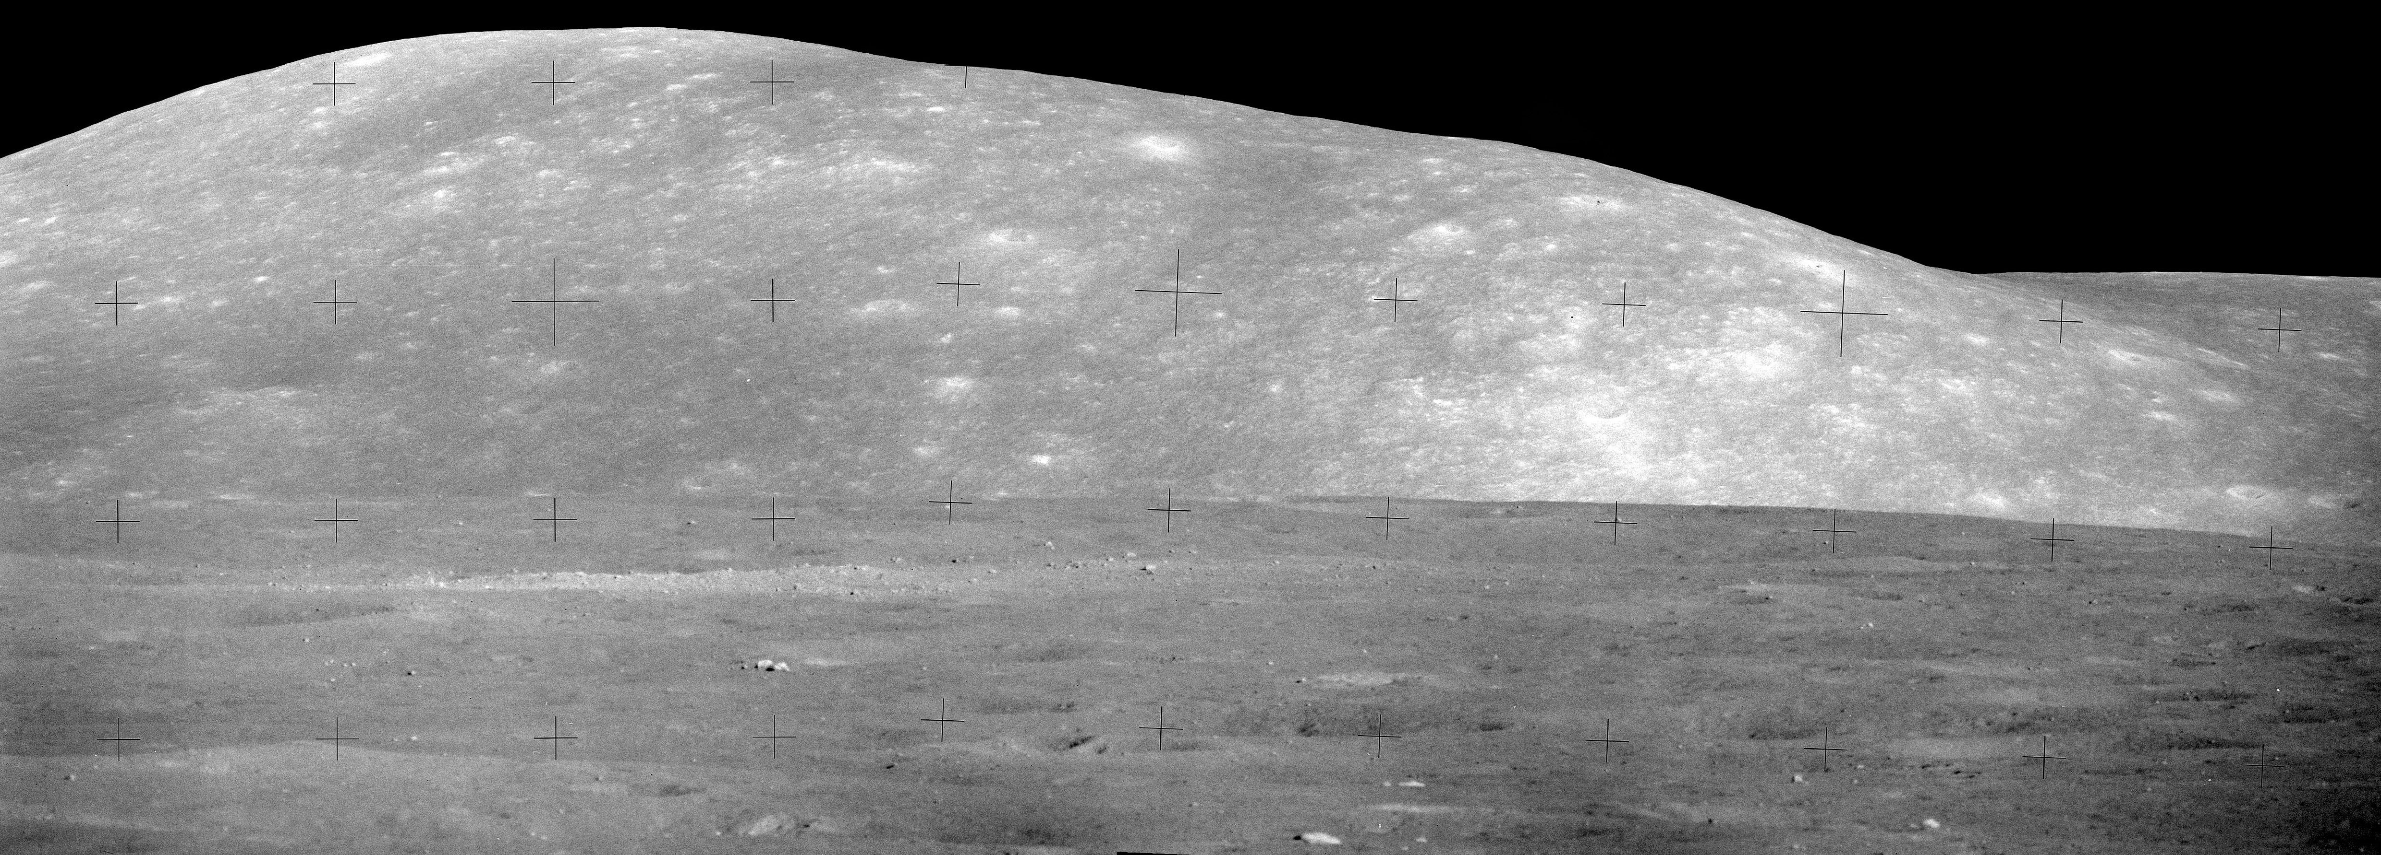

Slide 9
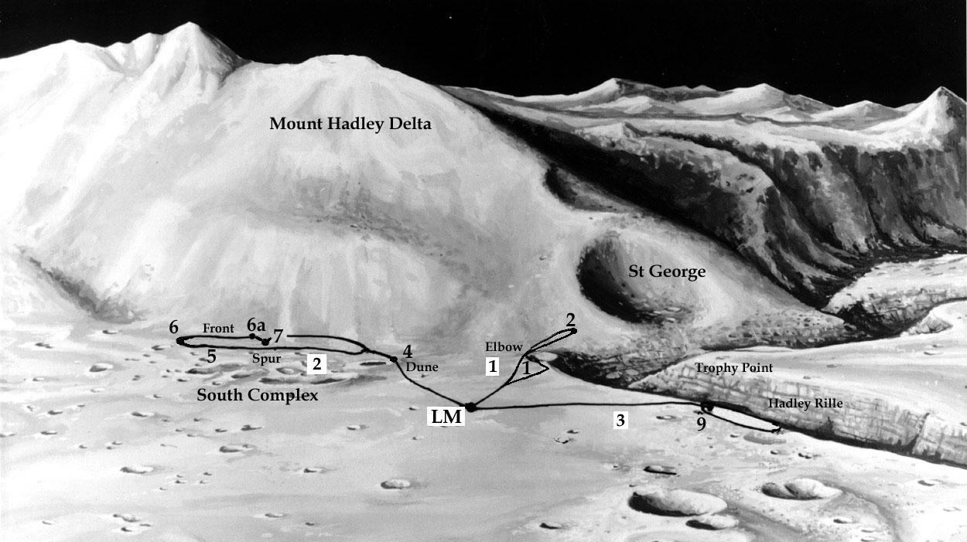

Slide 10
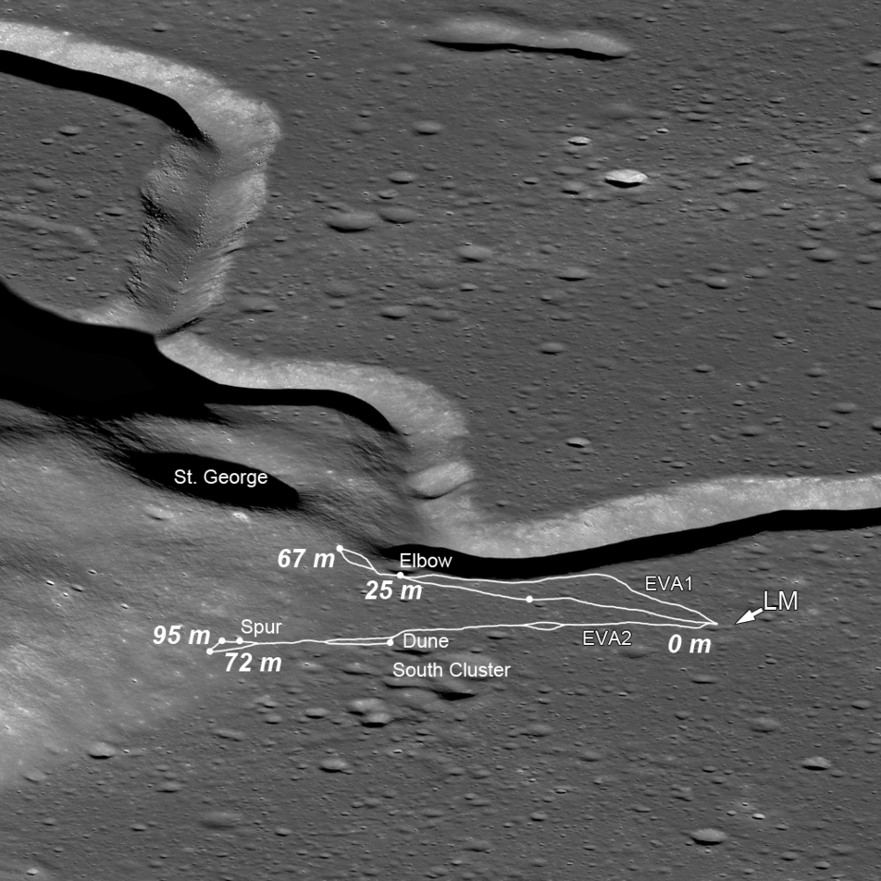
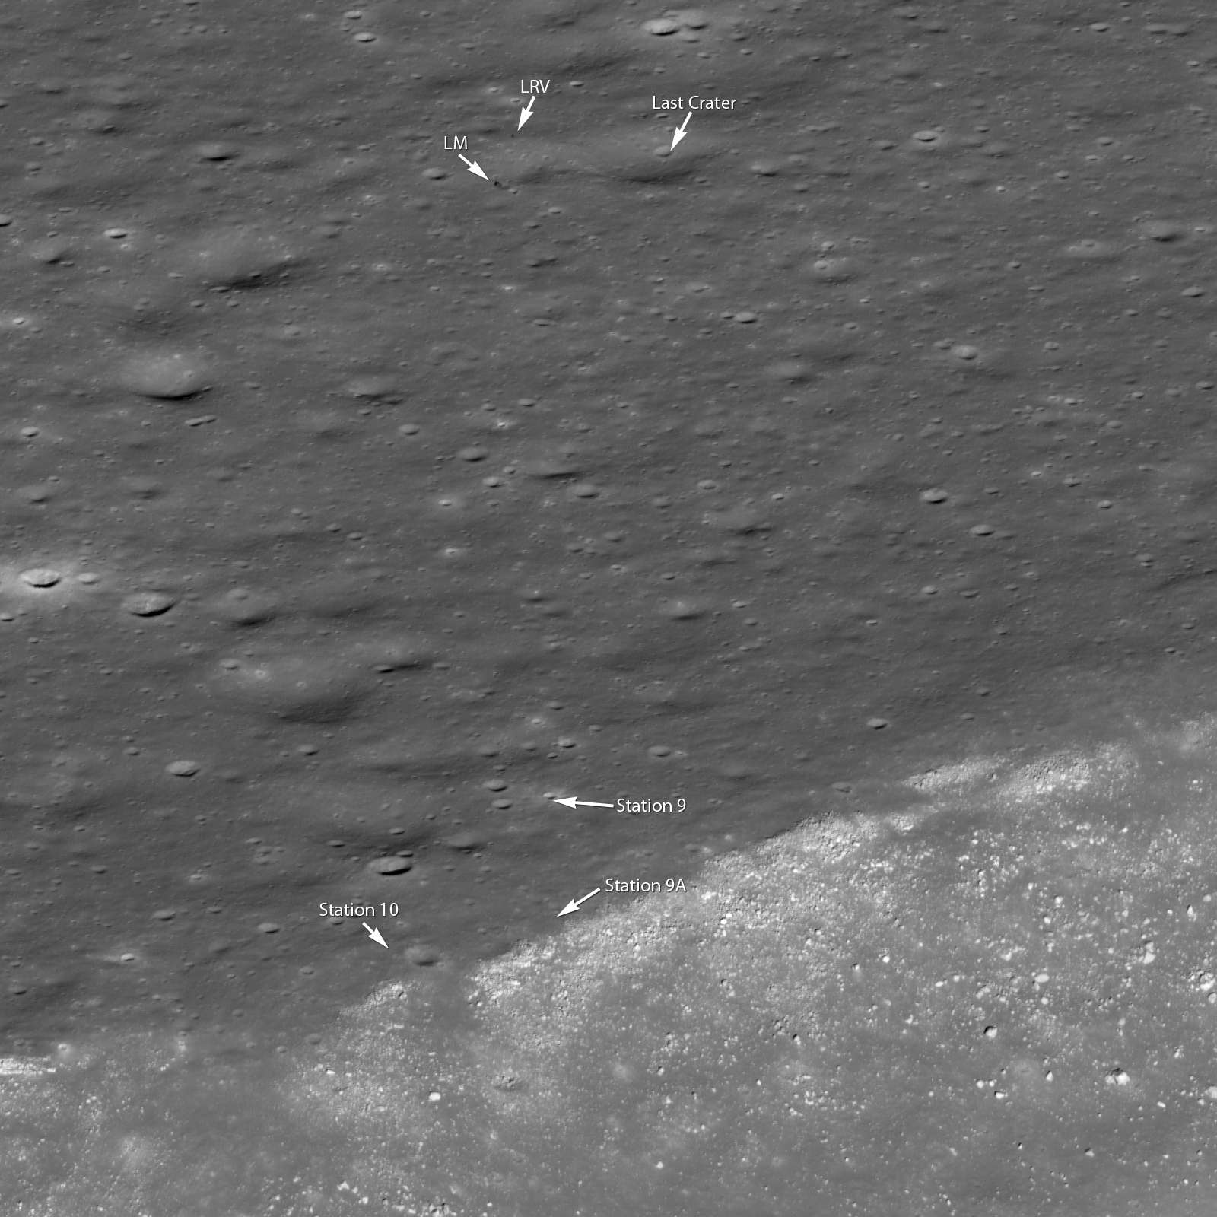

Slide 11
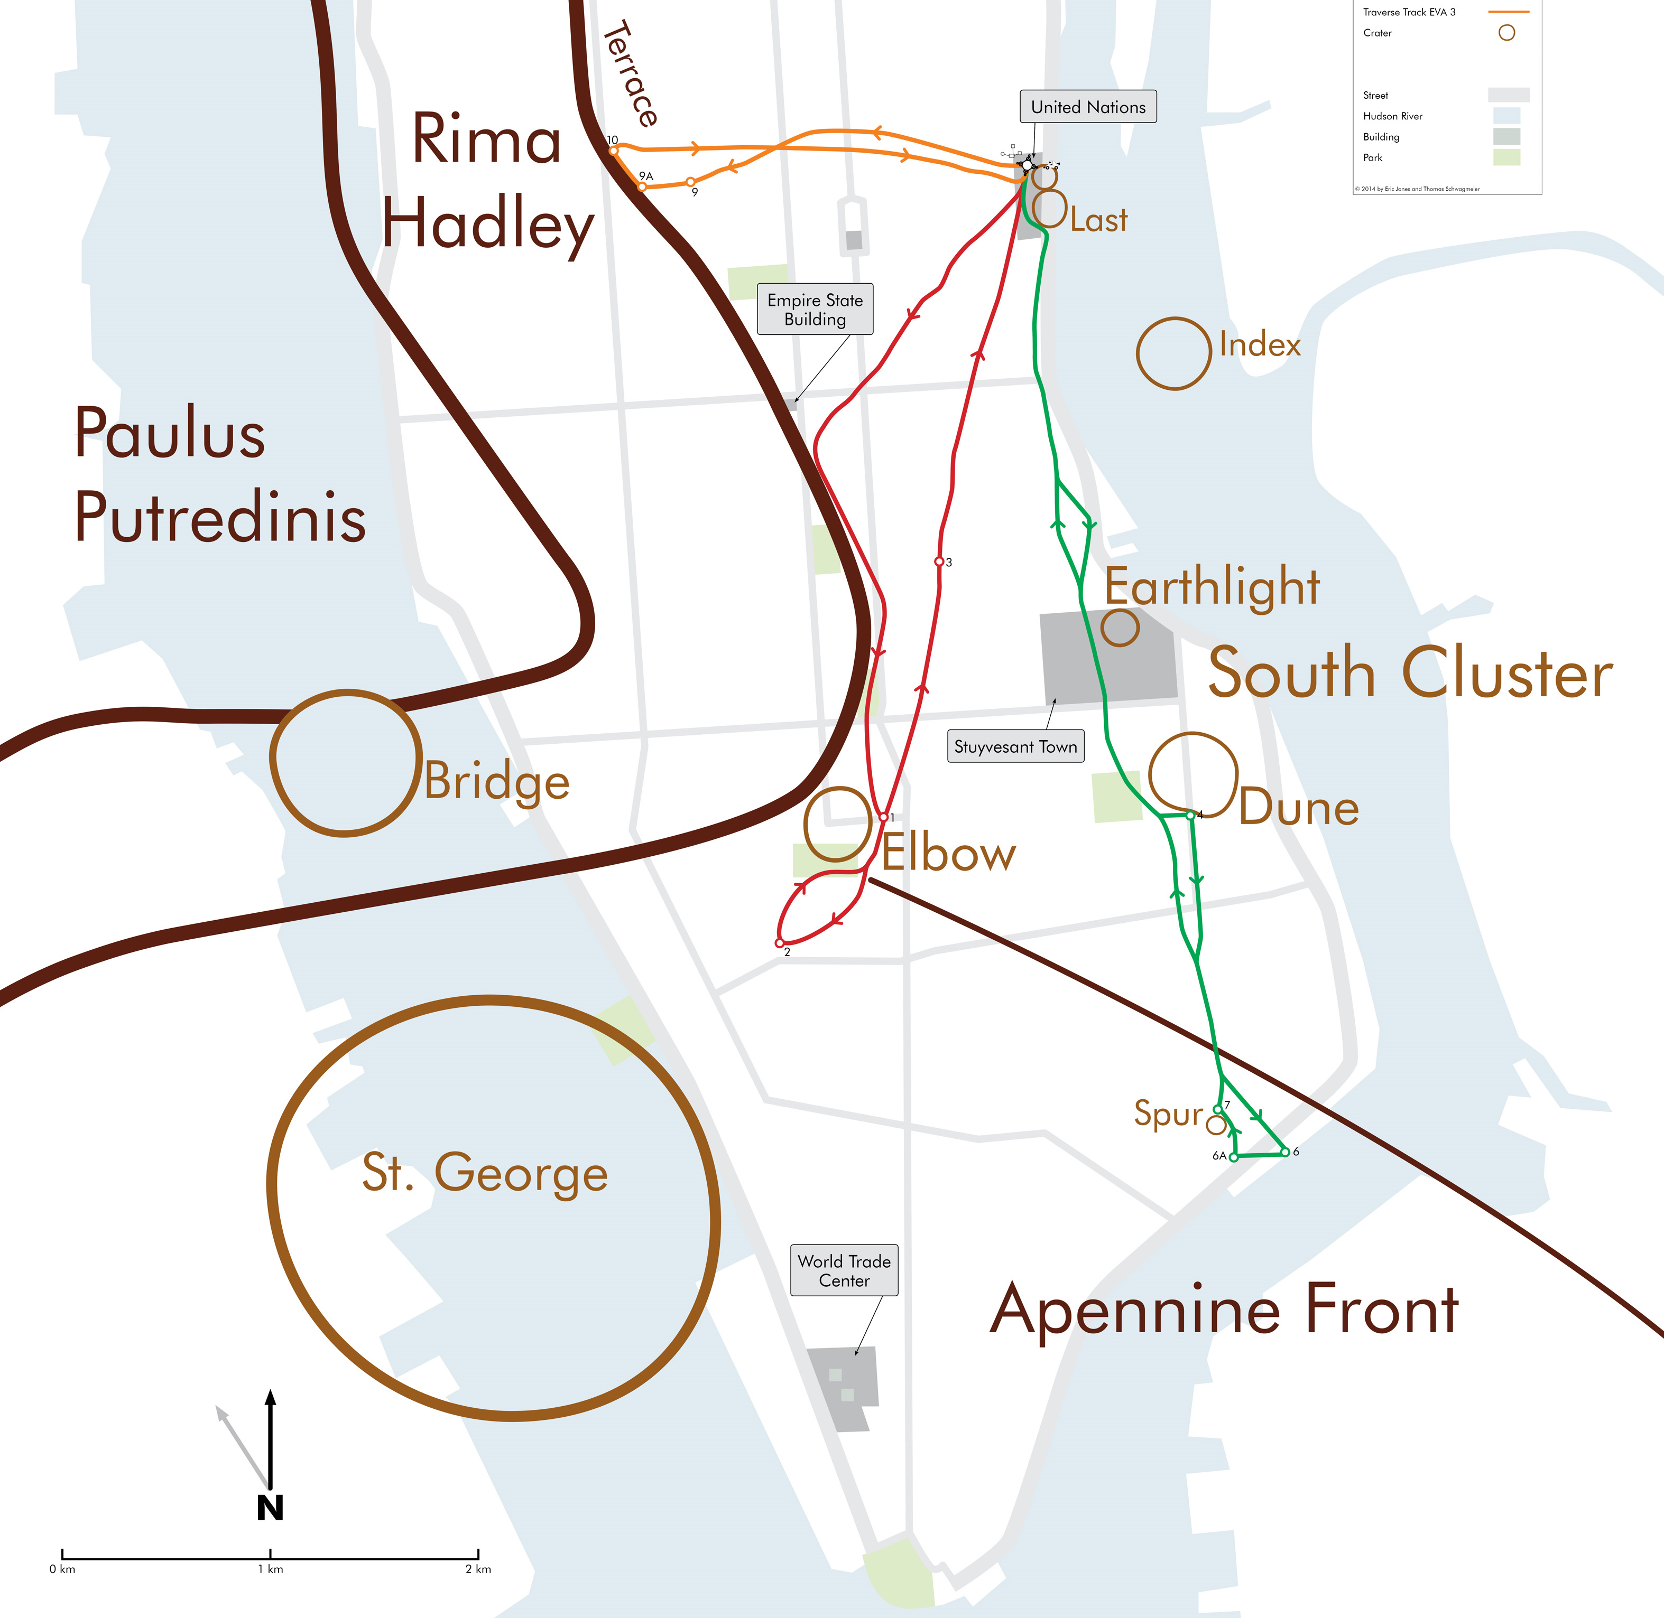

Slide 12
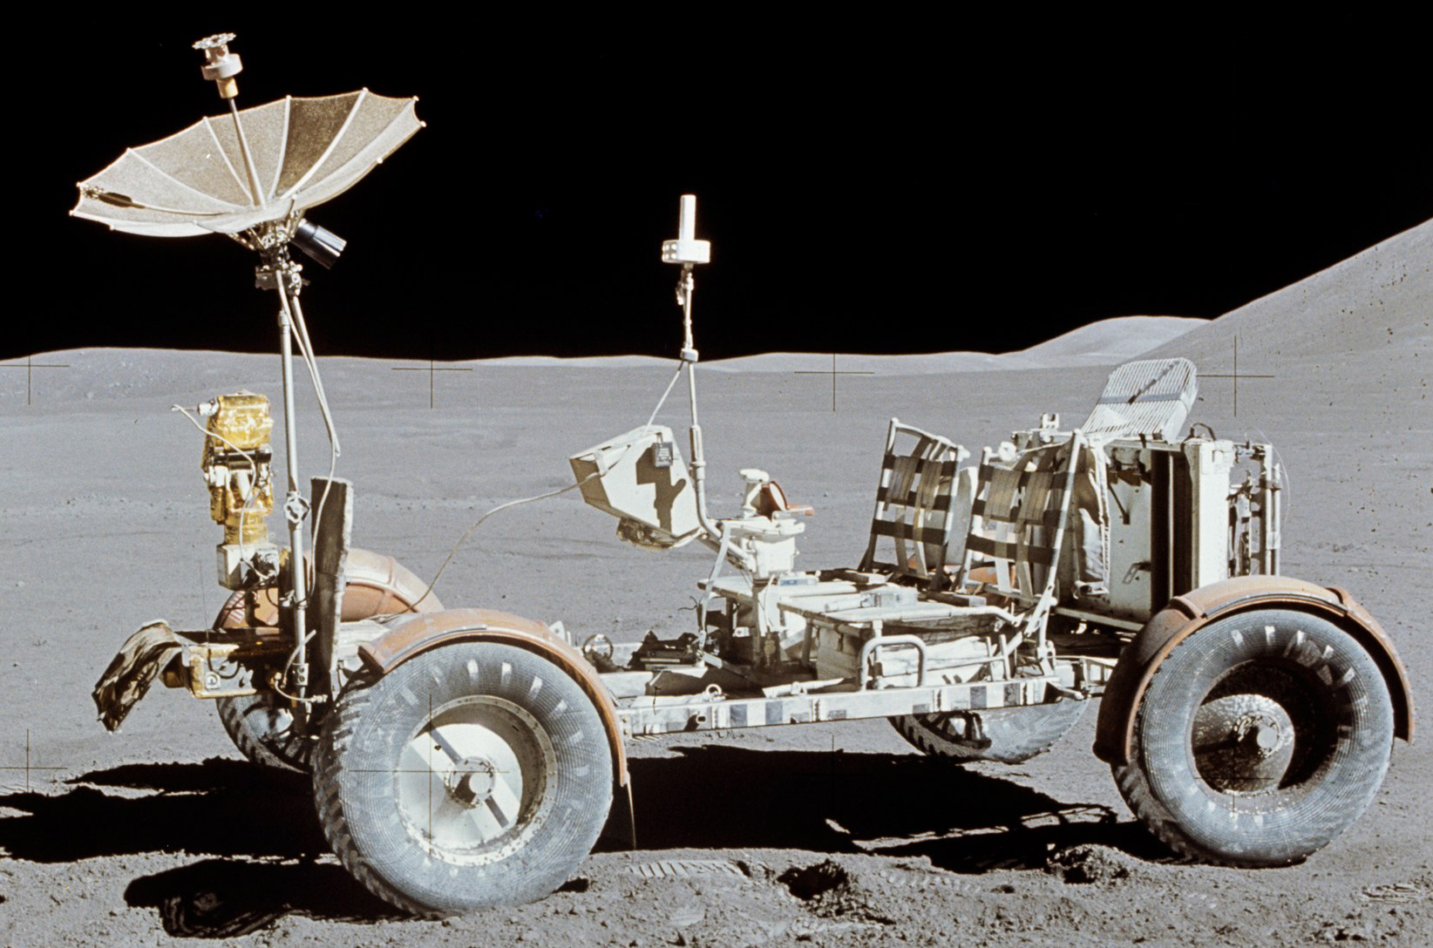

Slide 13
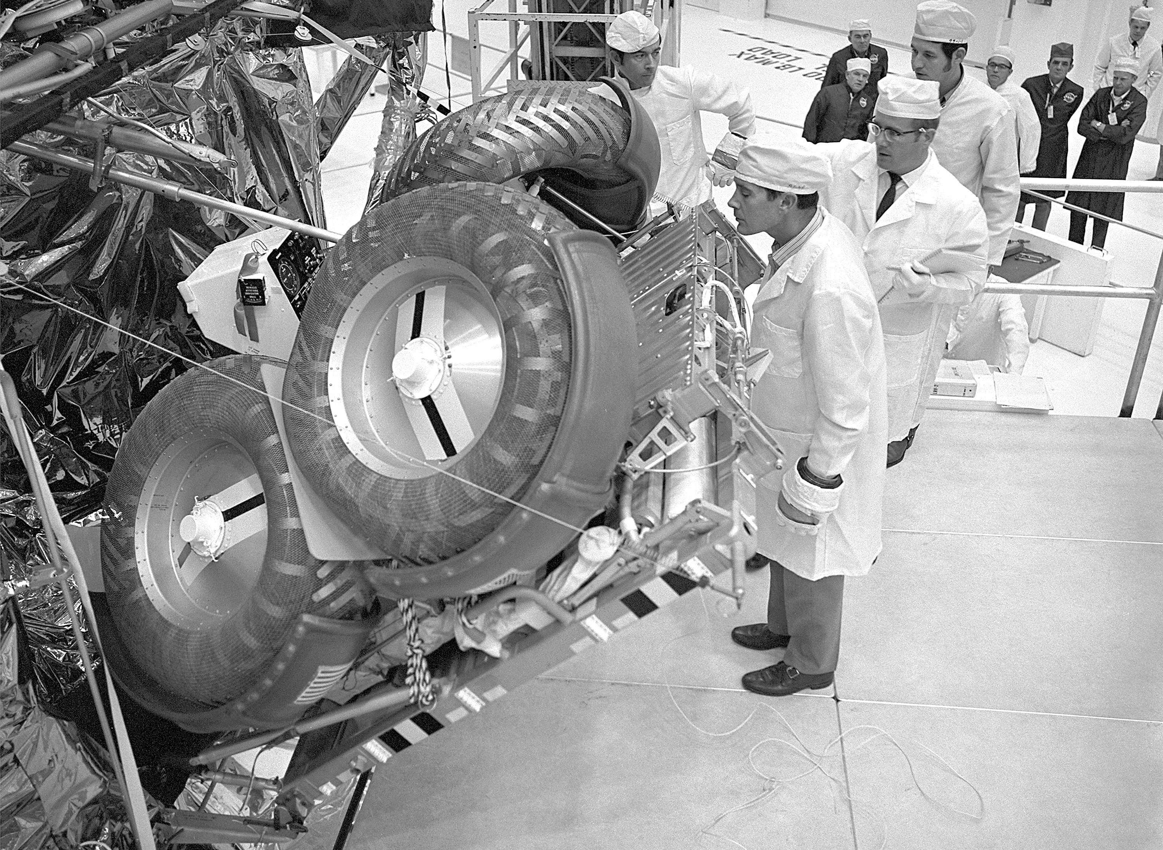
Animation

Slide 14
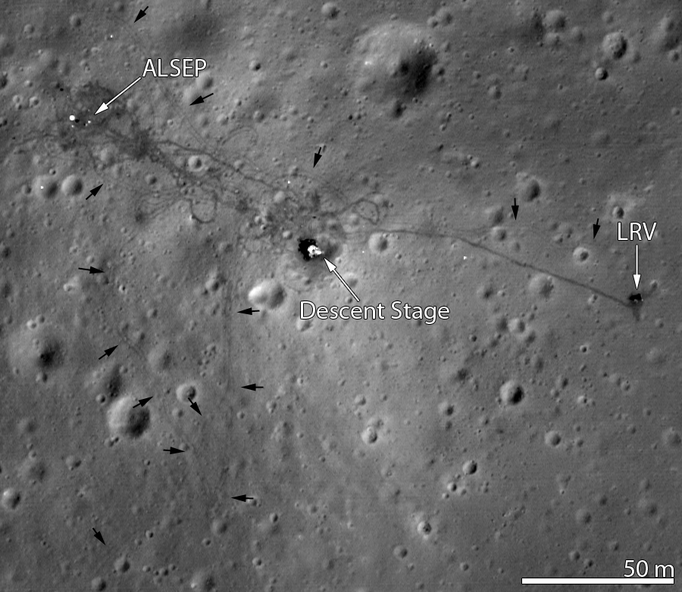

Slide 15
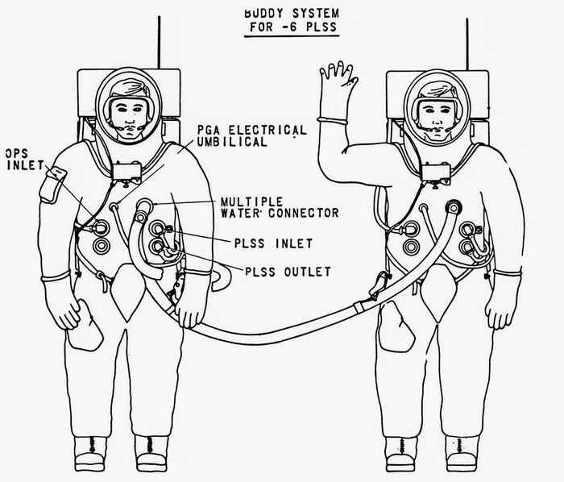

Slide 17
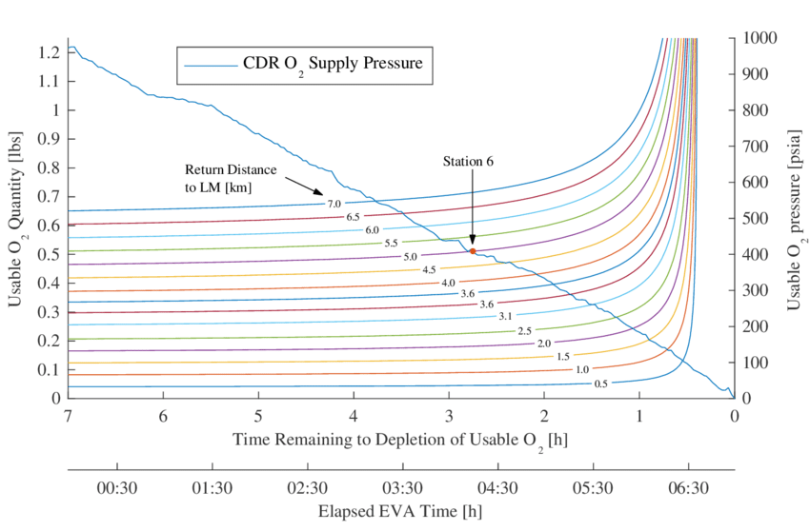

Slide 18
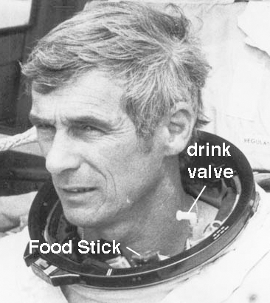
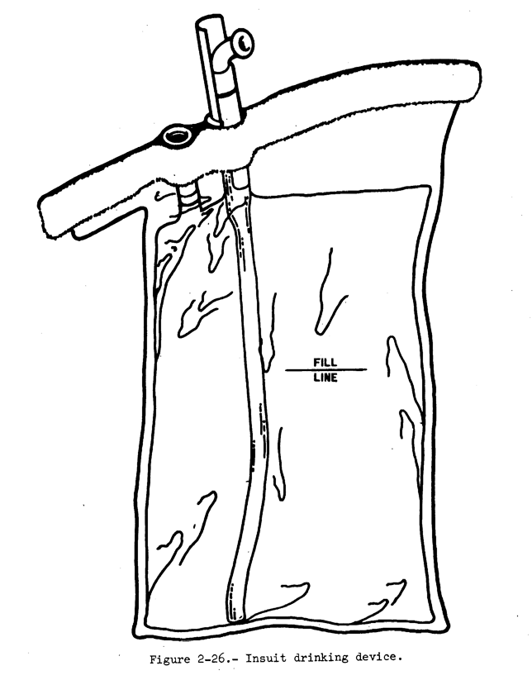

Slide 19
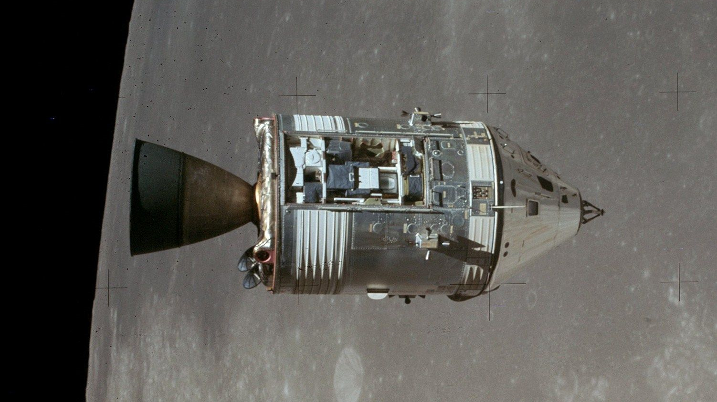

Slide 20
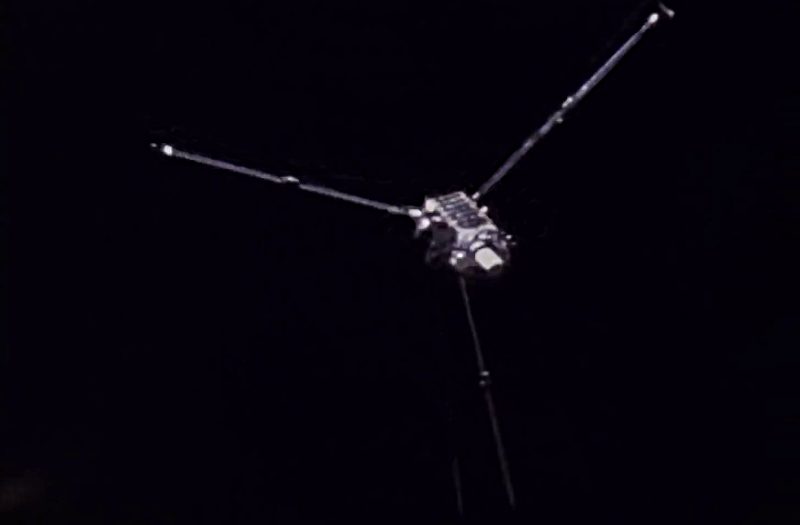

Slide 21
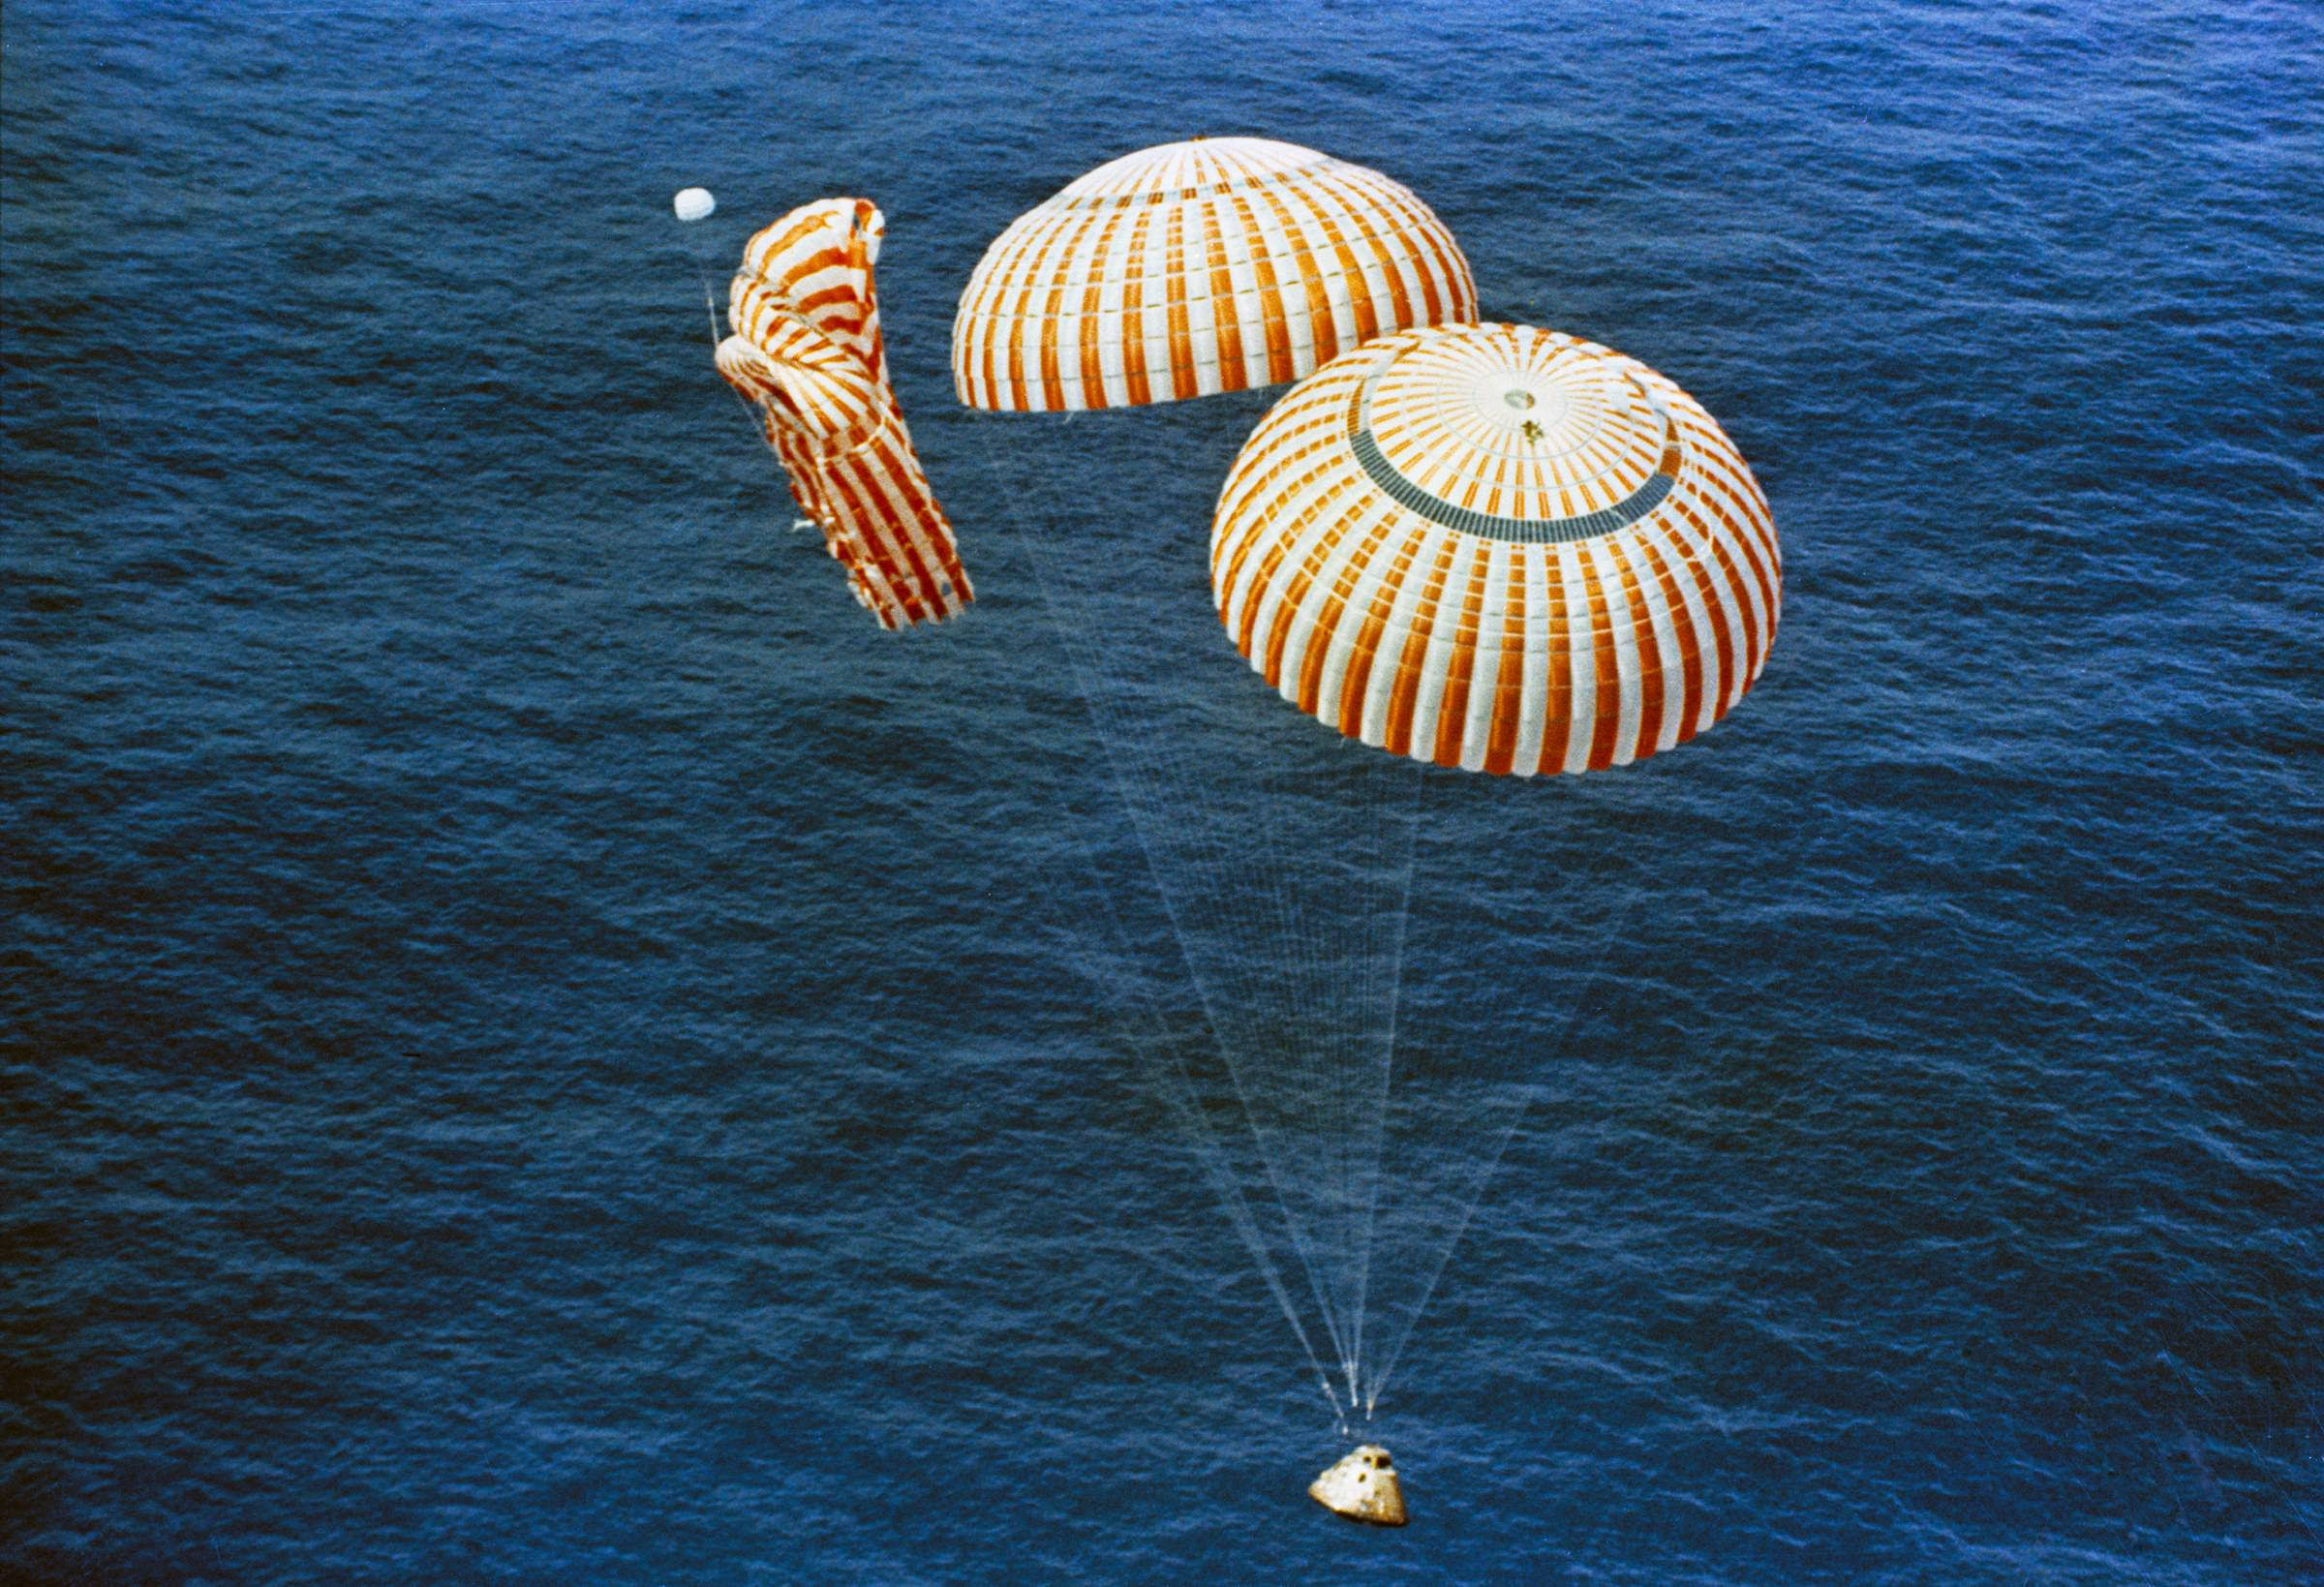

Slide 22
Discussion Groups
Worden and El Baz video
A discussion of the science performed in Lunar Orbit
Chaikin Chapter 11 (“To the Mountains of the Moon”)
The astronaut’s view of Apollo 15
Harland Chapter 5
A detailed look at the Apollo 15 moonwalks
Apollo Lunar Surface Journal
Annotated transcripts from the lunar portion of the mission

