Slide 1
The Cold War
INST 154
Apollo at 50
Duck and Cover

Slide 2
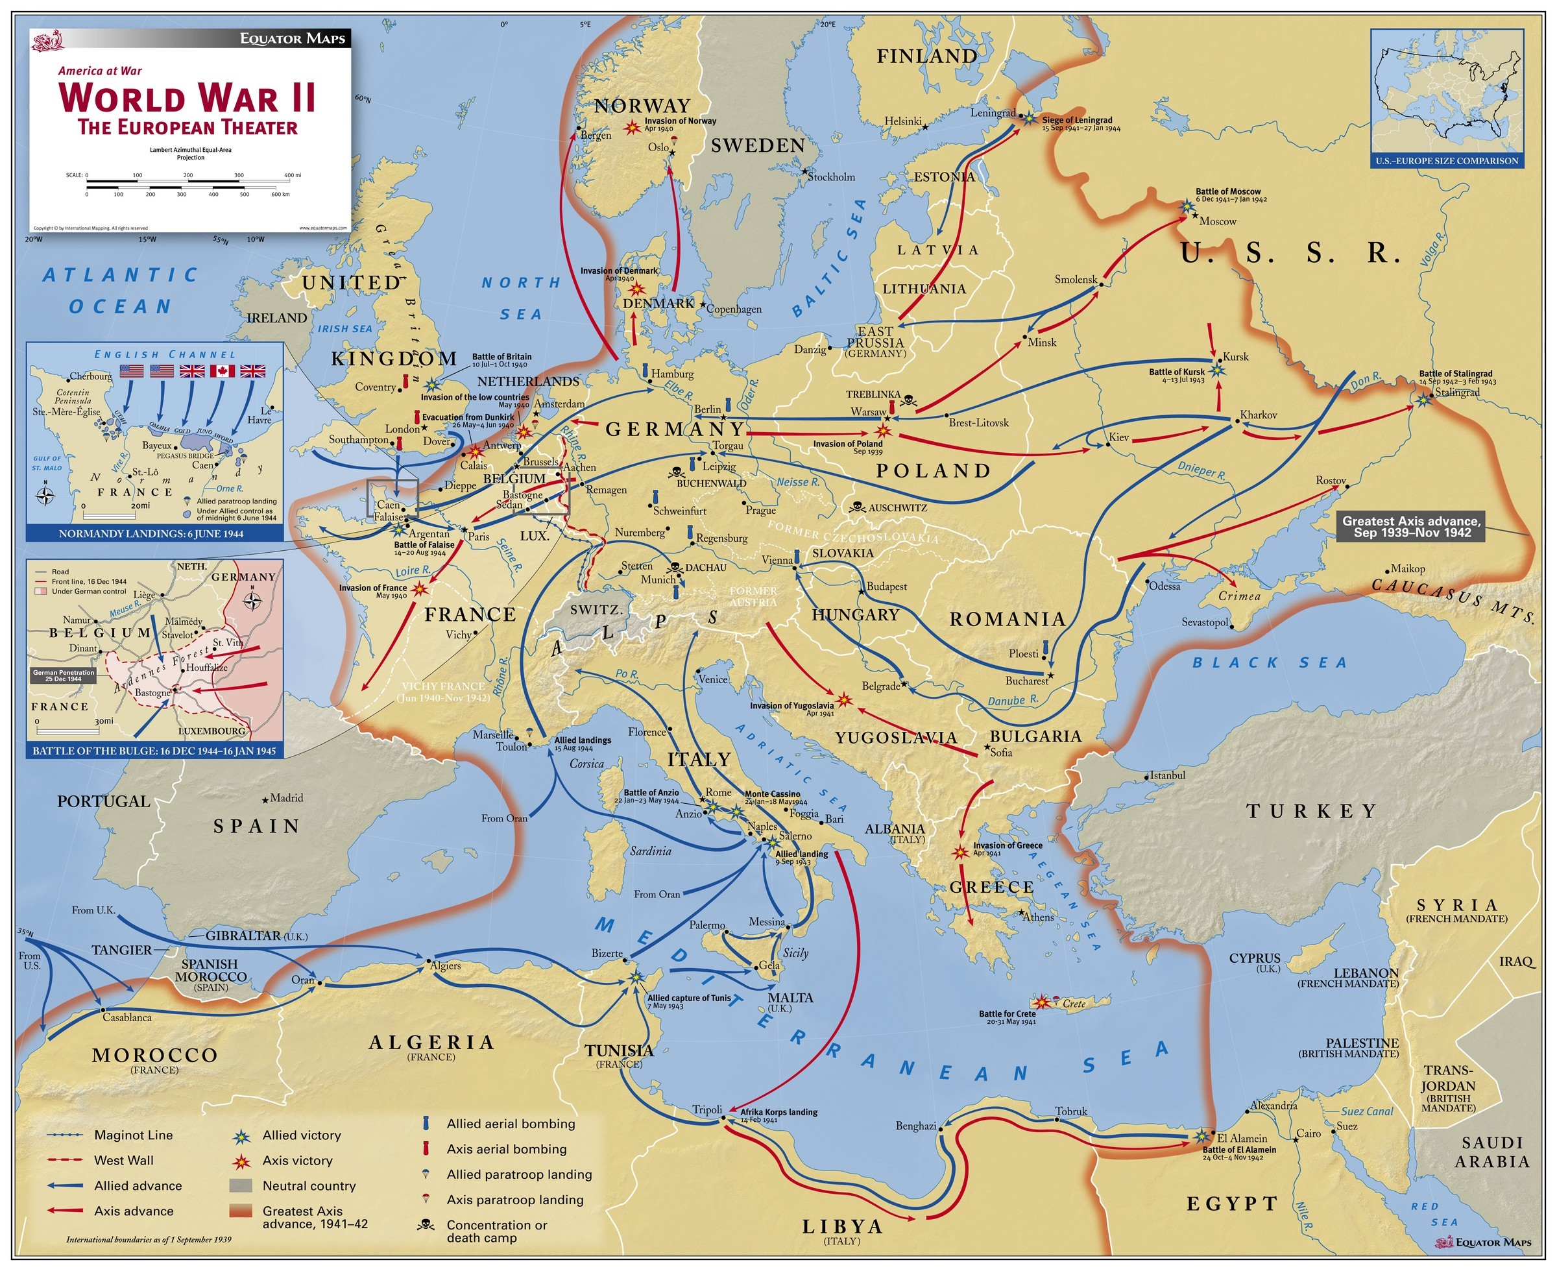

Slide 3
Origins of the Cold War
Truman (April 1945-January 1953)
Potsdam Conference (July 1945)
Atomic bombing of Hiroshima and Nagasaki (August 1945)
United Nations (October 1945)
Strategy: Containment (February 1946)
Truman Doctrine (March-May 1947)
Marshall Plan (April 1948)
Berlin Airlift (June 1948)
NATO (April, 1949)
Soviet atomic test (August 1949)
“Loss of China” (October 1949 to May 1950)
Korean War (June 1950)
Chinese entry into the Korean War (October 1950)
MacArthur relieved for insubordination (April 1951)

Slide 4
Early Cold War
Eisenhower (January 1953-January 1961)
Strategy: Massive Retaliation
15 megaton US hydrogen bomb test (March 1954)
Warsaw Pact (May 1955)
“Airborne alert” bombers (September 1958)
U-2 shootdown (May 1960)
Kennedy (January 1961-November 1963)
Strategy: Flexible Response
Bay of Pigs invasion (April 1961)
Berlin Wall (August 1961)
Cuban Missile Crisis (October 1962)
Johnson (November 1963-January 1969)
Strategy: Mutually Assured Destruction
Vietnam War (August 1964)

Slide 5
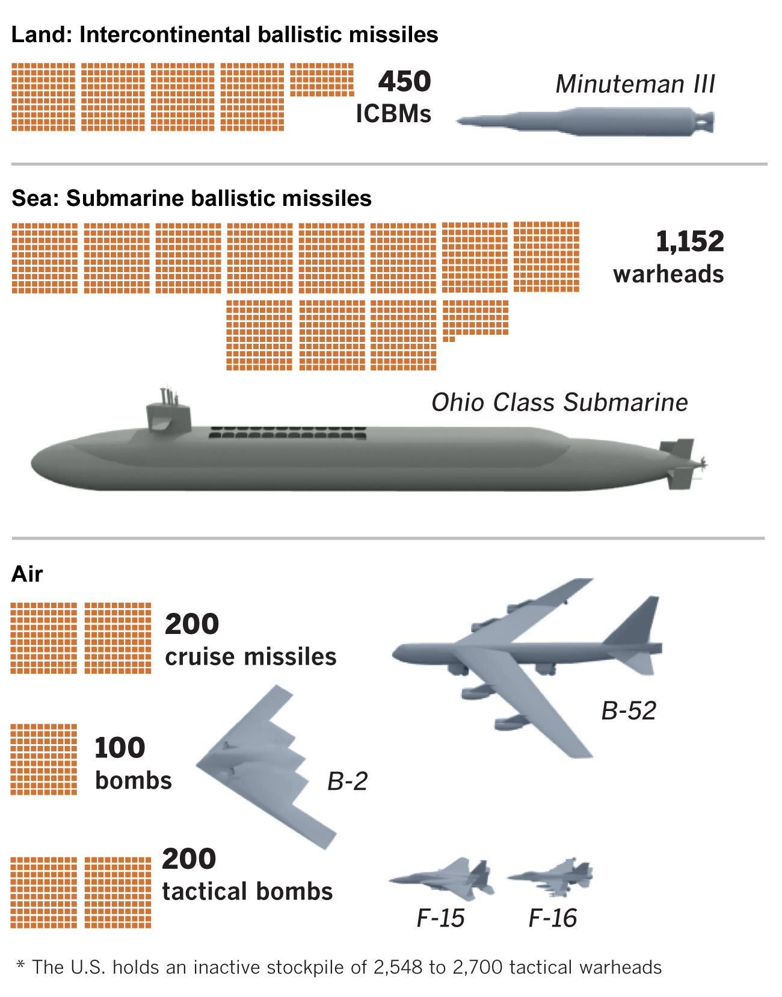
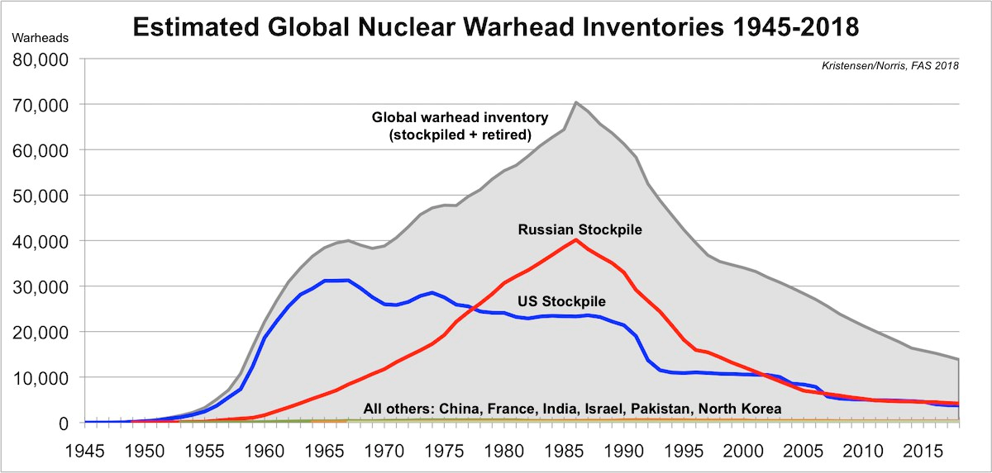
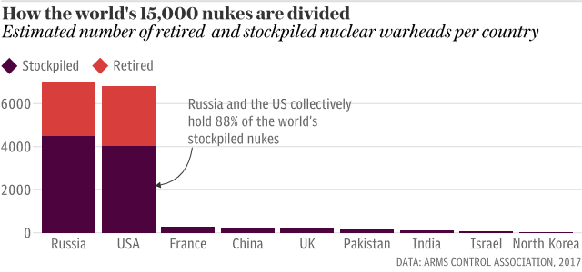
Nuclear Weapons

Slide 6
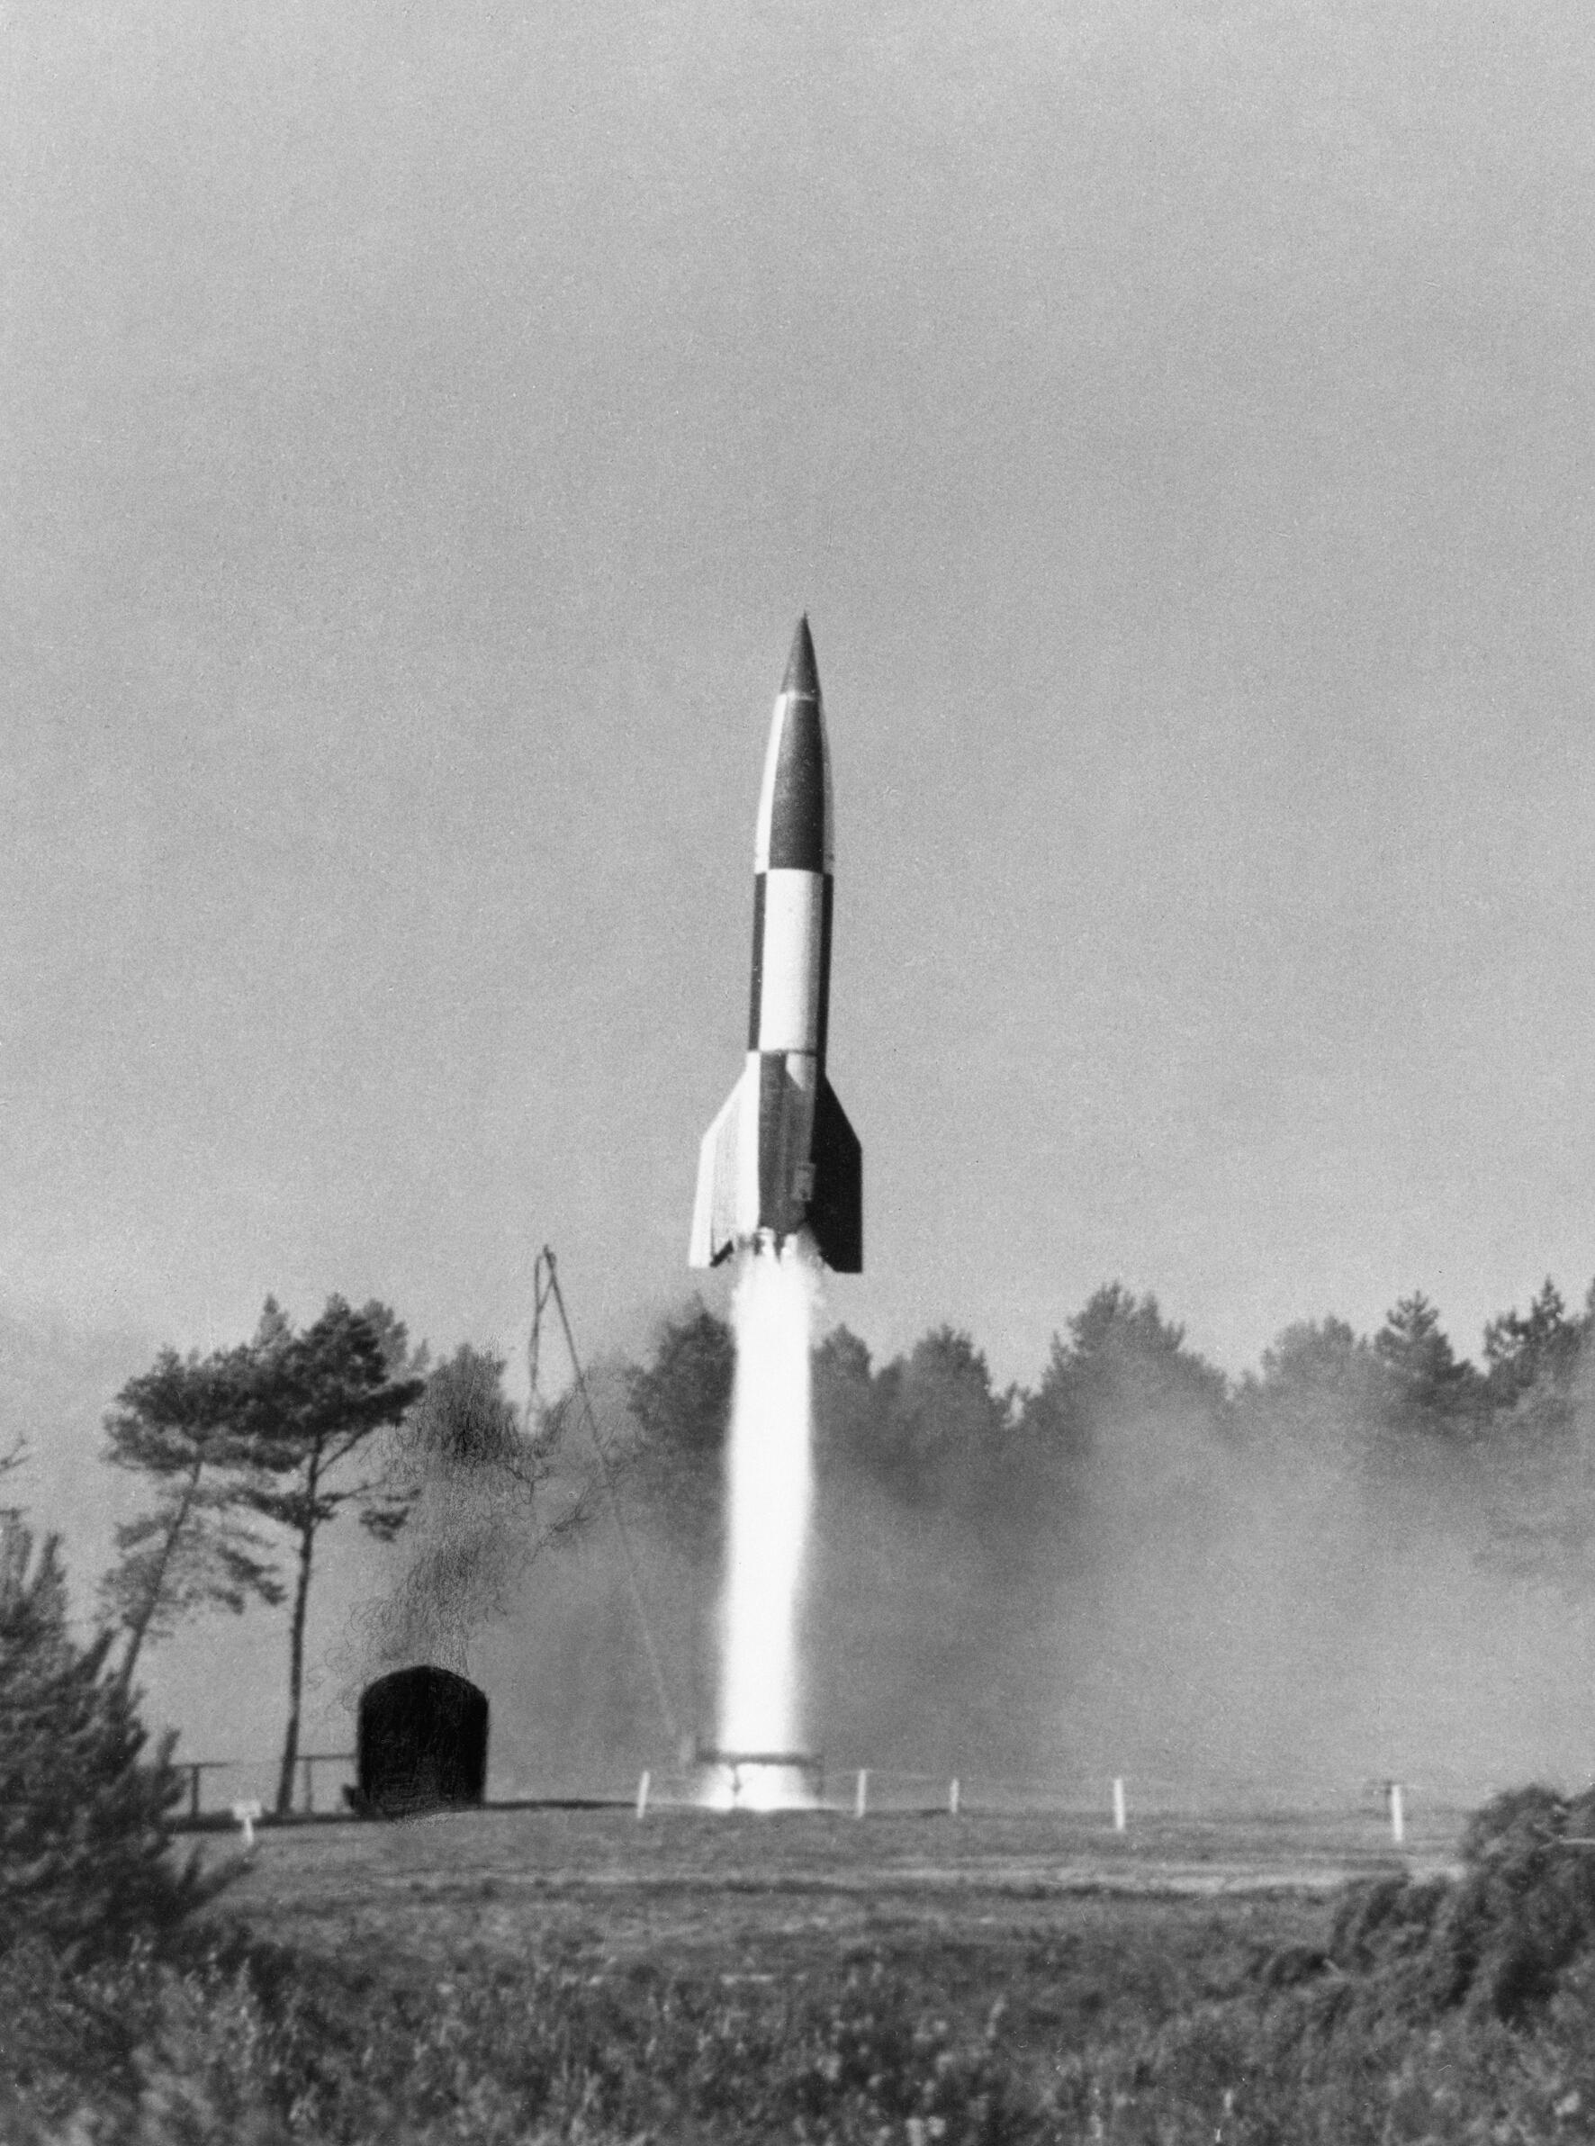
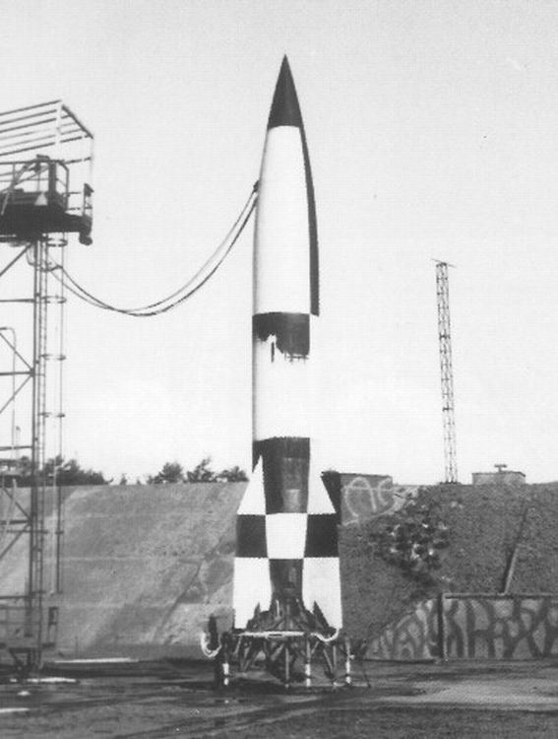
Peenemunde

Slide 7
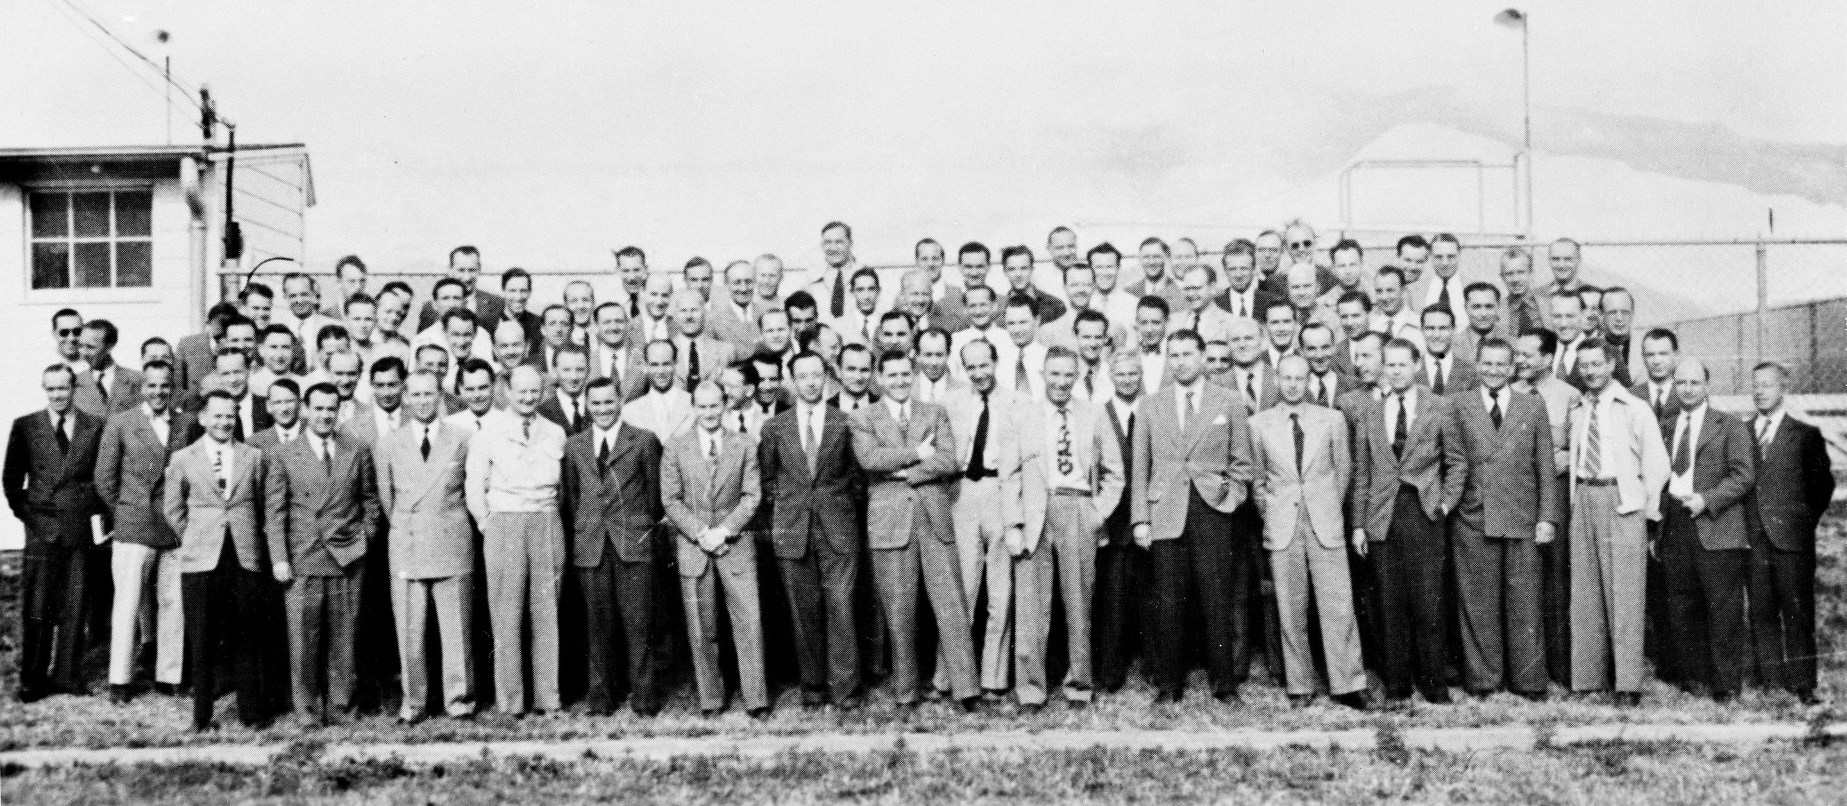
Operation Paperclip (1945-1952)

Slide 8
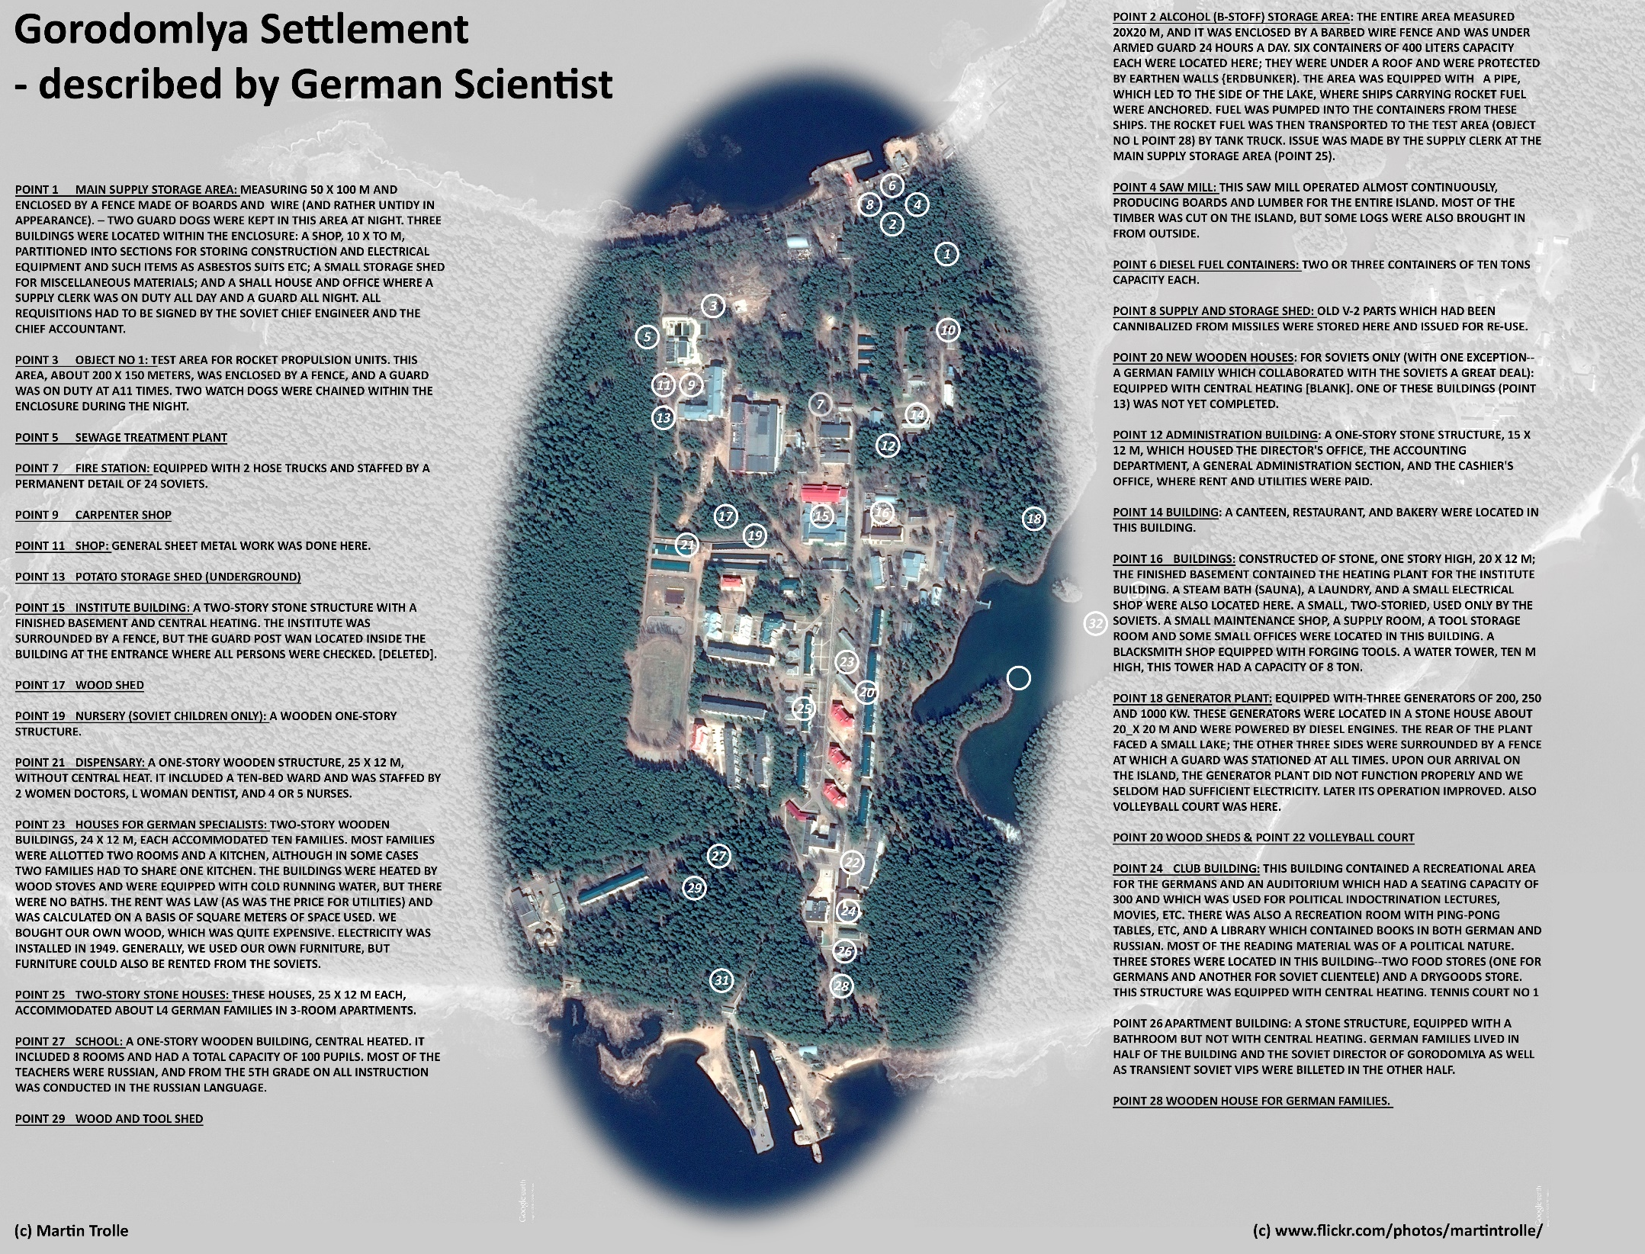
Operation Osoaviakhim (Oct 1946)

Slide 9
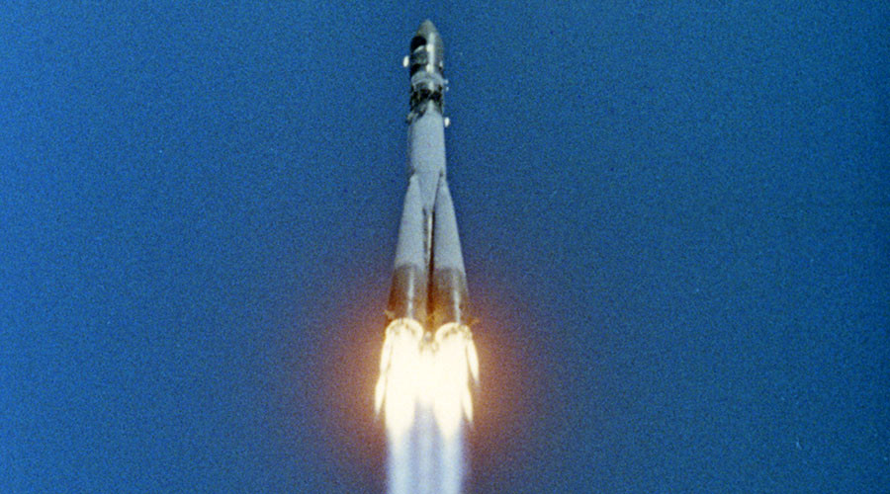
Vostok-R7

Slide 10
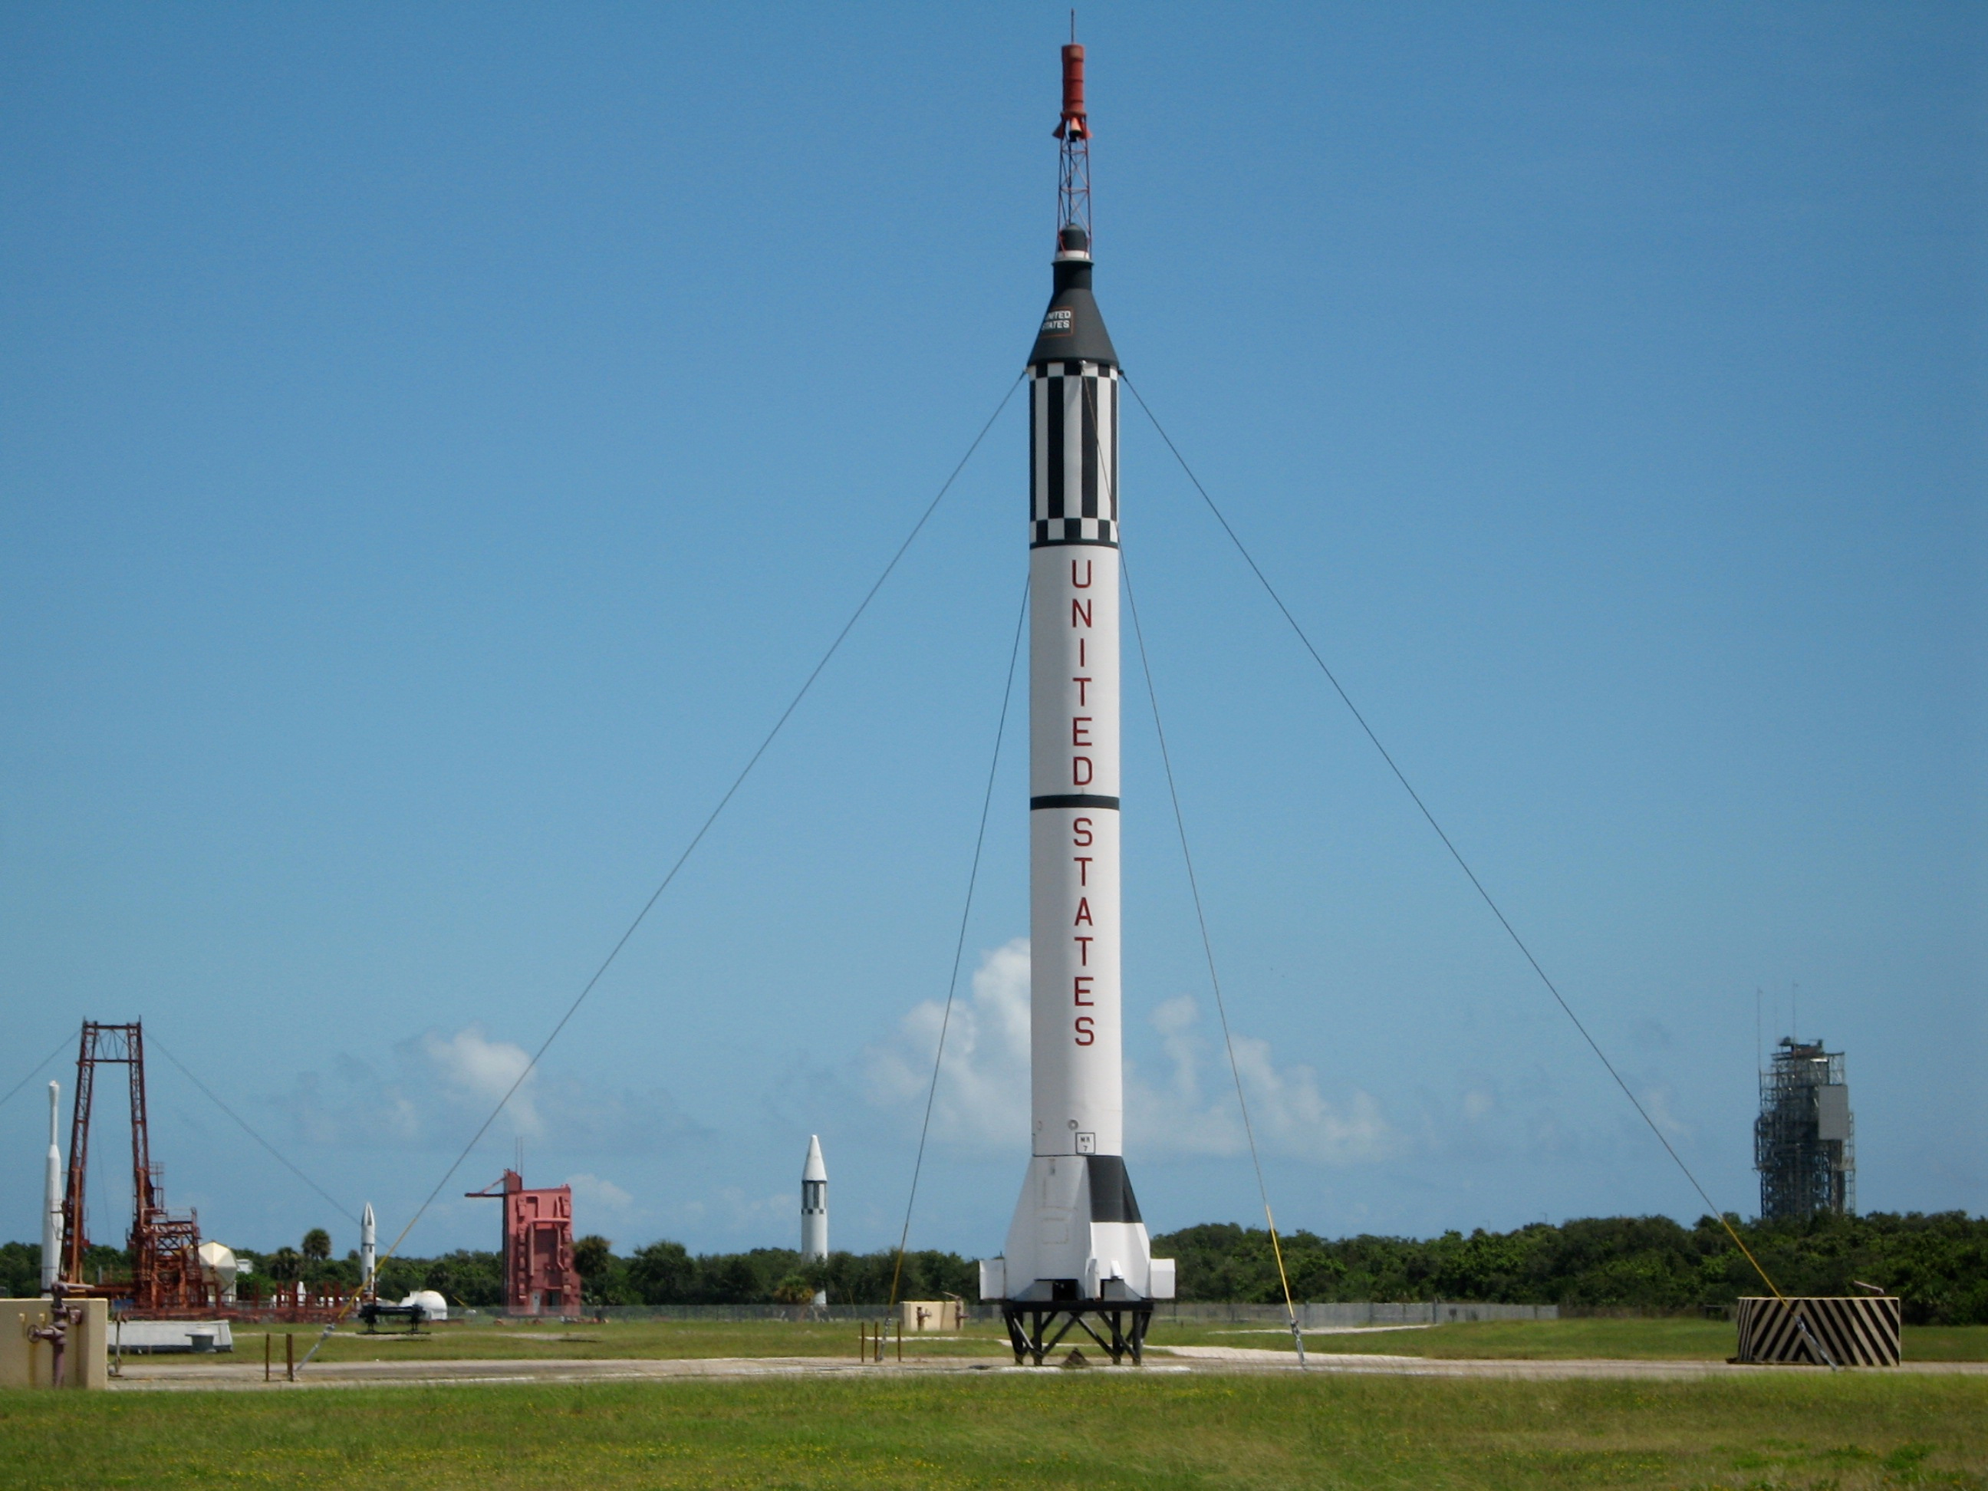
Mercury- Redstone

Slide 11
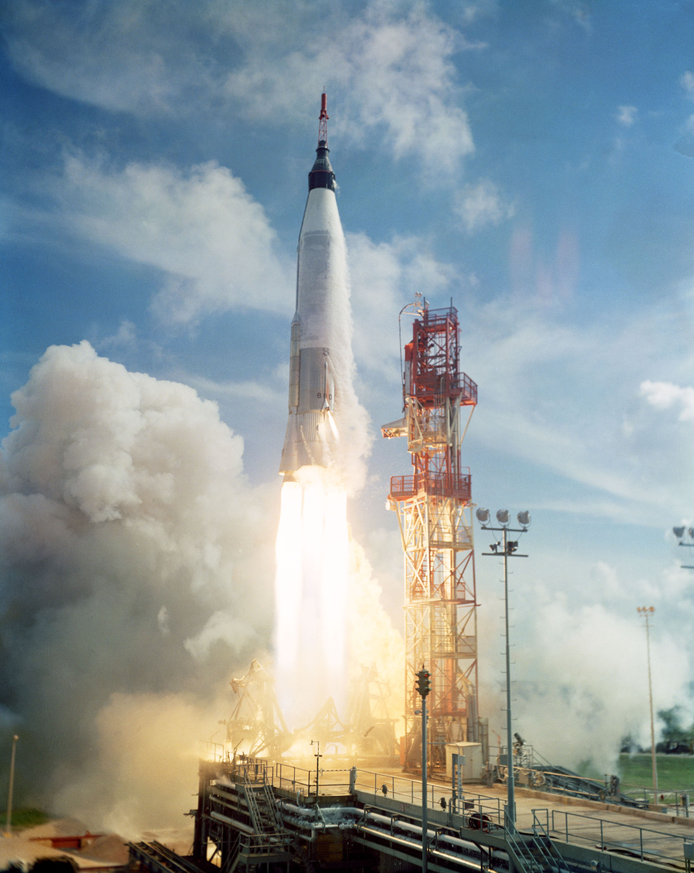
Mercury- Atlas

Slide 12
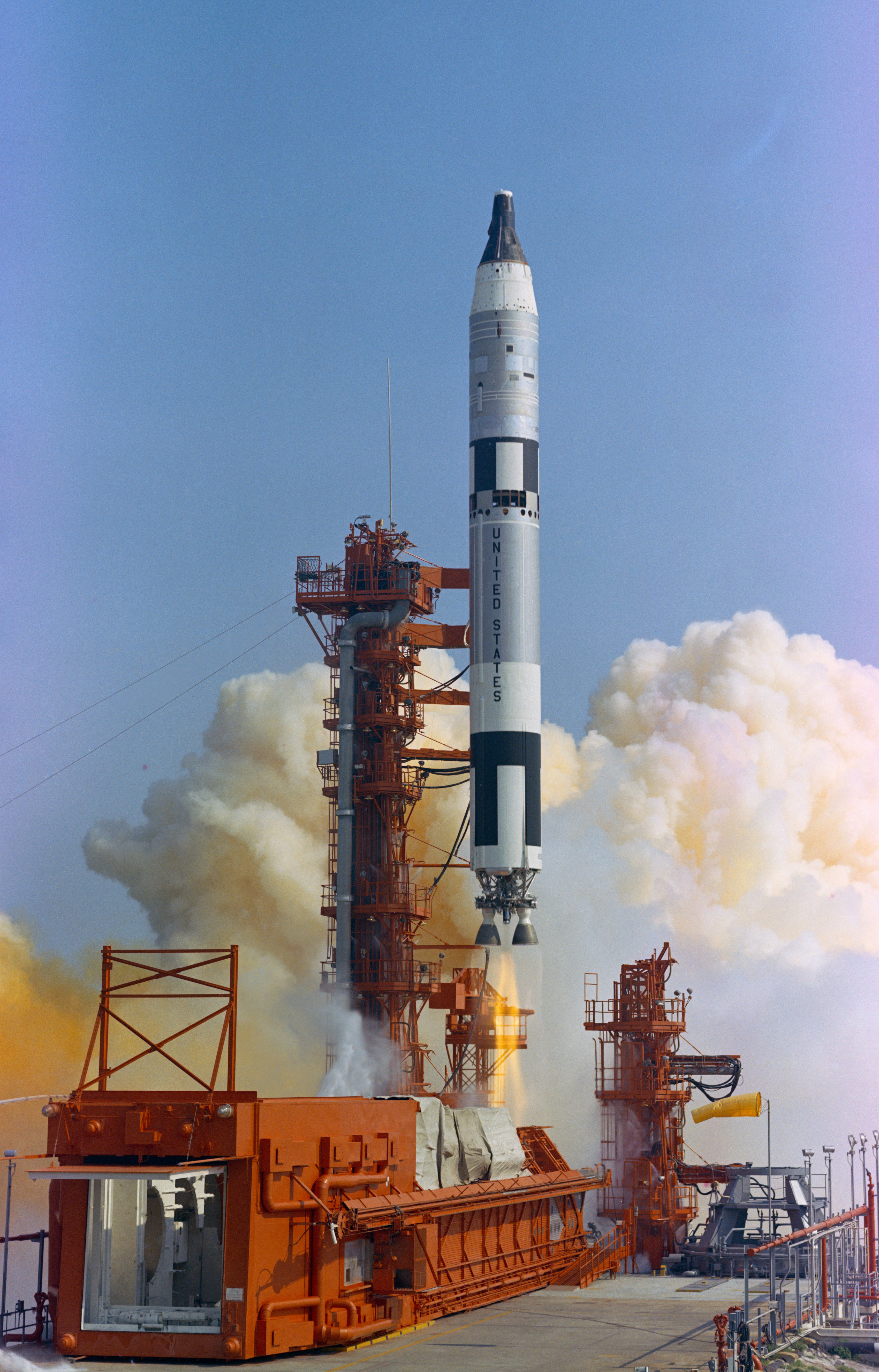
Gemini- Titan II

Slide 13
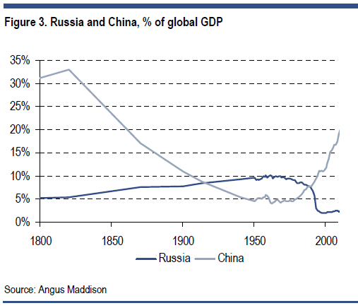
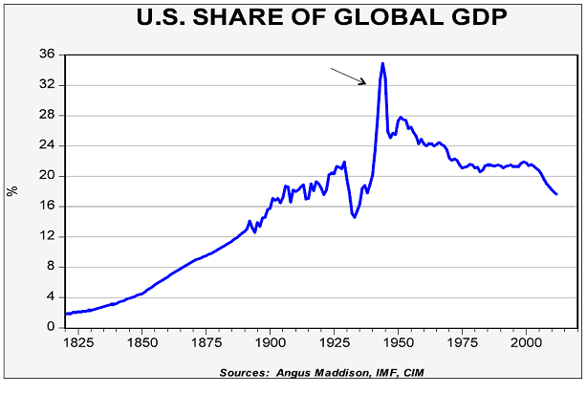

Slide 14
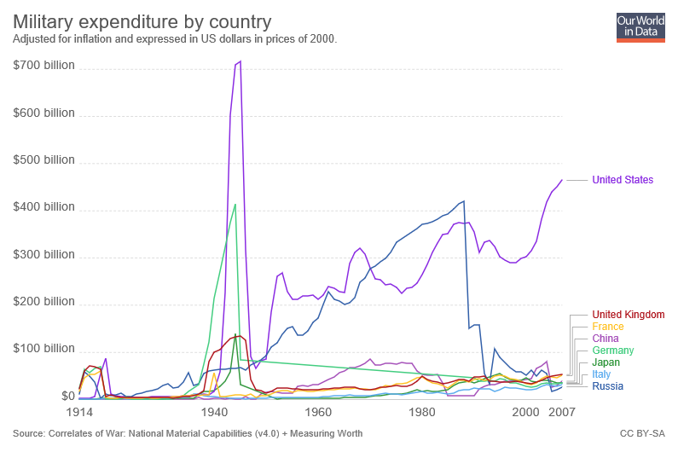

Slide 15
The “Readings”
Gaddis Chapter 2 (“Deathboats and Lifeboats”)
Learning to manage nuclear weapons
McDougall Chapter 12 (“The Missile Bluff”)
Development of ICBM’s and international law on use of outer space
Fail Safe (motion picture)
Shaping public thinking about nuclear weapons after the Cuban Missile Crisis

Slide 16
Case Study Process
Selections due before class on February 11 on ELMS
At least five from different categories, in preference order
We will select from these and make assignments
Read the initial reading (usually an oral history)
May need to use the Internet Archive is the JSC Oral History site remains down
Find at least four additional primary and secondary sources
Internet text/video/audio, books (allow time for interlibrary loan!), journals
Select a vignette and write about it
Background, role(s), one vignette, post-Apollo career
2-3 pages, single-spaced, standard margins, 12-point font (plus references)

Slide 17
Readings for NASA Before Apollo
McDougall Chapter 7 (“The Birth of NASA”)
“Inside baseball” from the American political system
Cox Chapter 1 (“The Famous Space Task Group is akin to the Mayflower”)
A vivid picture of the beginning of human space flight at NASA
The Right Stuff (motion picture)
An interpretation of the test pilot culture at the founding of NASA

