Slide 1
Part 1: America in 1968
INST 154
Apollo at 50

Slide 2
Apollo Chronology
January 1967 Apollo 1 fire
November 1967 Apollo 4 (Uncrewed Saturn V)
January 1968 Apollo 5 (Uncrewed Earth orbit LM test)
April 1968 Apollo 6 (Uncrewed Saturn V: 3 engines fail)
October 1968 Apollo 7
December 1968 Apollo 8
…
December 1972 Apollo 17

Slide 3
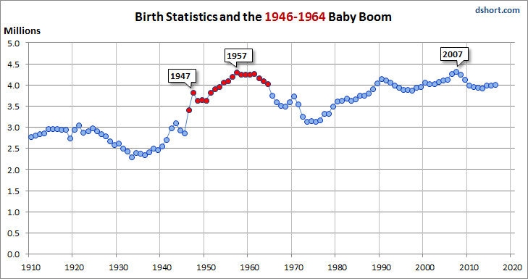

Slide 4
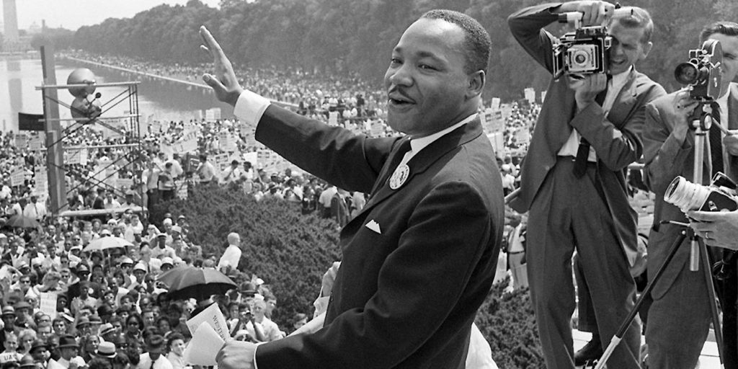

Slide 5
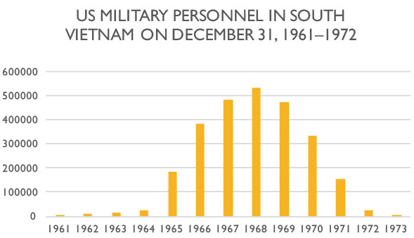
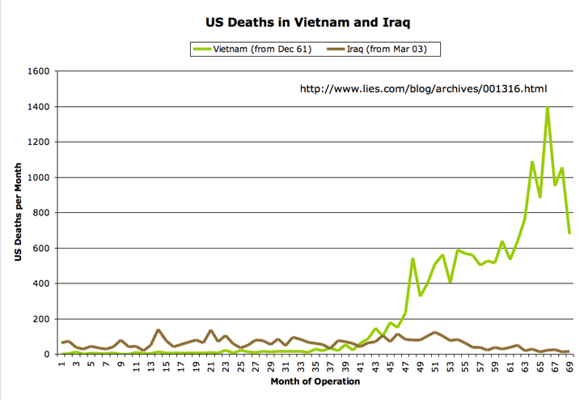

Slide 6
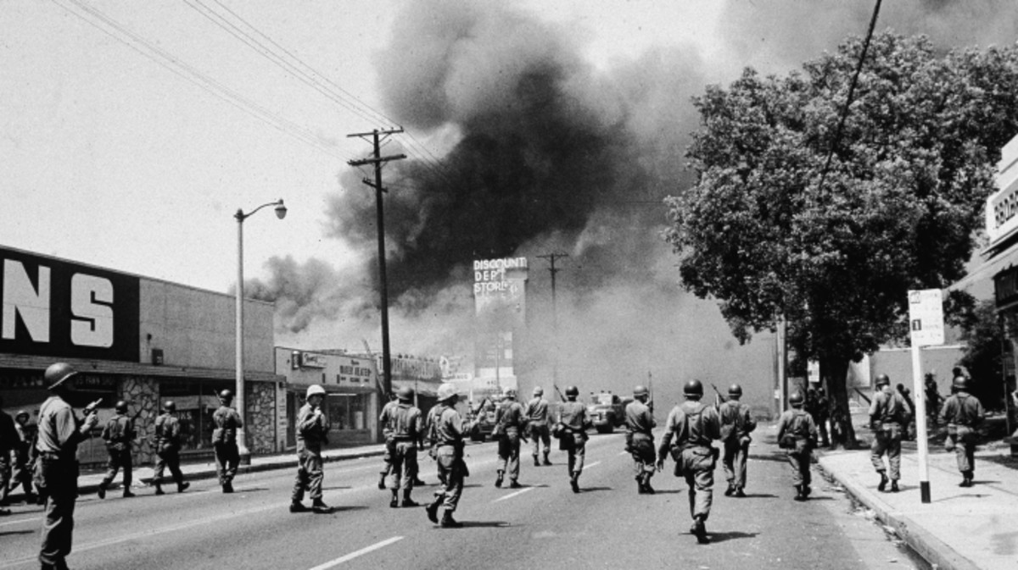

Slide 7
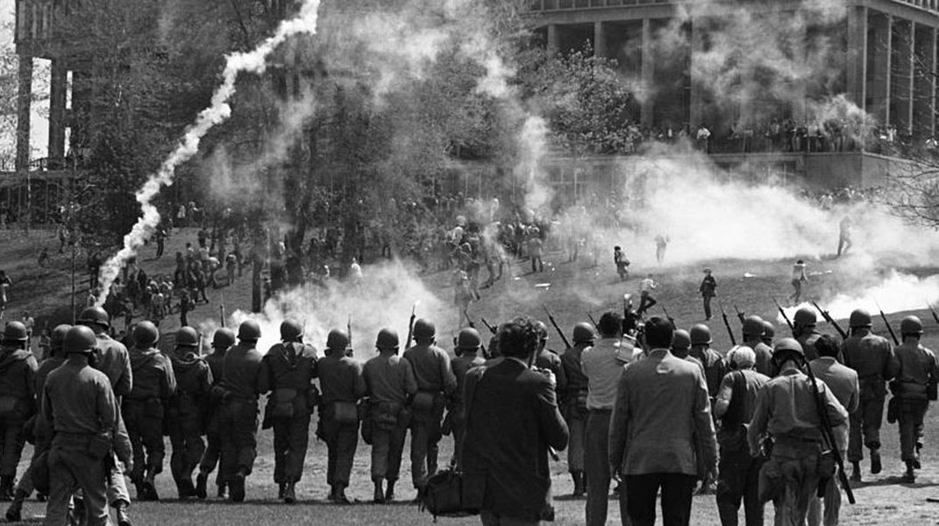

Slide 8
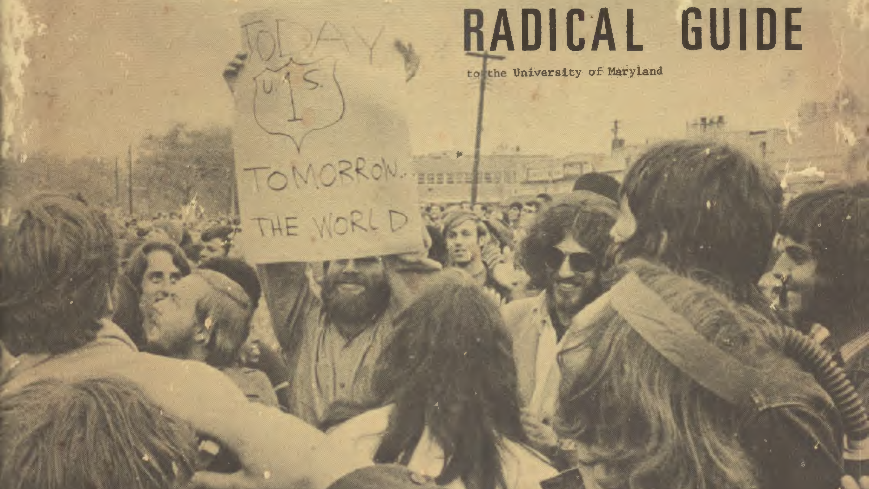

Slide 9
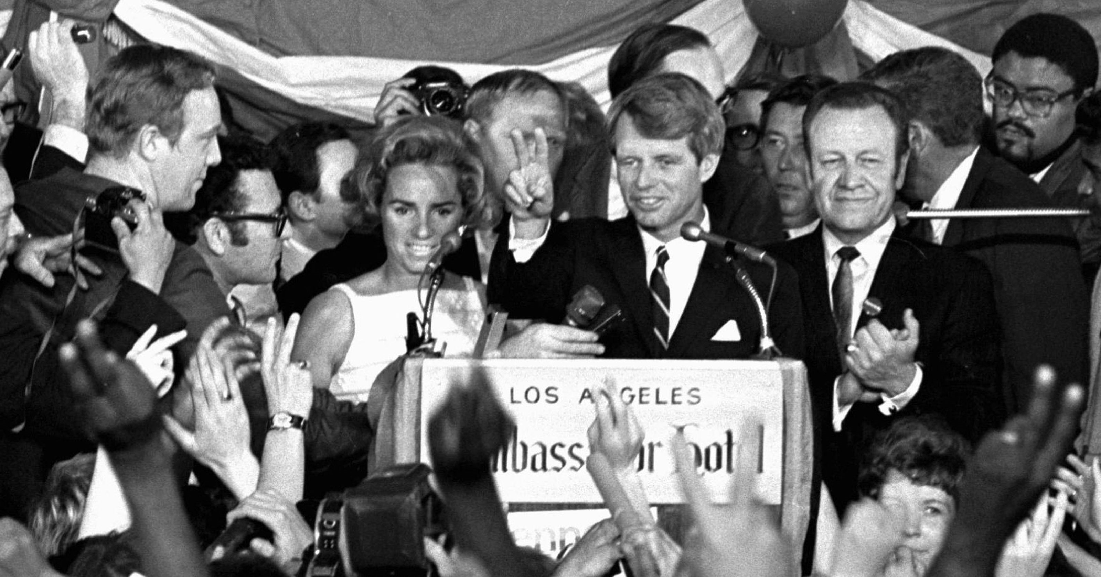

Slide 10
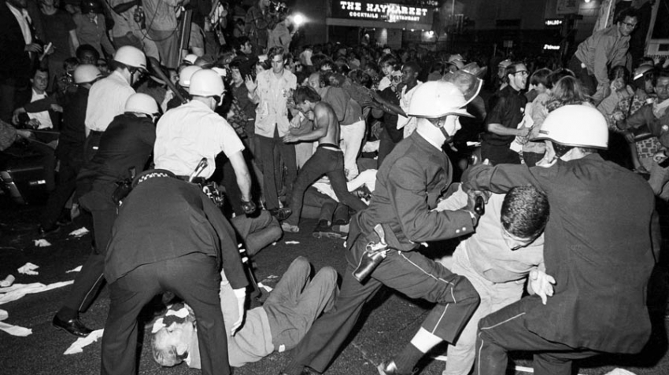

Slide 11
Part 2: Apollo 8: Lunar Orbit
INST 154
Apollo at 50

