Slide 1
The Command Module
INST 154
Apollo at 50
The Apollo 11 Command Module

Slide 2
Agenda
Command and Service Modules
Apollo Guidance Computer
Contracting
(Discussion Groups)
Writing your case study

Slide 3
Chronology
MIT guidance computer contract award (August 1961)
North American CSM contract award (November 1961)
LOR mode decision (July 1962)
Block II CSM design (January 1964)
First boilerplate launch (March 1964: Saturn 1)
First Block I launch (January 1966: Little Joe 2)
Apollo 1 fire in a Block I CM (January 1967)
First Block II launch (October 1968: Apollo 7)

Slide 4
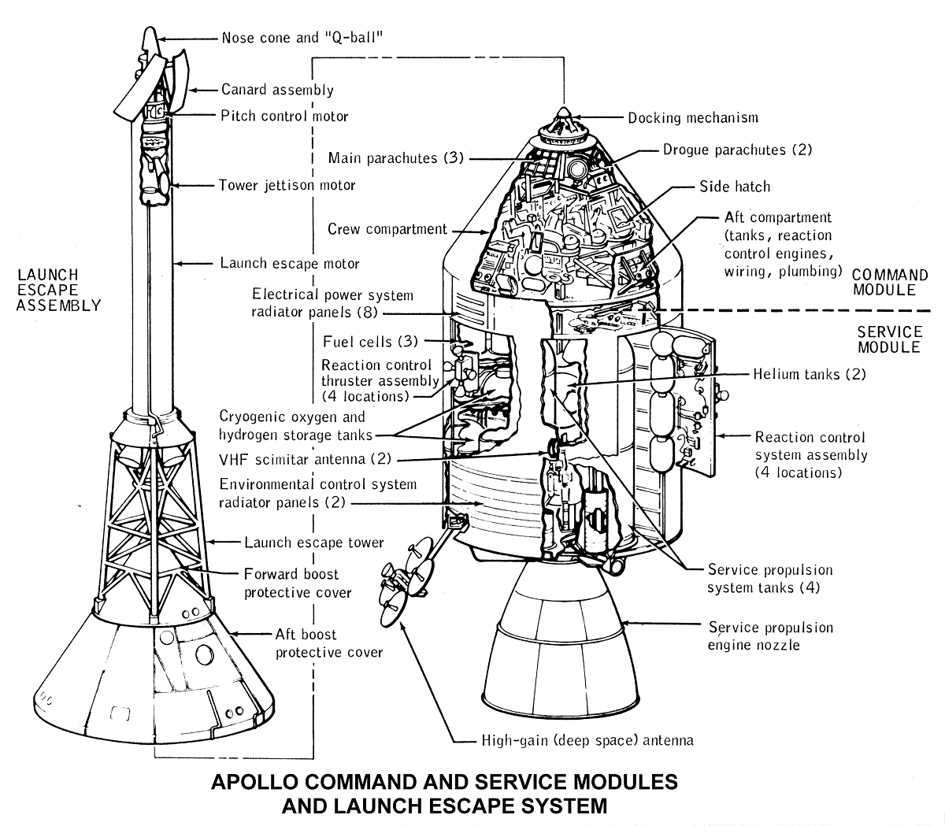

Slide 5
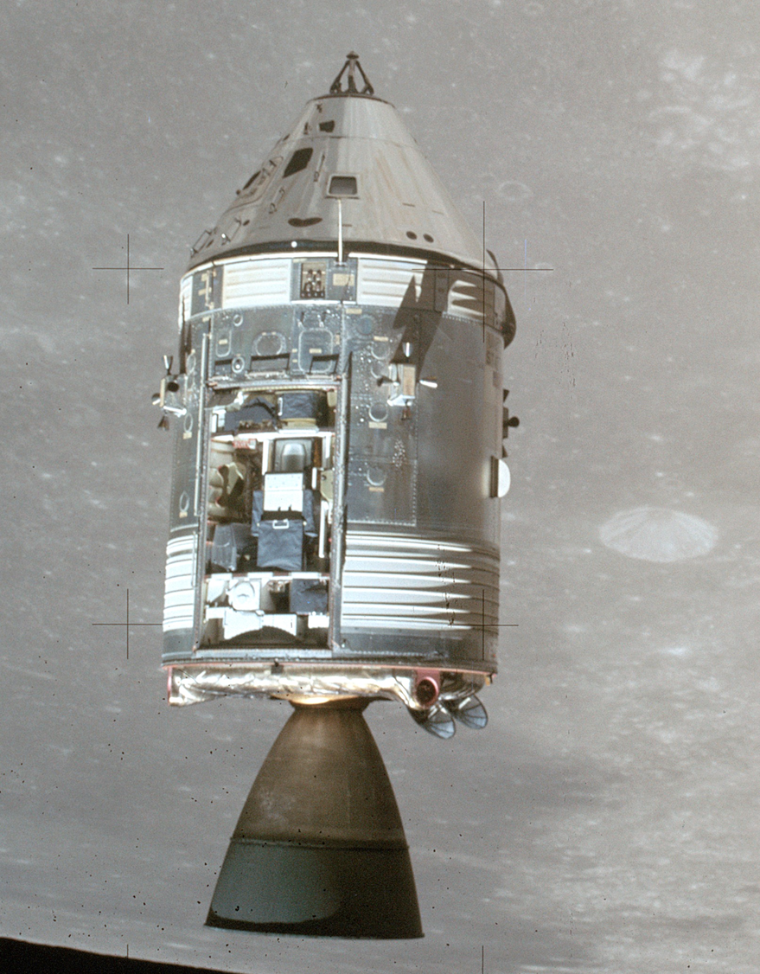

Slide 6
Some Design Questions
How many stageable modules?
The Soviets had 3, we had 2. Why?
How to transfer to the Lunar Module?
The Soviets used spacewalks, we used a tunnel. Why?
Whether to land on land or in the water
We tried land; it was hard.
How to navigate?
We spent $100 million for onboard navigation, and then did it from Earth.
When to wear spacesuits?
A bad decision on this killed three cosmonauts.
Whether to use normal air or pure oxygen?
Oxygen is much lighter. It killed three astronauts.
Whether to put a TV camera aboard
We had the technology to do this, but had chosen not to in Gemini.

Slide 7
Apollo Guidance Computer
Clock speed: ~500 µsec
ROM: ~70kB
RAM: ~4kB
Word length: 16 bits (15+parity)
Weight: 70 lbs.
Power: 55 watts
Language: Assembler
Peripherals: DSKY, IMU, landing radar, engine, …

Slide 8
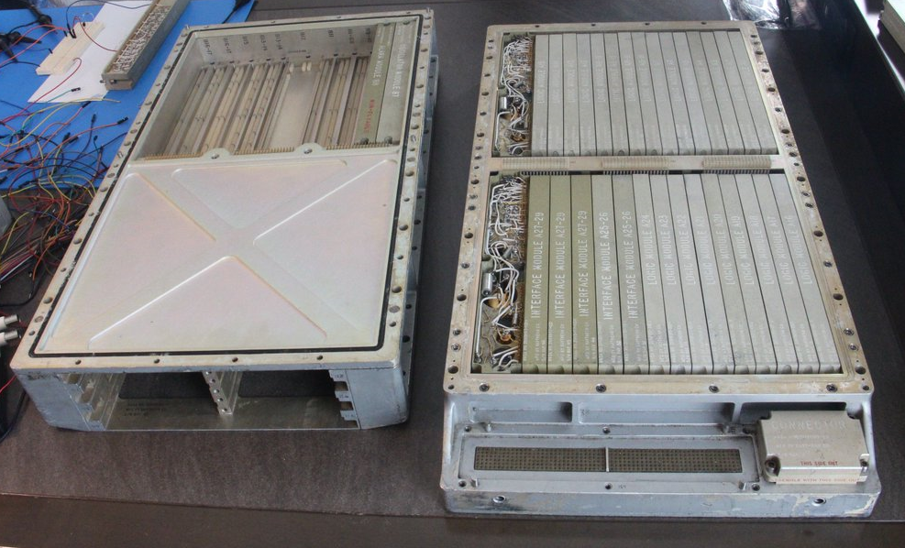
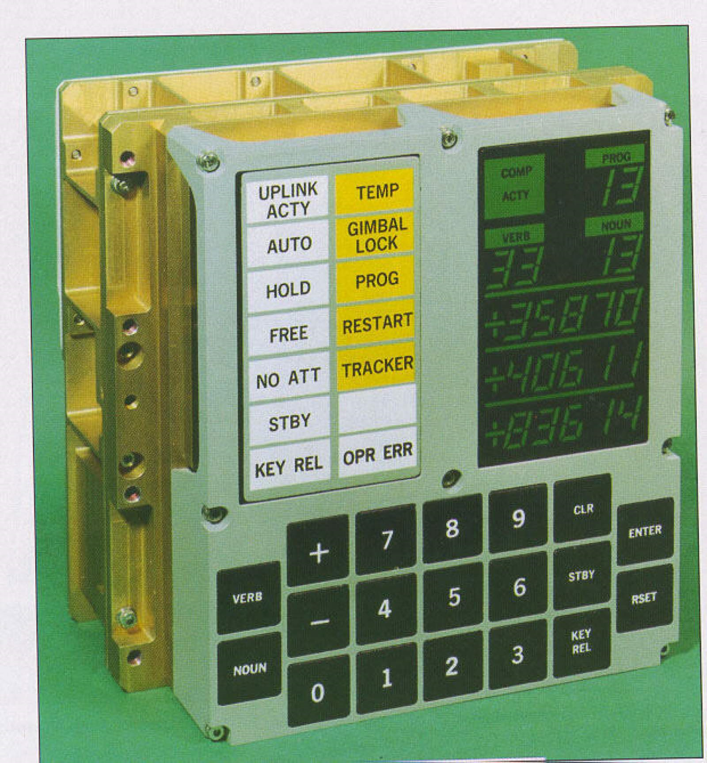
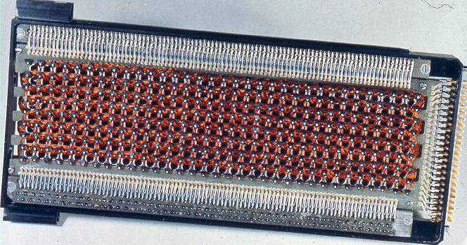

Slide 9
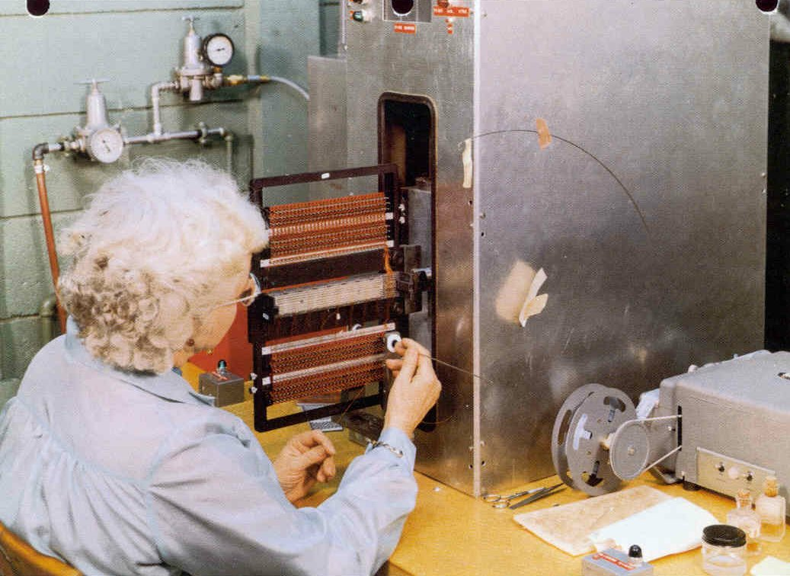
Programming Core Rope Memory

Slide 11
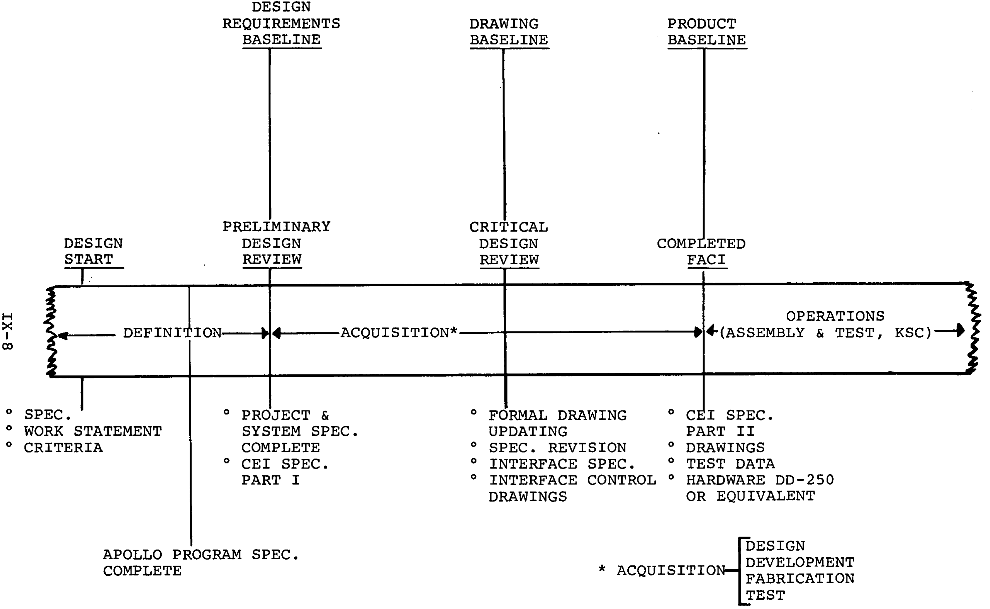
Configuration Management

Slide 12
Configuration Control Board

Slide 13
Discussion Groups
Moon Machines Video (“Command Module”)
An overview, including interviews with some of its builders
Brooks Chapter 5 (“Command Module and Program Changes”)
The view from NASA
Gray Chapter 12
The view from the North American (the CSM prime contractor)
Mindell Chapter 5 (“Braincase on the Tip of a Firecracker: Apollo Guidance”)
The view from MIT (the Guidance and Navigation prime contractor)

Slide 14
Case Study
Read broadly about your assigned person
The one linked reading is just a starting point
Consult at least five sources
May take time to get some library materials!
Organize your writing in four parts
Pre-Apollo career
Apollo career
Post-Apollo career
One vignette
References
Any quoted content must be in quotes
Sources for all content that is not original must be cited

