Slide 1
The Soviet Lunar Landing Program
INST 154
Apollo at 50
N1 Launches
LK Lunar Landing Animation

Slide 2
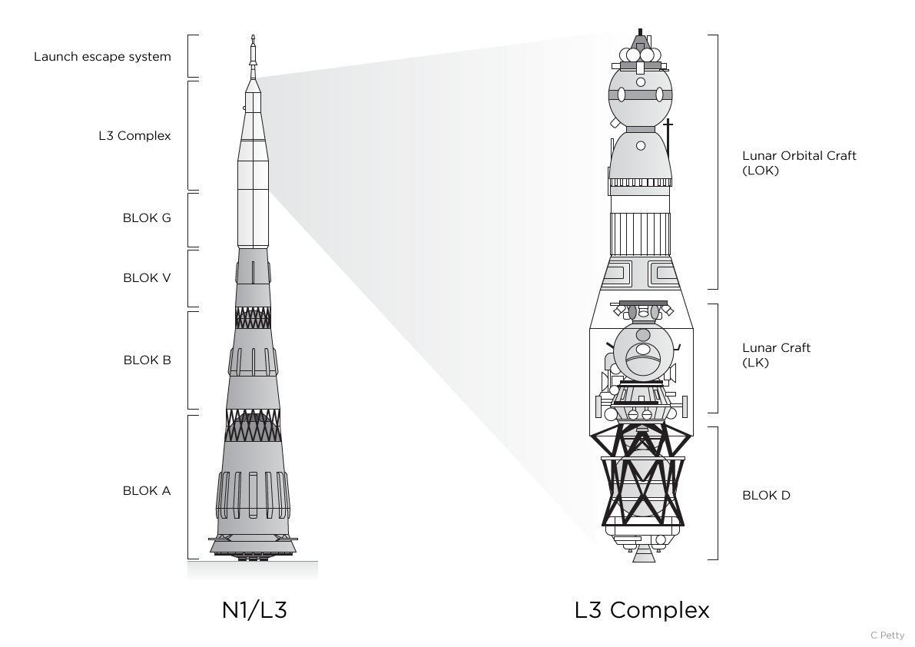

Slide 3
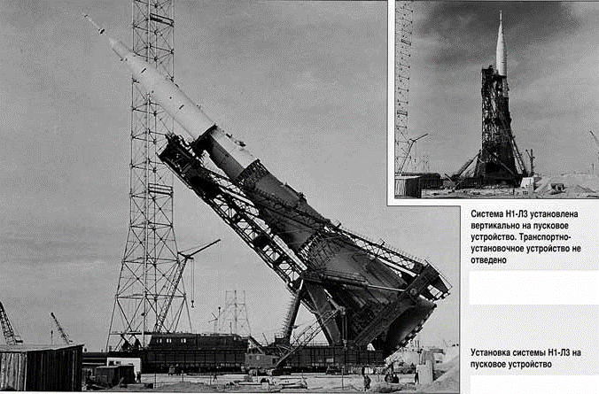
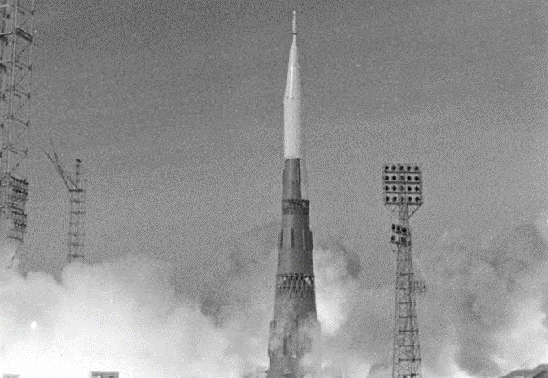
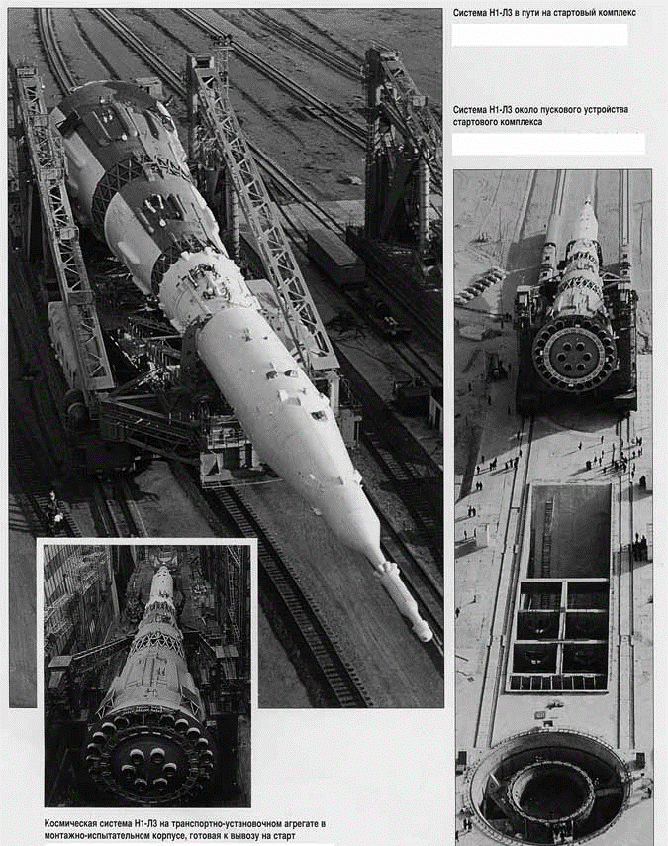
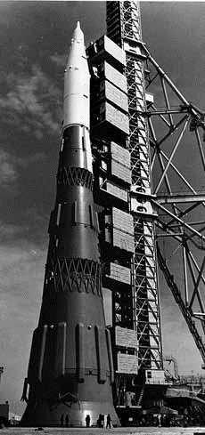
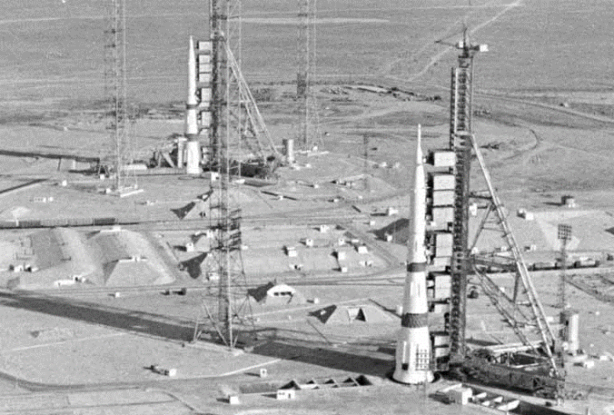
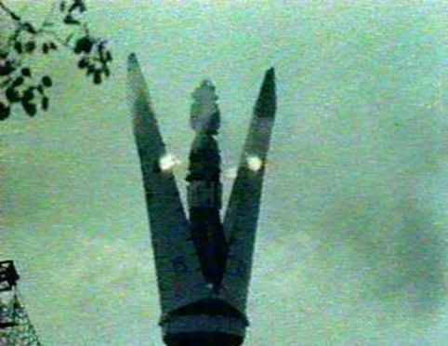

Slide 4
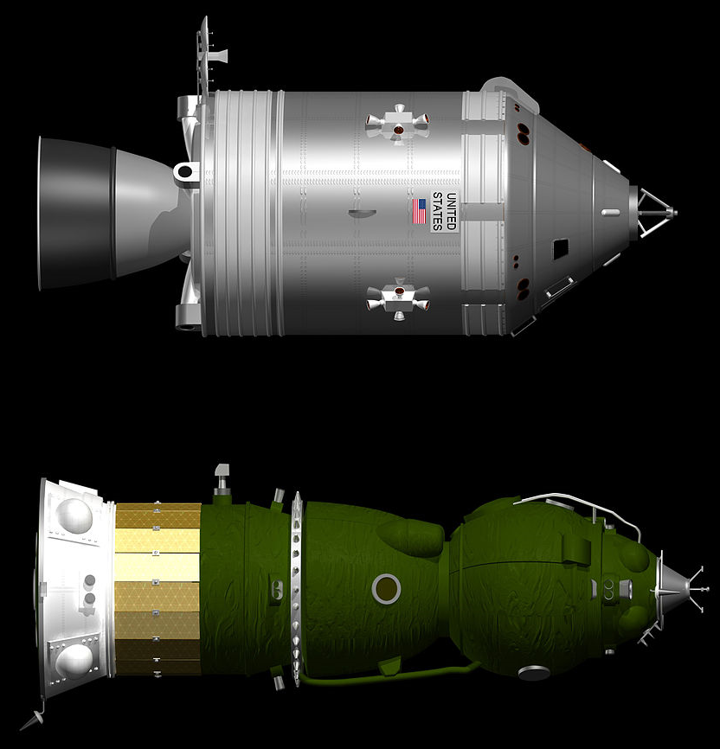
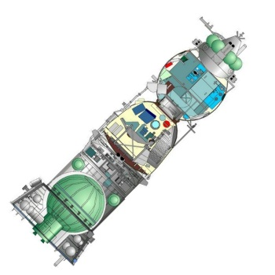

Slide 5
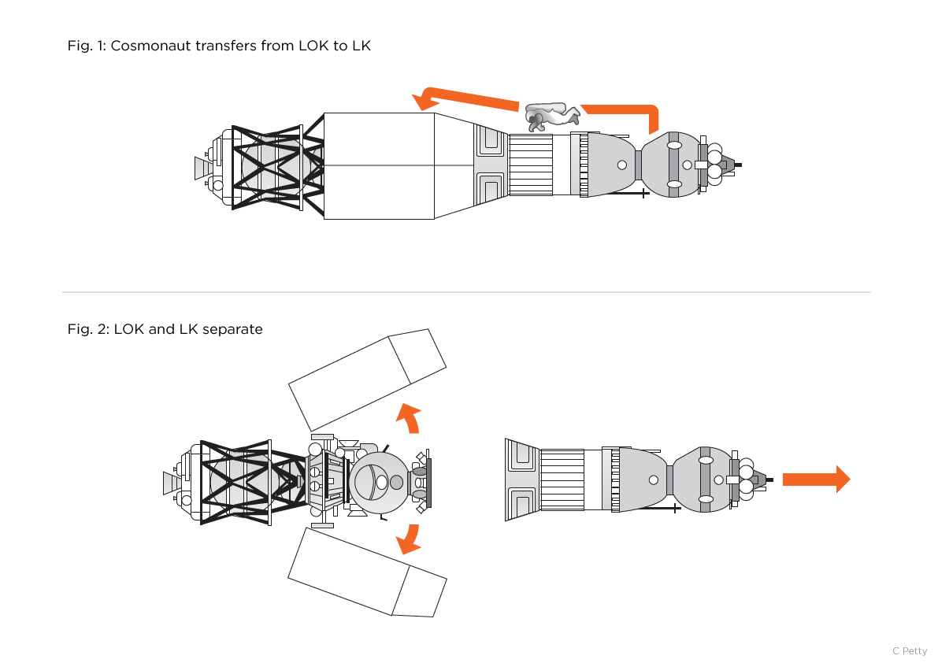

Slide 6
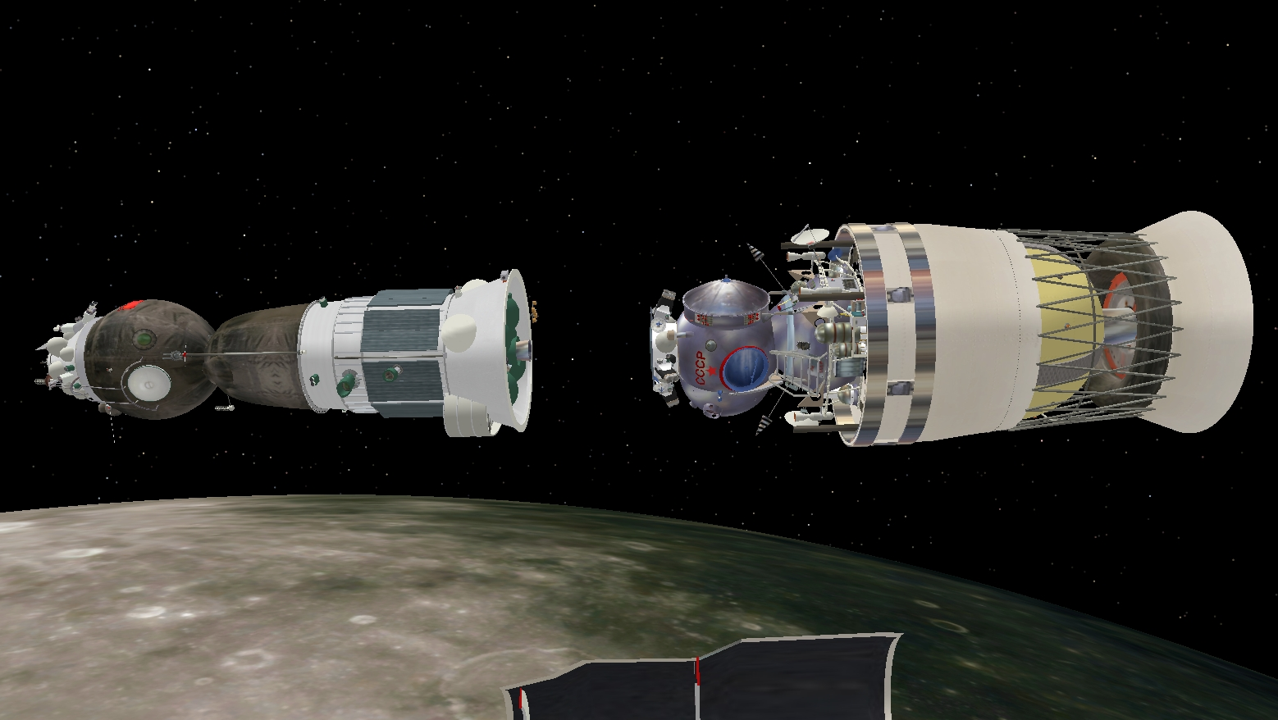

Slide 7
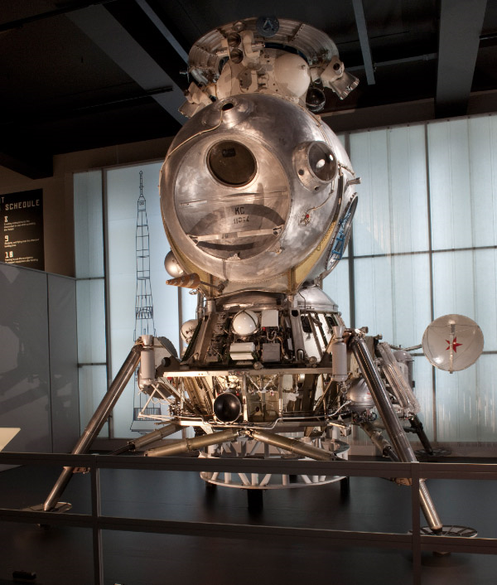

Slide 8
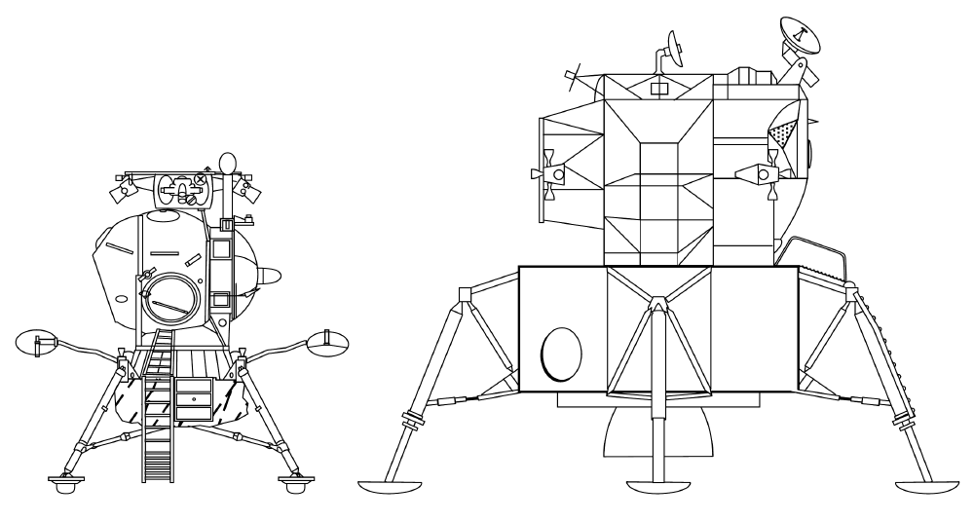

Slide 9
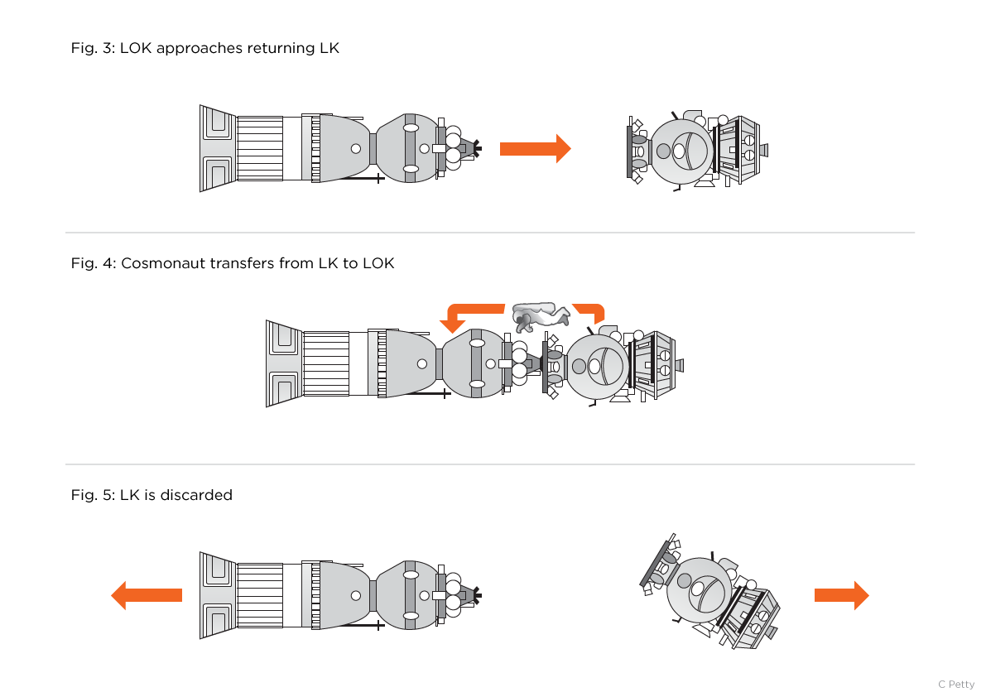

Slide 10
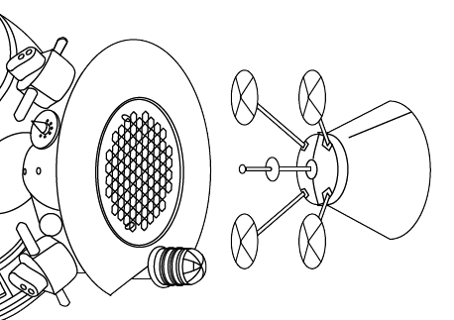
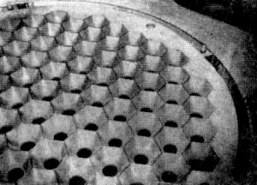
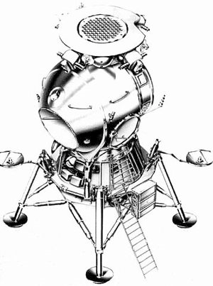

Slide 11
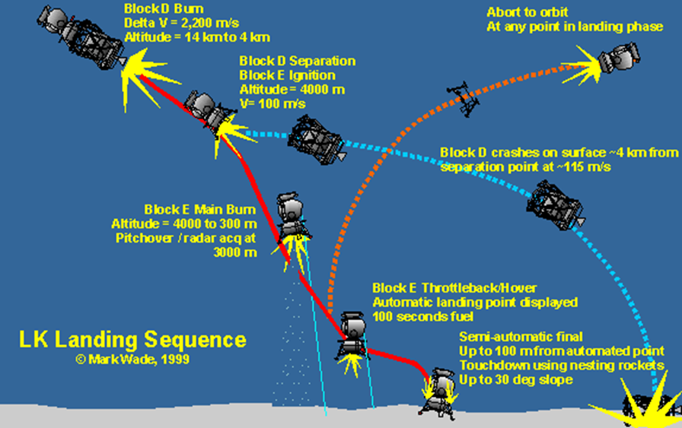
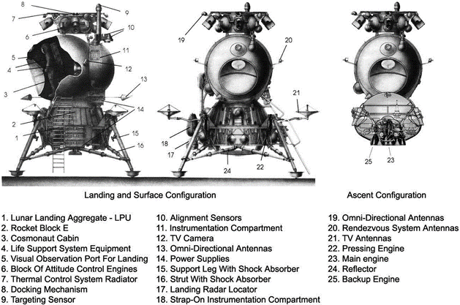
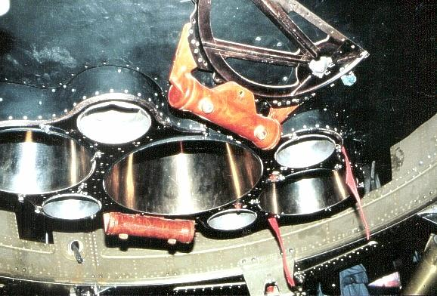
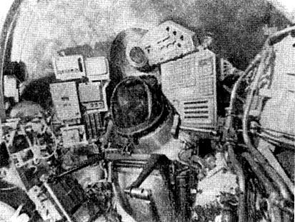
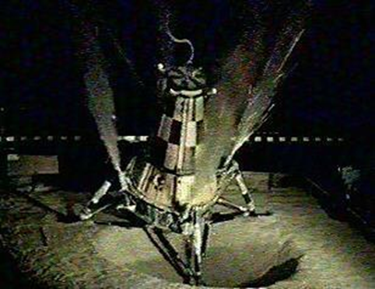

Slide 12
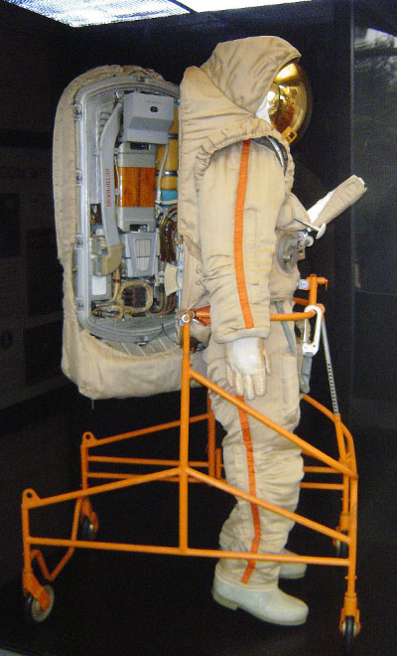
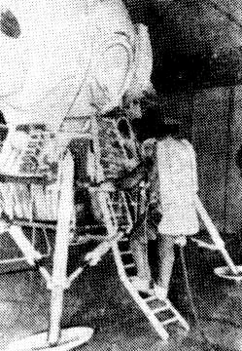
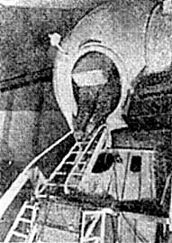

Slide 13
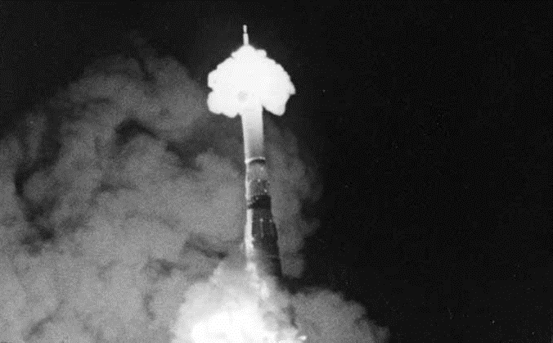
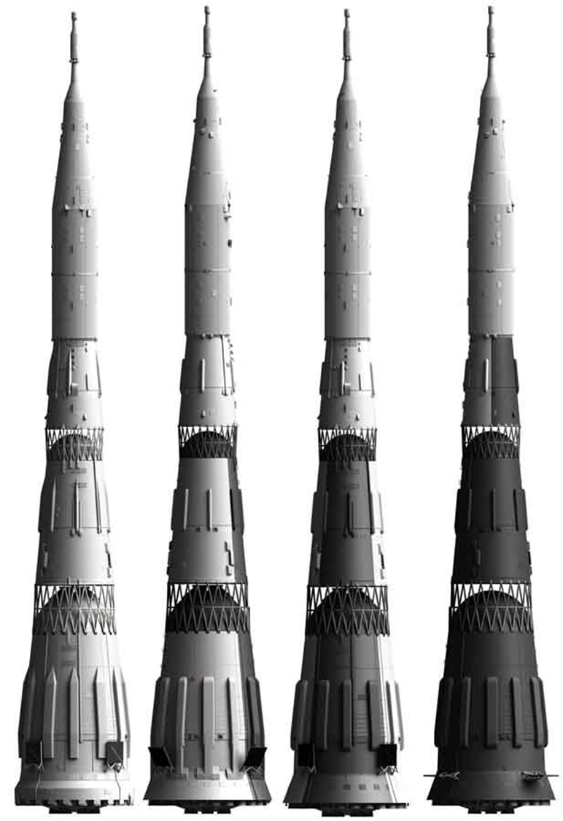
Lunar Landing Program Flights
Feb 1969 Uncrewed N1 test (first stage failure)
Jul 1969 Uncrewed N1 test (first stage failure, destroyed launch pad)
Nov 1969 Uncrewed Block D test (first stage failure)
Nov 1970 Cosmos 379: Uncrewed LK test
Dec 1970 Cosmos 382: Uncrewed Block D test
Feb 1971 Cosmos 398: Uncrewed LK test
Jun 1971 Uncrewed N1 test (first stage failure failure)
Aug 1971 Cosmos 434: Uncrewed LK test
Nov 1972 Uncrewed N1 test (first stage failure)

Slide 14
Discussion Groups
Siddiqi Chapter 15 (“Final Lap to the Moon”)
The Soviet space program between Apollo 1 and Apollo 11
Chertok Chapter 3 (“N1-L3 Lunar Program Under Korolev”)
The origins of the Soviet lunar landing program
Chertok Chapter 10 (“1969—The First N-1 Launch”)
The first attempt to launch the Soviet moon rocket
The Engines that Came in from the Cold video
The rebirth of the N1’s engines in American rockets

