Slide 1
Apollo 17: A Geologist on the Moon
INST 154
Apollo at 50
The Last Mission to the Moon

Slide 2
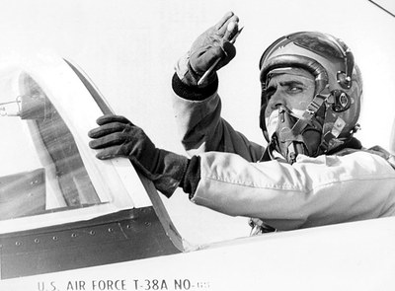
Harrison H. (“Jack”) Schmitt
1964 Ph.D. in geology from Harvard
U.S. Geological Survey, Astrogeologist
1965 Astronaut group 4
1966 1-year Air Force jet pilot training
1967 Astronaut candidate training
1970 Apollo 15 backup crew LMP
1972 Apollo 17 LMP
1975 Resigned from NASA
1976 Elected to the U.S. Senate (1 term)

Slide 3
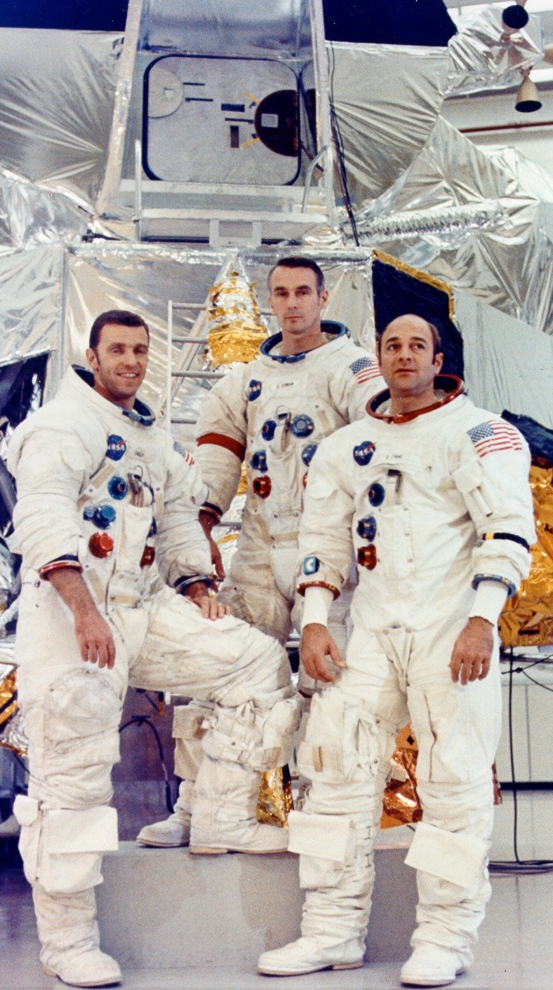
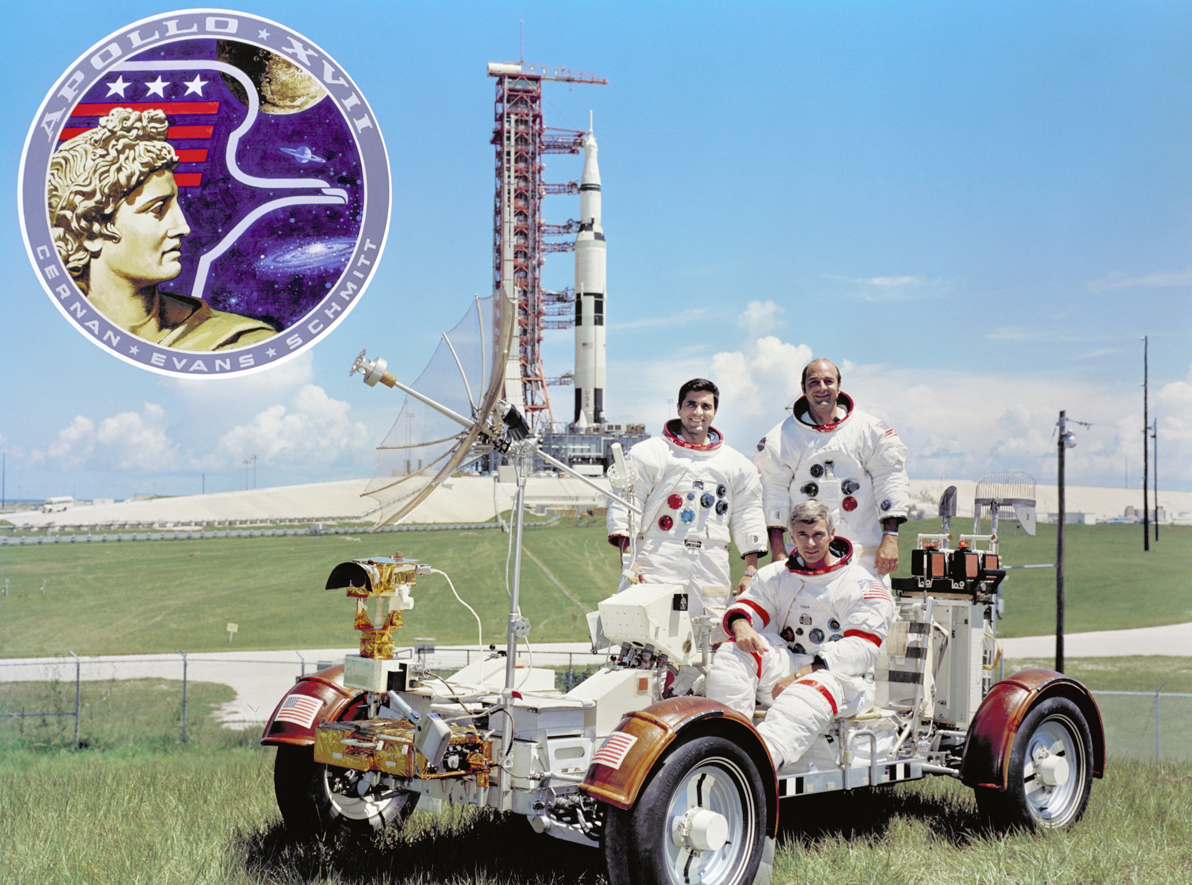
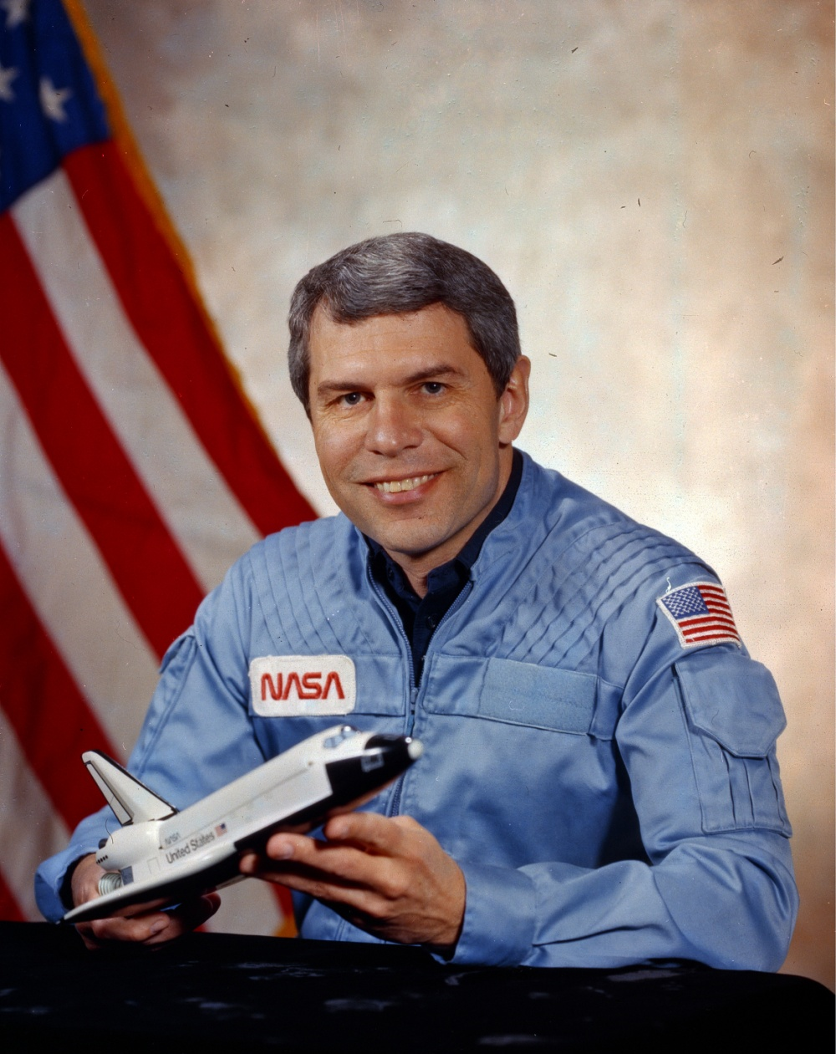

Slide 4
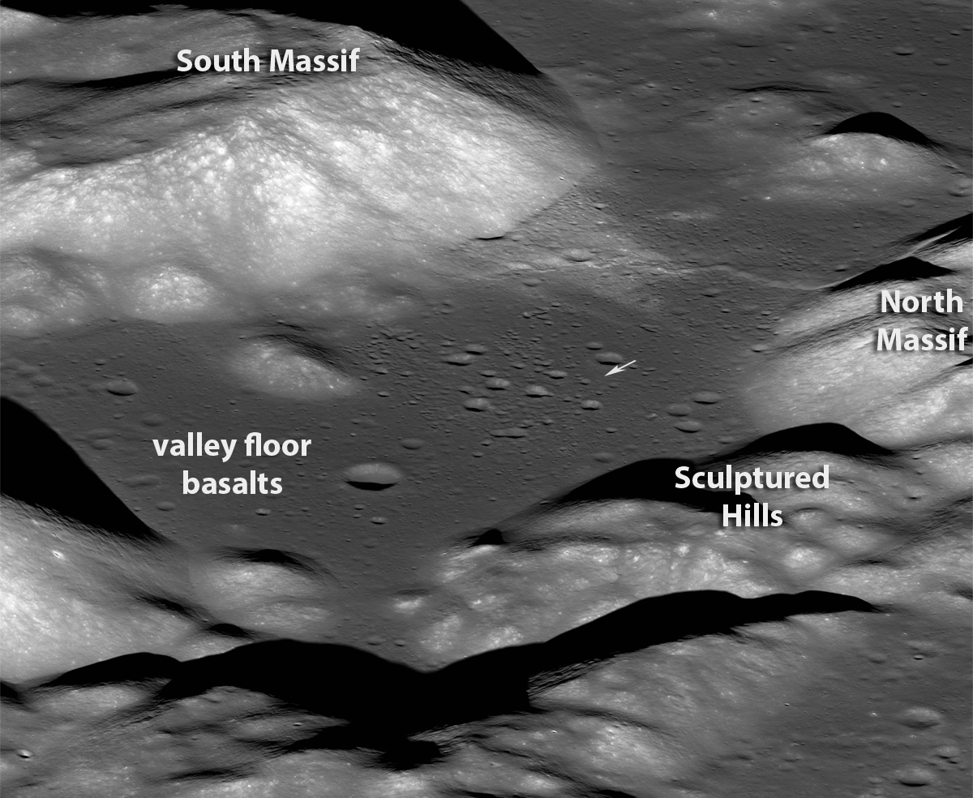

Slide 6
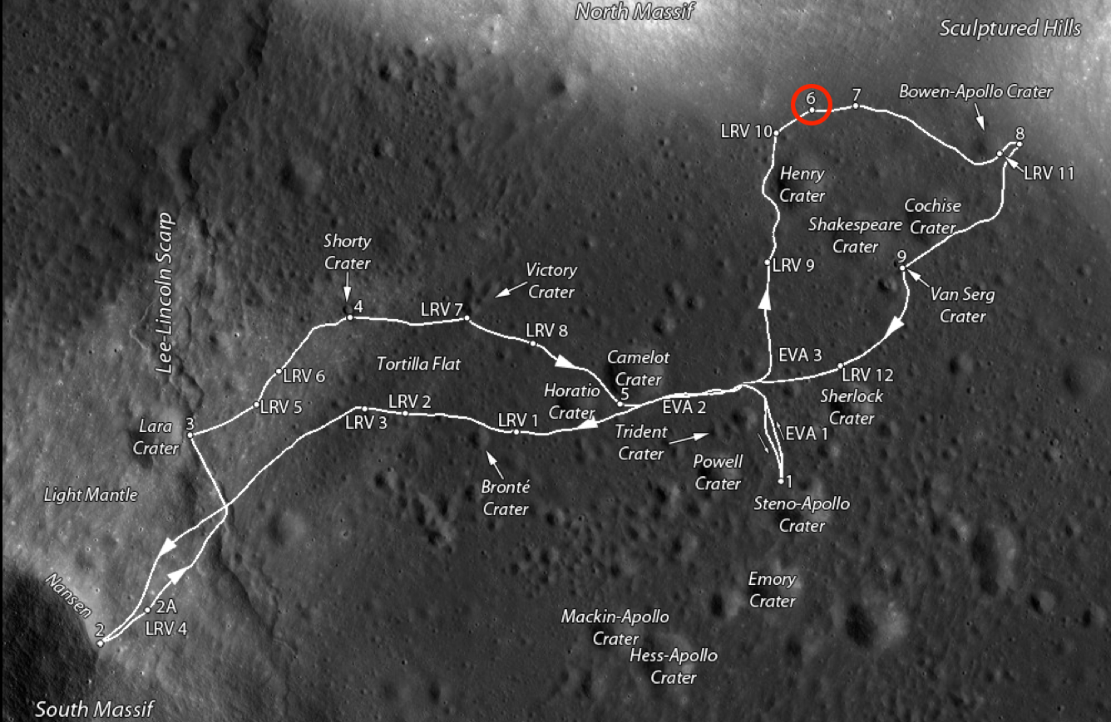

Slide 7
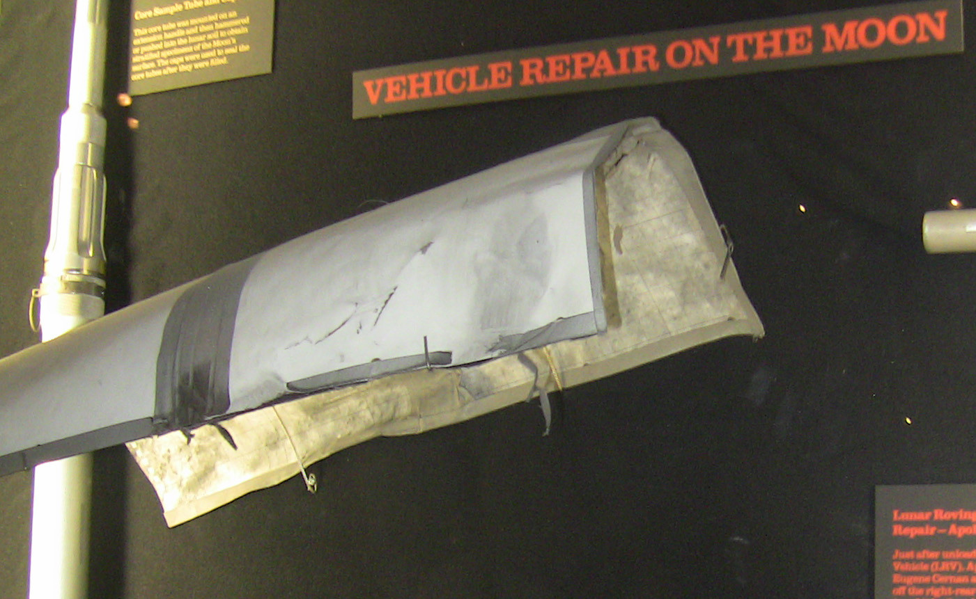

Slide 8
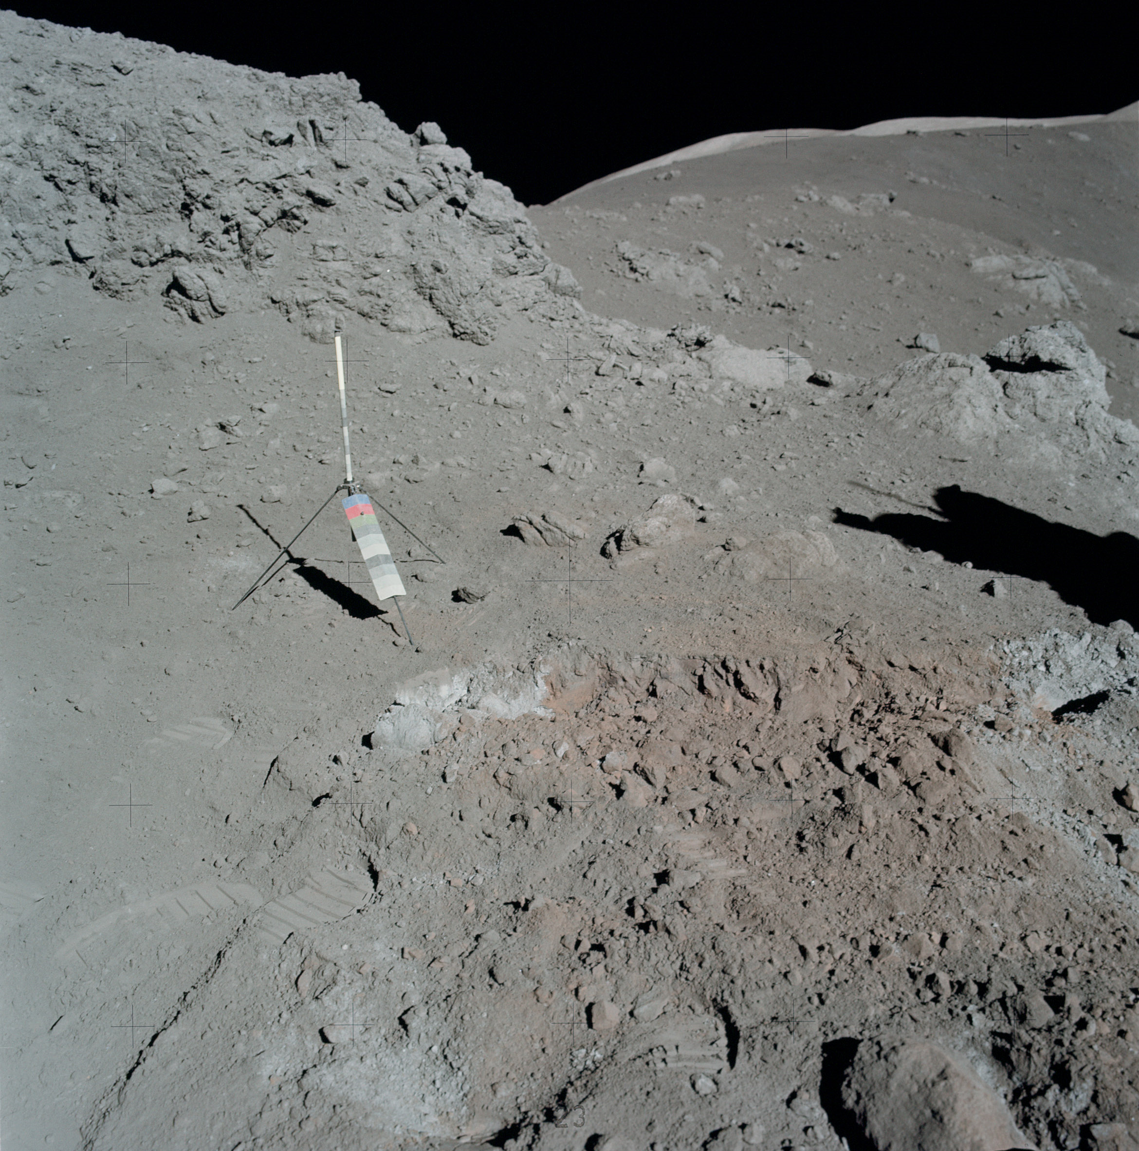
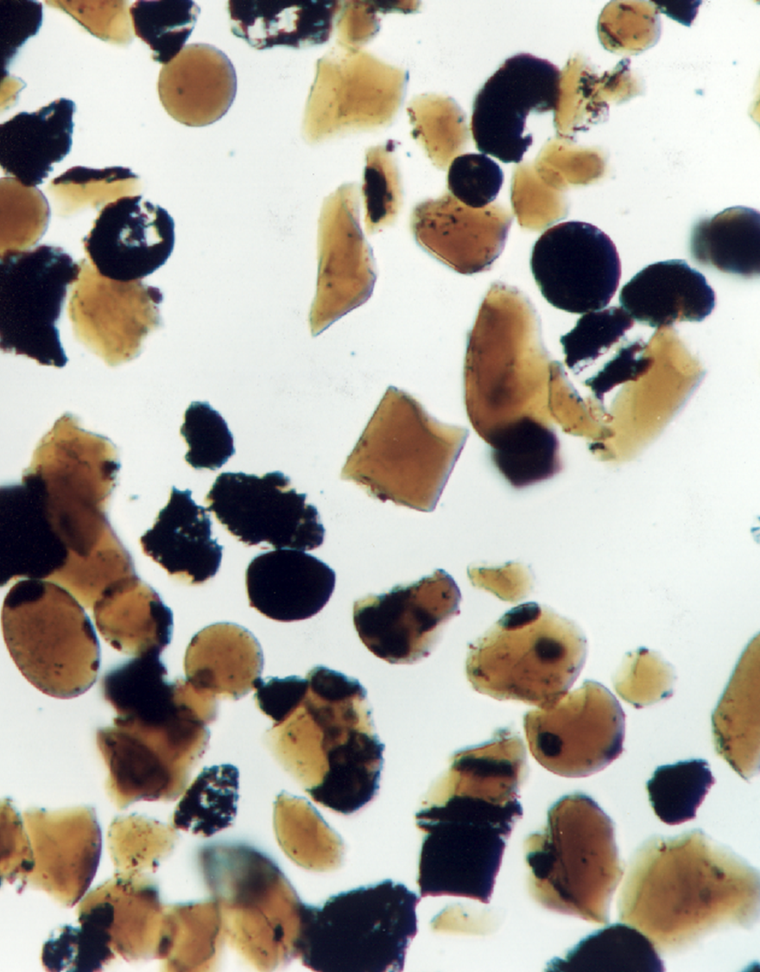

Slide 9
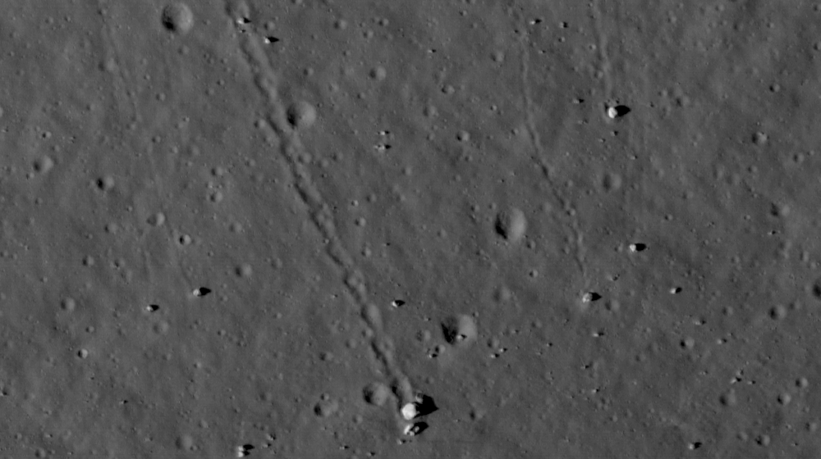

Slide 10
The Last Mission to the Moon
EVA 1 ALSEP deployment
118:51, 119:17:25, 119:38
EVA 2 Station 4
145.26, 145:33
EVA 3 Station 6
165:00, 165:03, 165:07:45
Lunar Liftoff
188:01

Slide 11
People Who Said No to a Moonwalk
Frank Borman
Before Apollo 8, Slayton asked if he would like to have his crew fly Apollo 11
Instead, he retired after Apollo 8
Jim McDivitt
Slayton asked if he would fly as Shepard’s LMP on (what became) Apollo 13
Instead be became the Apollo Spacecraft Program Office director
Gene Cernan
Slayton asked if he would like to serve as Young’s LMP on Apollo 16
Instead, he held out for the possibility of commanding Apollo 17
Mike Collins
Before Apollo 11, Slayton asked if he would like to command Apollo 14’s backup crew
Instead, he retired after Apollo 11

Slide 12
Discussion Groups
Chaikin Chapter 13 (“The Last Men on the Moon”)
The astronaut’s view of Apollo 17
Heikin Chapter 8 (“Boulder Rolling – the Last Apollo EVA”)
A book made form annotated transcripts from the lunar surface period
The Last Mission to the Moon website
A multimedia reconstruction of the Apollo 17 mission
A Voyage to the Moon and its Major Discoveries video
A seminar for a scientific audience at the Lunar and Planetary Institute

Slide 13
Soviet Lunar Landing Program Readings
Siddiqi Chapter 15 (“Final Lap to the Moon”)
The Soviet space program between Apollo 1 and Apollo 11
Chertok Chapter 3 (“N1-L3 Lunar Program Under Korolev”)
The origins of the Soviet lunar landing program
Chertok Chapter 10 (“1969—The First N-1 Launch”)
The first attempt to launch the Soviet moon rocket
The Engines that Came in from the Cold video
The rebirth of the N1’s engines in American rockets

