Slide 1
Apollo 15: Lunar Rover
INST 154
Apollo at 50

Slide 2
Cancellations
January 1970
Apollo 20 was cancelled to provide a Saturn V for Skylab
Apollo 18 and Apollo 19 were delayed until after Skylab to provide a backup
April 1970
Apollo 14 was assigned to repeat the aborted Apollo 13 mission to Fra Mauro
September 1970
Apollo 18 and 19 were cancelled for financial reasons
Apollo 15’s planned H mission was converted to a J mission
Apollo 16 and Apollo 17 would also fly J missions, as originally planned

Slide 3
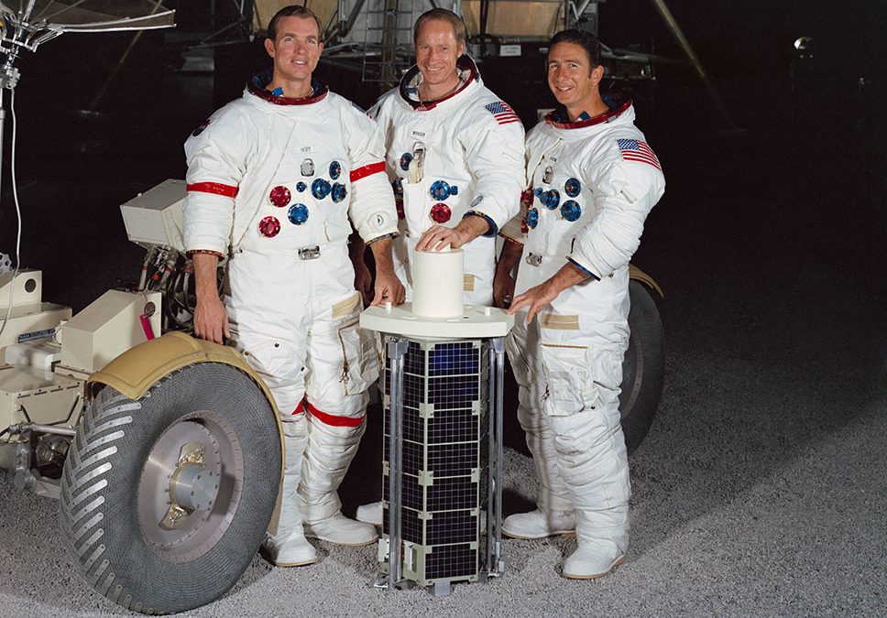

Slide 4
EVA-First Plan

Slide 5
Sleep-First Plan

Slide 6
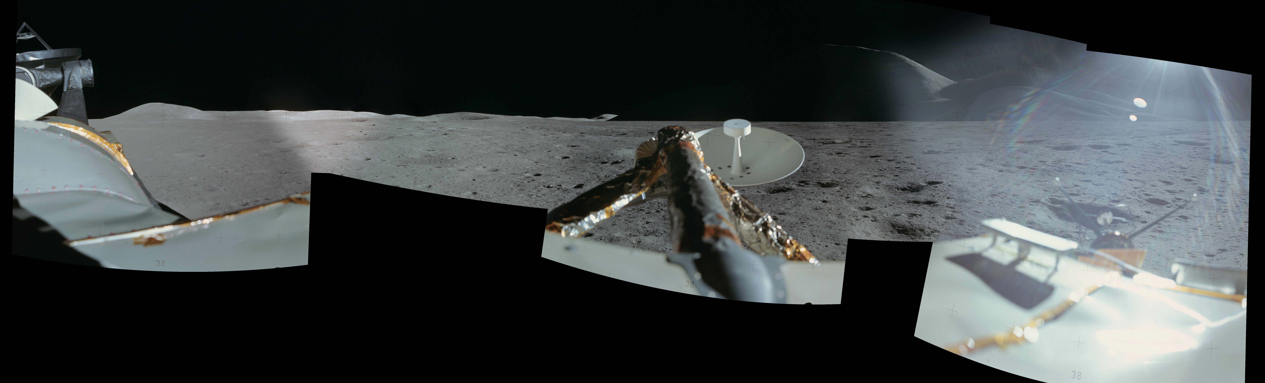

Slide 7
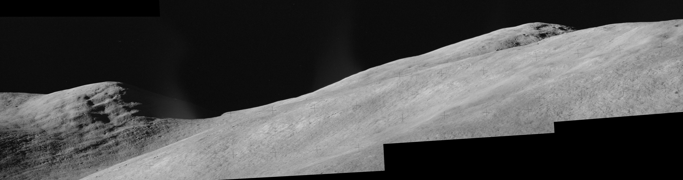
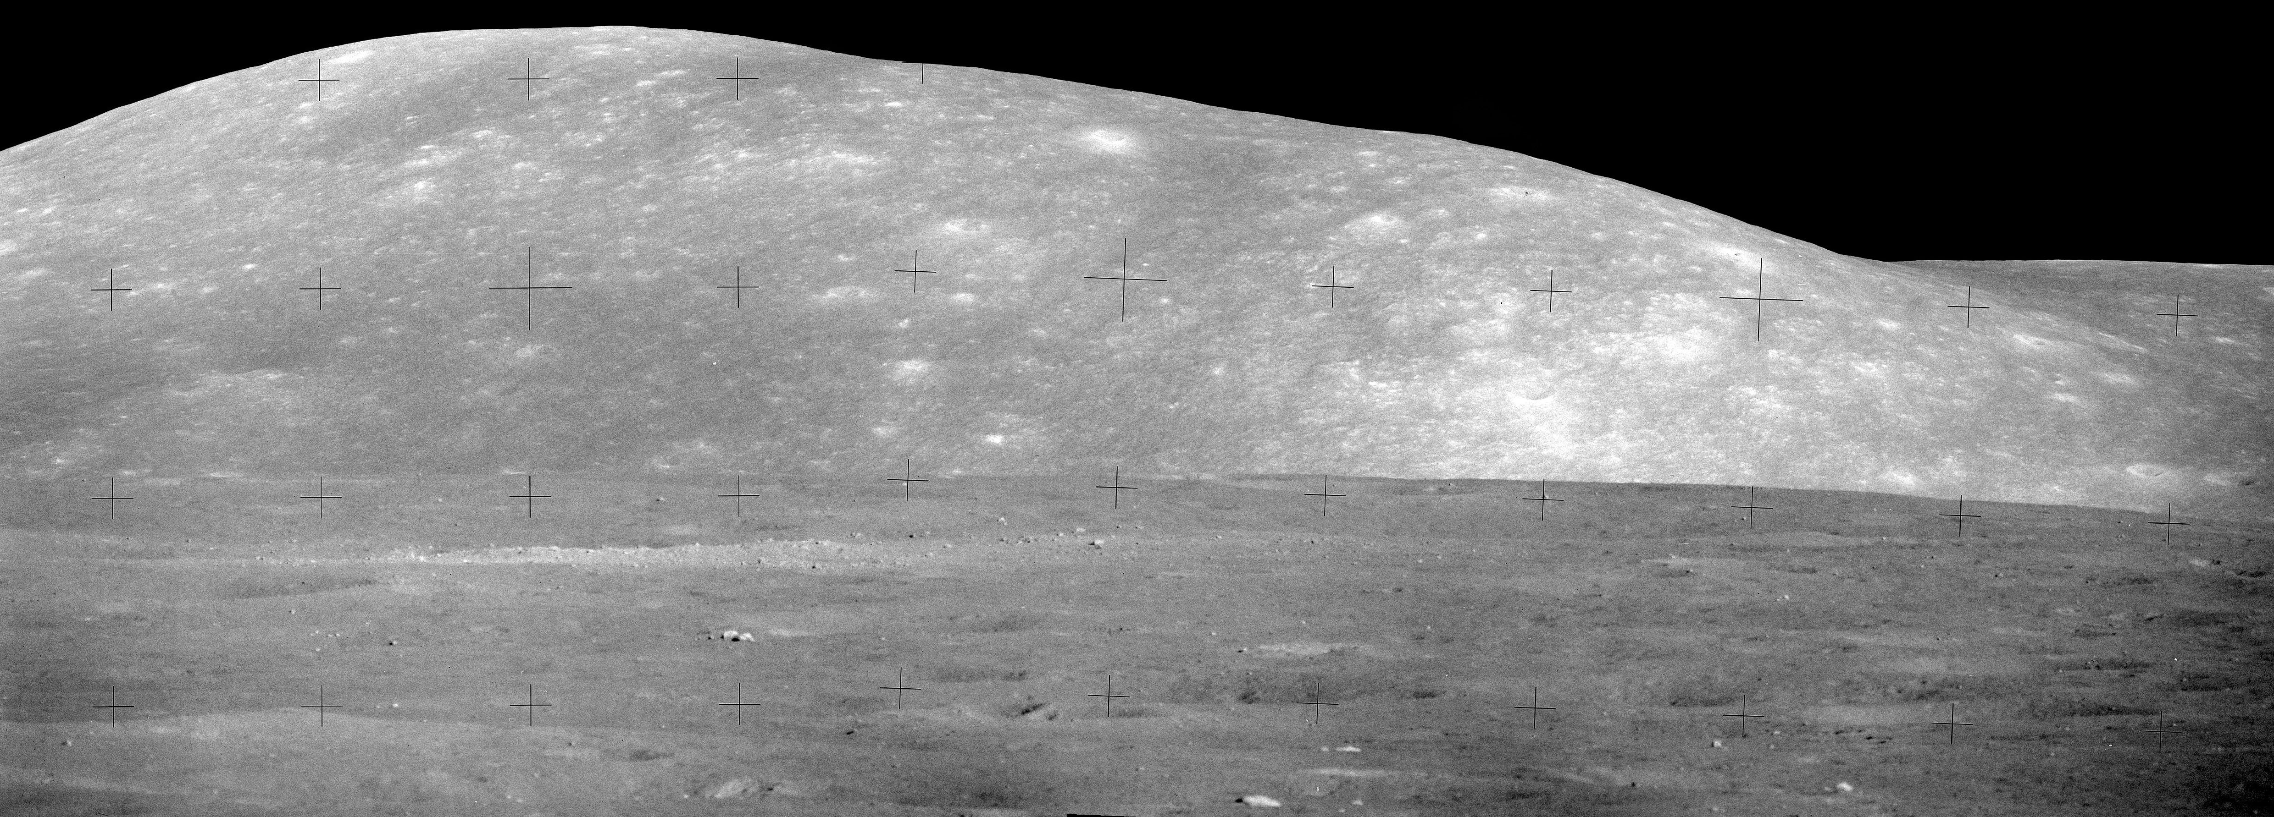

Slide 8
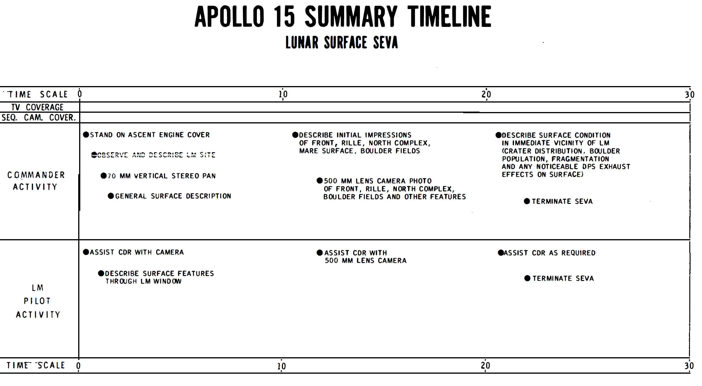

Slide 9
Sleep-First Plan

Slide 10
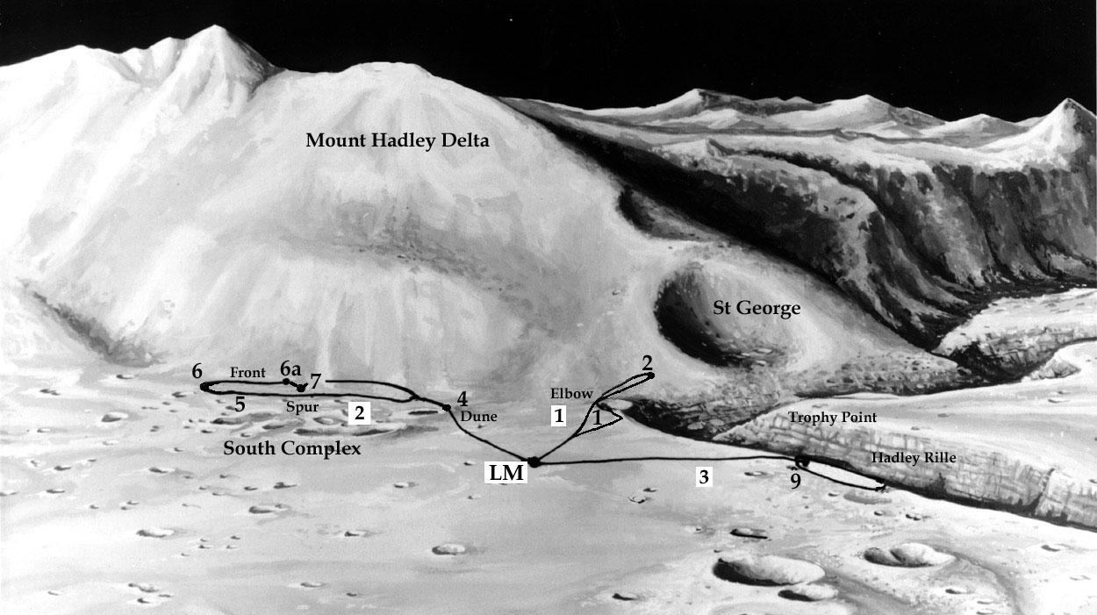

Slide 11
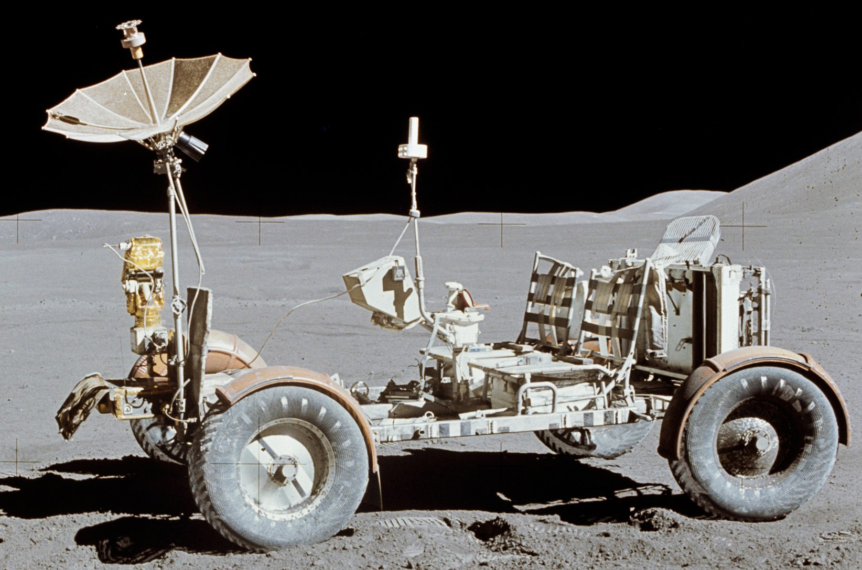

Slide 12
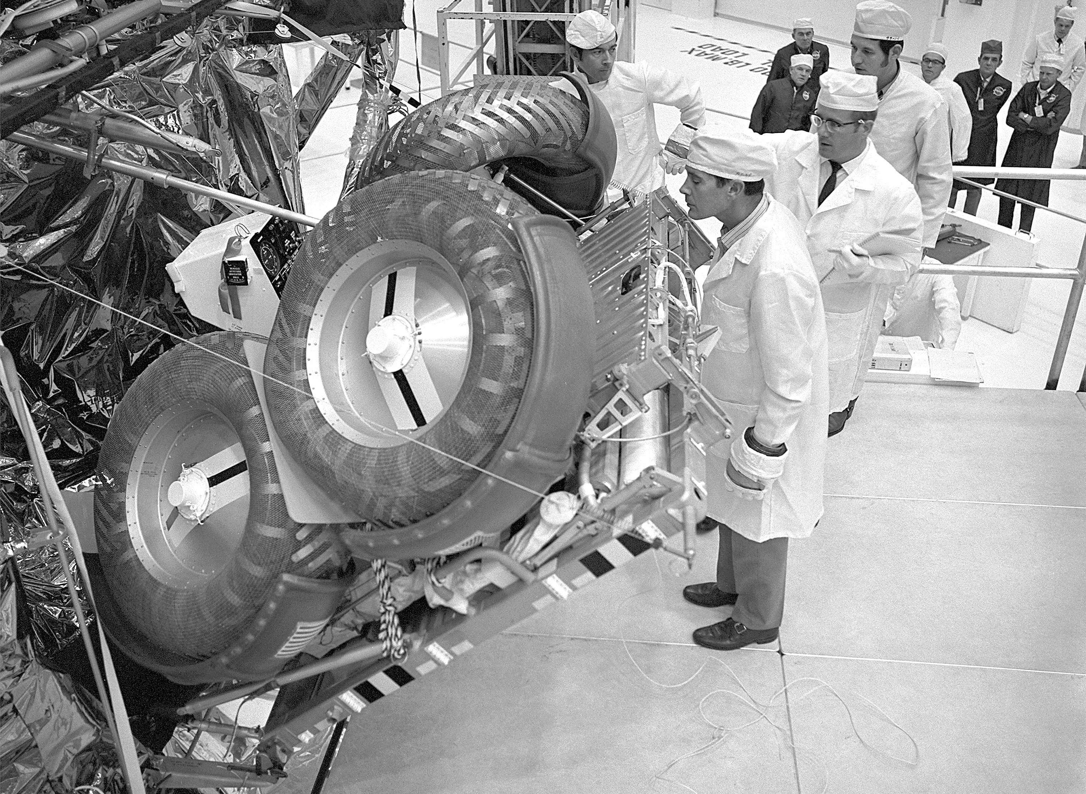
Animation

Slide 14
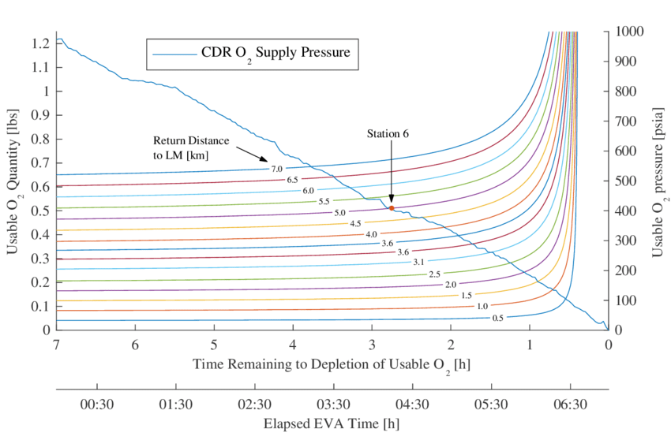

Slide 16
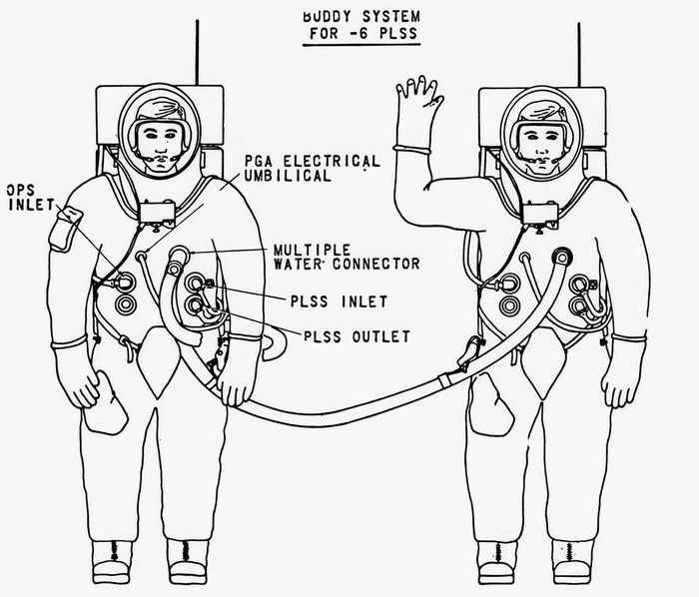

Slide 18
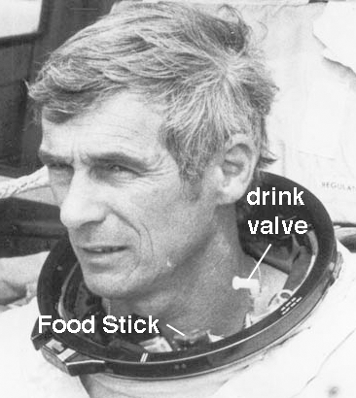
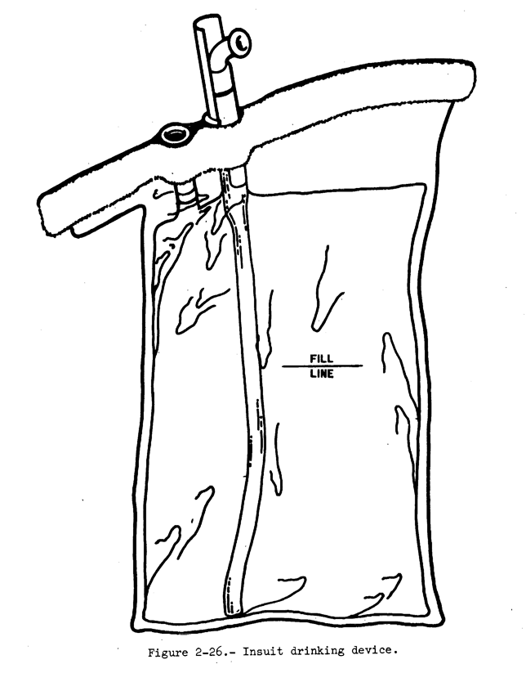

Slide 19
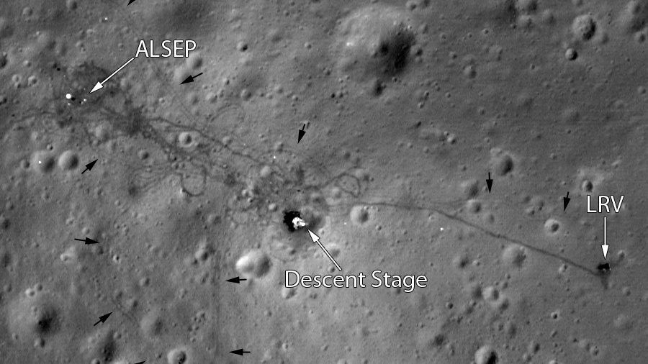

Slide 20
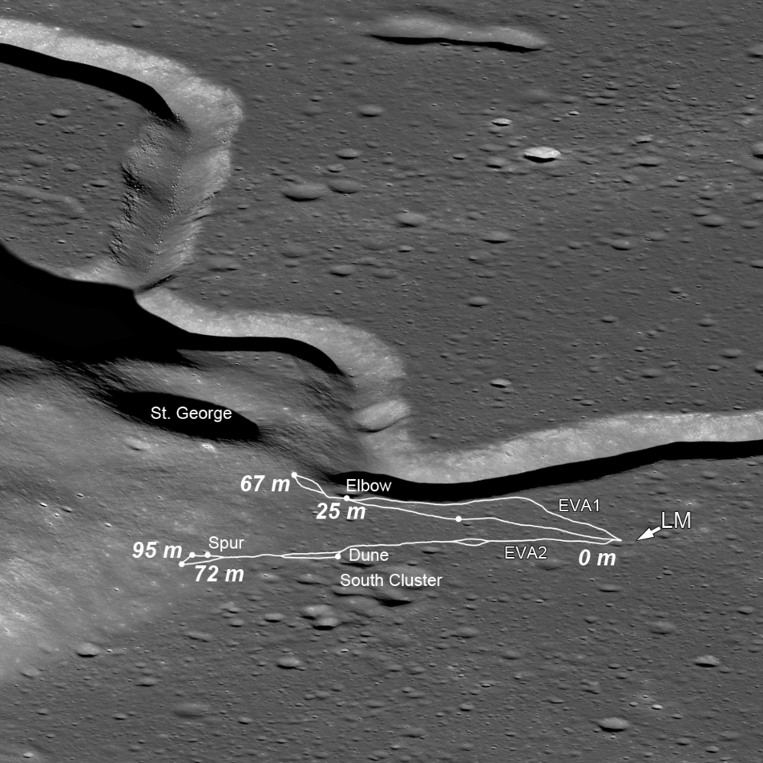
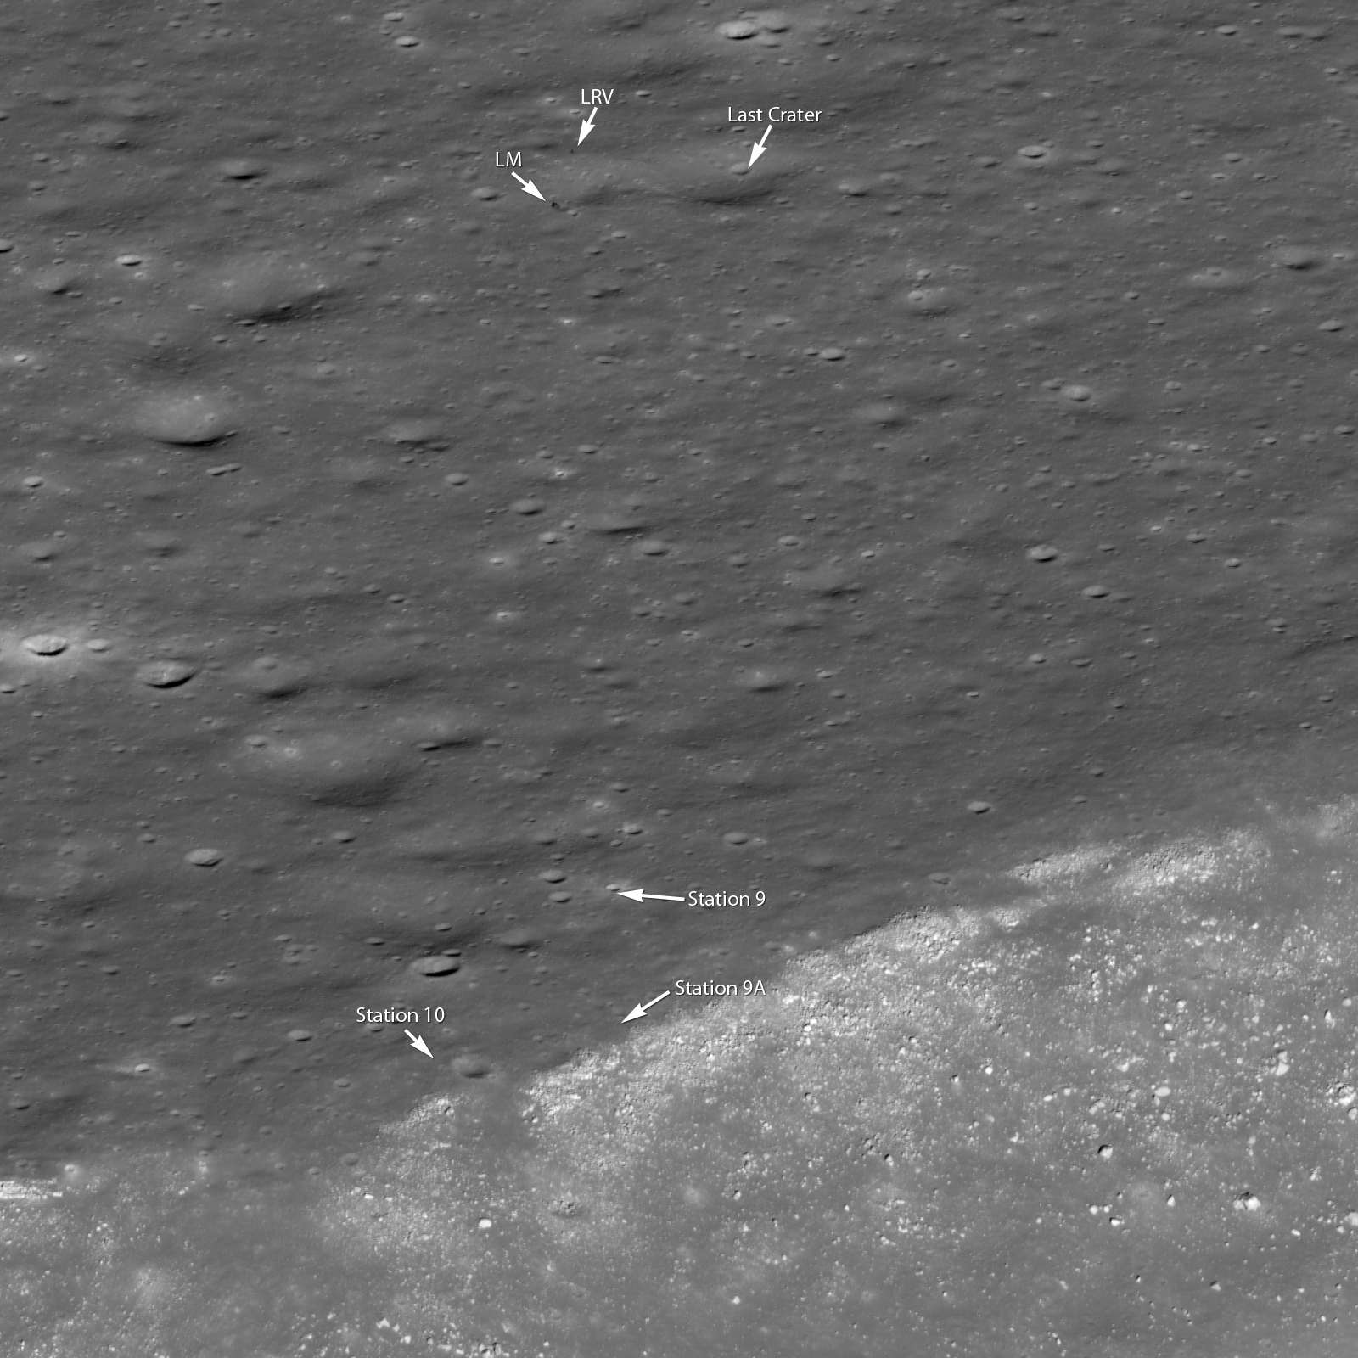

Slide 21
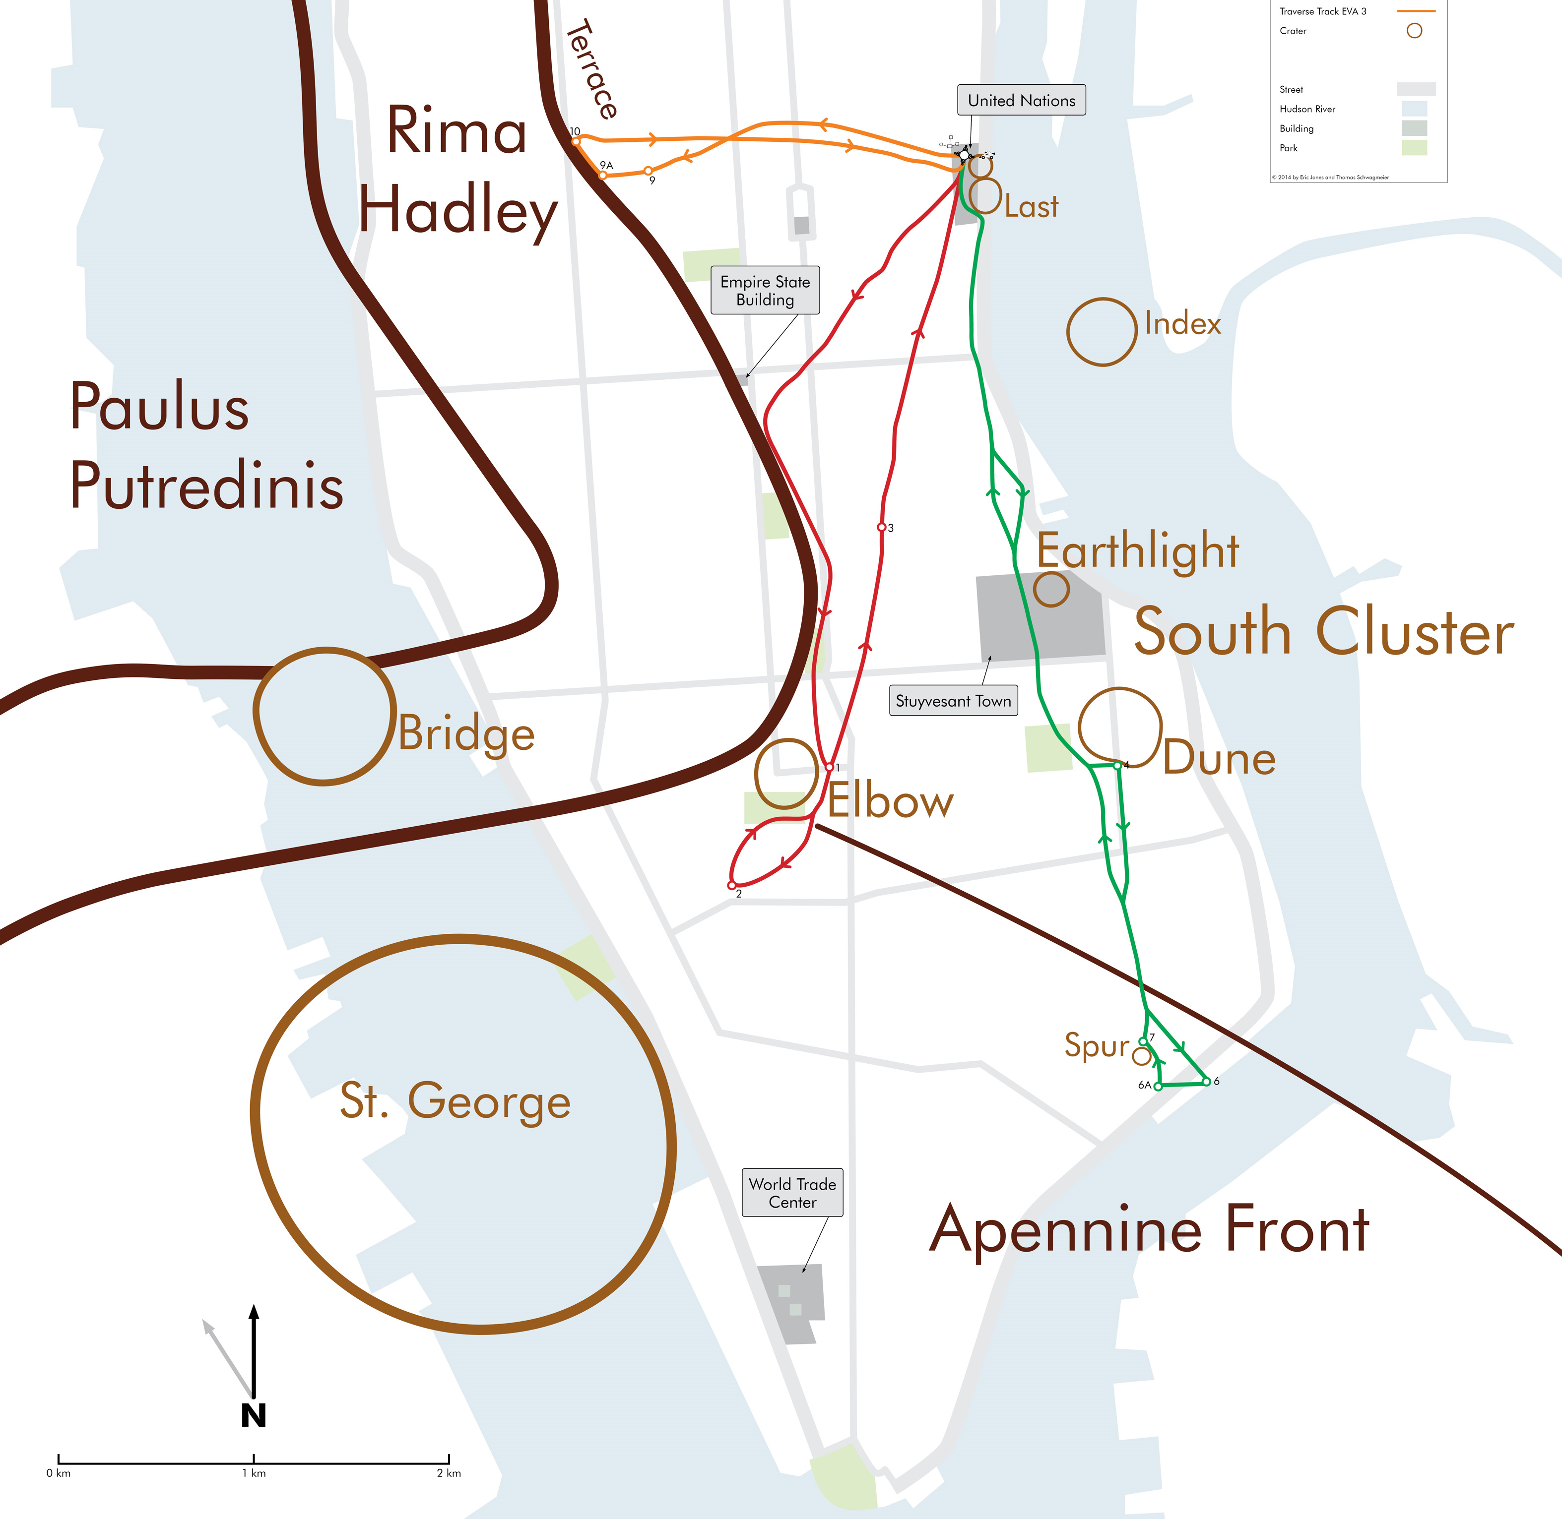

Slide 22
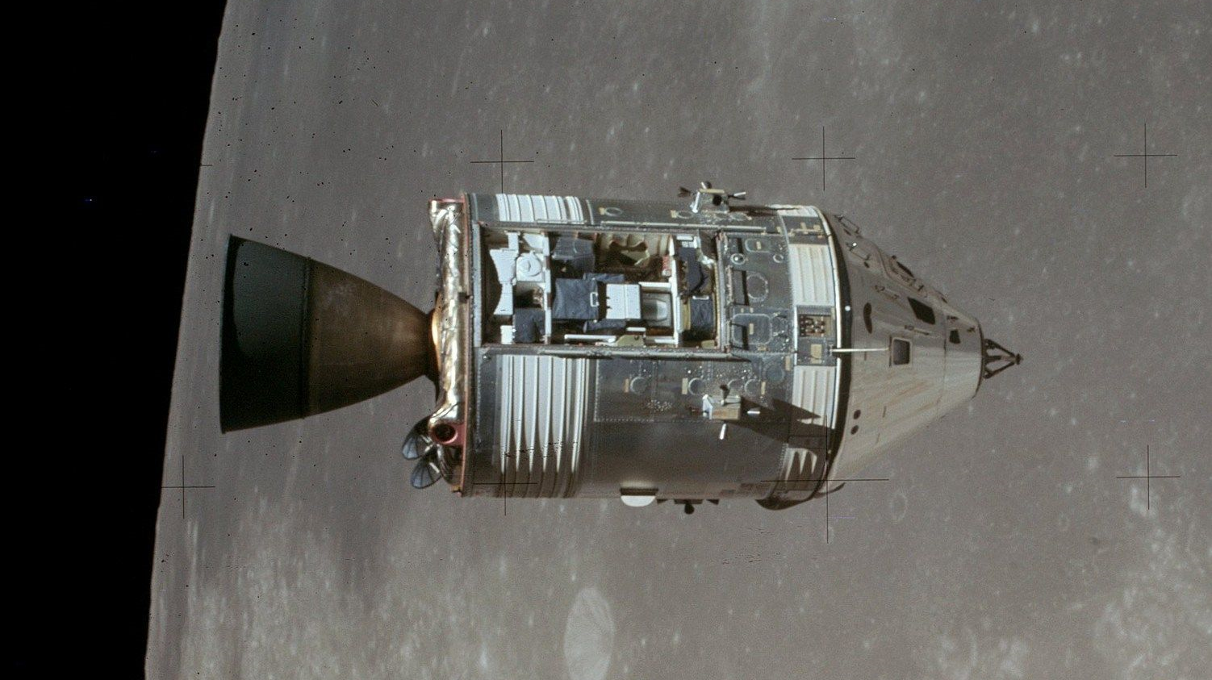

Slide 23
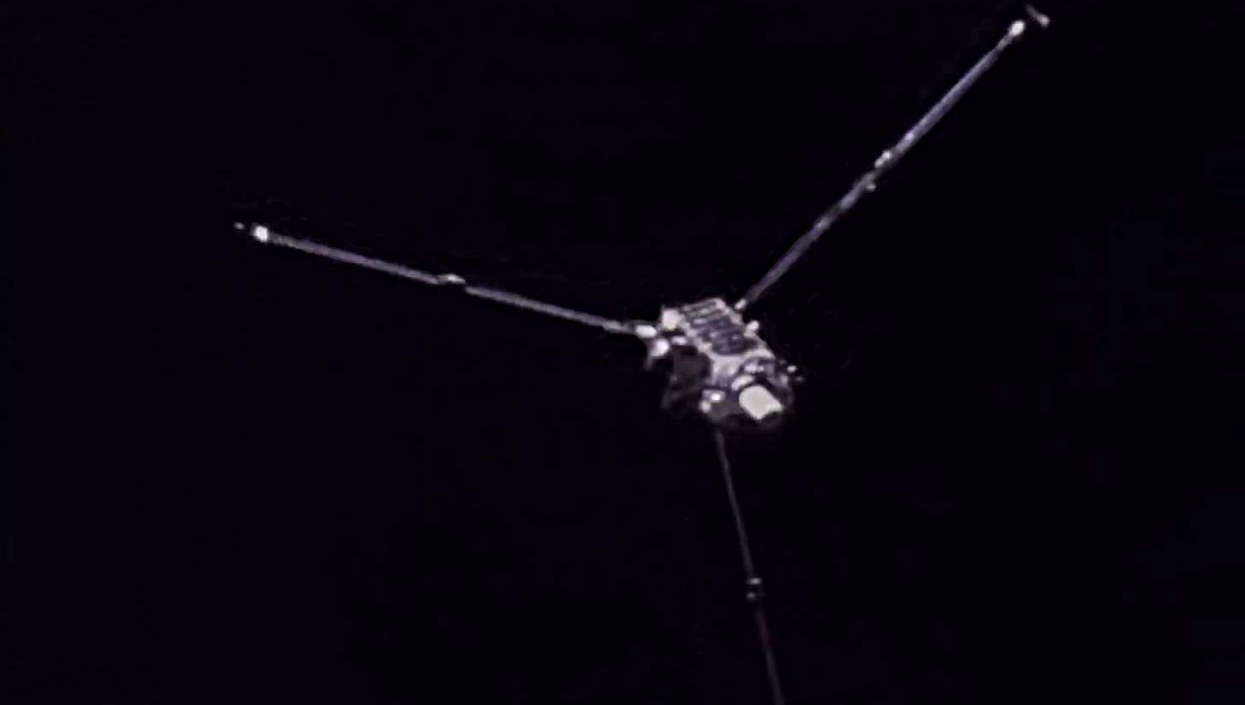

Slide 24
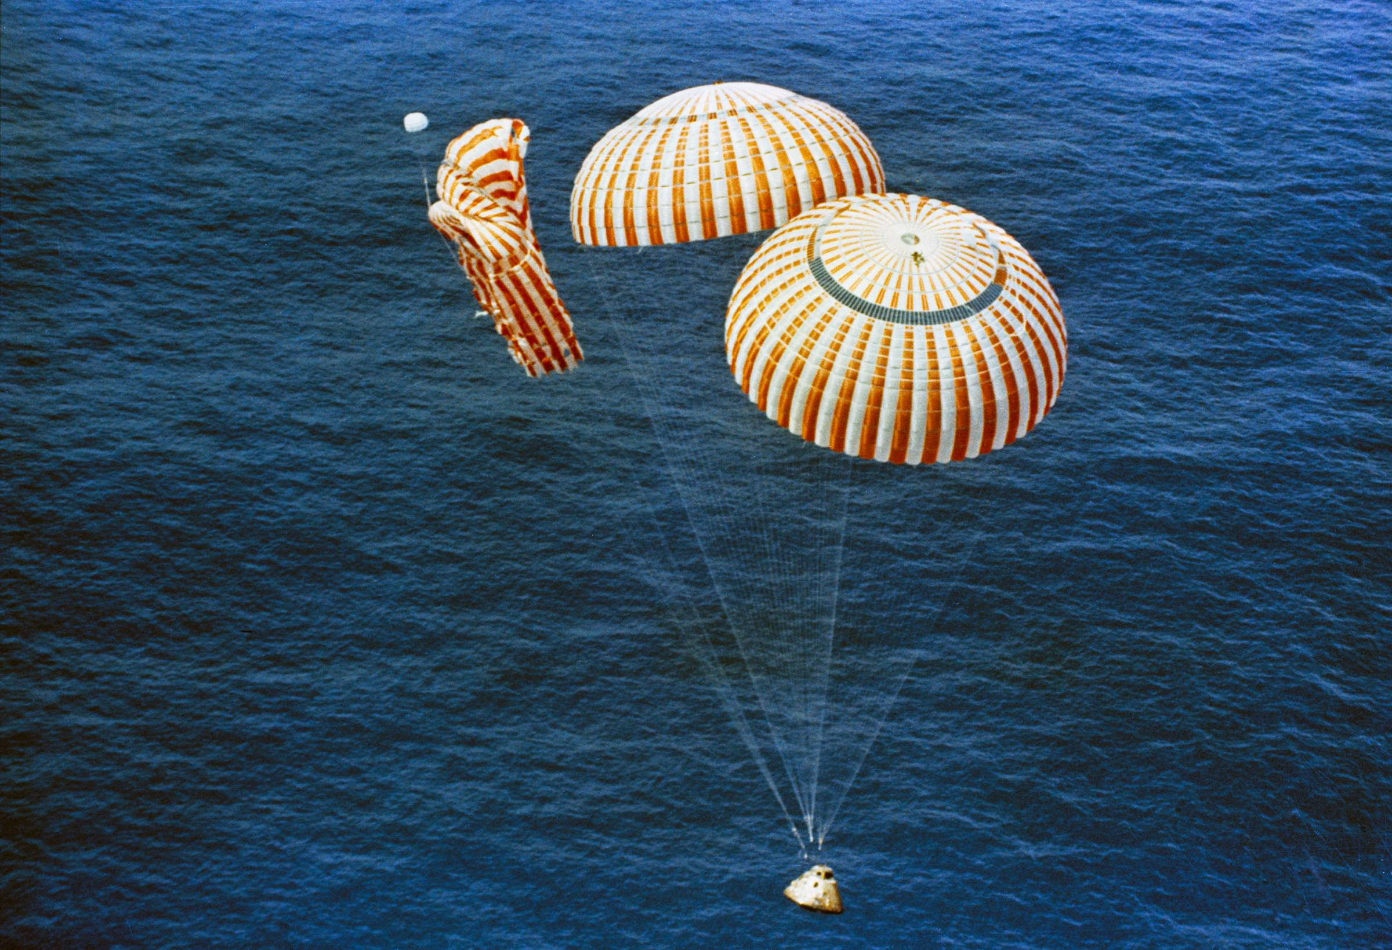

Slide 25
Discussion Groups
Worden and El Baz video
A discussion of the science performed in Lunar Orbit
Chaikin Chapter 11 (“To the Mountains of the Moon”)
The astronaut’s view of Apollo 15
Harland Chapter 5 (“The Wonder of the Unknown at Hadley-Apennine”)
A detailed look at the Apollo 15 moonwalks
Apollo Lunar Surface Journal
Annotated transcripts from the lunar portion of the mission

Slide 26
Tweeting Apollo 12: Sleep Periods (so far)
Nov 14: wake 6:05 AM (launch 11:22 AM)
Nov 15: sleep 4:47 AM, wake 3:15 PM
Nov 16: sleep 6:28 AM, wake 4:18 PM
Nov 17: sleep 8:39 AM, wake 5:20 PM (LOI 10:47 PM)
Nov 18: sleep 7:48 AM, wake 4:16 PM
Nov 19: (land 1:55 AM), (moonwalk), sleep 1:59 PM
Nov 20:
Nov 21:
Nov 22:
Nov 23:
Nov 24:

Slide 27
Apollo 17 Readings
Chaikin Chapter 13 (“The Last Men on the Moon”)
The astronaut’s view of Apollo 17
Heikin Chapter 8(“Boulder Rolling – the Last Apollo EVA”)
A book made form annotated transcripts from the lunar surface period
The Last Mission to the Moon website
A multimedia reconstruction of the Apollo 17 mission
A Voyage to the Moon and its Major Discoveries video
A seminar for a scientific audience at the Lunar and Planetary Institute

