Slide 1
Apollo 13: Abort
INST 154
Apollo at 50
Apollo 13 Flight Director Audio

Slide 2
Early Apollo Crew Planning
Apollo 7 (C)
  CDR: Schirra
  CMP: Eisele
  LMP: Cunningham
Apollo 10 (F)
  CDR: Stafford
  CMP: Young
  LMP: Cernan
Apollo 8 (D)
  CDR: McDivitt
  CMP: Scott
  LMP: Schweickart
Apollo 11 (G)
  CDR: Conrad
  CMP: Gordon
  LMP: Williams
Apollo 9 (E)
  CDR: Borman
  CMP: Collins
  LMP: Anders
Apollo 12 (H)
  CDR: Armstrong
  CMP: Lovell
  LMP: Aldrin
Bean
Haise

Slide 3
The Apollo 13 and 14 Crews
Apollo 7
  CDR: Schirra
  CMP: Eisele
  LMP: Cunningham
Apollo 9
  CDR: Borman
  CMP: Collins
  LMP: Anders
Apollo 10 Backup
  CDR: Cooper
  CMP: Eisele
  LMP: Mitchell
Apollo 11 Backup
  CDR: Lovell
  CMP: Anders
  LMP: Haise
Apollo 13
  CDR: Shepard
  CMP: Roosa
  LMP: Mitchell
Apollo 14
  CDR: Lovell
  CMP: Mattingly
  LMP: Haise
Apollo 14
  CDR: Shepard
  CMP: Roosa
  LMP: Mitchell
Apollo 13
  CDR: Lovell
  CMP: Mattingly
  LMP: Haise
(Schirra says no)
(McDivitt says no)
Apollo 8
  CDR: Borman
  CMP: Lovell
  LMP: Anders
Apollo 13
  CDR: Lovell
  CMP: Swigert
  LMP: Haise
(Borman says no)

Slide 4
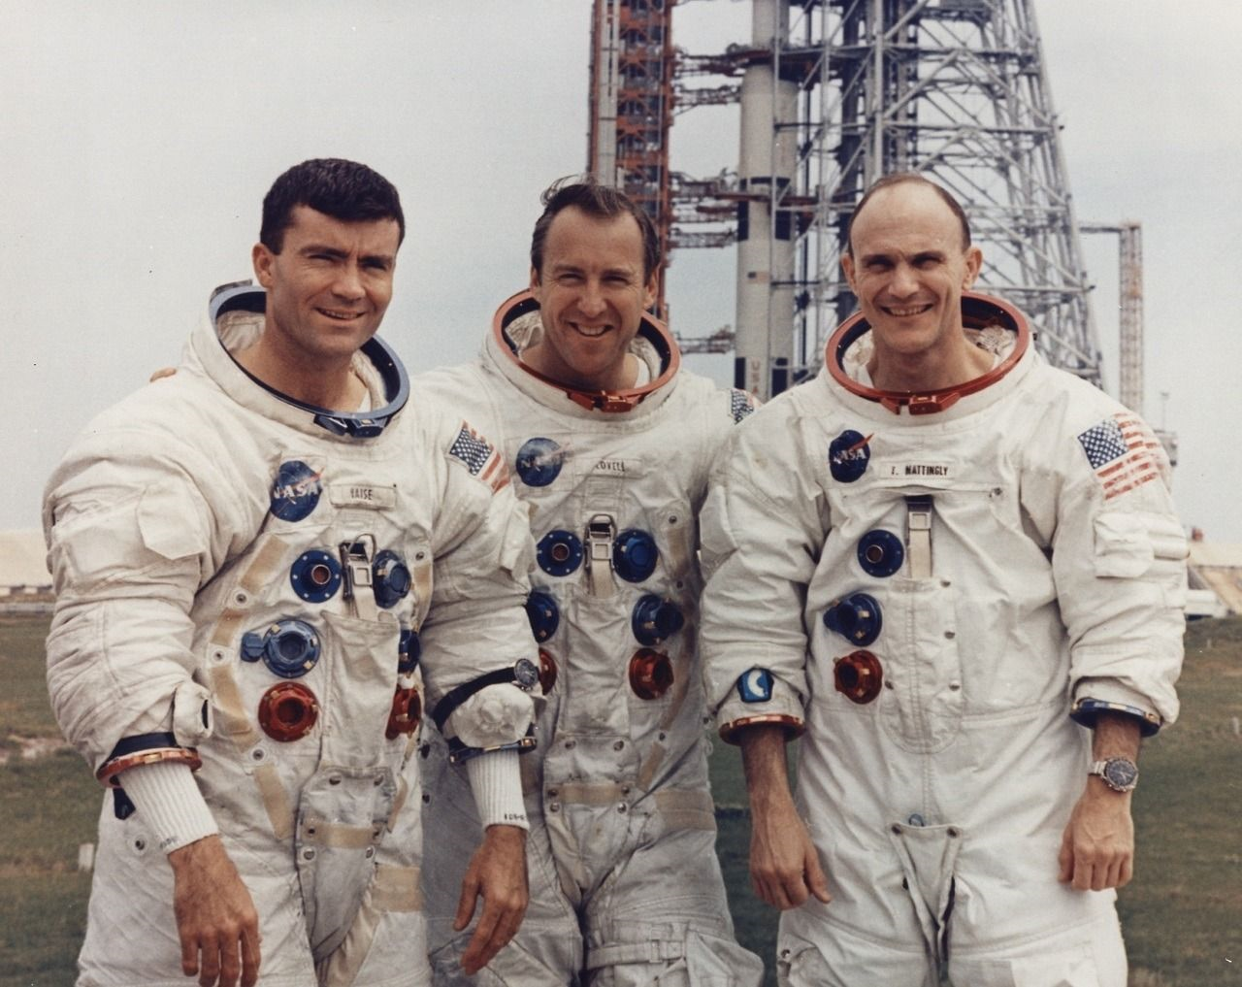

Slide 5
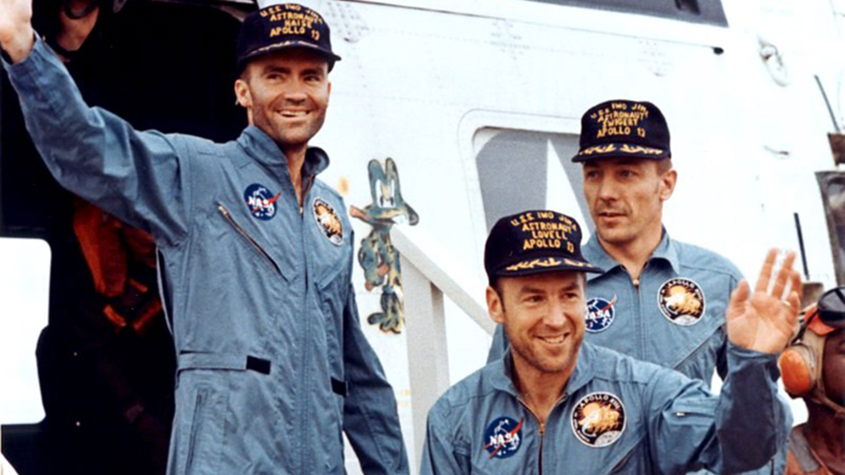

Slide 6
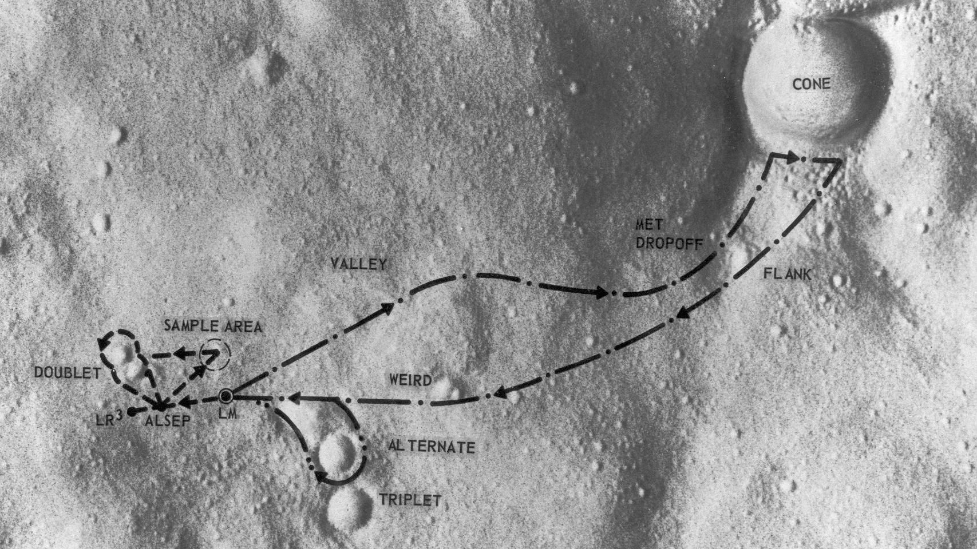

Slide 7
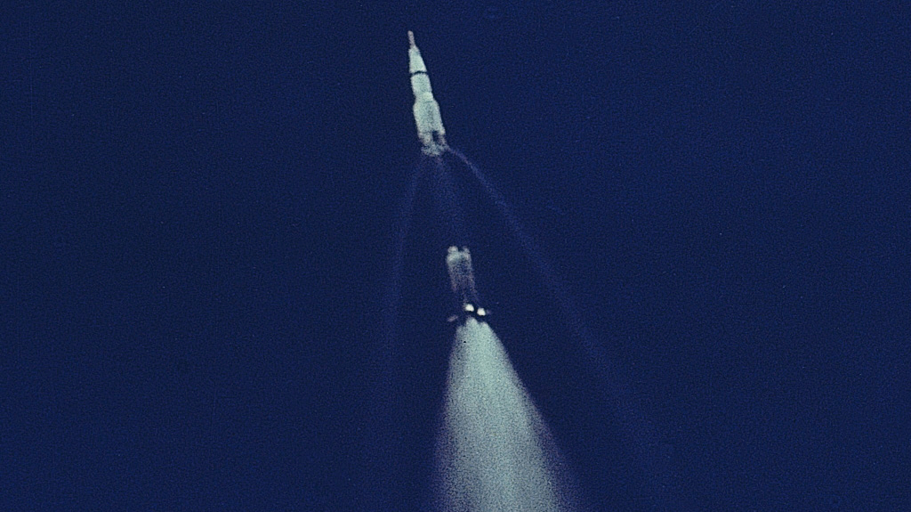

Slide 8

Planned S-II CECO

Slide 9
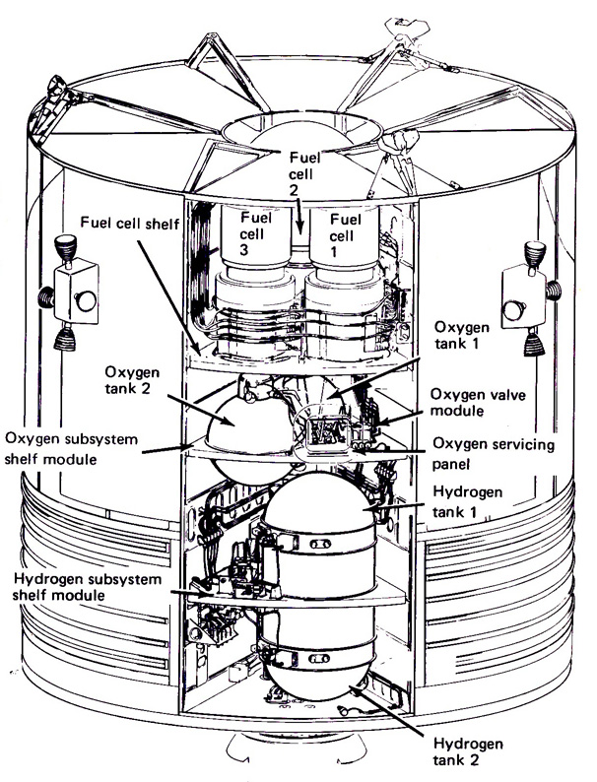
EECOM Audio

Slide 10
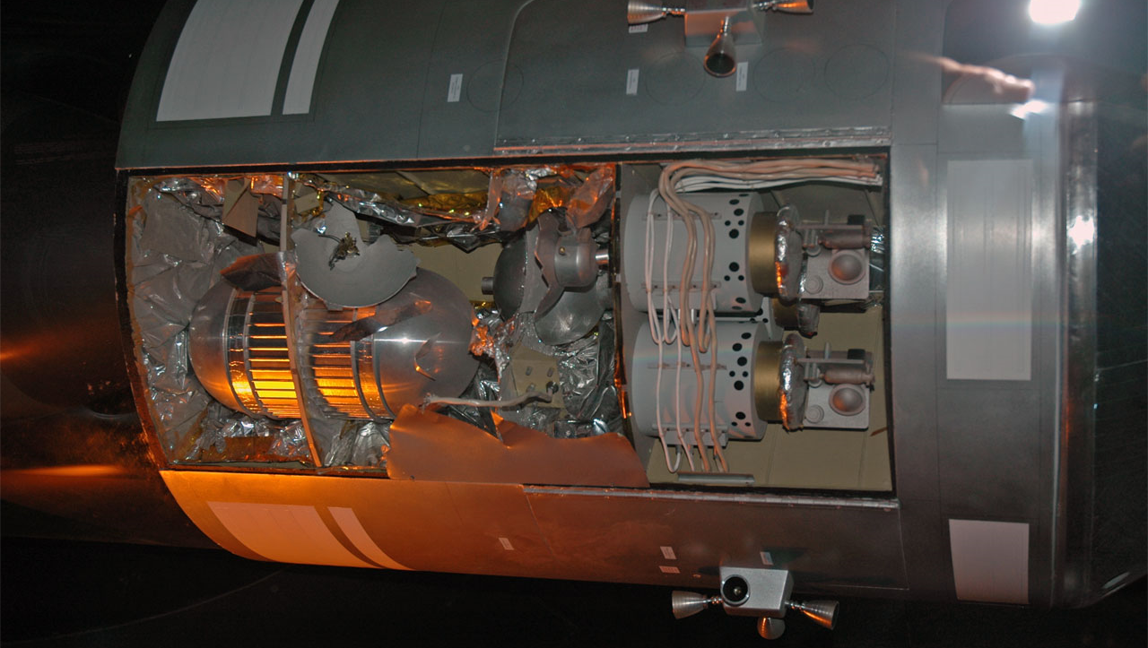

Slide 11
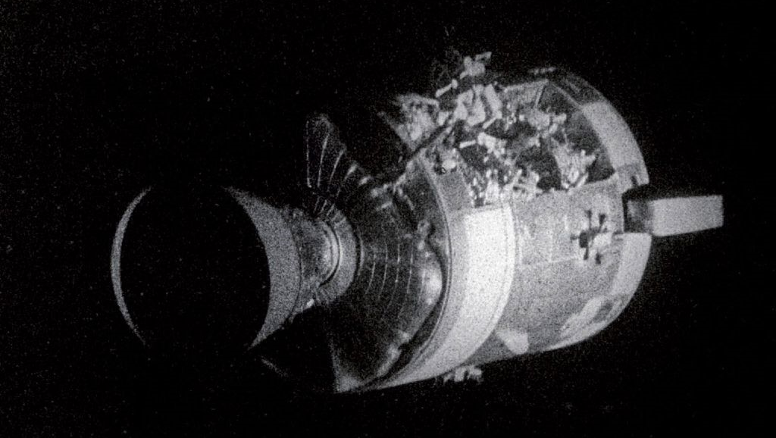

Slide 12
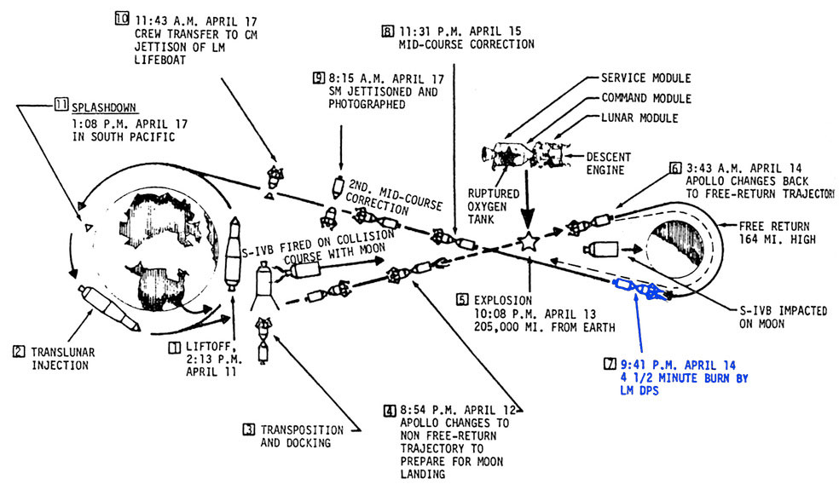

Slide 13
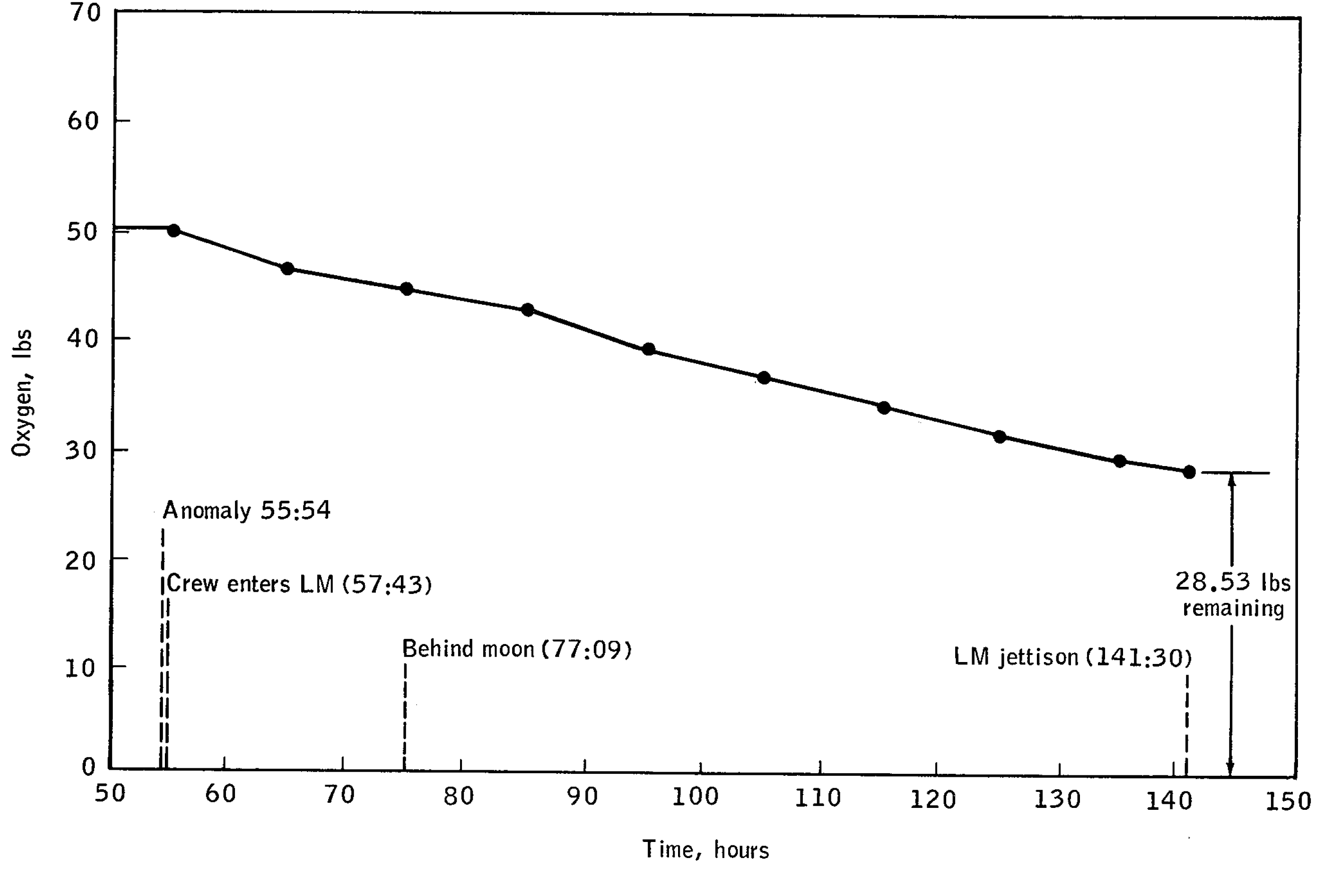

Slide 14
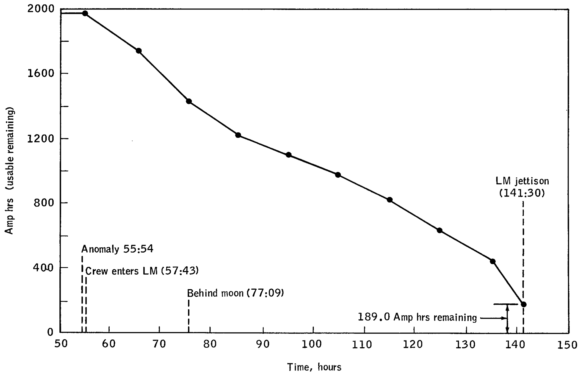

Slide 15
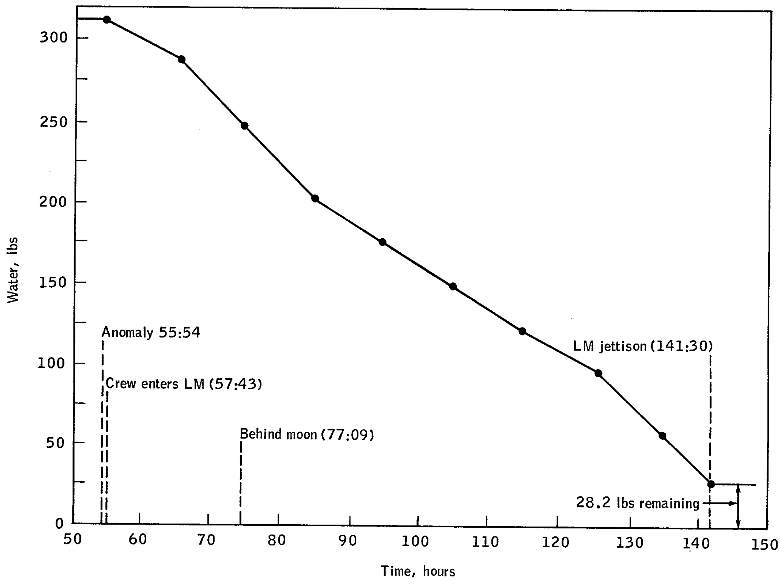

Slide 16
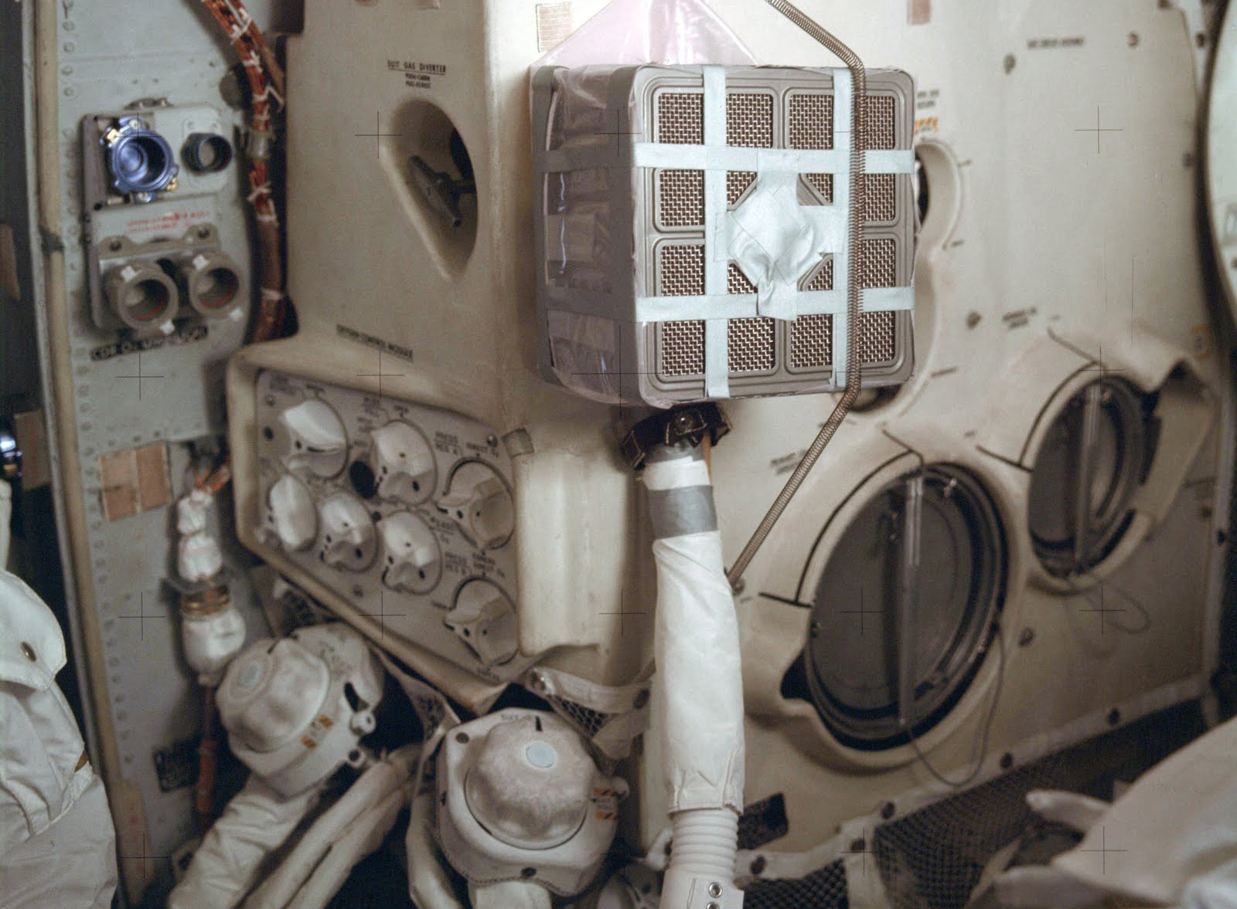

Slide 17
#1) Place the LCG bag over the top of the square lithium-hydroxide canister. The bag must be pulled down to just over the triangular ventilator slots on the side. NOTE: Be careful not to rip the bag because there are only three bags onboard.
#2) Tear the duct tape down the middle lengthwise to double the linear length.
#3) Seal the bag to the square canister by wrapping the duct tape around the canister where the bag opening is. NOTE: The tape must seal the opening to prevent leakage of air flow.
#4) Poke or cut a hole in the middle of the top of the covering bag approximately the diameter of the hose from the red suit.
#5) Insert the hose into the hole. Secure the hose connection into the LCG bag with duct tape. NOTE: The tape must seal the opening to prevent leakage of air flow.
#6) Cover the top of the LCG bag and hose attachment with the flight plan cover in an arch. The hose will stick out of one side of the arch.
#7) Attach the two sides of the cardboard flight plan cover that make contact with the square filter using a six inch long piece of duct tape over the top. This will prevent crushing the hose and air entry on the final mounting in step #19.
#8) Wrap the entire top sides of the filter cube with a three foot (about an arms length) piece of duct tape. Repeat wrapping on the bottom of the sides of the cube. NOTE: The tape must seal the opening to prevent leakage of air flow.
#9) Secure the bag with strips of duct tape two per side running from one side, under the bottom and back up the other side. Repeat on the other side. The bottom of the cube will resemble a tic tac toe board when this step is completed.
#10) Stuff the sock into the ventration hole in the center of the square scrubber. This will prevent the air from bypassing the filter. Cover the hole with a couple of pieces of tape to keep it from falling out.
#11) Repeat steps #3 through #10 for the second canister. This will be the replacement when the first filter becomes saturated.
#12) Open the sensor relief valve. This will normalize the pressure and allow you to attach the hose to the intake valve.
#13) Attach the free end of the hose to the scrubber intake.
#14) Attach the end of the bungee cord to the hook above the lithium canister mounting location on the bulkhead.
#15) Secure the canister to the bulkhead by hooking the other end of the bungee cord below the mounting location.
#16) Attach the crossover hose to the secondary air cleaner.
#17) Close the sensor relief valve opened in step 12.
#18) Set the CO2 select to secondary using the LM air cleaner selection switch on panel eleven.
#19) Engage the air cleaning scrubber fan by flipping the ACSF switch located on panel eleven.

Slide 18
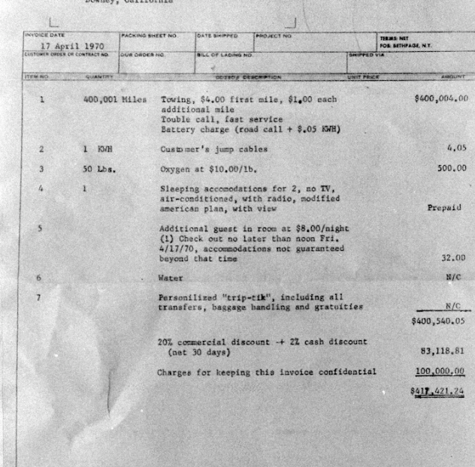

Slide 19
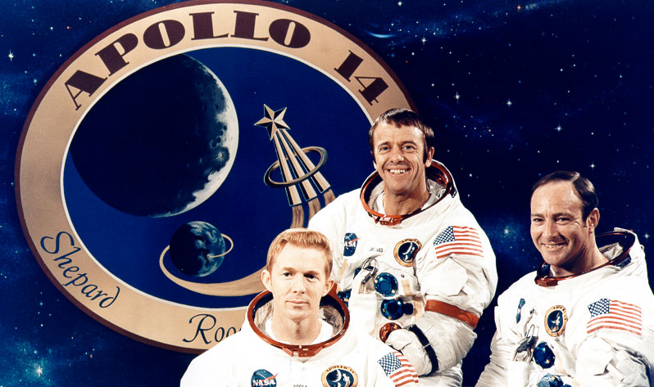

Slide 20
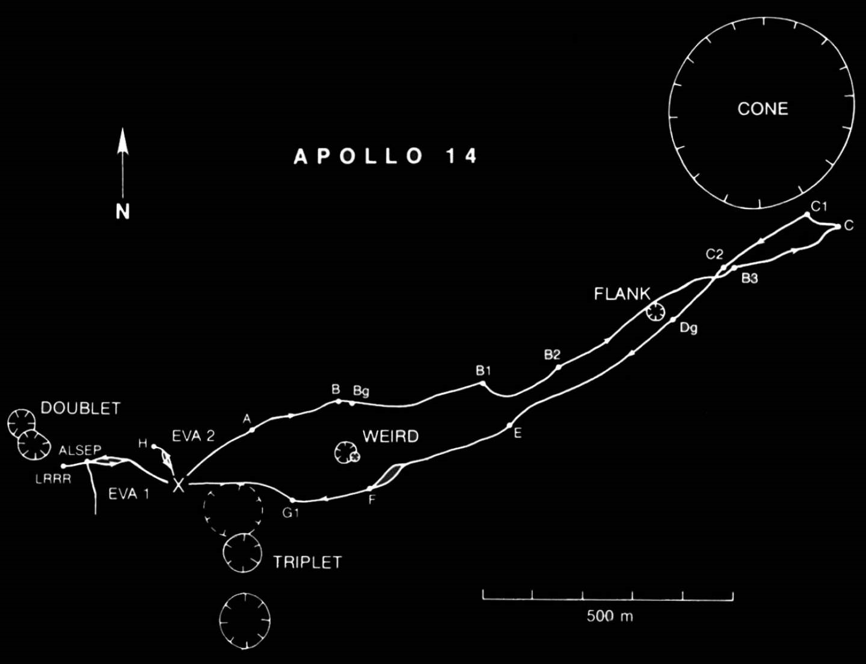

Slide 21
Discussion Groups
Apollo 13 Review Board Report
  The reconstruction of what happened
Chaikin Chapter 7
  The astronaut’s view of Apollo 13
Cox Chapter 27
  The initial response from Mission Control
Apollo 13 movie
  A unified dramatization of the events

