Slide 1
Apollo 11: Lunar Landing
INST 154
Apollo at 50
Lunar Landing

Slide 2
Apollo 11 Landing Site Selection Criteria
Smoothness: The sites should have relatively few craters
Slope: The general slope of the landing area must be less than 2 degrees
Approach path: There should be no large hills, tall cliffs or deep craters which could cause incorrect altitude signals to the landing radar
Free-return: The sites must be within reach of the Apollo spacecraft in the free-return trajectory
Fuel: Sites near the lunar equator were selected to allow for minimizing the need for plane change maneuvers by the CSM
Launch delays: Three sites were selected to allow for launch delays of up to 5 days

Slide 3
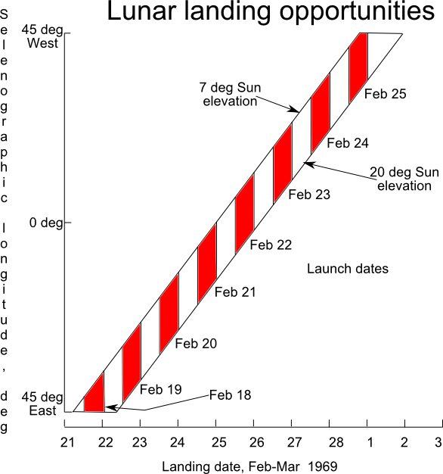
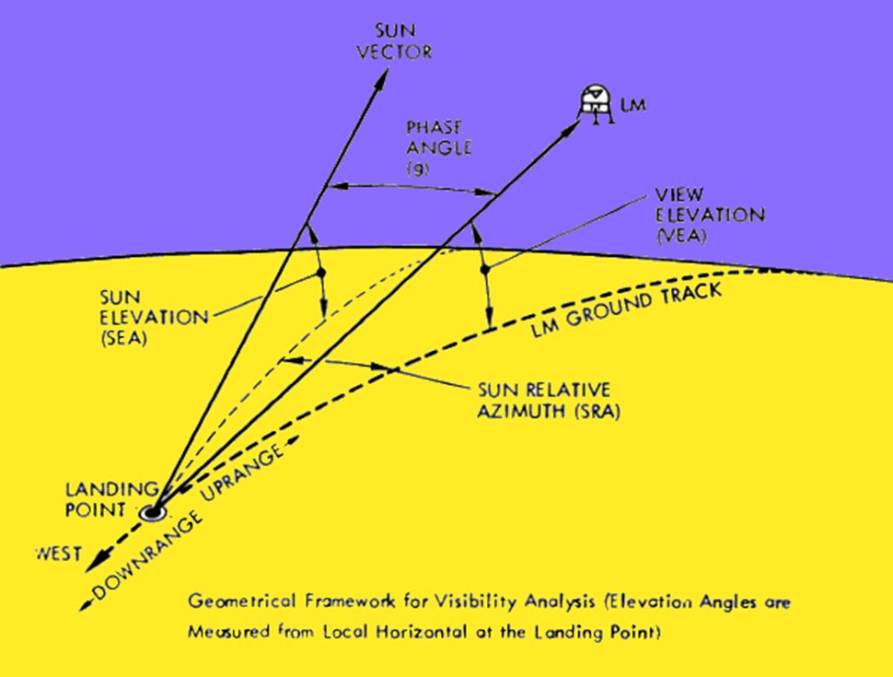

Slide 4
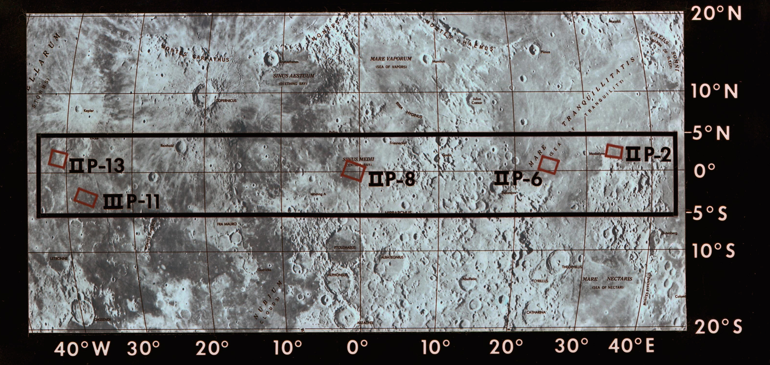

Slide 5
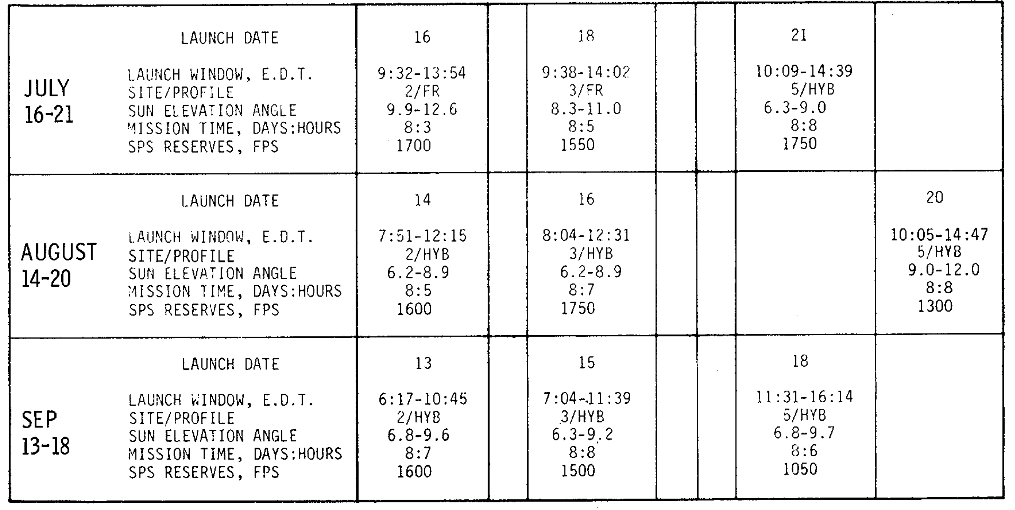
Possible Apollo 11 Launch Dates

Slide 6
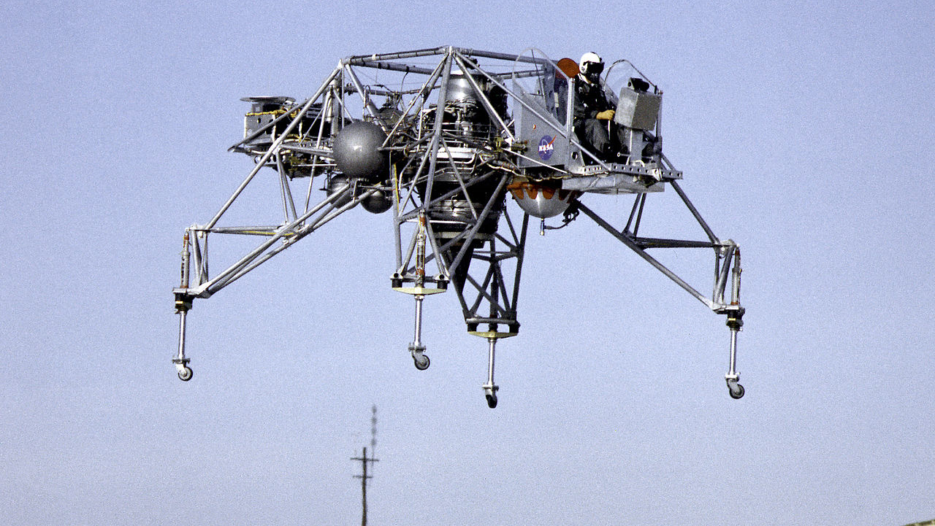

Slide 7
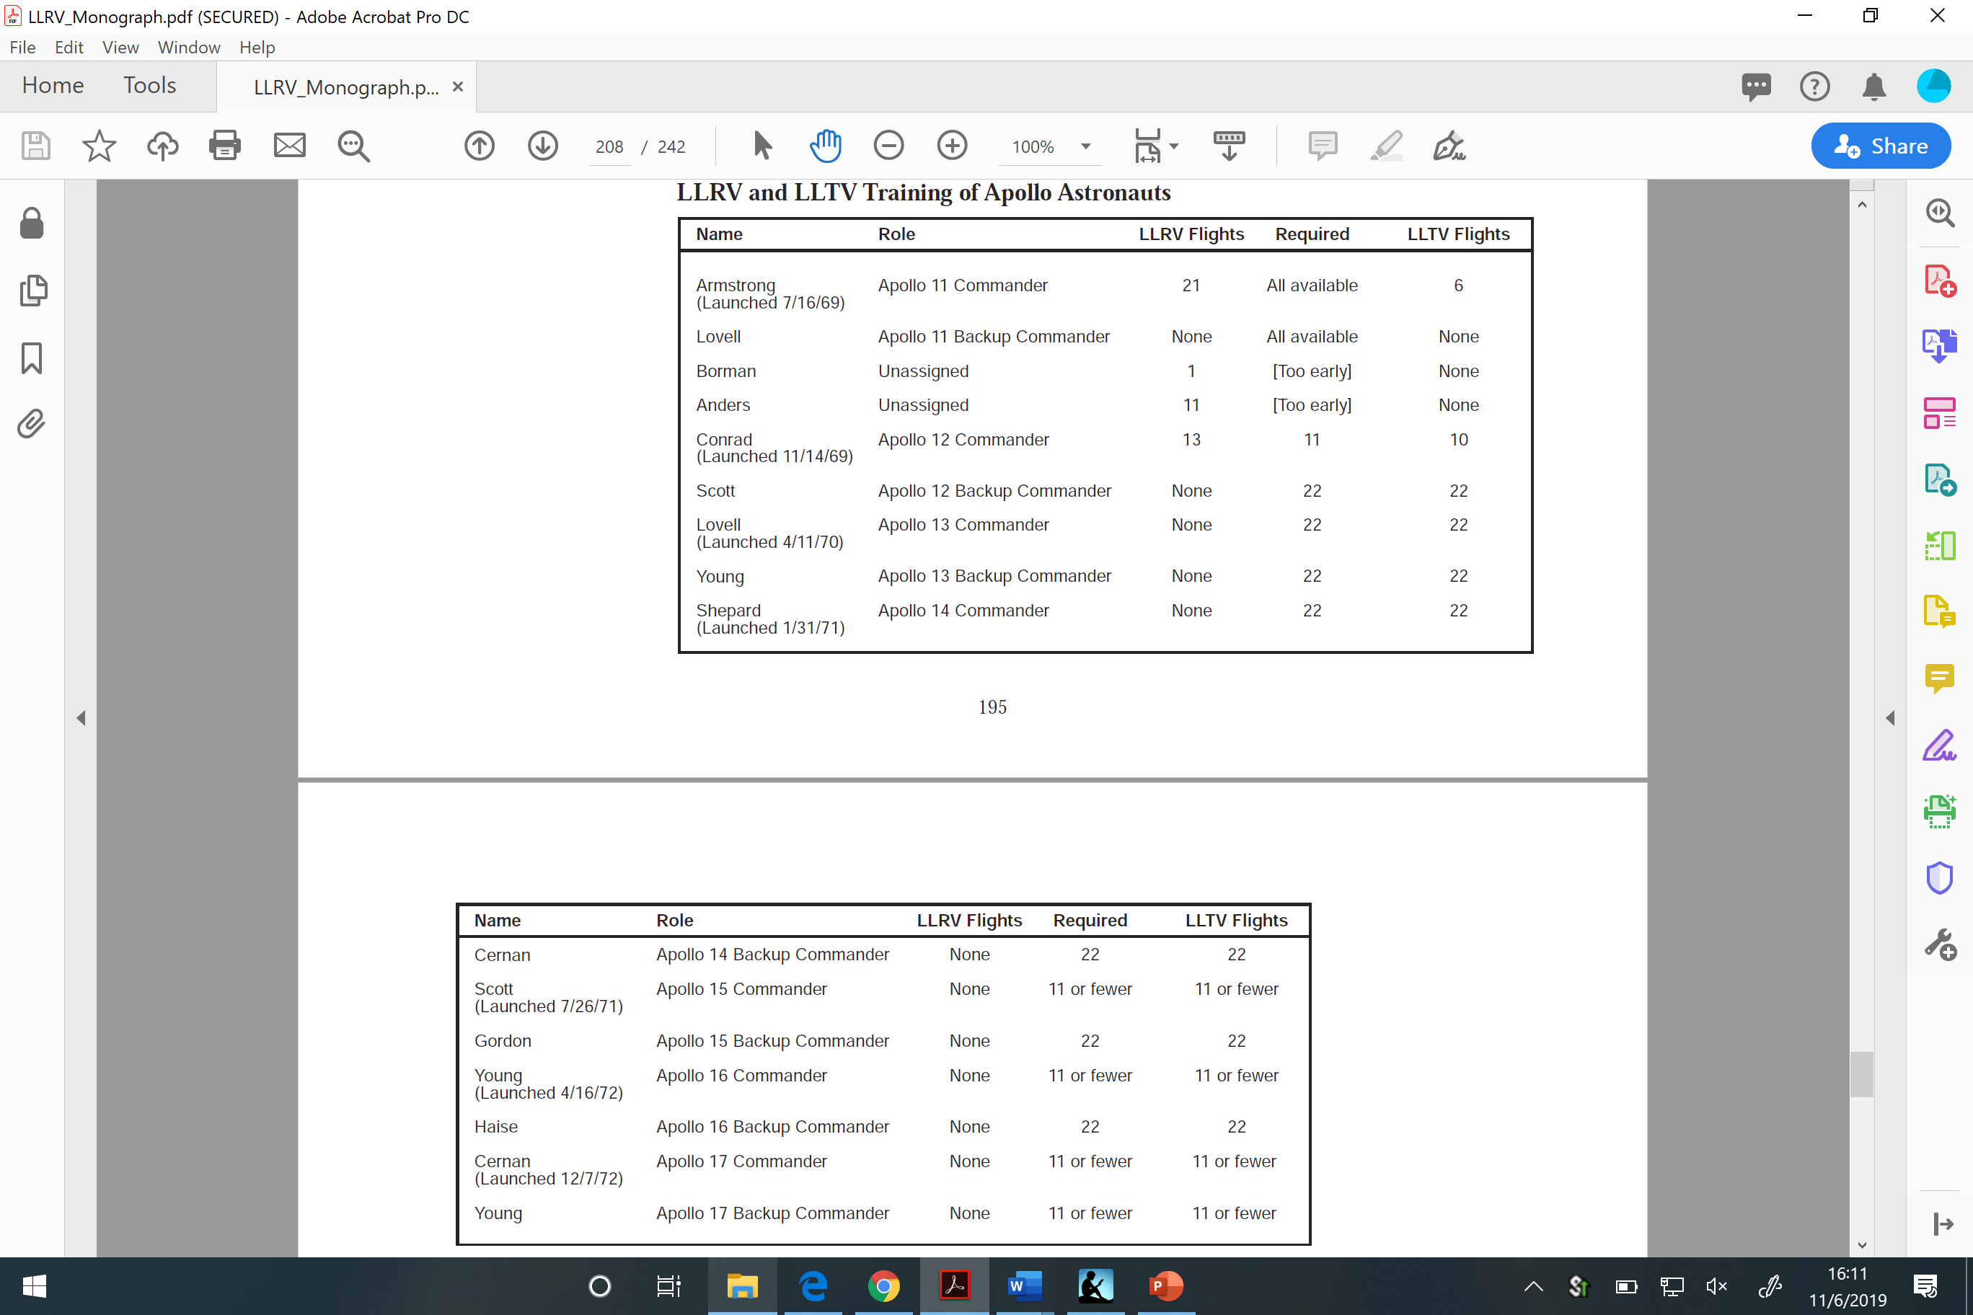

Slide 8
Decision Points
Launch
Translunar Injection
Lunar Orbit Insertion
Lunar orbit circularization (LOI-2)
Descent Orbit Insertion
Powered Decent Initiation
Post-landing lunar stay
EVA
Continued lunar orbit operations after docking

Slide 9
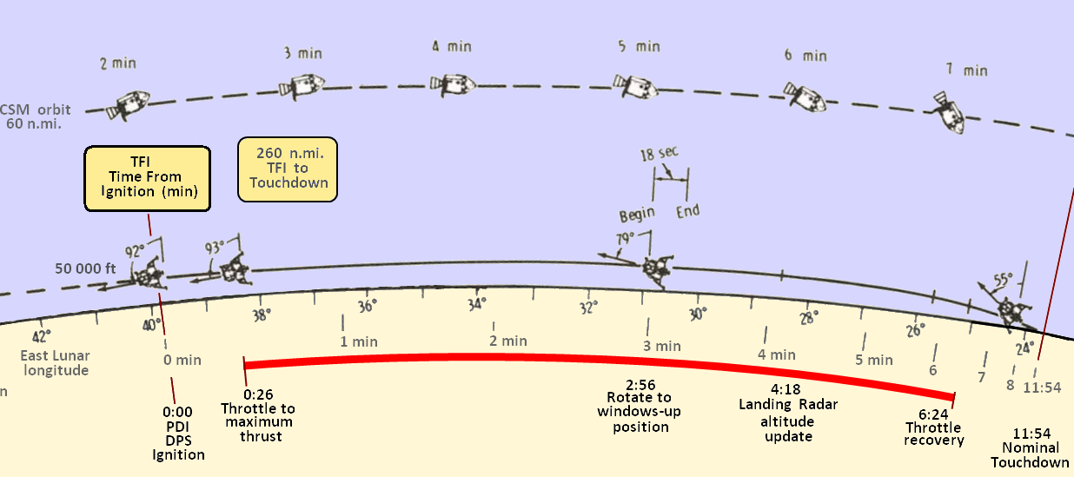

Slide 10
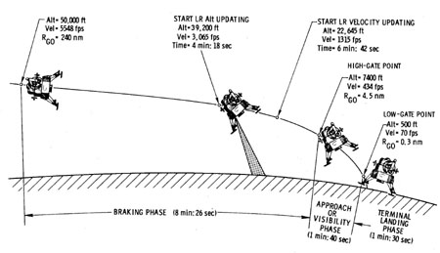
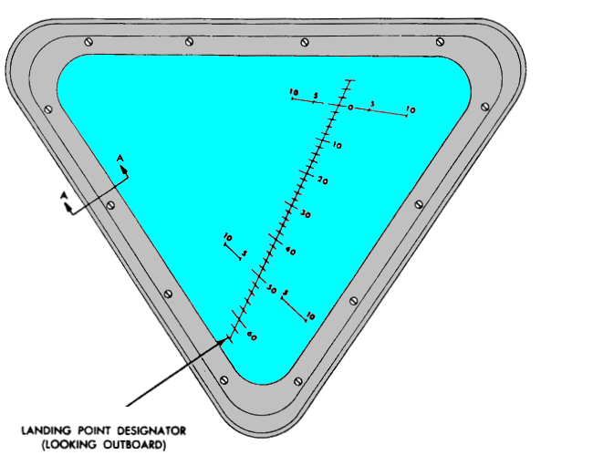
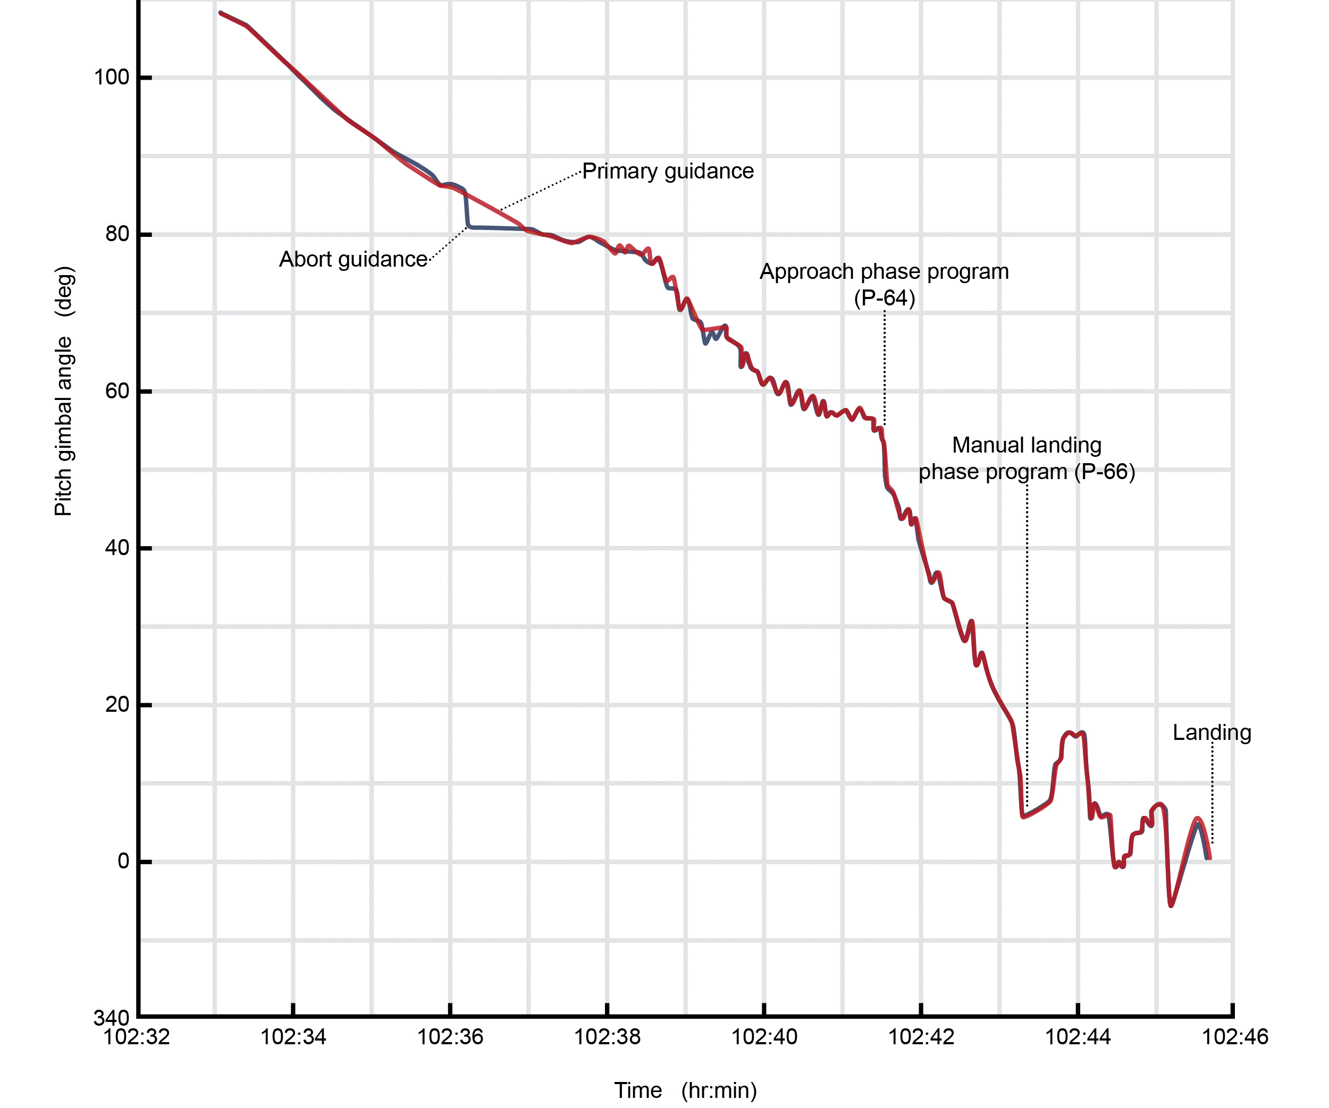
3D Visualization

Slide 11
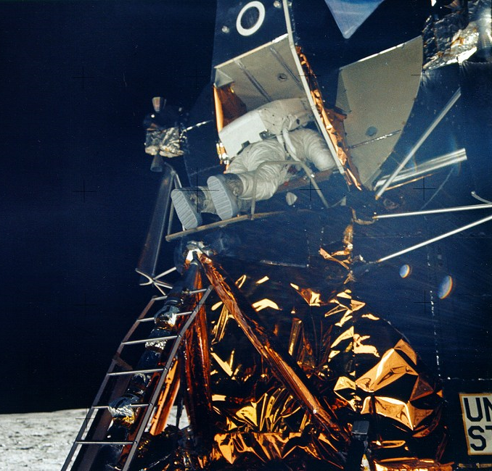
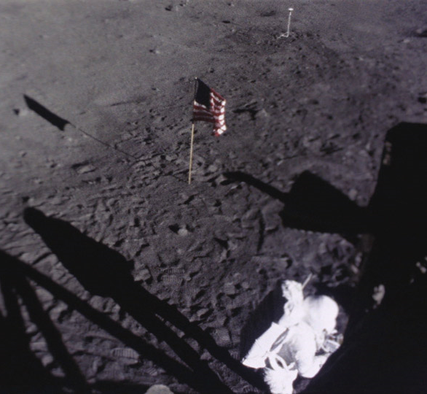
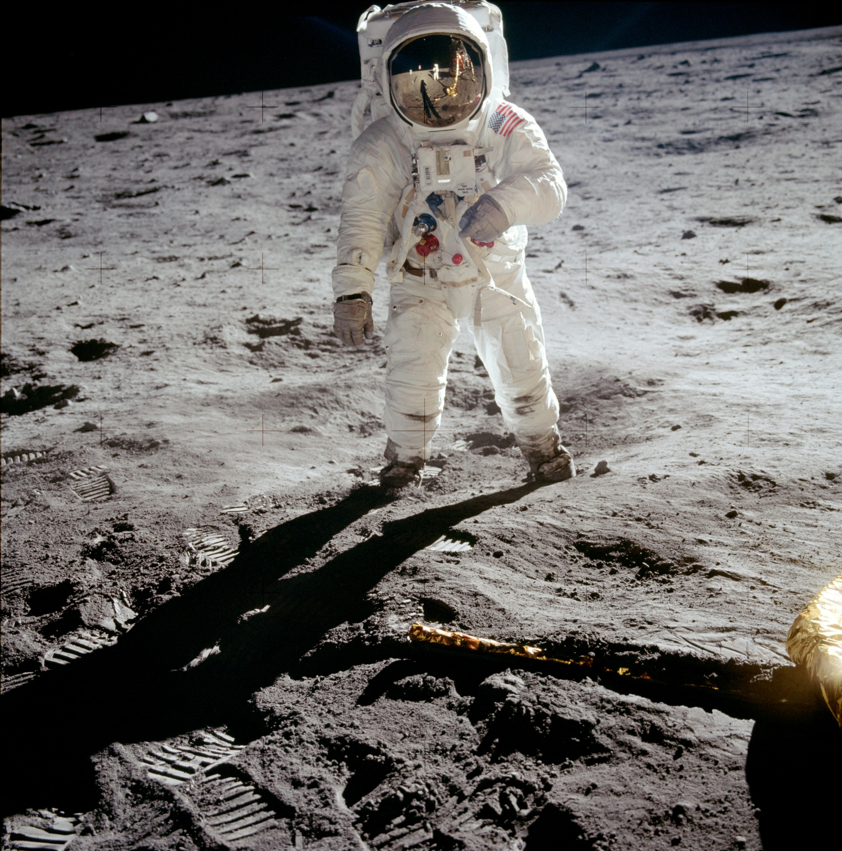
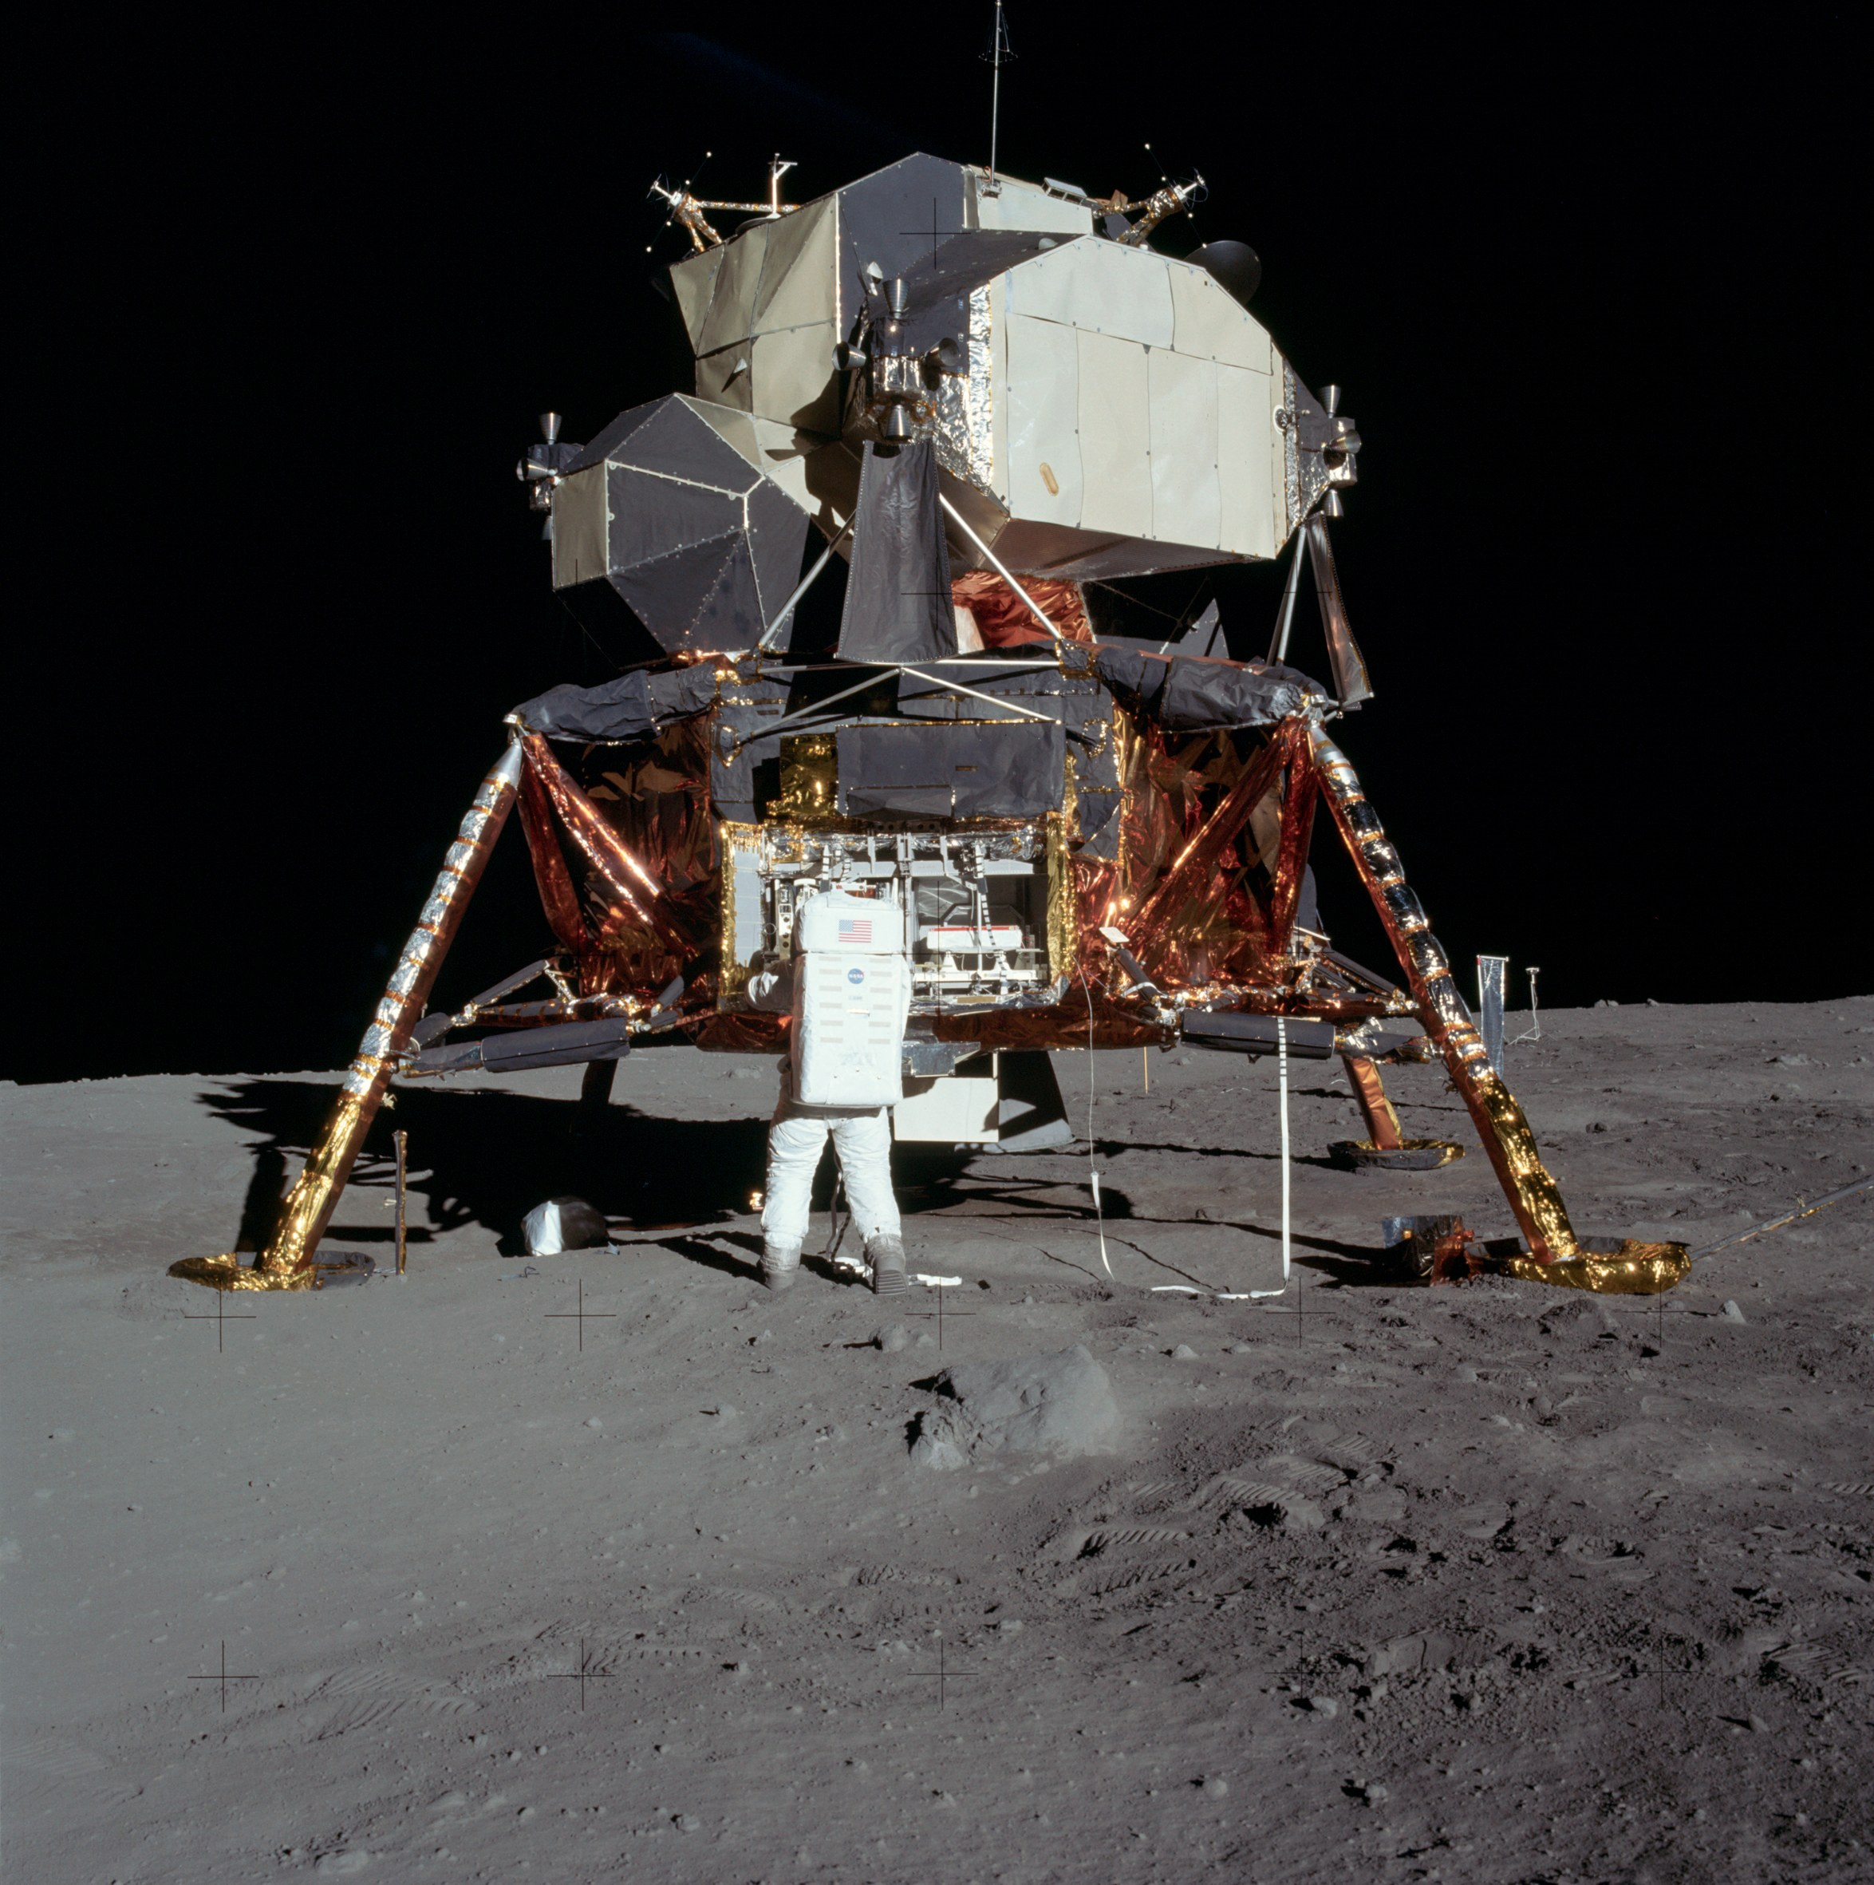
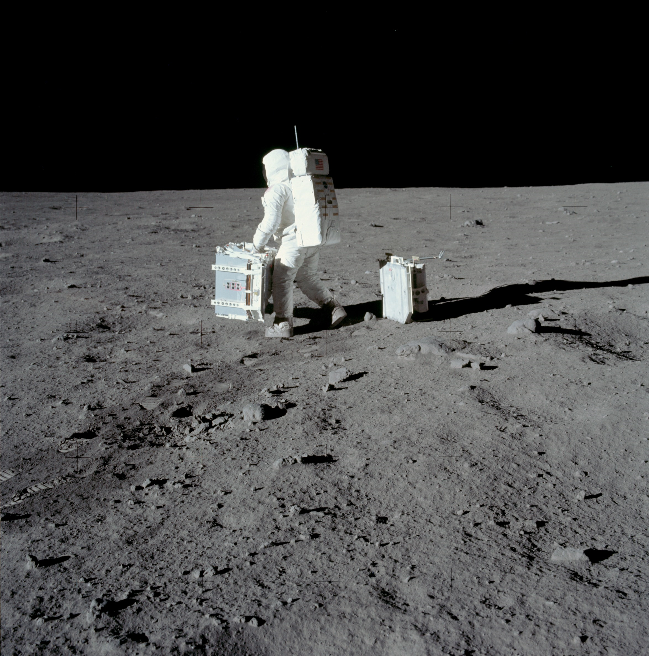
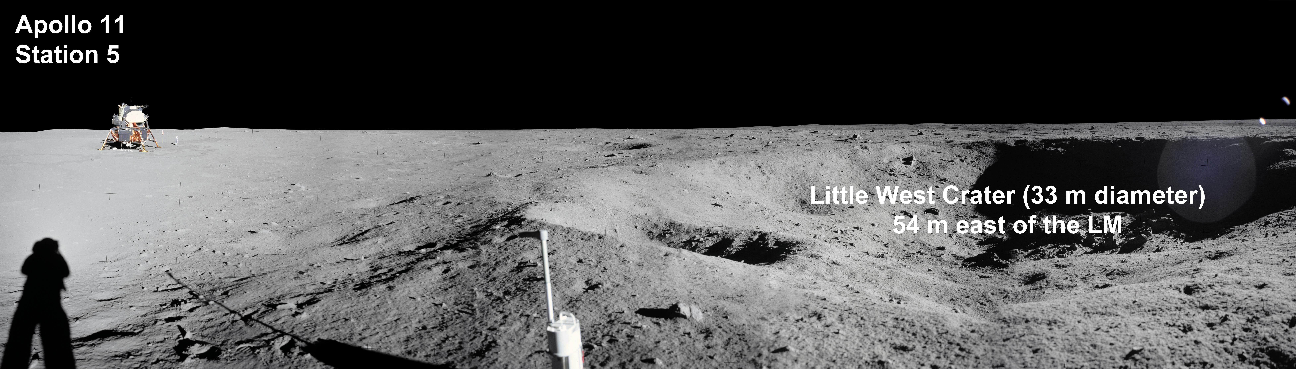

Slide 12
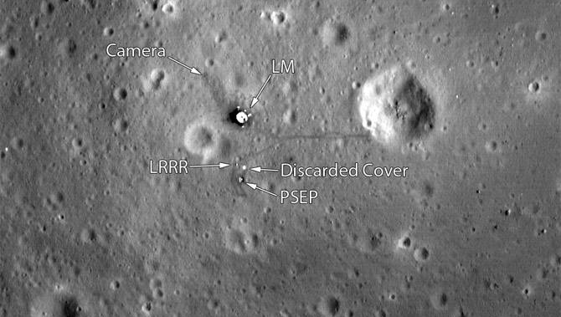

Slide 13
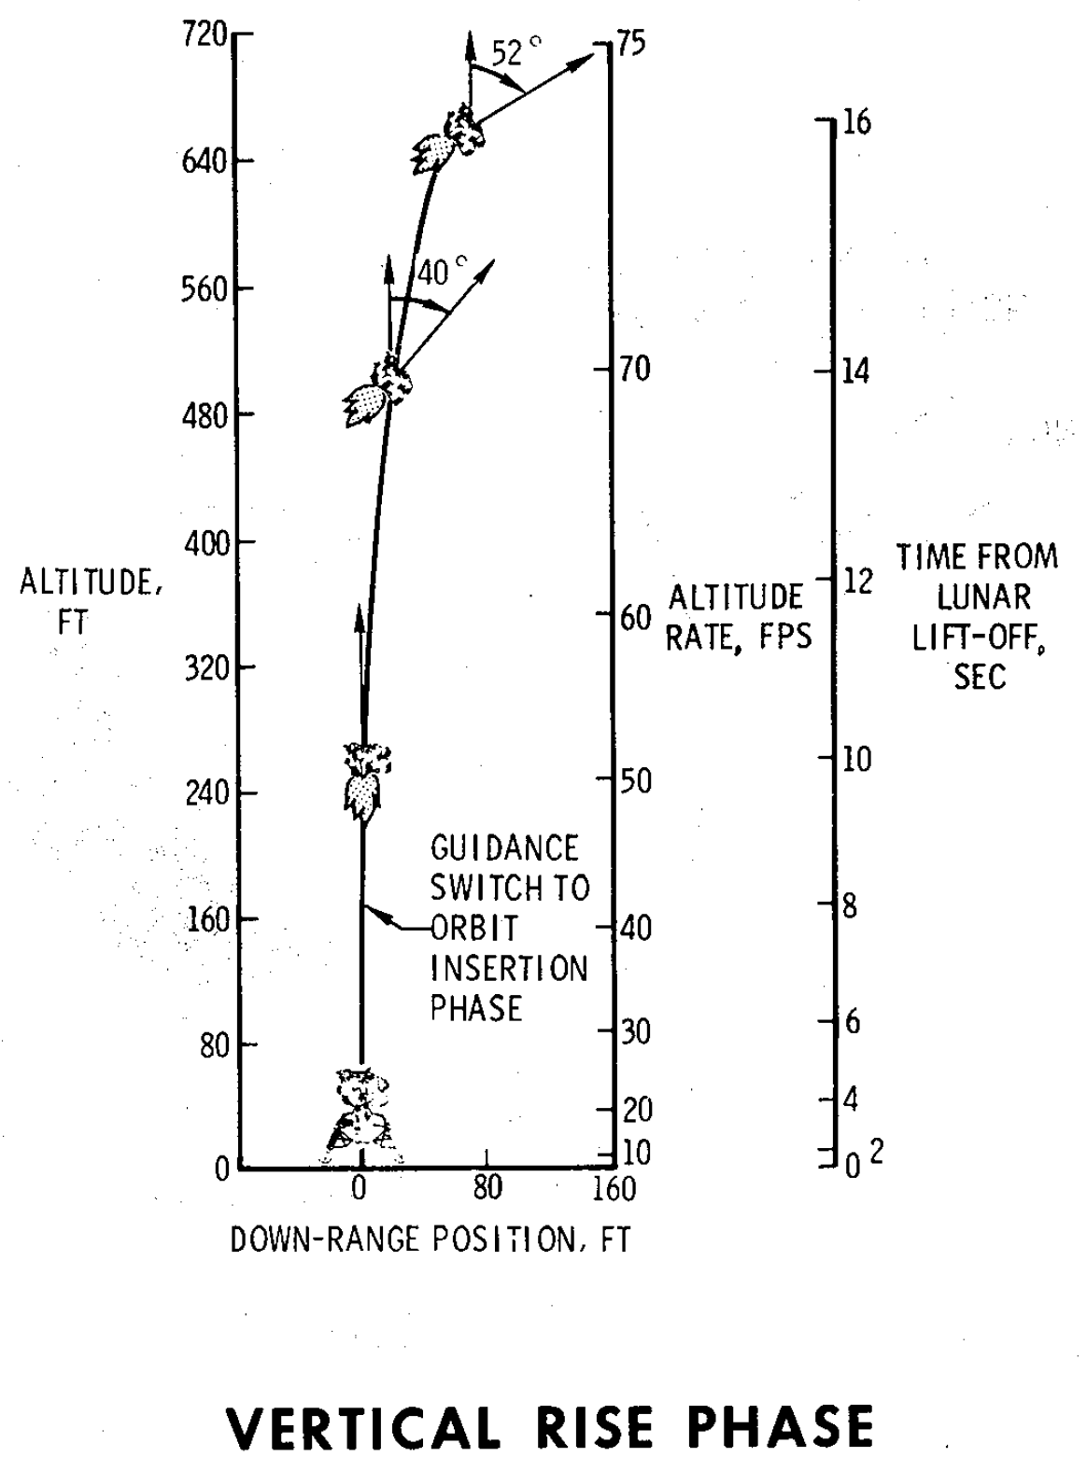
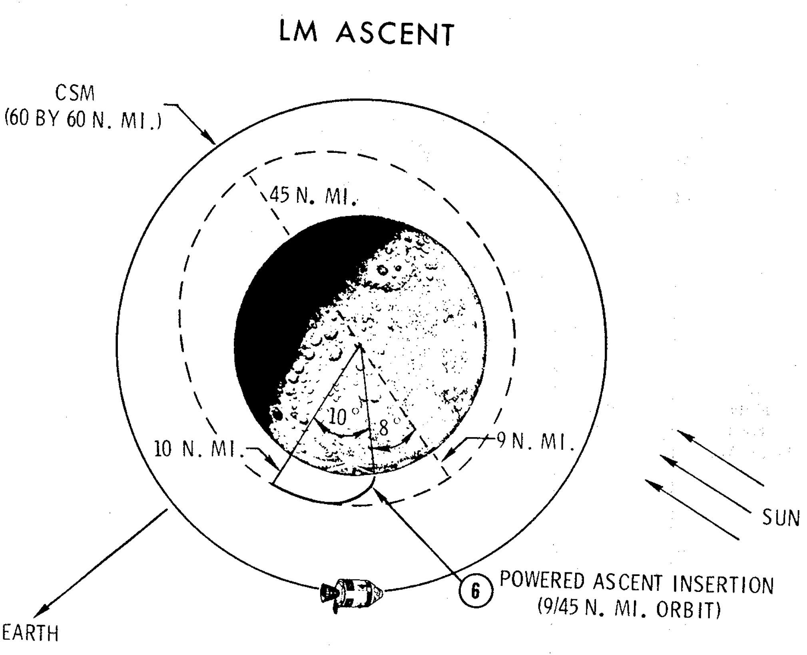

Slide 14
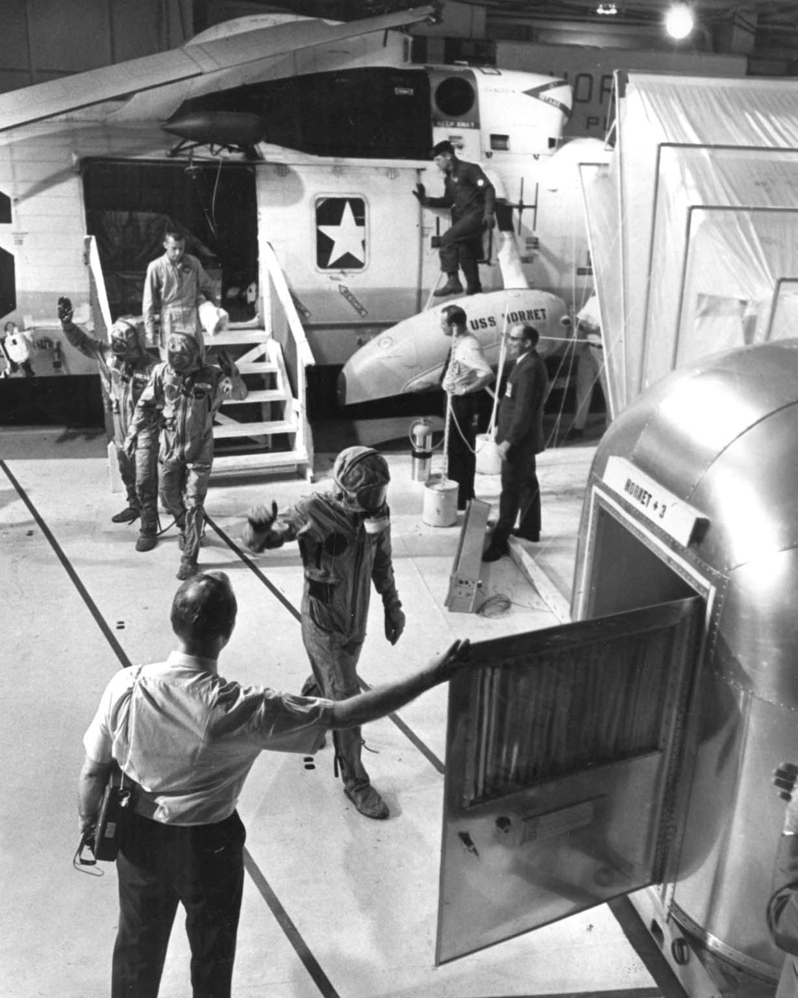
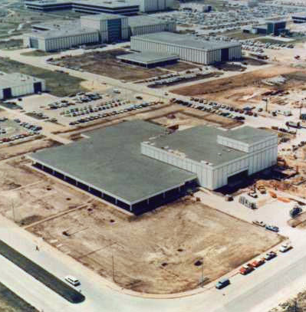

Slide 15
Discussion Groups
Chaikin Chapter 5 (“The First Lunar Landing”)
  The astronauts’ view of Apollo 11
Cox Chapter 24 (“We … We’re Go on That Flight!”)
  Mission control’s view of Apollo 11
Harland Chapter 2 (“Magnificent Desolation”)
  The first moonwalk
Glenn lecture video (“40th Anniversary of Apollo 11”)
  The three Apollo 11 astronauts tell their story 40 years later

Slide 16
Apollo 12 Readings
Chaikin Chapter 6 (“Sailors on the Ocean of Storms”)
  A telling of the astronaut’s view of Apollo 12
Apollo 12 Mission Report Chapter 9 (“Pilots’ Report”)
  The astronaut’s actual view of Apollo 12
Cox Chapter 26 (“I Think We Need to do a Little More All-Weather Testing”)
  A view of Apollo 12 from mission control
From the Earth to the Moon Episode 7 (“That’s All There Is”)
  An dramatization of a mission that largely lacked video

