Slide 1
Apollo 10: Lunar Orbit Rendezvous
INST 154
Apollo at 50
Sea of Tranquility

Slide 2
Apollo 8 Primary Detailed Test Objectives
To perform a guidance and navigation control system controlled entry from a lunar return.
To perform star‑lunar horizon sightings during the translunar and transearth phases.
To perform star‑earth horizon sightings during translunar and transearth phases.
To perform manual and automatic acquisition, tracking, and communication with the Manned Space Flight Network using the high‑gain command and service module S‑band antenna during a lunar mission.
To obtain data on the passive thermal control system during a lunar orbit mission.
To obtain data on the spacecraft dynamic response.
To demonstrate spacecraft lunar module adapter panel jettison in a zero‑g environment.
To perform lunar orbit insertion service propulsion system guidance and navigation control system controlled burns with a fully loaded command and service module. Achieved.
To perform a transearth insertion guidance and navigation control system controlled service propulsion system burn.
To obtain data on the command module crew procedures and timeline for lunar orbit mission activities.
To demonstrate command service module passive thermal control modes and related communication procedures during a lunar orbit mission.
To demonstrate ground operational support for a command and service module lunar orbit mission.
To perform lunar landmark tracking in lunar orbit from the command and service module.
To prepare for translunar injection and monitor the guidance and navigation control system and launch vehicle tank pressure displays during the translunar injection burn.
To perform translunar and transearth midcourse corrections.
To verify that modifications incorporated in the S‑IC stage since the Apollo 6 flight suppress low frequency longitudinal oscillations (POGO).
To confirm the launch vehicle longitudinal oscillation environment during the S‑IC stage burn.
To verify the modifications made to the J‑2 engine since the Apollo 6 flight.
To confirm the J‑2 engine environment in the S‑II and S‑IVB stages.
To demonstrate the capability of the S‑IVB to restart in Earth orbit.
To demonstrate the operation of the S‑IVB helium heater repressurization system.
To demonstrate the capability to safe the S‑IVB stage in orbit.
To verify the capability to inject the S‑IVB/instrument unit/lunar module test article "B" into a lunar "slingshot" trajectory.
To verify the capability of the launch vehicle to perform a free‑return translunar injection.

Slide 4
Apollo 9 Mandatory Detailed Test Objectives
To perform a medium duration descent propulsion system firing to include manual throttling with command and service module and lunar module docked, and a short duration descent propulsion system firing with an undocked lunar module and approximately half full descent propulsion system propellant tanks.
To perform a long duration ascent propulsion system burn.
To perform a long duration descent propulsion system burn and obtain data to determine that no adverse interactions existed between propellant slosh, vehicle engine vibration, and descent propulsion system performance during a burn.
To demonstrate the performance of the environmental control system during lunar module activity periods.
To determine the performance of the lunar module electrical power subsystem in the primary and backup modes.
To operate the landing radar during the descent propulsion system burns.
To deploy the lunar module landing gear and obtain data on landing gear temperatures resulting from descent propulsion system operation.
To verify the performance of the passive thermal subsystems (thermal blanket, plume protection, ascent and descent stage base heat shields, and thermal control coatings) to provide adequate thermal control when the spacecraft is exposed to the natural and propulsion induced thermal environments.
To demonstrate the structural integrity of the lunar module during Saturn V launch and during descent propulsion system and ascent propulsion system burn in an orbital environment.

Slide 5
Apollo 9 Primary Detailed Test Objectives
To demonstrate block II command and service module attitude control during service propulsion system thrusting with the command and service module and lunar module docked.
To perform inertial measurement unit alignments using the sextant while docked.
To perform an inertial measurement unit and a star pattern visibility check in daylight while docked.
To perform manual thrust vector control takeover of a guidance navigation control system initiated service propulsion docked burn.
To obtain data on the effects of the tower jettison motor, S‑II retrorockets, and service module reaction control system exhaust on the command and service module.
To perform lunar module inertial measurement unit alignments using the alignment optical telescope and calibrate the coarse optical alignment sight.
To demonstrate reaction control system translation and attitude control of the staged lunar module using automatic and manual primary guidance and navigation control system controls.
To obtain data to verify inertial measurement unit performance in the flight environment.
To perform a primary guidance and navigation control system/digital autopilot controlled long duration ascent propulsion burn.
To demonstrate an abort guidance system calibration and obtain abort guidance system performance data in the flight environment.
To demonstrate reaction control system translation and attitude control of unstaged lunar module using automatic and manual abort guidance system/control electric section control modes.
To perform an abort guidance system/control electric section controlled descent propulsion system burn with a heavy descent stage. Achieved.
To demonstrate tracking of command and service module rendezvous radar transponder at various ranges between the command and service module and the lunar module.
To perform a landing radar self‑test.
To obtain data on rendezvous radar corona susceptibility during lunar module ‑X translation reaction control system engine firings while undocked and during ‑X reaction control system engine firings while docked.
To demonstrate the lunar module/Manned Space Flight Network operational S‑band communication subsystem capability.
To demonstrate lunar module/command and service module/Manned Space Flight Network/extravehicular activity operational S‑band and VHF communication compatibility.
To demonstrate command and service module docking with the S‑IVB/spacecraft/lunar module adapter/lunar module.
To demonstrate lunar module separation and ejection of the command and service module/lunar module from the spacecraft/lunar module adapter.
To demonstrate the technique to be employed for the undocking of the lunar module from the command and service module prior to lunar descent.
To perform a lunar module active rendezvous with a passive command and service module.
To demonstrate lunar module active docking capability with the passive command and service module.
To perform a pyrotechnic separation of the lunar module and command and service module in flight.
To demonstrate mission support facilities performance during an Earth orbital mission.
To perform procedures required to prepare for a command and service module active rendezvous with the lunar module.
To demonstrate crew capability to transfer themselves and equipment from the command and service module to the lunar module and return.
To demonstrate extravehicular transfer and obtain extravehicular activity data.
To demonstrate S‑IVB/instrument unit control capability during transposition, docking and lunar module ejection maneuver.

Slide 6
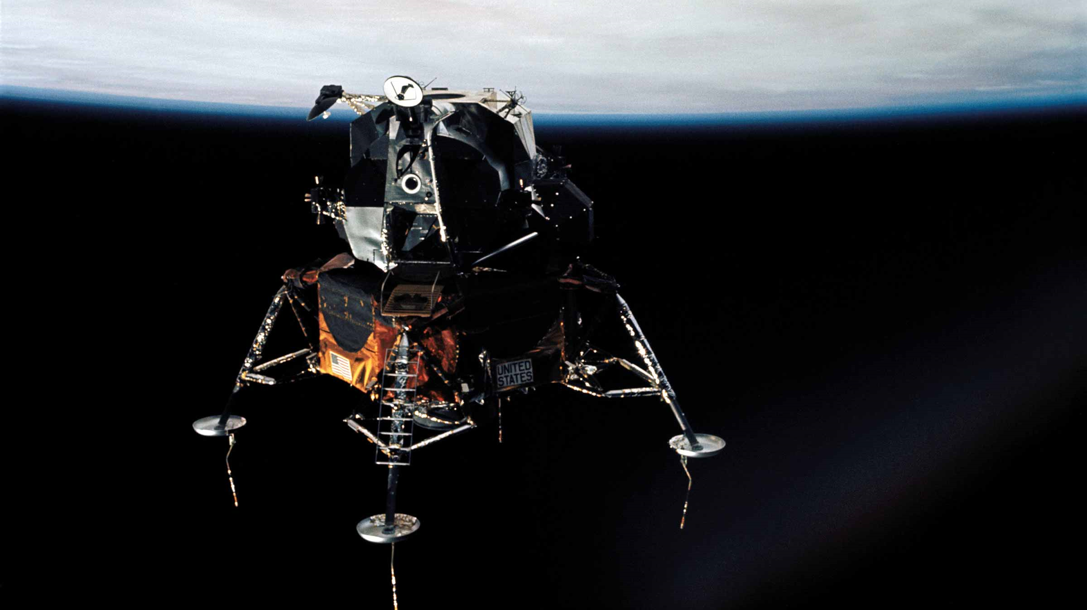

Slide 7
Deciding to fly Apollo 10 Without Landing
(Video from 7:20)
LM-4 (Apollo 10) flew 197 pounds heavier (dry) than LM-5 (Apollo 11)
And that LM-5 weight included all the lunar surface equipment
TV camera, PLSS backpacks, rock boxes, erectable antenna, 3 experiments, …
Apollo 10 could be launched in May
But LM-5 would not be available before June
Flying Apollo 11 in July would allow two more tries (in September and November)
Stafford had not flown the Lunar Landing Training Vehicle
It was grounded after a December 1968 accident (until June 14, 1969)
4 primary detailed test objectives required a LM in lunar orbit
Additional tracking would improve models of the lunar gravity field
The first test of the Soviet N-1 lunar booster in February 1969 had failed
That put the Soviet lunar landing program more than a year behind NASA’s

Slide 8
Apollo 10 Primary Detailed Test Objectives
To perform primary guidance and navigation control system/descent propulsion system undocked descent orbit insertion and a high thrust maneuver.
To perform manual and automatic acquisition, tracking, and communications with the Manned Space Flight Network using the steerable S‑band antenna at lunar distance.
To operate the landing radar at the closest approach to the Moon and during descent propulsion system burns.
To obtain data on the command module and lunar module crew procedures and timeline for the lunar orbit phase of a lunar landing mission.
To perform a lunar module active simulated lunar landing mission rendezvous.
To perform lunar landmark tracking in lunar orbit from the command and service module with the lunar module attached.
To perform lunar landmark tracking from the command and service module while in lunar orbit (not fully accomplished on Apollo 8)

Slide 9
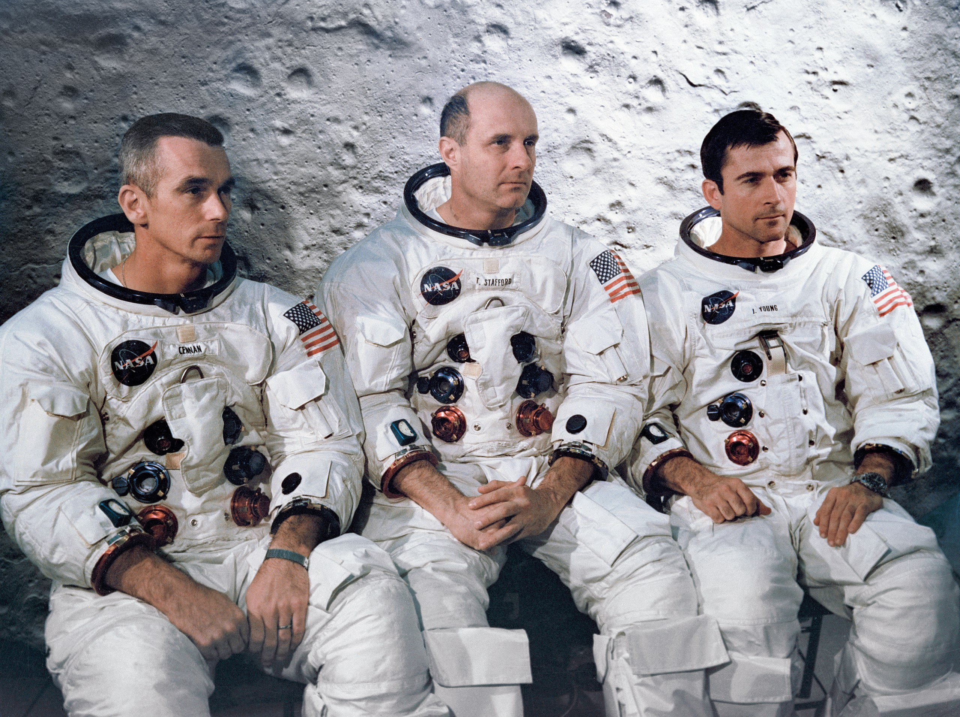
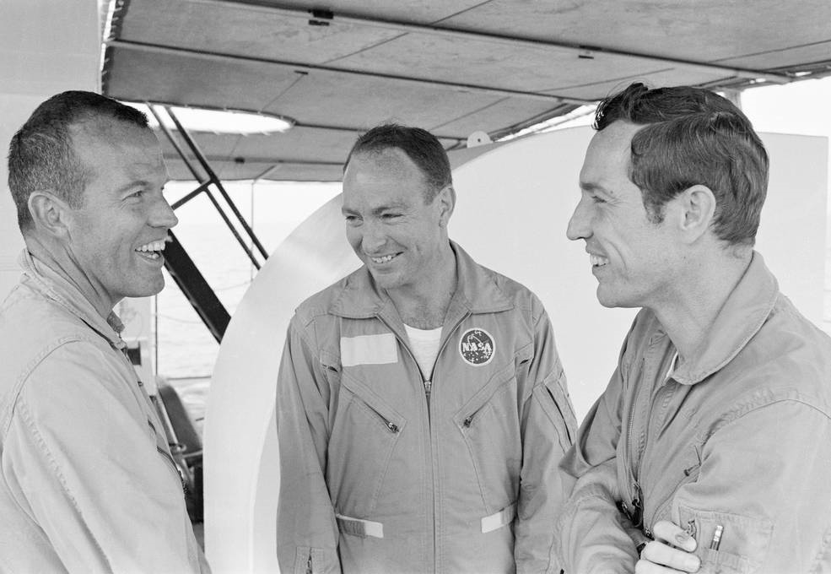
Apollo 10 Prime and Backup Crews

Slide 11
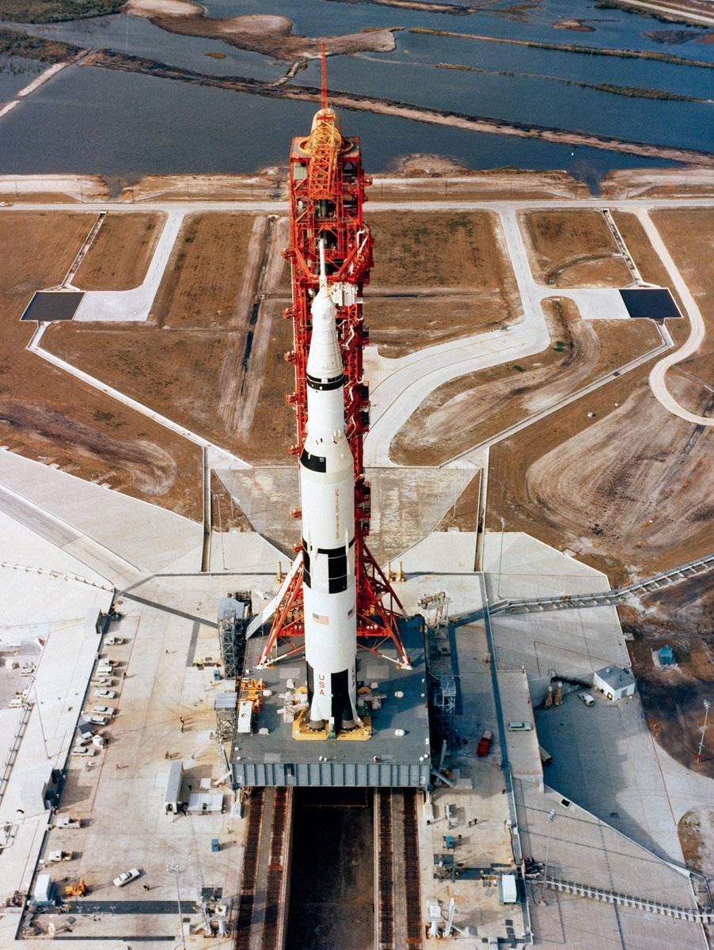
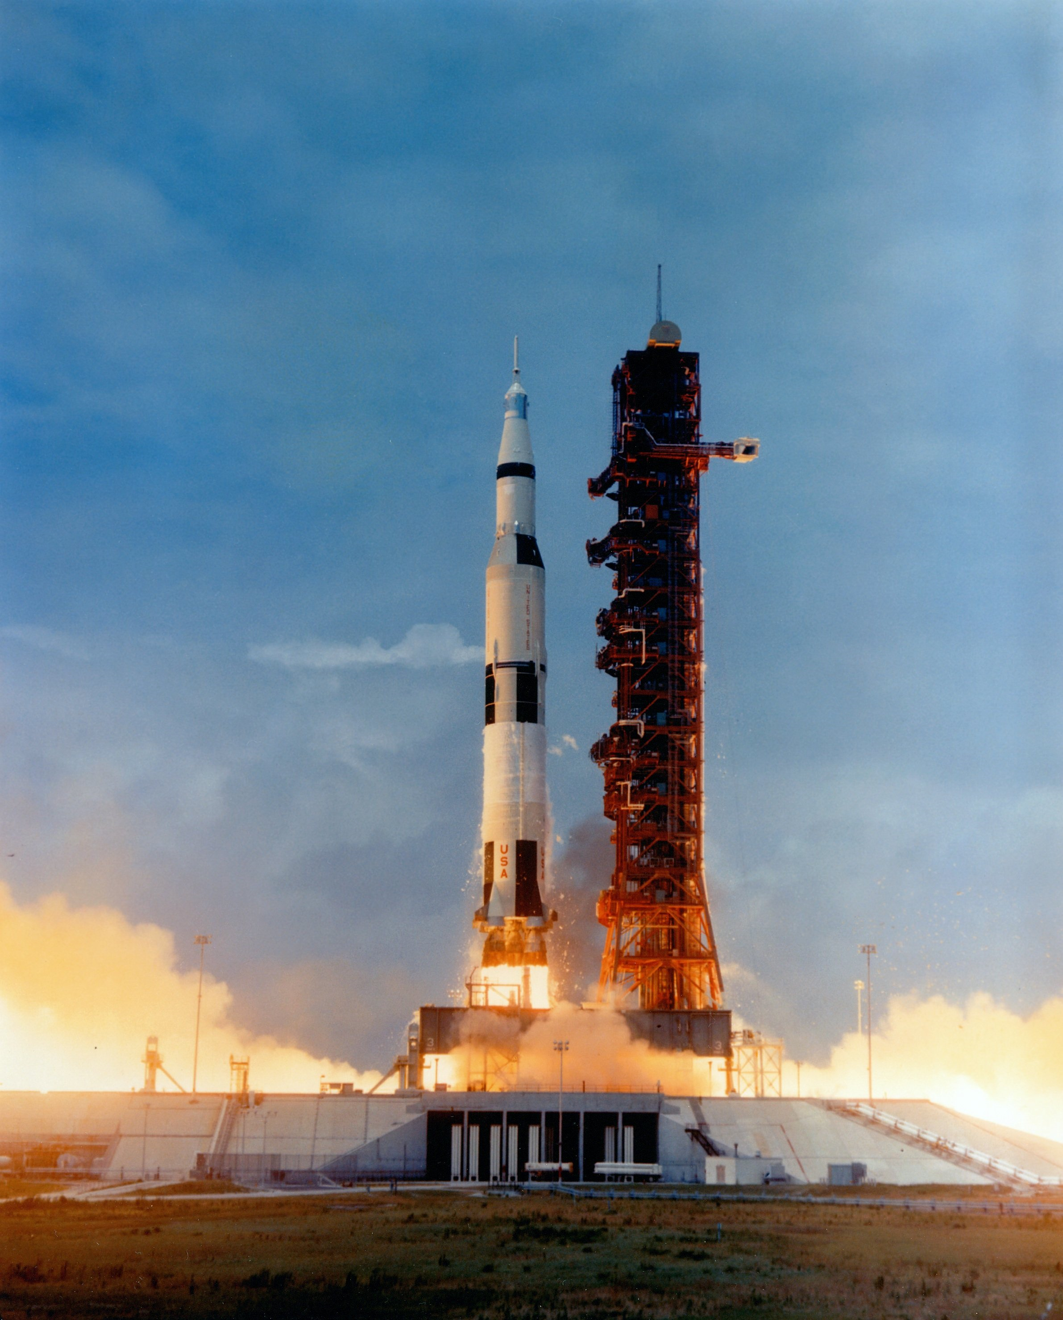
Launch Pad 39B

Slide 12
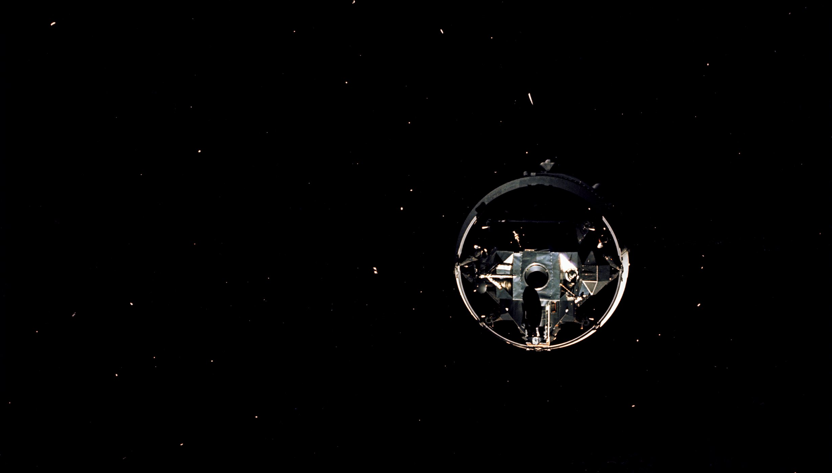

Slide 13
Apollo 10 LM Descent Orbit & Rendezvous Sequence
A

Slide 15
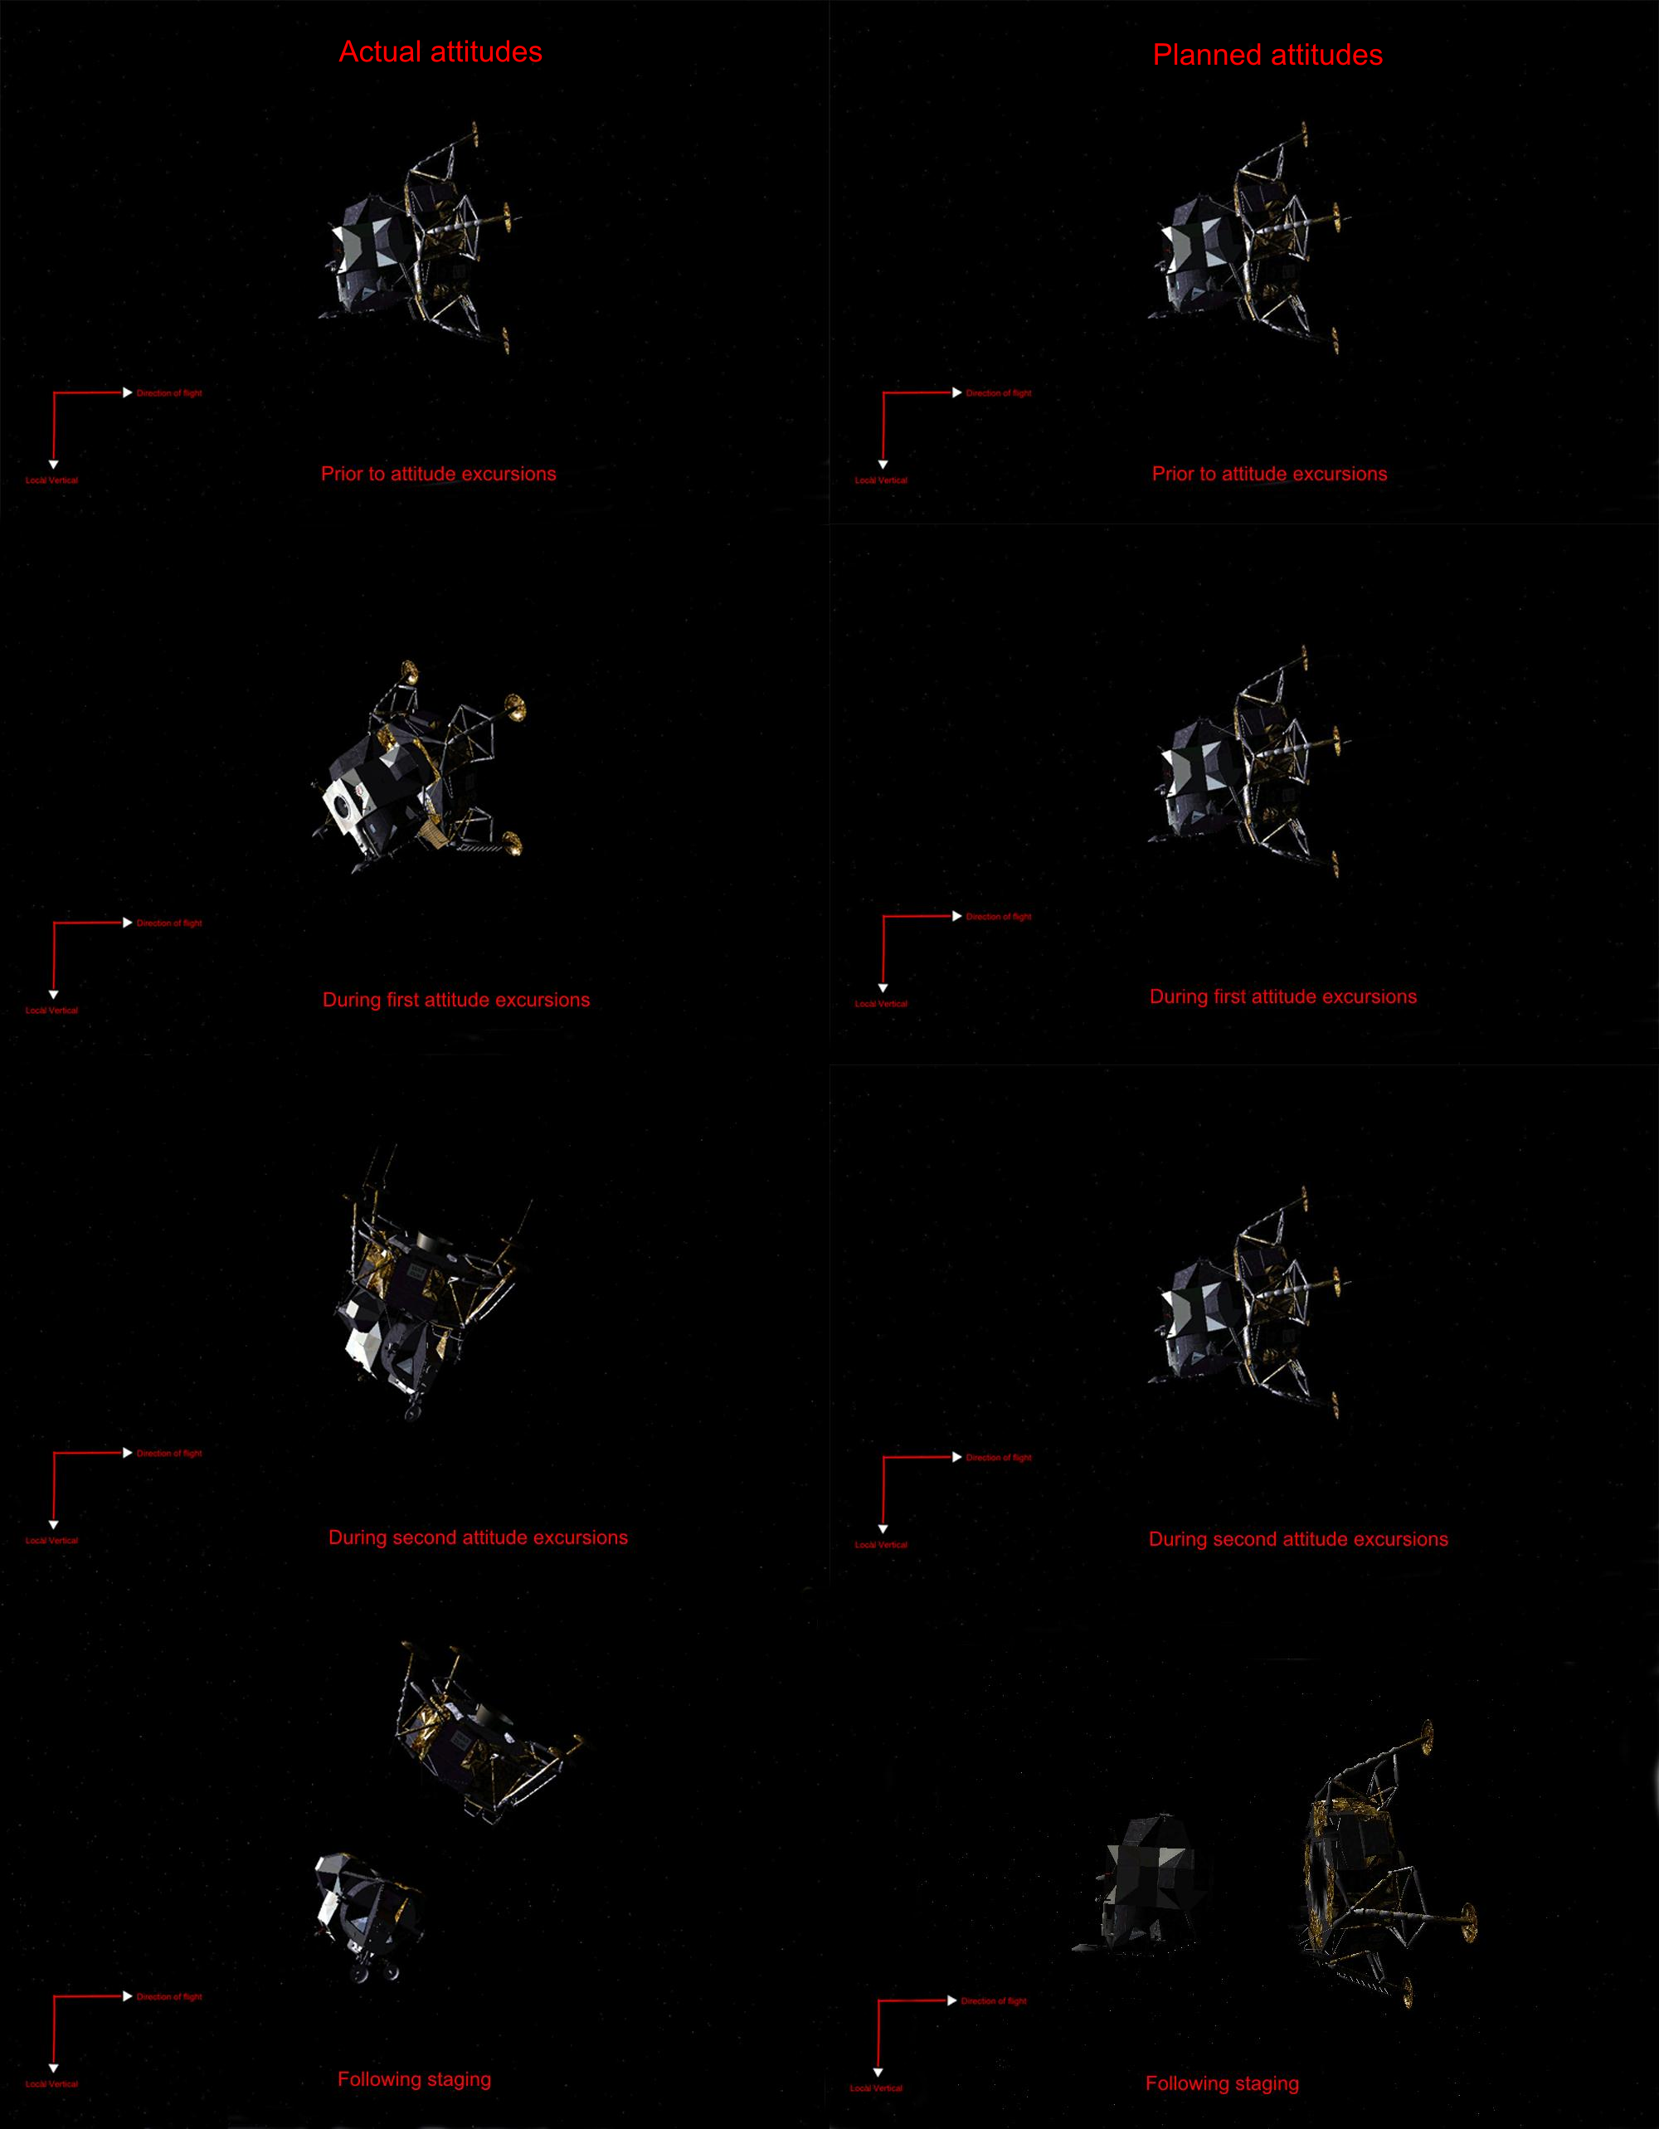
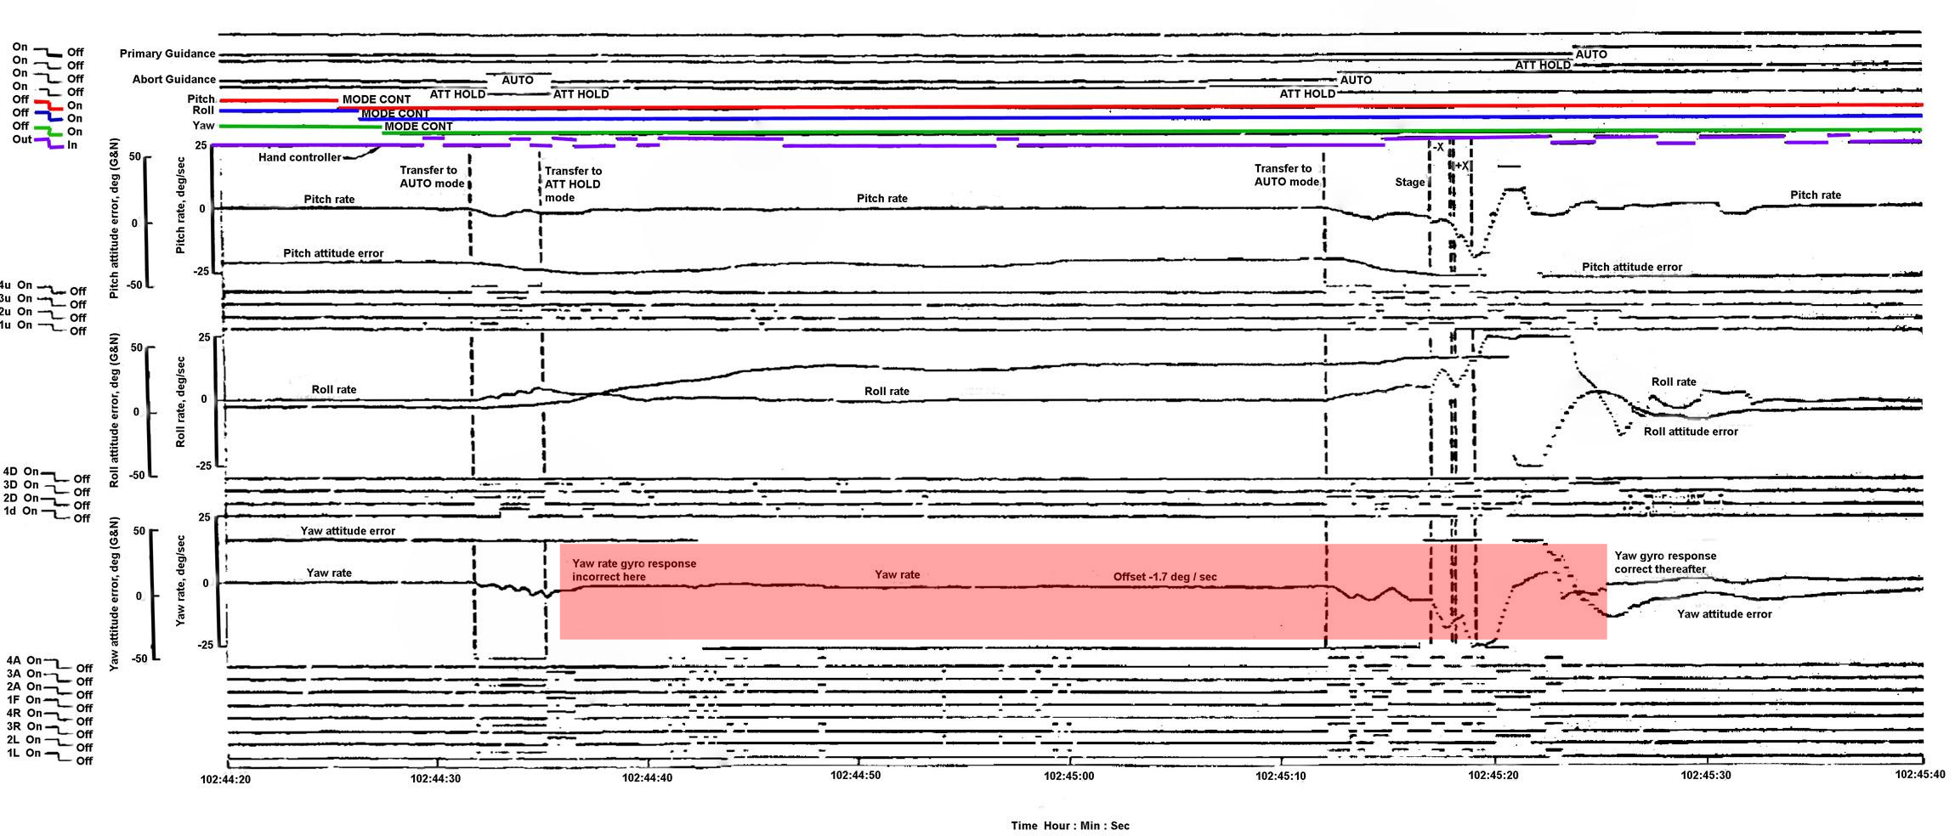
Attitude Excursions at Staging

Slide 16
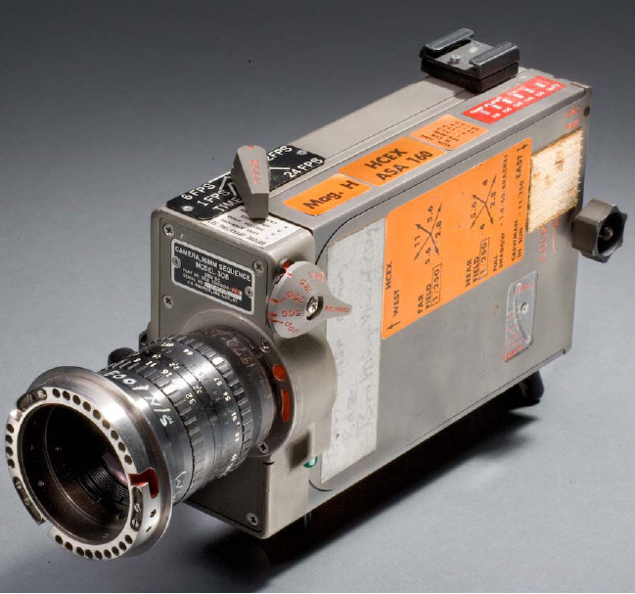
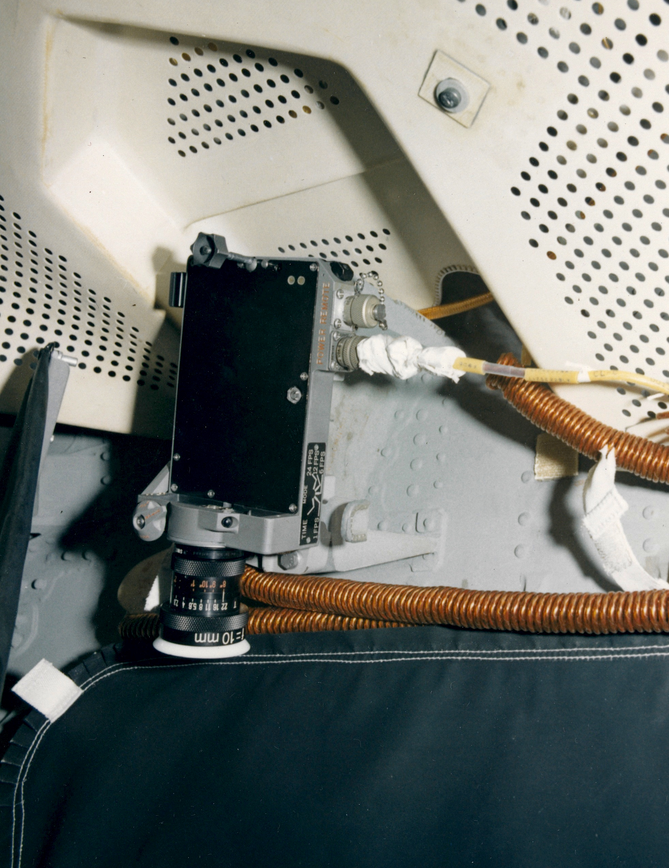
Sequence Camera

Slide 17
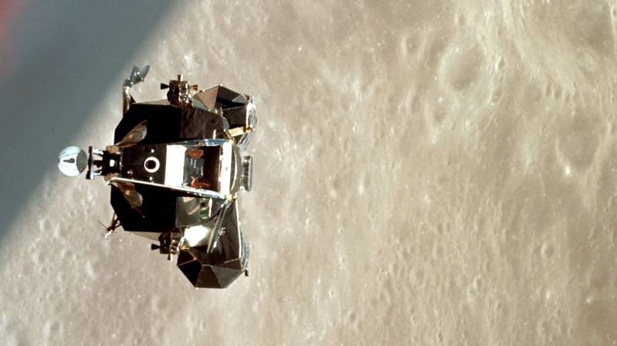

Slide 18
World Speed Record for Human Flight
24,816 (statute) Miles Per Hour

Slide 19
Discussion Groups
Chaikin Chapter 4: “Before This Decade is Out”
The astronaut’s view of Apollo 9 and Apollo 10
Cox Chapter 23: “It Was Darn Scary”
The engineer’s view of Apollo 10
Merritt: “Review of Apollo Test Objectives Remaining After Mission D”
Why fly Apollo 10?
“The Charming Genius of the Apollo Guidance Computer” video
How the onboard navigation was done

Slide 20
Apollo 11 Readings
Harland Chapter 2 (“Magnificent Desolation”)
The first moonwalk
Glenn lecture video (“40th Anniversary of Apollo 11”)
The three Apollo 11 astronauts tell their story 40 years later
Cox Chapter 24 (“We … We’re Go on That Flight!”)
Mission control’s view of Apollo 11
Chaikin Chapter 5 (“The First Lunar Landing”)
The astronauts’ view of Apollo 11

