Slide 1
The Cold War
INST 154
Apollo at 50
Duck and Cover

Slide 2
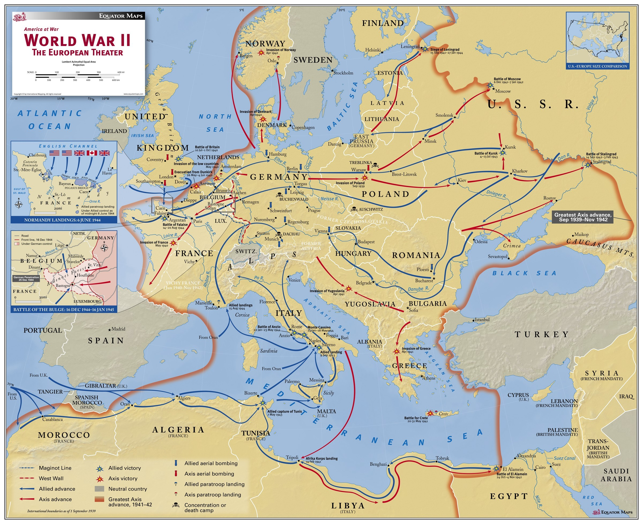

Slide 3
Origins of the Cold War
Truman (April 1945-January 1953)
  Potsdam Conference (July 1945)
  Atomic bombing of Hiroshima and Nagasaki (August 1945)
  United Nations (October 1945)
  Strategy: Containment (February 1946)
  Truman Doctrine (March-May 1947)
  Marshall Plan (April 1948)
  Berlin Airlift (June 1948)
  NATO (April, 1949)
  Soviet atomic test (August 1949)
  “Loss of China” (October 1949 to May 1950)
  Korean War (June 1950)
  Chinese entry into the Korean War (October 1950)
  MacArthur relieved of command for insubordination (April 1951)

Slide 4
Early Cold War
Eisenhower (January 1953-January 1961)
  Strategy: Massive Retaliation
  15 megaton US hydrogen bomb test (March 1954)
  Warsaw Pact (May 1955)
  “Airborne alert” bombers (September 1958)
  U-2 shootdown (May 1960)
Kennedy (January 1961-November 1963)
  Strategy: Flexible Response
  Bay of Pigs invasion (April 1961)
  Berlin Wall (August 1961)
  Cuban Missile Crisis (October 1962)
Johnson (November 1963-January 1969)
  Strategy: Mutually Assured Destruction
  Vietnam War (August 1964)

Slide 5
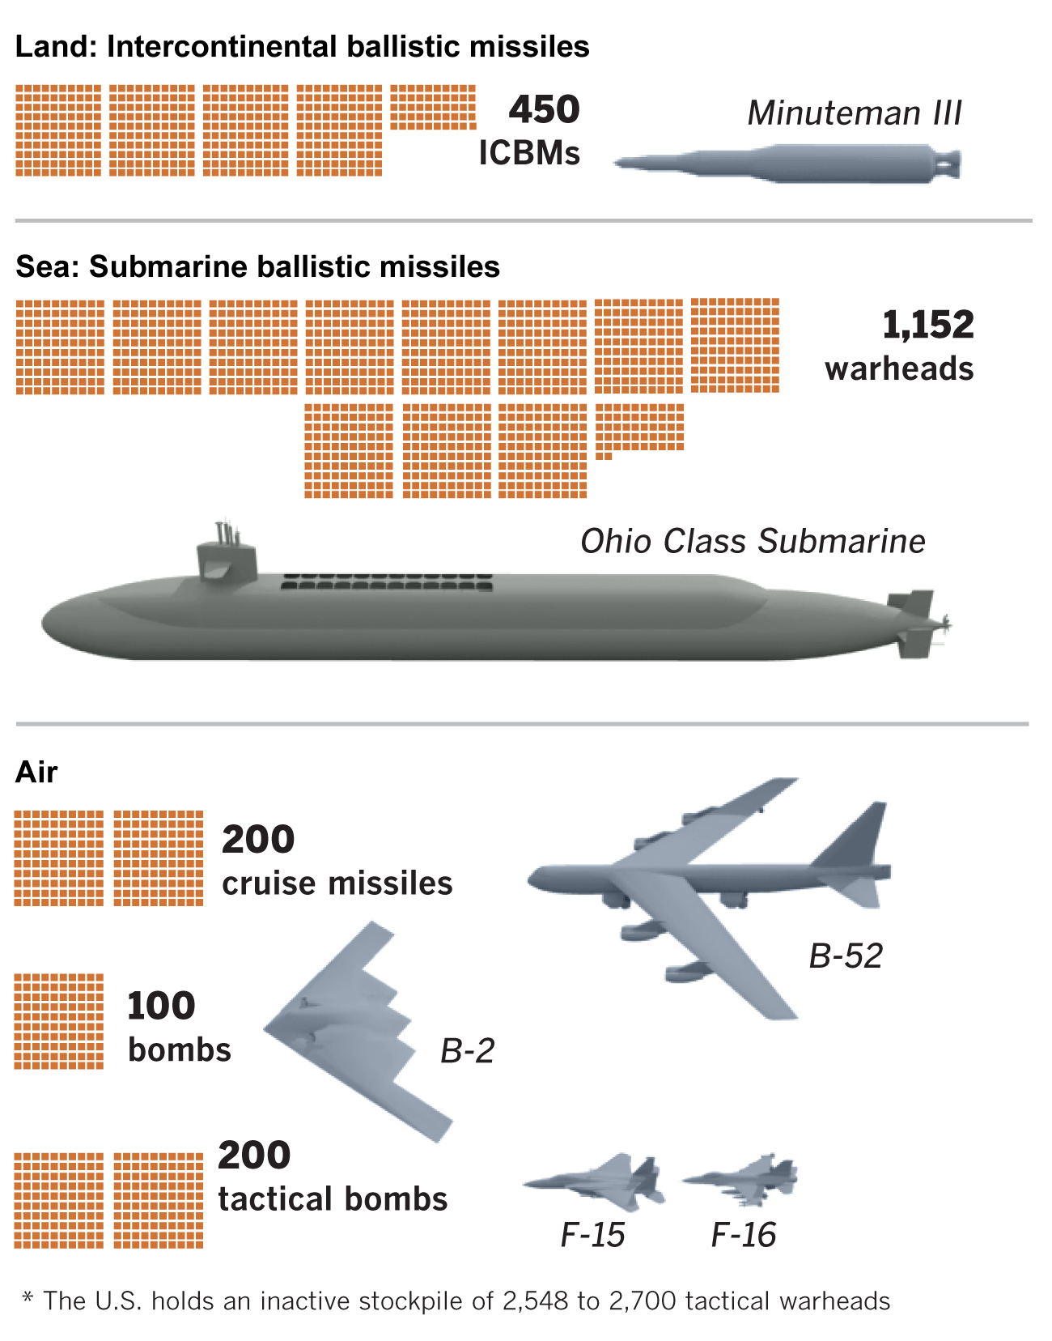
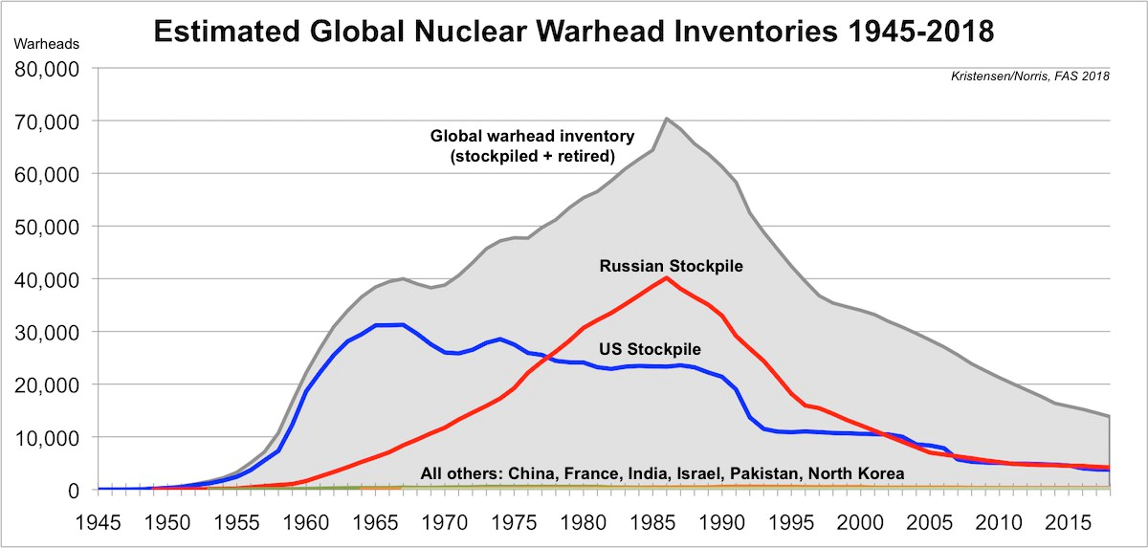
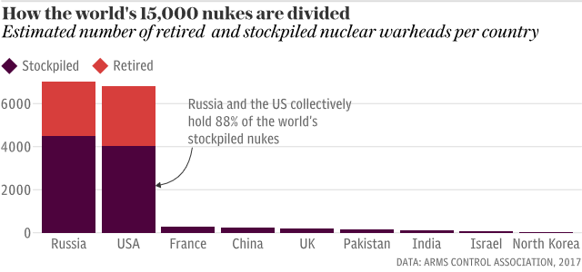
Nuclear Weapons

Slide 6
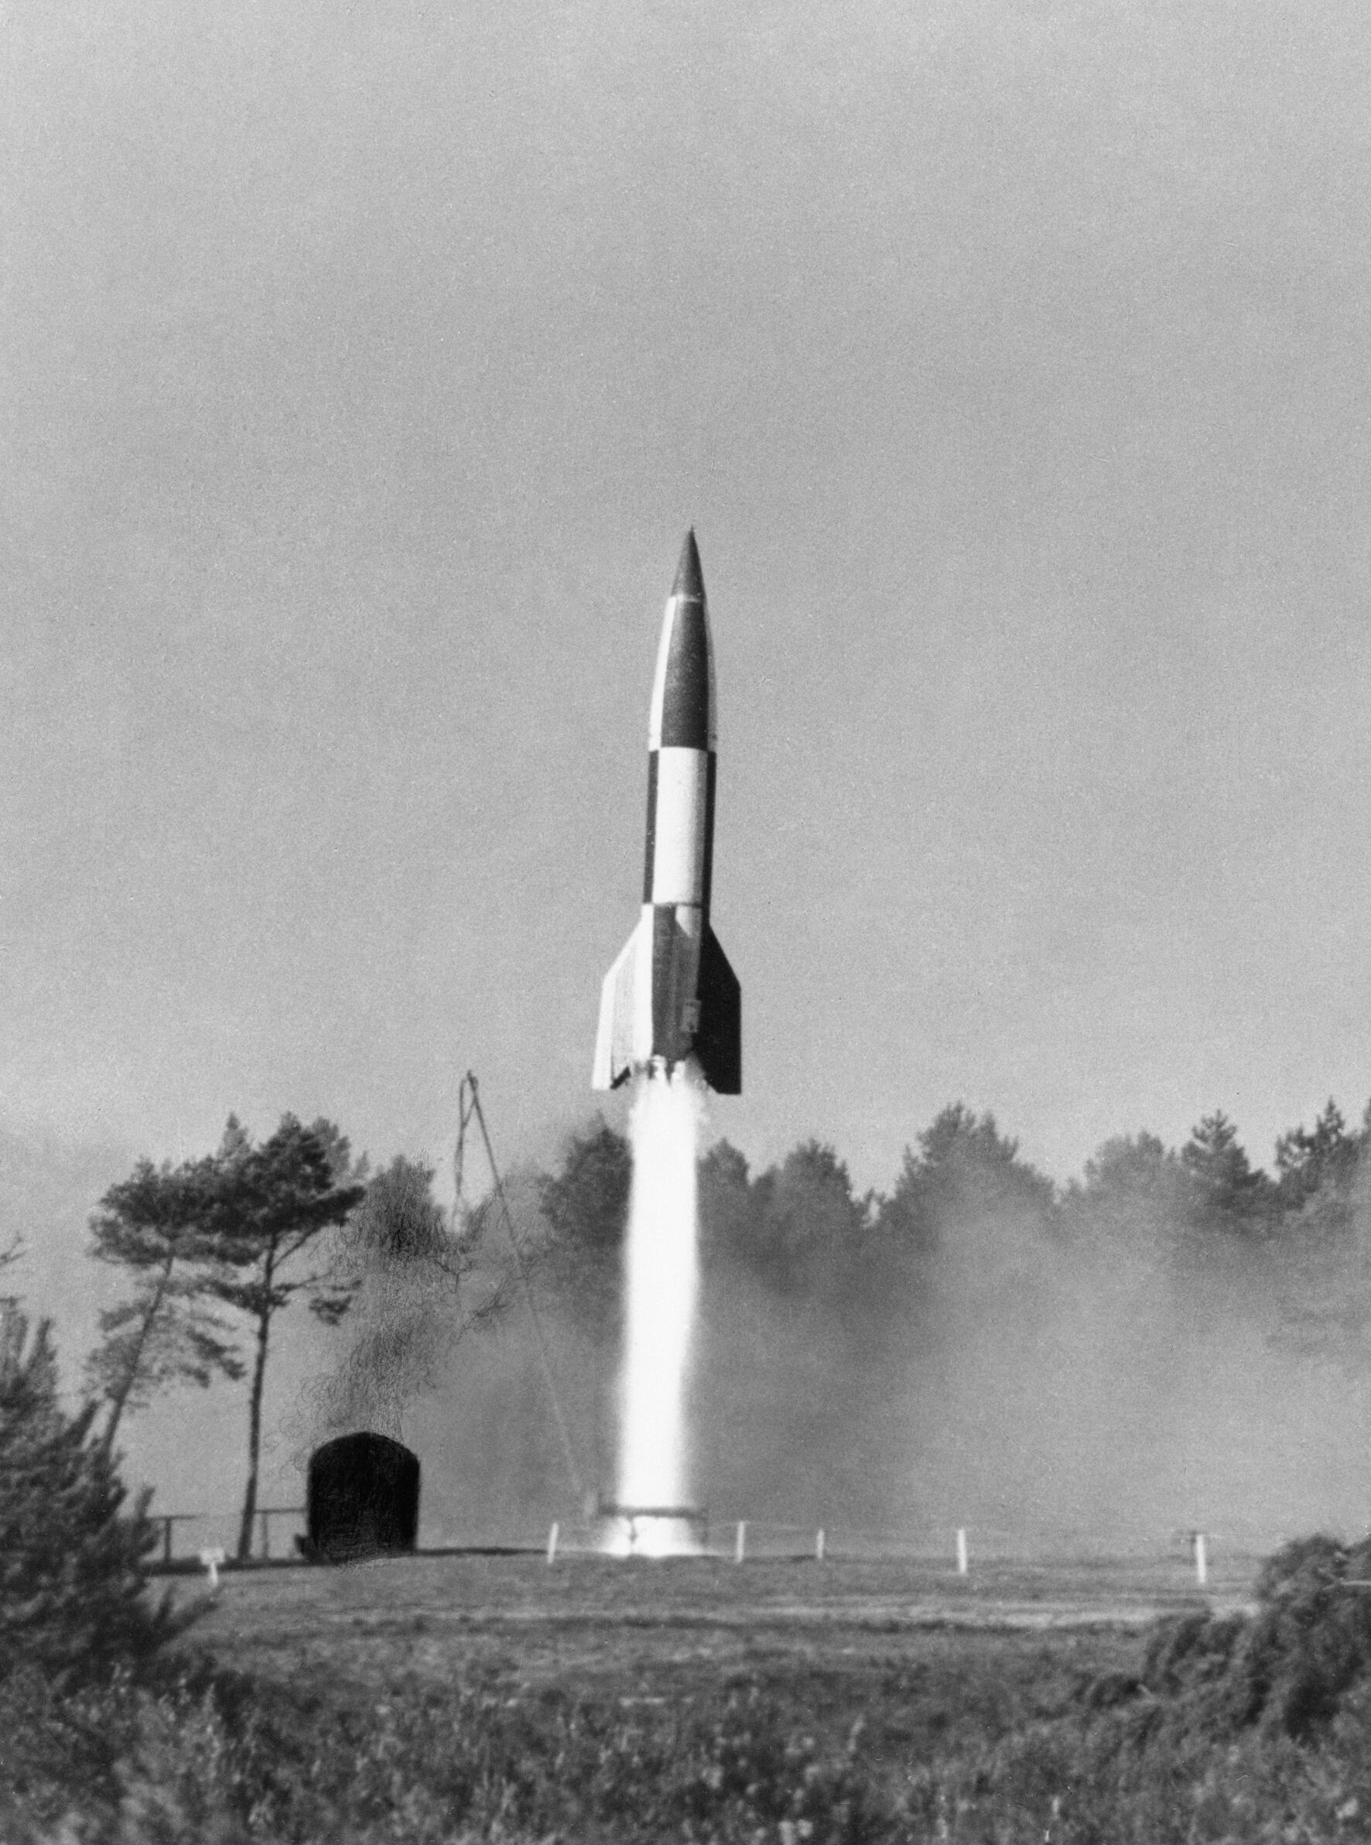
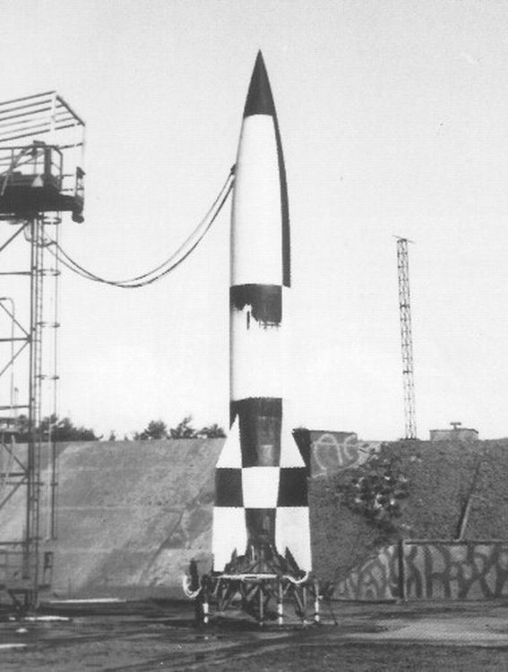
Peenemunde

Slide 7
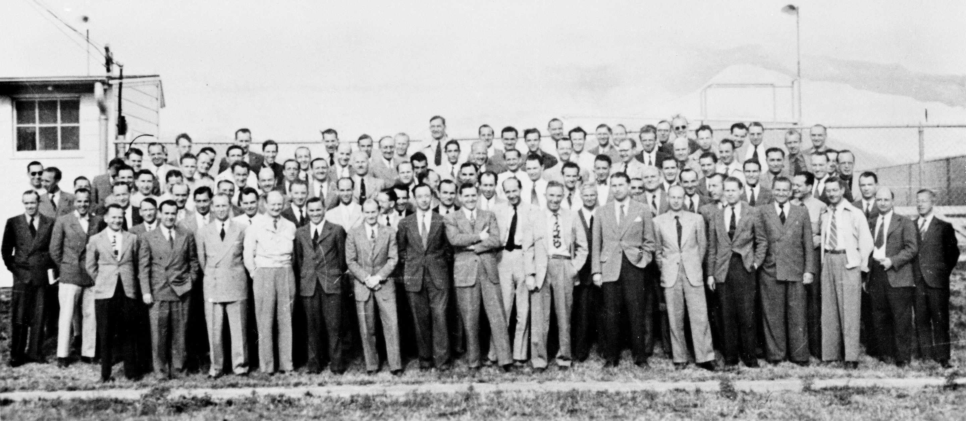
Operation Paperclip (1945-1952)

Slide 8
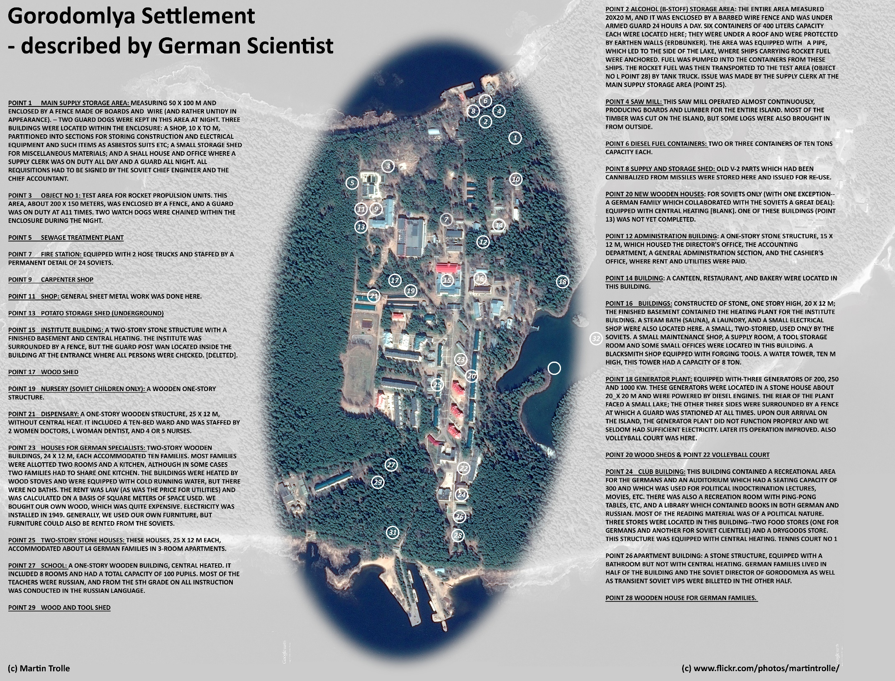
Operation
Osoaviakhim
(Oct 1946)

Slide 9
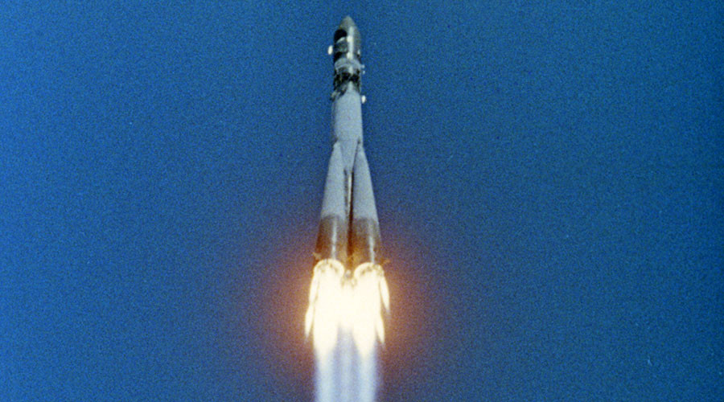
Vostok-R7

Slide 10
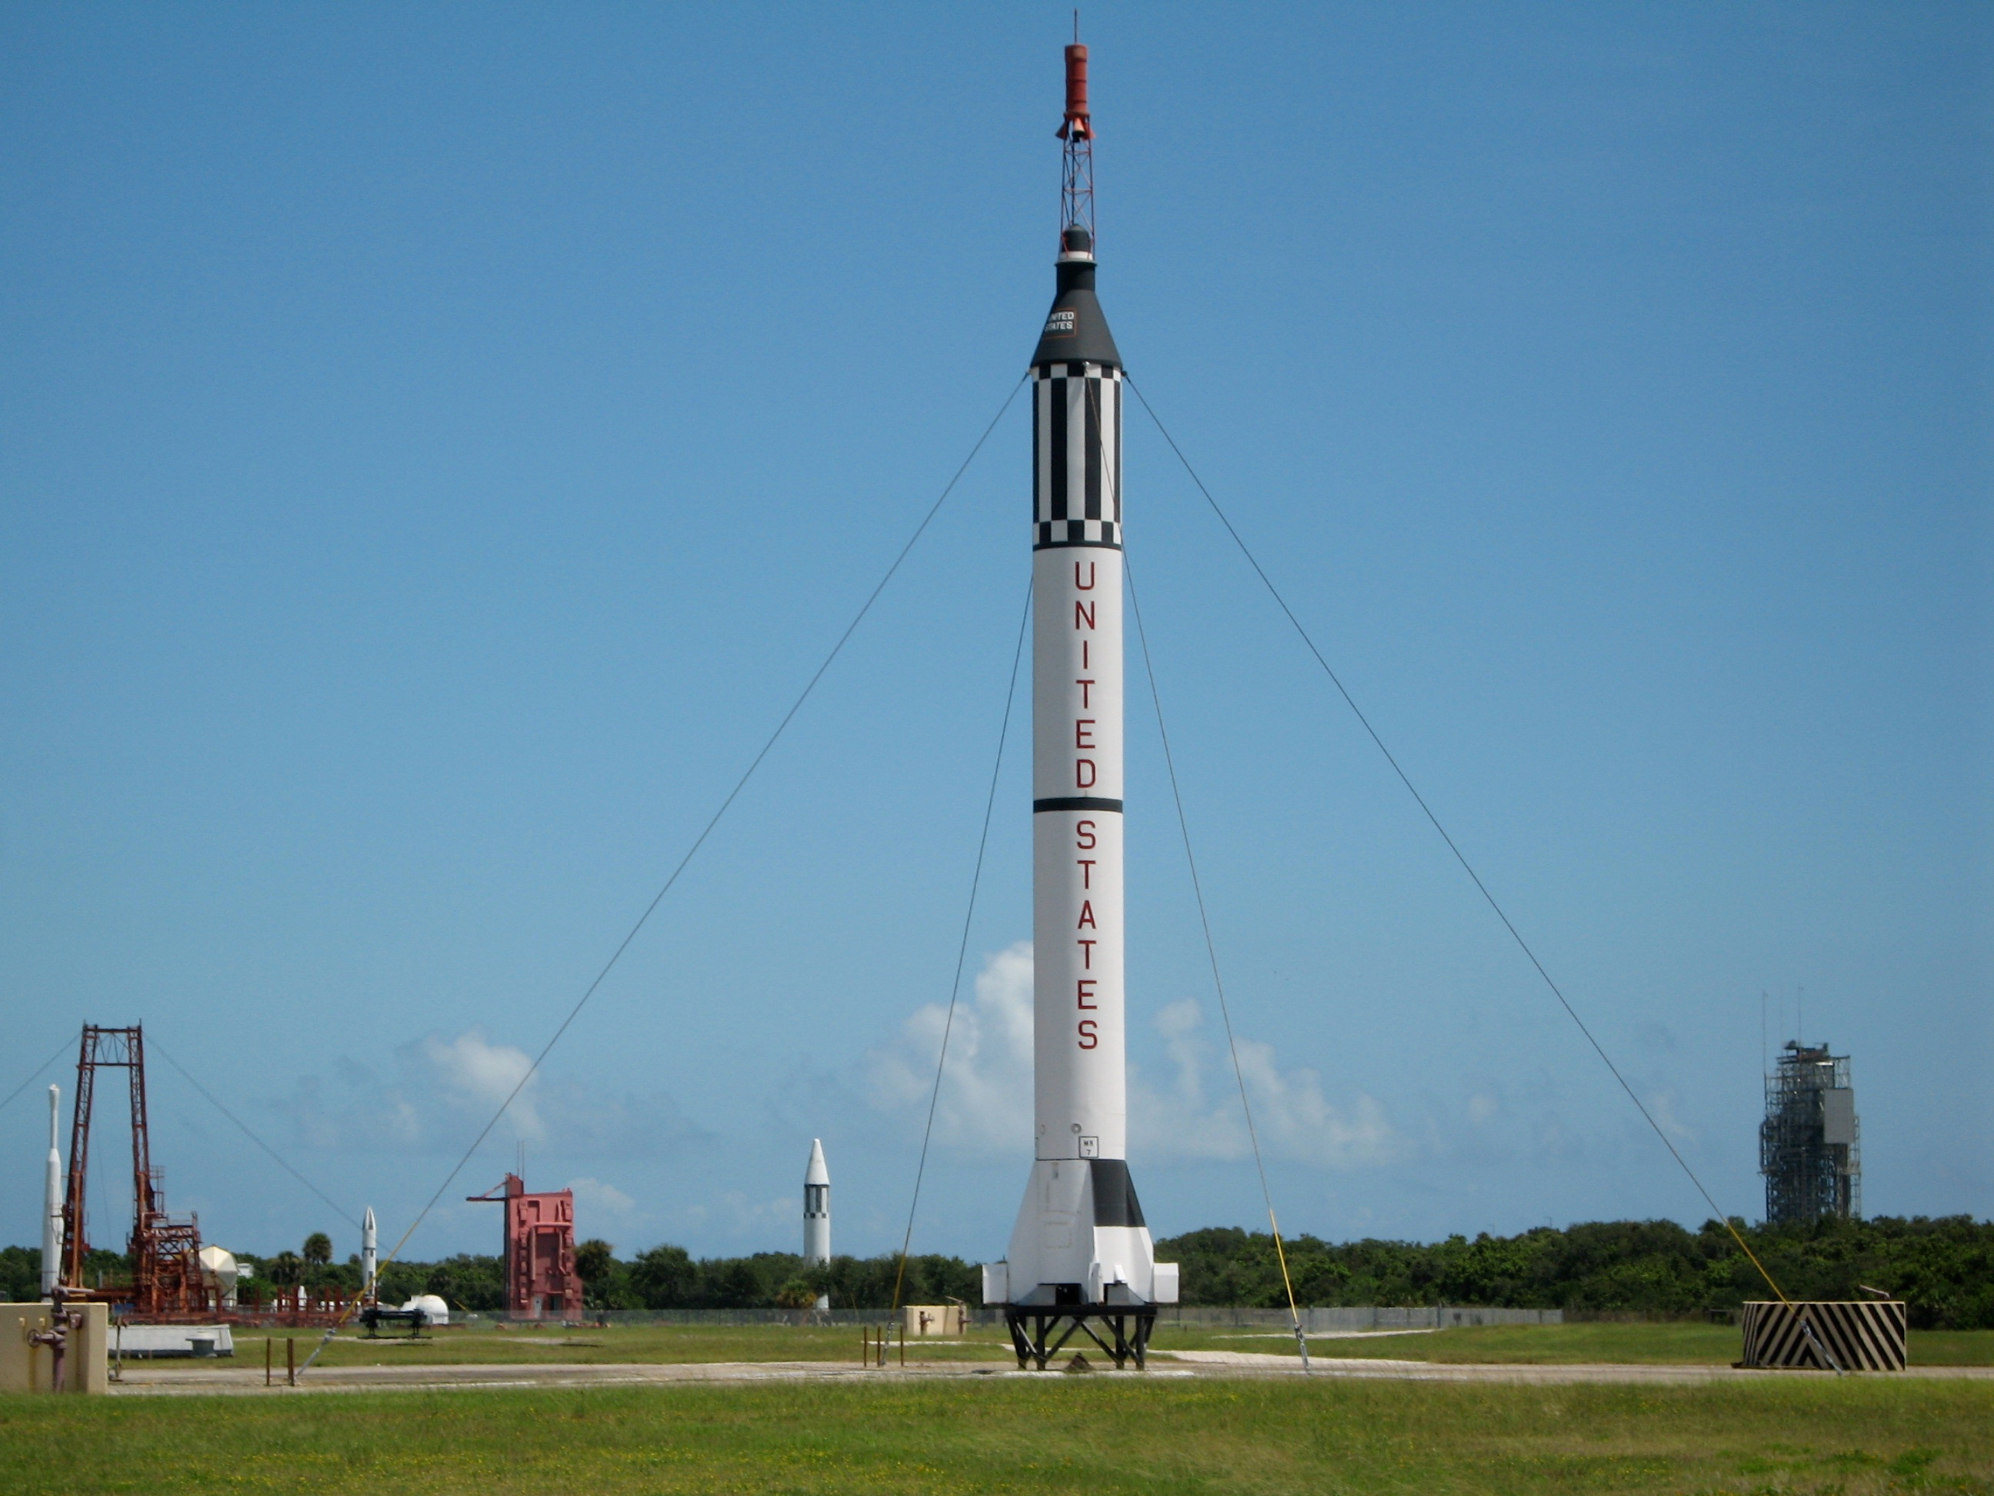
Mercury-
Redstone

Slide 11
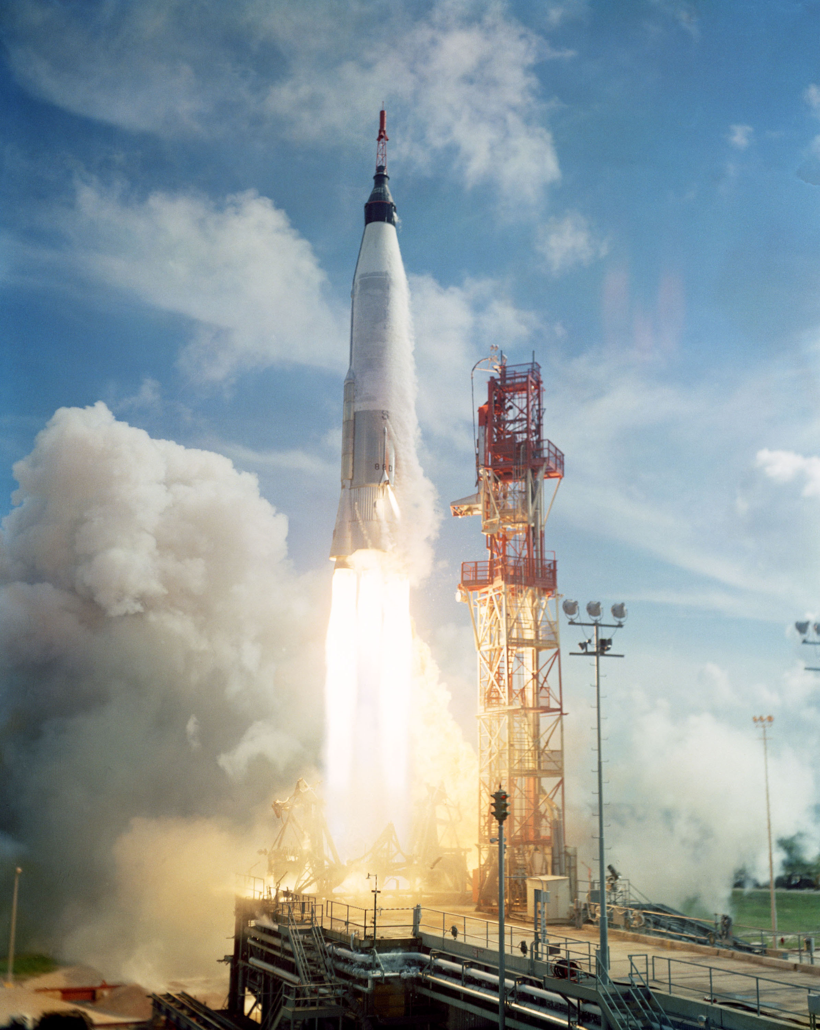
Mercury-
Atlas

Slide 12
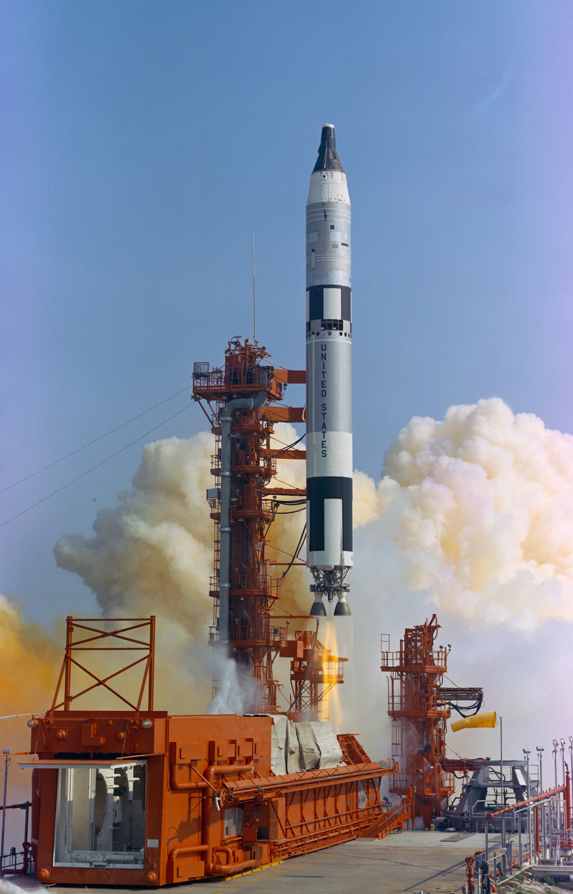
Gemini-
Titan II

Slide 13
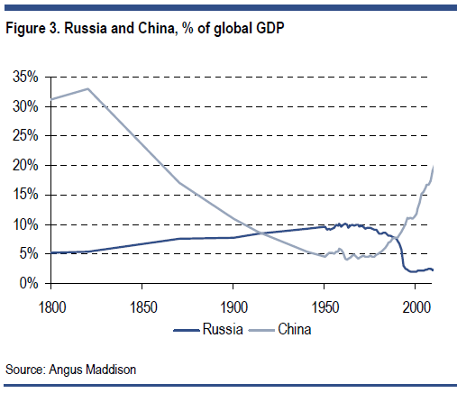
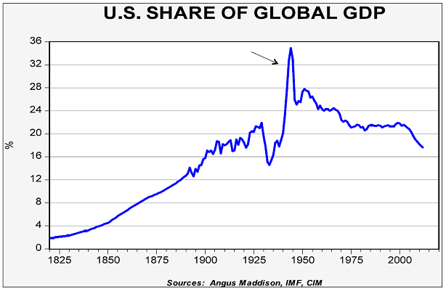

Slide 14
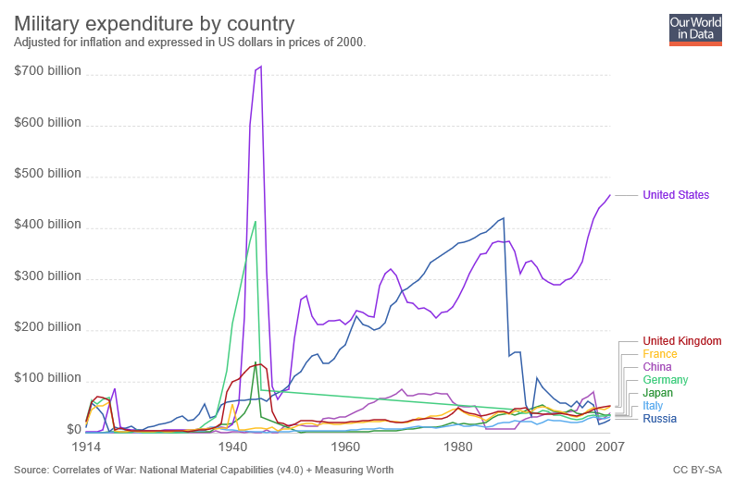

Slide 15
The “Readings”
Gaddis Chapter 2 (“Deathboats and Lifeboats”)
  Learning to manage nuclear weapons
McDougall Chapter 12 (“The Missile Bluff”)
  Development of ICBM’s and international law on use of outer space
Chertok Volume 3 Chapter 1 (“The Cold War”)
  The Cold War as seen from OKB-1 on the Soviet Union
Fail Safe (motion picture)
  Shaping public thinking about nuclear weapons after the Cuban Missile Crisis

Slide 16
Activity: Case Study Selections
By role:
  Managers, contractors, astronauts, engineers, operations, support, scientists, politicians, media, Soviet Union, other public figures
By background:
  Gender, race, social class, national origin, …

Slide 17
Case Study Process
Selections due before class on September 10 on ELMS
  At least five from different categories, in preference order
  We will select from these and make assignments
Read the initial reading (usually an oral history)
  May need to use the Internet Archive is the JSC Oral History site remains down
Find additional primary and secondary sources
  Internet text/video/audio, books (allow time for interlibrary loan!), journals
Select a vignette and write about it
  Background, role(s), one vignette, post-Apollo career
  2-3 pages, single-spaced, standard margins, 12-point font (plus references)

