Slide 1
1968 (to 1975)
INST 154
Apollo at 50
Chicago Democratic National Convention (start at 31:30)

Slide 2
What a Difference 7 Years Makes
Global challenges
Vietnam War
Prague Spring
Gold crisis
Domestic Challenges
Civil rights movement
War on Poverty
Inflation
Social Challenges
Baby boom generation
“Sex, Drugs, and Rock and Roll”

Slide 3
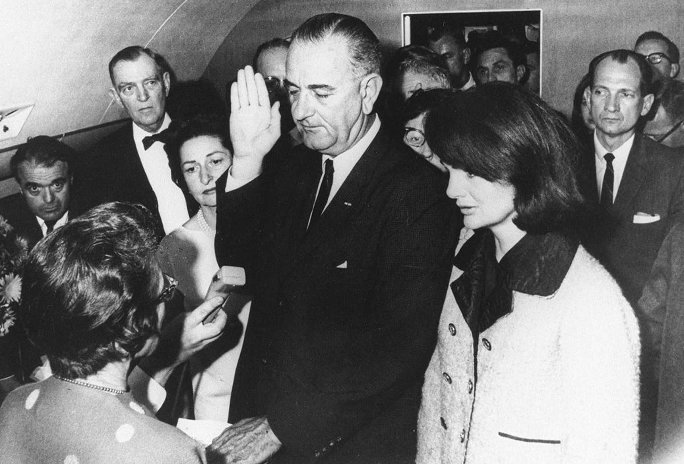

Slide 4
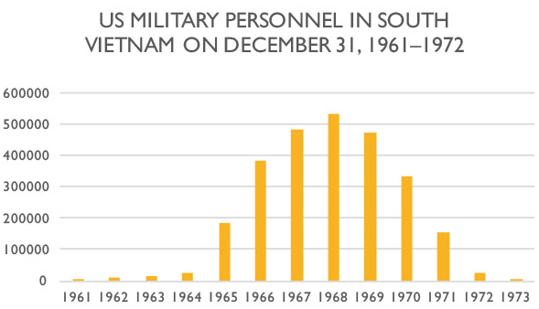
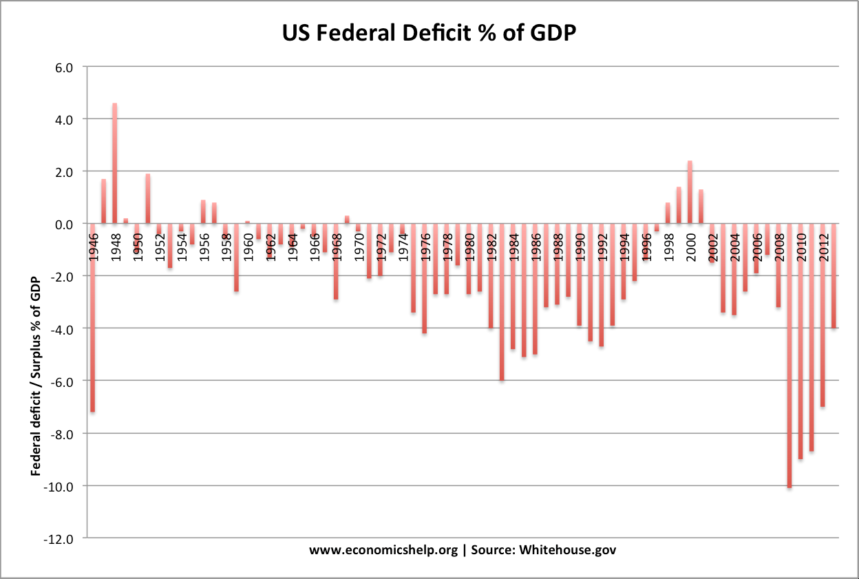
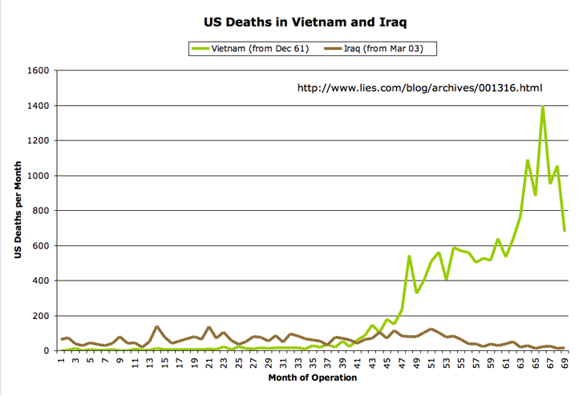
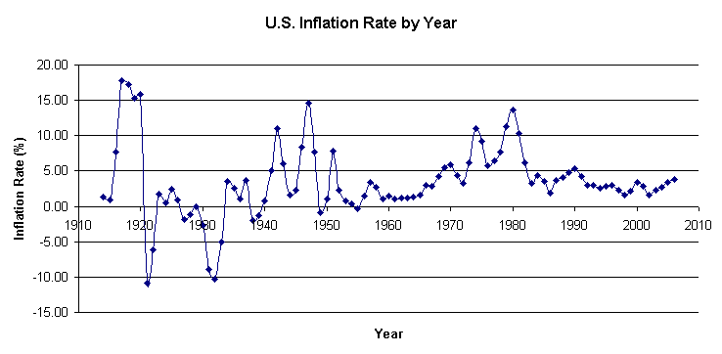

Slide 5
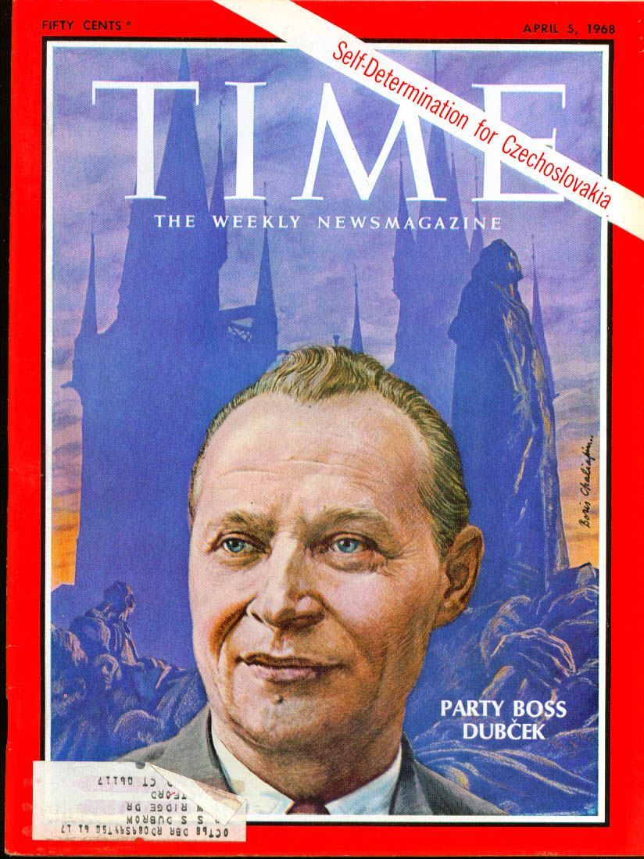
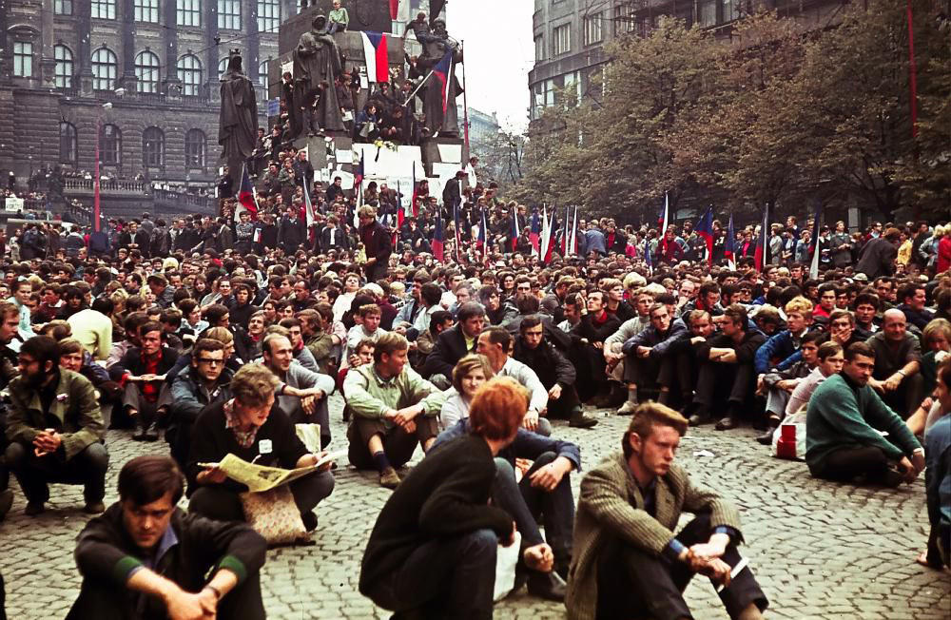
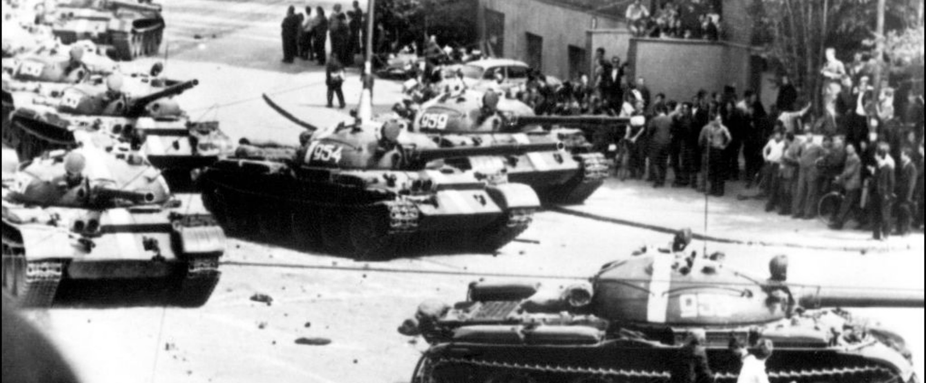

Slide 6
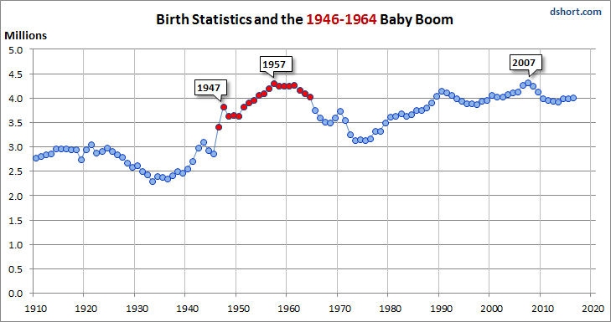

Slide 8
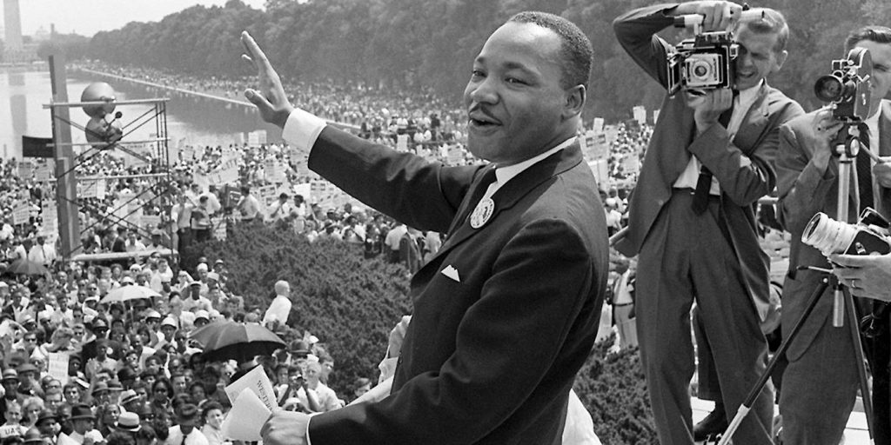

Slide 9
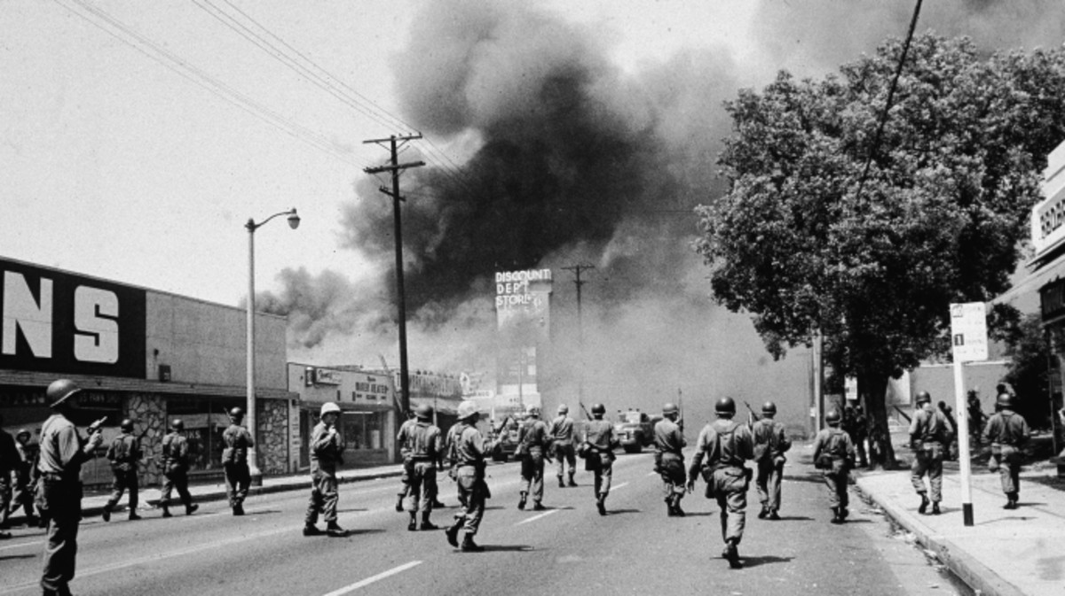

Slide 10
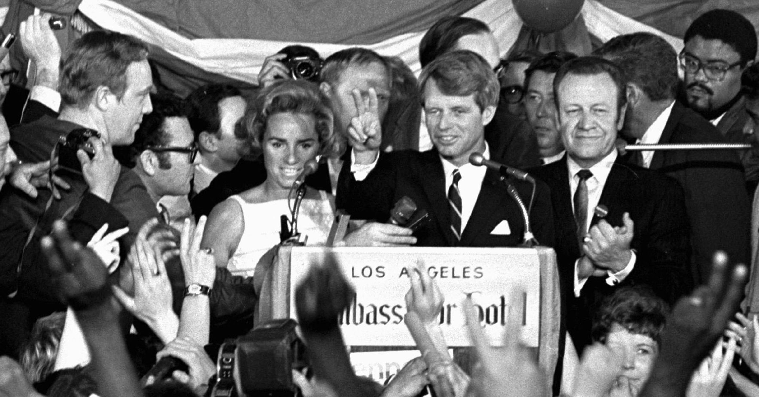

Slide 11
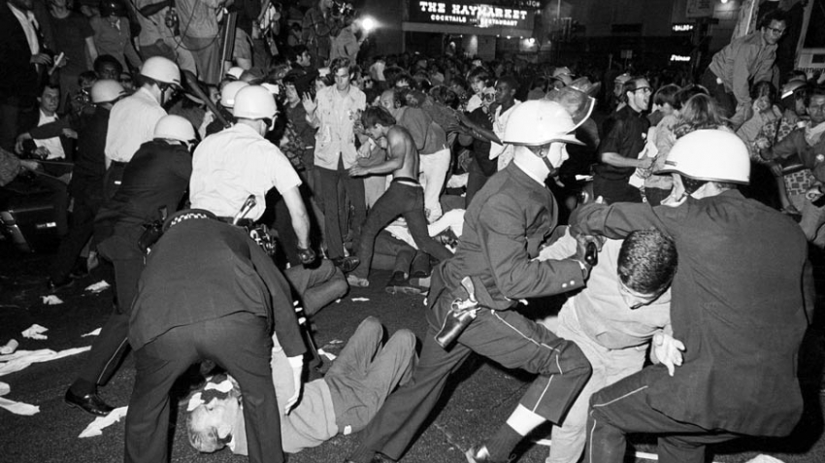

Slide 12
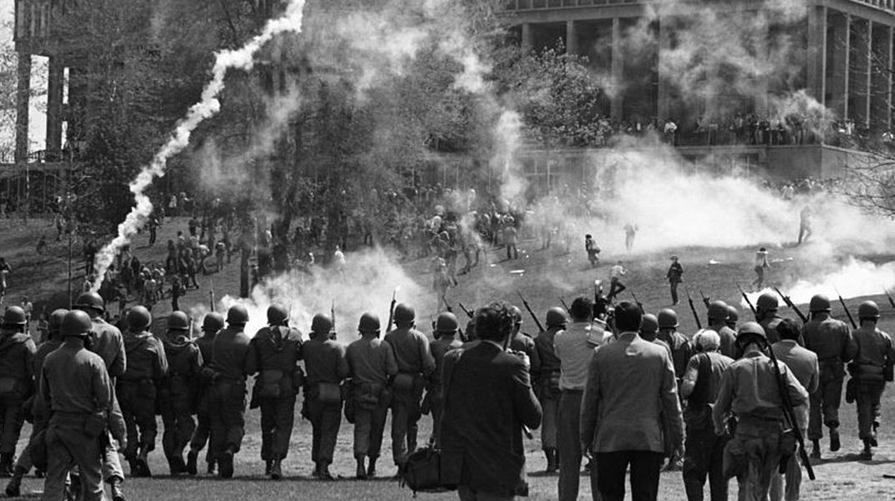

Slide 13
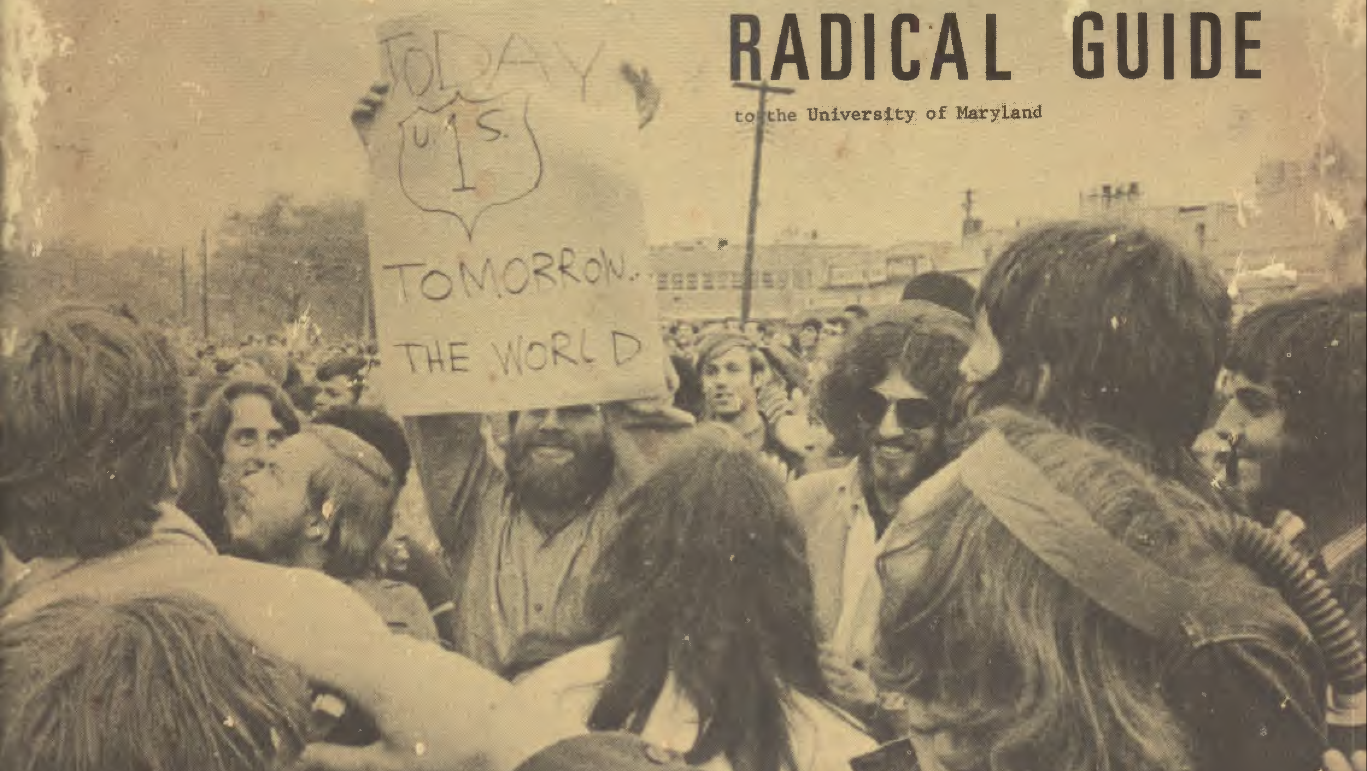

Slide 14
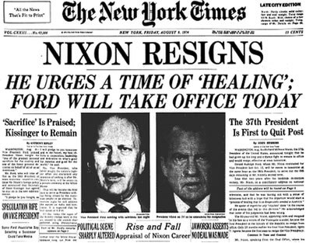
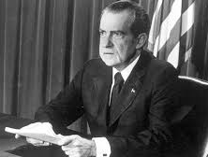

Slide 15
Apollo Chronology
January 1967 Apollo 1 fire
November 1967 Apollo 4 (Uncrewed Saturn V)
January 1968 Apollo 5 (Uncrewed Earth orbit LM test)
April 1968 Apollo 6 (Uncrewed Saturn V; 3 engines fail)
October 1968 Apollo 7
December 1968 Apollo 8
…
December 1972 Apollo 17

Slide 16
Discussion Groups
Brokaw Chapter 1 (“A Loss of Innocence”)
A personal story of social evolution in the 1960’s
Kurlansky Chapter 11 (“April Mother…s”)
A glimpse of the “counterculture” of the late 1960’s
Fink Chapter 3 (“The American Economic Consequences of 1968”)
The genesis of some really bad economic times in the 1970’s
The Sixties miniseries Episode 8 (“1968”)
A documentary depicting major events in 1968

Slide 17
Apollo 8 Readings
Chaikin Chapter 3 (“First Around the Moon”)
Apollo 8 from the Astronaut’s perspective
Woods Chapter 15 (“Re-entry”)
Reentry into the Earth’s atmosphere from a lunar trajectory
Kluger Chapter 7
How the lunar orbit decision was made
From the Earth to the Moon video episode 4 (“1968”)
An interleaved telling of the story of 1968’s social unrest and Apollo 8

Slide 18
Example Term Paper Topics: Social Challenges
Achieving the United Nations sustainable development goals
Winning Richard Nixon's "war on drugs"
Providing universal health care in the United States
Ending legal discrimination on the basis of race
Winning President Johnson's "war on poverty"
Ending the gender pay gap
Eliminating racial disparities in income and wealth
Preventing mass shootings
Ending the Great Depression
Resolving world hunger
Achieving universal suffrage in the United States
Eliminating homelessness in the United States

Slide 19
Example Topics: Technology Development
Combating the global AIDS crisis
Mitigating global warming
Developing nuclear weapons and their delivery systems
Making commercial air travel safe, fast, and inexpensive
Preventing or curing Alzheimer's disease
Ending U.S. reliance on foreign oil
Developing the modern Internet
Eradicating smallpox on a global scale
Establishing a permanent human colony on Mars
The innovation of firearms
Creation of national-scale rail systems
Adoption of the printing press and development of the publishing industry

Slide 20
Example Topics: Armed Conflict
Defeating of Nazi Germany in World War II
Achieving the North Vietnamese victory in the Vietnam War
Fighting The global war on terrorism
The southward and westward expansion of non-native settlements during the Indian Wars
Preventing nuclear war
The liberation of Haiti from France
The defeat of Napoleon
Spanish conquest of the New World
The end of the Roman Empire
The global spread of communism during the Cold War

Slide 21
Organizing Your Term Paper
Introduction
Goal, situation, factors
Background
Why and in what context did (or will) the need to act arise?
Factors
Politics, urgency, the economy, organization, technology, infrastructure, …
Outcome
What happened (and why)
Conclusion
Important lessons (note: all must have been present earlier)
Comparisons to Apollo

