Slide 1
The Apollo 1 Fire
INST 154
Apollo at 50
Lee Atwood Interview

Slide 2
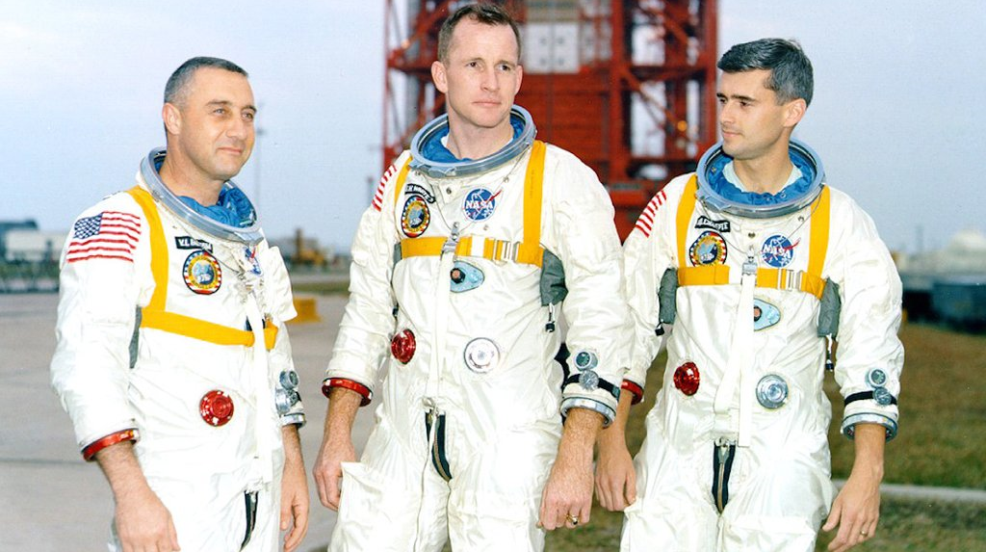

Slide 3
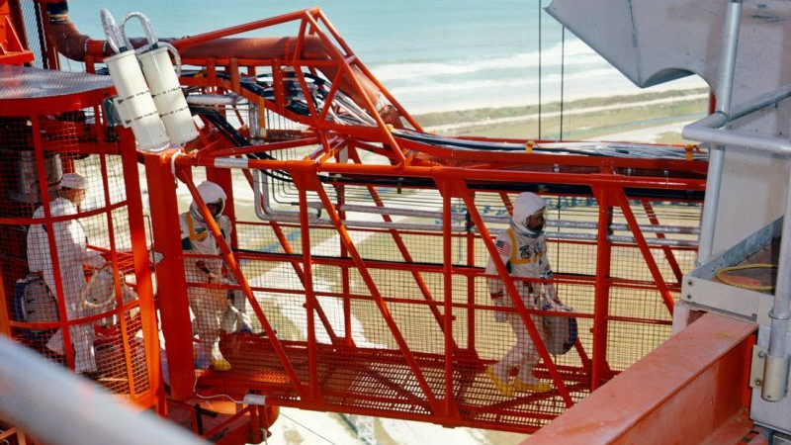

Slide 4
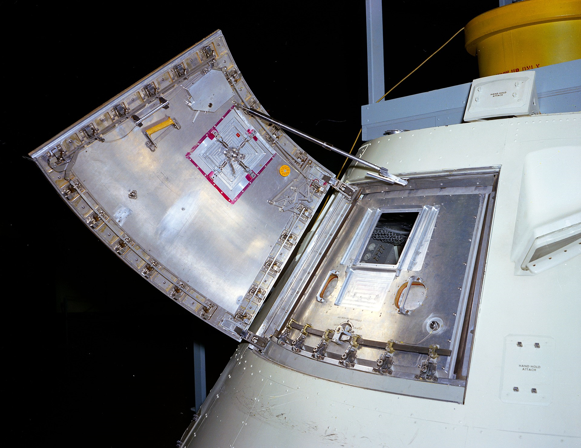

Slide 5
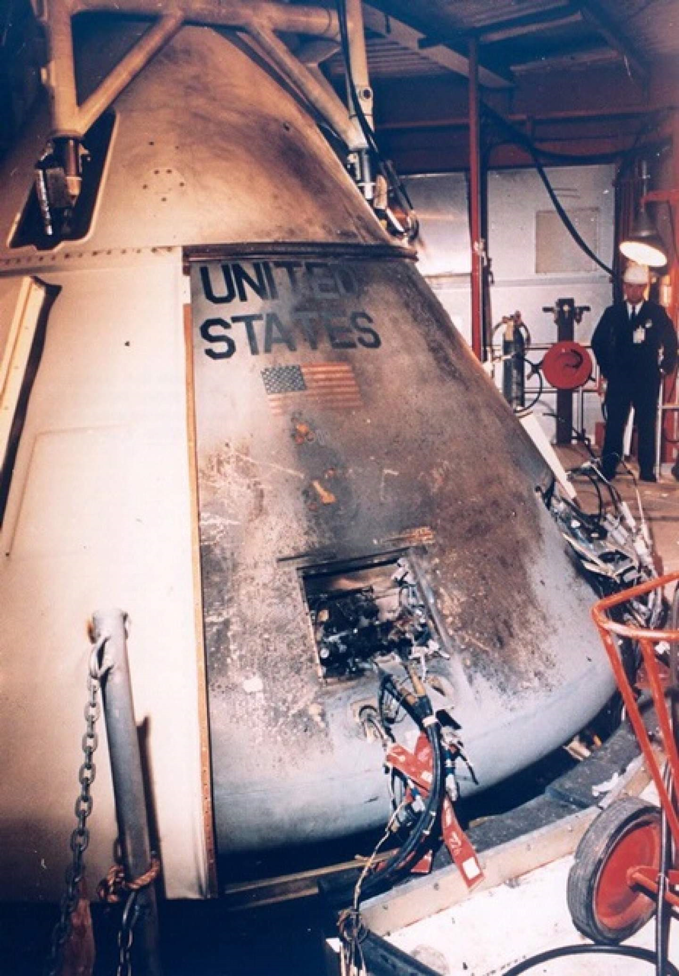
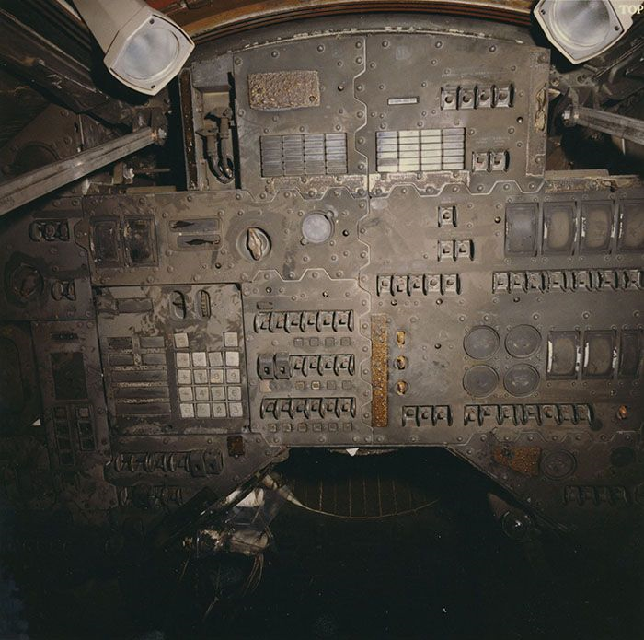

Slide 6
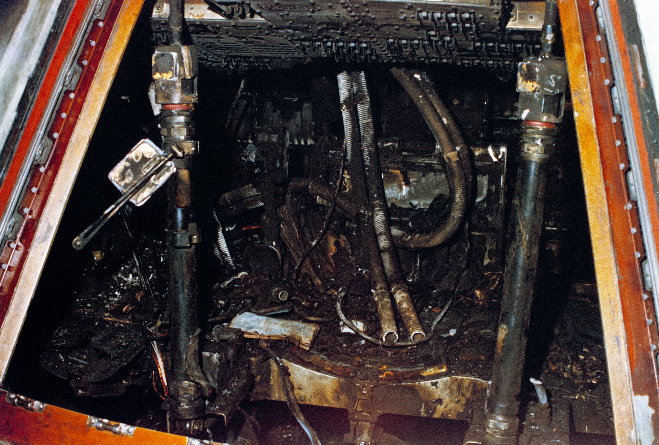
Apollo 1 Audio

Slide 7
Apollo 204 Review Board
Floyd Thomson, Langley Research Center (Director)
Max Faget, Manned Spacecraft Center (Apollo designer)
Frank Borman, Astronaut (Gemini 7, Apollo 8)
Colonel Charles Strang, US Air Force (Missile and Space Safety Chief)
Barton Geer, Langley Research Center (Flight Vehicles Division)
George White, HQ Apollo Program Office (Apollo Reliability Director)
John Williams, Kennedy Space Center (Spacecraft Operations Director)
George Malley, Lawyer
Frank Long, Cornell University (Presidential Science Advisory Committee)
George Jeffs, North American Aviation (Chief Engineer)
Robert Van Dolah, Bureau of Mines (fire expert)

Slide 8
The Path to the Fire
North American’s proposal had a mixed-gas environment
  NASA directed a change to 5psi oxygen for weight and operational reasons
Two approaches to minimizing fire risk:
  Eliminate ignition sources
  Minimize paths for fire propagation
Preflight tests involve pressurizing spacecraft to check for leaks
  In Apollo, a 2 psi overpressure above the normal sea level 14.7 psi was used
This type of test was not recognized as hazardous

Slide 9
Spacecraft Design Recommendations
The amount and location of combustible materials in the Command Module must be severely restricted and controlled.
Studies of the use of a diluent gas be continued with particular reference to assessing the problems of gas detection and control and the risk of additional operations that would be required in the use of a two-gas atmosphere.
An in-depth review of all elements, components and assemblies of the Environmental Control System be conducted to assure its functional and structural integrity and to minimize its contribution to fire risk.
Investigation be made of the most effective means of controlling and extinguishing a spacecraft fire. Auxiliary breathing oxygen and crew protection from smoke and toxic fumes be provided.
Present design of soldered joints in plumbing be modified to increase integrity or the joints be replaced with a more structurally reliable configuration.
Deleterious effects of coolant leakage and spillage be eliminated.

Slide 10
Major Changes
Decision not to fly Block I command modules
  To allow focus on correcting deficiencies in the Block II command modules
Comprehensive flammability review to prevent flame propagation
  Command module and lunar module
Mixed gas atmosphere before and during launch
  60% oxygen, 40% nitrogen (normal air is 78% nitrogen)
New outward-opening hatch
  Reduced time to open from 60 seconds to 3 seconds
Congress established the Aerospace Safety Advisory Board
  To advise the NASA Administrator on safety

Slide 11
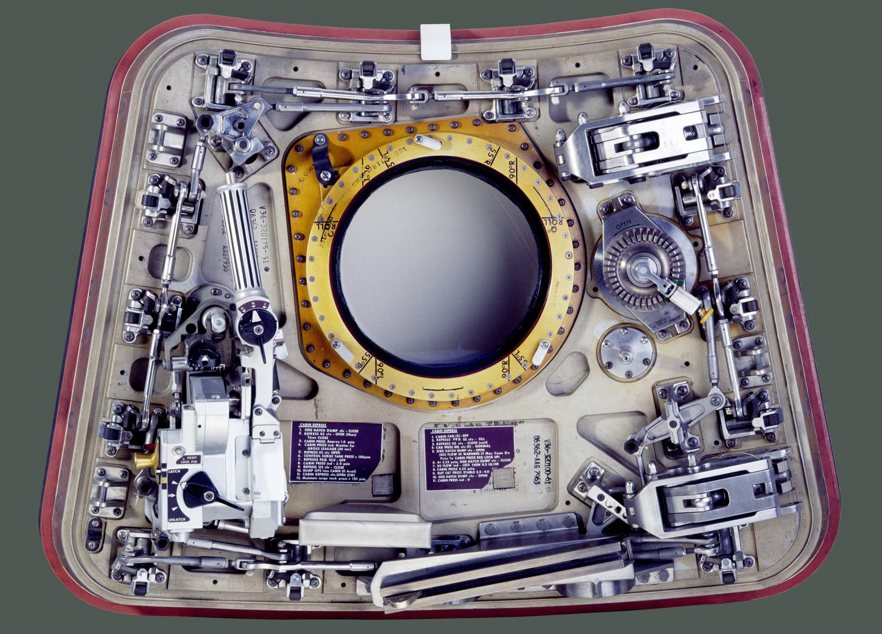

Slide 12
Testing Recommendations
Full-scale mock-ups in flight configuration be tested to determine the risk of fire.
The fire safety of the reconfigured Command Module be established by full-scale mock-up test.
Vibration tests be conducted of a flight-configured spacecraft.
Management continually monitor the safety of all test operations and assure the adequacy of emergency procedures.
All emergency equipment (breathing apparatus, protective clothing, deluge systems, access arm, etc.) be reviewed for adequacy.
Personnel training and practice for emergency procedures be given on a regular basis and reviewed prior to the conduct of a hazardous operation.
The Ground Communication System be improved to assure reliable communications between all test elements as soon as possible and before the next manned flight.

Slide 13
Other Recommendations
That the time required for egress of the crew be reduced and the operations necessary for egress be simplified.
The necessity for electrical connections or disconnections with power on within the crew compartment be eliminated.
Review of specifications be conducted, 3-dimensional jigs be used in manufacture of wire bundles and rigid inspection at all stages of wiring design, manufacture and installation be enforced.
Service structures and umbilical towers be modified to facilitate emergency operations.
A detailed design review be conducted on the entire spacecraft communication system.
Every effort must be made to insure the maximum clarification and understanding of the responsibilities of all the organizations involved, the objective being a fully coordinated and efficient program.

Slide 14
Discussion Groups
FETM episode 2 (“Apollo One”)
  A dramatization of the effects of the fire
Cox Chapter 14 (“Did He Say Fire?”)
  The engineers’ view of the fire
Report of the Apollo 204 Review Board
  Complete history, timeline and analysis of the accident
Chaikin Chapter 1 (“Fire in the Cockpit”)
  The astronaut’s view of the fire

Slide 15
Voskhod, Soyuz and Zond
Scott Chapter 3 (“Red Star, White Star”)
  Astronaut perspectives on the American and Soviet space programs
Chertok Volume 3 Chapter 9 (“The Voskhods and the First Spacewalk”)
  An insider’s story of Voskhod 1 and Voskhod 2
Spacewalker video
  A dramatization of the Voskhod 2 mission
Harvey Chapter 5 (“The First Cosmonauts to the Moon”)
  The Zond and Soviet lunar landing programs

