Slide 1
Lunar Science
INST 154
Apollo at 50
ALSEP

Slide 2
Chronology
June-August 1962 Iowa Space Science Board Summer Study Group
December 1963 Sonnet Report on Apollo Science
  July 1964 First successful Ranger mission
October 1964 Scientist Astronaut applications invited
June-July 1965 Woods Hole Space Science Board Conference
July 1965 Falmouth Lunar Science Conference
July 1965 Apollo Site Selection Board established
February 1966 Office of Space Science decision on experiments
  May 1966 First successful Surveyor mission
  August 1966 First successful Lunar Orbiter mission
  July 1969 First Apollo lunar landing
September 1977 Termination of ALSEP monitoring

Slide 3
The Sonnet Report (1963)
Office of Manned Space Flight specifically requested input on:
  Number of missions
  Background of crew members
  Duration of lunar stay
  Payload (weight and power)
  Mobility (e.g., surface vehicle)
  Space suit capabilities
Additional input was requested on:
  Landing site selection
  Need for a soft-landed supply vehicle

Slide 4
Reasons for Scientific Inquiry
Advancing human knowledge
Providing a scientific basis for engineering
Supporting operational activities

Slide 5
Selection Criteria
Scientific importance
Feasibility
Particular to the Moon
Best carried out with human assistance

Slide 6
Scientific Disciplines
In-Situ:
  Geology (mapping, sampling, drilling, …)
  Solid body geophysics (heat flow, radioactivity, seismology, gravity, …)
  Atmosphere (density, scattering, …)
  Plasma physics (electric field, magnetic field, plasma flows, …)
  Surface physics (bombardment, dust structure, dust transport, electrostatic, …)
  Astronomy (ultraviolet, radio, …)
Sample analysis:
  Geochemistry
  Biology

Slide 7
Scientific Activities on the Moon
Observation of natural phenomena
Collection of material
  Geological samples
  Biological samples
Emplacement of long-term monitoring equipment

Slide 8
Operational Needs
Spacesuit mobility
  Necessary for sampling and emplacement
High-resolution maps
  Based on orbital photography with resolution of less than 3 feet
Precise positioning, helmet-mounted TV, high resolution camera
  To maximize scientific return given limited time
Multi-day surface stays with multiple moonwalks
  Characterizing one square mile on earth takes a week
Landing site selection
  Any site for the first landing, then guided by scientific interest
Lunar rover
  To reconcile landing risk with scientifically interesting sites

Slide 9
Scientist Astronauts
One on each (initially 3-person) lunar landing crew
Optimally, a combined background in geology and geophysics
Continuing involvement in research
Based at a research institute near Manned Spacecraft Center
  Hosting visiting scientists
Contribute to scientific training of pilot astronauts
Less than 50% of time spent on flight training (except short periods)

Slide 10
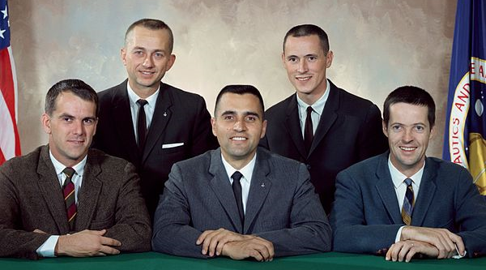
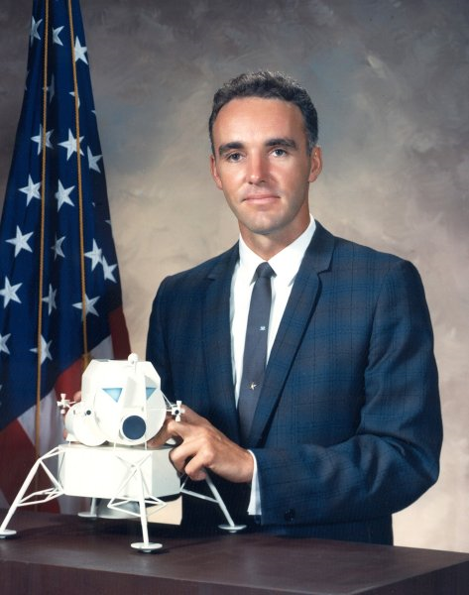
Astronaut Group 4 (June 1965)
Physics
Physics
Medicine
Geology
Medicine
Physics

Slide 11
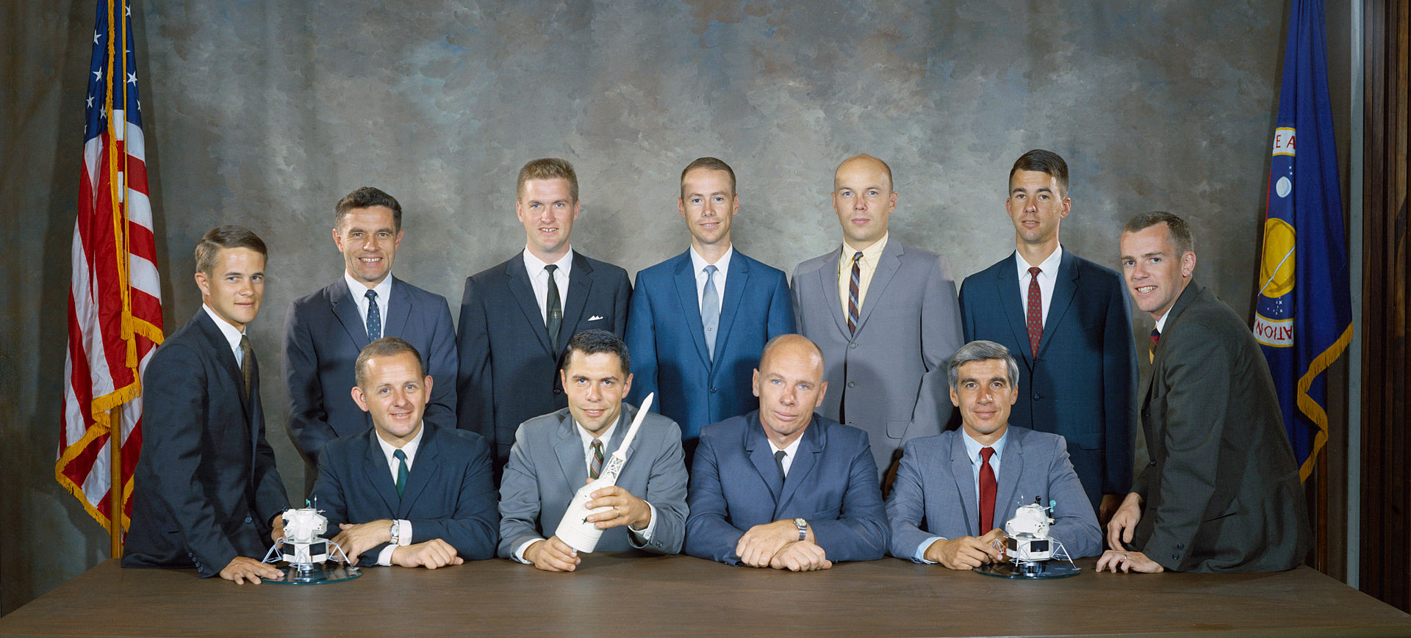
Astronaut Group 6 (1967)
Geochemistry
Medicine
Medicine
Engineer
Astronomy
Physics
Astronomy
Astronomy
Engineer
Medicine
Biochemistry

Slide 12
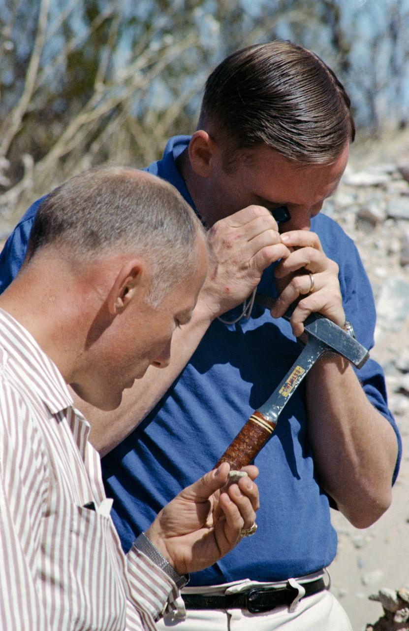
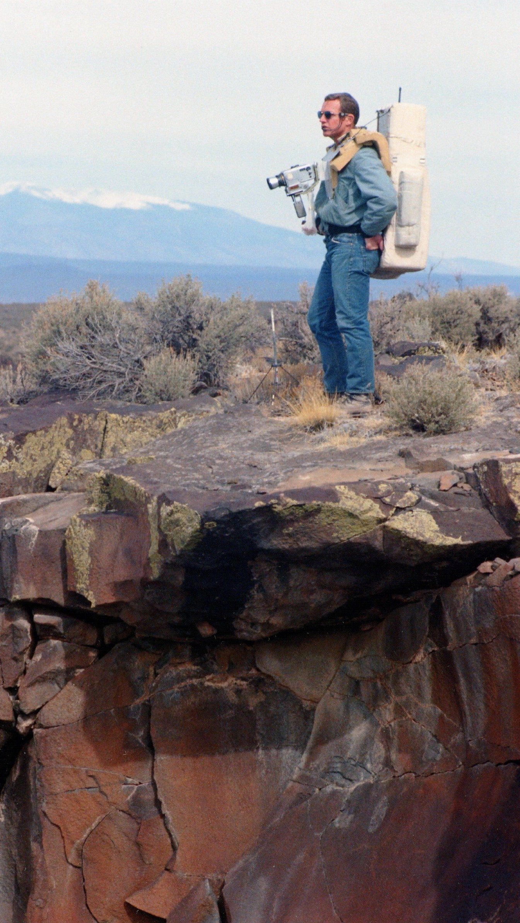
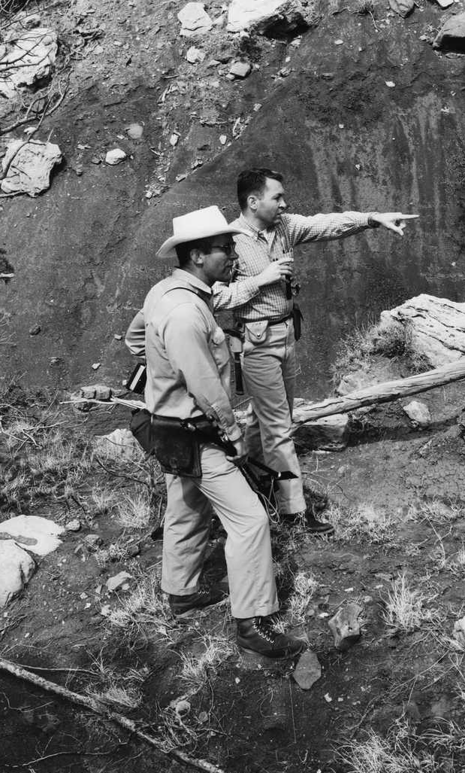

Slide 13
NASA and the National Reconnaissance Office
Lunar Orbiter
  Apollo site certification
  Based on Air Force Samos program design

Slide 14
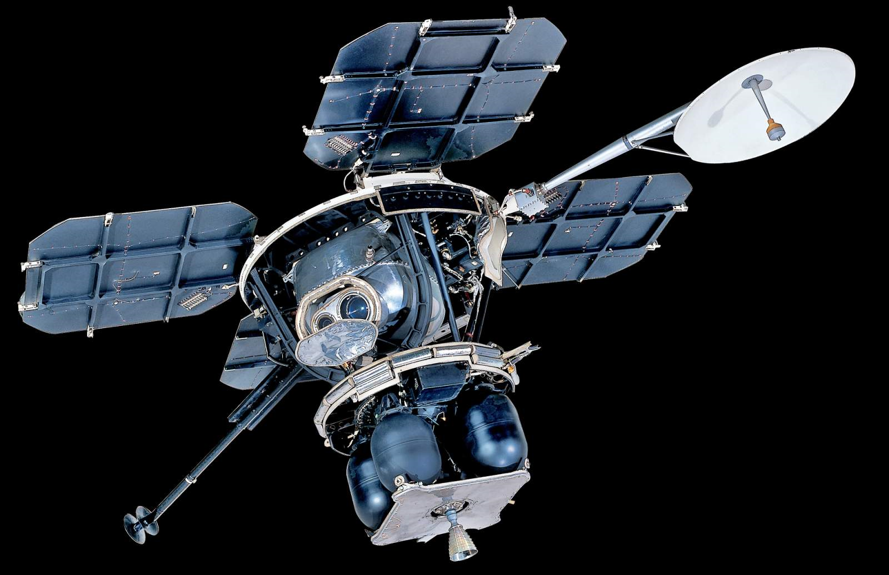

Slide 15
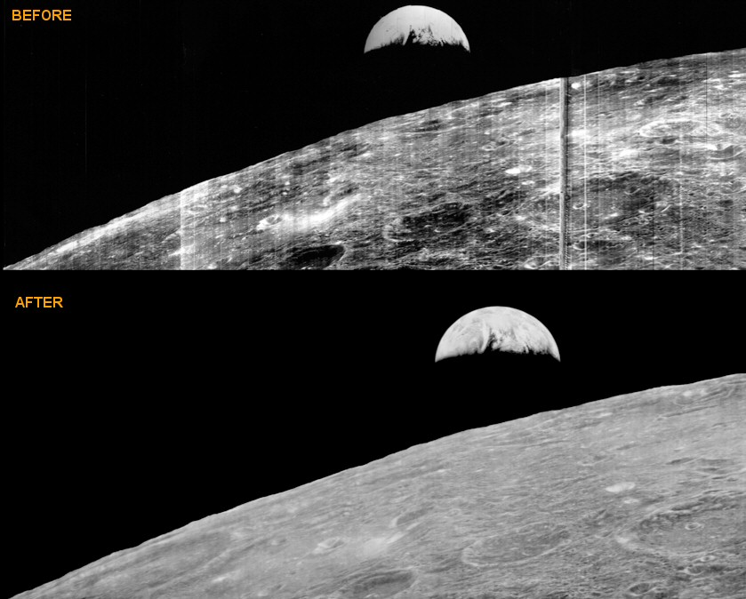

Slide 16
NASA and the National Reconnaissance Office
Lunar Orbiter
  Apollo site certification
  Based on Air Force Samos program design
Lunar Mapping and Survey System (“Upward”)
  Backup plan for Apollo site certification
  KH-7 Gambit-1 camera (2 ft resolution on Earth)

Slide 17
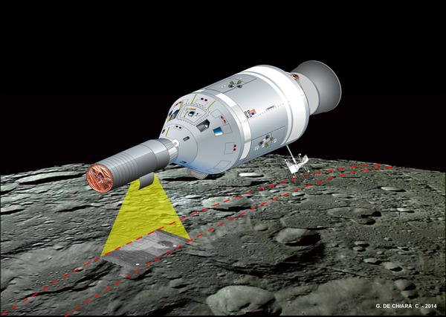

Slide 18
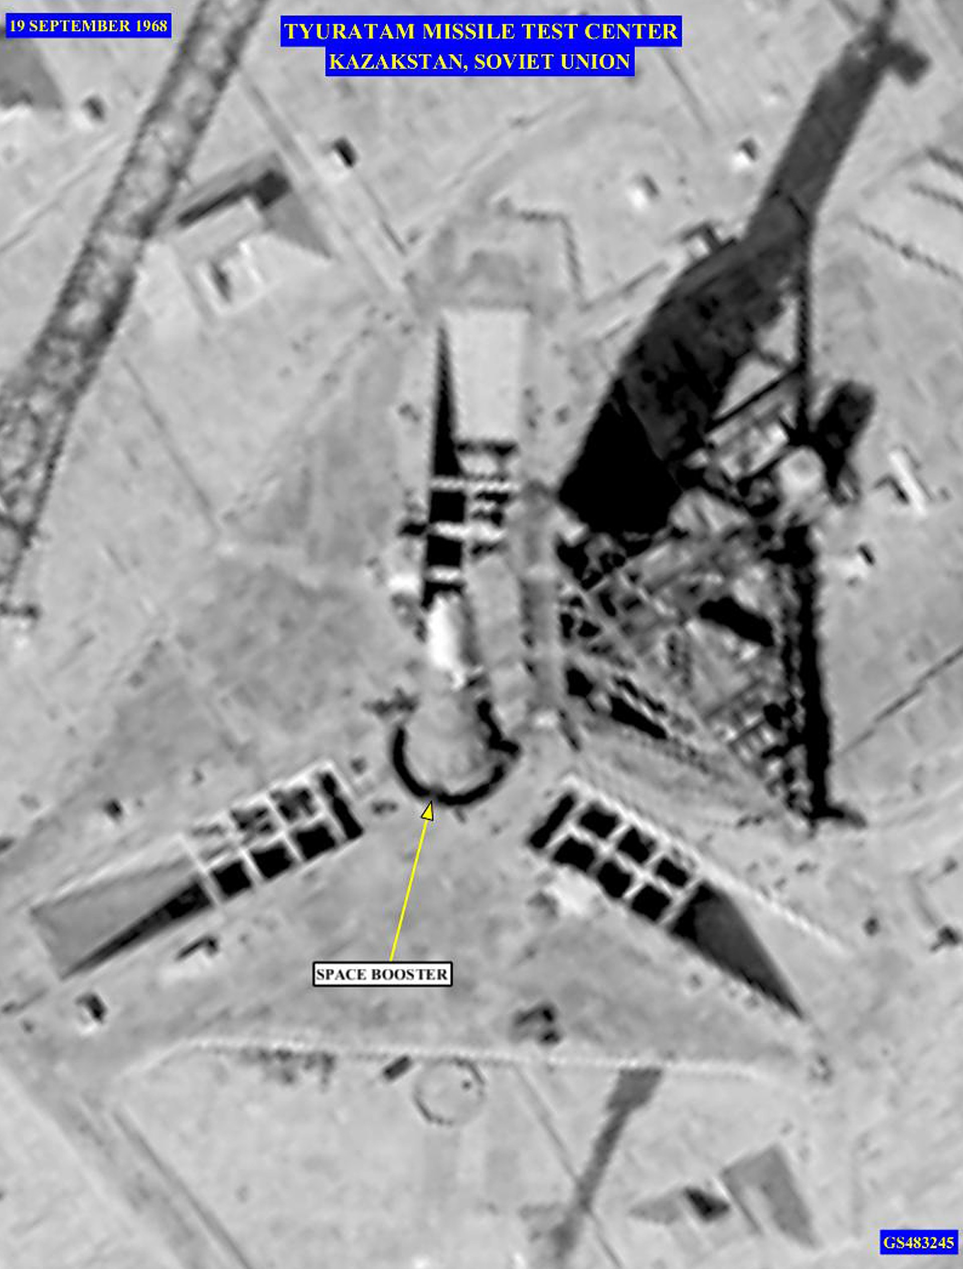

Slide 19
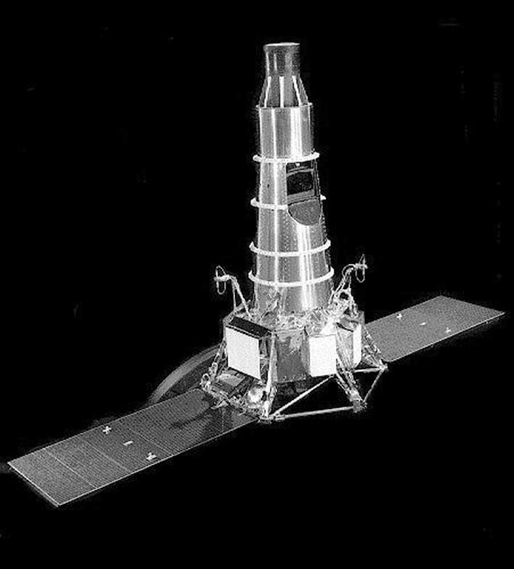

Slide 20
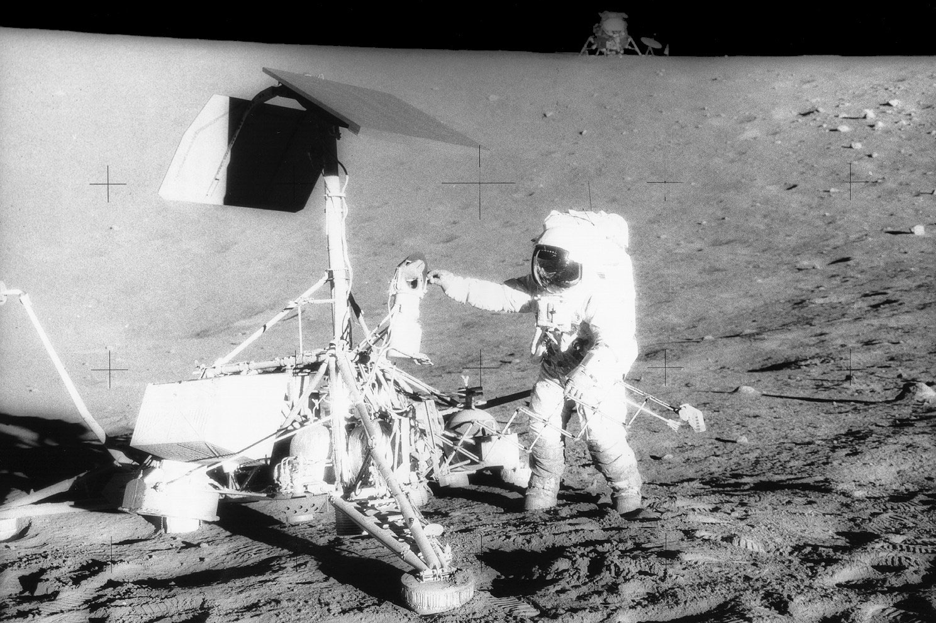

Slide 21
Discussion Groups
Sonnet Report (“Report of the Ad Hoc Working Group on Apollo Experiments and Training on the Scientific Aspects of the Apollo Program”)
  The first try to nail down what Apollo should do on the Moon
Compton chapter 3 (“Apollo’s Lunar Exploration Program”)
  An explanation of what happened after the Sonnet Report
FETM episode 10 (“Galileo was Right”)
  A dramatization of scientific training for an Apollo mission
NRO Draft (“Project Upward: The NRO and NASA”)
  Reuse of spy satellite technology in the Apollo program

Slide 22
Discussion Groups
FETM episode 2 (“Apollo One”)
  A dramatization of the effects of the fire
Cox Chapter 14 (“Did He Say Fire?”)
  The engineers’ view of the fire
Report of the Apollo 204 Review Board
  Complete history, timeline and analysis of the accident
Chaikin Chapter 1 (“Fire in the Cockpit”)
  The astronaut’s view of the fire

