Slide 1
Gemini: EVA
INST 154
Apollo at 50
Gemini XII

Slide 2
Gemini and Apollo EVA Before Apollo 11
Gemini 4 (36 minutes): Handheld maneuvering unit
Gemini 9 (129 minutes): Backpack maneuvering unit [EVA aborted]
Gemini 10 (39 minutes): Proximity operations [EVA aborted]
Gemini 11 (38 minutes): Tethering two spacecraft [EVA aborted]
Gemini 12 (129 minutes): Body restraint tests
Apollo 9 (46 minutes): No umbilical

Slide 3
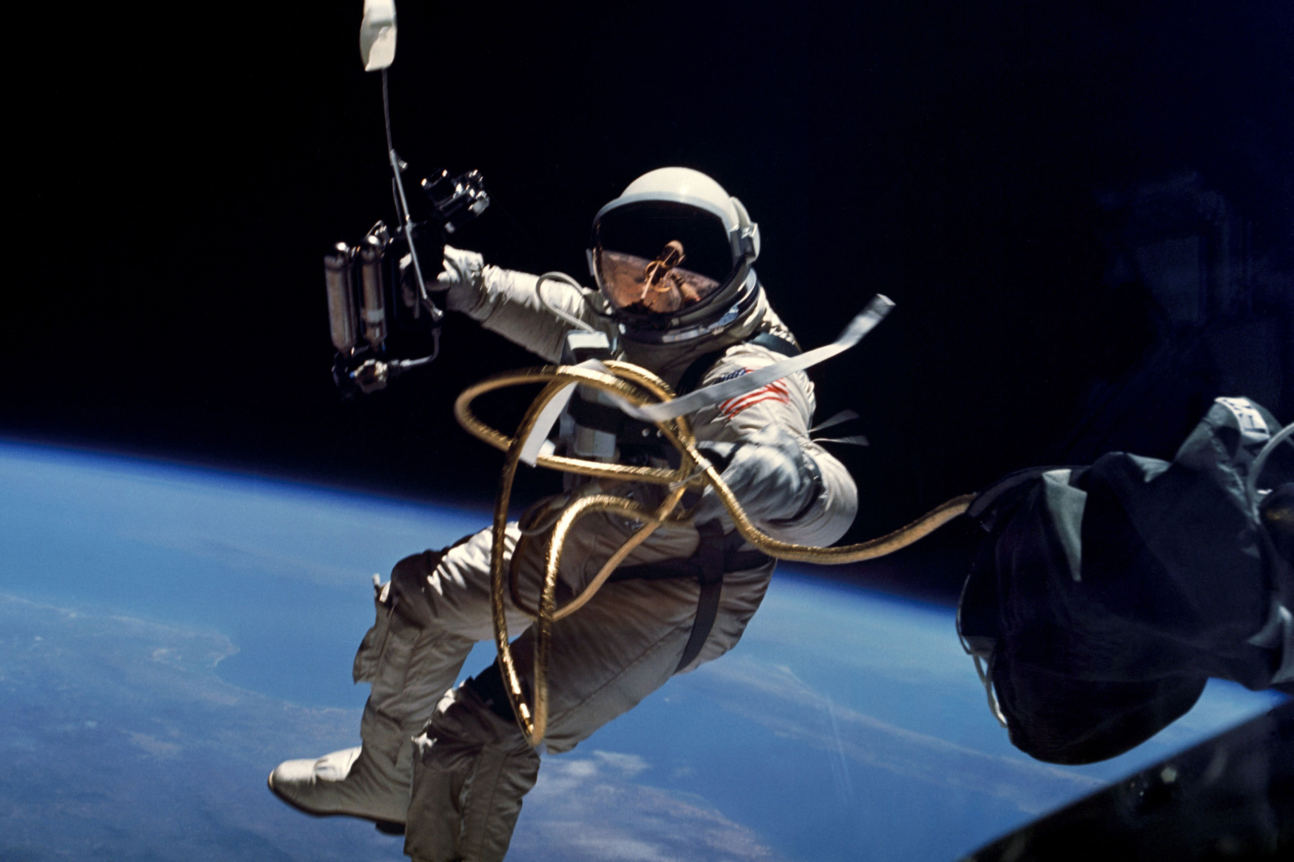

Slide 4
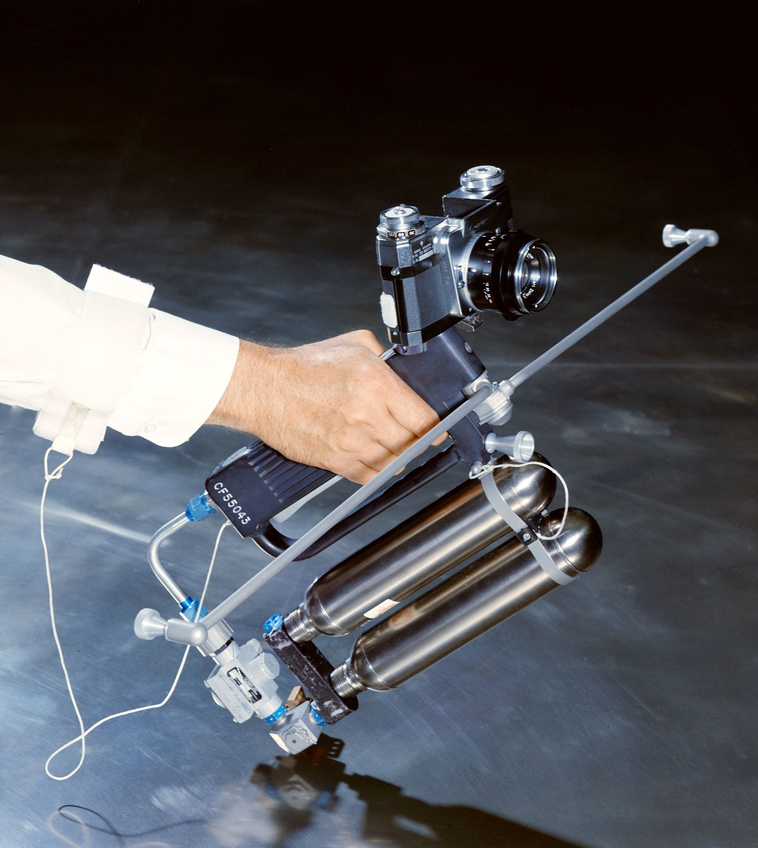
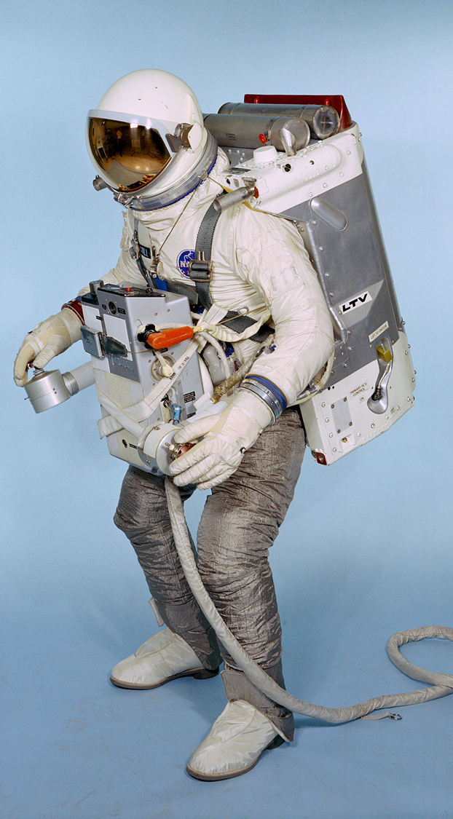
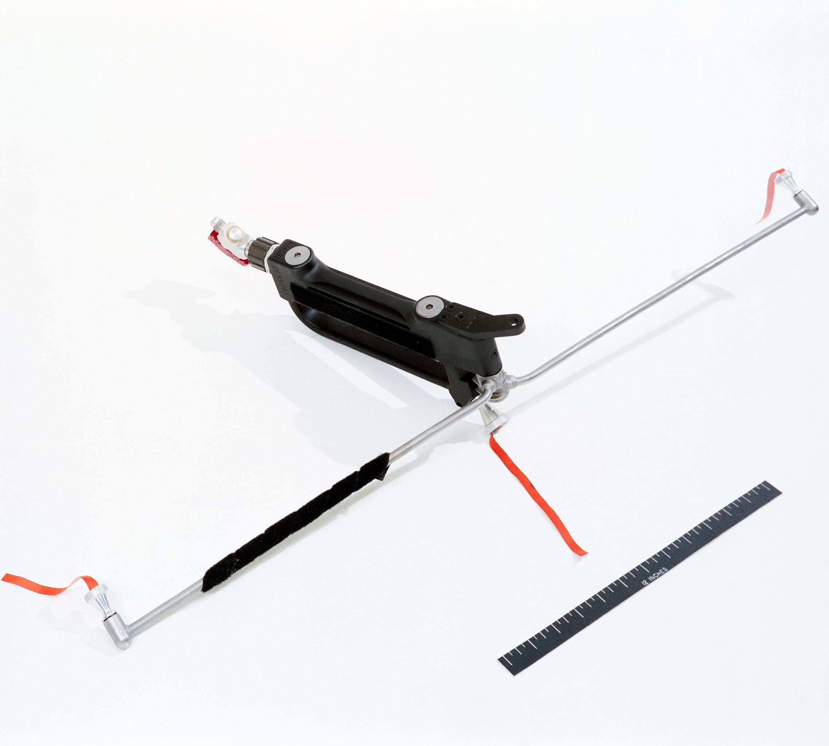
Maneuvering Units
Gemini 4
6 ft/sec
Gemini 9
250 ft/sec
Gemini 10 and 11
84 ft/sec

Slide 5
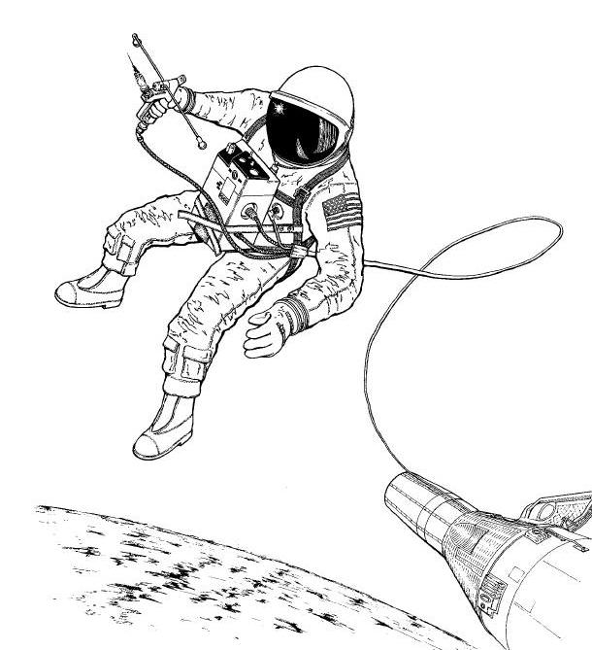
Gemini 10/11 Handheld Maneuvering Unit

Slide 6
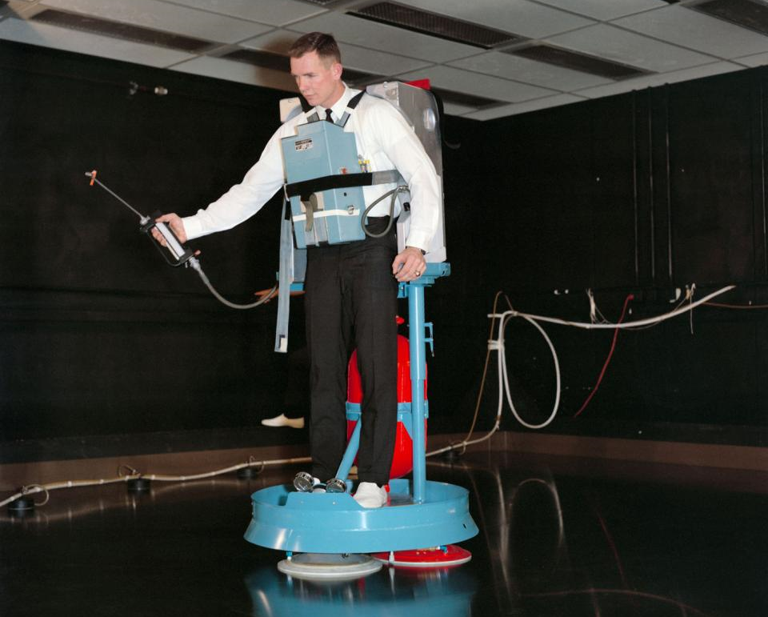
Air-Bearing Floor EVA Trainer (Gemini 8)

Slide 7
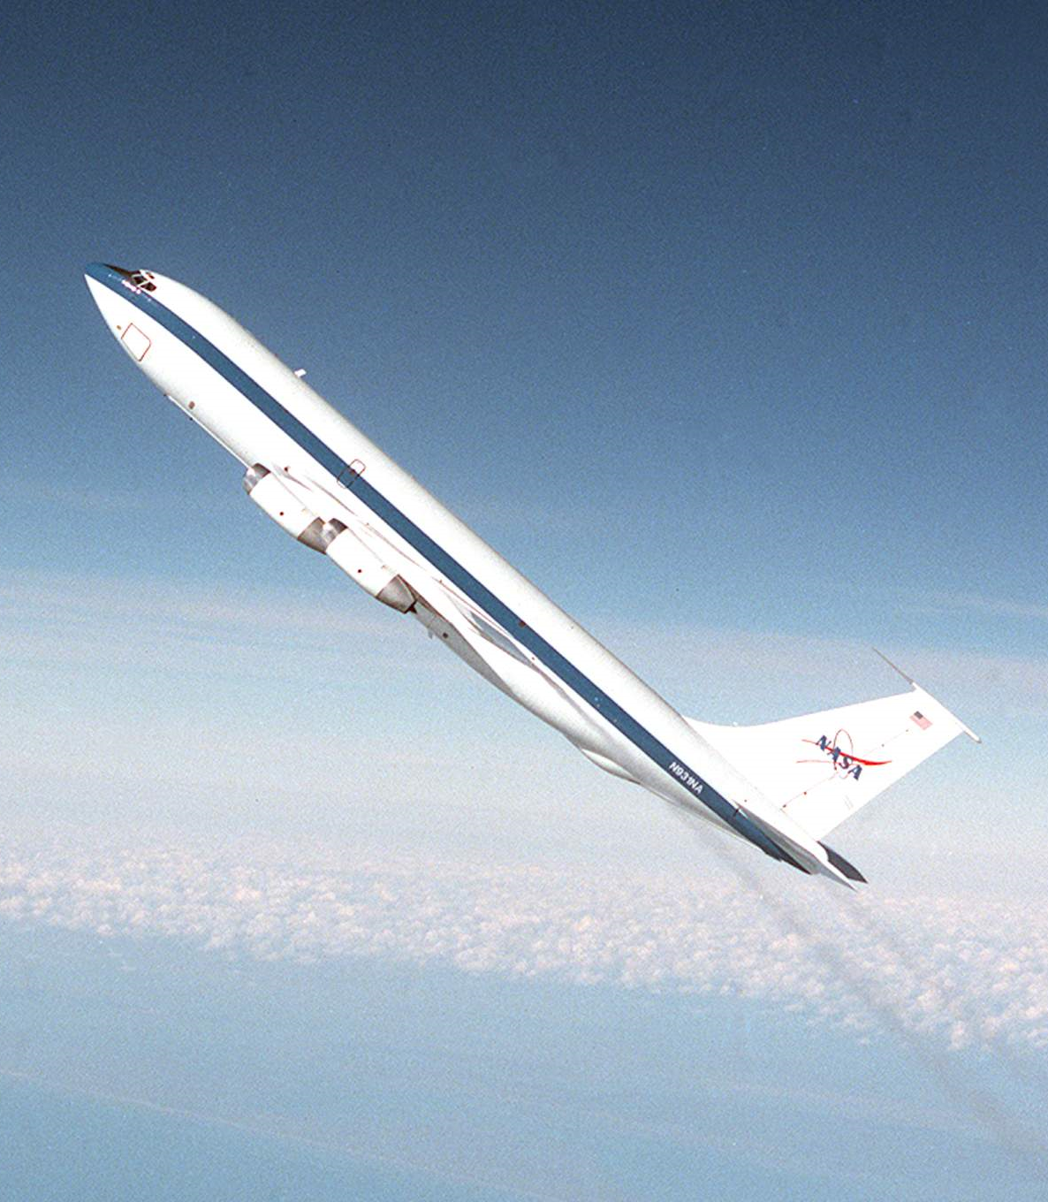
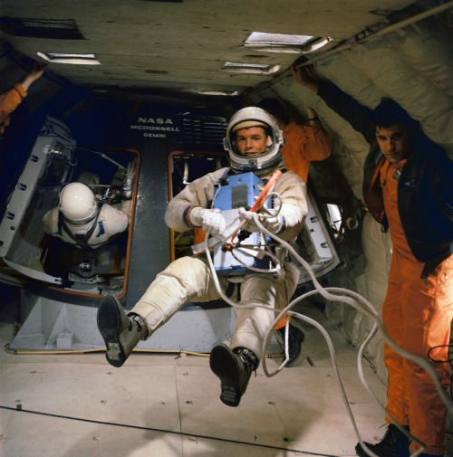

Slide 8
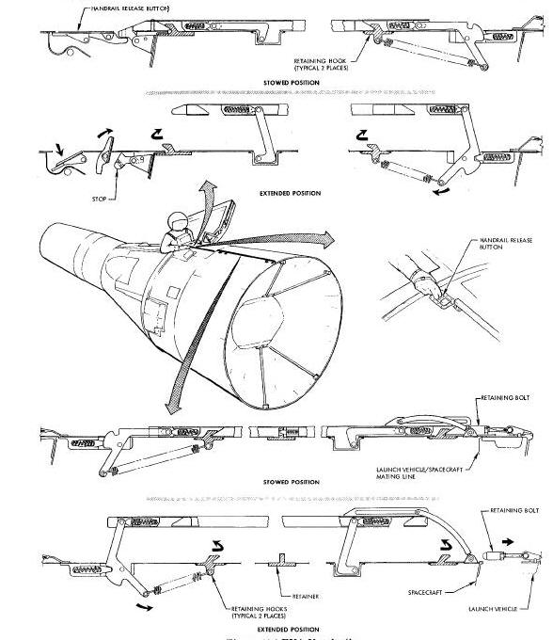
Adapter Section Handrails

Slide 9
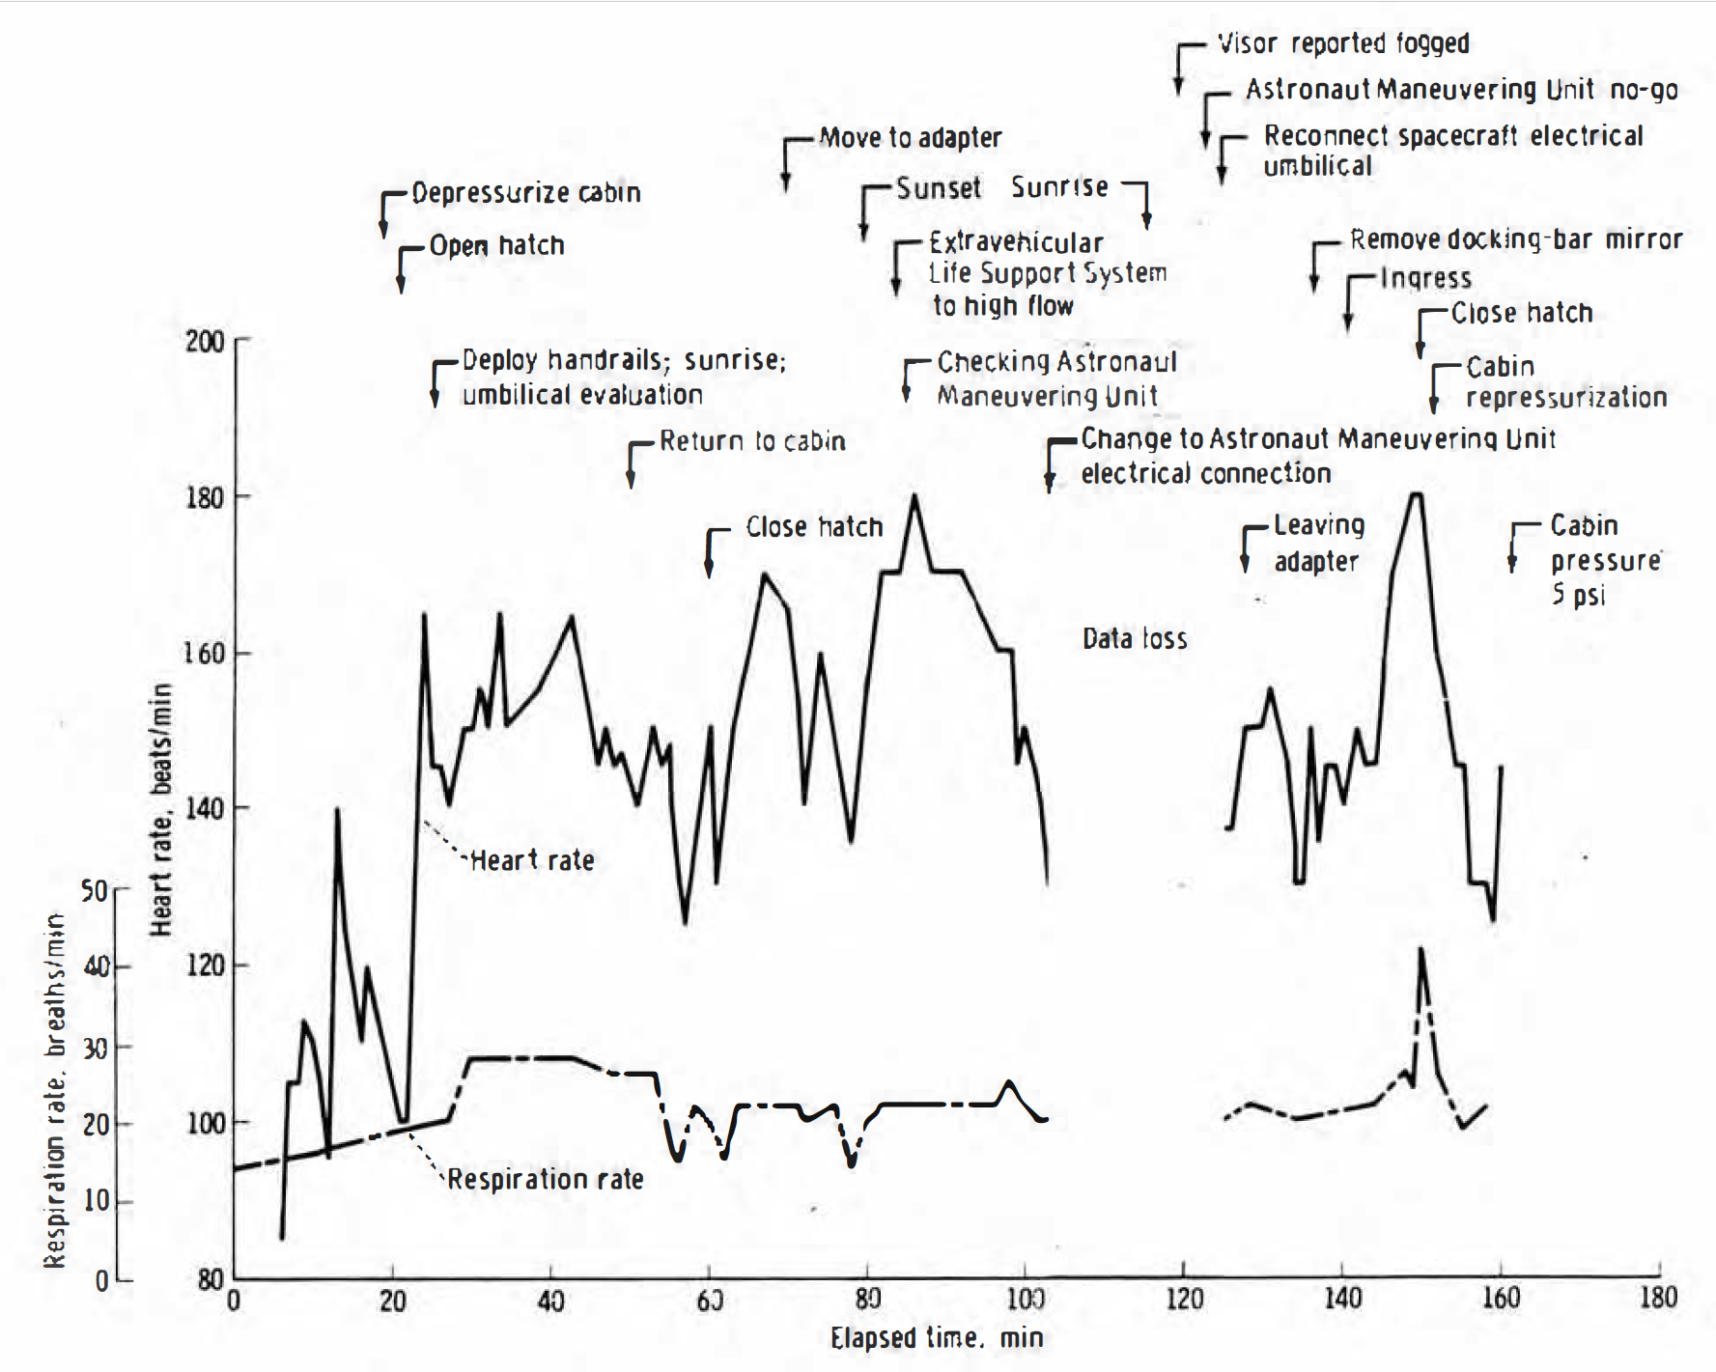
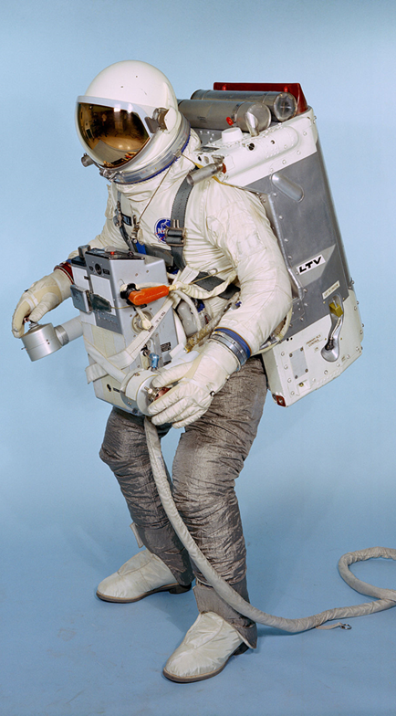
Gemini 9

Slide 10
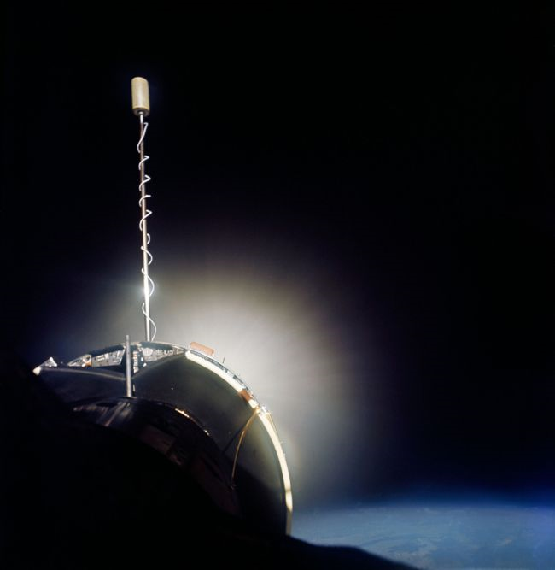
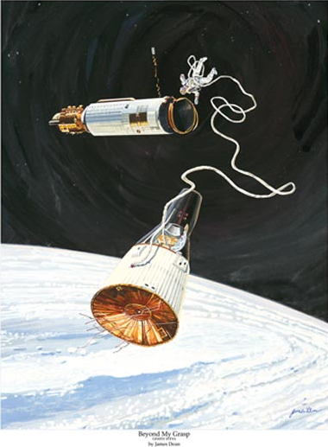

Slide 11
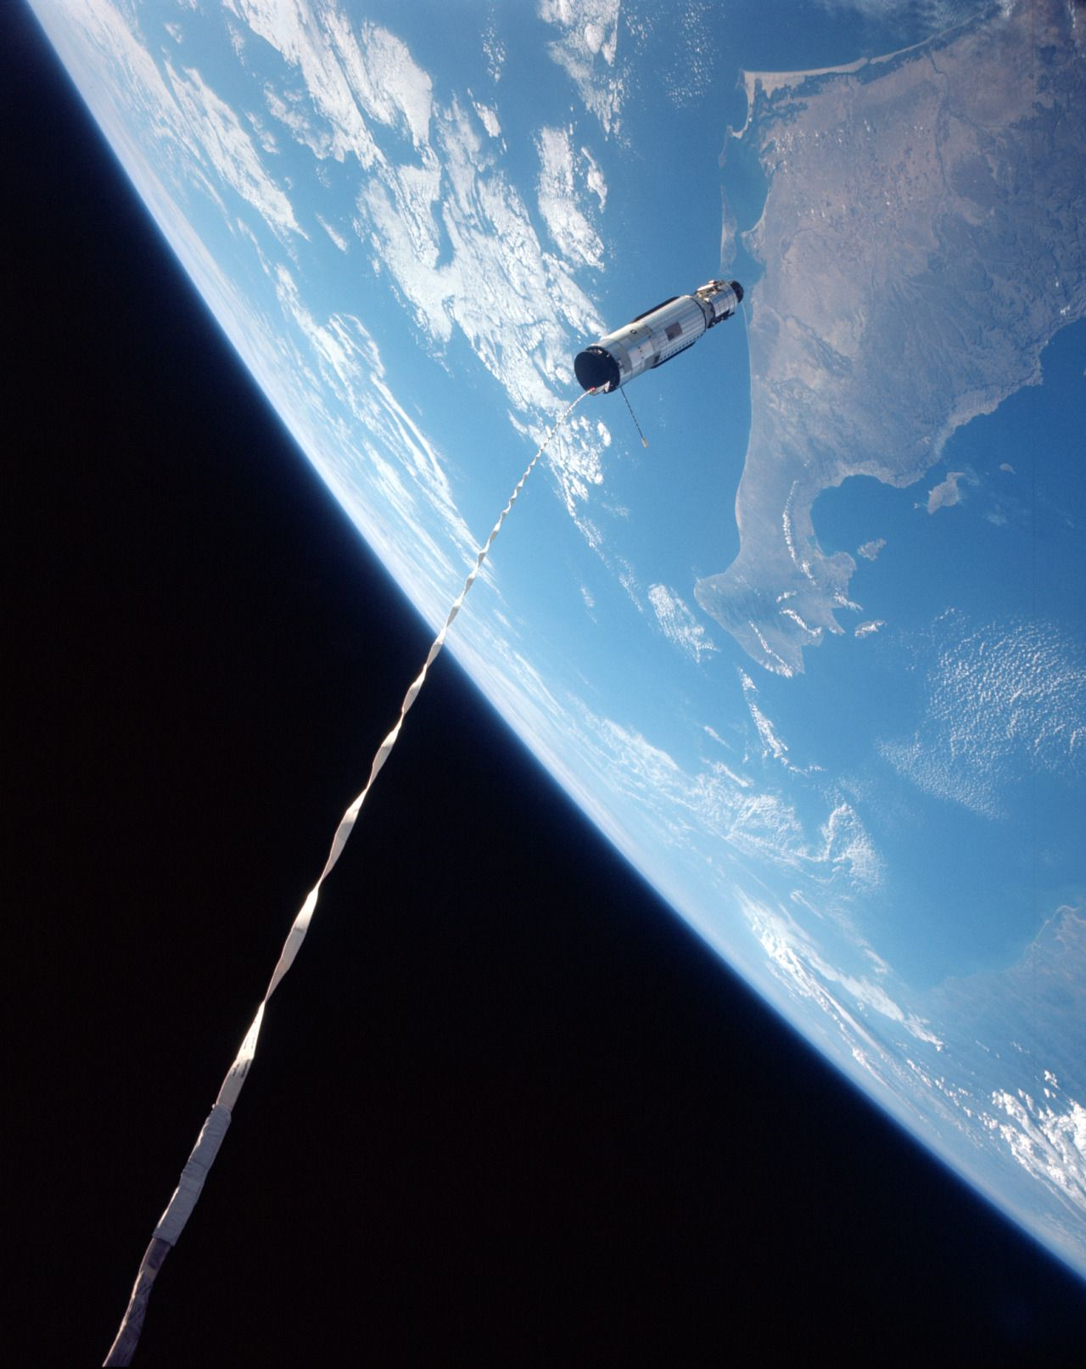
Gemini 11 Tethered Stationkeeping

Slide 12
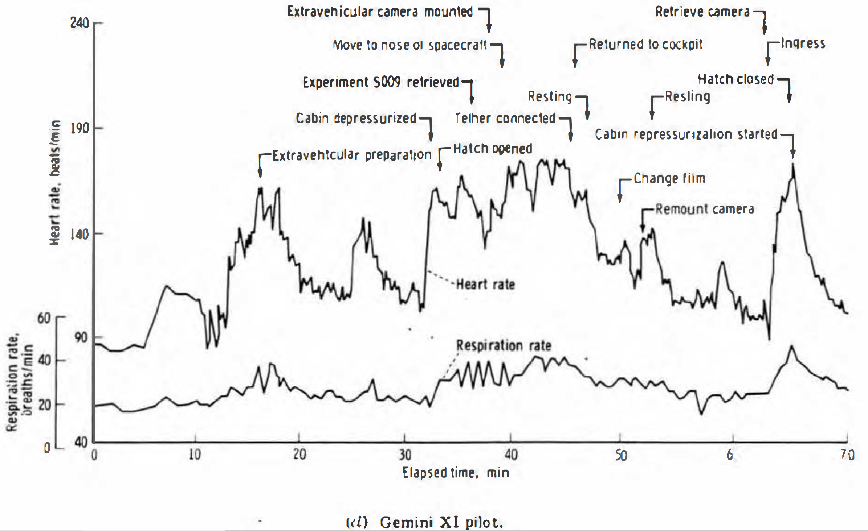

Slide 13
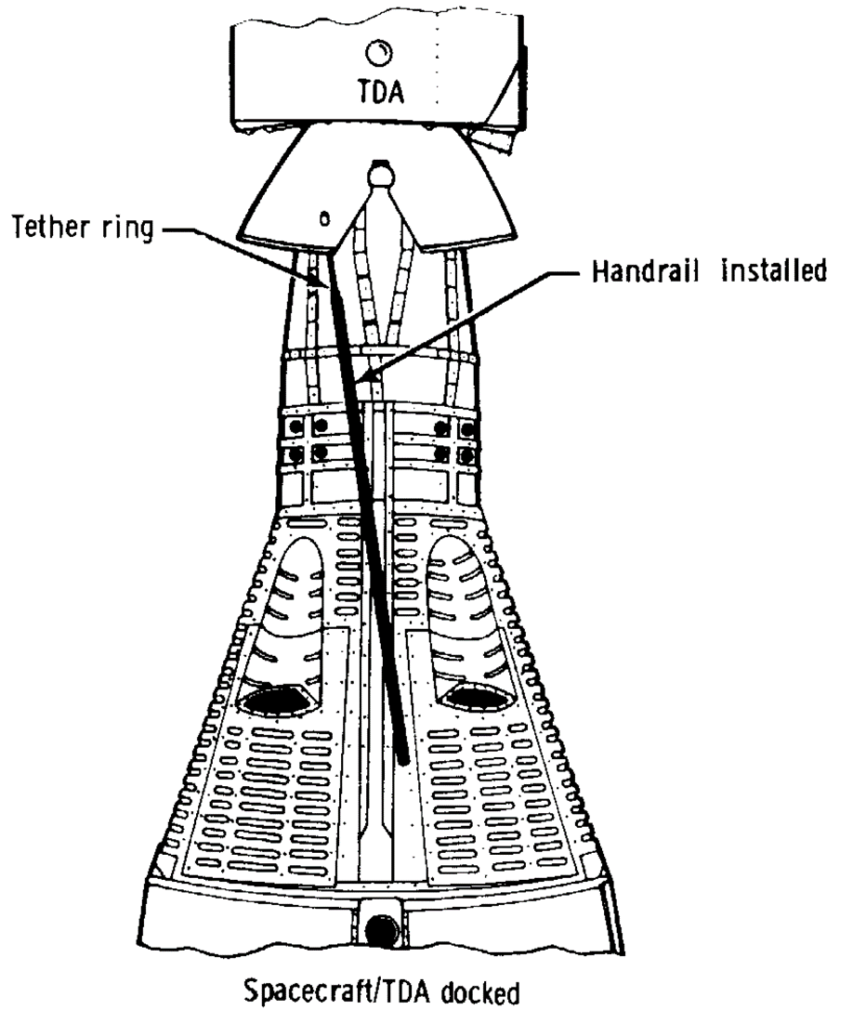
Gemini 12 Body Position Aids

Slide 14
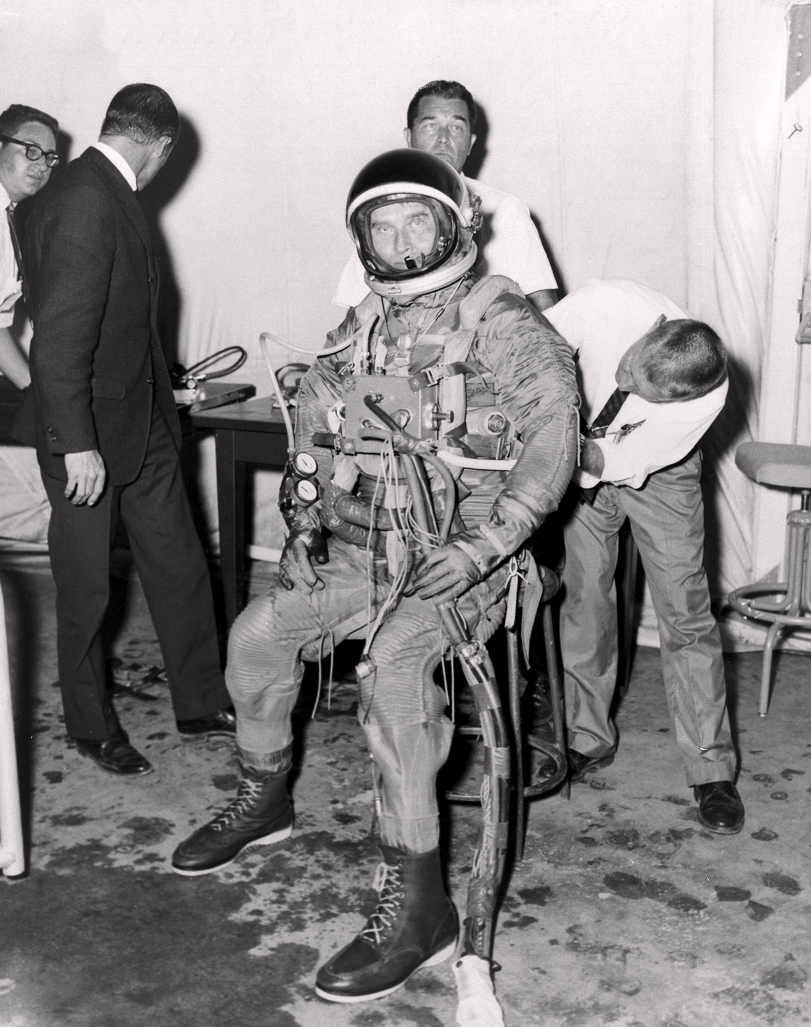
Neutral Buoyancy Experimentation
Boeing Bioastronautics Division: 1963 [water pressurized]
Air Force X-20 DynaSoar (cancelled December 1963)
Mattingly and Loats (“Environmental Research Associates”): 1964 [air pressurized]
Langley Manned Orbiting Research Laboratory (study ended 1966)
Gemini
Marshall Space Flight Center: 1964 [air]
Wet Workshop (alternative to Skylab)
General Electric Space Technology Lab: 1964 [water]
Air Force Manned Orbiting Laboratory
MSFC Wet Workshop
Convair: 1964 [water]
Air Force (Manned Orbiting Laboratory?)

Slide 15
Gemini Neutral Buoyancy Simulations (1966)
June 3-6: Gemini 9A
June 15: Wet Workshop demo to Marshall (MSFC) and Houston (MSC)
June 30/July 1 Gemini 10 procedures development
July 18-21: Gemini 10
July 25: Gilruth letter directing neutral buoyancy training: July 25
July 28/29 Gemini 9 postflight evaluation (Cernan)
August 10 Gemini 11 procedures development
August 22 Gemini 12 procedures development
September 11-12 Gemini 12 training (Aldrin)
September 12-15: Gemini 11
September 14 Gemini 12 procedures development
October 16-17, 29 Gemini 12 training (Aldrin)
November 11-15: Gemini 12: November 11-15
December 1 Gemini 12 postflight evaluation (Aldrin)

Slide 16
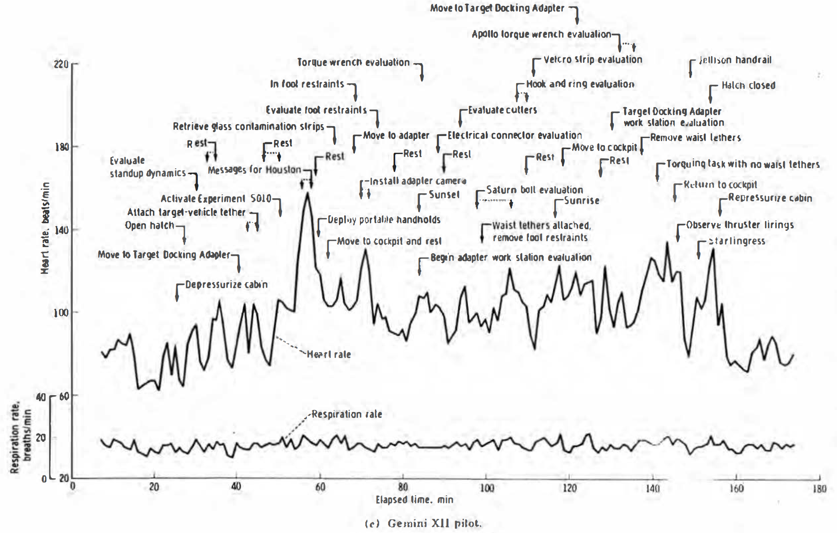

Slide 17
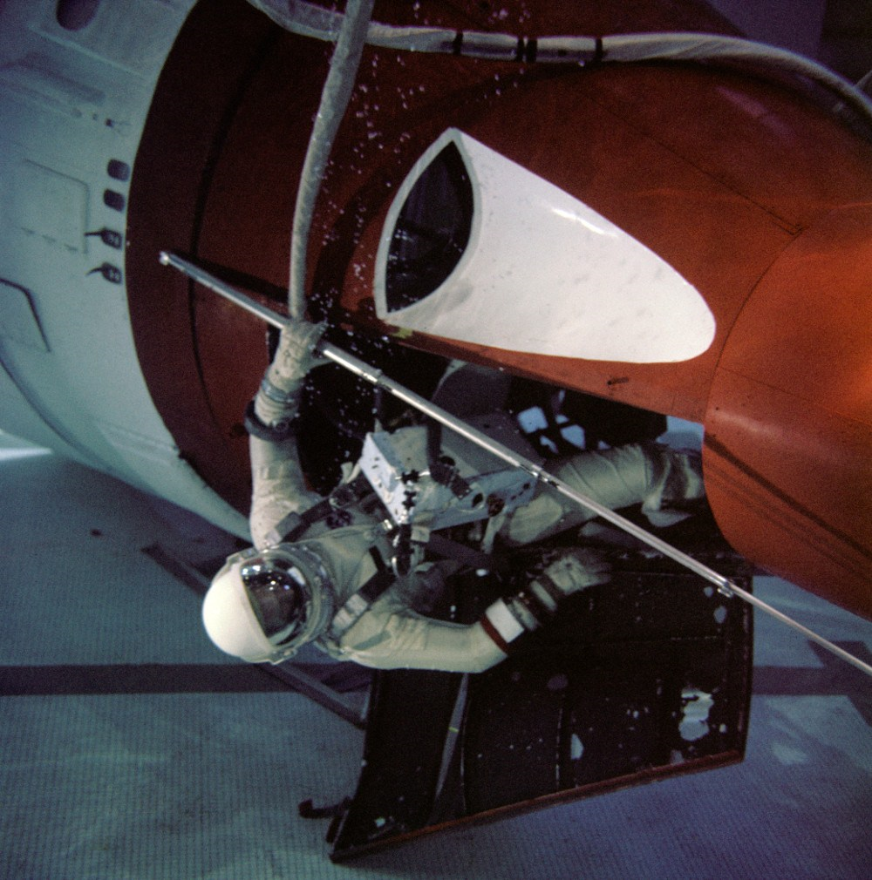

Slide 18
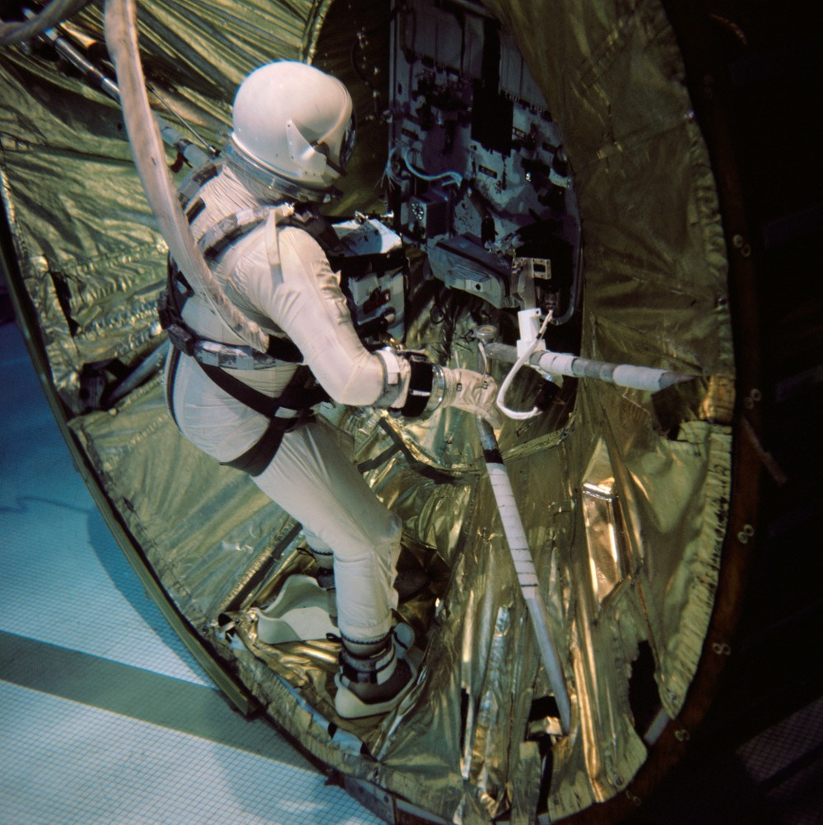
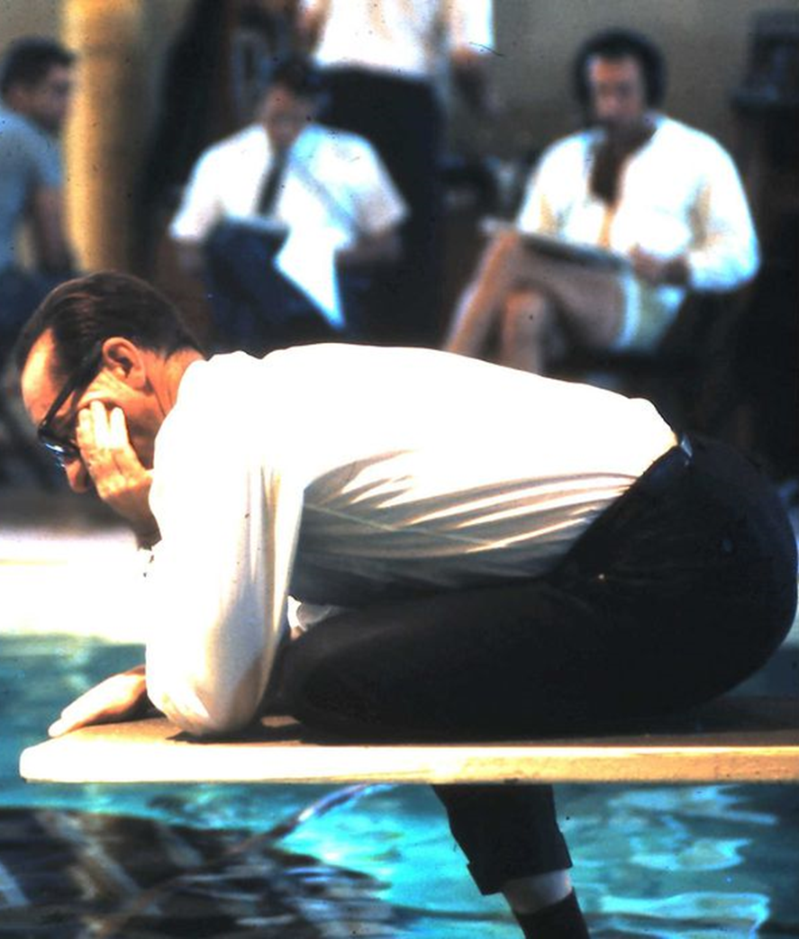

Slide 19
Gemini Accomplishments
Specific Objectives
Other Benefits
Long duration flight
Rendezvous
Docking
EVA
Precision landing
Tethered stationkeeping
Flight experience
Mission operations experience
Training experience
Launch operations experience
Responsive planning experience
Hardware maturation

Slide 20
Discussion Groups
Portree (“Spacewalks that Never Were: The Gemini EVA Planning Group”)
The original plans for Gemini EVA – no plan survives first contact with reality!
Gemini Summary chapter 9 (“Body Positioning and Restraints during EVA”)
A description of what was learned during the Gemini “EVA crisis”
Neufeld (“Practicing for Space Underwater: Inventing Neutral Buoyancy Training”)
A nicely nuanced treatment of the development of the invention of underwater training
Gemini 12 Mission video
An excellent documentary on the Gemini XII underwater training and the mission

Slide 21
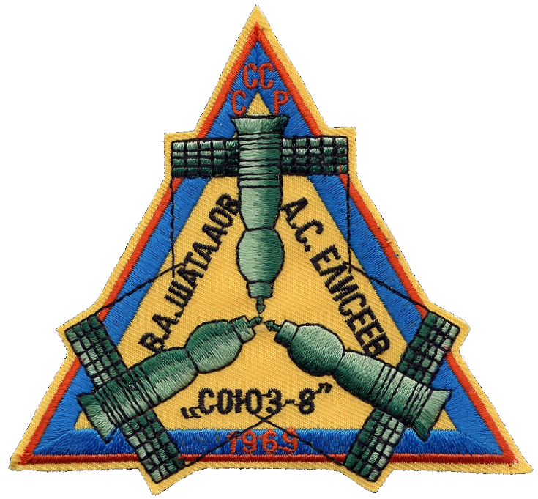

Slide 22
Discussion Groups
Sonnet Report (“Report of the Ad Hoc Working Group on Apollo Experiments and Training on the Scientific Aspects of the Apollo Program”)
The first try to nail down what Apollo should do on the Moon
Compton chapter 3 (“Apollo’s Lunar Exploration Program”)
An explanation of what happened after the Sonnet Report
FETM episode 10 (“Galileo was Right”)
A dramatization of scientific training for an Apollo mission
NRO Draft (“Project Upward: The NRO and NASA”)
Reuse of spy satellite technology in the Apollo program

