Slide 1
Gemini: Rendezvous and Docking
INST 154
Apollo at 50
Gemini Flight Controller Orientation

Slide 2
Gemini Objectives
To demonstrate endurance of humans and equipment in spaceflight for extended periods, at least eight days required for a Moon landing, to a maximum of two weeks [succeeded]
To effect rendezvous and docking with another vehicle, and to maneuver the combined spacecraft using the propulsion system of the target vehicle [succeeded]
To demonstrate Extra-Vehicular Activity (EVA), or space-"walks" outside the protection of the spacecraft, and to evaluate the astronauts' ability to perform tasks there [succeeded]
To perfect techniques of atmospheric reentry and touchdown at a pre-selected location on land [failed]

Slide 3
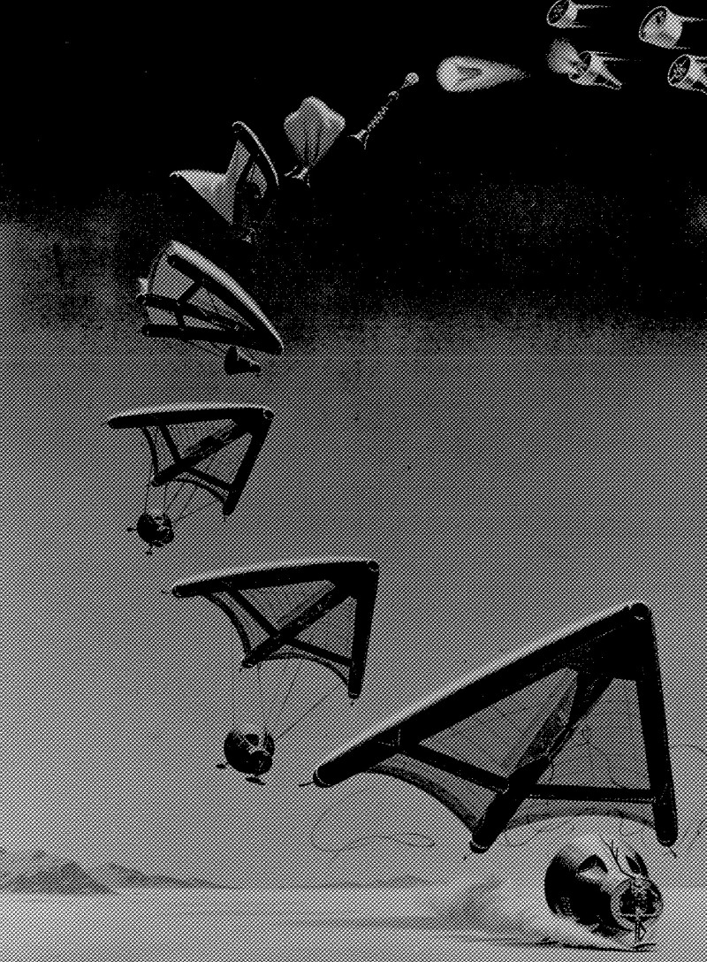
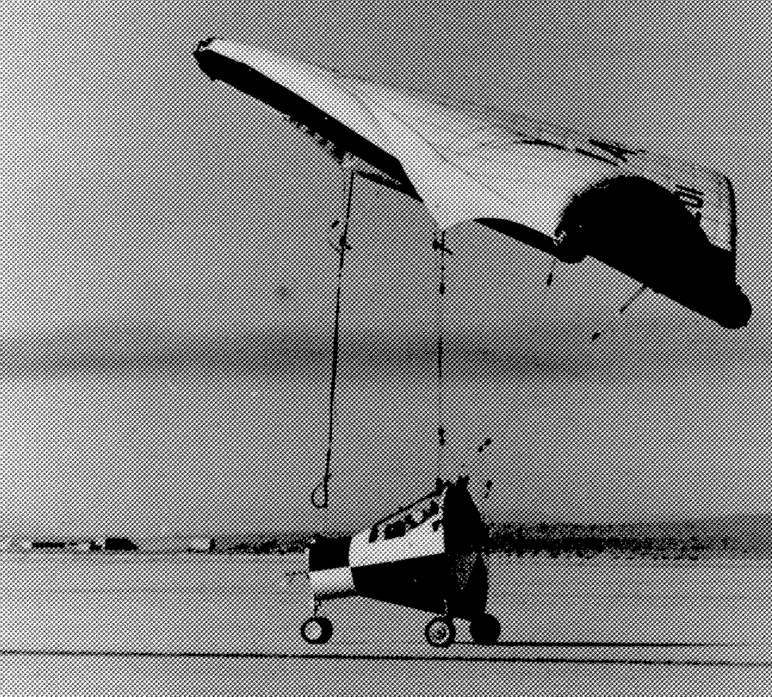

Slide 4
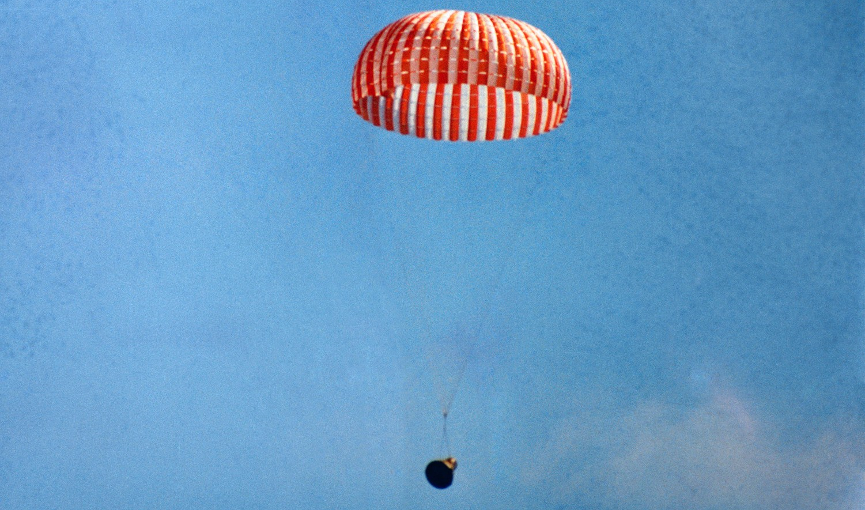

Slide 5
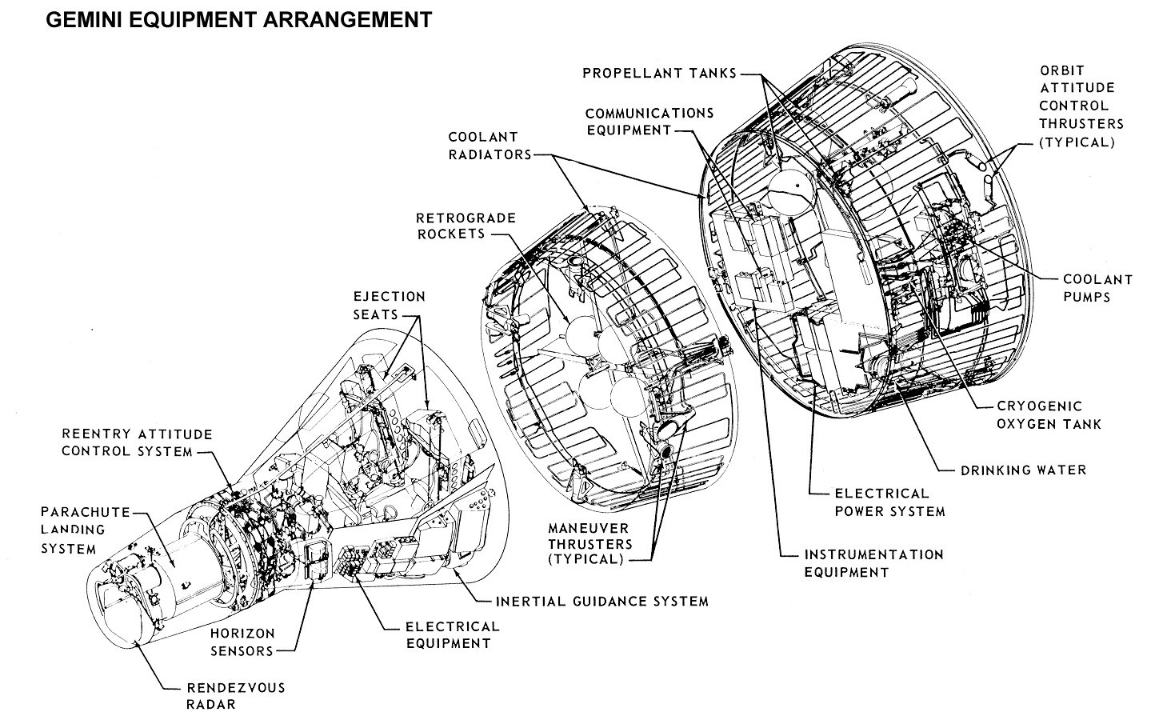

Slide 6
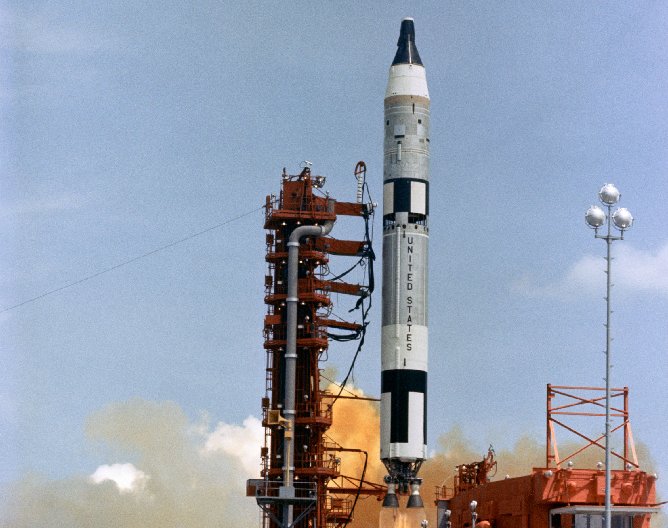

Slide 7
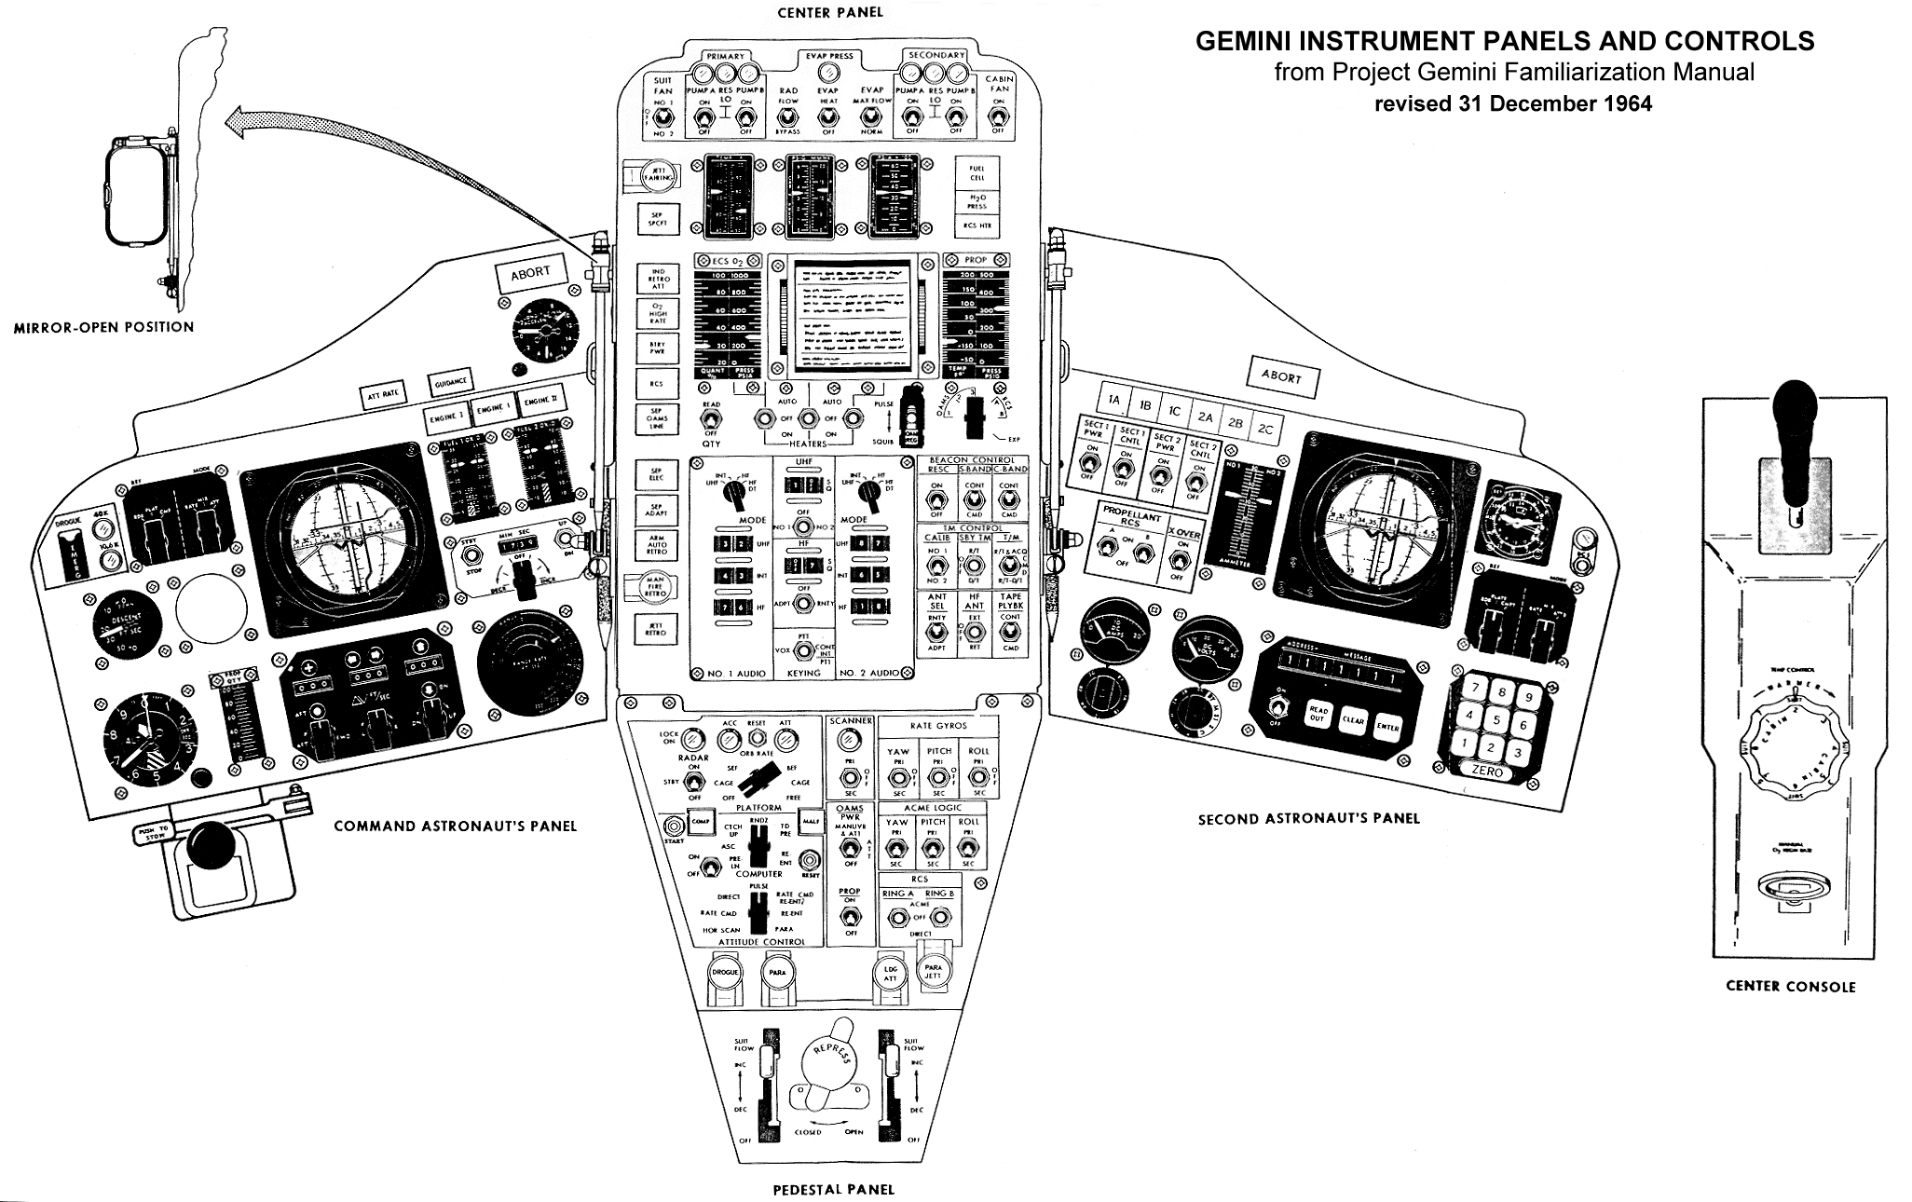

Slide 8
Timeline
Mercury Mark II program approval (December 1961)
Last Mercury mission (May 1963)
First uncrewed Gemini mission (April 1964)
First crewed Gemini mission (March 1965)
First US Spacewalk (June 1965)
First Rendezvous (December 1965)
Last Gemini mission (November 1966)
Uncrewed Air Force Gemini B (MOL program) launch (November 1966)
Air Force Manned Orbiting Laboratory program cancelled (June 1969)

Slide 9
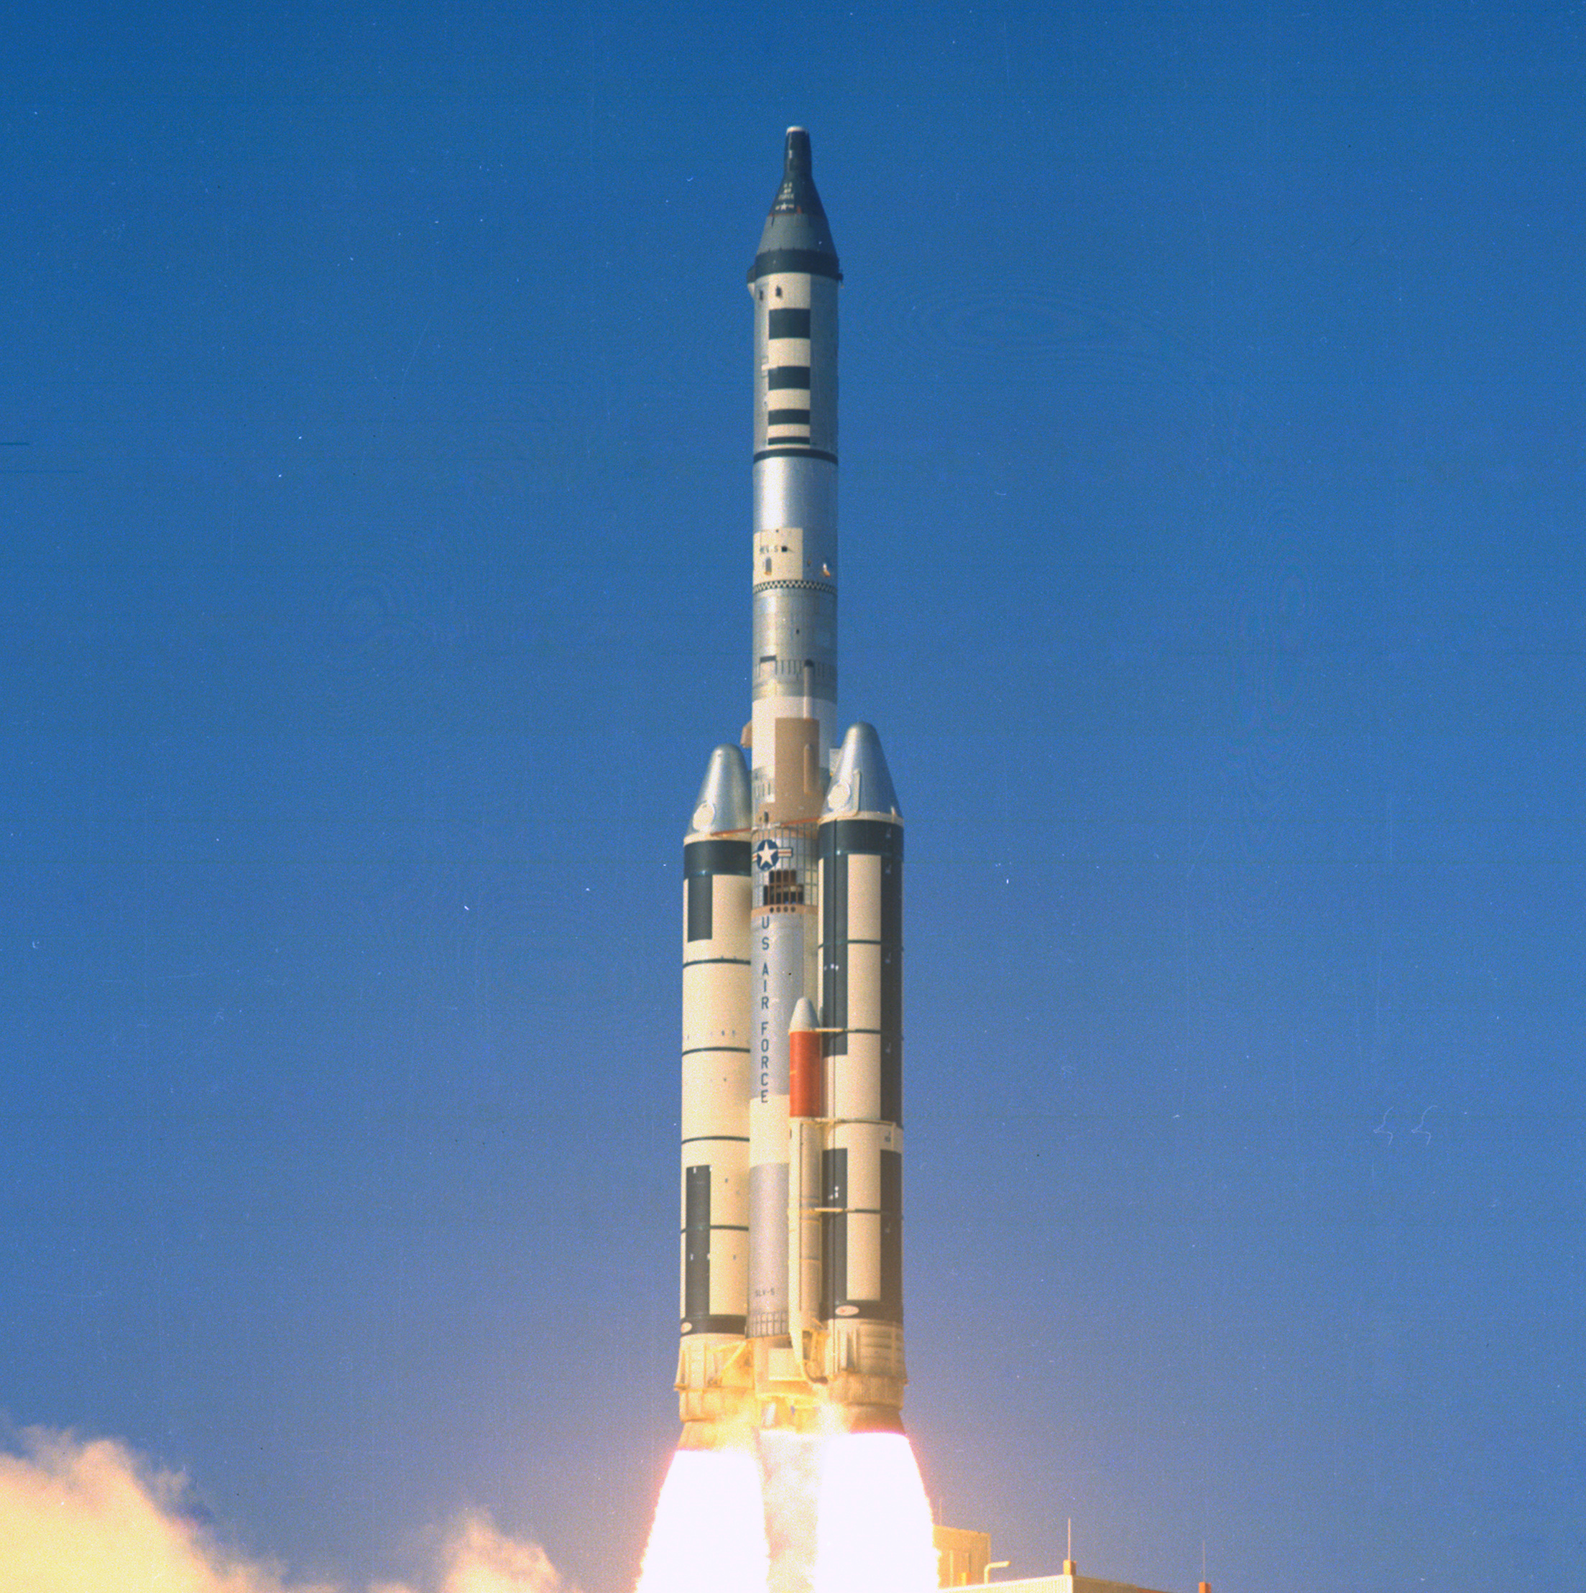

Slide 10
Long Duration Missions (before Shuttle/Mir)
Mercury-Atlas 9 1.4 days
Gemini 4 4.1 days
Gemini 5 7.9 days
Gemini 7 13.8 days
Skylab 2 28.0 days
Skylab 3 59.5 days
Skylab 4 84.1 days

Slide 11
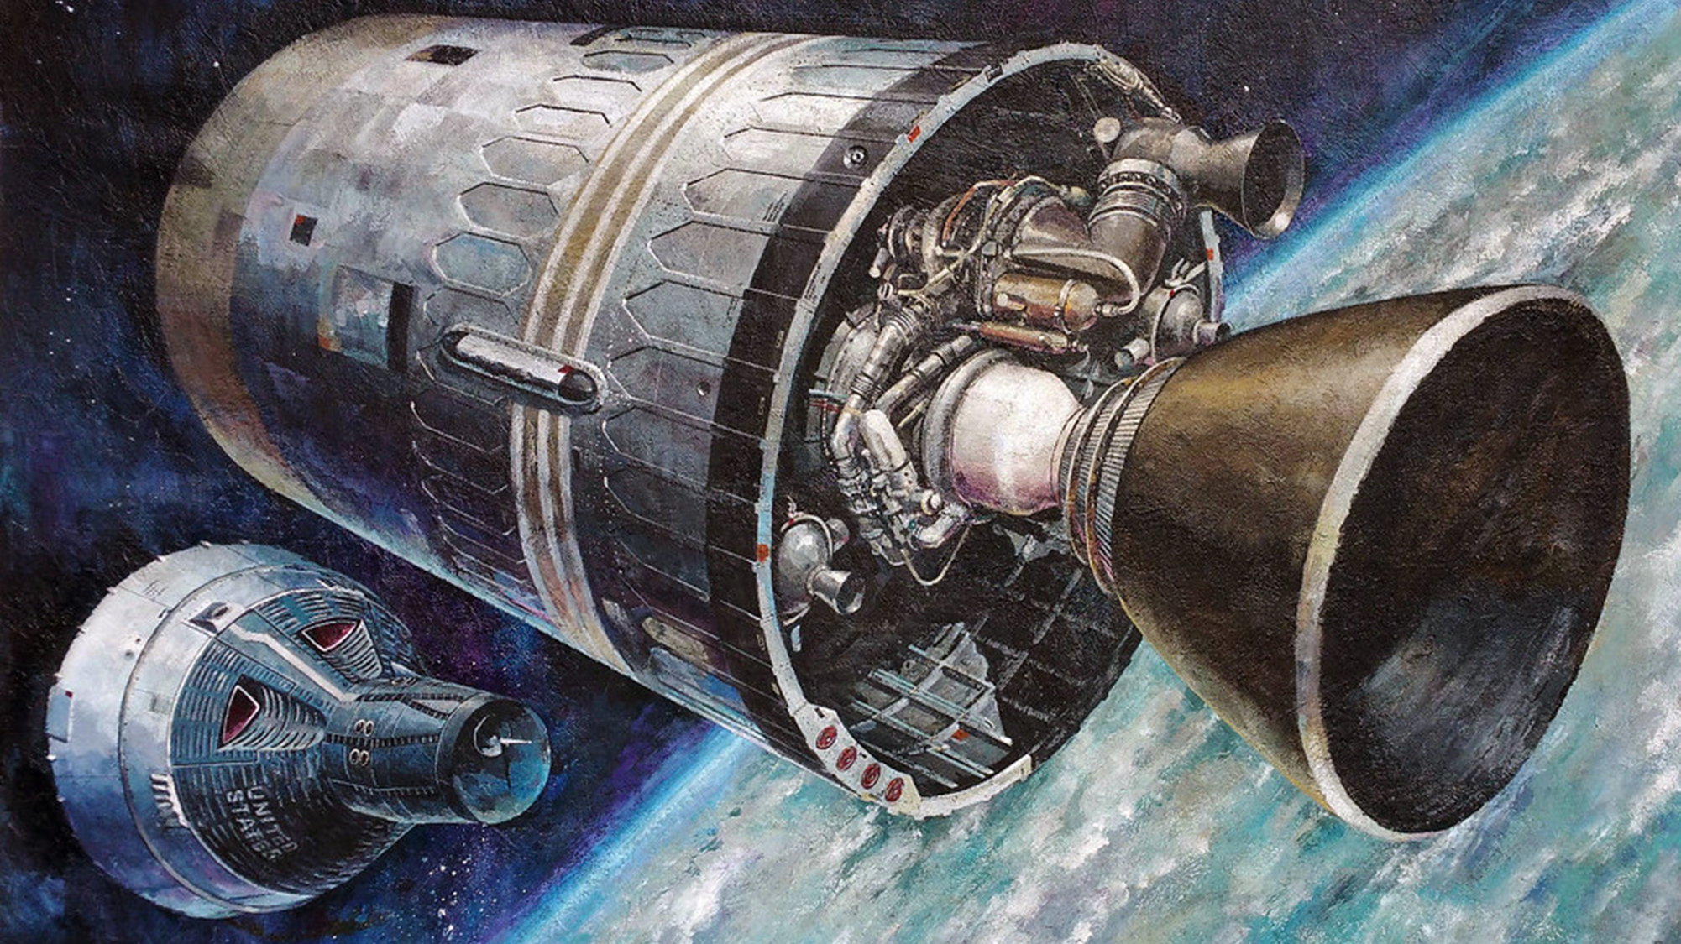
Rendezvous Missions (before Apollo 11)
Gemini 4 (second stage re-rendezvous) [venting, line of sight thrusting]

Slide 12
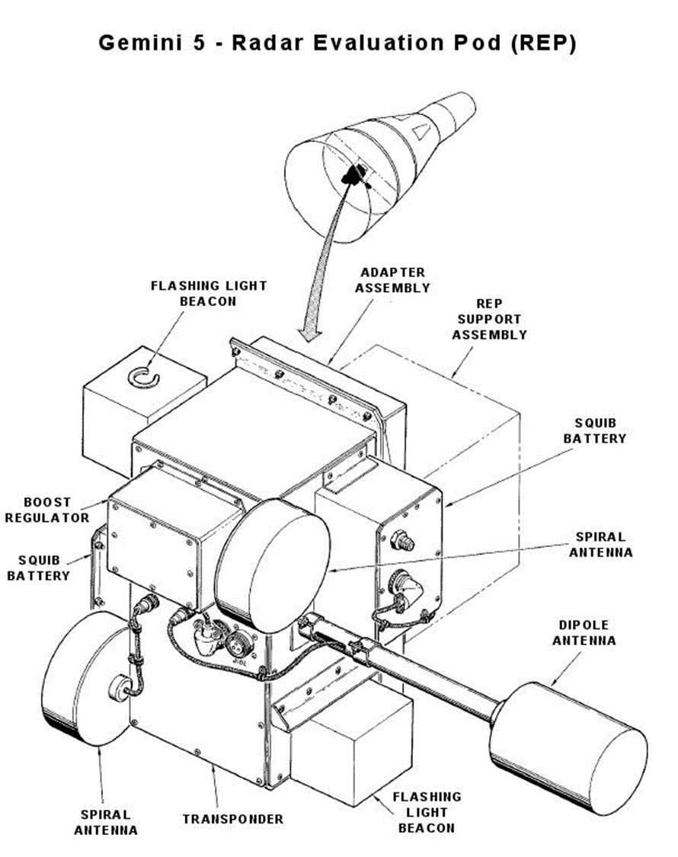
Rendezvous Missions (before Apollo 11)
Gemini 4 (second stage re-rendezvous) [venting, line of sight thrusting]
Gemini 5 (Radar Evaluation Pod) [fuel cell problems]

Slide 13
Rendezvous Missions (before Apollo 11)
Gemini 4 (second stage re-rendezvous) [venting, line of sight thrusting]
Gemini 5 (Radar Evaluation Pod) [fuel cell problems]
Gemini 6A (first rendezvous – with Gemini 7) [Agena fail, pad abort]

Slide 14
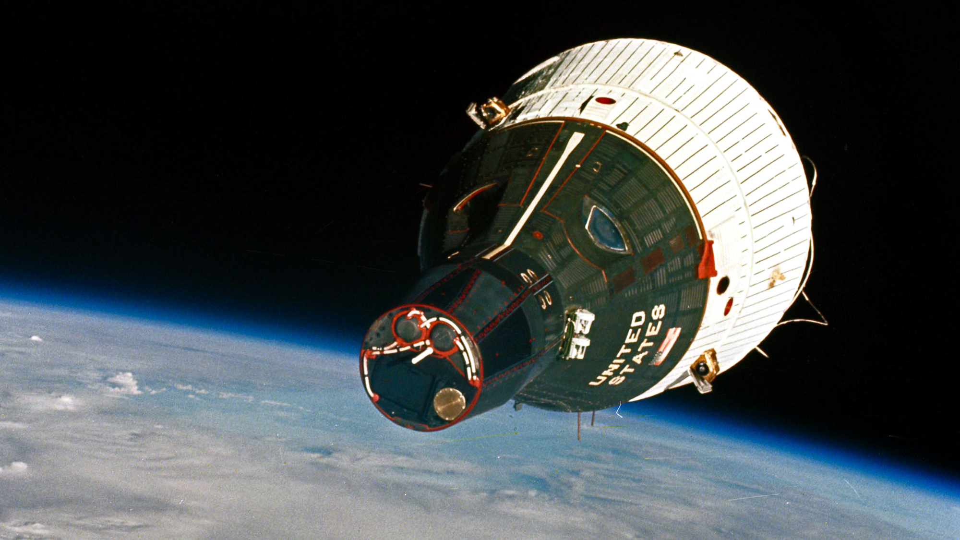

Slide 15
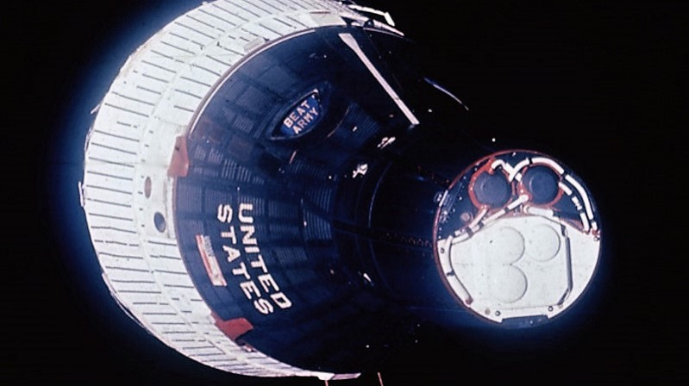

Slide 16
Rendezvous Missions (before Apollo 11)
Gemini 4 (second stage re-rendezvous) [venting, line of sight thrusting]
Gemini 5 (Radar Evaluation Pod) [fuel cell problems]
Gemini 6A (first rendezvous – with Gemini 7) [Agena fail, pad abort]
Gemini 8 (first docking) [emergency reentry]
Gemini 9A (rendezvous from above) [backup crew, Atlas fail, ADTA fail]
Gemini 10 (rendezvous with an uncooperative target)
Gemini 11 (rapid one-orbit rendezvous)
Gemini 12 (unplanned rendezvous without radar)
Apollo 9 (LM-active rendezvous)
Apollo 10 (Lunar Orbit Rendezvous)

Slide 17
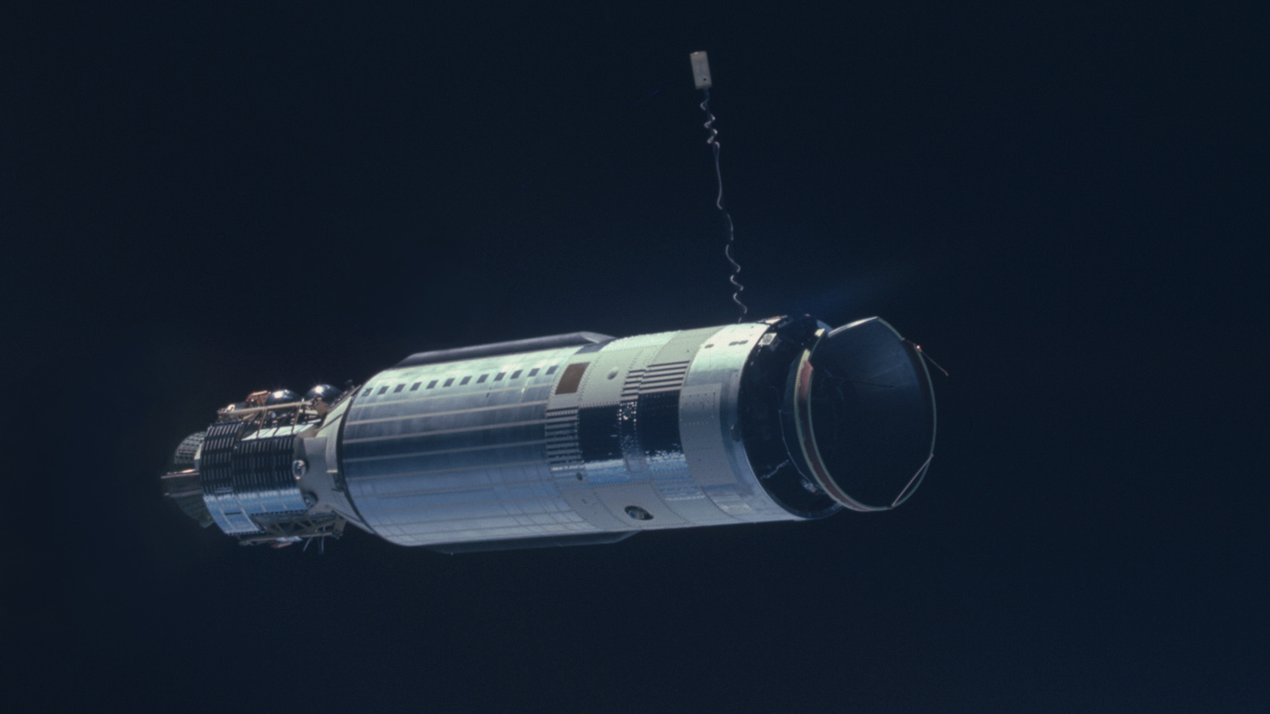

Slide 18
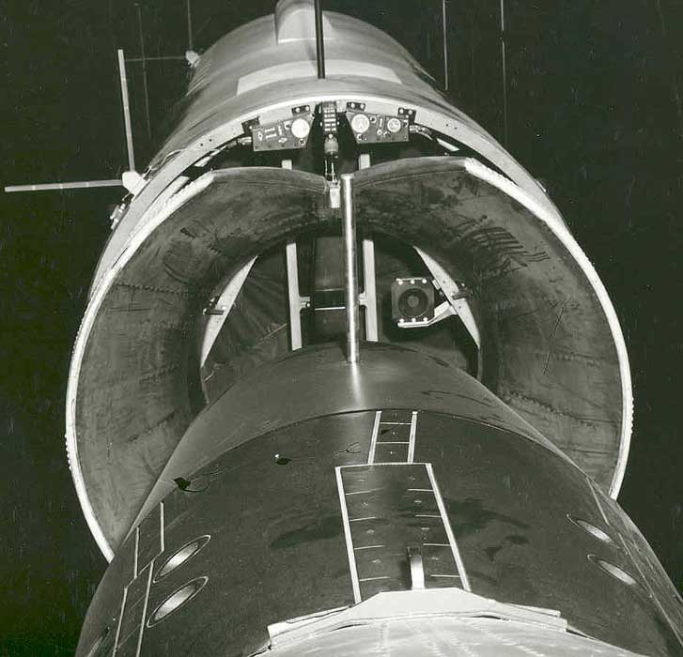

Slide 19
Rendezvous Missions (before Apollo 11)
Gemini 4 (second stage re-rendezvous) [venting, line of sight thrusting]
Gemini 5 (Radar Evaluation Pod) [fuel cell problems]
Gemini 6A (first rendezvous – with Gemini 7) [Agena fail, pad abort]
Gemini 8 (first docking) [emergency reentry]
Gemini 9A (rendezvous from above) [backup crew, Atlas fail, ADTA fail]

Slide 20
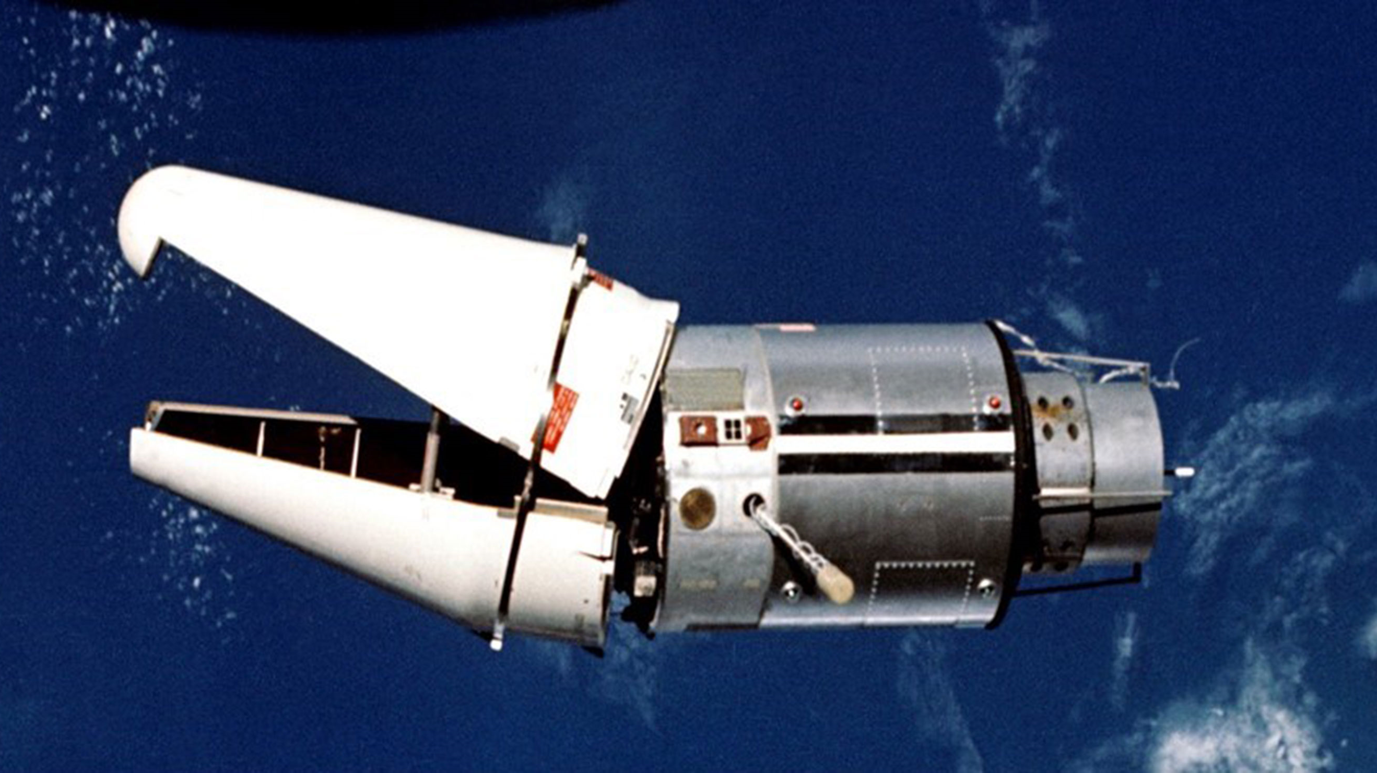

Slide 21
Rendezvous Missions (before Apollo 11)
Gemini 4 (second stage re-rendezvous) [venting, line of sight thrusting]
Gemini 5 (Radar Evaluation Pod) [fuel cell problems]
Gemini 6A (first rendezvous – with Gemini 7) [Agena fail, pad abort]
Gemini 8 (first docking) [emergency reentry]
Gemini 9A (rendezvous from above) [backup crew, Atlas fail, ADTA fail]
Gemini 10 (rendezvous with an uncooperative target)
Gemini 11 (rapid one-orbit rendezvous)
Gemini 12 (unplanned rendezvous without radar)
Apollo 9 (LM-active rendezvous)
Apollo 10 (Lunar Orbit Rendezvous)

Slide 24
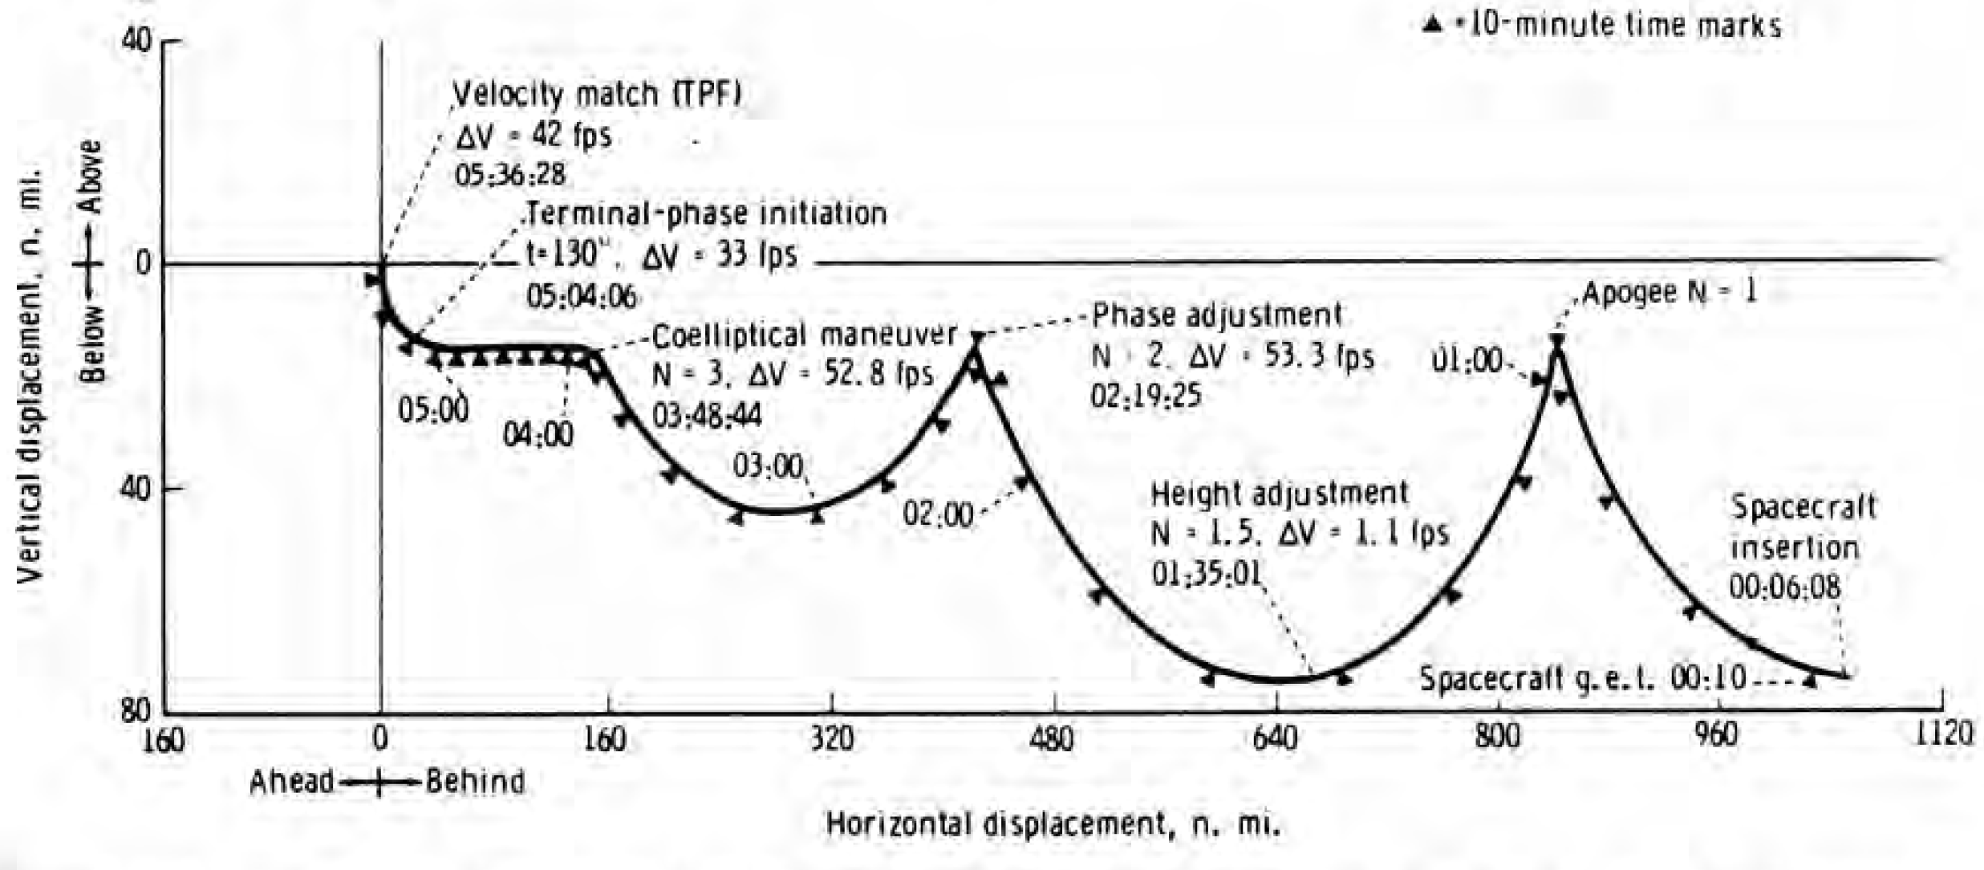
M=4 Rendezvous (e.g., Gemini 6A)

Slide 25
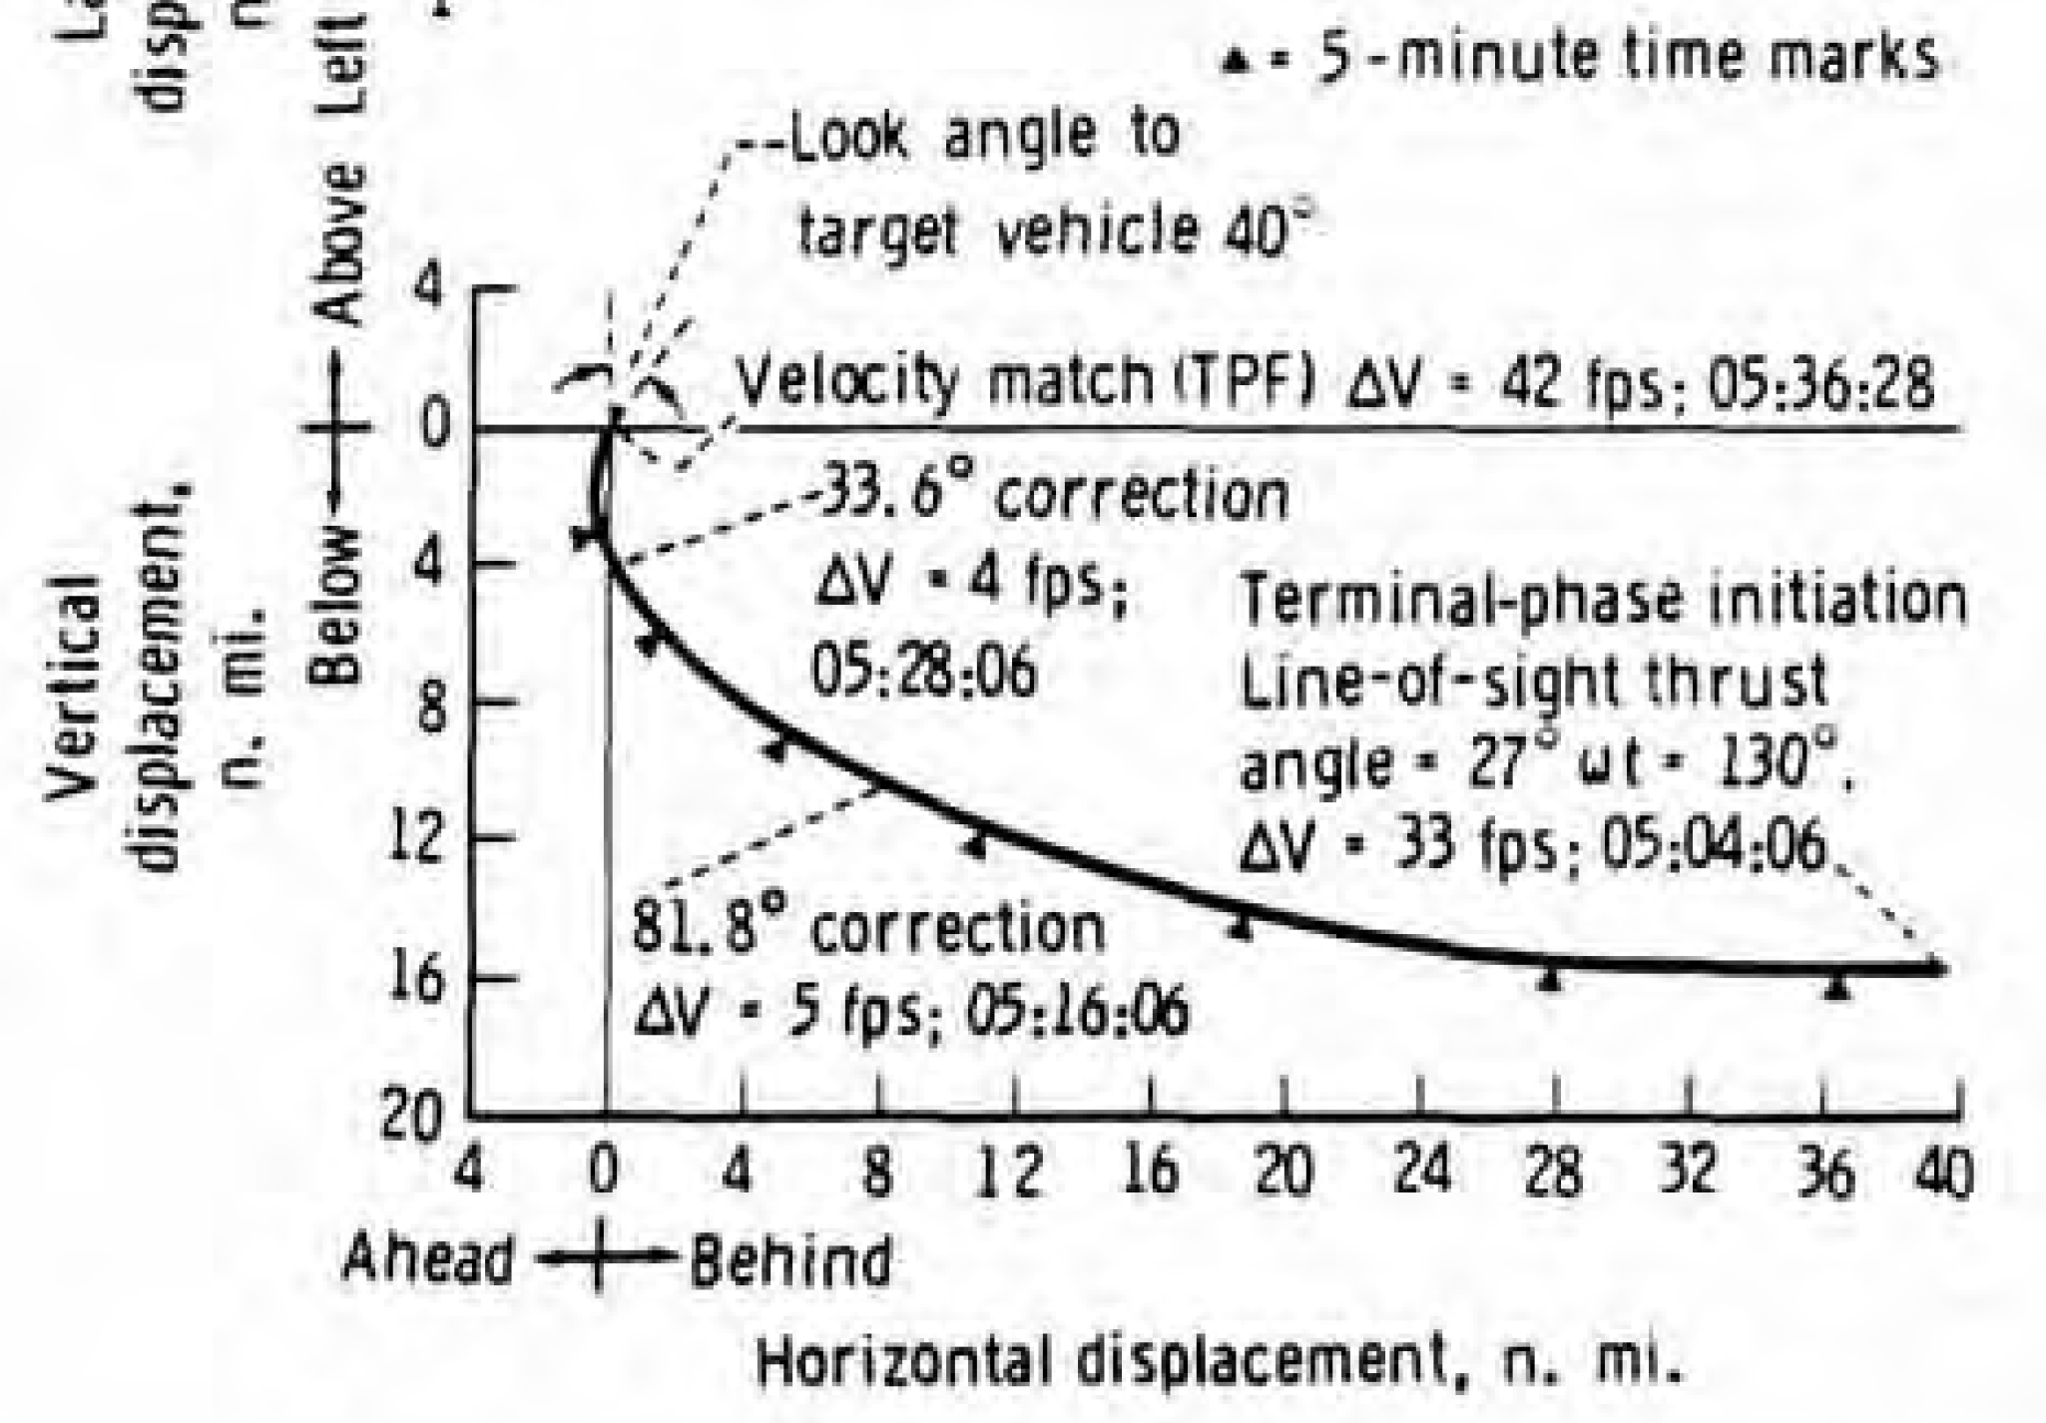
Terminal Phase

Slide 26
Braking Schedule
Apollo LOR:
6000 feet: -30 fps
3000 feet: -20 fps
1500 feet: -10 fps
600 feet: - 5 fps
Gemini 12 Pilot Report:
Braking was accomplished in increments, starting with a 3 ft/sec decrease to a closing rate of 45 ft/sec at the fourth midcourse correction. At a range of about 1.5 nautical miles, the closing rate had been decreased to about 17 ft/sec. The inertial indicators were used for an inertial reference during this period. The line-of-sight rates were very small throughout this portion of the braking sequence, requiring only one input correction, according to the inertial indicators. At a range of approximately one nautical mile, inertial reference was shifted to the stars.
From approximately one mile range, braking was accomplished in small increments. The analog range and range-rate indicators did not function during the braking phase. Position and closing rates were maintained by monitoring computer information and by visual observations of the target. At the completion of the rendezvous, the propellant-quantity-remaining indicator read 69 percent.

Slide 29
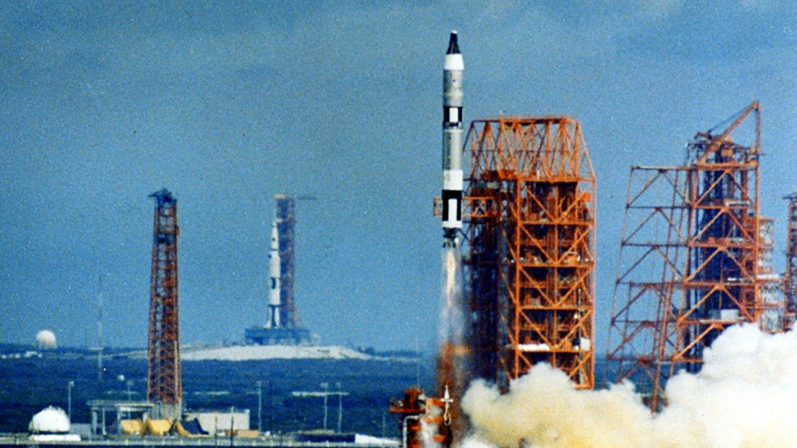

Slide 30
Discussion Groups
FETM video episode 1 (“Can We Do This?”)
NASA from the lunar landing decision through the end of Project Gemini
Mathews (“Collective Knowledge Gained from Gemini”)
An conference paper providing an overview of goals and accomplishments
Summary Conference chapter 2 (“Summary of Rendezvous Operations”)
A detailed review of Gemini rendezvous
Hacker chapter 12 (“Spirit of 76”)
The story of the first rendezvous

Slide 31
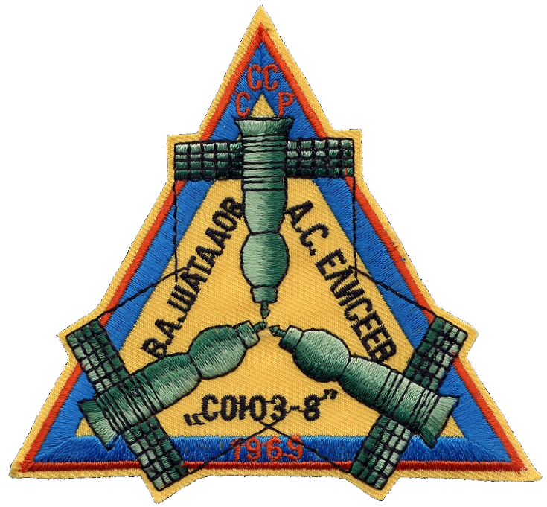

Slide 32
Readings for Gemini: EVA
Portree (“Spacewalks that Never Were: The Gemini EVA Planning Group”)
The original plans for Gemini EVA – no plan survives first contact with reality!
Gemini Summary chapter 9 (“Body Positioning and Restraints during EVA”)
A description of what was learned during the Gemini “EVA crisis”
Neufeld (“Practicing for Space Underwater: Inventing Neutral Buoyancy Training”)
A nicely nuanced treatment of the development of the invention of underwater training
Gemini 12 Mission video
An excellent documentary on the Gemini XII underwater training and the mission

Slide 33
Team Project Status Reports
Due on ELMS before class next Tuesday
And a second one the following Tuesday
Paragraph 1: What you have done so far
Paragraph 2: Problems you have encountered
Only needed if you have had problems
If you need help with problems, also send us an email!

Slide 34
