Slide 1
Astronauts
INST 154
Apollo at 50
Mercury 7 Press Conference

Slide 2
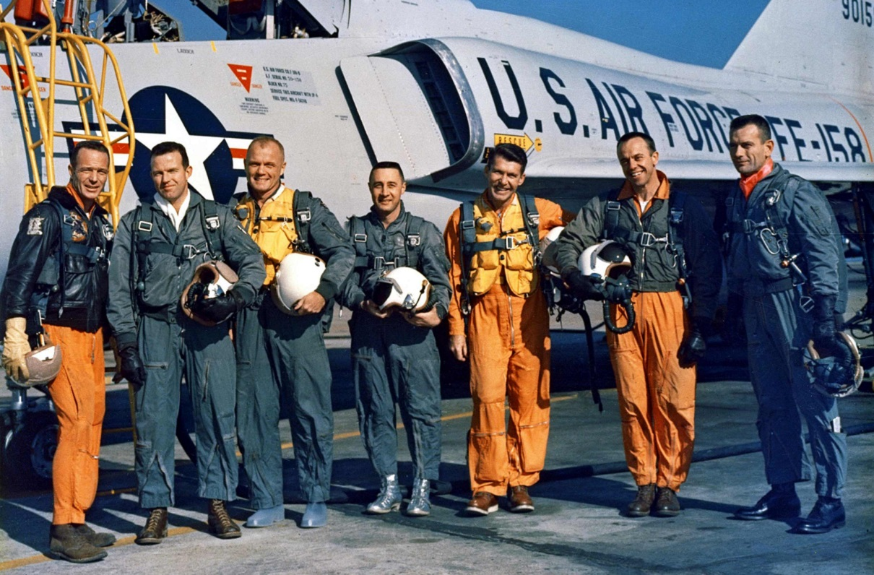
“Mercury 7” Astronaut Selection
Criteria
  Age<40, Height<5’11”, Hours≥1500, Test Pilot, Jets, B.S., Active Duty
Screened 110 of 508 military test pilot records
  58 Air Force, 47 Navy, 5 Marine
Interviewed 69 of those 110
  16 declined, 21 were rejected (6 for height!)
Ran medical tests on the remaining 32
  1 failed (Lovell)
Selected 7 of the remaining 31
  2 more were selected in later rounds (Conrad, Givens)
Six flew in Project Mercury

Slide 3
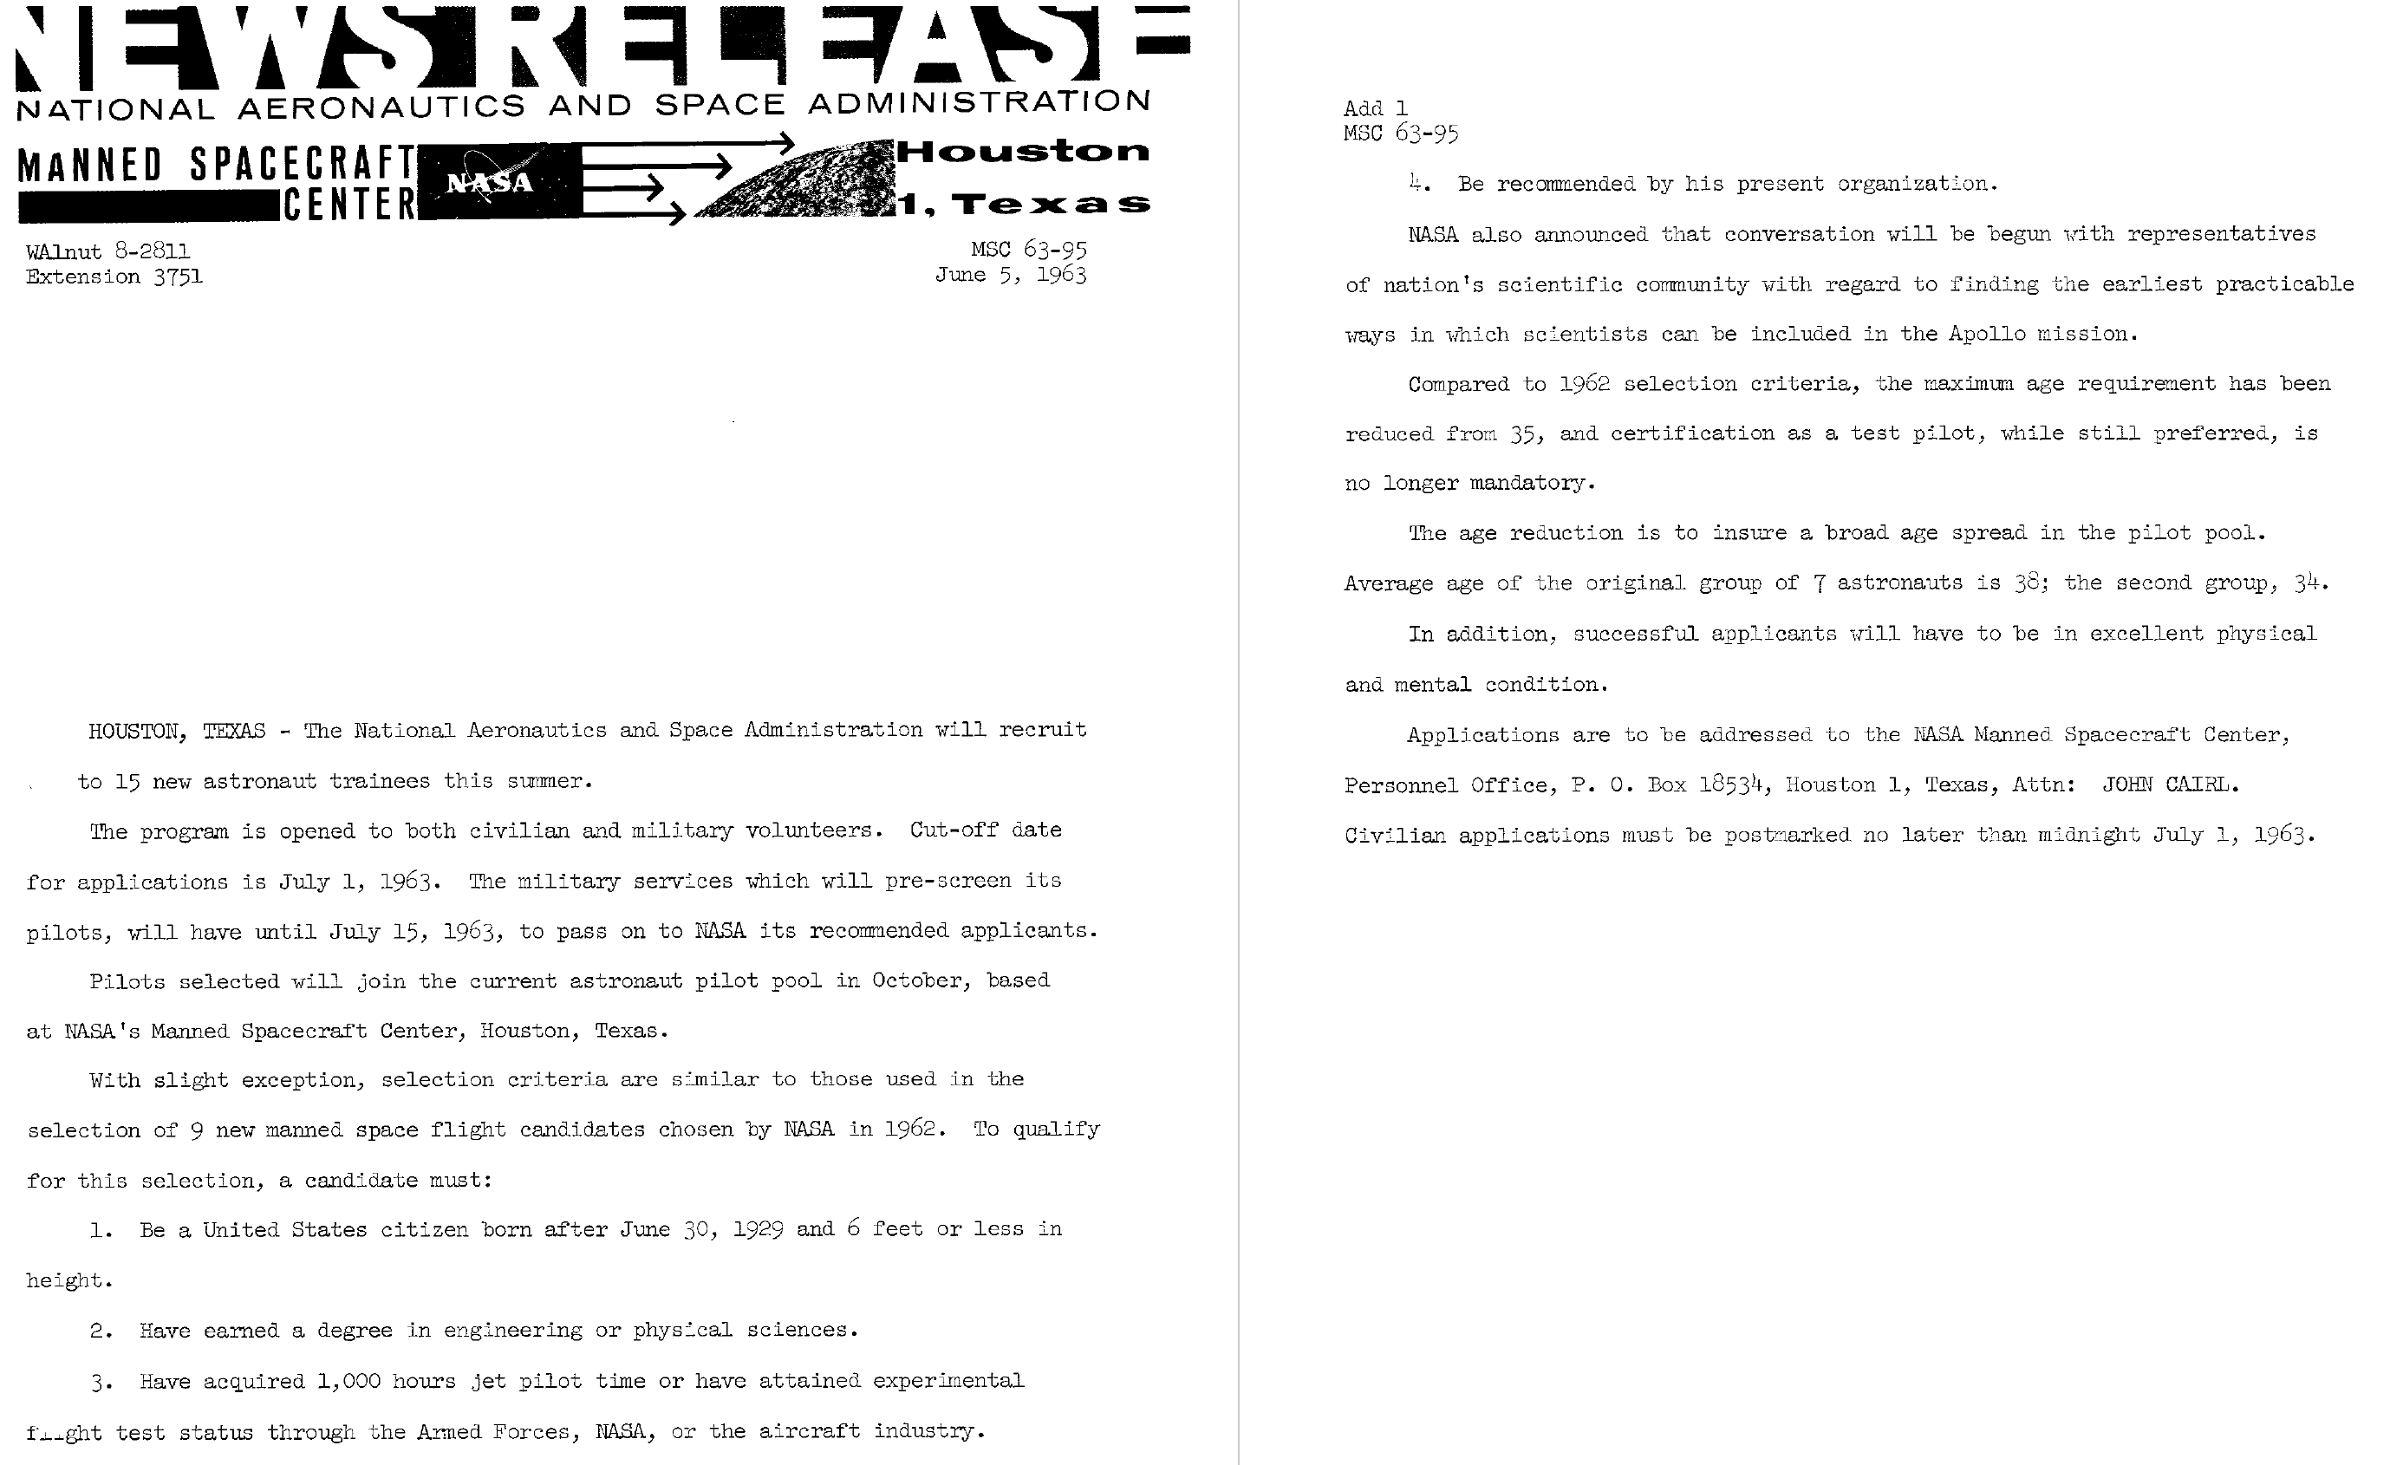
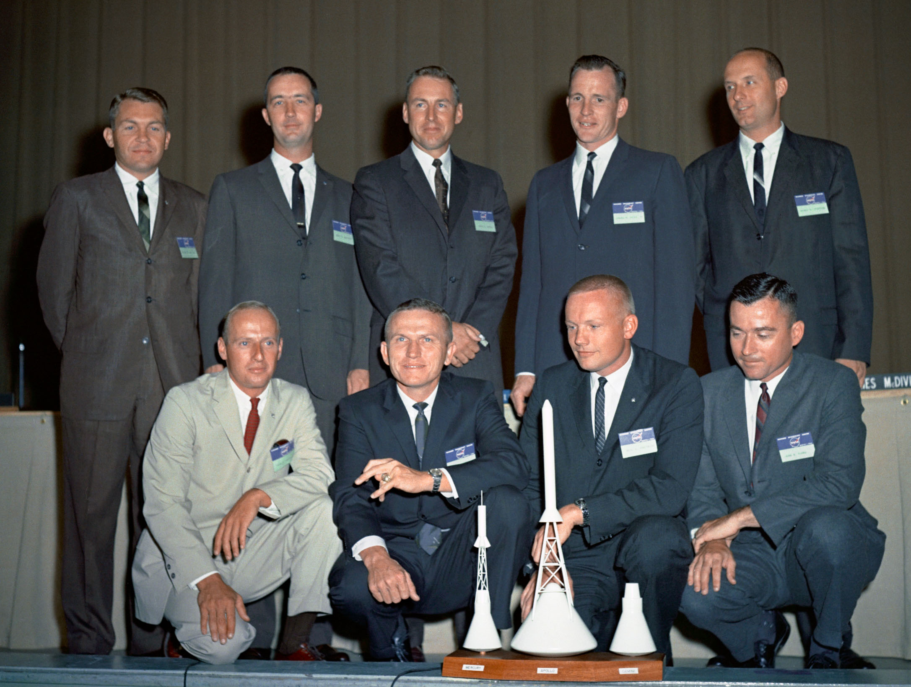
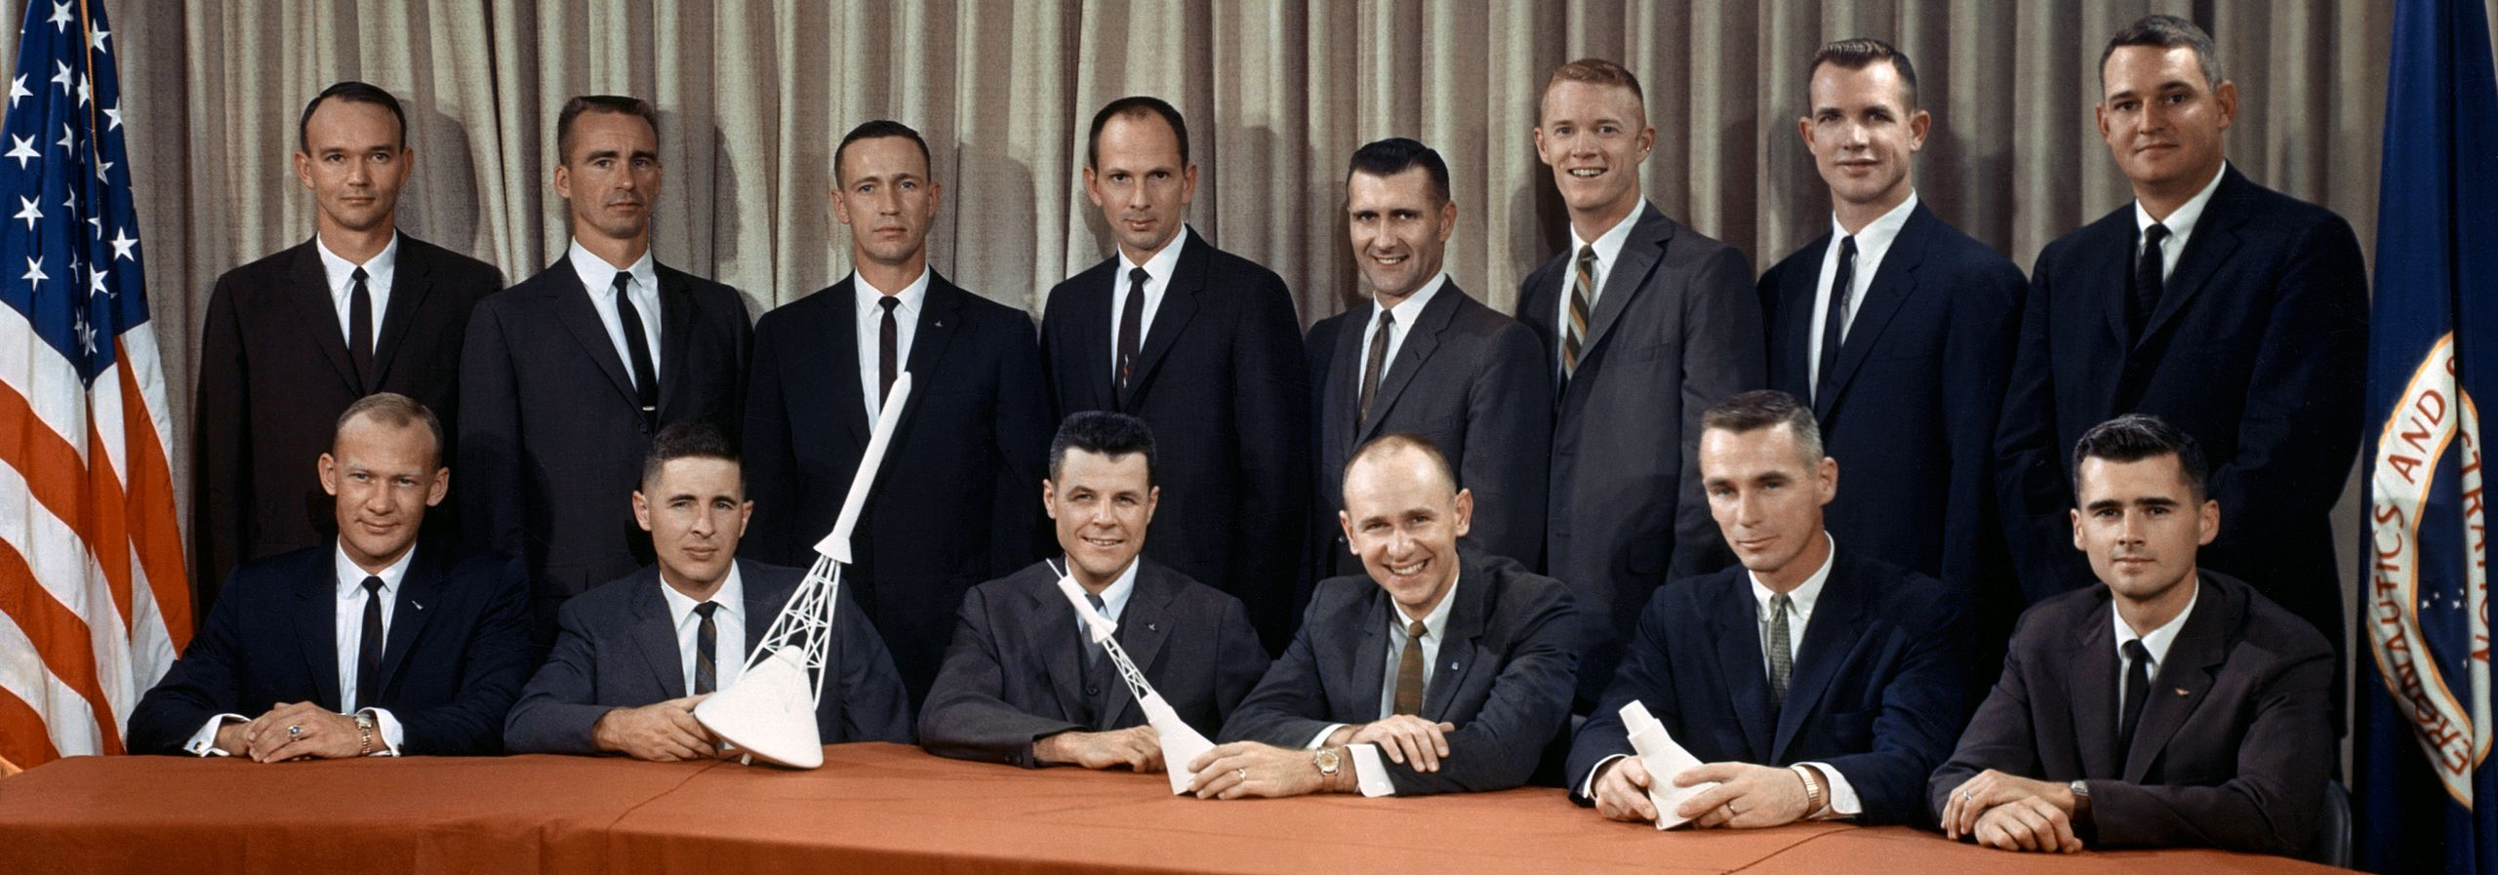
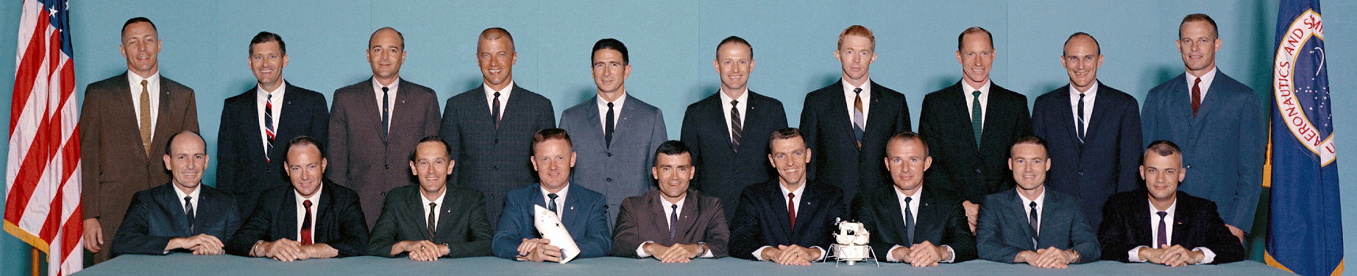

Slide 4
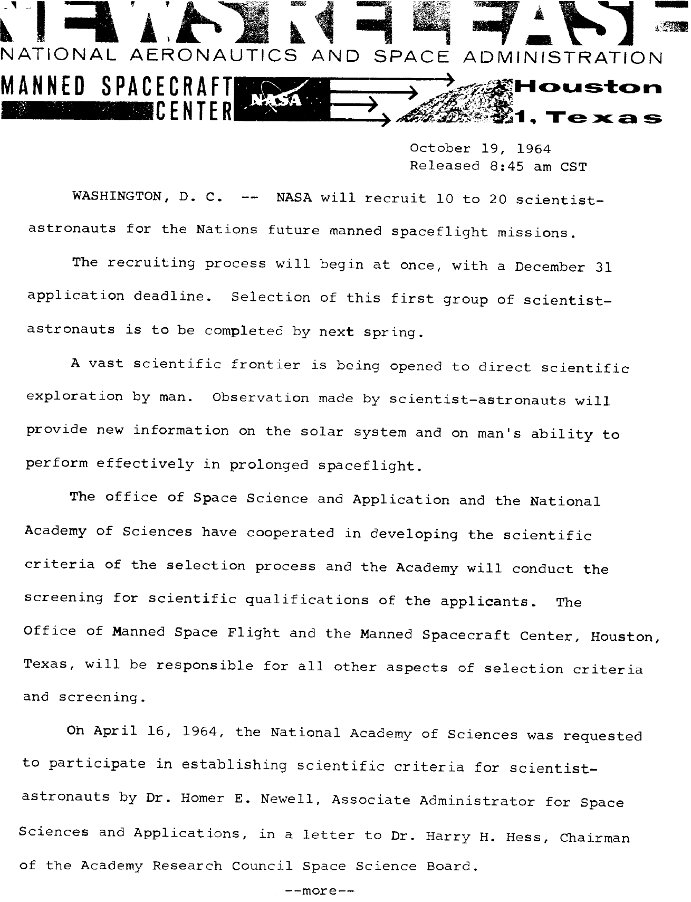
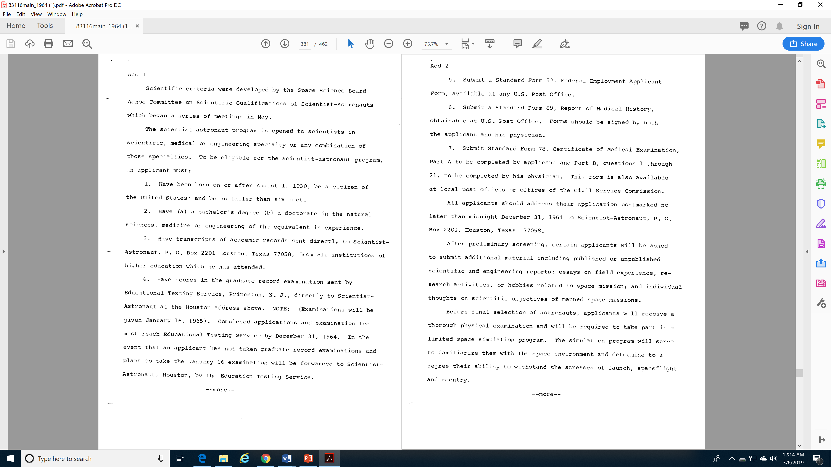
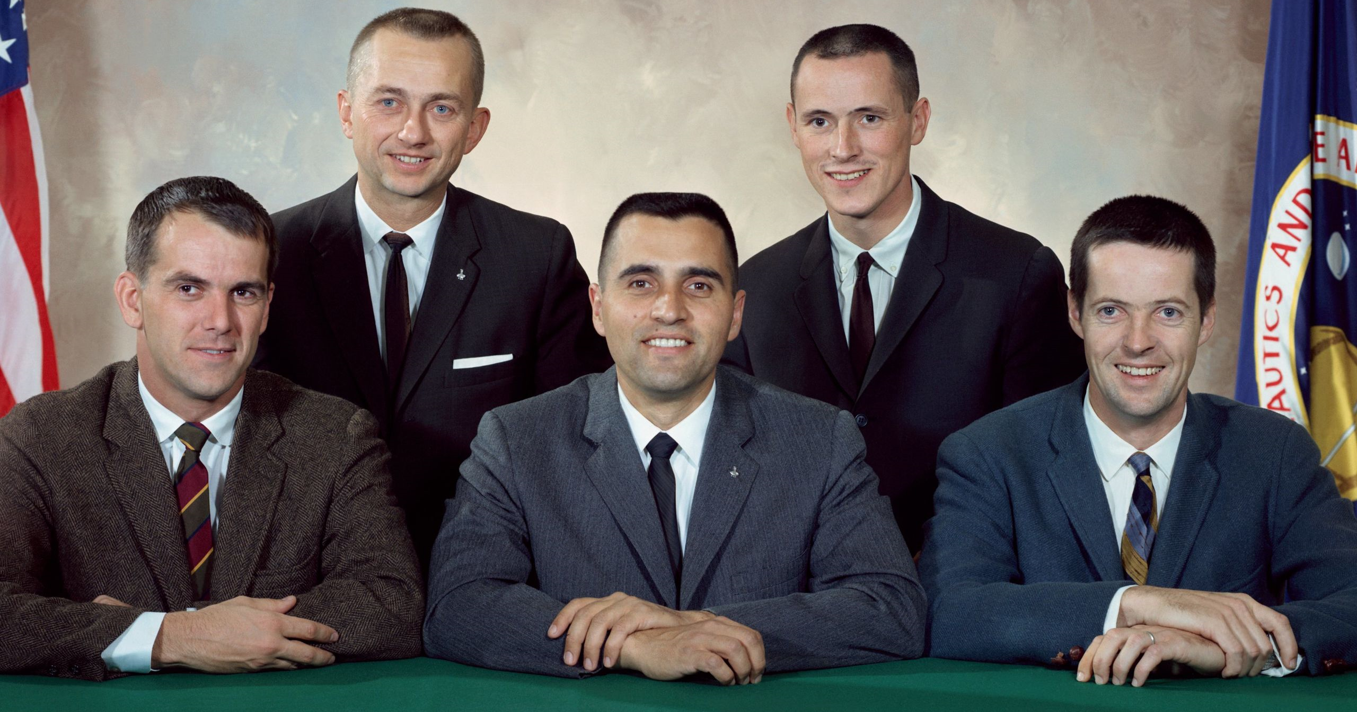
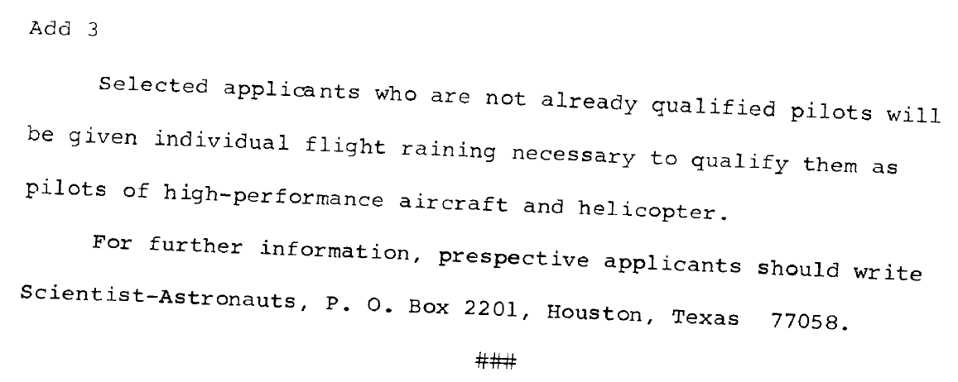

Slide 5
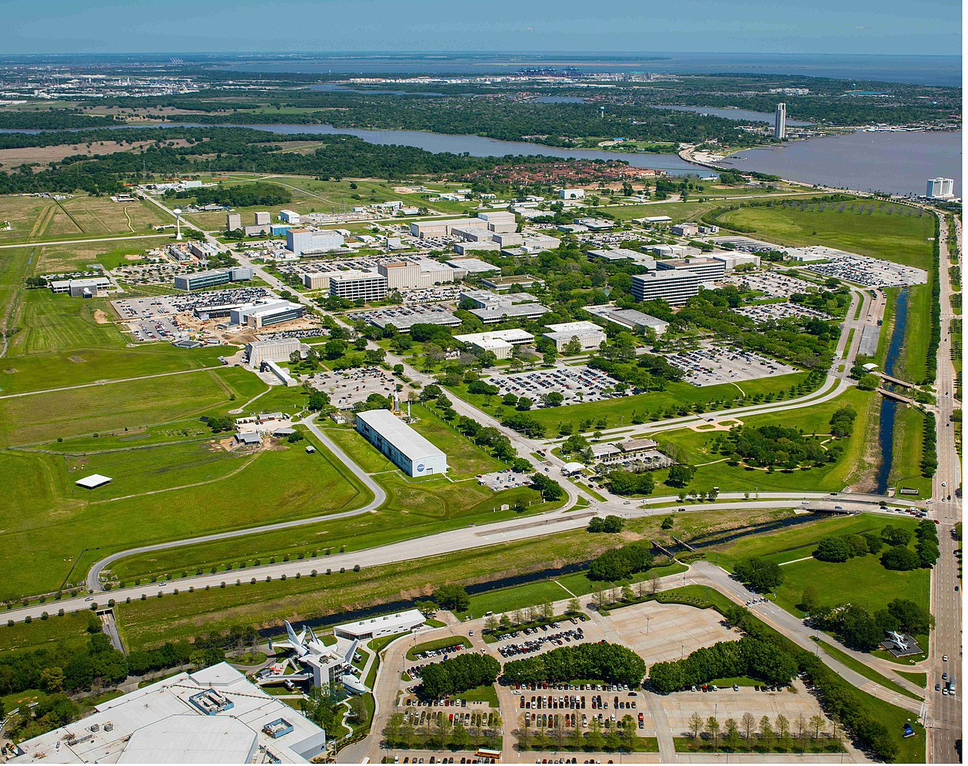
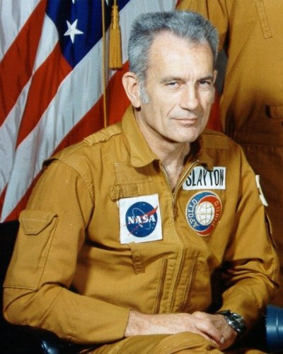
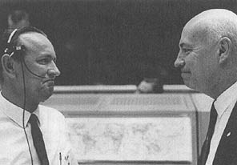
Houston
Manned Spacecraft Center: Bob Gilruth
Flight Crew Operations: Deke Slayton
  Astronaut Office: Alan Sheppard
  Flight Crew Support
  Aircraft Operations
Flight Operations: Chris Kraft
  Mission Control

Slide 6
The Rotation
Astronaut Candidate Training
  Orbital mechanics, Spacecraft systems, Survival, Geology, …
CAPCOM, (Apollo) Support Crew
  Support crew: Spacecraft tests, Logistics, Protocol, …
Backup Crew
  Train to fly the mission (individually or as a crew)
Prime Crew (3 flights later)
  Fly the mission

Slide 7
Group 1 (7): “Mercury 7”
  Mercury (6), Gemini (3), Apollo (1), ASTP (1), Shuttle (1)
Group 2 (9):
  Gemini (8), Apollo (8), Skylab (1), ASTP (1), Shuttle (1)
Group 3 (14):
  Gemini (5), Apollo (10), Skylab (1)
Group 4 (6): Scientists
  Apollo (1), Skylab (3), Shuttle (1)
Group 5 (19)
  Apollo (9), Skylab (4), ASTP (1), Shuttle (7)
Group 6 (11): Scientists
  Shuttle (7)
Group 7 (7): ex-Manned Orbiting Laboratory
  Shuttle (7)

Slide 8
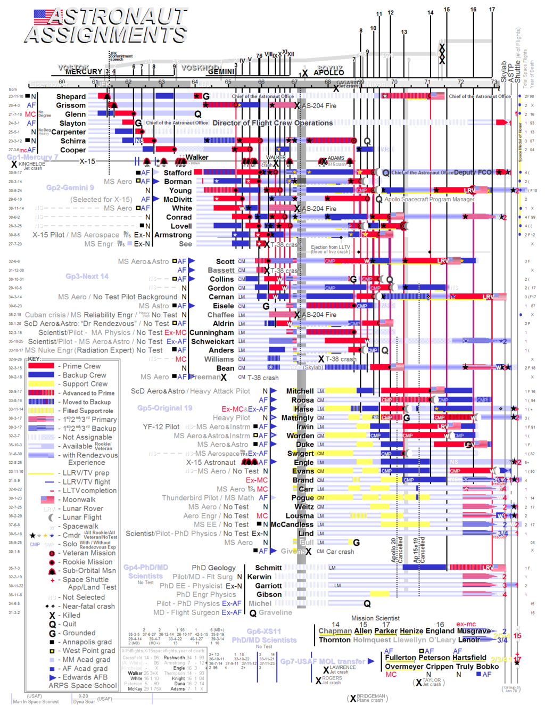

Slide 9
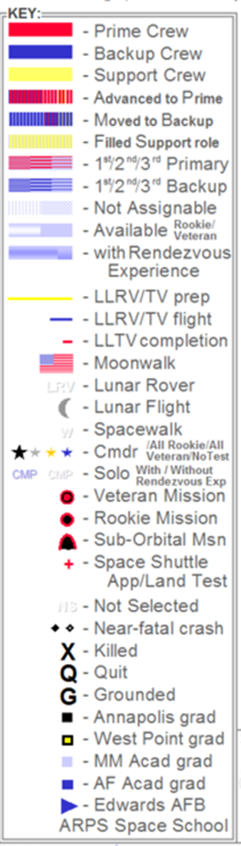

Slide 11
Discussion Groups
Chaikin Chapter 2 (“The Office”)
  The culture of the Astronaut Office at Houston
Slayton Chapter 14 (“Flight Crew Operations”)
  How the early Gemini astronauts got selected for a flight
Collins Chapter 3
  Brief profiles of the first 30 astronauts by the best writer among them
Moon Shot video
  An astronaut-centered documentary (based on Sheppard’s book)

