Slide 1
Apollo in 60 Minutes
INST 154
Apollo at 50

Slide 2
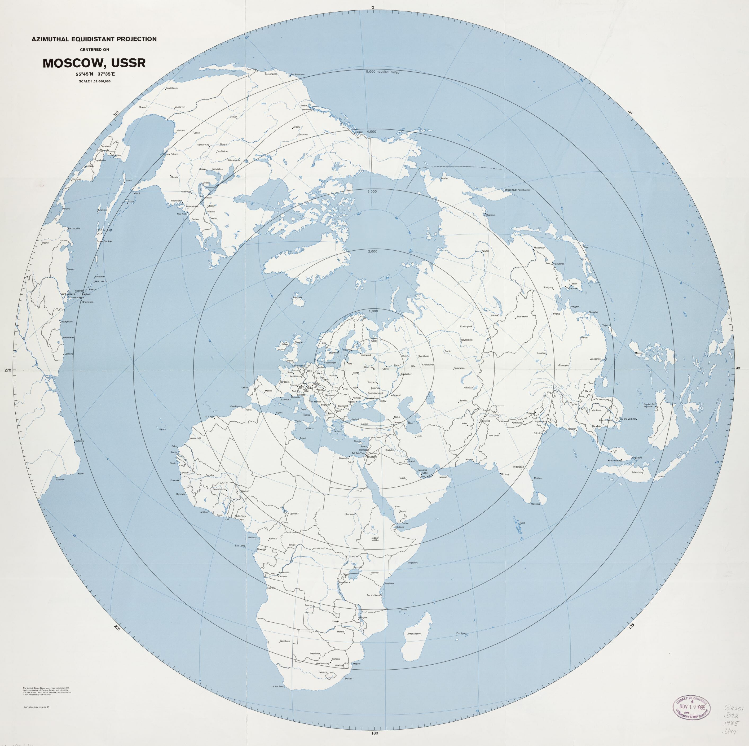
The View
From Moscow

Slide 3
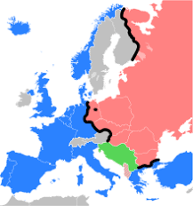
The “Cold War”

Slide 4
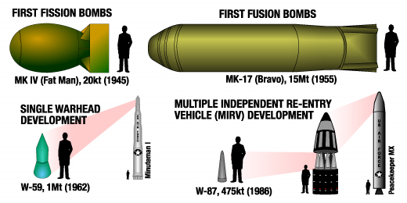
Nuclear Weapons

Slide 5
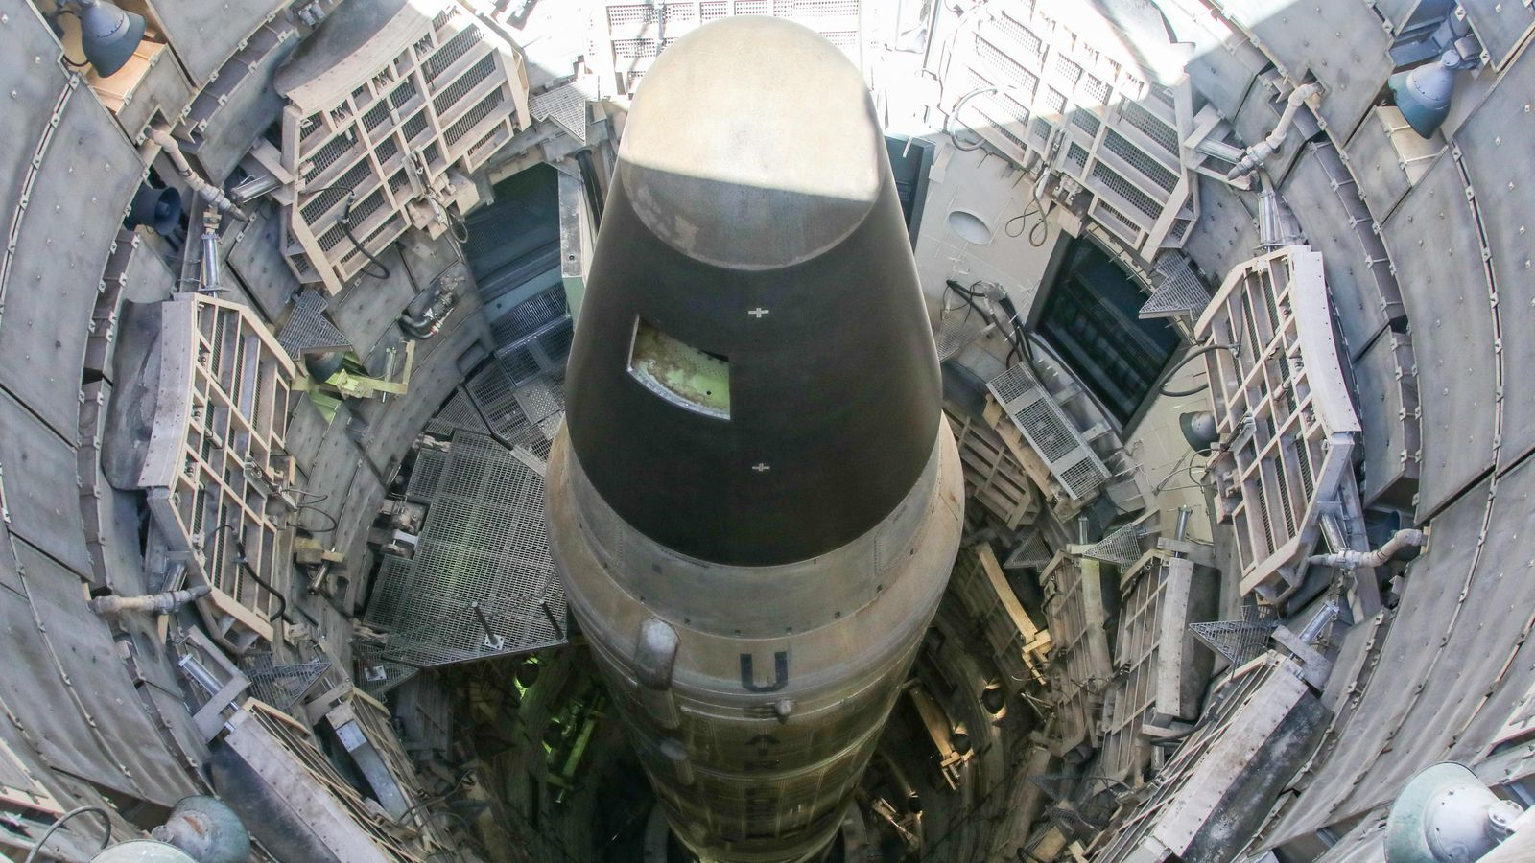
Intercontinental Ballistic Missiles

Slide 6
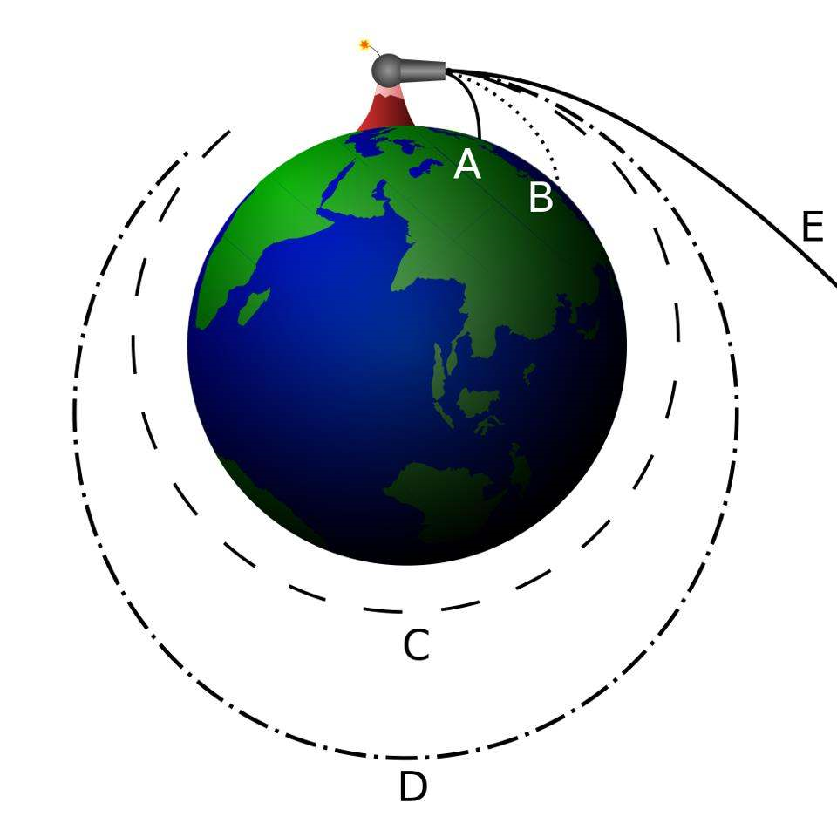
Orbital
Mechanics

Slide 7
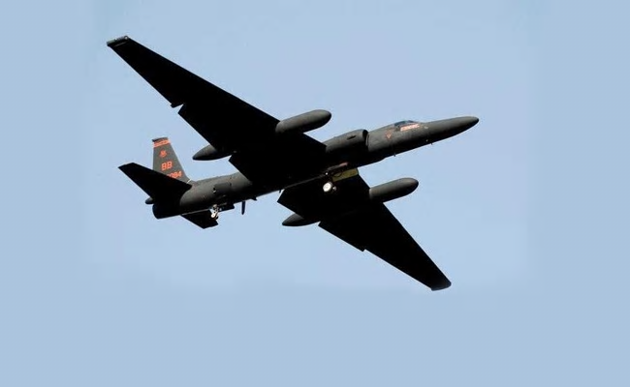
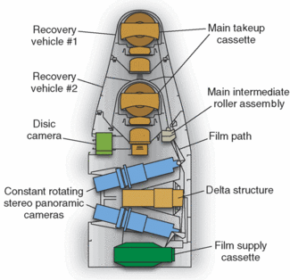
Reconnaissance

Slide 8
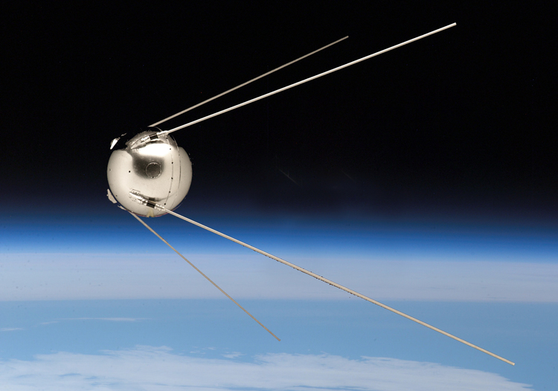
Sputnik

Slide 9
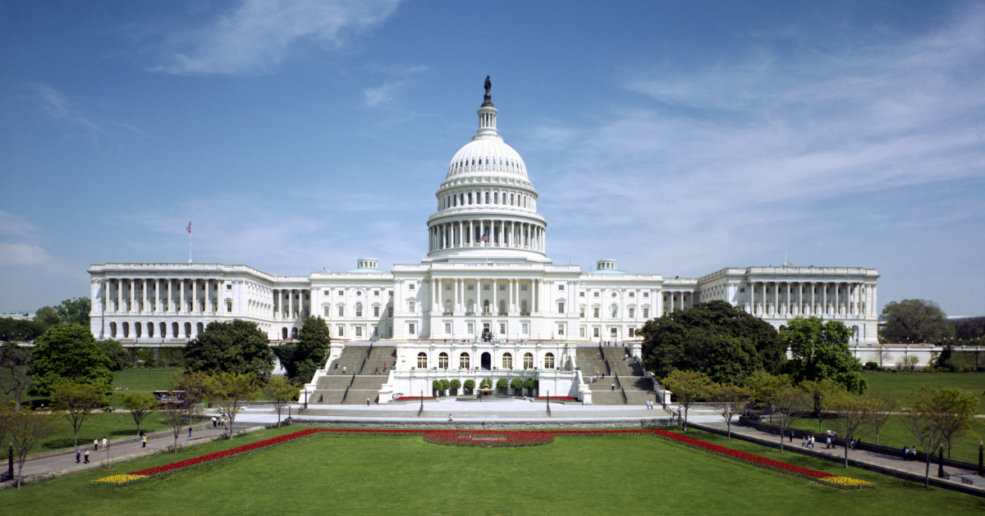
American Domestic Politics

Slide 10


Slide 11
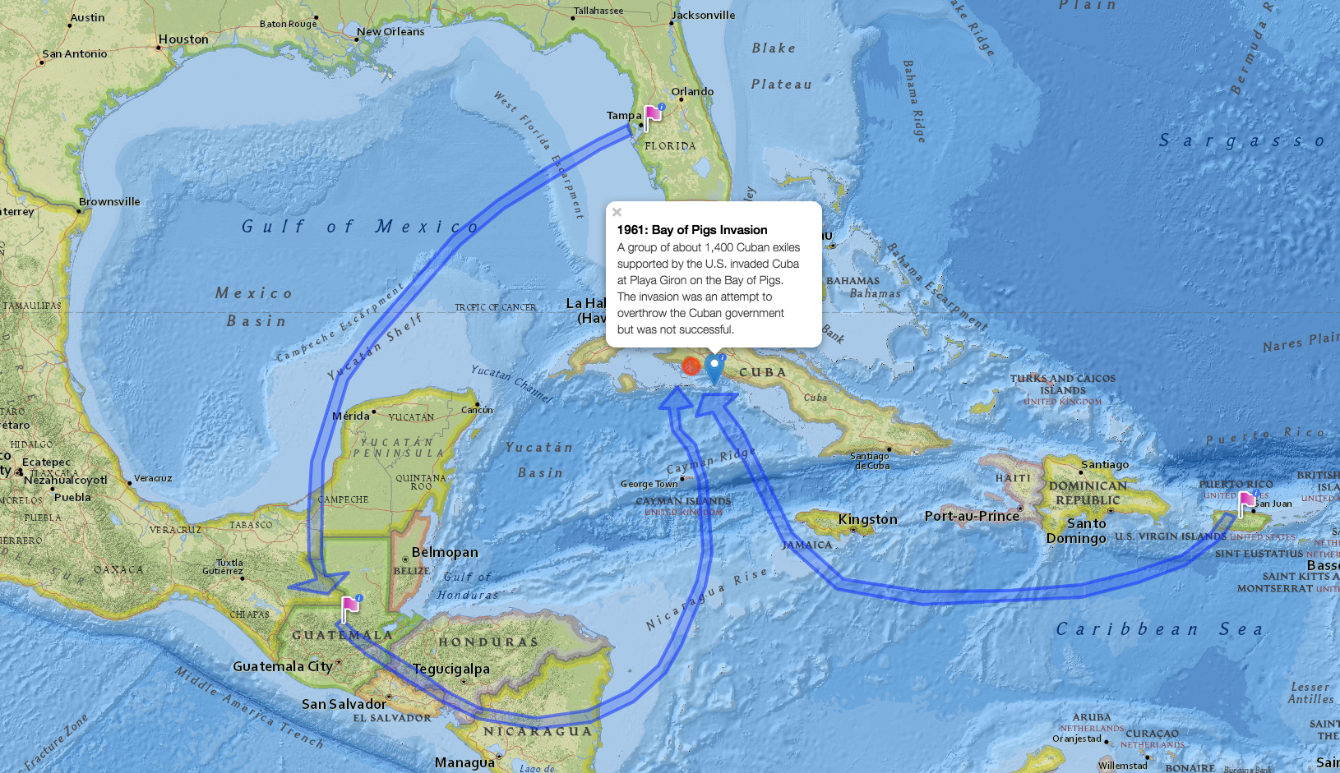

Slide 12
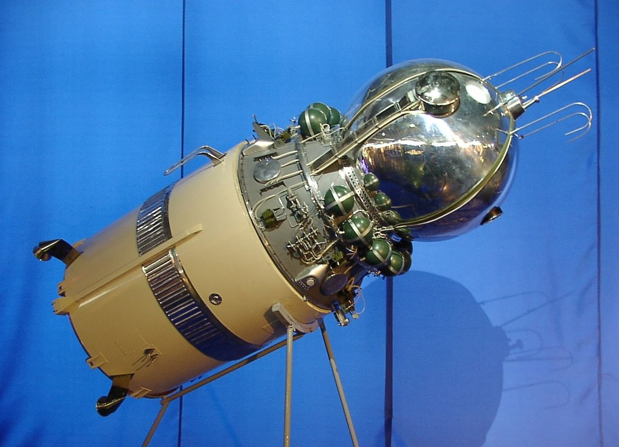
Vostok

Slide 13
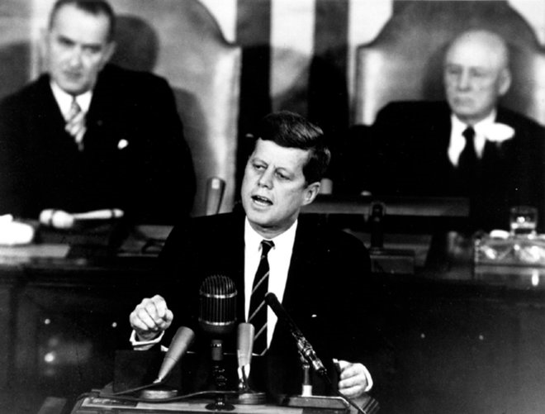
The Apollo Decision

Slide 14
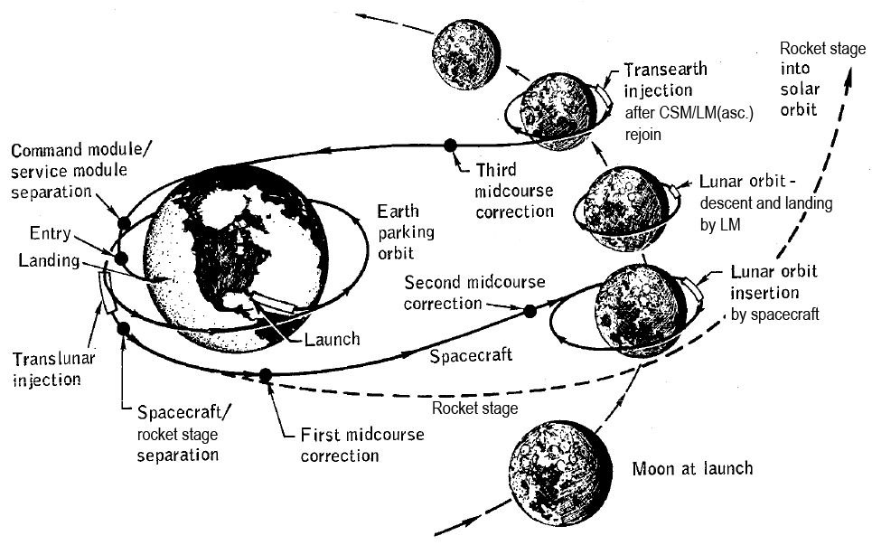
Lunar Orbit Rendezvous

Slide 15
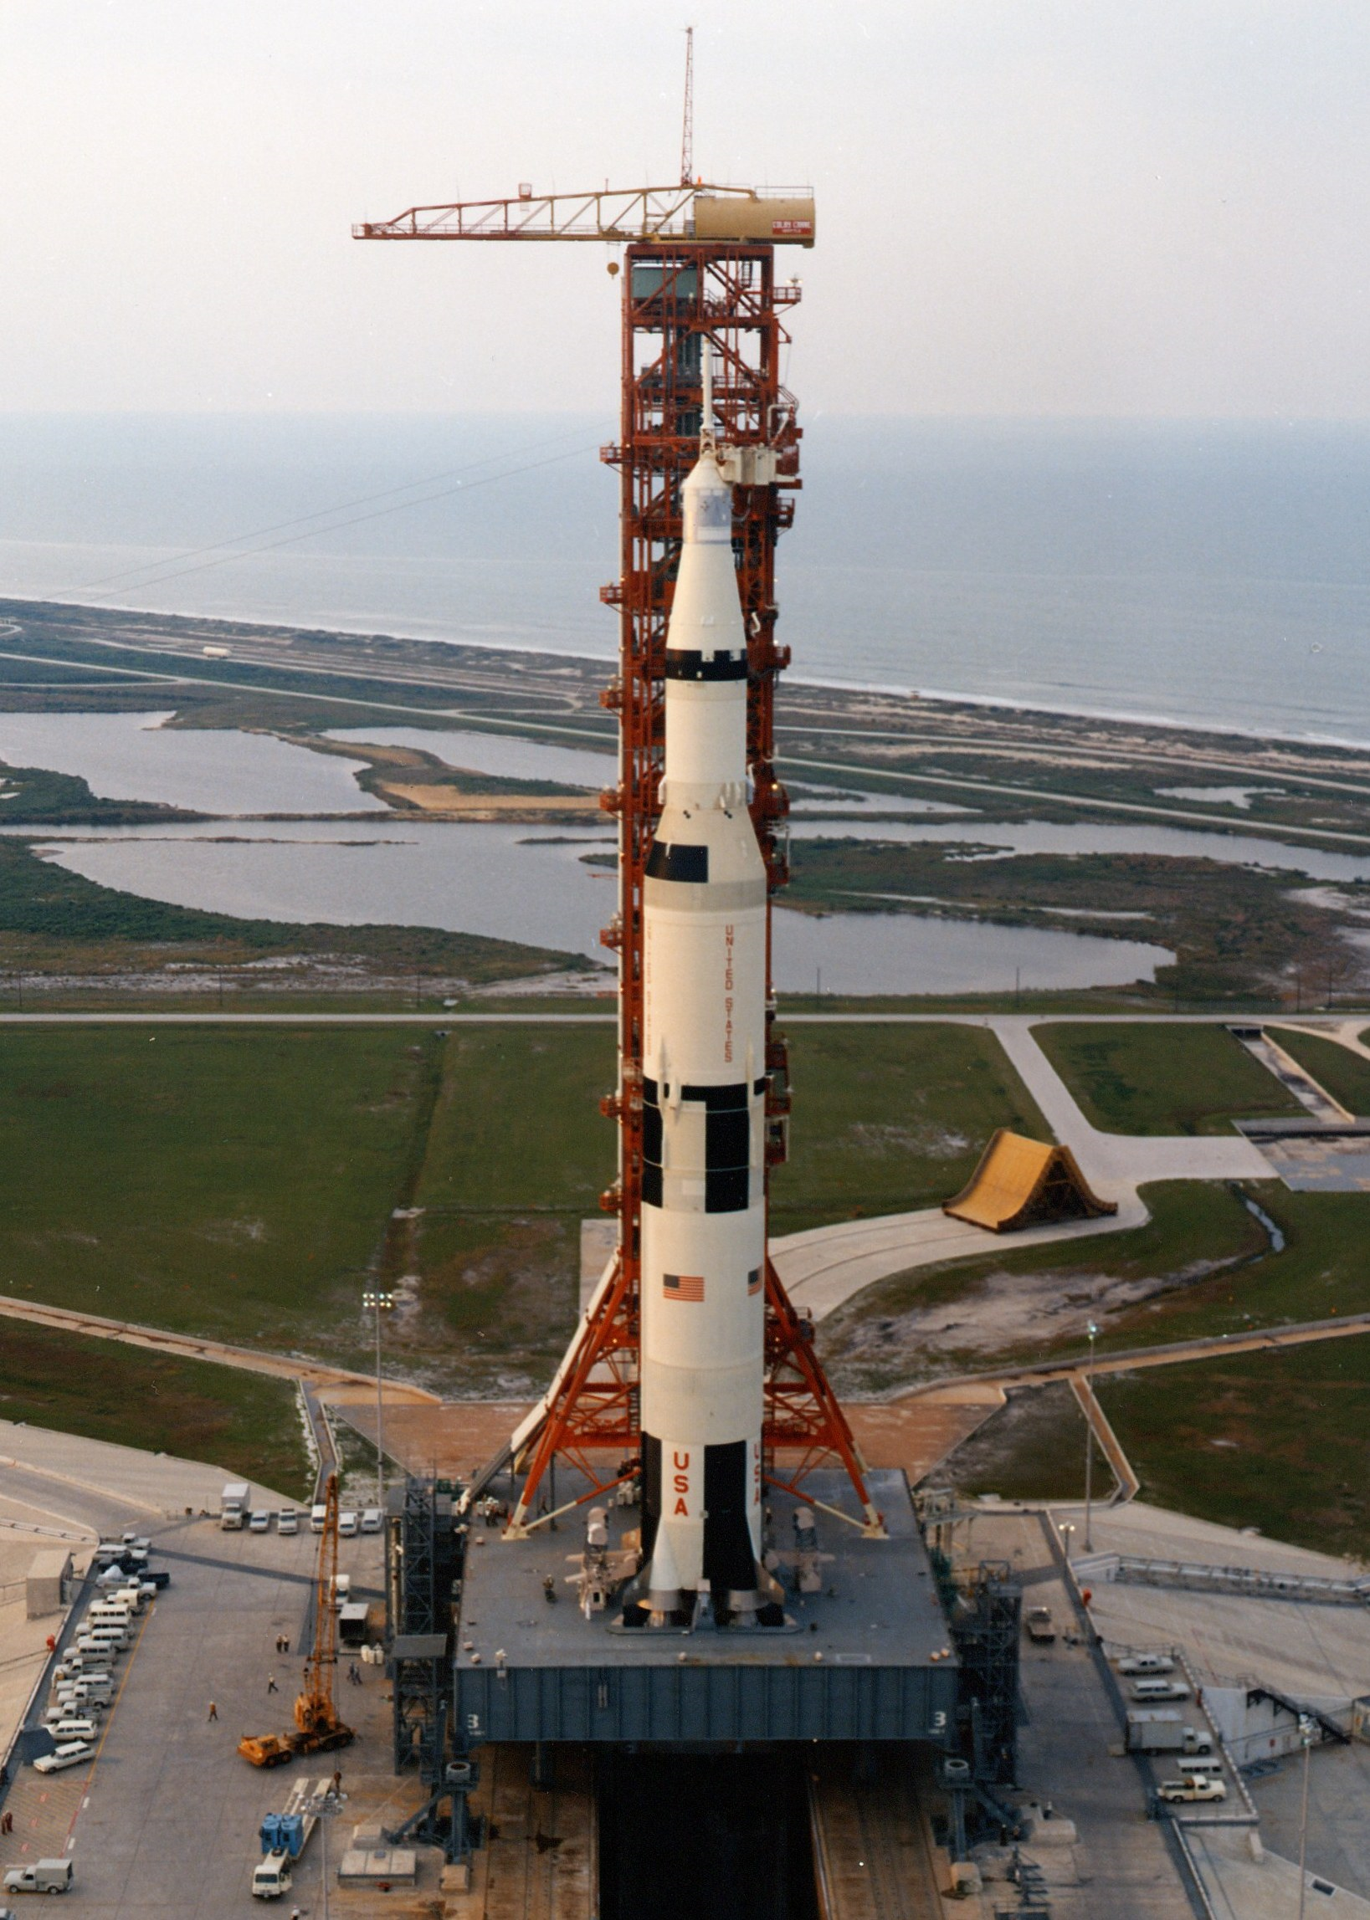
The Saturn V Rocket

Slide 16
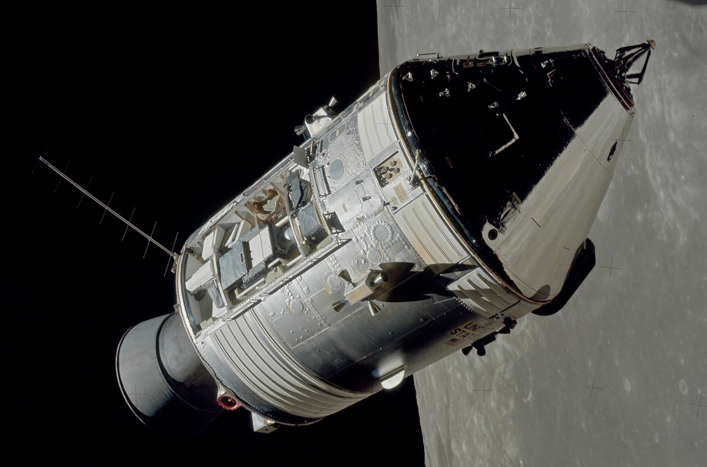
The Apollo Command and Service Modules

Slide 17
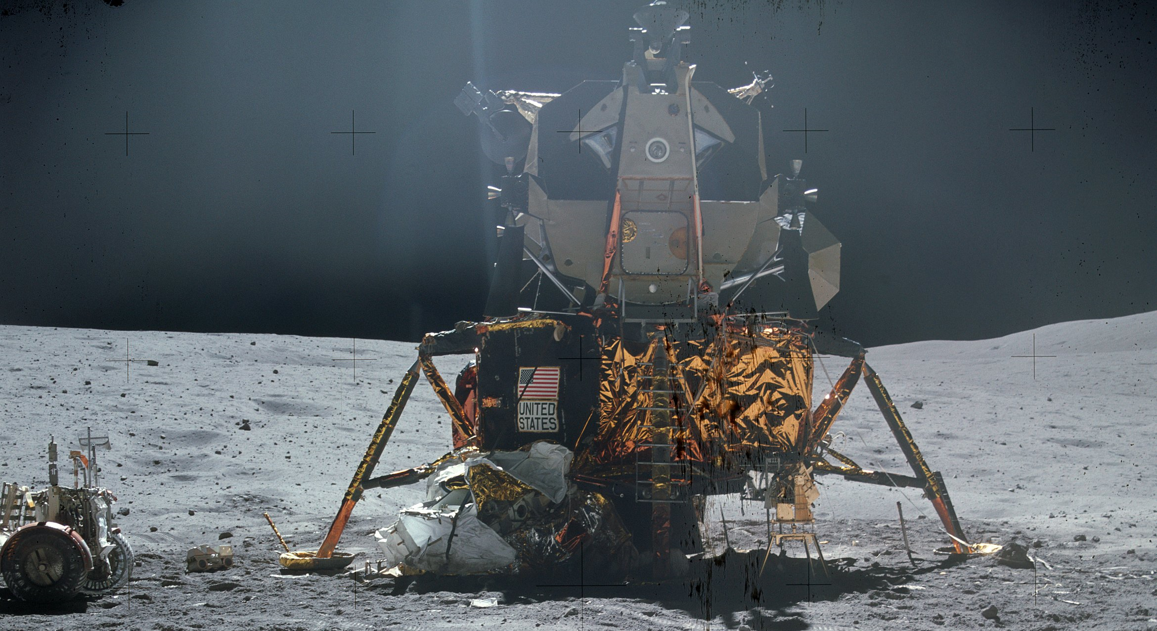
The Lunar Module

Slide 18
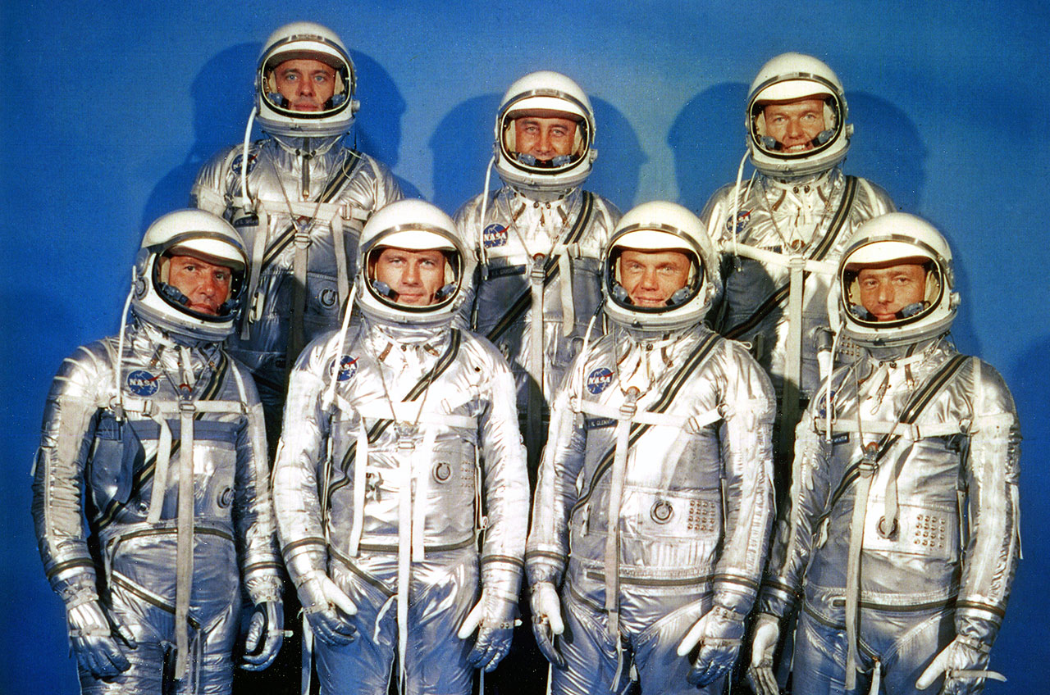
Astronauts

Slide 19
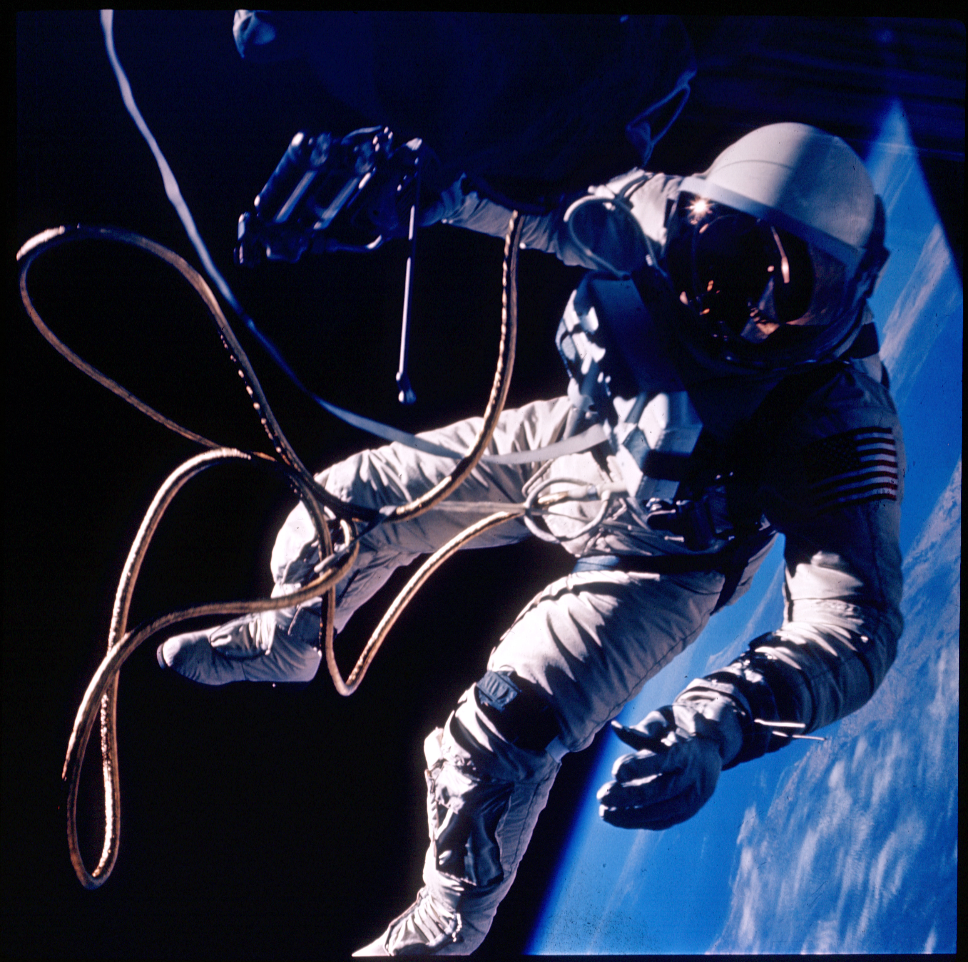
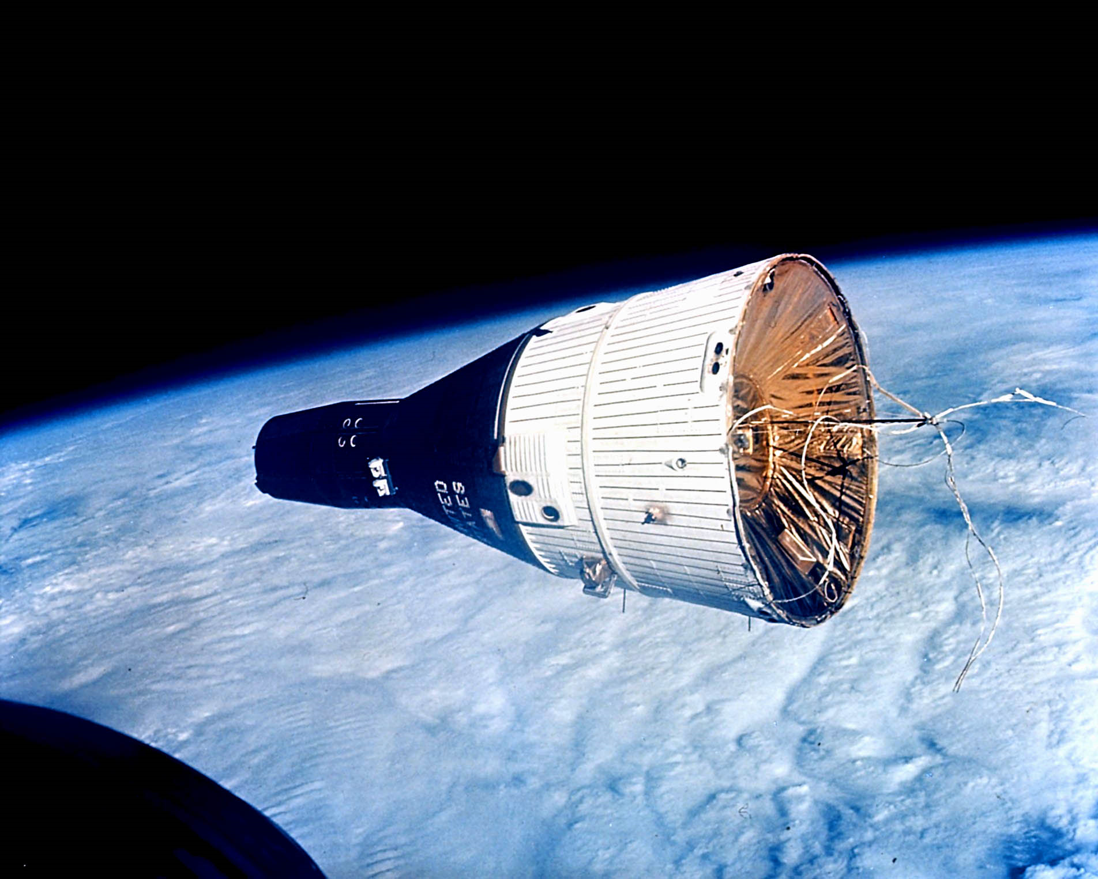
Gemini

Slide 20
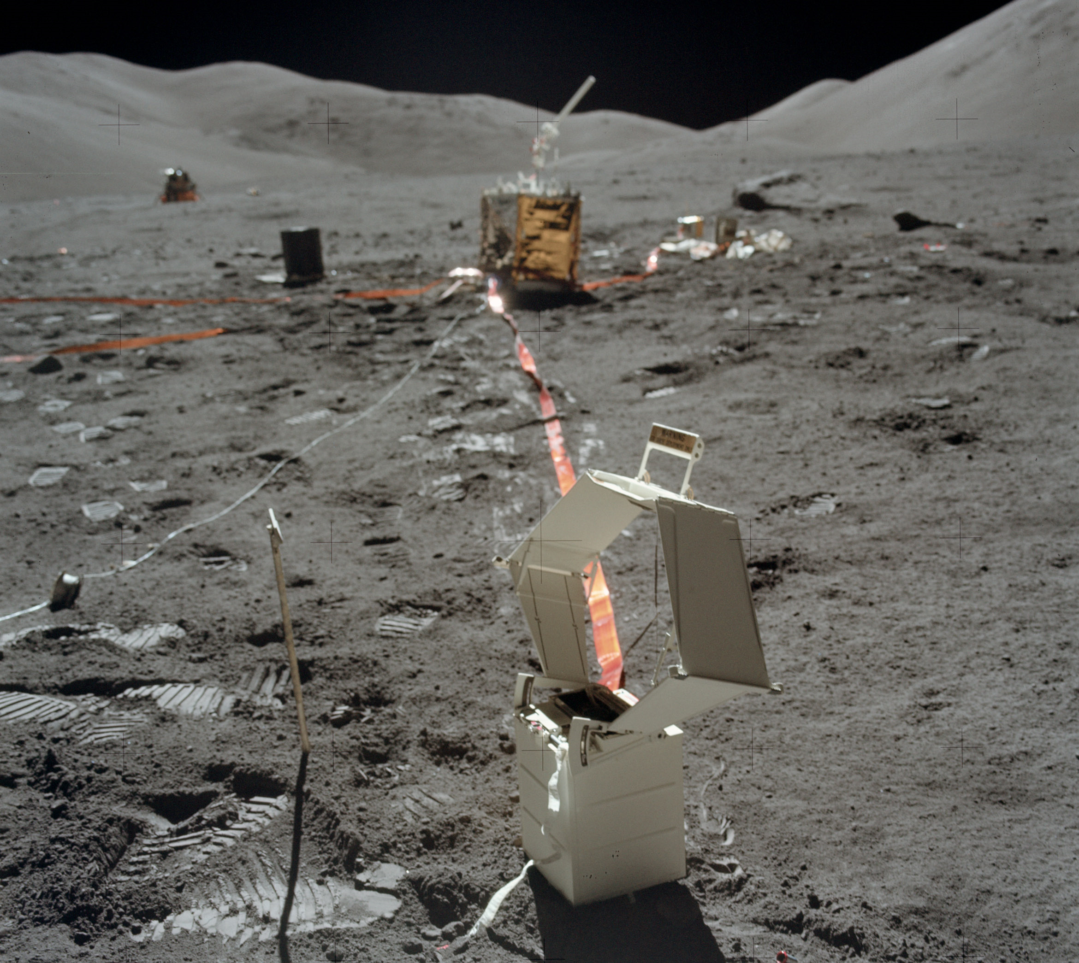
Science

Slide 21
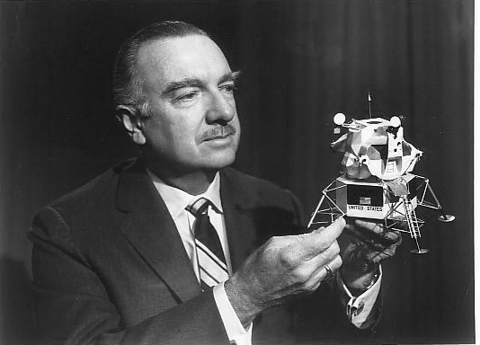
Public Relations

Slide 22
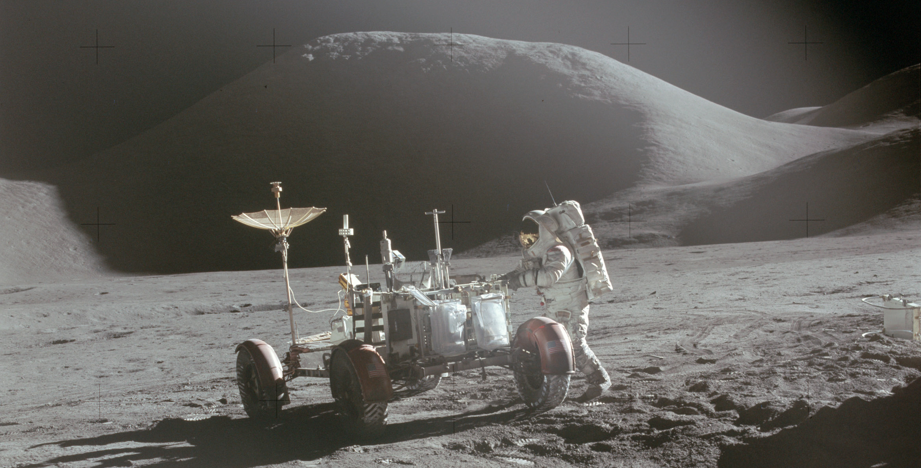
Operational Apollo

Slide 23
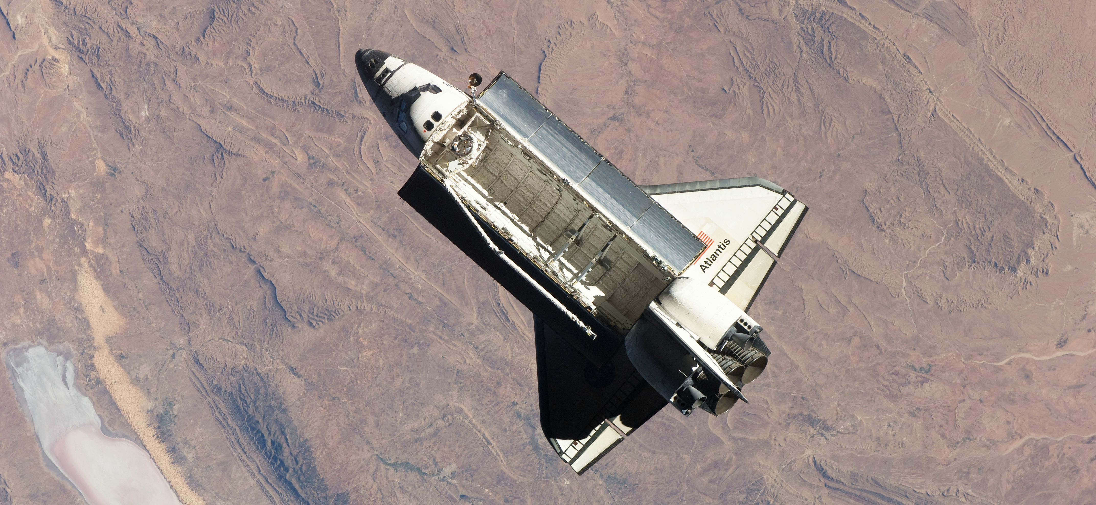
The Space Shuttle Decision

Slide 24
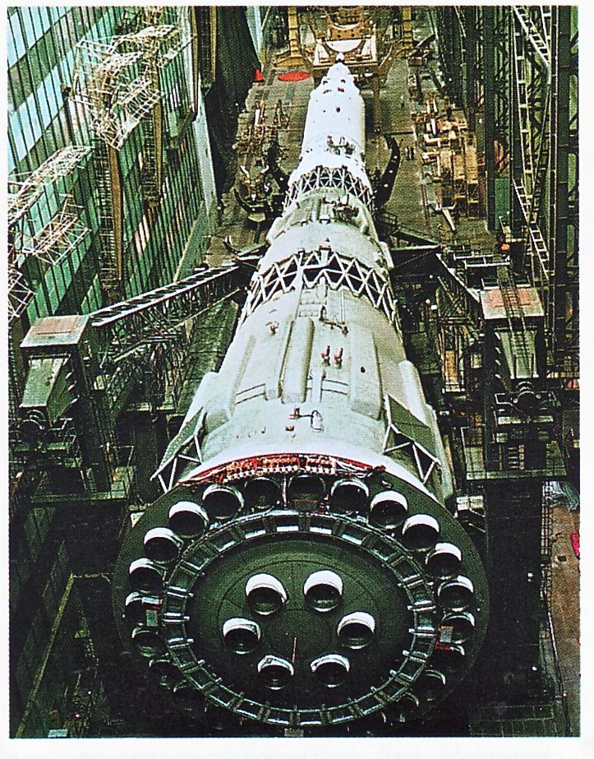
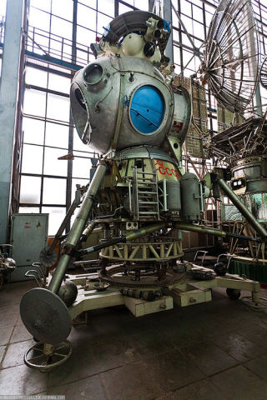
The Soviet Lunar Program

Slide 25
Some Lessons of Apollo
Clarity
Political commitment
Societal support
Near-term time frame
Economic capacity
Organizational capacity
Technology readiness
Existing infrastructure
…

Slide 26
Wicked Problems
The problem is not understood until after the formulation of a solution.
Wicked problems have no stopping rule.
Solutions to wicked problems are not right or wrong.
Every wicked problem is essentially novel and unique.
Every solution to a wicked problem is a 'one shot operation.'
Wicked problems have no given alternative solutions.
Jeff Conklin, Wicked Problems and Social Complexity, 2005

Slide 27
Learning Together
40-minute lecture
  Provides some common background
25-minute group discussion
  Collective sensemaking
  Guided by written discussion questions
  Scribe uploads a one-page summary to ELMS (same day)
10-minutes of support for your current “activity”
  Activities are designed to be completed in 3 hours per week
  Class discussion is intended to help you make progress

Slide 28
Reading, Watching, and Listening
One hour of preparation for every class session
  Reading, video, or audio
  Assignments are linked from the schedule (keyed to “student number”)
Skim first to allocate your time well
Read for comprehension, not for detail
  Goal is to bring important points to the discussion

Slide 29
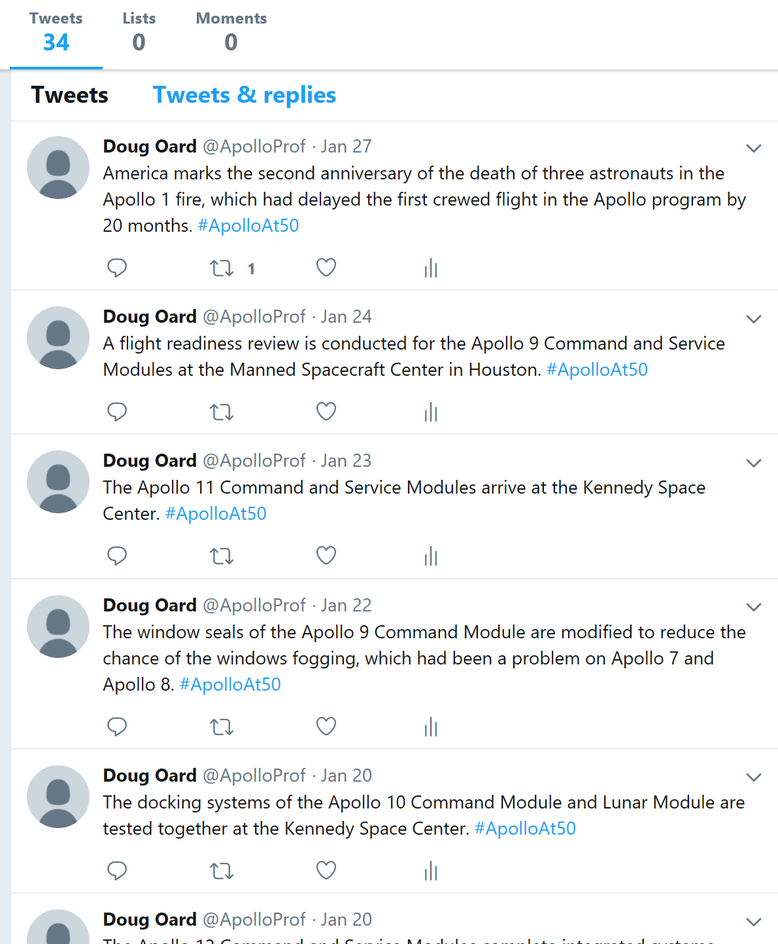
Tweeting 1969

Slide 30
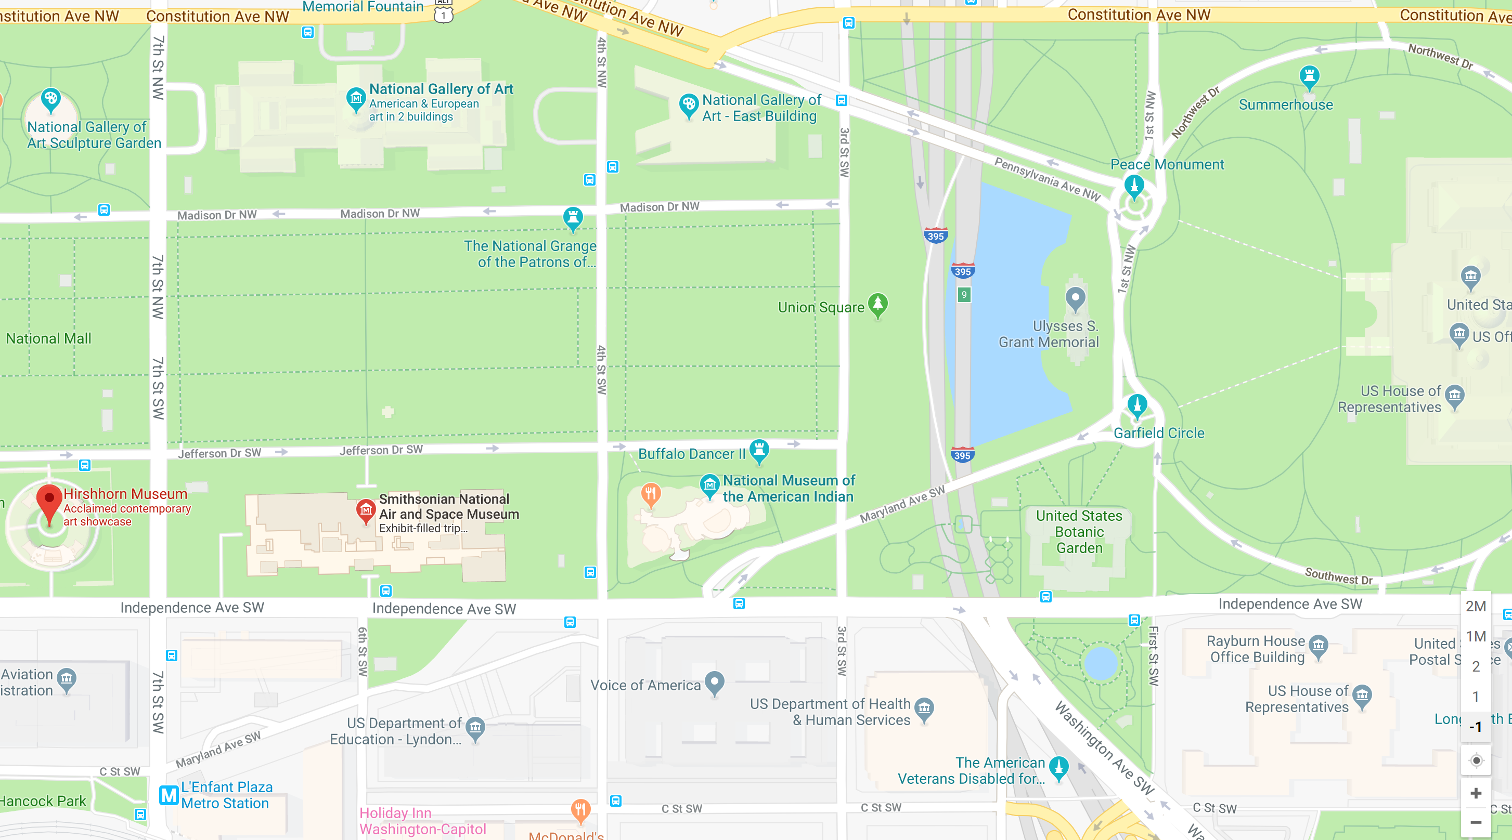
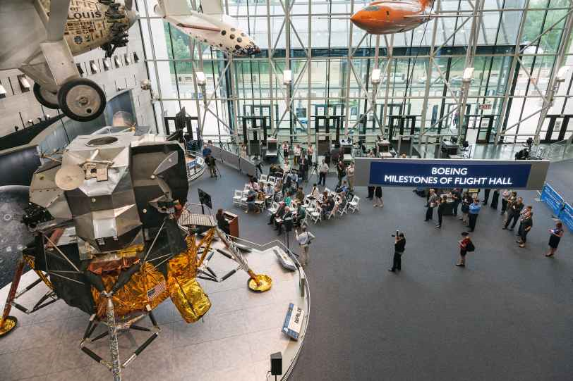
National Air and Space Museum

Slide 31
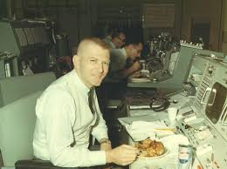
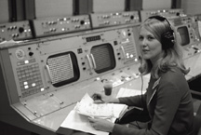
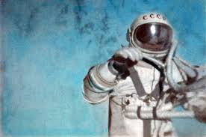
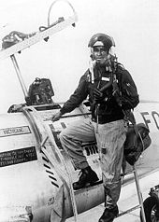
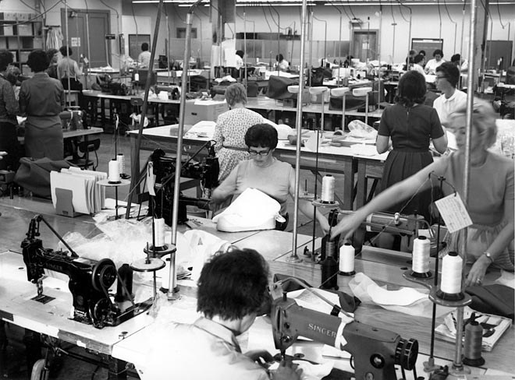
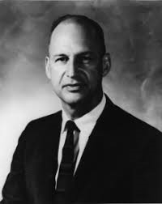
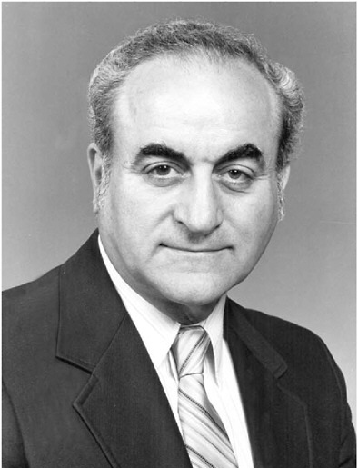
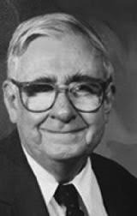
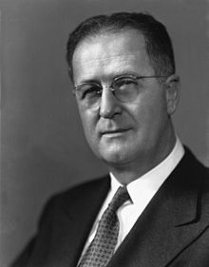
Adopt Someone: An Individual Perspective

Slide 32
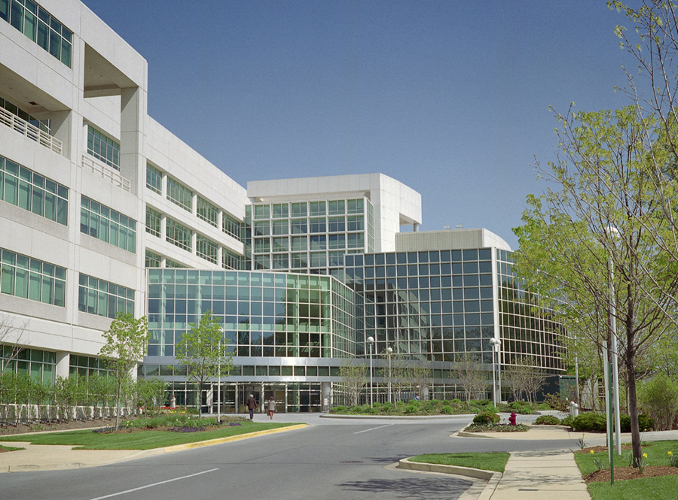
Archival Records: An Organizational Perspective

Slide 33
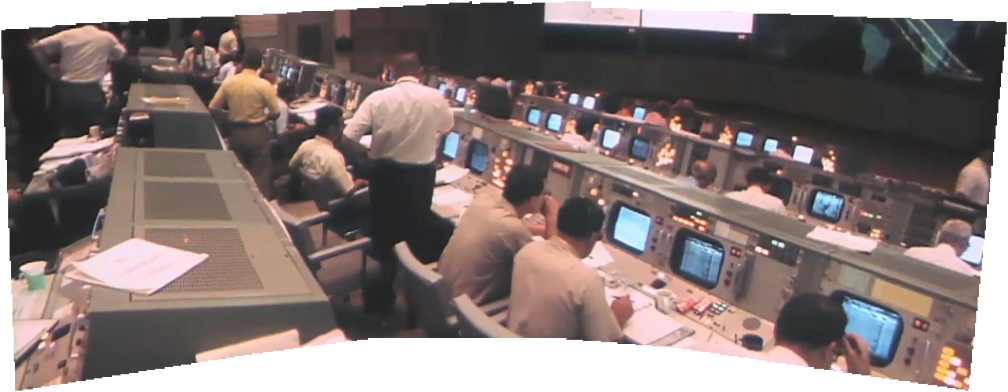
Mission Control: An Operational Perspective

Slide 34
Term Paper
Pick one big thing to study
  A social challenge, a large-scale technology challenge, an armed conflict, …
  Choice is due after team project is submitted
Draw on the lessons of Apollo
  Compare and contrast, at the level of enablers and inhibitors
  Learn about your chosen challenge –what do we know already?
  Compile insights throughout the semester
  Write early and then get several people to read it!

Slide 35
What’s Where
Course Web Site
  Schedule
  Grading, etc.
  Links to most things (including most readings)
ELMS
  Copyrighted materials (Files for PDF, Modules for Video)
  Recorded class sessions (Panopto)
  Student work
  Grades
Twitter (#ApolloAt50 or @ApolloProf)
Email (please don’t use ELMS to send messages)
Office Hours

